Slide 1
Data Science Project on Daily Step Counts

Slide 2
Motivation
Interesting dataset
Insights about myself
A lot of data to work with
Pattern analysis
Using machine learning to predict future data

Slide 3
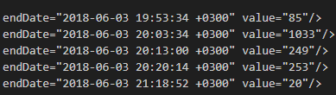
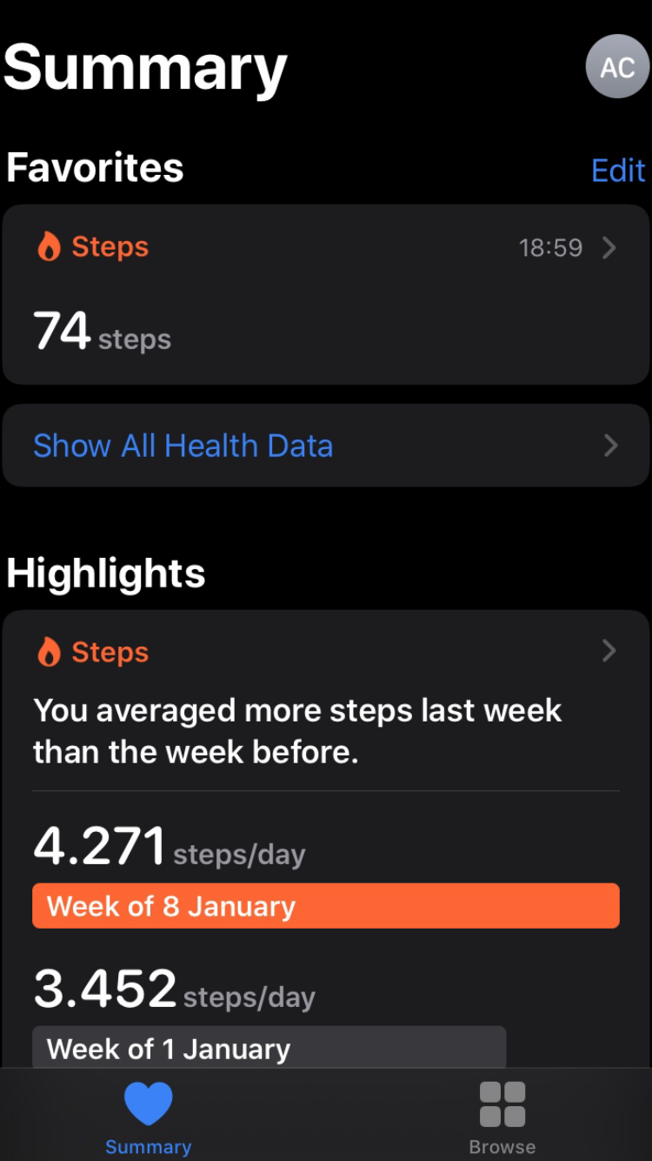
Data Source
Apple’s “Health” app keeps track of daily steps
There are over 5 years of data about me approximately 2000 days
All data from the app can easily be exported into a xml file
Data inside xml file is in a very easy format to read, allowing parsing and working on the data easy.

Slide 4
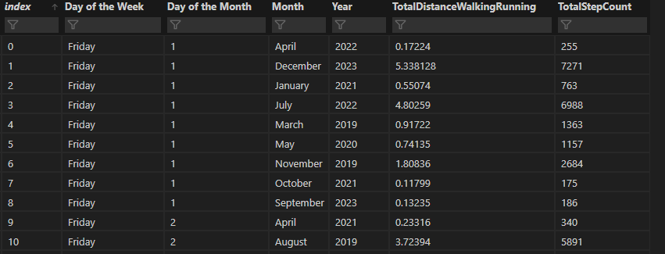
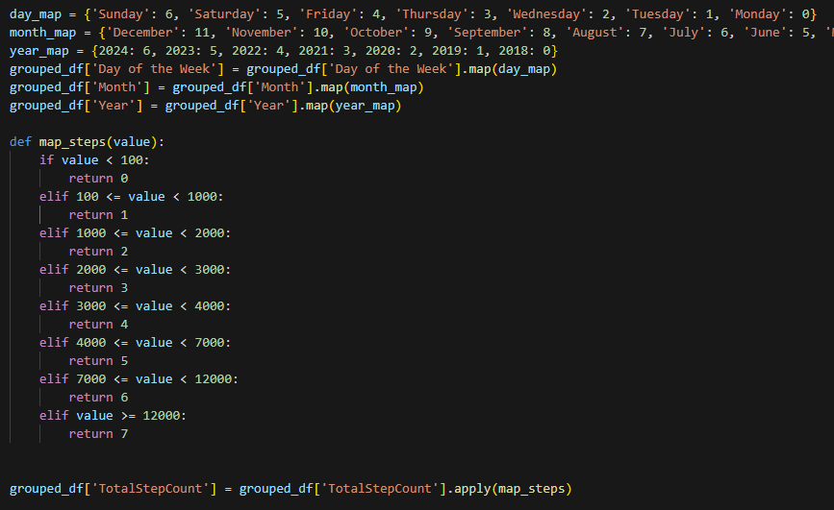
Data analysis
Data is parsed into a pandas data frame
First to work on data and later for machine learning data needs to be binned / maped
Steps divided into 8 bins
All columns are maped

Slide 5
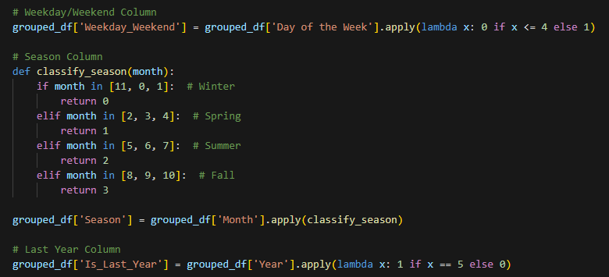
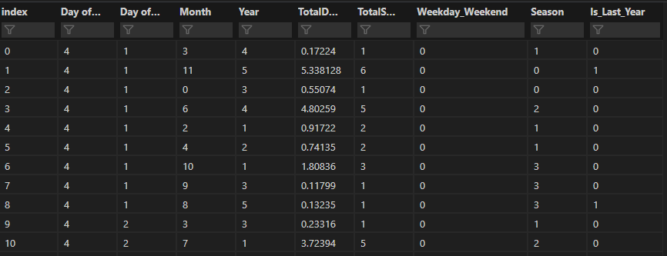
Data analysis
Adding new features helps to better understand data with creating new features from existing ones
For example: different seasons might have an impact on the data, we can create this from Month data
Helps machine learning to realize patterns

Slide 6
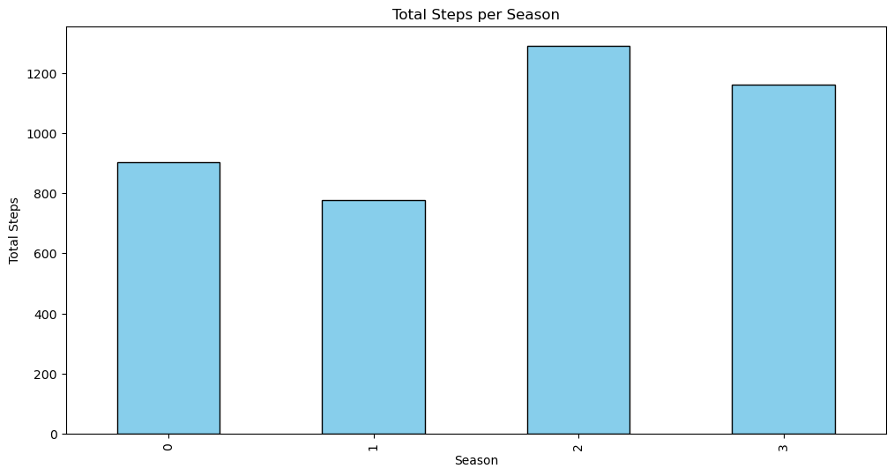
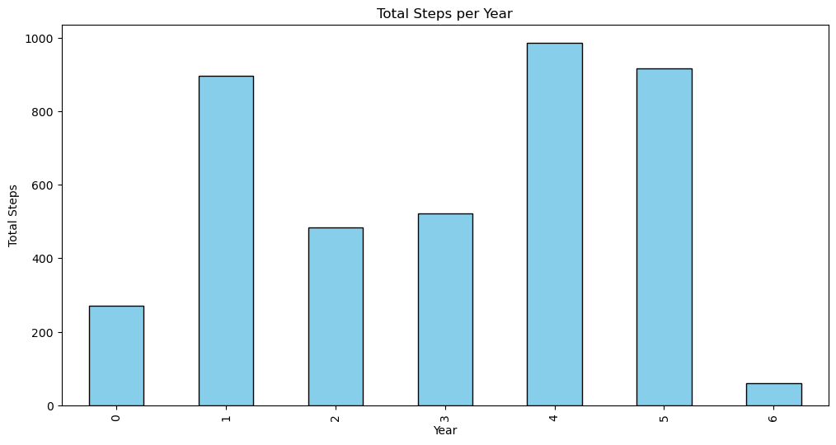
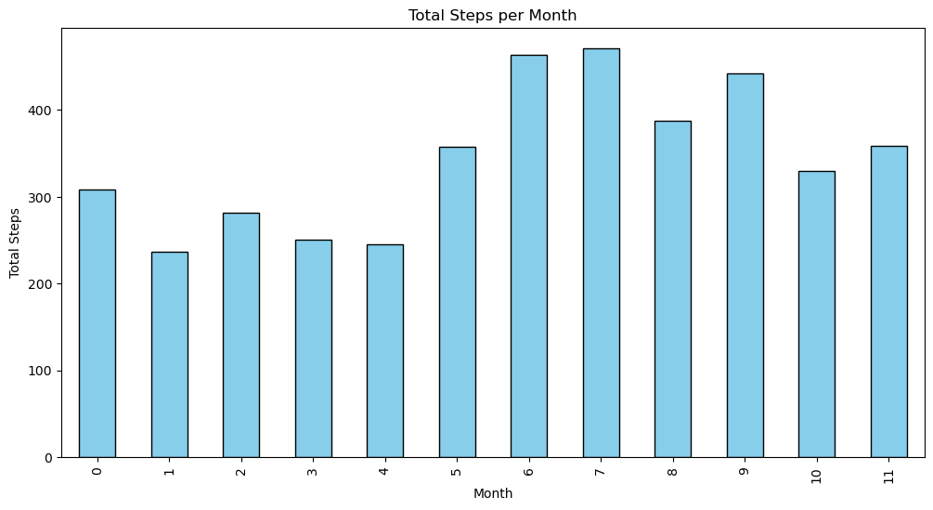
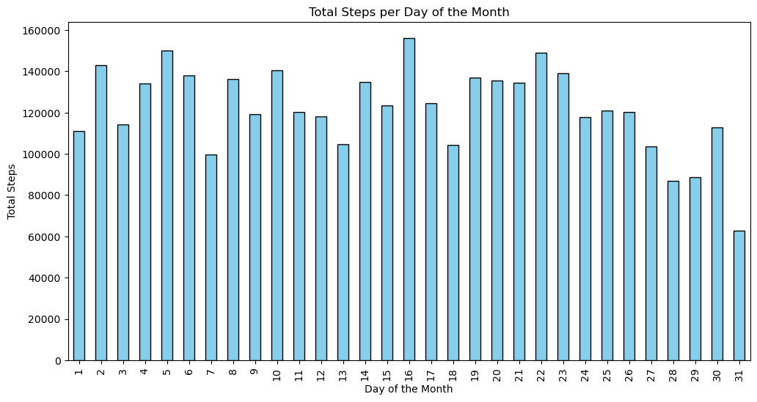

Slide 7
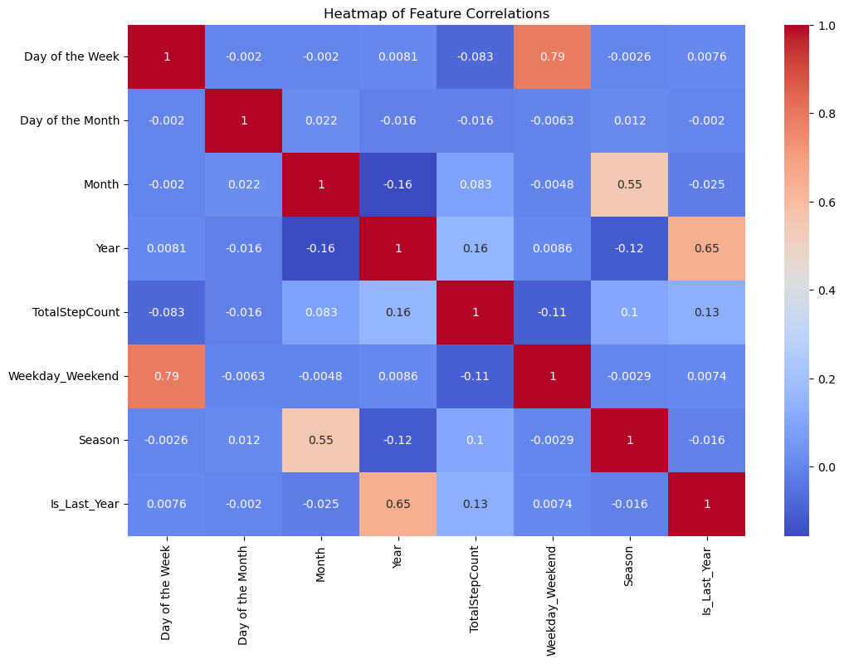
Data analysis
Correlation heatmap shows no significant correlation between specific features (expected)
Correlation between derived features is expected but irrelevant

Slide 8
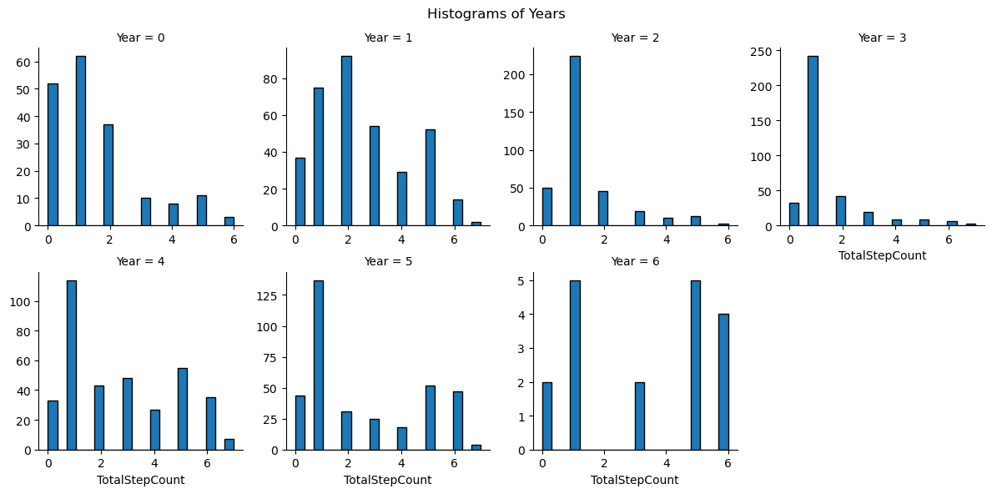

Slide 9
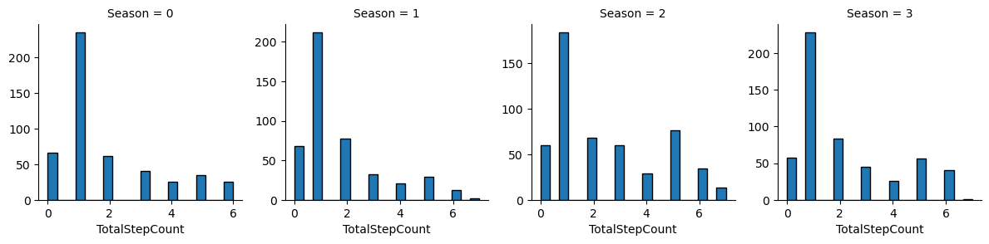

Slide 10
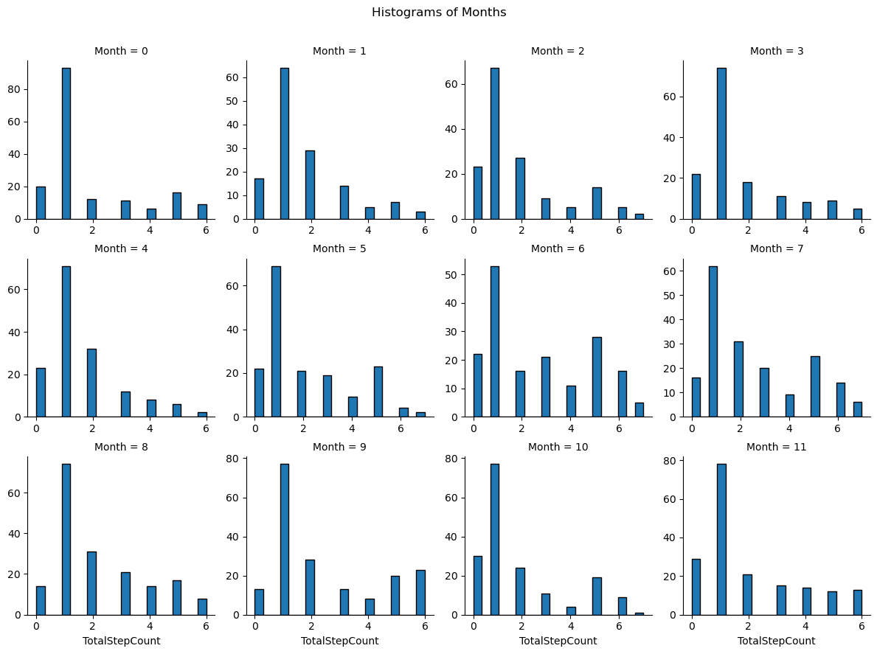

Slide 11
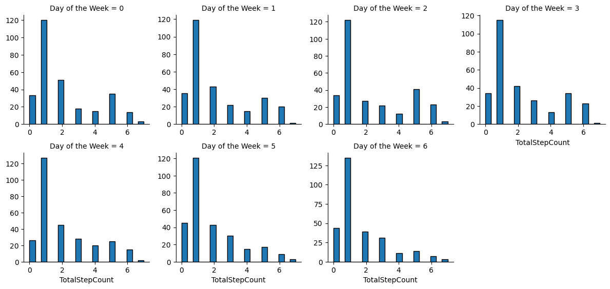
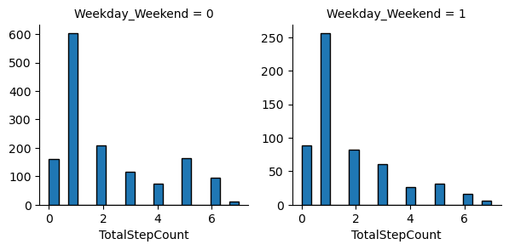

Slide 12

Machine Learning Model
Using Random Forests
Random forests or random decision forests is an ensemble learning method for classification, regression and other tasks that operates by constructing a multitude of decision trees at training time

Slide 13
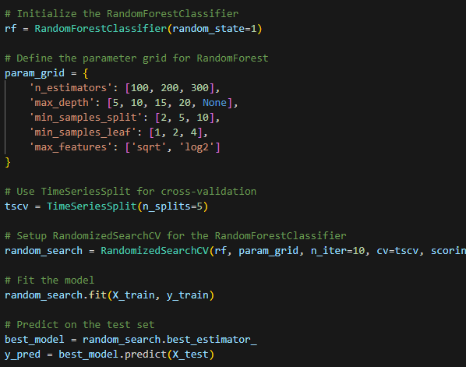
Training
%80 (1600 days) of the data set is used for training and the rest %20 (400 days) for testing
Data set is shuffled before splitting
Split between X and Y columns Y being the Total Step Count and X being rest of the features

Slide 14
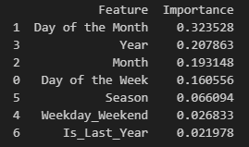
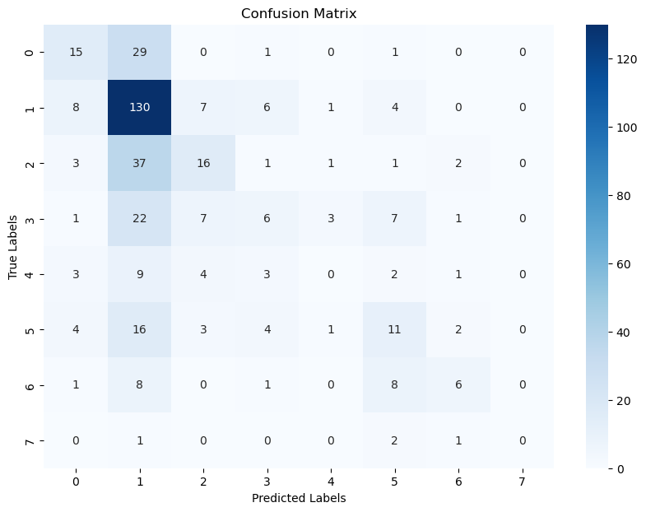
Machine learning results
Overall %45 accuracy (decent)
There seems to be a pattern between steps and date, we can predict step counts with some accuracy
Heavily biased towards “1” bin
Imbalanced data, most of step count is between 100 – 1000 steps per day
Can we improve?

Slide 15
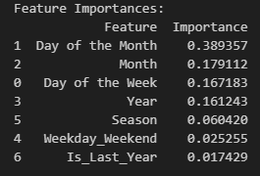
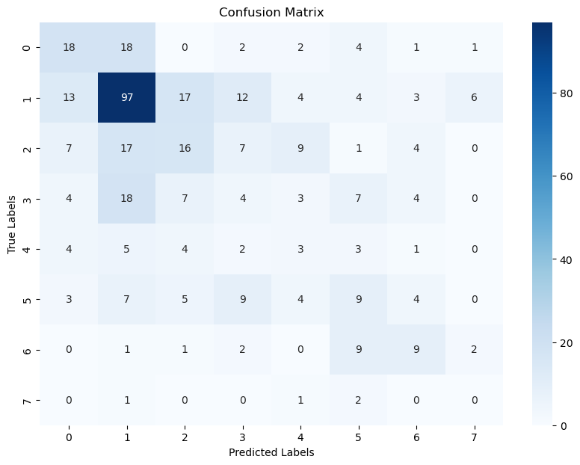
Weight balancing
We can give more weight to underrepresented classes
Reduces the bias towards one bin
Better accuracy for predicting bins other than “1”
Overall reduced accuracy

Slide 16

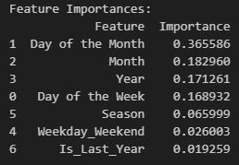
Finding a balanced Weight

Slide 17
Findings: What did we learn?
there seems to be a pattern between steps I take everyday depending on the date
Different seasons, weekdays, months and years have all different effects on my step count
Although with not very high accuracy it is possible to make predictions on my step count based solely on date. Which is not bad considering we only know the date

Slide 18
Limitations and future work: What could be done better?
Better predictions can be made provided with more data other just dates. For example; exam schedules, holidays
Data can be filtered from exceptions to make better predictions. For example; one time when broke my foot had significant impact on my step count for 2 months and disrupts the overall pattern
Machine learning can be improved with testing variety of different models and making comparisons.
I could increase my overall step count

