Slide 1



SoI Architecture Group
03 Aug 2017

Slide 2
Agenda
Group Description
Group Objectives
Group Accomplishments
Lessons Learned
Recommended Future Directions

Slide 3









Group Description
Update logos
Primary goal: Develop a formal architecture for UxAS in an assume/guarantee framework
Team Members
Sean Regisford – AFRL
Aaron Fifarek – LinQuest (LQ)/AFRL
Brian Hulbert – LinQuest (LQ)/AFRL
Jen Davis – Rockwell Collins (RC)
Chris Elliott – Lockheed Martin (LM)
Ratnesh Kumar – Iowa State University (ISU)
Cat McGhan – University of Cincinnati (UC)
Paul Meng – GE
Hao Ren – Honeywell (H)
Ben Rodes – Dependable Computing (DC)
Han Yu – GE

Slide 4
Group Objectives
Develop a formal architecture for the current state of UxAS in an assume/guarantee framework
Identify strengths, weaknesses, and problems for the current architecture
Document decisions made along the way with supporting rationale
Make / begin to implement a revised formal architecture to mitigate challenges
(Non-objective) We did NOT attempt to prove that the component contracts are true for the existing C++ code for UxAS.

Slide 5
Group Accomplishments
Extracted data types, input and output ports, and connections from code into both AADL/AGREE and ASSERT (LQ/AFRL, GE, RC)
Created formal contracts for 6-8 services and tasks based on the OpenUxAS Wiki and conversations with the developer (DC, RC)
Stated and analyzed properties of these component-level contracts (DC, RC)
Idioms and lemmas developed and documented for effective use of AGREE (DC, RC)
Developed tool to compose component contracts into a system contract (H, ISU)
Added support for timing with finite history (i.e., “previous”)
Created an assurance argument for state machine correctness (DC)
Abstraction of task service finite state machine for simulation and formal analysis (LM)
Connected UxAS to the Robot Operating System (ROS) (UC)

Slide 6
Storyline (to be deleted and spoken instead)
Wanted to formalize UxAS to enable analysis
Found issues along the way. Fixed some.
Gave us insights.
To do this, we needed to capture contracts for the components in a formal language.

Slide 7
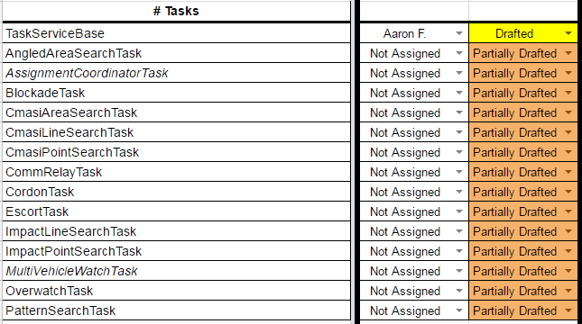
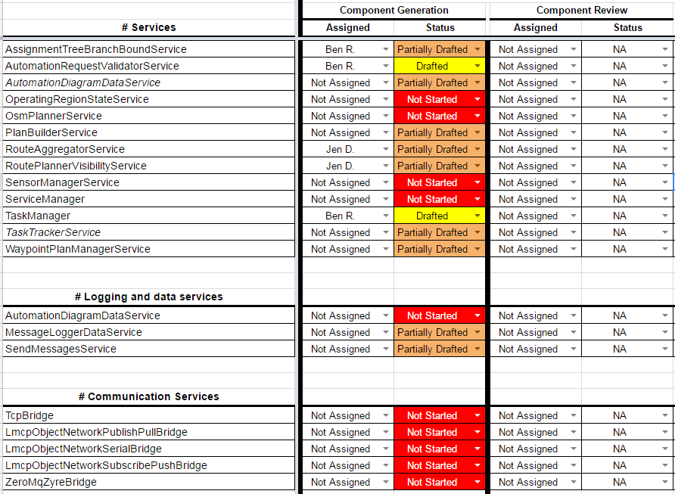

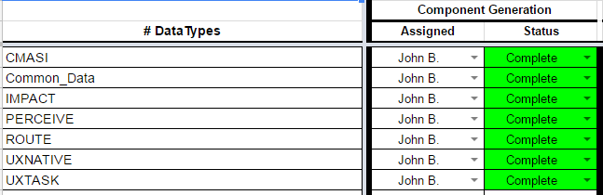
UxAS Formal Model Status
Add legible headers for all sections
UPDATE

Slide 8
[Think about bridge b/w architecture and state machines (how they relate), message passing, etc.]

Slide 9
Behavioral properties of component contracts
For components with state machines, we can check that
All states and transitions are reachable
Only the states and transitions specified are possible
All input/output events are possible
We can also check that each component is realizable

Slide 10
[Document bugs/issues found via formalization and analysis]
Chris found stuff by talking to the Bens
Jen—ping Derek for list

Slide 11
[Placeholder for GE’s work]

Slide 12

Proposed Approach
Extract architecture information through reverse engineering.
Transform extracted architecture information into SADL ontology.
Import SADL ontology into ASSERT™to enable requirement capture, analysis, and test generation in ASSERT™
Software Codebase
(C, C++, Java, C#, Python, Ada, …)
Reverse Engineering
Software Design Information
Architecture Information Extraction
Architecture & Ontology Mapping Template
Automated Ontology Generation
Ontology Model
ASSERT™ SADL Ontology files
(.sadl files)
*SADL: Semantic Application Design Language

Slide 13
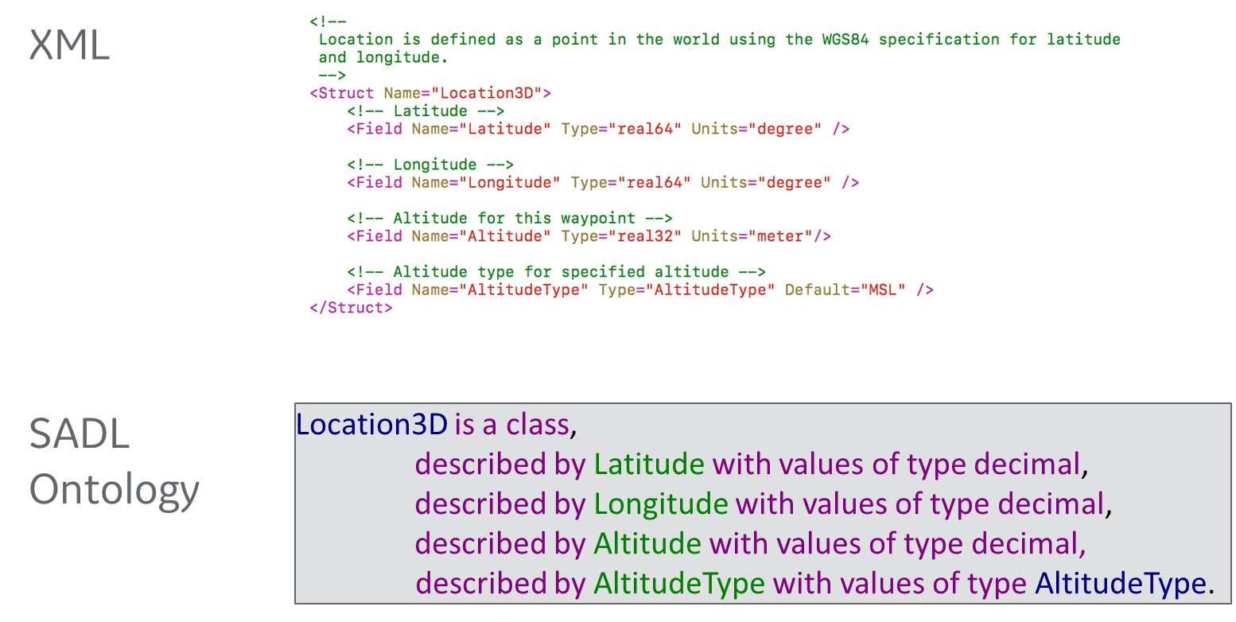
Modeling Message Type Definition in SADL Ontology

Slide 14
Modeling Dataflow in SADL Ontology
Illustrative Example in SADL Ontology
Context:
TaskAssignmentSummary__Subscription of PlanBuilderService is TaskAssignmentSummary_out of AssignmentTreeBranchBoundBase
and
TaskImplementationRequest__Subscription of TaskServiceBase is TaskImplementationRequest_out of PlanBuilderService
and
…
AssignmentTreeBranchBoundBase
TaskAssignmentSummary_out
PlanBuilderService
TaskImplementationRequest_out
TaskAssignmentSummary_Subscription
TaskServiceBase
TaskImplementationRequest_Subscription

Slide 15
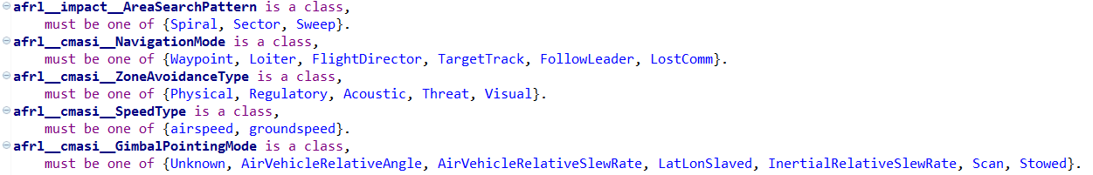
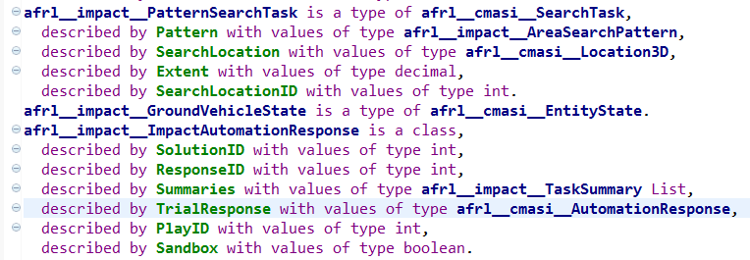
Modeling Data types and Variable Declarations in SADL Ontology
Snapshot of SADL Ontology Representation of AFRL UxAS Data Type
Snapshot of SADL Ontology Representation of AFRL UxAS Data Type
Data types of AFRL UxAS source code represented in SADL ontology

Slide 16
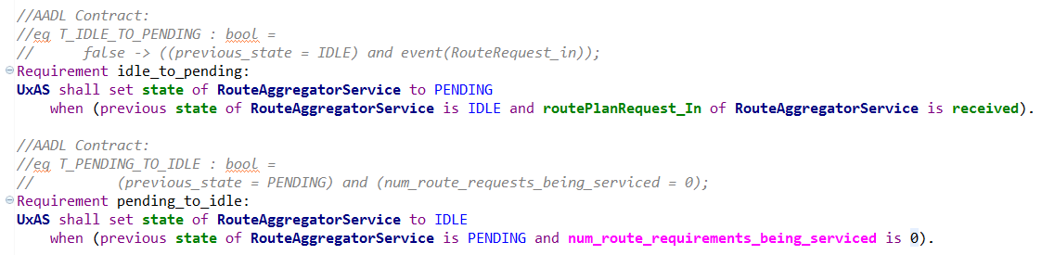
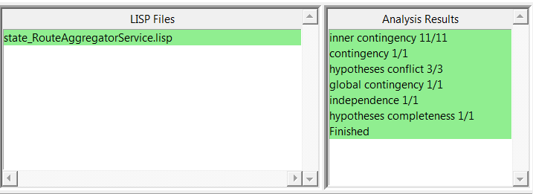
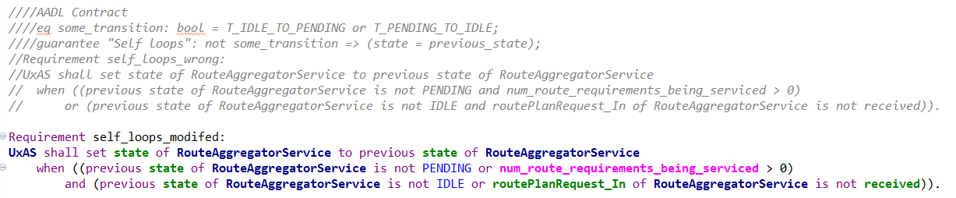
Illustrative example: Modified AADL Contracts Pass Analysis
What we learned: errors introduced in the manual contracts/requirements capturing process can be found earlier through automated analysis.

Slide 17
State Machine Correctness Argument
Argument pattern for individual AADL component state machine correctness:
Structure repeated for each component
Vision: Situated within a larger model correctness argument
Argument situates proposed AGREE lemmas:
Purpose
Rationale
Limitations and benefits

Slide 18
Argument-Derived Observations
Best practices/standards for AADL/AGREE use are needed
Situate proofs within modeling fault analysis/mitigation
Supports arguments that the set of lemmas are complete and correct
Additional tool support to reduce human error
E.g., Lemmas and repetitive infrastructure are developed manually
Minimize repetitive concerns in the argument about human error
Enhanced integration between AADL and AGREE
Minimize repetitive arguments about AADL and AGREE consistency/agreement
A simpler higher-level protocol state machine spec for validation
Provide a structure to validate against
Simplify validation activity and simplify validation arguments

Slide 19
[Placeholder for Chris Elliott’s work]
Enabling simulation
Enabling analysis from Simulink
Visualizing counterexamples

Slide 20
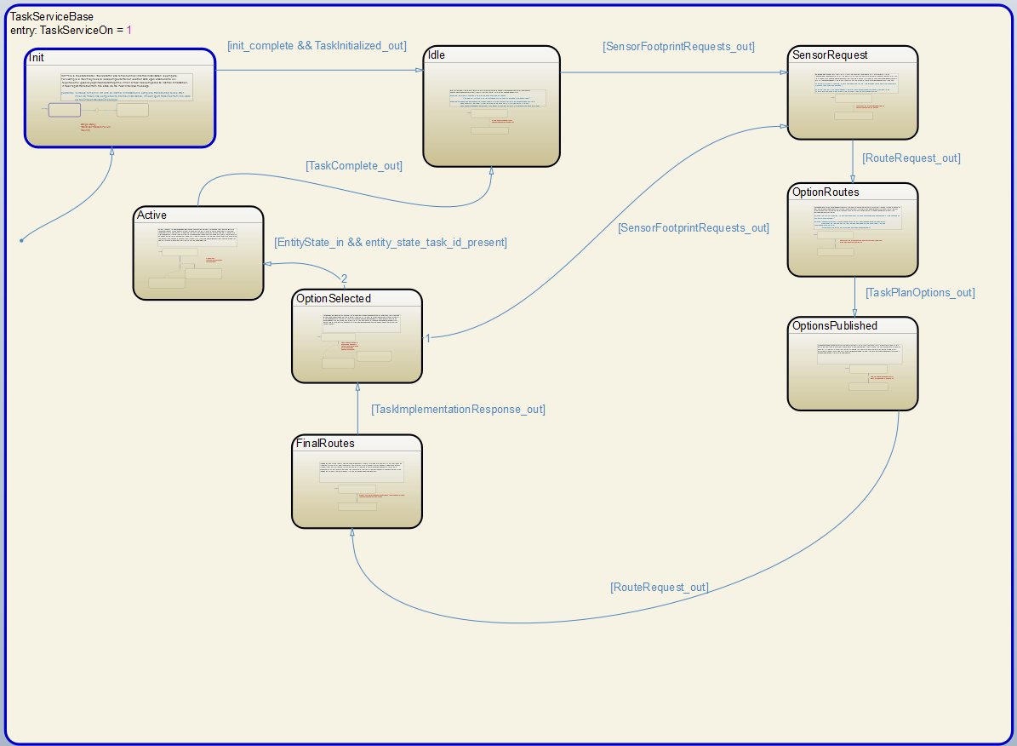

Slide 29
Lessons Learned
Many problems are identified through the process of formalization, before analysis
Data types (or an ontology), ports, and connections can be automatically extracted from code (with some moderate up front work)
Reusable (template) properties help find common mistakes
Not every error can be detected with a template property--a review of the specification itself is still worthwhile
Assurance arguments are useful to capture the “rest of the story”
Differences between the model and the real world
Specification versus intent
Enhancements to the formal analysis tools could simplify the argument
SpeAR, ASSERT, AADL/AGREE, and QVtrace are all very capable analysis tools. There are synergies between them.
Challenges: arrays, inheritance

Slide 30
Recommended Future Directions
Write contracts for the remaining components
State and analyze system-level properties (in progress)
Generate code from AADL
Generate test cases from AGREE and run on UxAS implementation
Continue documenting decisions and the assurance case for the architecture
Model of Heterogeneous System (Distributed Mission-Task-Autopilot Management-Dubin)

