Slide 1
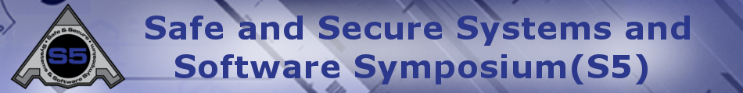


SoI Architecture Group
03 Aug 2017

Slide 2
Agenda
Group Description
Group Objectives
Group Accomplishments
Lessons Learned
Recommended Future Directions

Slide 3
Group Description
Primary goal: Develop a formal architecture for UxAS in an assume/guarantee framework
Team Members
Sean Regisford – AFRL
Aaron Fifarek – LinQuest (LQ)/AFRL
Brian Hulbert – LinQuest (LQ)/AFRL
Jen Davis – Rockwell Collins (RC)
Ratnesh Kumar – Iowa State University (ISU)
Cat McGhan – University of Cincinnati (UC)
Paul Meng – GE
Hao Ren – Honeywell (H)
Ben Rodes – Dependable Computing (DC)
Han Yu – GE

Slide 4
Group Objectives
Develop a formal architecture for the current state of UxAS in an assume/guarantee framework
Identify strengths, weaknesses, and problems for the current architecture
Document decisions made along the way with supporting rationale
Make / begin to implement a revised formal architecture to mitigate challenges
(Non-objective) We did NOT attempt to prove that the component contracts are true for the existing C++ code for UxAS.

Slide 5
Group Accomplishments
Extracted data types, input and output ports, and connections from code into both AADL/AGREE and ASSERT (LQ/AFRL, GE, RC)
Created formal contracts for 6-8 services and tasks based on the OpenUxAS Wiki and conversations with the developer (DC, RC)
**Stated and analyzed behavioral properties of these component-level contracts (DC, RC)
**Stated and analyzed structural properties of UxAS in Resolute (LQ/AFRL, DC)
Idioms and lemmas developed and documented for effective use of AGREE (DC, RC)
Developed tool to compose component contracts into a system contract (H, ISU)
Added support for timing with finite history (i.e., “previous”)
Connected UxAS to the Robot Operating System (ROS) (UC)
Created an assurance argument for state machine correctness (DC)
**(If we get to it) Stated and analyzed X system-level behavioral properties for UxAS

Slide 6
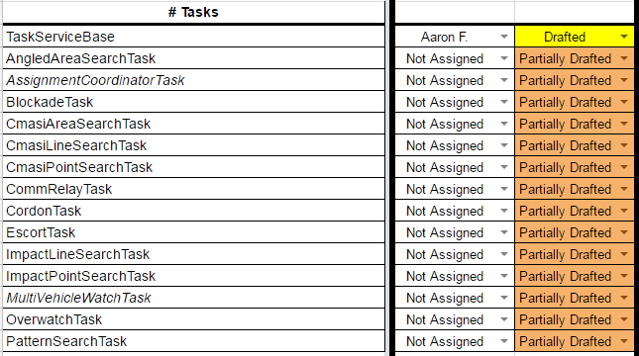
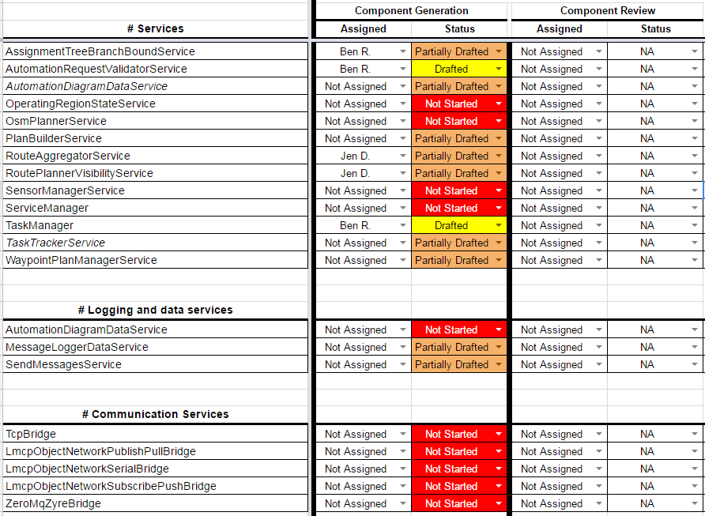

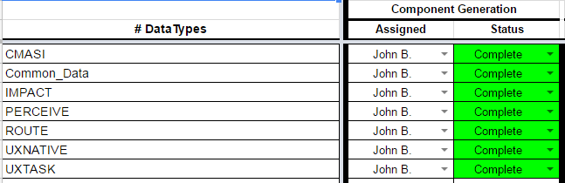
Accomplishments: UxAS Formal Model Status
UPDATE

Slide 7
Accomplishments: Behavioral properties of component contracts
For components with state machines, we can check that
All states and transitions are reachable
Only the states and transitions specified are possible
All input/output events are possible
We can also check that each component is realizable

Slide 8
Accomplishments: Structural properties of UxAS
[Aaron and Ben fill in]

Slide 9
Accomplishments: State Machine Correctness Argument
[Ben fill in]

Slide 10
Lessons Learned
Data types (or an ontology), ports, and connections can be automatically extracted from code (with some moderate up front work)
Reusable (template) properties help find common mistakes
Not every error can be detected with a template property--a review of the specification itself is still worthwhile
Assurance arguments are useful to capture the “rest of the story”
Differences between the model and the real world
Specification versus intent
SpeAR, ASSERT, and AADL/AGREE are all very capable analysis tools. Each one has some advantages over the others.
Challenges: arrays, inheritance

Slide 11
Recommended Future Directions
Write contracts for the remaining components
State and analyze system-level properties
Generate code from AADL
Generate test cases from AGREE and run on UxAS implementation
Continue documenting decisions and the assurance case for the architecture

