Slide 1



SoI Architecture Group
03 Aug 2017

Slide 2
Agenda
Group Description
Group Objectives
Group Accomplishments
Lessons Learned
Recommended Future Directions

Slide 3
Group Description
Primary goal: Develop a formal architecture for UxAS in an assume/guarantee framework
Team Members
Sean Regisford – AFRL
Aaron Fifarek – LinQuest/AFRL
Brian Hulbert – LinQuest/AFRL
Jen Davis – Rockwell Collins
Ratnesh Kumar – Iowa State University
Cat McGhan – University of Cincinnati
Paul Meng – GE
Hao Ren – Honeywell
Ben Rodes – Dependable Computing
Han Yu – GE

Slide 4
Group Objectives
Develop a formal architecture for the current state of UxAS in an assume/guarantee framework
Identify strengths, weaknesses, and problems for the current architecture
Document decisions made along the way with supporting rationale
Make / begin to implement a revised formal architecture to mitigate challenges
(Non-objective) We did NOT attempt to prove that the component contracts are true for the existing C++ code for UxAS.

Slide 5
Group Accomplishments
Extracted data types, input and output ports, and connections from code into both AADL/AGREE and ASSERT
Created formal contracts for 6-8 services and tasks based on the OpenUxAS Wiki and conversations with the developer
**Stated and analyzed behavioral properties about these component-level contracts
**Stated and analyzed structural properties about UxAS in Resolute
Idioms developed and documented for effective use of AGREE
Developed tool to compose component contracts into a system contract
Added support for timing with finite history (i.e., “previous”)
Connected UxAS to the Robot Operating System (ROS)
Created an assurance argument for state machine correctness
**(If we get to it) Stated and analyzed X system-level behavioral properties for UxAS

Slide 6
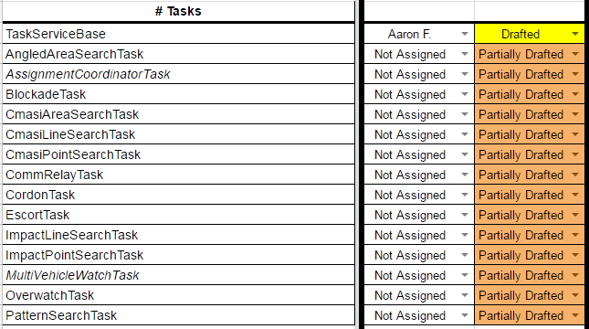
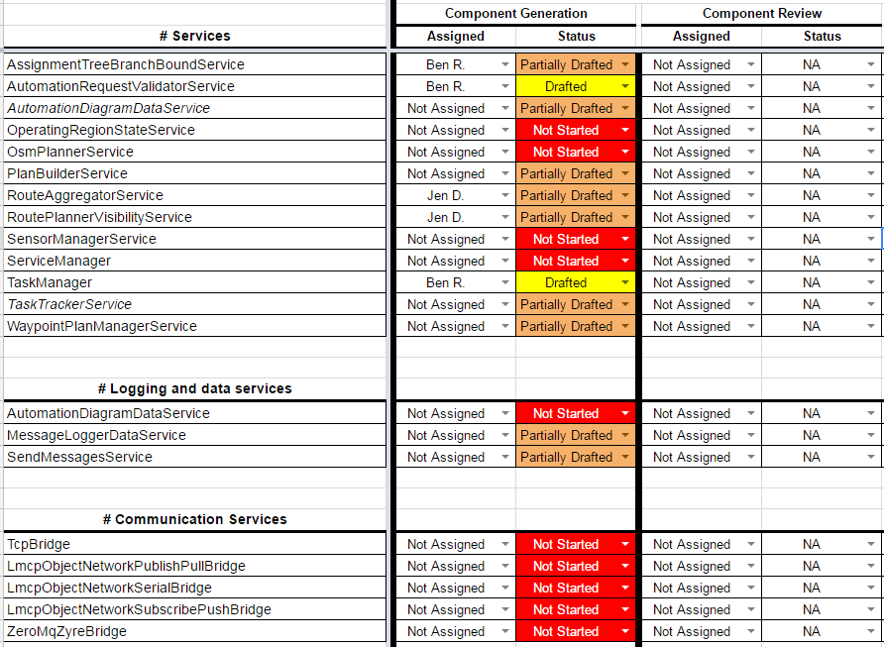

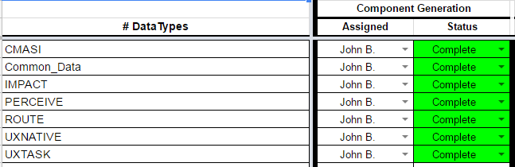
Accomplishments: UxAS Formal Model Status
UPDATE

Slide 7
Accomplishments: Behavioral properties of component contracts
States and transitions are reachable
[Ben and Jen fill in]

Slide 8
Accomplishments: Structural properties of UxAS
[Aaron and Ben fill in]

Slide 9
Accomplishments: State Machine Correctness Argument
[Ben fill in]

Slide 10
Lessons Learned
[TBD]

Slide 11
Recommended Future Directions
[TBD]

