Slide 1




SoI Architecture Group
03 Aug 2017

Slide 2
Agenda
Group Description
Group Objectives
Group Accomplishments
Lessons Learned
Recommended Future Directions

Slide 3










Group Description
Primary goal: Develop a formal architecture for UxAS in an assume/guarantee framework
Team Members
Sean Regisford – AFRL
Aaron Fifarek – LinQuest (LQ)/AFRL
Brian Hulbert – LinQuest (LQ)/AFRL
Jen Davis – Rockwell Collins (RC)
Chris Elliott – Lockheed Martin (LM)
Ratnesh Kumar – Iowa State University (ISU)
Cat McGhan – University of Cincinnati (UC)
Paul Meng – GE
Hao Ren – Honeywell (H)
Ben Rodes – Dependable Computing (DC)
Han Yu – GE

Slide 4
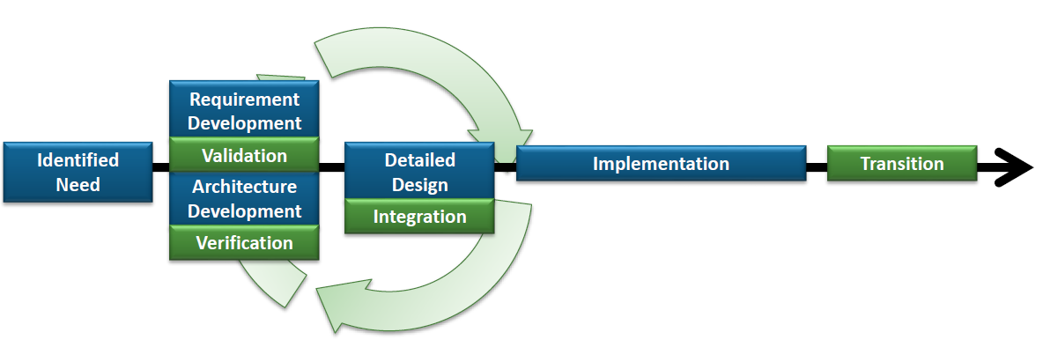
Group Objectives
Develop a formal architecture for the current state of UxAS in an assume/guarantee framework
Identify strengths, weaknesses, and problems for the current architecture
Document decisions made along the way with supporting rationale
Begin to implement a revised formal architecture to mitigate challenges
Architecture Analysis
A
C
Assumption: Input < 20
Guarantee: Output < 2*Input
Assumption: none
Guarantee: Output = Input1 + Input2
B
Assumption: Input < 20
Guarantee: Output < Input + 15
Assumption: Input < 10
Guarantee: Output < 50
Notes:
Current state – did we evolve with UxAS (yes).
Clarify where we used the code (structure) and where we used the Wiki (behavior).
Wanted to formalize UxAS to enable analysis
Found issues along the way. Fixed some.
Gave us insights.
To do this, we needed to capture contracts for the components in a formal language.

Slide 5
Group Accomplishments
UxAS formalization in AADL/AGREE :
Extracted data types, input and output ports, and connections from code (LQ/AFRL, RC)
Created formal contracts for nine services and tasks based on the OpenUxAS Wiki and conversations with the developer (DC, RC)
Stated and analyzed properties of these component-level contracts including timing aspects (DC, RC, LQ)
Idioms and lemmas developed and documented for effective use of AGREE (DC, RC)
UxAS formalization in ASSERT:
Created an ontology of the system (GE)
Examined contractual obligations of a representative component (GE)
Enhanced tool to compose component contracts in AGREE into a system contract (H, ISU)
Created an assurance argument for state machine correctness (DC)
Abstracted a task service finite state machine in Stateflow for simulation and formal analysis (LM)
Connected UxAS to the Robot Operating System (ROS) (UC)
We improved UxAS through formalization
Notes:
Add slide numbers throughout (some missing)
Restructure:
Formalized the structure of UxAS as well as behaviors for some tasks and services
Captured and analyzed system properties <- can we say this?
Slide that shows how this work recombines to achieve our goal
*whiteboard this*

Slide 6
Developing the UxAS Formal Representation

Slide 7
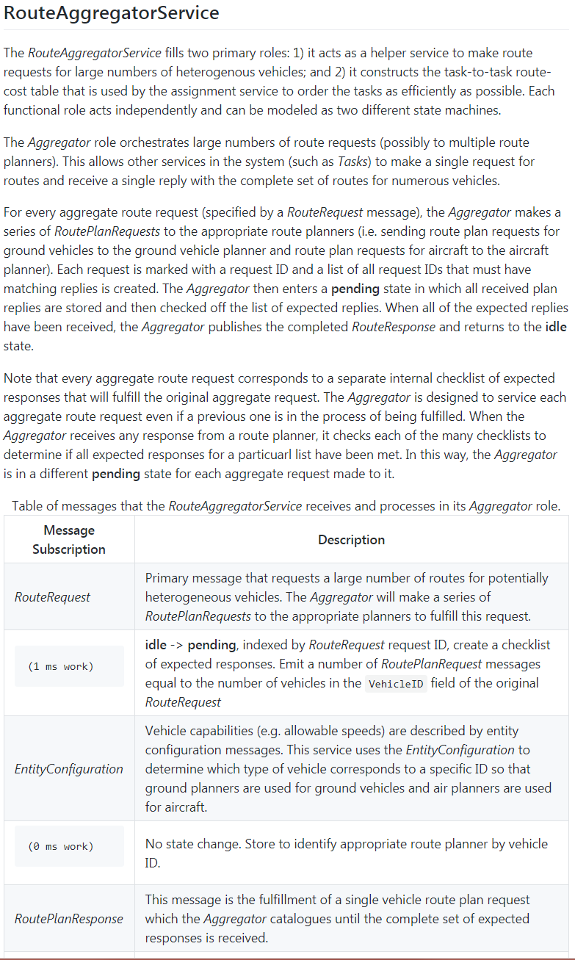
Producing the Formal Architecture
The formal architecture relied on the documentation that was found on the UxAS Wiki page.
Direct code decomposition was going to be too intensive to meet objectives efficiently.
Through formalization, gaps were identified.
Just the effort to formalize components proved extremely valuable to the SMEs, even before the analysis.

Slide 8
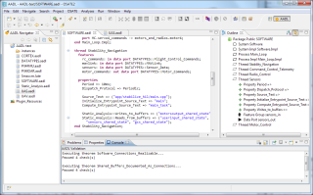

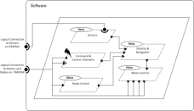
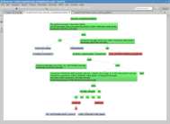
AADL Tools: Architecture-Driven Assurance
Resolute
OSATE
Assurance Case
AGREE
Trusted
Build
Behavioral Analysis
SIM
Simulation
Architecture Models
Architecture Analysis
Architecture Translation
A
C
Assumption: Input < 20
Guarantee: Output < 2*Input
Assumption: none
Guarantee: Output = Input1 + Input2
B
Assumption: Input < 20
Guarantee: Output < Input + 15
Assumption: Input < 10
Guarantee: Output < 50
seL4
Kind/JKind
Model Checker
SMT Solvers
eChronos
VxWorks
Rockwell Collins, Dependable Computing, AFRL/LinQuest

Slide 9
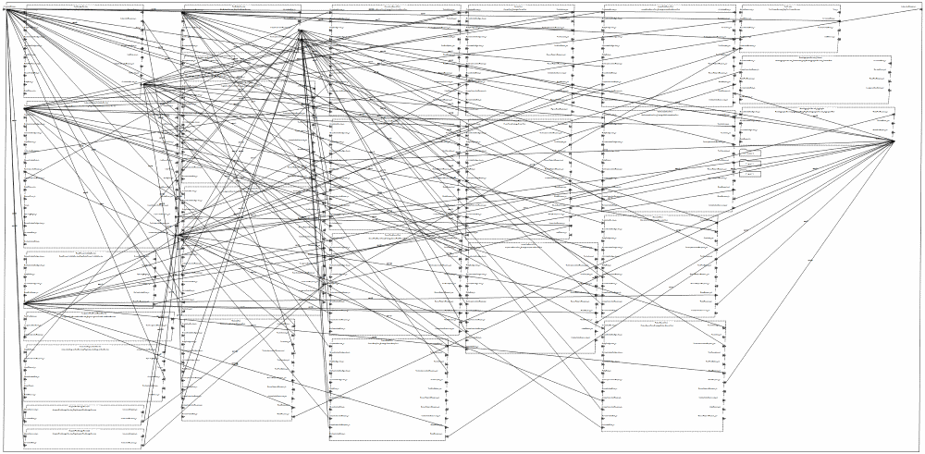
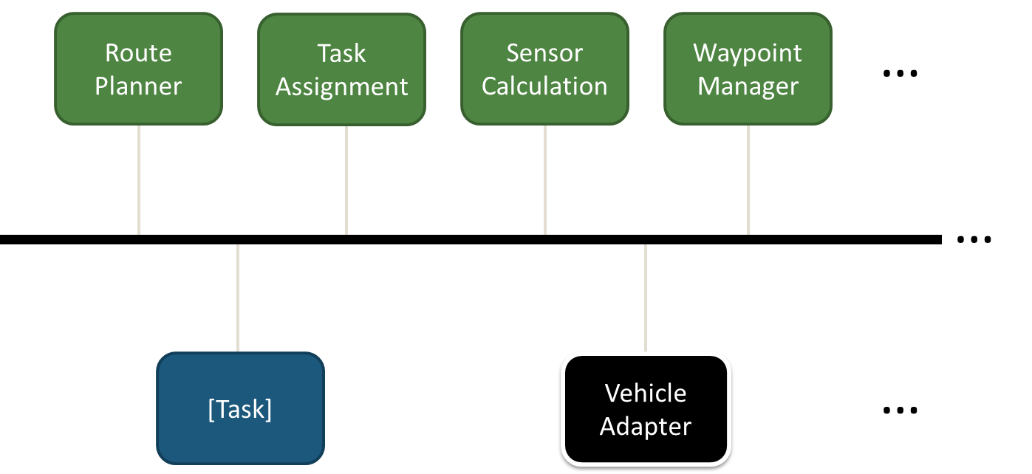
Formalization in AADL/AGREE Formalize Services
Wrote a script to extract data types, input/output ports, and connections from code into AADL
Abstracted the common message bus by direct port connections
The structural representation of the Waterways mission is nearly complete
Created formal contracts (captured behaviors) for nine services and tasks based on the OpenUxAS Wiki and conversations with the lead developer
Waterways system level AADL connections diagram
Rockwell Collins, Dependable Computing, AFRL/LinQuest

Slide 10
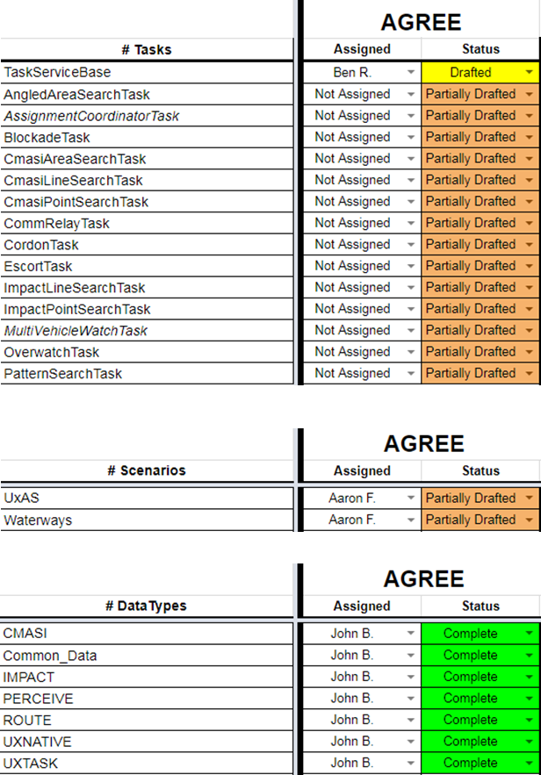
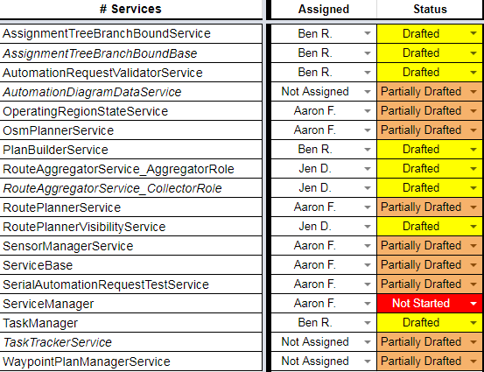
Formalization in AADL/AGREE UxAS Formal Model Status
Data Types
Add legible headers for all sections
Tasks
Services
Scenarios
Rockwell Collins, Dependable Computing, AFRL/LinQuest

Slide 11
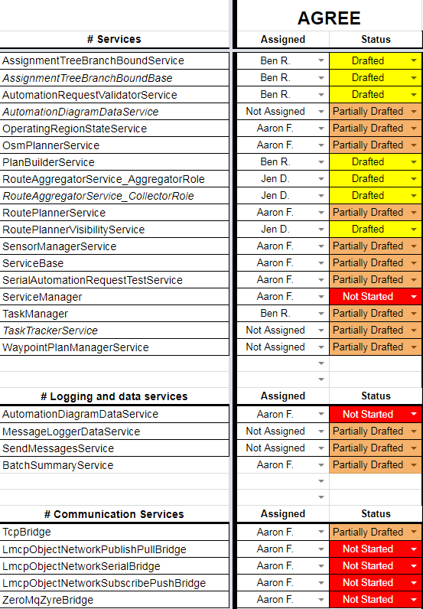
Formalization in AADL/AGREE UxAS Formal Model Status
Data Types
Add legible headers for all sections
Tasks
Services
Logging and Data Services
Communication Services
Scenarios
Rockwell Collins, Dependable Computing, AFRL/LinQuest

Slide 12
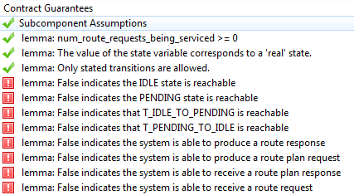
Formalization in AADL/AGREE What Did We Prove?
Realizability
Checks that a component implementation is possible and that there are no conflicts amongst the guarantees in the component’s contract
Assume/guarantee reasoning
Checks that higher-level guarantees and lemmas using the guarantees of the subcomponents, and check that the assumptions of the subcomponents hold
Check that all input/output events are possible
Capture response times in components and analyze system-level response times
Analyze behavior of state machines that represent component behavior
Some analysis results for the Route Aggregator Service
(Aggregator Role):
Observers
Rockwell Collins, Dependable Computing, AFRL/LinQuest
Notes:
Consider adding or replacing with a screenshot of a Waterways timing guarantee
Use term observer and explain it.
Maybe add another slide with actual contracts.

Slide 13
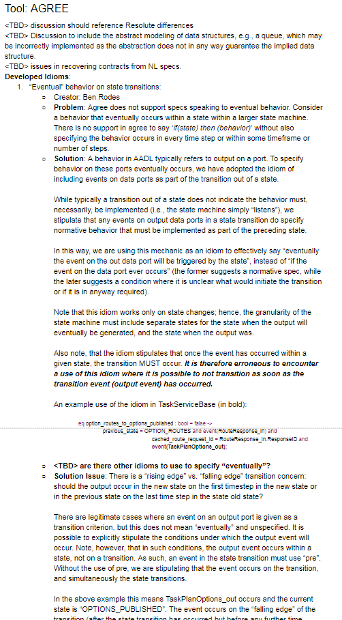
Formalization in AADL/AGREE What Did We Learn?
Idioms and lemmas developed and documented for effective use of AGREE
“Eventual” behavior on state transitions
Tracking and maintaining IDs
Dummy parent components for proving lemmas
Preventing inadvertent solutions space constraints
Abstraction of complex data structures
Skolemization idea for arrays
Fully specifying output event conditions
Use of AGREE connections
Real-time patterns
Rockwell Collins, Dependable Computing, AFRL/LinQuest

Slide 14
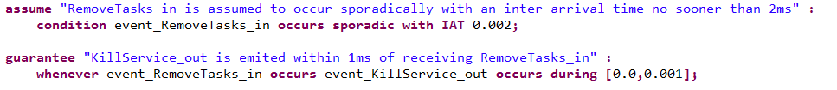
System-level contracts
System-level guarantees are in progress
Responsiveness/timing example
Task Manager Service:
Waterways (system-level) – not yet proven:
Rockwell Collins, Dependable Computing, AFRL/LinQuest

Slide 15
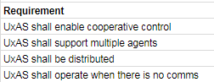
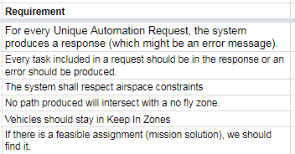
System-level contracts
System-level guarantees are in progress
Challenges
Many system-level requirements for UxAS are informal
Others require significant infrastructure (supporting contract guarantees) in order to prove them
Perhaps we can compose the component contracts we have to discover new system-level properties…
Rockwell Collins, Dependable Computing, AFRL/LinQuest

Slide 16
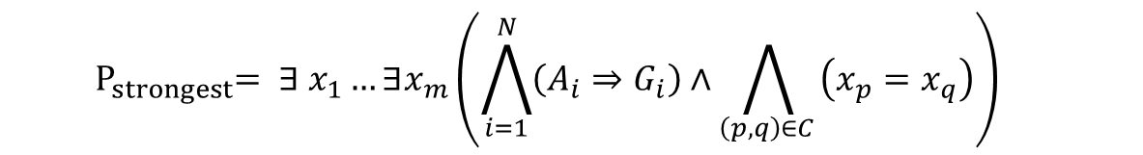

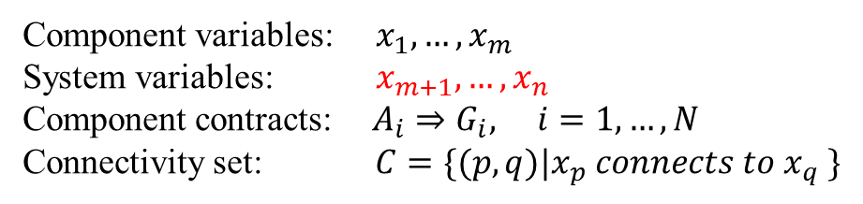
Quantifier Elimination based Property Composition and Verification
Quantifier Elimination: a powerful technique for gaining insight, through simplification, into problems involving
logic expressions in various theories.
Strongest system property: the system property that implies any other system properties established upon the given constraints of component properties and their connectivity.
Component variables: $x_{1},…,x_{m}$ System variables: $x_{m+1},…,x_{n}$ Component contracts: $A_{i}⇒G_{i}, i=1,…,N$ Connectivity set: $C=\{(p,q)|x_{p} connects to x_{q} \}$
$$Sys≔Comp(Sub_{1},…,Sub_{N}):$$
Prove postulated system property from the strongest system property:
$$∀ x_{m+1}…∀x_{n} \left(P_{strongest}\text{⇒ }P_{postulated}\right)=true$$
Theorem: The strongest system property, established upon the component contracts and connectivity is given by:
$${ P}_{strongest}= ∃ x_{1}…∃x_{m}\left(\bigwedge_{i=1}^{N}{\left(A_{i}⇒G_{i}\right)}∧\bigwedge_{\left(p,q\right)∈C }{\left(x_{p}=x_{q}\right)}\right)$$
Honeywell, Iowa State University
Notes:
Maybe bridge here with system-level timing properties and there difficulty
Formula is for non-time-dependent systems
Can reuse strongest system property to prove other postulated properties. Can save analysis time.
Can be reduced to QE problem

Slide 17
Quantifier Elimination based Property Composition and Verification
Quantifier Elimination: a powerful technique for gaining insight, through simplification, into problems involving
logic expressions in various theories.
Strongest system property: the system property that implies any other system properties established upon the given constraints of component properties and their connectivity.
Component variables: $x_{1},…,x_{m}$ System variables: $x_{m+1},…,x_{n}$ Component contracts: $A_{i}⇒G_{i}, i=1,…,N$ Connectivity set: $C=\{(p,q)|x_{p} connects to x_{q} \}$
AGREE contracts can be composed into a system-level contract
$$Sys≔Comp(Sub_{1},…,Sub_{N}):$$
Prove postulated system property from the strongest system property:
$$∀ x_{m+1}…∀x_{n} \left(P_{strongest}\text{⇒ }P_{postulated}\right)=true$$
Theorem: The strongest system property, established upon the component contracts and connectivity is given by:
$${ P}_{strongest}= ∃ x_{1}…∃x_{m}\left(\bigwedge_{i=1}^{N}{\left(A_{i}⇒G_{i}\right)}∧\bigwedge_{\left(p,q\right)∈C }{\left(x_{p}=x_{q}\right)}\right)$$
Honeywell, Iowa State University

Slide 18
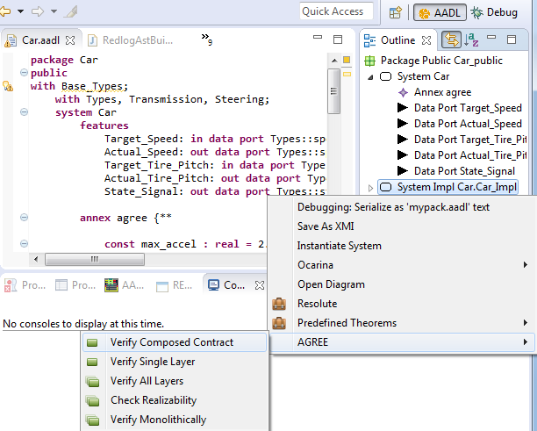

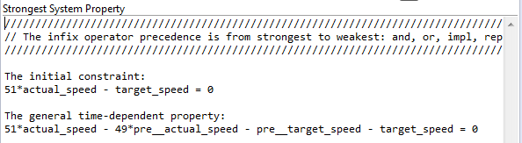
Implementation and Experimental Result
Redlog-integrated AGREE:
.aadl
Redlog model
result
Extended-AGREE
Result parser
Redlog
OSATE2
AGREE
Eclipse
Honeywell, Iowa State University
Notes:
* Redlog is the QE solver (substitute for Jkind).

Slide 19

Formalization in ASSERT Proposed Approach
Extract architecture information through reverse engineering.
Transform extracted architecture information into SADL ontology.
Import SADL ontology into ASSERT™ to enable requirement capture, analysis, and test generation in ASSERT™
Software Codebase
(C, C++, Java, C#, Python, Ada, …)
Reverse Engineering
Software Design Information
Architecture Information Extraction
Architecture & Ontology Mapping Template
Automated Ontology Generation
Ontology Model
ASSERT™ SADL Ontology files
(.sadl files)
*SADL: Semantic Application Design Language
GE
Notes:
Grab Tony’s version(?)
Two parts:
Import C++ to Enterprise Architect (“reverse engineering button”)
Use API to extract ontology (interfaces and connections)
Implement XML parser for message types -> output SADL for message type definition

Slide 20
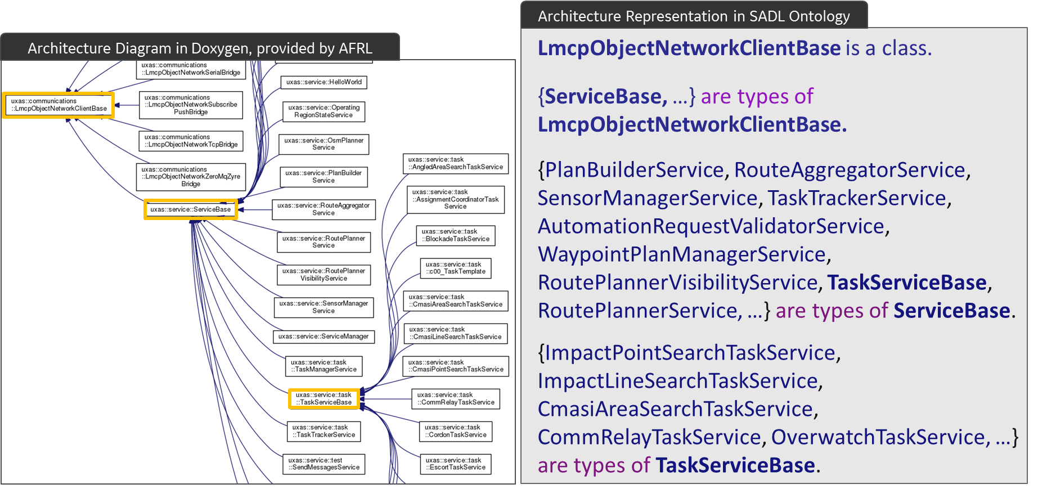
Modeling UxAS System Architecture in SADL Ontology
GE
Notes:
*Subtypes capture the inheritance hierarchy

Slide 21
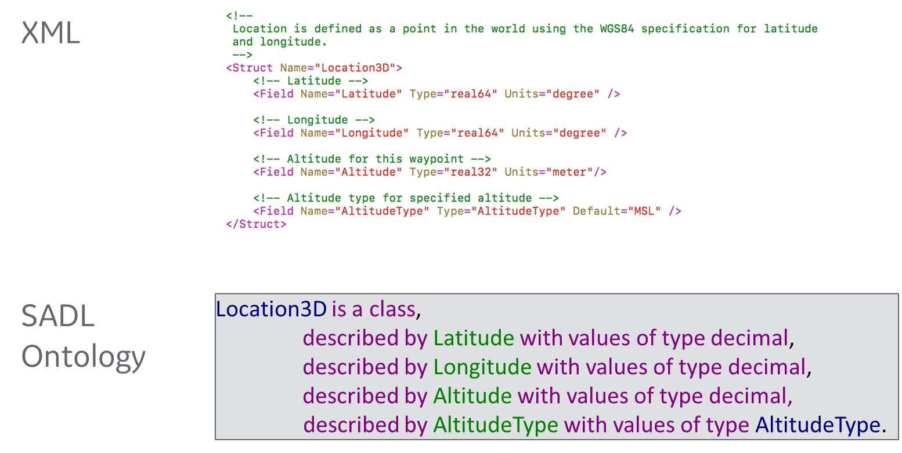
Modeling Message Type Definition in SADL Ontology
GE

Slide 22
Modeling Dataflow in SADL Ontology
Illustrative Example in SADL Ontology
Context:
TaskAssignmentSummary__Subscription of PlanBuilderService is TaskAssignmentSummary_out of AssignmentTreeBranchBoundBase
and
TaskImplementationRequest__Subscription of TaskServiceBase is TaskImplementationRequest_out of PlanBuilderService
and
…
AssignmentTreeBranchBoundBase
TaskAssignmentSummary_out
PlanBuilder
Service
TaskImplementationRequest_out
TaskAssignmentSummary_Subscription
TaskServiceBase
TaskImplementationRequest_Subscription
GE

Slide 23
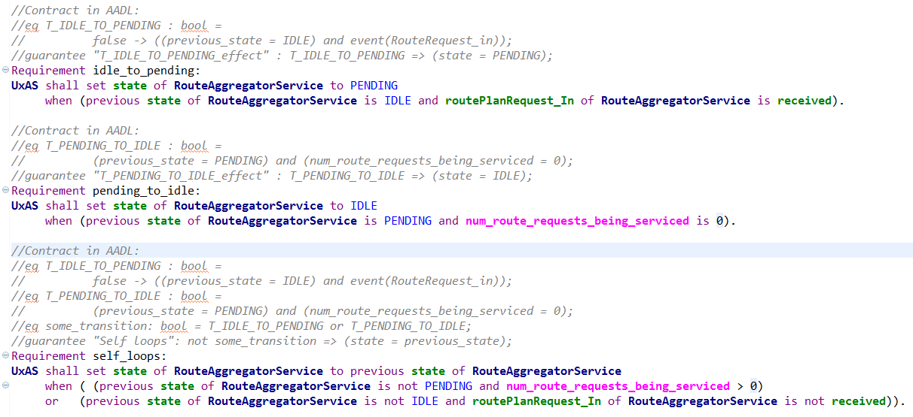
Illustrative example: Sample AADL Contracts Captured in SADL
GE

Slide 24
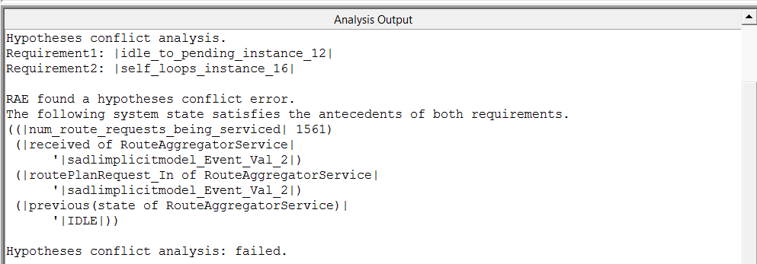
Illustrative example: Contracts Analysis
Conflicts!
A counter example:
num_route_requests_being_serviced = 1561
routePlanRequest_In of RouteAggregatorService is received
previous state of RouteAggregatorService is IDLE
state of RouteAggregatorService could be either PENDING or IDLE!
GE

Slide 25
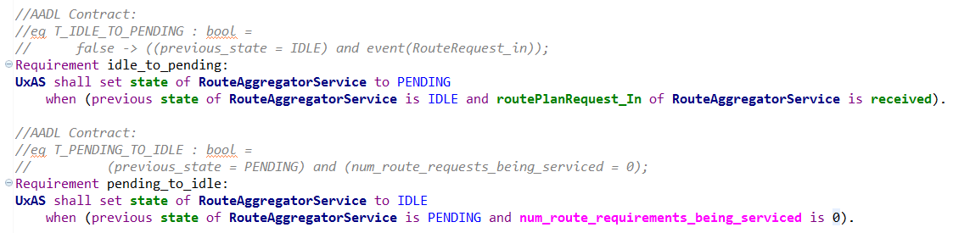
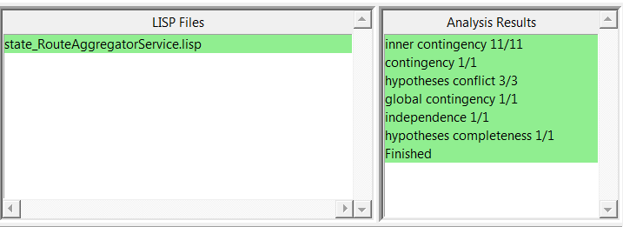
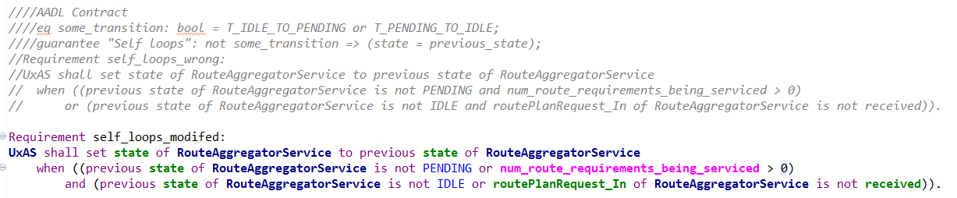
Formalization in ASSERT Illustrative example: Modified Contracts Pass Analysis
Analysis enabled:
Redundancy check
Conflict check
Completeness check (e.g., handle all cases of a variable’s value)
What we learned: errors introduced in the manual contracts/requirements capturing process can be found earlier through automated analysis.
GE

Slide 26
From the lead developer: Impact of Formalization on UxAS
Recognition of key assumptions
IDs are unique (not guaranteed by the implementation today)
Illumination of design flaws
Missing ID checks
All services need to use the Route Planner for routes to ensure there is no conflict with an airspace constraint
Restructuring to avoid redundant or problematic logic
Split RouteAggregatorService into two services for two functional roles
Removal of some dead code in the Route Planner
We improved UxAS through formalization
Notes:
*Victory slide*
Note that this came from Derek

Slide 27
State Machine Reasoning

Slide 28
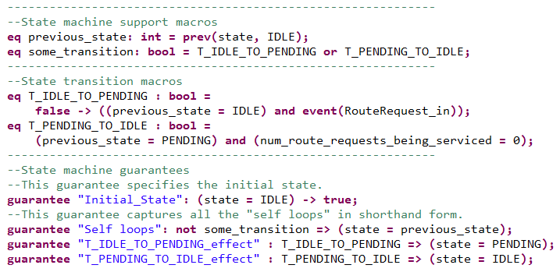
State Machine for the Route Aggregator Service
IDLE
PENDING

Slide 29
State Machine Reasoning in AGREE
Example properties that we can prove:
States are reachable
Transitions are viable
Even so, the modeler can make mistakes
We use an assurance case to capture the rest of the argument

Slide 30
State Machine Correctness Argument
Argument pattern for individual AADL component state machine correctness:
Structure repeated for each component
Vision: Situated within a larger model correctness argument
Argument situates proposed AGREE lemmas:
Purpose
Rationale
Limitations and benefits
Dependable Computing

Slide 31
Argument-Derived Observations
Best practices/standards for AADL/AGREE use are needed
Situate proofs within modeling fault analysis/mitigation
Supports arguments that the set of lemmas are complete and correct
Additional tool support to reduce human error
E.g., lemmas and repetitive infrastructure are developed manually
Minimize repetitive concerns in the argument about human error
Enhanced integration between AADL and AGREE
Minimize repetitive arguments about AADL and AGREE consistency/agreement
A simpler higher-level protocol state machine spec for validation
Provide a structure to validate against
Simplify validation activity and simplify validation arguments
Dependable Computing

Slide 32
Stateflow Representation
Benefits
Enable simulation
Enable analysis from Simulink
QVtrace
Simulink-to-PVS
Simulink Design Verifier
Visualize counterexamples
Evidence in the assurance argument: “gold standard state machine”
Created a Stateflow representation of the Task Service Base state machine
Simulink/Stateflow Abstractions cross-checked with AADL model
Found erroneous initial conditions, unused from/goto flags, and incorrect settings on if-else cases in Stateflow model
Lockheed Martin, Dependable Computing, Rockwell Collins

Slide 33
Notes:
Each state has a sub state machine. Emulates failure in each state.

Slide 34
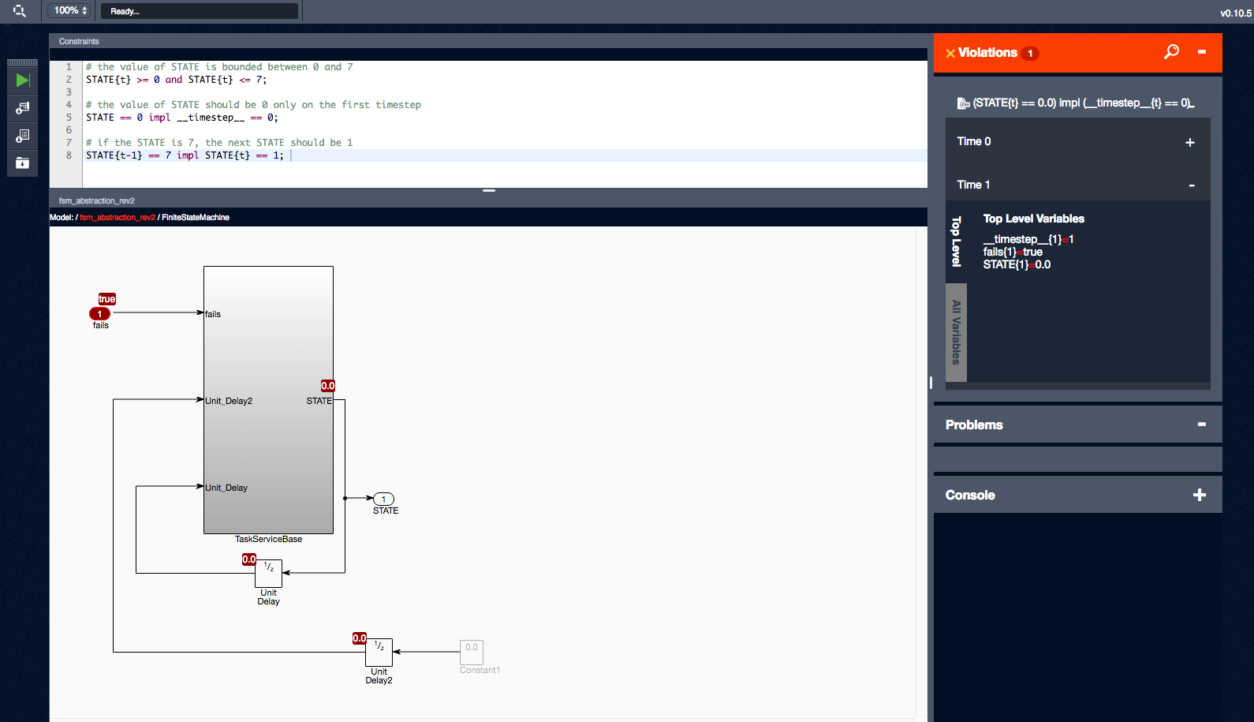
Analysis with QVtrace
Matlab Simulink Construction for Simulation → QVtrace
QVtrace is a model checker for Simulink that uses SMT Solvers such as Z3
Helped validate expected behavior of the abstraction
Enables path from contracts to code generation
Lockheed Martin, Dependable Computing, Rockwell Collins
Notes:
Maybe cut out middle

Slide 35
Lessons Learned
Many problems are identified through the process of formalization, before analysis
Data types (or an ontology), ports, and connections can be automatically extracted from code (with some moderate up front work)
Reusable (template) properties help find common mistakes
Not every error can be detected with a template property--a review of the specification itself is still worthwhile
Assurance arguments are useful to capture the “rest of the story”
SpeAR, ASSERT, AADL/AGREE, and QVtrace are all very capable analysis tools. There are synergies between them.
Challenges: arrays, inheritance
Notes:
Assurance arguments:
Differences between the model and the real world
Specification versus intent
Enhancements to the formal analysis tools could simplify the argument

Slide 36
Recommended Future Directions
Write contracts for the remaining thirty-one components
State/compose and analyze system-level properties (in progress)
Generate code from AADL
Generate test cases from AGREE and run on UxAS implementation
Continue documenting decisions and the assurance case for the architecture
Notes:
Discuss: Model of Heterogeneous System (Distributed Mission-Task-Autopilot Management-Dubin)

Slide 37
Backup
Notes:
Maybe show a contract for a service
22 min at dry run

Slide 38
Formalization in ASSERT SADL Ontology Generation
Modeling Dataflow in SADL Ontology
Context:
TaskAssignmentSummary__Subscription of PlanBuilderService is TaskAssignmentSummary_out of AssignmentTreeBranchBoundBase
and
TaskImplementationRequest__Subscription of TaskServiceBase is TaskImplementationRequest_out of PlanBuilderService
and
…
Modeling Message Type Definition
AssignmentTreeBranchBoundBase
TaskAssignmentSummary_out
TaskAssignmentSummary_Subscription
TaskImplementationRequest_out
PlanBuilderService
TaskServiceBase
TaskImplementationRequest_Subscription
GE
Architecture Group
Notes:
Improve legibility (maybe go back to two slides)

