Slide 1


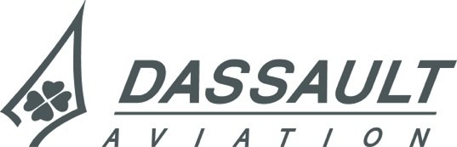
A Collaborative Development Assurance Lab.
RESSAC Case Study
Emmanuel Ledinot
FAA Workshop Dallas September 15th, 2016,
Notes:
This briefing presents the RESSAC Use Case’s highlights

Slide 2
Outline
Why ?
What ?
How ?
Expected Outcomes
FAA Workshop #4 Dallas 2016/09/15 RESSAC Use Case: A Development Assurance Lab.

Slide 3
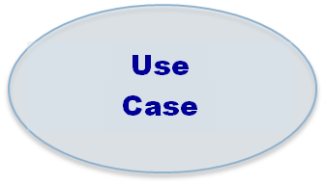
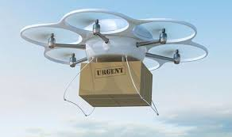
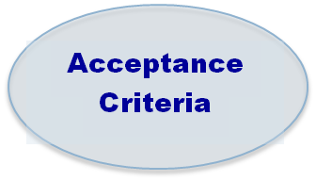

Why ?
In Theory
« Give it a try »
Systems
‘Intent’
‘Necessity’
Items
‘Correctness’
?
« Bridge the gap»
In Practice
  Demonstrate Applicability
  Experiment SYS-SW-HW uniformity
Notes:
The ‘Overarching Properties’ WG reached a consensus on the statement of the OPs, and on a first set of constraints to be met when demonstrating that these OPs are satisfied by the final product and by its development artefacts.
But the WG is unanimously aware that the approach is too abstract at that time to be usable. The OP approach limited to the 3-page outcome would probably even be counterproductive by introducing more interpretation variability than with present AMCs. (perceived as too prescriptive and too amenable to interpretation variability).
The WG’s next goal is to find OP-acceptance criteria through concrete exercices. The primary goal of the use case is to provide open material to make experiments on OPs’ applicability.

Slide 4


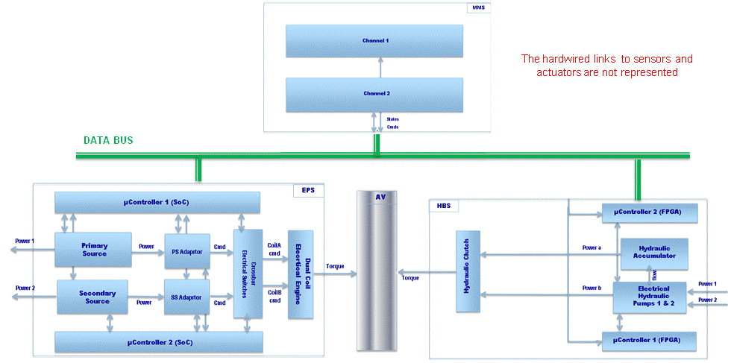
What ?
A small UAV …
… but many Seeds of Complexity
External Disturbances
Adaptative Control
3 Functions at AV level
4 Systems
3 Energy Domains (CPS)
2 Software Items
4 Hardware Items
~ 20 Events
6 AV-level Failure Conditions
Notes:
The use case was intended to be as small as possible but to cover the aircraft level (multisystem), the system level and the item level. Addressing «risk-based » development assurance for software-intensive tightly coupled systems (coupled by physics and data exchanges) requires to do so.
The intent of the use case is to address a seamless approach to risk-based development assurance as it was envisioned by Mike Dewalt’s seminal TIAM proposal (and his prior IP 217 proposal in DO-178C WG).
RESSAC’s use case will experiment a less « silos-ed » approach to development assurance. Refinement contracts will be the main tool-supported concept to identify and test acceptance criteria for the Overarching Properties.

Slide 5
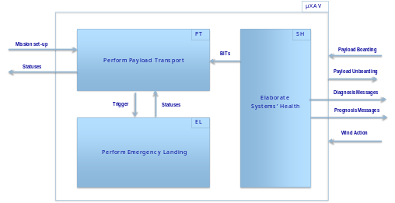
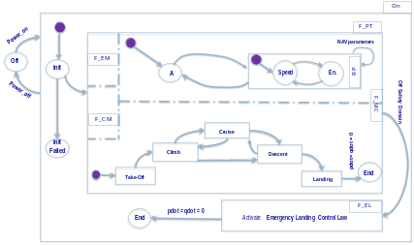

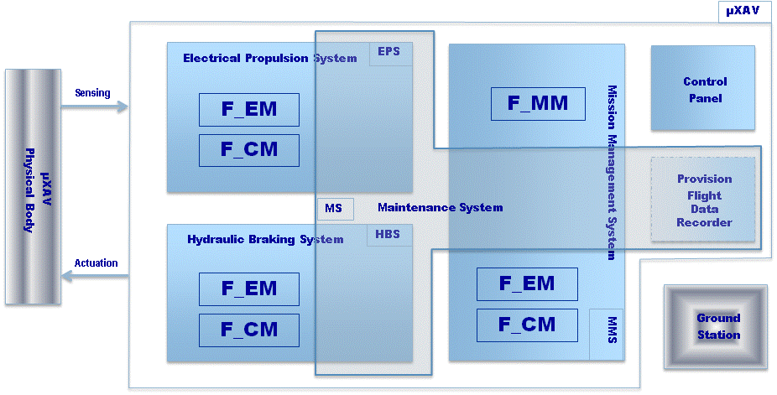
How ?
Desired Behavior
Intent
AV level Defined Intended Functions
tier 1
Intent
Necessity
Correctness
Correctness
Recursive Application of the 3 OPs
Contract-based Refinement
Architecting
Necessity
tier 2
Intent
Necessity
Correctnes
tier 3
Intent
Necessity
Correctnes
Final Implementation
Notes:
As the OPs are intended to be applied at various refinement steps, the use case will exemplify at least four of them:
From Air Vehicle functions to System-mapped functions,
From System-mapped functions to equipment-mapped functions,
From Equipment mapped-functions to item-mapped functions,
Item level (SW & AEH) refinement steps

Slide 6
What: The Artefacts of the Use Case
Desired Behaviour Documents
  Air Vehicle
  Mission Management System
  Electrical Propulsion System
  Hydraulic Braking System
Defined Intended Functions Documents
  Air Vehicle
  Mission Management System
  Electrical Propulsion System
  Hydraulic Braking System
Global Modelica Model of the DIF Documents
  Properties + Behaviours
MMS Software (x3)
  Three different Applicant Processes
    (x1) Model-based development + Qualified ACG
    (x2) Contract-based manual coding (Ada, C)
EPS AEH Controller (x1)
  TBD
Modification process to be experimented (stage 2)
Process variability to be be experimented
FAA Workshop #4 Dallas 2016/09/15 RESSAC Use Case: A Development Assurance Lab.
Notes:
The orientation of the RESSAC WG is to experiment the OPs on development processes relying extensively on advanced and qualified tools (model-based system and software development, model checking, static analysis, qualified ACGs etc.)

Slide 7
How: Contributors
  ACG Solutions
    Set up of the integral processes (CC, CM, QA, Planning) and life-cycles of the Use Case
  AdaCore
    GitHub collaborative workspace
    SPARK Ada version of the MMS software
  Dassault Aviation
    Specification Documents + Safety Assessment
    Modelica Model
    MMS Software (Annotated C version)
  ANSYS - Esterel Technologies
    SysML modeling + Simplorer port of the Modelica model
    System to software transition with SCADE-system and SCADE (with Zodiac)
  Safran
    Specification of the EPS’ Hardware Control Units
  Zodiac
    SCADE version of the MMS software
FAA Workshop #4 Dallas 2016/09/15 RESSAC Use Case: A Development Assurance Lab.
Notes:
No additional comments

Slide 8
How: Collaborative Workspace
https://github.com/AdaCore/RESSAC_Use_Case (2016/10/01)
Read: Open
Write: RESSAC
Repository 1: Safety Process
  Readme
  Hazard Analysis
  Functional Hazard Analysis
  Prelimnary AVSafety Assessment
  Prelimnary EPSSafety Assessment
  Prelimnary MMSSafety Assessment
  DAL Assignment
Done for context information on the safety aspects of the Use Case. Focus of the Use Case is exclusively on Development Assurance.
DAL Assignment is outside of the scope of RESSAC.
Repository 2: Development Process
  Air Vehicle Level
  Electric Propulsion System
  Hydraulic Braking System
  Mission Management System
  MMS Software Item
  EPS Hardware Control Unit Item
  HBS Hardware Control Unit Item
Pool of the volunteered development artefacts (specification documents, models, simulation results, etc.) that will support the OP-based experiments for the chosen life-cycles and processes
FAA Workshop #4 Dallas 2016/09/15 RESSAC Use Case: A Development Assurance Lab.
Notes:
The use case is intended to be open, and its results to be shared with everybody. Contributions are welcome (from academics on contract-based hybrid system verification in particular).
The safety assurance process is outside of the scope of the use case. But the safety process artefacts of the use case will be provided because they are necessary inputs to the use case’s development and development assurance processes.

Slide 9
How: Collaborative Workspace
Repository 3: Baseline Development Assurance
  Air Vehicle
  Electric Propulsion System
  Hydraulic Braking System
  Mission Management System
  MMS Software
  EPS Hardware
  HBS Hardware
ARP 4754, DO-178, DO-254 Development Assurance Artefacts
For comparison with the alternate OP-based approach
Repository 4: OP-based Development Assurance
  Air Vehicle
  Electric Propulsion System
  Hydraulic Braking System
  Mission Management System
  MMS Software
  EPS Hardware
  HBS Hardware
The evidences that support the OP satisfiability statuses based on the RESSAC-defined Acceptance Criteria
FAA Workshop #4 Dallas 2016/09/15 RESSAC Use Case: A Development Assurance Lab.
Notes:
The two development assurance approaches (baseline present AMCs and OP-based) will be compared. The comparison will be technical only. Economic impact of the OP-basd approach, though of primary interest, is beyond reach and not even addressed in this first round of experiments.

Slide 10

What ?
Use Case’s Perimeter
OP-Based
Development Assurance
Safety Assurance
Baseline
Development Assurance
AV Level
DIF Document
Global Hybrid System Model
FHA
PASA
CCA
ASA
ARP 4754A
Goals, Activities, Artefacts
System Level
DIF Documents
FHA (x4)
PSSA (x4)
CCA (x4)
SSA (x4)
ARP 4754A
Goals, Activities, Artefacts
Requirements Allocated to Items
Process and Life-cycle dependent artefacts (x3)
Item Level
DO 178C + TSs, DO 254
Process and Life-cycle dependent artefacts (x3 SW + x2 HW)
Conformance-based ?
Or / And
Risk-based ?
Safety Agnostic Zone
(Conformance)
FAA Workshop #4 Dallas 2016/09/15 RESSAC Use Case: A Development Assurance Lab.
Notes:
The red boarder line represents the « frontier » between development assurance and safety assurance. « Frontier » is not an appropriate word as development assurance is part of safety assurance.
The red line underlines the fact that from the OPs’ perspective a part of ARP 4754 (e.g DAL assignment) is off perimeter. In particular in the use case. This part is addressed by the safety group and the safety process.

Slide 11
What ?
‘Design’ faults in the product ↔ Behavioural Complexity
  Risk-based Approach
  in the Use Case
DEVELOPMENT
ASSURANCE
Faults in the product ↔ Betrayed by tools (Qualification)
    Software-intensive-Systems’ Functional Safety lies at the frontier between Safety Assurance and Development Assurance
      Use Case: STPA –based FHAs, exploring the frontier …
FAA Workshop #4 Dallas 2016/09/15 RESSAC Use Case: A Development Assurance Lab.
Notes:
STPA (System Theoretic Process Analysis)-based FHAs will be tested on the use case. As FHA at any level is a safety process activity, it should not be part of OPs’ applicability analysis.
But are system-system interaction failures specifically targeted by ARP 4761? This sort of failures has become a major concern in software intensive tightly coupled systems. Interaction failures are a development assurance concern. So STPA will be used as a « hybrid » activity: assumed to belong to the development assurance process and to the safety assessment process..

Slide 12
Expected Outcomes
A set of Process Acceptance Criteria for Correctness, Intent, Necessity
  Tested on the Contract-based Refinement Steps of the Use Case
  Derived from a formal Safety Case on the Use Case (with academics)
  Deadline: June 2017 (1st release)
  A ‘Job Aid’ - like document
  Draft proposal to help the Applicants & Authorities using the Criteria
  Problem-solving oriented (i.e not means prescriptive)
  Deadline: June 2018
FAA Workshop #4 Dallas 2016/09/15 RESSAC Use Case: A Development Assurance Lab.

