Slide 1
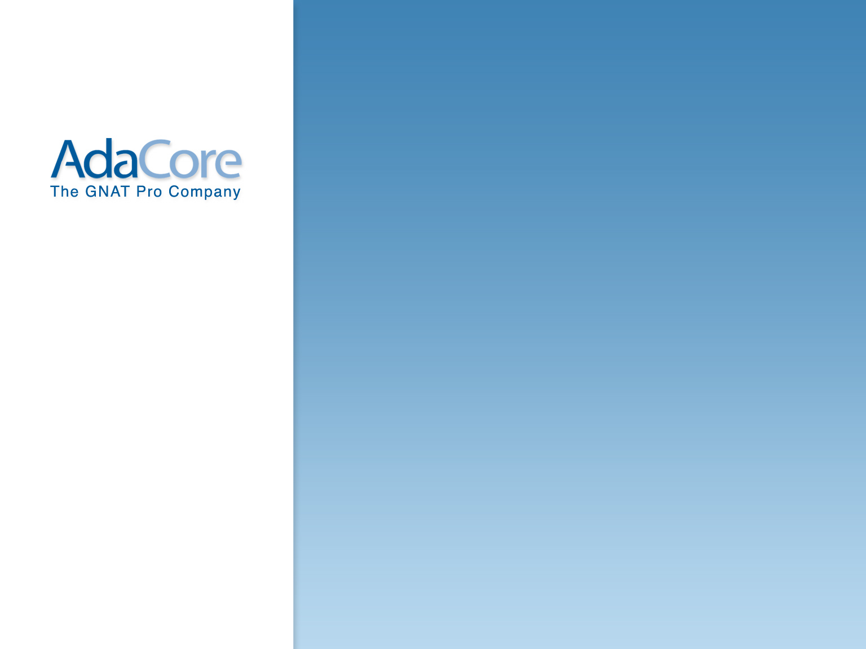
Presentation cover page EU
Integrating Test And Proof In The Verifiable Spark 2014 Language Using Contracts And SMT Solvers
Tucker Taft
AdaCore Inc
32nd DASC Conference
Syracuse, NY
October, 2013
www.adacore.com

Slide 2
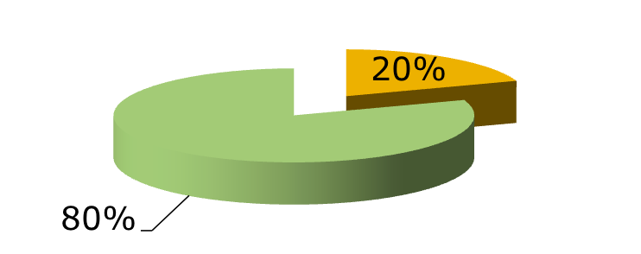
Cost of testing
Cost of testing greater than cost of development
10% increase each year for avionics software (Boeing META Project)
Uneven partitioning:
Uneven quality: 80% of errors traced to 20% of code (NASA Software Safety Guidebook)
Need to reduce and focus the cost of testing
← 80% of effort!

Slide 3
DO-178C: formal methods can replace testing
DO-178C: formal methods can replace testing
Formal methods […] might be the primary source of evidence for the satisfaction of many of the objectives concerned with development and verification.
2011: Formal Methods Supplement (DO-333)

Slide 4
Myths of formal methods
Myths of formal methods
Myth 4: Formal methods require highly trained mathematicians
Myth 5: Formal methods increase the cost of development
Myth 6: Formal methods are unacceptable to users
Myth 7: Formal methods are not used on real, large-scale software
(Anthony Hall, Praxis Systems, 1990)

Slide 5
Practice of formal methods
Practice of formal methods
Since 2001, Airbus has been integrating several tool supported formal verification techniques into the development process of avionics software products.
2009: Formal Verification of Avionics Software Products
(Souyris, Wiels, Delmas, Delseny)

Slide 6
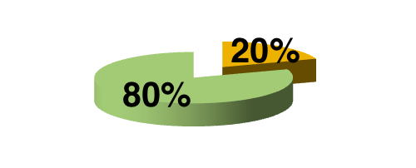
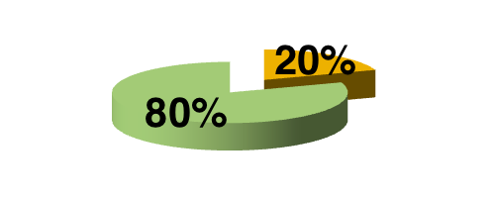
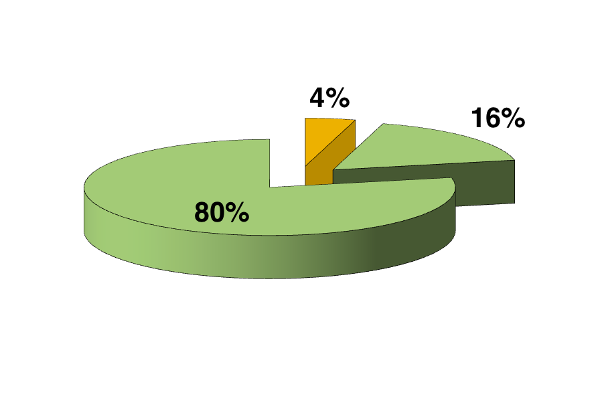
Cost of verification
80% of
testing effort
80% of
formal effort
Proof+test goal: using formal verification first, then testing…
testing
formal
… to reduce and focus the cost of verification

Slide 7
SPARK 2014 +
Ada 2012
Proof + Test

Slide 8
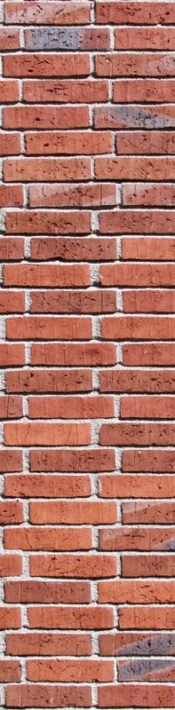
Programming Contracts
{P}C{Q} Hoare logic (1969)
logic contracts
for proofs
SPARK (1987)
executable contracts
for tests
Eiffel DbC (1986)
SPARK 2014: Executable Annotation Language
based on Ada 2012

Slide 9
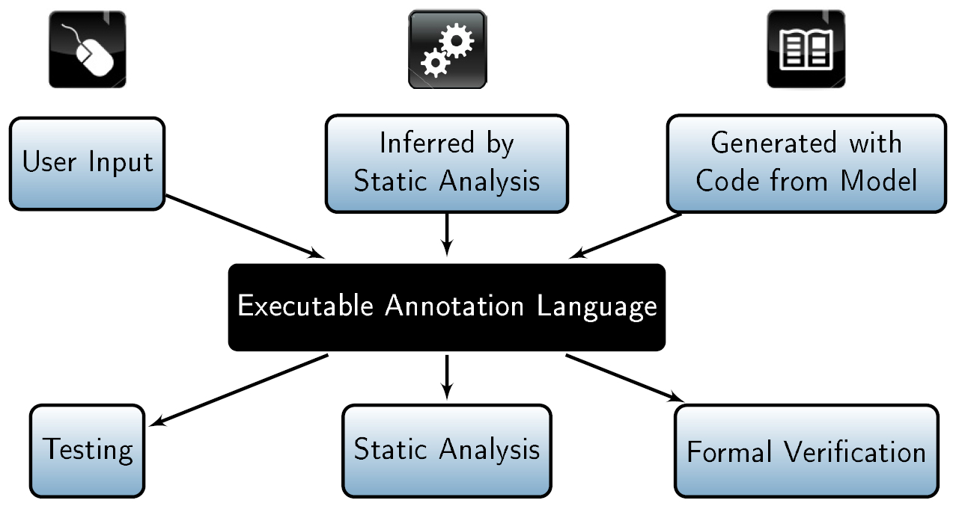
SPARK 2014 toolset based on open-source “Hi-Lite”Project

Slide 10


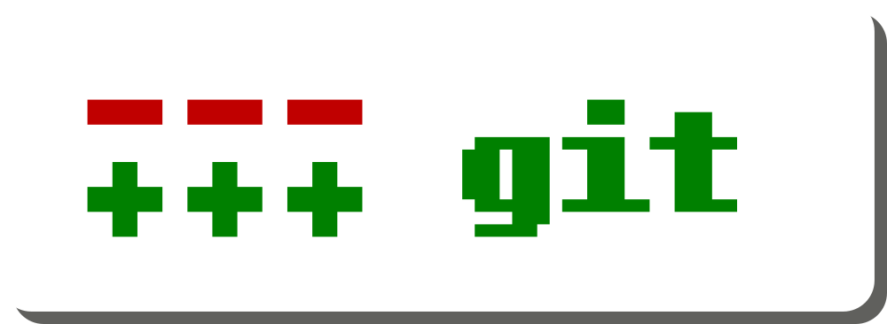

Project: Benefits of openness
.org
announcements
meeting slides
articles / docs
public:
  meeting minutes
  technical work
  69 members
private:
  management
  partner code
all code
dev docs
user docs
→ external collaborations with industry and academia

Slide 11
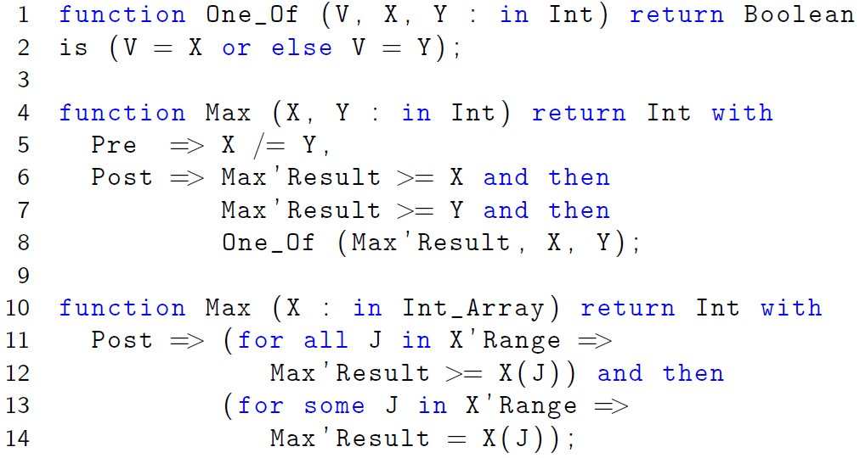
Ada 2012 has built-in support for run-time contract checking

Slide 12
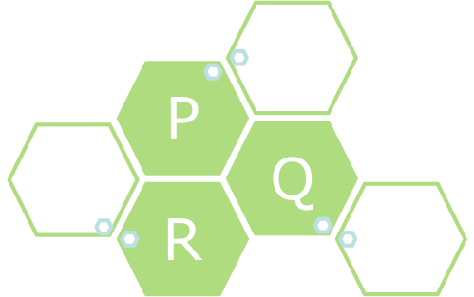
Testing vs. Formal Verification
use Q code
cover P constructs
prove pre of Q
assume post of Q
P calls Q
P calls Q
P
P
Q
Q
actual body of Q
or stub…
assume pre of Q
prove post of Q
local exhaustivity argument:
each function covered
enough behaviors
explored
global soundness argument:
all functions proved
→ all assumptions justified

Slide 13
Combining tests and proofs
P is tested
P calls Q
How do we justify
assumptions made
during proof?
P
Q
Q is proved
Q calls P
verification combining tests and proofs should be
AT LEAST AS GOOD AS
verification based on tests only

Slide 14
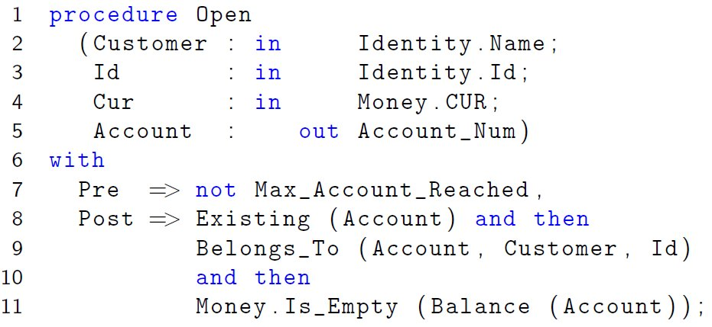
Caution: contracts are not only pre/post!
strong typing
parameters not aliased
) …
parameters initialized
data dependences

Slide 15
Combination 1: tested calls proved
P is tested
during testing:
check that
pre-condition of Q
is respected
P calls Q
P
Q
Q is proved
assumption for proof:
pre-condition of Q
is respected

Slide 16
Combination 2: proved calls tested
P is tested
during testing:
check that
post-condition of P
is respected
P
Q
Q is proved
Q calls P
assumption for proof:
post-condition of P
is respected

Slide 17


Testing + Formal Verification
tested
proved
proved
local exhaustivity argument:
test: function covered
proof: by nature of proof
global soundness argument:
proof: assumptions proved
test: assumptions tested
Testing must check additional properties
Done by compiler instrumentation

Slide 18
Proof + Test toolsuite
executable
Ada 2012 compiler/ front end
Ada unit testing
aggregated
verification
results
SPARK + SMT solver unit proof

Slide 19
SPARK 2014
proof + test
Conclusion

Slide 20
Airbus 5 “must-have”s of formal methods
Soundness
Applicability to the code
Usability by normal engineers on normal computers
Improve on classical methods
Certifiability
ongoing research

Slide 21
How to learn more
http://www.spark-2014.org
http://www.ada2012.org
http://www.adacore.com
S. Tucker Taft, VP & Director of Language Research
AdaCore
24 Muzzey Street 3rd Floor
Lexington, MA 02421 USA
taft@adacore.com

