Slide 1
Levels of Software Assurance in SPARK
Yannick Moy
HCSS 2017

Slide 2
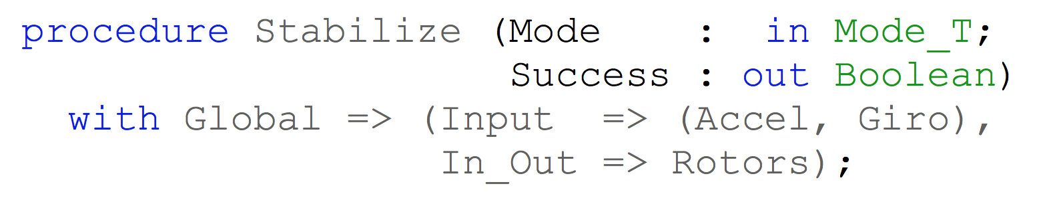
SPARK – Flow Analysis
Specification of effects
Flow analysis
Program implements specification

Slide 3
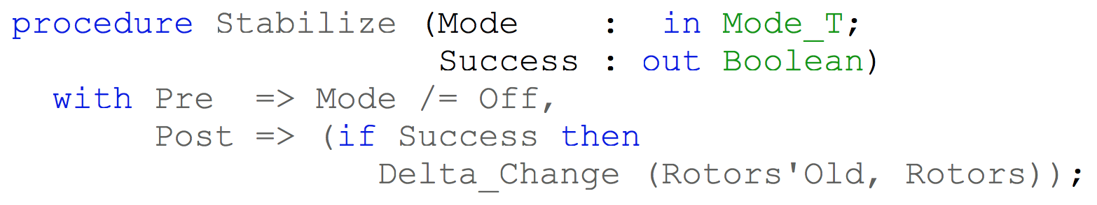
SPARK – Proof
Specification of properties
Proof
Program implements specification

Slide 4
Levels of Software Assurance

Slide 5
Stone Level
Strong semantic coding standard
Program respects all the SPARK language legality rules
Enforces safer use of language features:
Restricted concurrency (Ravenscar profile)
Expressions and functions without side-effects
Forbids language features that make analysis difficult:
Unrestricted pointers
Exception handlers

Slide 6
Bronze Level
Initialization and correct data flow
Program passes SPARK flow analysis without violations
Detects programming errors:
Read of uninitialized data
Problematic aliasing between parameters
Data race between concurrent tasks
Checks user specifications:
Data read or written
Flow of information from inputs to outputs

Slide 7
Silver Level
Absence of run-time errors
Program passes SPARK proof without violations
Detects programming errors:
Divide by zero
Array index out of bounds
Integer, fixed-point and floating-point overflow
Integer, fixed-point and floating-point range violation
Explicit exception raised
Violation of Ceiling Priority Protocol

Slide 8
Gold Level
Proof of key integrity properties
Program passes SPARK proof without violations
Checks user specifications:
Type invariants (weak and strong)
Preconditions
Postconditions
Checks correct use of OO wrt Liskov Substitution Principle

Slide 9
Platinum Level
Proof of full functional correctness
Program passes SPARK proof without violations
Checks complete user specifications:
Type invariants (weak and strong)
Preconditions
Postconditions
Checks loop termination (loop variant)

Slide 10
Industrial Practice

Slide 11
Established Practice at Altran UK
Software Integrity Level |  | SPARK Software Assurance Level
DAL | SIL | Bronze | Silver | Gold | Platinum
A | 4
B | 3
C | 2
D | 1
E | 0

Slide 12
Past Projects at Altran UK
C130J: 1996 - now
Bronze (Lockheed Martin) and Gold (UK RAF and BAE Systems)
SHOLIS: 1995
DEFSTAN 00-55 SIL4
First Gold
iFACTS: 2006 - now
Silver (NATS)

Slide 13
Adoption Experiments at Thales
Use case 1: porting to new platform context: 300 klocs radar software target: Stone level significant manual refactoring (several days) on the way to completion on 300 klocs | Use case 2: demonstrate compliance to LLR context: small numerical function target: Gold level difficulties in expressing suitable context property was not proved automatically
Use case 3: identify and fix weakness context: 100s slocs code generator target: Gold level half a day to reach Silver property related to inner memory bounds two days to reach Gold | Use case 4: guarantee safety properties context: 7 klocs command & control target: Gold level one day to reach Silver property expressed as automaton four days to reach Gold

Slide 14
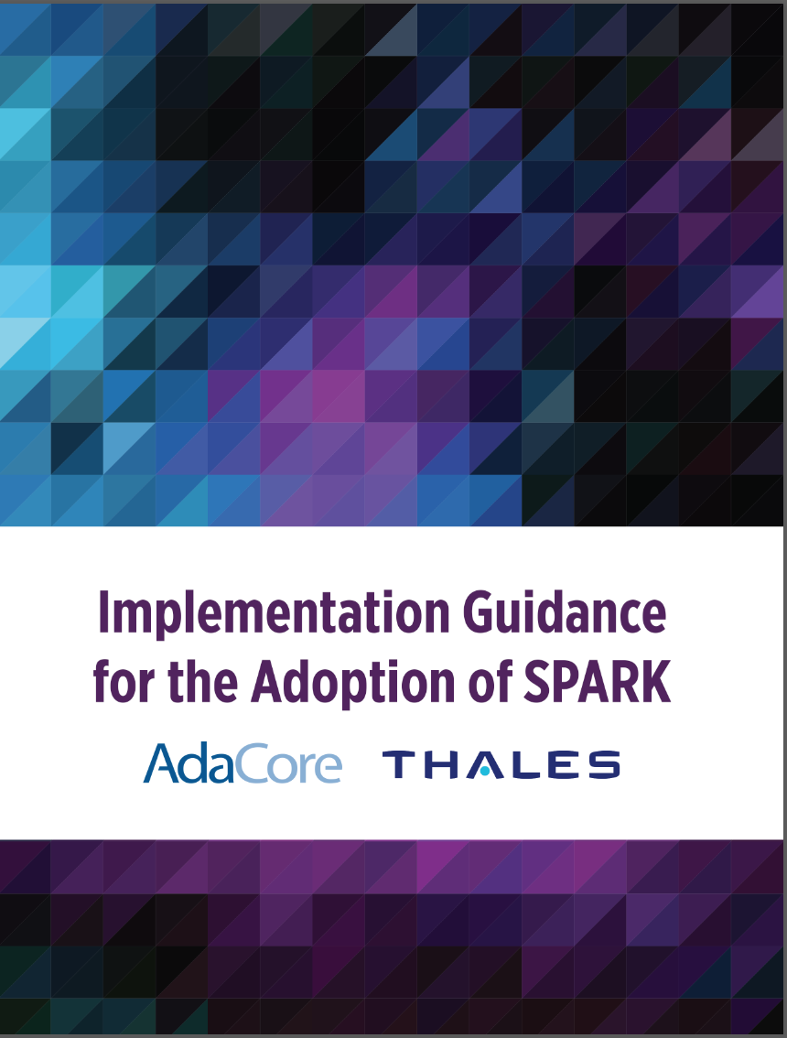
Adoption Guidelines with Thales
For every level, we present:
Benefits, Impact on process, Costs and limitations
Setup and tool usage
Violation messages issued by the tool
Remediation solutions
Guidance was put to test:
During adoption experiments at Thales
On example (SPARK tool) presented in last section

Slide 15
Features that Matter

Slide 16
Stone Level – Large Language Subset
SPARK_Mode => On
Ada types, expressions, statements, subprograms
SPARK_Mode => Off
Ada pointers
Ada exception handlers
Ada generics
Ada object orientation
Ada concurrency
SPARK_Mode => On
Ada types, expressions, statements, subprograms
SPARK_Mode => Off
Ada pointers
Ada exception handlers
Ada generics
Ada object orientation
Ada concurrency

Slide 17
Stone Level – Large Language Subset
SPARK_Mode => On
Ada types, expressions, statements, subprograms
SPARK_Mode => Off
Ada pointers
Ada exception handlers
Ada generics
Ada object orientation
Ada concurrency
Ada pointers
SPARK_Mode => On
Ada types, expressions, statements, subprograms
SPARK_Mode => Off
Ada pointers
Ada exception handlers
Ada generics
Ada object orientation
Ada concurrency
work in progress to include safe Rust-like pointers in SPARK

Slide 18
Bronze/Silver Level – Generation of Contracts
Example: SPARKSkein Skein cryptographic hash algorithm (Chapman, 2011)
target: Silver level
initial version (SPARK 2005) | current version (SPARK 2014)
41 non-trivial contracts for effects and dependencies | 1 – effects and dependencies are generated
31 conditions in preconditions and postconditions on internal subprograms | 0 – internal subprograms are inlined
43 conditions in loop invariants | 1 – loop frame conditions are generated
23 annotations to prevent combinatorial explosion | 0 – no combinatorial explosion

Slide 19
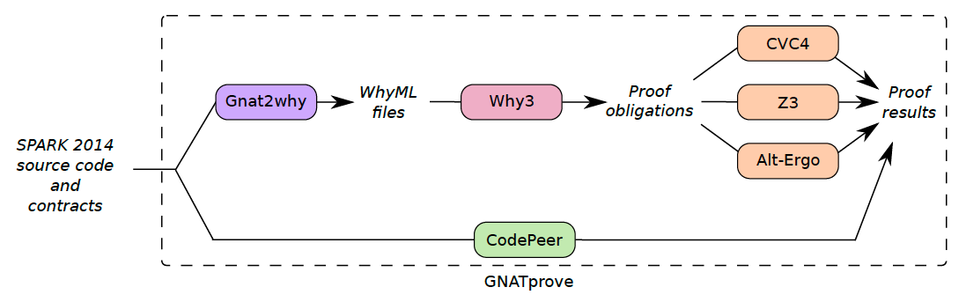
Silver/Gold Level – Combination of Provers

Slide 20
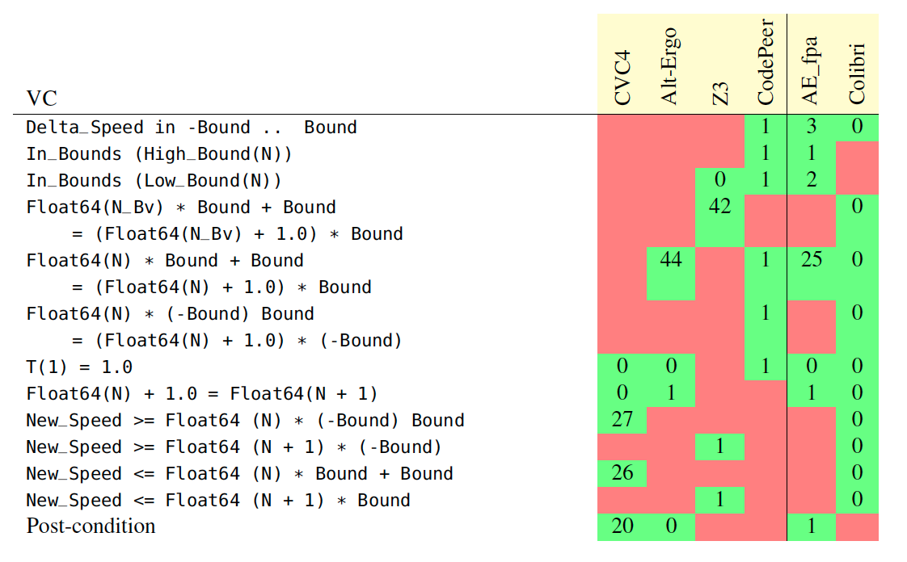
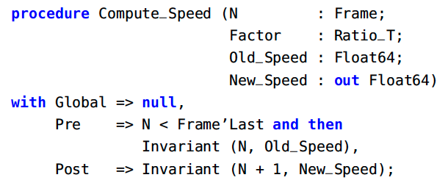

Silver/Gold Level – Combination of Provers
Example: Safe bounds on trajectory computation (submitted to VSTTE 2017)
target: Gold level

Slide 21
Gold/Platinum Level – Auto-Active Verification
Example: Functional correctness of red-black trees (NFM 2017)
target: Platinum level
Auto-Active = portmanteau of Automatic and interActive
supported by ghost code: contracts, loop invariants,
intermediate assertions, lemma procedures
ghost code used to:
define model of data used in specifications
prove intermediate lemmas (e.g. for inductive proofs)
provide witness for property (e.g. for transitivity relation)
2
1
4
3
5

Slide 22
Gold/Platinum Level – Auto-Active Verification

Slide 23
Conclusion

Slide 24
Levels of Software Assurance
From strong semantic coding standard to full functional correctness
Every level implicitly builds on the lower levels
Lower levels require lower costs/efforts
Good match from DAL/SIL to Bronze-Silver-Gold-Platinum
Adoption greatly facilitated by detailed level-specific guidance
Catchy names are easy to remember!

Slide 25
SPARK Resources
SPARK toolset
http://www.adacore.com/sparkpro http://libre.adacore.com/
SPARK adoption guidance
www.adacore.com/knowledge/technical-papers/implementation-guidance-spark
SPARK blog and resources (User’s Guide)
http://www.spark-2014.org
SPARK online training
http://u.adacore.com

