Slide 1
Dynamic and Formal Program Validation with SPARK 2014
Yannick Moy
Senior Software Engineer
Astrium Space Transportation - 4th R&T Days - November 28th, 2013

Slide 2
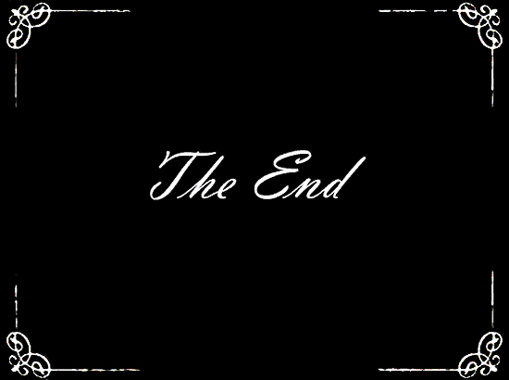
“Ada is not for me!”

Slide 3
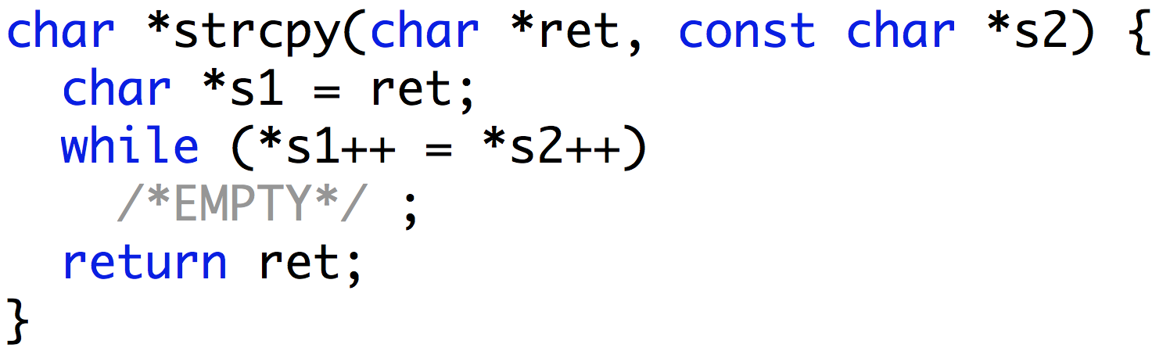
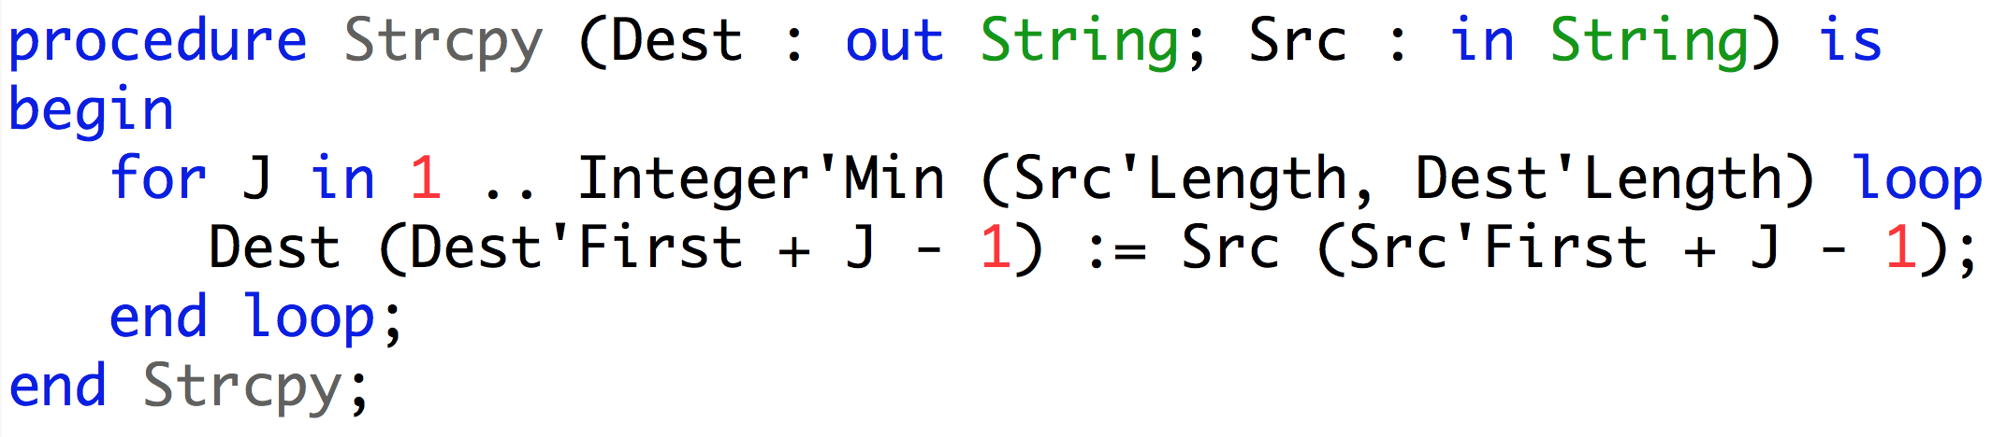
“Ada, why not?”
Ada favors clarity over conciseness, reader over writer
C
116 characters
Ada
208 characters

Slide 4
“Ada, why not?”
Ada favors clarity over conciseness, reader over writer
Means that “ret” is an output
Means that “s2” is an input
C
At the same time an assignment and a test
that the end of the string has been reached
Means that “Dest” is an output
Means that “Src” is an input
Ada
Loop
Assignment

Slide 5
“Ada, why not?”
Ada allows run-time detection of typing and memory errors
C
Possible buffer overflow
Ada
Overflow detected at run-time

Slide 6
“SPARK, why not?”
SPARK allows static detection of typing and memory errors
C
Possible buffer overflow
SPARK
Overflow detected statically

Slide 7
Advantages of Ada and SPARK over C
Buffer overflows in Ada?
Easily avoided by programmers (array types carry their bounds)
Automatically caught at run-time
Integer overflows in Ada?
Easily avoided by programmers (using bounded integer types)
Automatically caught at run-time
Buffer and integer overflows in SPARK?
If present, automatically caught by analysis
If absent, automatic proof that no such error can occur
Buffer overflows and integer overflows are still major sources of pain in C

Slide 8
Languages for Critical Software

Slide 9
Ada 2012 and SPARK 2014
Ada: programming language for long-lived embedded critical software
SPARK: Ada subset for formal validation
Ada version | Main features
Ada 83 | modularity + genericity + type safety + tasking
Ada 95 | + object orientation + protected objects
Ada 2005 | + containers + interfaces
Ada 2012 | + contracts
SPARK version | Main features
SPARK 83/95/2005 | contracts in comments mathematical semantics of contracts many language restrictions
SPARK 2014 | contracts in the language executable semantics of contracts few language restrictions

Slide 10
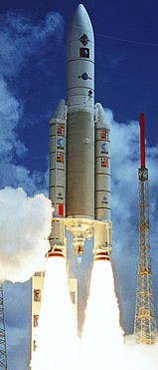


Ada 2012 and SPARK 2014
Ada: programming language for long-lived embedded critical software
SPARK: Ada subset for formal validation
Ada version | Main features
Ada 83 | modularity, genericity, type safety
Ada 95 | + object orientation + protected objects
Ada 2005 | + containers + interfaces
Ada 2012 | + contracts
Already used on Astrium products
SPARK version | Main features
SPARK 83/95/2005 | contracts in comments mathematical semantics of contracts many language restrictions
SPARK 2014 | contracts in the language executable semantics of contracts few language restrictions

Slide 11
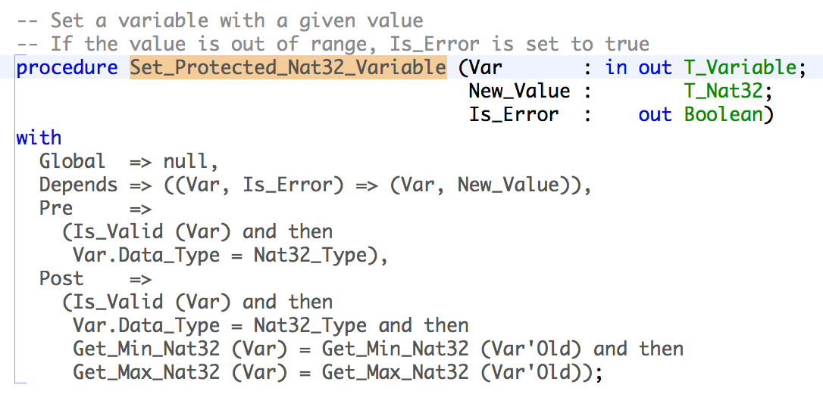
Ada and SPARK Contracts
Contract: agreement between the client and the supplier of a service
Program contract: agreement between the caller and the callee subprograms

Slide 12
Dynamic Validation

Slide 13
Contracts = Assertions
Precondition: assertion checked at subprogram entry
Replaces defensive coding
Postcondition: assertion checked at subprogram return
Replaces equivalent assertion at all “return” points
Makes it easy to mention pre-call values X’Old
In a function, makes it easy to mention function result F’Result
At run time:
Assertion failure → exception Assertion_Error is raised
X’Old → copy of X made at subprogram entry
Fine-grain control of enabled assertions:
Compiler switch
Pragma Assertion_Policy in code, for each kind of assertion

Slide 14
Use Cases for Checking Contracts at Run Time
During design and specification
Express dependencies and constraints on unit specs
During development
More precise documentation of intent than comments
Provides quick initial feedback
Assertion failure can be analyzed in debugger
During testing
Provides oracles for unit testing
Can be reused for integration testing
Can sometimes achieve exhaustive verification (using “for all”)
In production code
Preconditions can replace defensive coding

Slide 15
Formal Validation

Slide 16
Correct Access to Data
Correct access to global variables
Abstract_State contract on packages specs specifies hidden state
Global contract on subprograms specifies modes of global variables accessed
Depends contract on subprograms specifies flow of information
Correct access to initialized data
no reads of uninitialized data
in parameters and Input globals must be fully initialized on subprogram entry
out parameters and Output globals must be fully initialized on subprogram exit
Fast static analysis (≈ compilation time) checks correct access
Also detects unused parameters, globals, assignments, statements

Slide 17
Proof of Properties
Properties of interest:
Absence of run-time errors
Compliance with Low-Level Requirements formalized as subprogram contracts
(See Airbus use of Unit Proof: http://www.open-do.org/wp-content/uploads/2013/04/IEEE_Software_Formal_Or_Testing.pdf)
Property = mathematical formula
Proof is done subprogram by subprogram
Run-time checks in contracts are also proved

Slide 18
Space Case Study

Slide 19
Case Study by Astrium Space Transportation (David Lesens)
Numerical control/command algorithms
Mission and vehicle management
Formal Verification of Aerospace Software, DASIA 2013, http://www.open-do.org/wp-content/uploads/2013/05/DASIA_2013.pdf
Part | # subprograms | # checks | % proved
Math library | 15 | 27 | 92
Numerical algorithms | 30 | 265 | 98
Part | # subprograms | # checks | % proved
Single variable | 85 | 268 | 100
List of variables | 140 | 252 | 100
Events | 24 | 213 | 100
Expressions | 331 | 1670 | 100
Automated proc | 192 | 284 | 74
On board control proc | 547 | 2454 | 95

Slide 20
Case Study Conclusions
SPARK 2014 very good for:
Proof of absence of run-time errors
Correct access to all global variables
Absence of out-of-range values
Internal consistency of software unit
Correct numerical protection
Correctness of a generic code in a specific context
SPARK 2014 is good for:
Proof of functional properties
Areas requiring improvements:
Sound treatment of floating-points (done)
Support of tagged types (in the development roadmap for 2014)
Helping user with unproved checks (for example counter-examples, in roadmap)

Slide 21
Conclusion
SPARK 2014 is the only language and toolset providing industrial support for both dynamic and formal contract-based validation of software.
Now available as beta
First release April 2014
See http://www.adacore.com/sparkpro and http://www.spark-2014.org

