Slide 1
Dynamic and Static Program Validation with SPARK 2014
Yannick Moy
Senior Software Engineer
Astrium Space Transportation - 4th R&T Days - November 28th, 2013

Slide 2
Languages for Critical Software

Slide 3
Ada 2012 and SPARK 2014
Ada: programming language for long-lived embedded critical software
SPARK: Ada subset for static validation
Ada version | Main features
Ada 83 | modularity, genericity, type safety
Ada 95 | + object orientation + protected objects
Ada 2005 | + containers + interfaces
Ada 2012 | + contracts
SPARK version | Main features
SPARK 83/95/2005 | contracts in comments mathematical semantics of contracts many language restrictions
SPARK 2014 | contracts in the language executable semantics of contracts few language restrictions

Slide 4
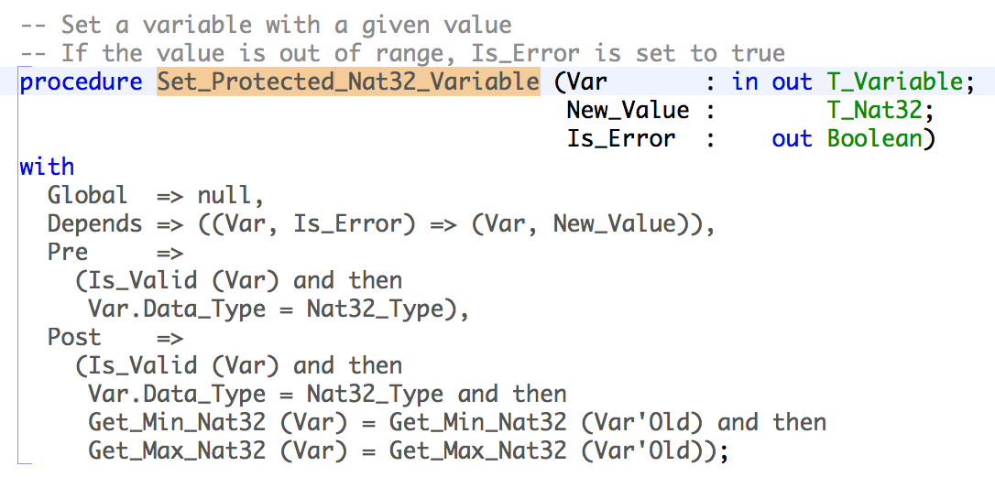
Ada and SPARK Contracts
Contract: agreement between the client and the supplier of a service
Program contract: agreement between the caller and the callee subprograms

Slide 5
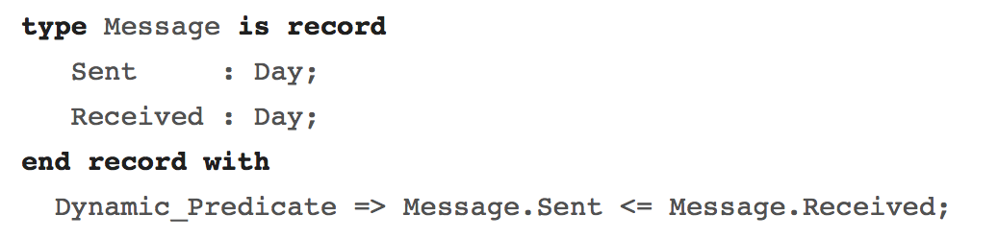
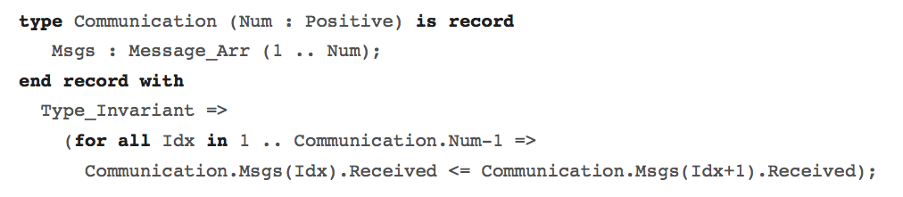
Ada Type Invariants and Predicates
Type predicate: permanent property of objects
Type invariant: property of objects at public boundary

Slide 6
Dynamic Validation

Slide 7
Contracts and Invariants = Assertions
Precondition: assertion checked at subprogram entry
Postcondition: assertion checked at subprogram return
Replaces equivalent assertion at all “return” points
Makes it easy to mention pre-call values X’Old
In a function, makes it easy to mention function result F’Result
At run time:
Assertion failure → exception Assertion_Error is raised
X’Old → copy of X made at subprogram entry
“if” / “case” expressions → corresponding statements
“for all” / “for some” expressions → corresponding loops
Fine-grain control of enabled assertions:
Compiler switch
Pragma Assertion_Policy in code, for each kind of assertion

Slide 8
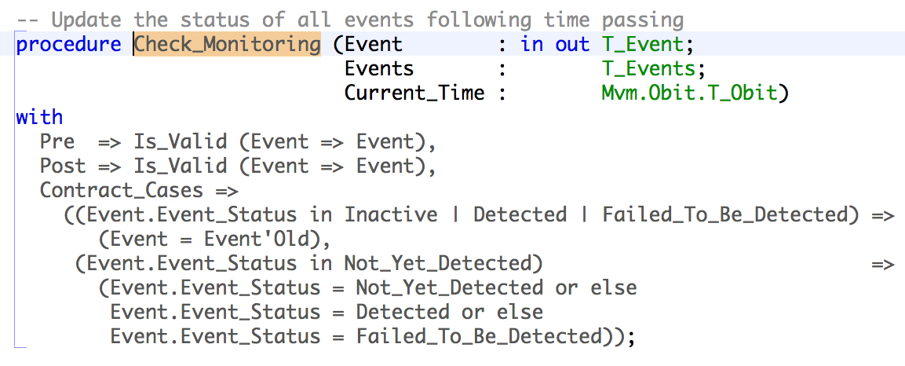
Contracts by Cases
Many subprograms are more easily specified by cases that are:
Disjoint: two different cases should not be enabled at the same time
Complete: cases should cover all possibilities
→ Additional properties also checked at run time

Slide 9
Use Cases for Checking Assertions at Run Time
During design and specification
Express dependencies and constraints on unit specs
During development
More precise documentation of intent than comments
Provides quick initial feedback
Assertion failure can be analyzed in debugger
During testing
Provides oracles for unit testing
Can be reused for integration testing
Can sometimes achieve exhaustive verification (using “for all”)
In production code
Preconditions can replace defensive coding

Slide 10
Static Validation

Slide 11
Correct Access to Global Variables
Global state of a program is made up of:
Visible global variables
Hidden global variables (in private parts and bodies)
Abstract_State contract on packages specs specifies hidden state
Global contract on subprograms specifies modes of global variables accessed
Depends contract on subprograms specifies flow of information
Fast static analysis (≈ compilation time) checks correct access
Typical errors / warnings:
file.adb:20:09: "G" must be a global output of ”T" [illegal_update]
f.adb:18:3: warning: missing dependency "Y => Pa" [depends_missing]

Slide 12
Correct Access to Initialized Data
Modes of parameters and globals have a strong semantics in SPARK:
in parameters and Input globals must be fully initialized on subprogram entry
out parameters and Output globals must be fully initialized on subprogram exit
Packages declare initialized state in Initializes contract
Fast static analysis (≈ compilation time) checks correct initialization
Typical errors / warnings:
file.adb:103:13: ”Rec.Arr" is not initialized [uninitialized]
file.adb:8:4: warning: "X" might not be initialized [uninitialized]
Also detects unused parameters, globals, assignments, statements

Slide 13
Absence of Run-Time Errors
Run-time check = mathematical formula
Ex: absence of division by zero in expression “X / Y” if formula “Y /= 0” holds
Checks in SPARK:
Range check (bounds of scalar types)
Index check (bounds of arrays)
Overflow check (bounds of machine scalar types)
Division by zero check
Length check (array operations)
Discriminant check (access to discriminant record)
Proof is done subprogram by subprogram
Run-time checks in contracts are also proved

Slide 14
Compliance with Low-Level Requirements
Low-level requirement can be formalized as subprogram contract
(See Airbus use of Unit Proof:
http://www.open-do.org/wp-content/uploads/2013/04/IEEE_Software_Formal_Or_Testing.pdf)
Assertion = mathematical formula
Proof is done subprogram by subprogram:
Precondition is assumed
Precondition of each call is proved
Postcondition of each call is assumed
Postcondition is proved
Additional assertions may be needed for proof:
Pragma Loop_Invariant for summarizing loop effects
Pragma Loop_Variant to prove loop termination
Pragma Assert to guide automatic prover

Slide 15
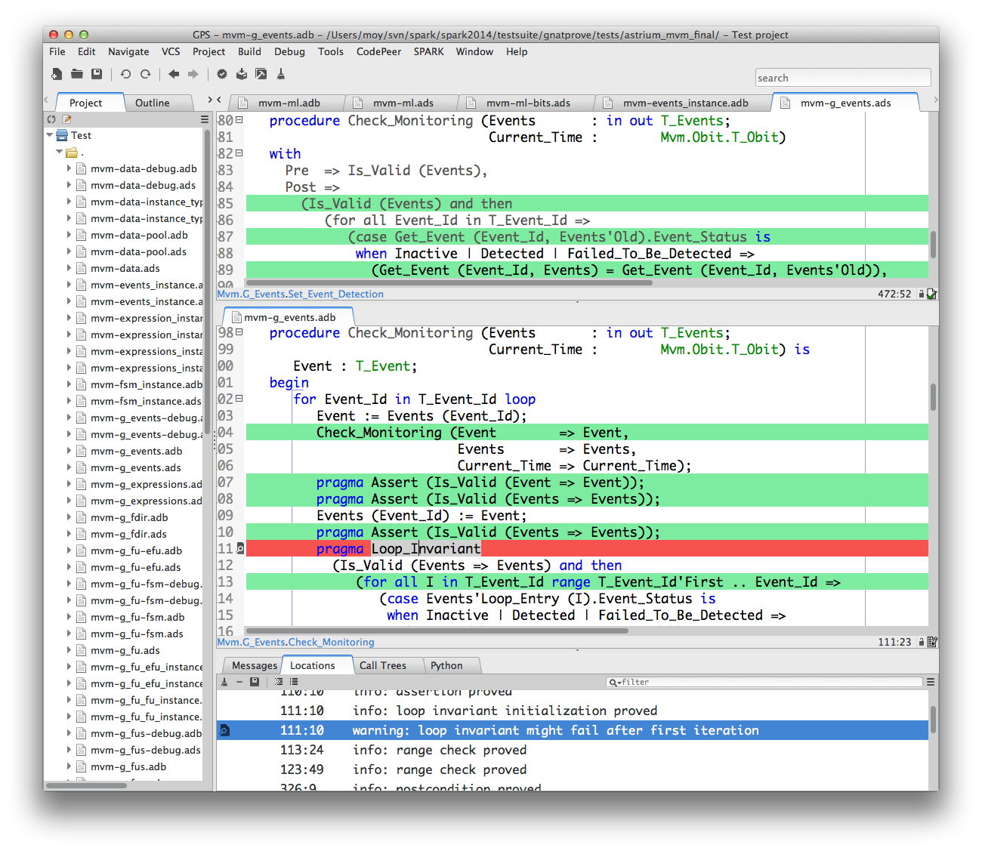
Integration of Static Validation in Developer Workflow

Slide 16
Space Case Study

Slide 17
Case Study by Astrium Space Transportation (David Lesens)
Numerical control/command algorithms
Mission and vehicle management
Formal Verification of Aerospace Software, DASIA 2013, http://www.open-do.org/wp-content/uploads/2013/05/DASIA_2013.pdf
Part | # subprograms | # checks | % proved
Math library | 15 | 27 | 92
Numerical algorithms | 30 | 265 | 98
Part | # subprograms | # checks | % proved
Single variable | 85 | 268 | 100
List of variables | 140 | 252 | 100
Events | 24 | 213 | 100
Expressions | 331 | 1670 | 100
Automated proc | 192 | 284 | 74
On board control proc | 547 | 2454 | 95

Slide 18
Case Study Conclusions
SPARK 2014 very good for:
Proof of absence of run-time errors
Correct access to all global variables
Absence of out-of-range values
Internal consistency of software unit
Correct numerical protection
Correctness of a generic code in a specific context
SPARK 2014 is good for:
Proof of functional properties
Areas requiring improvements:
Sound treatment of floating-points (done)
Support of tagged types (in the development roadmap for 2014)
Helping user with unproved checks (for example counter-examples, in roadmap)

Slide 19
Conclusion
Topics that we did not discuss:
Mixing SPARK and full Ada code
Automatic generation of Global / Depends contracts
Using infinite precision integers in contracts
Formalizing test cases with pragma Test_Case
Combining the results of proof and testing
Validating the assumptions made for proofs
Qualification of the toolset
Alternative objectives to coverage when replacing testing with proof
Now available as beta
First release April 2014
See http://www.adacore.com/sparkpro and http://www.spark-2014.org

