Slide 1
A Complete Solution to the Nose Gear Challenge
Yannick Moy
Senior Software Engineer

Slide 2
The Extended Nose Gear Challenge

Slide 3
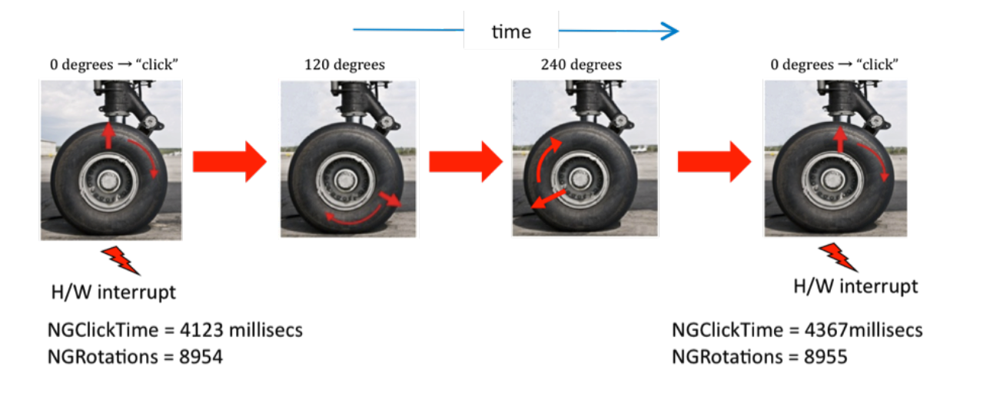
The Original Nose Gear Challenge
HLR 1: when available, computed velocity should be close to actual velocity
HLR 2: computed velocity should be available most of the time

Slide 4
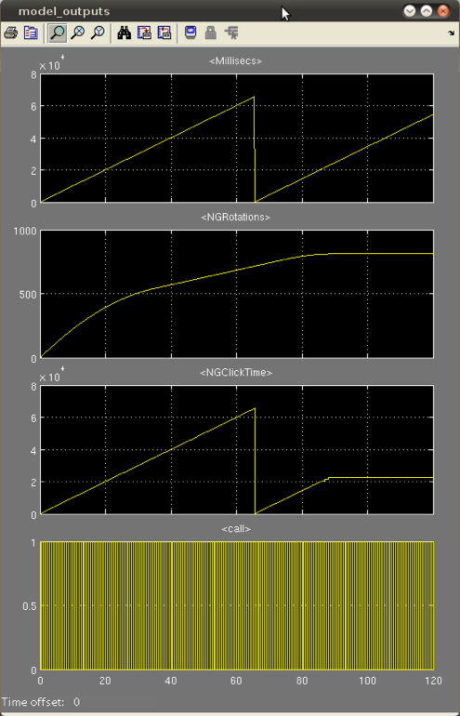
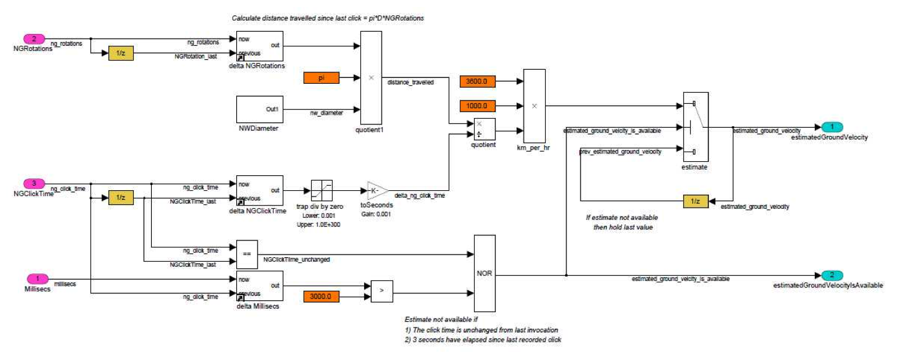
Solutions from 2nd Workshop (2011)
Best solution so far presented by Colin O'Halloran: from Simulink to SPARK with CLawZ
Other solutions use contract-based specification / verification with SPARK to:
guarantee absence of run-time errors
prove that implementation conforms to contract

Slide 5
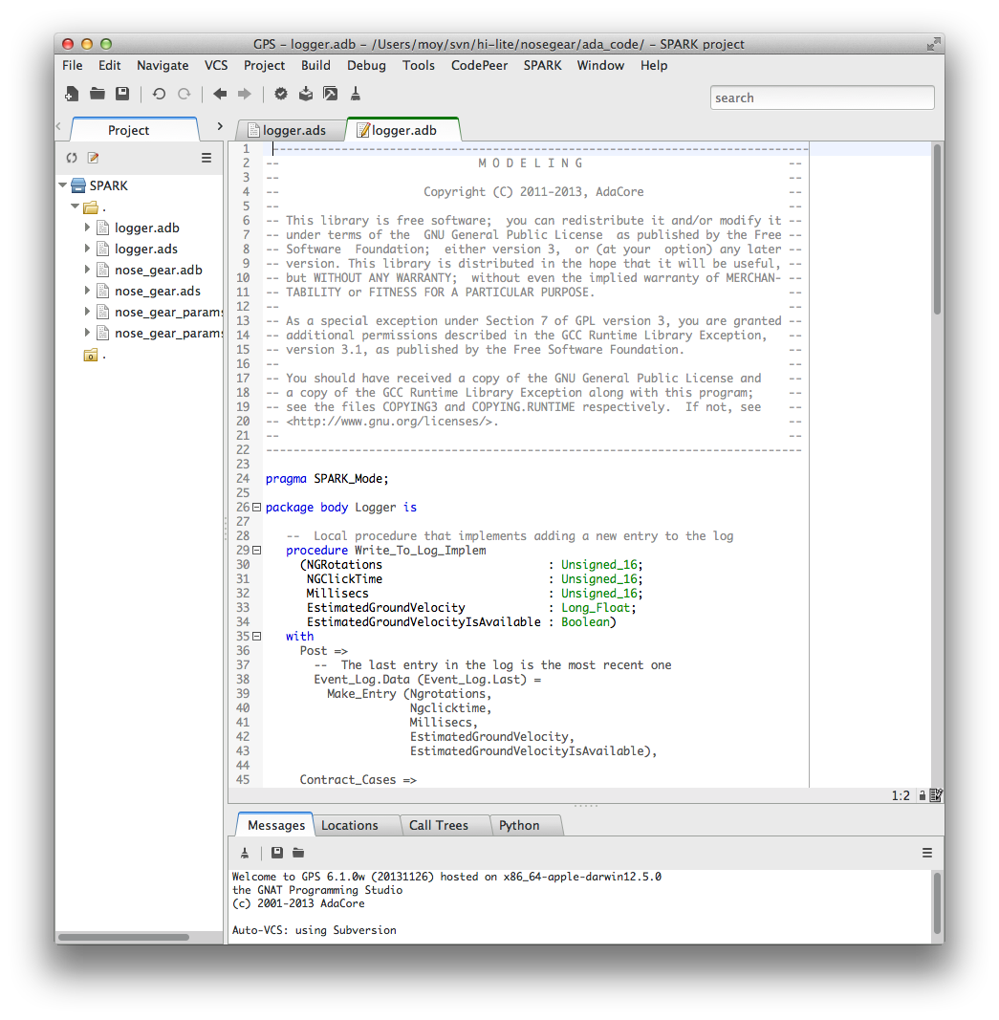
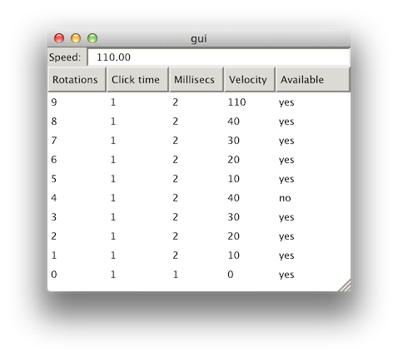
The Extended Nose Gear Challenge
COMPUTATION
LOGGER
GUI
HLR 1: when available, computed velocity should be close to actual velocity
HLR 2: computed velocity should be available most of the time
HLR 3: a log of all events of the latest five minutes shall be saved
HLR 4: the graphical user interface shall show
the estimated velocity computed
a warning message if the velocity is not available
all events collected

Slide 6
A Solution Focused on Integrity Preservation

Slide 7
System to Software Integrity Preservation
Our main goal for the Nose Gear Challenge
6 ways to preserve integrity:
peer review at different levels (classical approach)
extensive testing at different levels and compare output (Simulink vs gen. code)
qualifiable automatic code generation (SCADE, GNAT Pro Simulink)
formalize requirement as source code contracts (Ada 2012, SPARK)
translate contracts across different levels (Simulink assertion to SPARK contract)
extract properties at different levels and compare them (CLawZ, Mathworks)

Slide 8
System to Software Integrity Preservation
HLR
AADL System Model
HLR formalised as formal assertions in BLESS
preservation of integrity
traceability
LLR
Simulink &
Ada 2012 assertions
Architecture
AADL
HLR formalised as model verification blocks in Simulink
and assertions in Ada 2012
traceability
preservation of integrity
SRC
Ada 2012 & SPARK 2014
HLR and LLR formalised as formal assertions
traceability
preservation of integrity
Obj
Traceability study & run-time monitoring

Slide 9
Our Choice of Languages and Tools
Languages:
AADL architecture description language
Simulink modeling language
Ada 2012 programming language (with contracts)
SPARK 2014 subset of Ada for formal verification
Tools:
Ocarina code generator: AADL → Ada
GNAT Pro for Simulink (qualifiable): Simulink → Ada
SPARK formal verification toolset: SPARK → proofs
CodePeer static analyzer: Ada → potential errors
GNAT Pro: Ada → executable
GNAT Dashboard: Ada → visualization of certification artifacts
Qualifying Machine (QM): artifacts → agile qualification management

Slide 10
AADL
System-level design
SW Architecture design
Code generation
System &
Software engineer
GNAT Pro
Simulink
Qualifiable
Code generation
QM
Information broker for
certification data
GNAT Dashboard
Certification artifacts
quality
Control
engineer
SPARK 2014
Low-level design
Formal verification
Software
engineer
DER
Certification Manager
QA Manager
Project/Quality Manager
CodePeer
Verification
Software
engineer
Notes:
On a more technical side, we were able to:
Manage certification artifacts with the QM
Develop design in Simulink and AADL
And generate correct SPARK and Ada with GNAT Pro Simulink and Ocarina
Develop Low-Level Requirements in SPARK
And prove them on manually written code
Integrate all code above
Perform additional verification with CodePeer
Track quality with GNAT Dashboard

Slide 11
AADL
System-level design
SW Architecture design
Code generation
Improve communication between departments
System &
Software engineer
GNAT Pro
Simulink
Qualifiable
Code generation
QM
Information broker for
certification data
GNAT Dashboard
Certification artifacts
quality
Control
engineer
SPARK 2014
Low-level design
Formal verification
Software
engineer
DER
Certification Manager
QA Manager
Project/Quality Manager
CodePeer
Verification
Software
engineer

Slide 12
AADL
System-level design
SW Architecture design
Code generation
System &
Software engineer
Decrease V&V costs
GNAT Pro
Simulink
Qualifiable
Code generation
QM
Information broker for
certification data
GNAT Dashboard
Certification artifacts
quality
Control
engineer
SPARK 2014
Low-level design
Formal verification
Software
engineer
DER
Certification Manager
QA Manager
Project/Quality Manager
CodePeer
Verification
Software
engineer

Slide 13
AADL
System-level design
SW Architecture design
Code generation
System &
Software engineer
GNAT Pro
Simulink
Qualifiable
Code generation
QM
Information broker for
certification data
GNAT Dashboard
Certification artifacts
quality
Control
engineer
SPARK 2014
Low-level design
Formal verification
Software
engineer
DER
Certification Manager
QA Manager
Project/Quality Manager
Ensure end-to-end
property preservation
CodePeer
Verification
Software
engineer

Slide 14
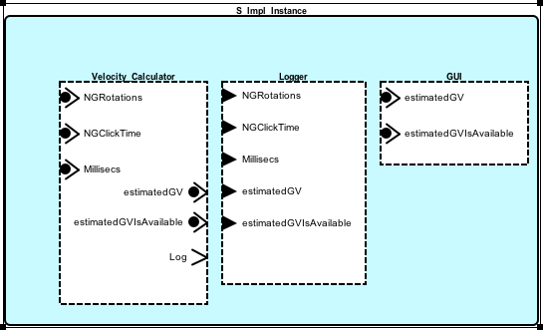
System-level Specification in AADL
abstract Velocity_Calculation
features
NGRotations : in data port Integer;
NGClickTime : in data port Date;
Millisecs : in data port Date;
estimatedGroundVelocity : requires data access Velocity;
estimatedGroundVelocityIsAvailable : requires data access Boolean;
properties
Dispatch_Protocol => Periodic;
Period => 500 Ms;
Compute_Entrypoint => classifier (Velocity_Calculation_Spg);
Compute_Execution_Time => 10 Ms .. 100 Ms;
System I/O
Real-time properties and allocation
Notes:
We see AADL as a pivot formalism where components are identified and connected, and requirements are allocated to them.
The requirements are formalised as properties (real-time properties) or using annex extension languages (next slide).

Slide 15
System-level Specification in AADL
thread Velocity_Calculation
...
assert
<<hlr_availability: :
(((Millisecs + NGClickTime^(-1)) - Timing_Properties::Period) <= 3000)
iff estimatedGroundVelocityIsAvailable >>
states
s0 : initial state;
s1 : complete state;
transitions
s0 -[ ]-> s1 {};
s1 -[ on dispatch ]-> s1 {
Velocity_Calculation_Spg(
NGRotations, NGClickTime, Millisecs,
estimatedGroundVelocity, estimatedGroundVelocityIsAvailable)
<< hlr_availability() >>
};
end Velocity_Calculation;
HLR formalised as assertions
Formal specification of behaviour (skeleton) plus
verification of assertions
Notes:
With the BLESS annex language, we are able to formalize the HLRs as assertions involving the components’ interfaces.

Slide 16
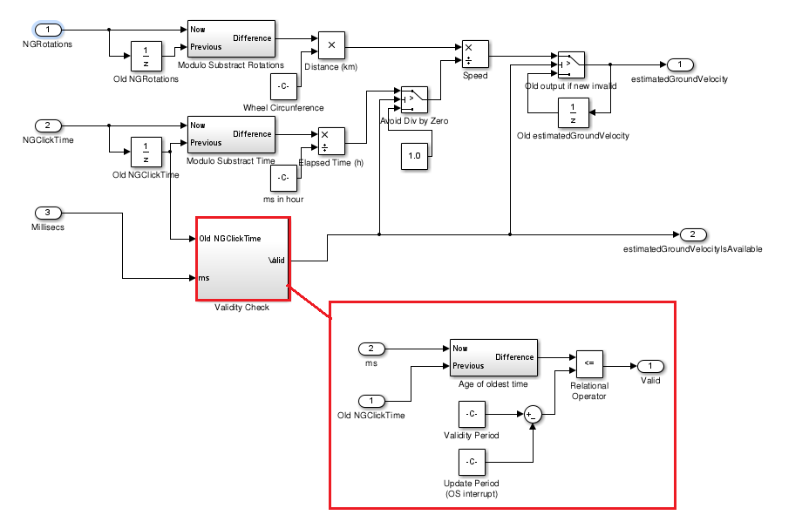
Simulink Model (LLR)

Slide 17
Generated Code in SPARK
Only code currently generated, contract manually translated
In the future: contract generated from Simulink observer
procedure nose_gear_comp
(NGRotations : Unsigned_16;
NGClickTime : Unsigned_16;
Millisecs : Unsigned_16;
estimatedGroundVelocity : out Long_Float;
estimatedGroundVelocityIsAvailable : out Boolean)
with Post =>
-- @llr Compute
-- The ground velocity shall be available only if the time difference
-- between the current calculation and the previous one is less than
-- 2500.
(EstimatedGroundVelocityIsAvailable =
(Millisecs + 500 - Old_NGClickTime_memory <= 3000));

Slide 18
Formal Specification and Verification in SPARK
HLR 3: a log of all events of the latest five minutes shall be saved
events scheduled at rate of one every 500 ms → 600 events in 5 mn
API of logger should give:
function to retrieve content of the log Log_Content
procedure to update content of the log Write_To_Log
Most natural specification cannot be expressed as contract: “Log_Content returns the set of events that have been added to the log by calls to Write_To_Log”
Use contract on Write_To_Log instead

Slide 19
Formal Specification and Verification in SPARK
procedure Write_To_Log (E : Log_Entry)
-- @llr Write_To_Log
with Contract_Cases =>
-- The logger component shall be able to accept a new logging message.
-- For an old empty log, the new content is the new entry alone.
(Is_Empty =>
Log_Content = Singleton_Log (E),
-- For an old full log, the new content is the old one, with the
-- oldest entry removed, plus the new entry.
Is_Full =>
Log_Content =
Log_Content'Old (Log_Content'Old'First + 1 .. Log_Content'Old'Last)
& E,
-- For an old log neither empty not full, the old content is
-- preserved, and the new entry added.
others =>
Log_Content = Log_Content'Old & E);

Slide 20
Formal Specification and Verification in SPARK
automatic formal verification of contract
→ verification of HLR 3
+ automatic formal verification of absence of run-time errors
work in progress, current tool limitation does not allow 100% proof…

Slide 21
Summary of Verification Strategies for HLR 1 - 4
HLR 1: when available, computed velocity should be close to actual velocity
→ simulation in Simulink, same as done by Colin O’Halloran in 2011
HLR 2: computed velocity should be available most of the time
→ BLESS annotation in AADL → observer in Simulink → contract in SPARK
→ formally verified against implementation
HLR 3: a log of all events of the latest five minutes shall be saved
→ contract in SPARK → formally verified against implementation
HLR 4: the graphical user interface shall show …
→ tests

Slide 22
Agile Management of Certification Artifacts
Problem: “big-freeze” in certification
Development is frozen after start of certification, due to high cost of manual certification activities
Solution: automatic management of artifacts dependencies
Demo of the Qualifying Machine

Slide 23
Progress on Verification Activities

Slide 24
Initial Experiments
Use of static analysis (CodePeer) and formal verification (SPARK) detected errors in manually-written contracts...
and one error (!) in the code generator:
Sum_out_1 := Integer_32
((NGRotations_out_1) - (Old_NGRotations_out_1));
should be
Sum_out_1 := Integer_32 (NGRotations_out_1) -
Integer_32 (Old_NGRotations_out_1);

Slide 25
Preserving Integrity from Simulink to SPARK
Initial code generation strategy used many type conversions
→ Hard to analyze automatically
New code generation strategy preserves types
→ Much better automation of proof
Simulink has no concept of bounded integer types
→ Information on ranges is not passed on to generated code
Suitable assertion blocks in Simulink can give this information
→ Possible use in code generator to generate ranges in Ada code

Slide 26
Warnings!
You may feel a sense of over engineering
A side effect of showing several tools applied to a simple system
Real systems REALLY demand the use of several tools
Tool maturity
CodePeer is the most mature one
SPARK 2014 is close to be a used product
AADL and AADL code generation have been tested in several projects
GNAT Pro Simulink is being tested on industrial use cases
QM and GNAT Dashboard are used internally

