Slide 1
Why3 as Intermediate Language for SPARK
Claire Dross
Journées GT Verif 2018

Slide 2
Ada – A language designed for safety
Strong typing
Precise type constraints
Multiple compile-time and run-time checks
X : Integer; Y : Float := X / 2; -- COMPILATION ERROR : type mismatch
type Index is range 1 .. 100; X : Index := 0; -- raised CONSTRAINT_ERROR : range check failed
A : Nat_Array := (1 .. 2 => 5); Y := A (3); -- raised CONSTRAINT_ERROR : index check failed

Slide 3
Ada 2012 – Programming by contracts
Boolean expressions as contracts
Extended expressions to enhance expressivity
Checked at runtime
function Find (A : Nat_Array; E : Natural) return Natural with Post => Find’Result in 0 | A’Range;
function Find (A : Nat_Array; E : Natural) return Natural with Post => (if (for all I in A’Range => A (I) /= E) then Find’Result = 0 else Find’Result in A’Range and then A (Find’Result) = E);
raised SYSTEM.ASSERTIONS.ASSERT_FAILURE : failed postcondition

Slide 4

SPARK – Formal verification
procedure Increment (X : in out Integer) with Global => null, Depends => (X => X), Pre => X < Integer'Last, Post => X = X'Old + 1; procedure Increment (X : in out Integer) is begin X := X + 1; end Increment;
data dependencies
flow dependencies
functionality
absence of runtime error

Slide 5
SPARK Language

Slide 6
SPARK – a Subset of Ada
strong typing
generics
object orientation
concurrency
Global
Depends
Loop_Invariant
Loop_Variant
Contract_Cases
pointers
exception handlers
function with effects
Ada
features outside
the SPARK subset
Core language constructs common to Ada and SPARK
Additional SPARK aspects
Ada
SPARK

Slide 7
Type Contracts – Subtype Predicate
Strong invariant, true at every program point
function Is_Sorted (A : Nat_Array) return Boolean is (for all I in A’Range => (if I < A’Last then A (I) <= A (I + 1))); -- Returns True if A is sorted in increasing order. subtype Sorted_Nat_Array is Nat_Array with Dynamic_Predicate => Is_Sorted (Sorted_Nat_Array); -- Elements of type Sorted_Nat_Array are all sorted.

Slide 8
Type Contracts – Type Invariant
Weak invariant, true only outside of its immediate scope
type Sorted_Nat_Array is private; -- The implementation is private to avoid fiddling. function Open (A : Sorted_Nat_Array) return Nat_Array with Post => Is_Sorted (Open’Result); -- The input of Open is always sorted. private type Sorted_Nat_Array is new Nat_Array with Type_Invariant => Is_Sorted (Sorted_Nat_Array); procedure Sort (A : in out Sorted_Nat_Array) with Post => Is_Sorted (A); -- The input of Sort may not be sorted.

Slide 9
Object Orientation
Classwide contracts apply to all overridings
Redefined contracts should follow Liskov Substitution Principle
procedure Initialize (X : in out Root) with Post’Class => Is_Initialized (X); procedure Run (X : in out Root) with Pre’Class => Is_Initialized (X);
procedure Initialize (X : in out Child) with Post’Class => Is_Initialized (X) and Additional_Property (X); -- info: class-wide postcondition is stronger than overridden one procedure Run (X : in out Child) with Pre’Class => True; -- info: class-wide precondition is weaker than overridden one

Slide 10
SPARK Proof Tool

Slide 11
GNATprove – User view
SPARK Code + Contracts
Verification
Results
GNATprove

Slide 12




GNATprove – Analysis performed
Flow Analysis
SPARK Code + Contracts
Deductive Proof
Verification
Results
$$∀$$
$$∃$$
$$→$$
Abstract Interpretation
(CodePeer)
$$]2, 3]∪[5, 7[$$
GNATprove

Slide 13
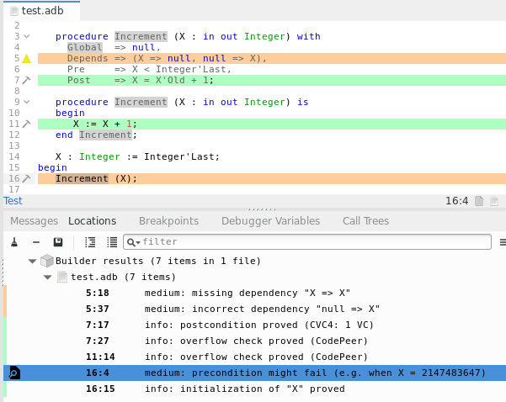
GNATprove – Analysis performed
Deductive Proof
Flow Analysis
Abstract Interpretation

Slide 14
GNATprove – Deductive proof
Z3
WhyML Code + Contracts
SmtLib2
SPARK Code + Contracts
Gnat2why
Why3
CVC4
Sat/Unsat
Alt-Ergo input
Alt-Ergo
Verification
Results

Slide 15
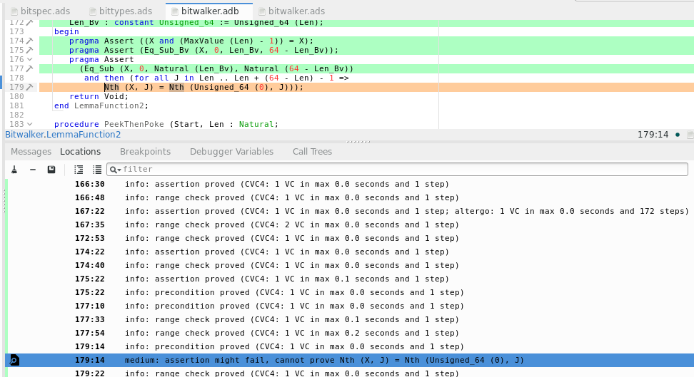
GNATprove – Deductive proof
Partially unproved check:
Unproved part is highlighted
More complex check requiring combination of provers

Slide 16
GNATprove – Deductive proof – Counterexamples
WhyML Code + Contracts
+ Model Info
SPARK Code + Contracts
SmtLib2 + Get_Model
Gnat2why
Why3
CVC4
Value + Variable Id + Source location
SmtLib2
Model
Paths with counterexample values

Slide 17
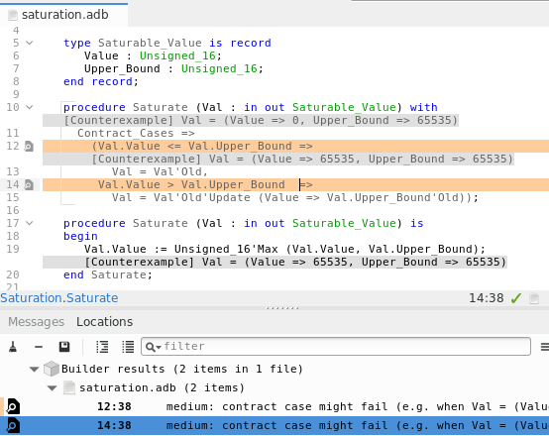
GNATprove – Deductive proof – Counterexamples
Counterexample value at different program points
Reconstructed record value

Slide 18
GNATprove – Deductive proof – Manual proof
Work In Progress
SPARK Code + Contracts
WhyML Code + Contracts
+ Ada names
Verification
Results
Gnat2why
Why3
Command
using Ada names
Command using Ada names
Why3 interactive server
SPARK IDE
Why3 session file
Proof tree + Verification Condition
Proof task using Ada names

Slide 19
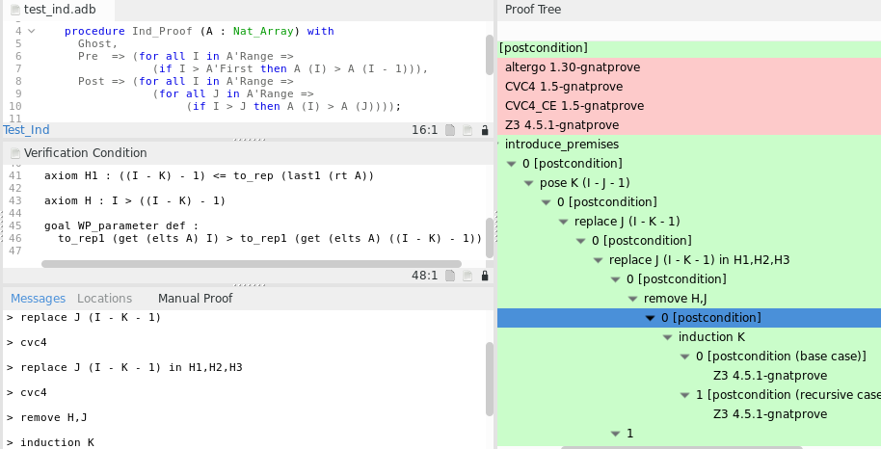
GNATprove – Deductive proof – Manual proof
Work In Progress
Verification condition
Proof Tree
Ada name
Commands

Slide 20
WhyML Translation of Ada Loops

Slide 21
Ada Loops
Partial update of an array
Maximum value in a linked data structure
for I in Tasks’Range loop if Tasks (I).Status = Running then Tasks (I).Step := Tasks (I).Step + 1; end if; end loop;
loop pragma Loop_Invariant (Cursor > 0); M := Max (M, List.Cells (Cursor).Value); Cursor := List.Cells (Cursor).Next; exit when Cursor = 0; end loop;

Slide 22
Translation in Why
Always translated as an infinite loop with raise…
… to get Ada semantics of loop invariants
loop pragma Loop_Invariant (Cursor > 0); … exit when Cursor = 0; end loop;
while Cursor > 0 loop pragma Loop_Invariant (…); … end loop;
if !cursor > 0 then try while True do invariant { … } …; if !cursor <= 0 then raise L; done with L -> () end
try while True do invariant { !cursor > 0 } …; if !cursor = 0 then raise L done with L -> () end

Slide 23
Loop Invariant Placement
In Ada, a loop invariant can be located anywhere in the loop
The beginning of the loop is unrolled before the loop
for I in Tasks’Range loop if Tasks (I).Status = Running then Tasks (I).Step := Tasks (I).Step + 1; end if; pragma Loop_Invariant (for all K in Tasks’First .. I => (if Tasks (K).Status = Running then Tasks (K).Step = Tasks’Loop_Entry (K).Step + 1)); end loop;
loop pragma Loop_Invariant (…); end loop;
try while True do invariant { … } done with L -> () end
-- Before loop invariant
(* Before loop invariant *)
-- After loop invariant
(* After loop invariant *)
(* Before loop invariant *)

Slide 24
Implicit Invariants (aka Frame Condition)
Unmodified variables (why3 does this)
Range of variables (more generally type constraints)
Unmodified parts of variables (best effort)
List is not modified
loop pragma Loop_Invariant (Cursor > 0); M := Max (M, List.Cells (Cursor).Value); Cursor := List.Cells (Cursor).Next; exit when Cursor = 0; end loop;
type Index is range 0 .. 100; type Cell_Array is array (Index range 1 .. 100) of Cell; Cursor : Index := List.Head;
for I in Tasks’Range loop if Tasks (I).Status = Running then Tasks (I).Step := Tasks (I).Step + 1; end if; end loop;
Cursor stays in the range of Cells
The bounds of Tasks are not modified
for I in Tasks’Range loop if Tasks (I).Status = Running then Tasks (I).Step := Tasks (I).Step + 1; end if; end loop;
try while True do invariant { !cursor > 0 } assume { 0 <= !cursor <= 100 }; …;
assume { (forall k : int. first <= k <= last -> (if i < k then tasks[k] = tasks_loop_entry[k] else tasks[k].status = tasks_loop_entry[k].status)) };

Slide 25
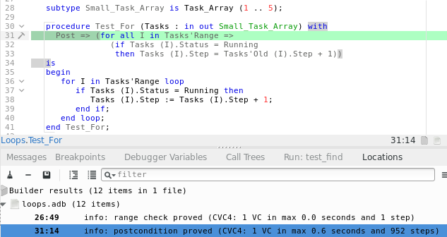
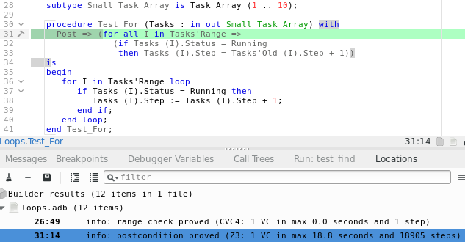
Loop Unrolling of Small For Loops
Avoid having to write an invariant…
… but may cause verification to timeout.
10 iterations
5 iterations
proved in less than 1 s
proved in nearly 20s

Slide 26
Conclusion

Slide 27
Why3 as Intermediate Language for SPARK
Deductive proof on an expressive language
Real world imperative language used in industry
Powerful specification features
Tight integration with Why3 to offer smooth user interaction
Multiple provers and strategies
Counterexamples
Interactive proof
Finetuned translation to enhance provability
Preserve SPARK semantics
Adapt to underlying technology

Slide 28
SPARK Resources
SPARK toolset
http://www.adacore.com/sparkpro http:// www.adacore.com/community
SPARK source code
https://github.com/AdaCore/spark2014
SPARK reference documents (User’s Guide + Reference Manual)
https://www.adacore.com/documentation/#SPARK
SPARK online training
http://u.adacore.com

