Slide 1



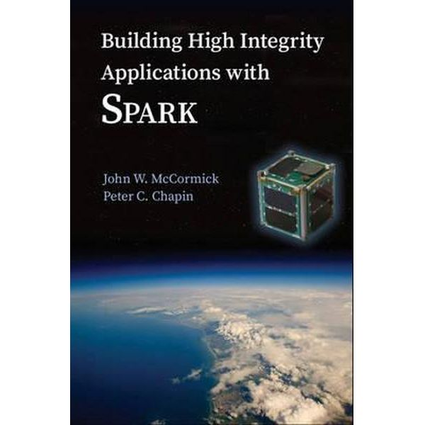
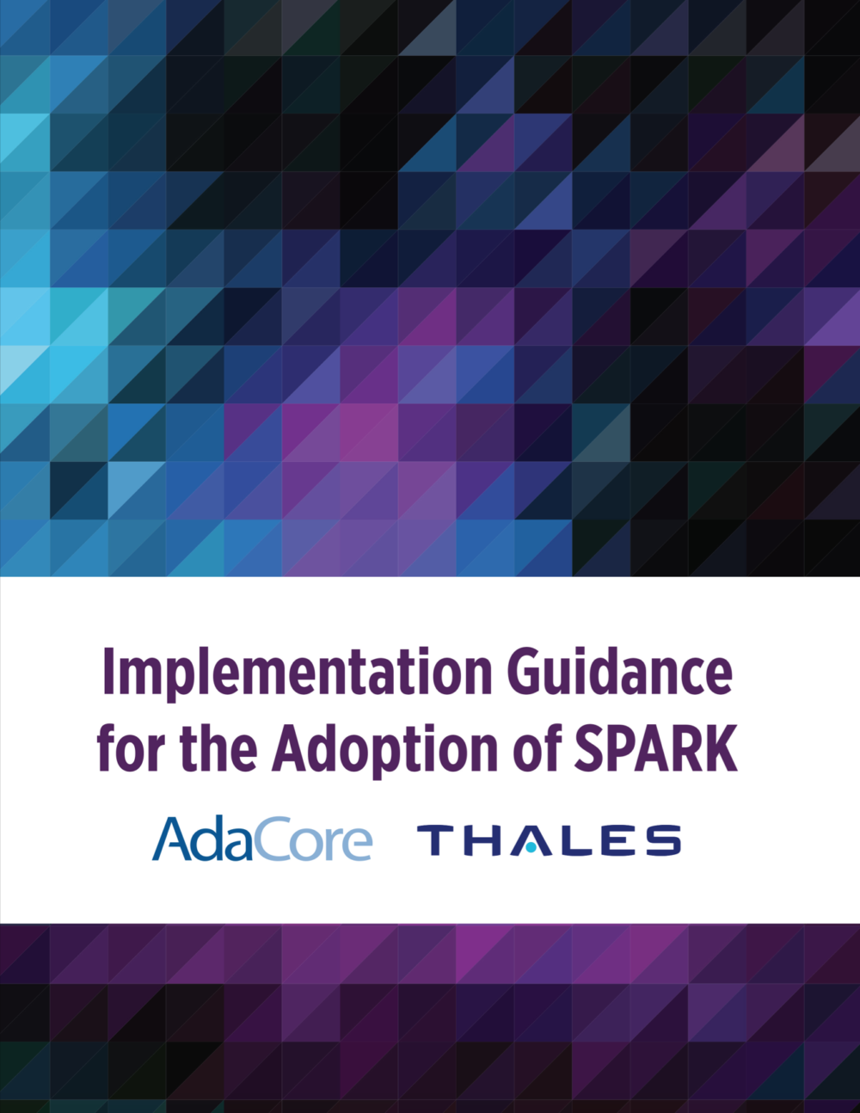
SPARK Language: Historical Perspective & FOSS Development
Yannick Moy – SPARK Product Manager – AdaCore
…
Notes:
Bernard Carré 1997 – Peter Amey 2003 – Rod Chapman 2012 – 2015 – 2017 (years of edition of these books)

Slide 2

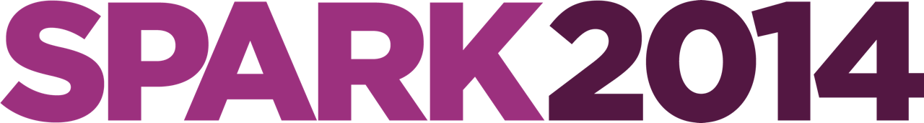

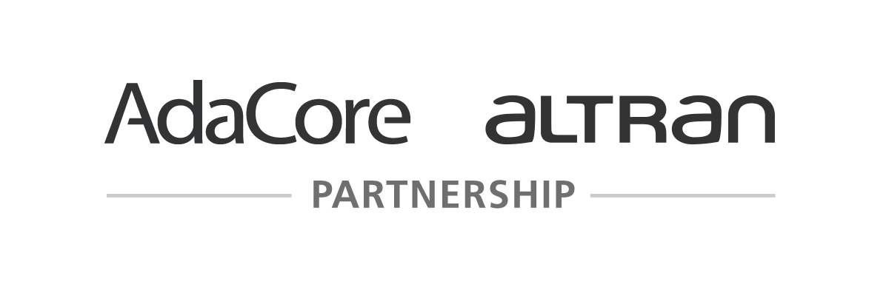
Historical Perspective
1987
SPARK
PVL
2008
1997
C130J
2005
Tokeneer
2011
iFACTS
2013
Muen
Are We There Yet? 20 Years of Industrial Theorem Proving with SPARK, Chapman and Schanda, Altran, ITP 2014

Slide 3
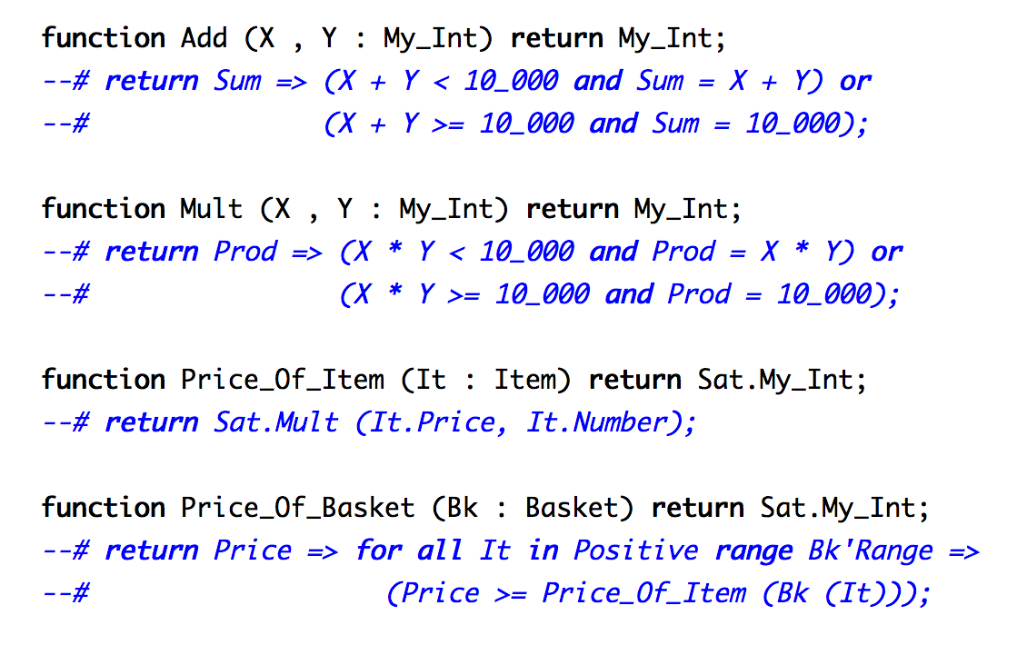
From SPARK 2005…
http://www.open-do.org/projects/hi-lite/a-lighter-introduction-to-hi-lite/

Slide 4
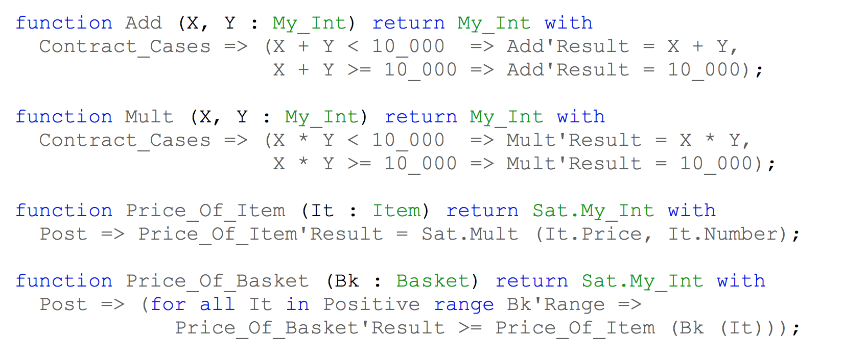
…to SPARK 2014

Slide 5
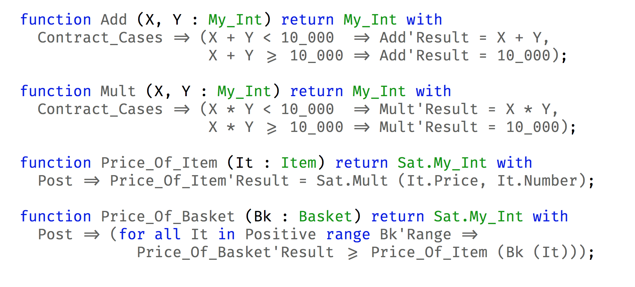
…to SPARK 2014
… in a monospace font with ligatures like FiraCode

Slide 6
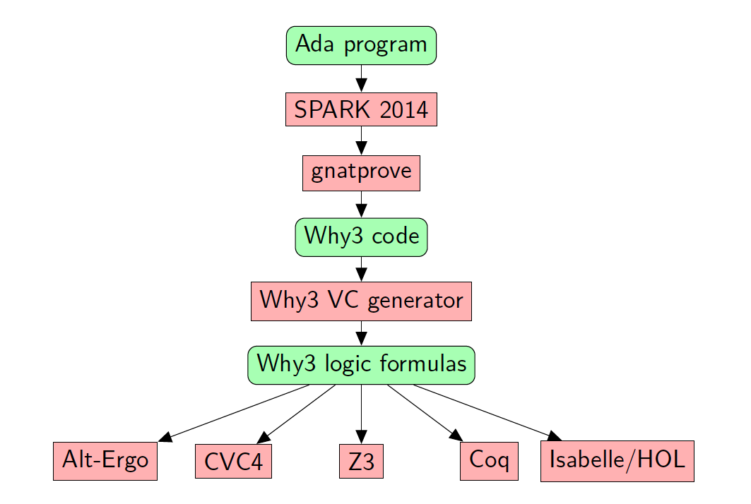

SPARK Open Source Ecosystem

Slide 7
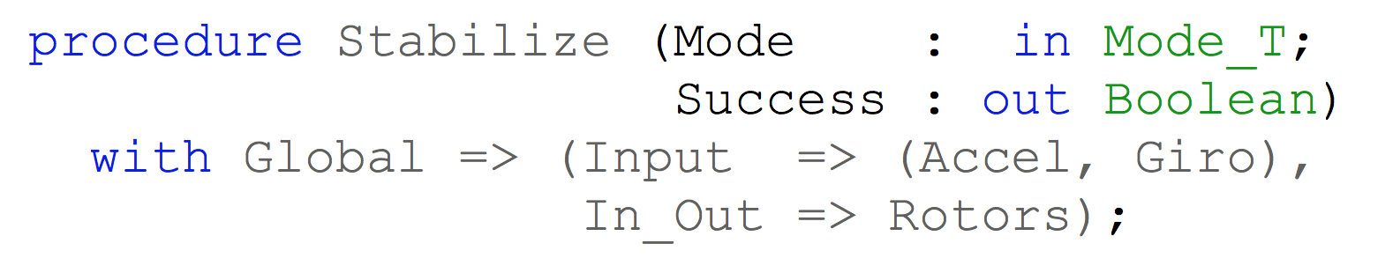
SPARK Flow Analysis
Specification of effects
Flow analysis
Program implements specification

Slide 8
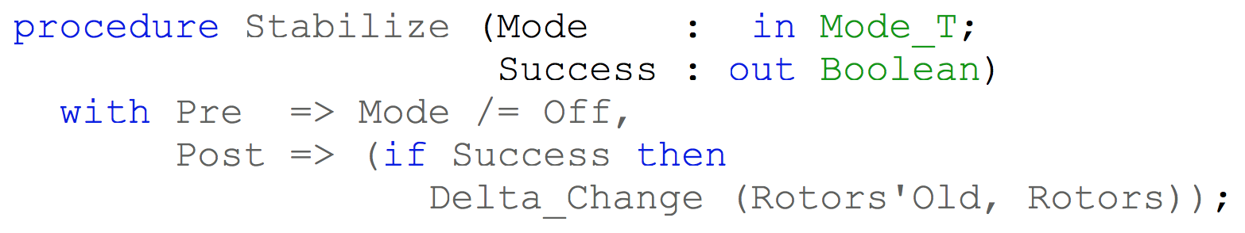
SPARK Proof
Specification of properties
Proof
Program implements specification

Slide 9
Main Objectives for SPARK 2014
Functional contracts can be executed, tested, debugged
Ada subset supported is as large as possible
User needs no annotation to start proving code
User needs few annotations to fully prove code
Manual proof of formulas is not needed

Slide 10
Contracts can be executed, tested, debugged
Use the Ada 2012 preconditions (aspect Pre) and postconditions (aspect Post)
CONTRACTS = CODE
Needed quantified-expressions in Ada 2012
(for [some/all] V in Low .. High => Property(V))
Needed expression-functions in Ada 2012
function Property (V : T) return Boolean is (…);

Slide 11
Ada subset supported is as large as possible
Only exclude features that make formal verification impossible:
Pointers (but references and addresses are OK)
Exceptions (but raising one is OK)
Support in particular all types (except access and tagged), no restriction on control flow, recursion, generics
Initial version of SPARK 2014 did not yet support OO programming, concurrency, data invariants, but…
SPARK code can be mixed with Ada code at fine granularity and…

Slide 12
Ada subset supported is expanding
Support for OO programming in 2015, based on Liskov Substitution Principle
Support for concurrency in 2016, based on Ravenscar
Support for type predicates in 2016 and for type invariants in 2017
Support for safe ownership (Rust-like) pointers in 2019-2020

Slide 13
User needs no annotation to start proving
Subprogram signature defines a default functional contract:
Precondition: inputs (parameters and global variables) in their types
Postcondition: outputs (parameters and global variables) in their types
Global variables read/written generated by the tool when not provided

Slide 14
User needs few annotations to fully prove code
er
Proof is mostly modular
Preconditions and postconditions needed to analyze calls
Inlining mechanisms to do without annotations:
Inlining of internal subprograms with no contracts
Unrolling of simple for-loops
Factorization of annotations with data invariants
Better generation of formulas → fewer loop invariants, no cutpoints

Slide 15
User really needs few annotations!
er
Example: SPARKSkein Skein cryptographic hash algorithm (Chapman, 2011)
http://www.spark-2014.org/entries/detail/sparkskein-from-tour-de-force-to-run-of-the-mill-formal-verification
initial version (SPARK 2005) | current version (SPARK 2014)
41 non-trivial contracts for effects and dependencies | 1 – effects and dependencies are generated
31 conditions in preconditions and postconditions on internal subprograms | 0 – internal subprograms are inlined
43 conditions in loop invariants | 1 – loop frame conditions are generated
23 annotations to prevent combinatorial explosion | 0 – no combinatorial explosion

Slide 16
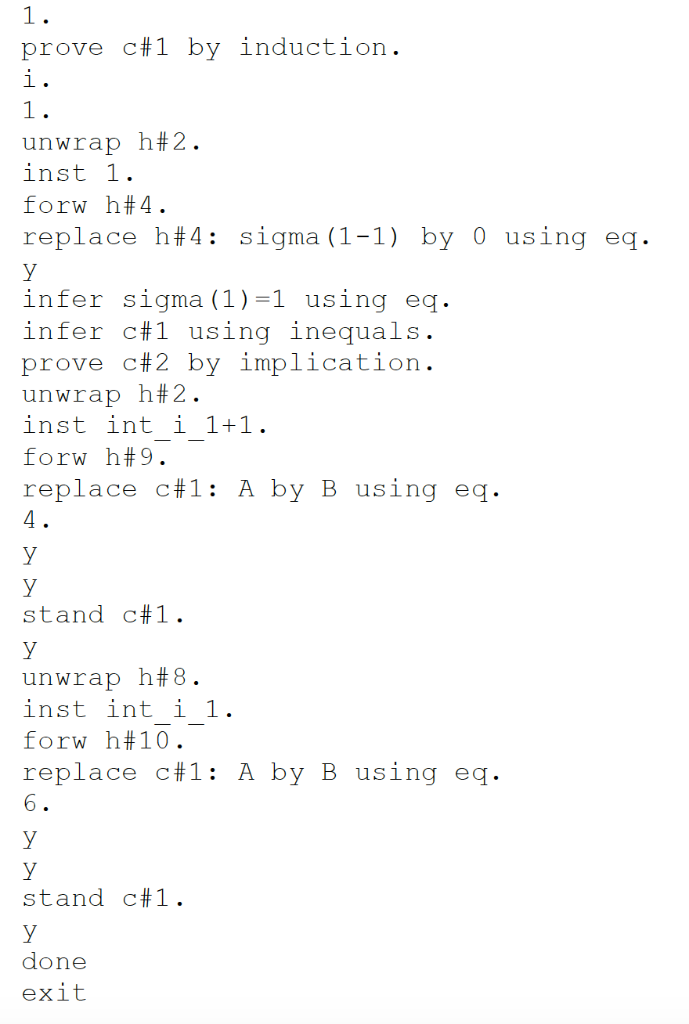
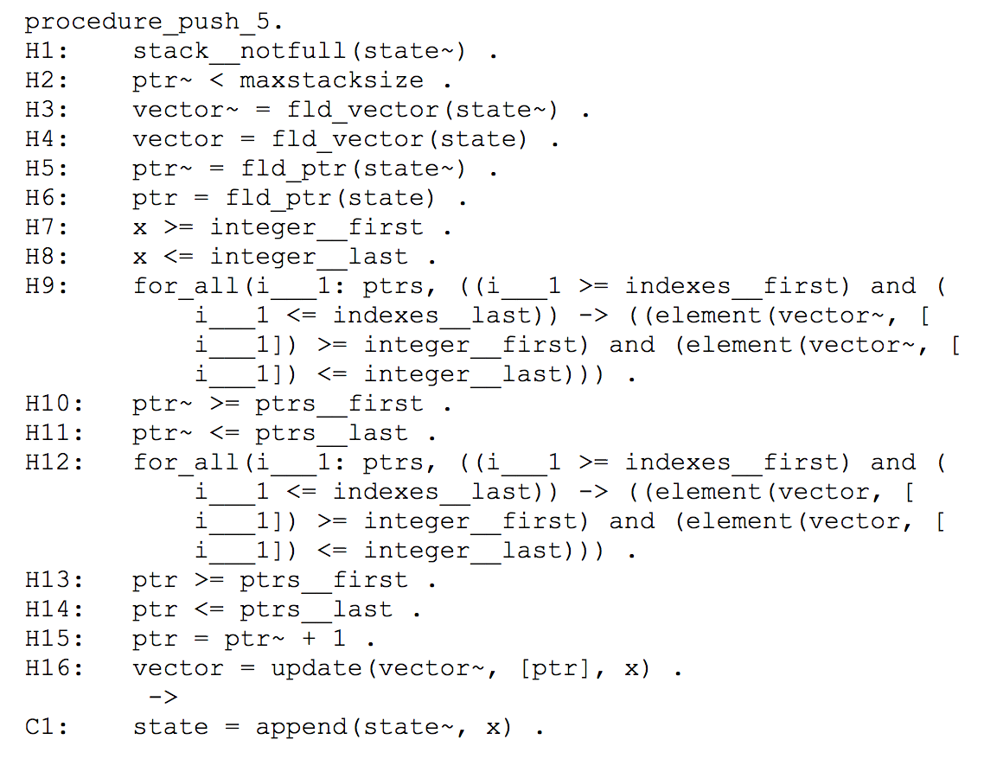
Manual proof of formulas was needed
Verification Condition
in SPARK 2005
Manual Proof
in SPARK 2005

Slide 17
Manual proof of formulas was needed
Verification Condition
in SPARK 2005
Manual Proof
in SPARK 2005

Slide 18
Manual proof of formulas is not needed
Use of state-of-the-art SMT solvers: Alt-Ergo, CVC4, Z3
Why3 platform adapts each formula for each prover
Mix of arithmetic and quantified properties natively understood by these provers
Encoding of data in logic tailored for automatic proof by SMT solvers
Encoding not tailored for manual proof
User control over proof strategy (provers combination, timeout)

Slide 19
FOSS Projects in SPARK

Slide 20
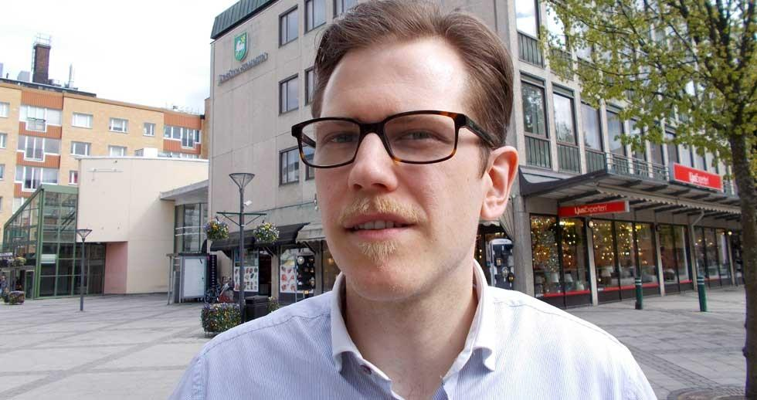
Aida library
https://github.com/joakim-strandberg/aida_2012
Library suitable for use in SPARK code, mostly coded in SPARK:
Bounded strings
Bounded hash maps, vectors
UTF8 support
XML SAX & DOM parsers
JSON SAX & DOM parsers
Directories, stream & textual input-output

Slide 21
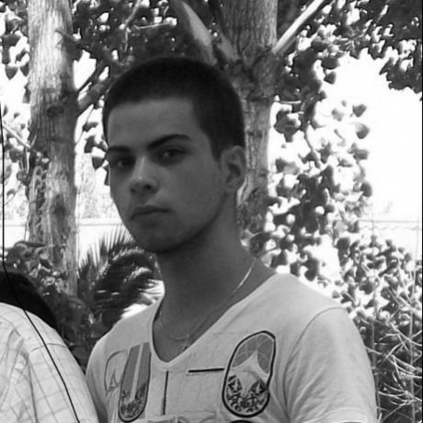
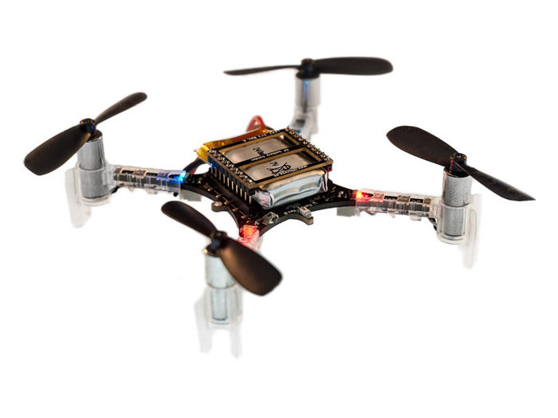
Certyflie drone software
https://github.com/AdaCore/Certyflie
Rewrite of the original Crazyflie firmware in SPARK:
FreeRTOS replaced by Ravenscar
C stabilization and communication code rewritten in SPARK (AoRTE proof)
Demo feature: free-fall detection and landing
Used for prototyping, teaching and research
Sogilis using it for prototyping
Jérôme Hugues (ISAE-Supaero) using it for teaching/research

Slide 22
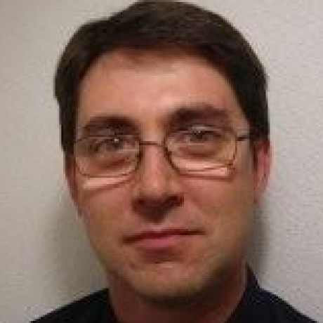
PolyORB-HI
https://github.com/OpenAADL/polyorb-hi-ada
High-integrity middleware for code generation from AADL:
marshalling and unmarshalling facilities
messages management
patterns for periodic, sporadic tasks etc.
Proof of AoRTE + functional contracts (see Frama-C & SPARK Day 2017 - https://frama-c.com/FCSD17.html)

Slide 23
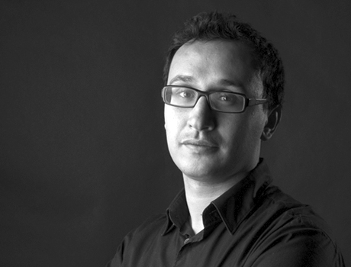
Pulsar drone autopilot
https://www.hionos.com/#pulsar
No public code repository yet
Part of ongoing funded research project CAP2018
Should be available by end of 2018
Autopilot developed with agile process targeting civil avionics certification (DO-178C level A)
SPARK used for proving some of the functionalities + AoRTE

Slide 24
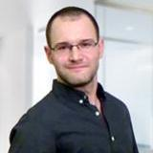
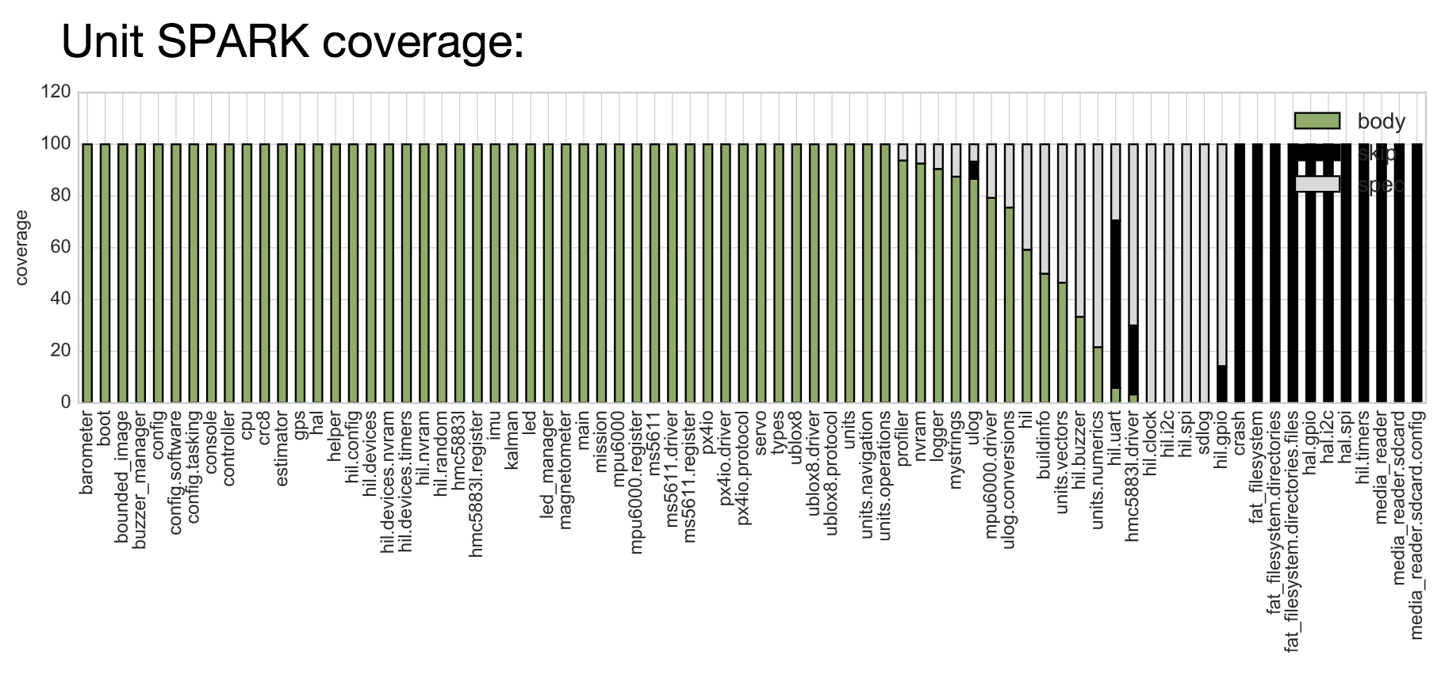
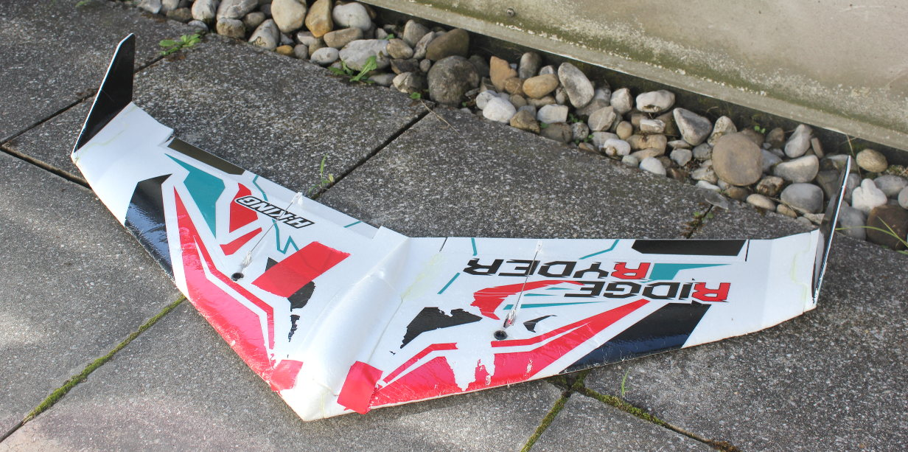
StratoX glider software
https://github.com/tum-ei-rcs/StratoX
Firmware to control an unmanned fixed-wing glider model
Proof of AoRTE + functional contracts (see Frama-C & SPARK Day 2017 - https://frama-c.com/FCSD17.html)

Slide 25
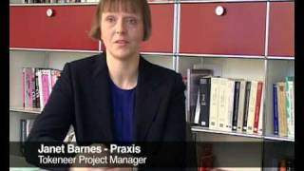
Tokeneer biometric enclave
https://www.adacore.com/tokeneer
https://github.com/AdaCore/spark2014/tree/master/testsuite/gnatprove/tests/tokeneer
Demo project done by Altran for NSA in 2005, open-sourced in 2008
All project artifacts & statistics collected and available
Code fully annotated with contracts, even if not needed anymore
Goal of achieving very high level of security (EAL 5)

Slide 26


Muen separation kernel
https://muen.sk/
Developed since 2013 at University of Rapperswil (Switzerland) with secunet (Germany)
Runs on Intel x86/64 platform
First version in 2015: 3000 sloc SPARK, 300 sloc assembly
Just released version 0.9
Project website served by MirageOS on Muen!

Slide 27
Muen separation kernel
The Muen Separation Kernel is the world’s first Open Source microkernel that has been formally proven to contain no runtime errors at the source code level.
Originally written in SPARK 2005. Then fully migrated to SPARK 2014.

Slide 28
Muen vs Meltdown/Spectre
Muen not vulnerable to Meltdown: Meltdown is defended by our design decision to have a simple architecture which only utilizes a single isolation mechanism: hardware virtualization.
https://groups.google.com/forum/#!topic/muen-dev/1ILwIz8h-kM
Muen little vulnerable to Spectre: The Muen kernel is affected by Spectre (one indirect jump in debug build, one indirect access after range check). The observed issues can be fixed with small local changes and no architectural modifications.
https://groups.google.com/forum/m/#!topic/muen-dev/4tC3MbPxTOQ

Slide 29
SPARK Community Resources

Slide 30
SPARK Community Releases
Every year in June - https://www.adacore.com/community
SPARK will be bundled with GNAT in the Community release 2018
Current differentiator between SPARK Pro and SPARK Discovery:
Provers CVC4 and Z3 not shipped in SPARK Discovery
Static analyzer CodePeer not shipped in SPARK Discovery
As a result, counterexamples not available, and proof less automatic
Installation of CVC4 and Z3 documented in SPARK User’s Guide
Section “Installing CVC4 and Z3 for SPARK Discovery”

Slide 31
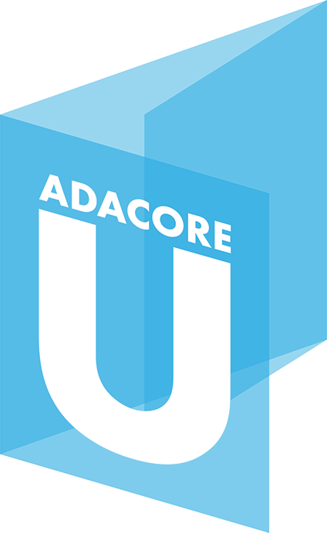
SPARK Learning Resources
AdaCore University – 5-module class on SPARK
u.adacore.com → will move to new Ada/SPARK learning website
This + advanced 5-module class on SPARK on AdaCoreU GitHub:
https://github.com/AdaCoreU
Blog http://www.spark-2014.org/ → will move to AdaCore blog in 2018
Online SPARK RM, SPARK User’s Guide, distributed examples, booklet

Slide 32
SPARK Learning Community Resources
SPARK by Example - https://github.com/yoogx/spark_examples
by researchers Jérôme Hugues and Christophe Garion
Similar to ACSL-by-Example by Fraunhofer for Frama-C
(not to be confused with “GNATprove by Example” section of SPARK UG)
Introduction to SPARK - https://www.rcs.ei.tum.de/spark2014-intro/
by researcher Martin Becker
You’re developing your own material? Let us know!

Slide 33
SPARK Community Events
SPARK and Frama-C Days 2018 at NIST (near Washington DC)
Keynotes by Dave Wheeler, Rustan Leino, David Cok
Talks, tutorials
June 27-28
Presentations at conferences
Alexander Senier at BOB Konferenz 2018 (Berlin, February 23) "What happens when we use what's best for a change?" (also in Embedded, mobile and automotive devroom)
Ada Europe (Lisbon, June 18-22)

Slide 34
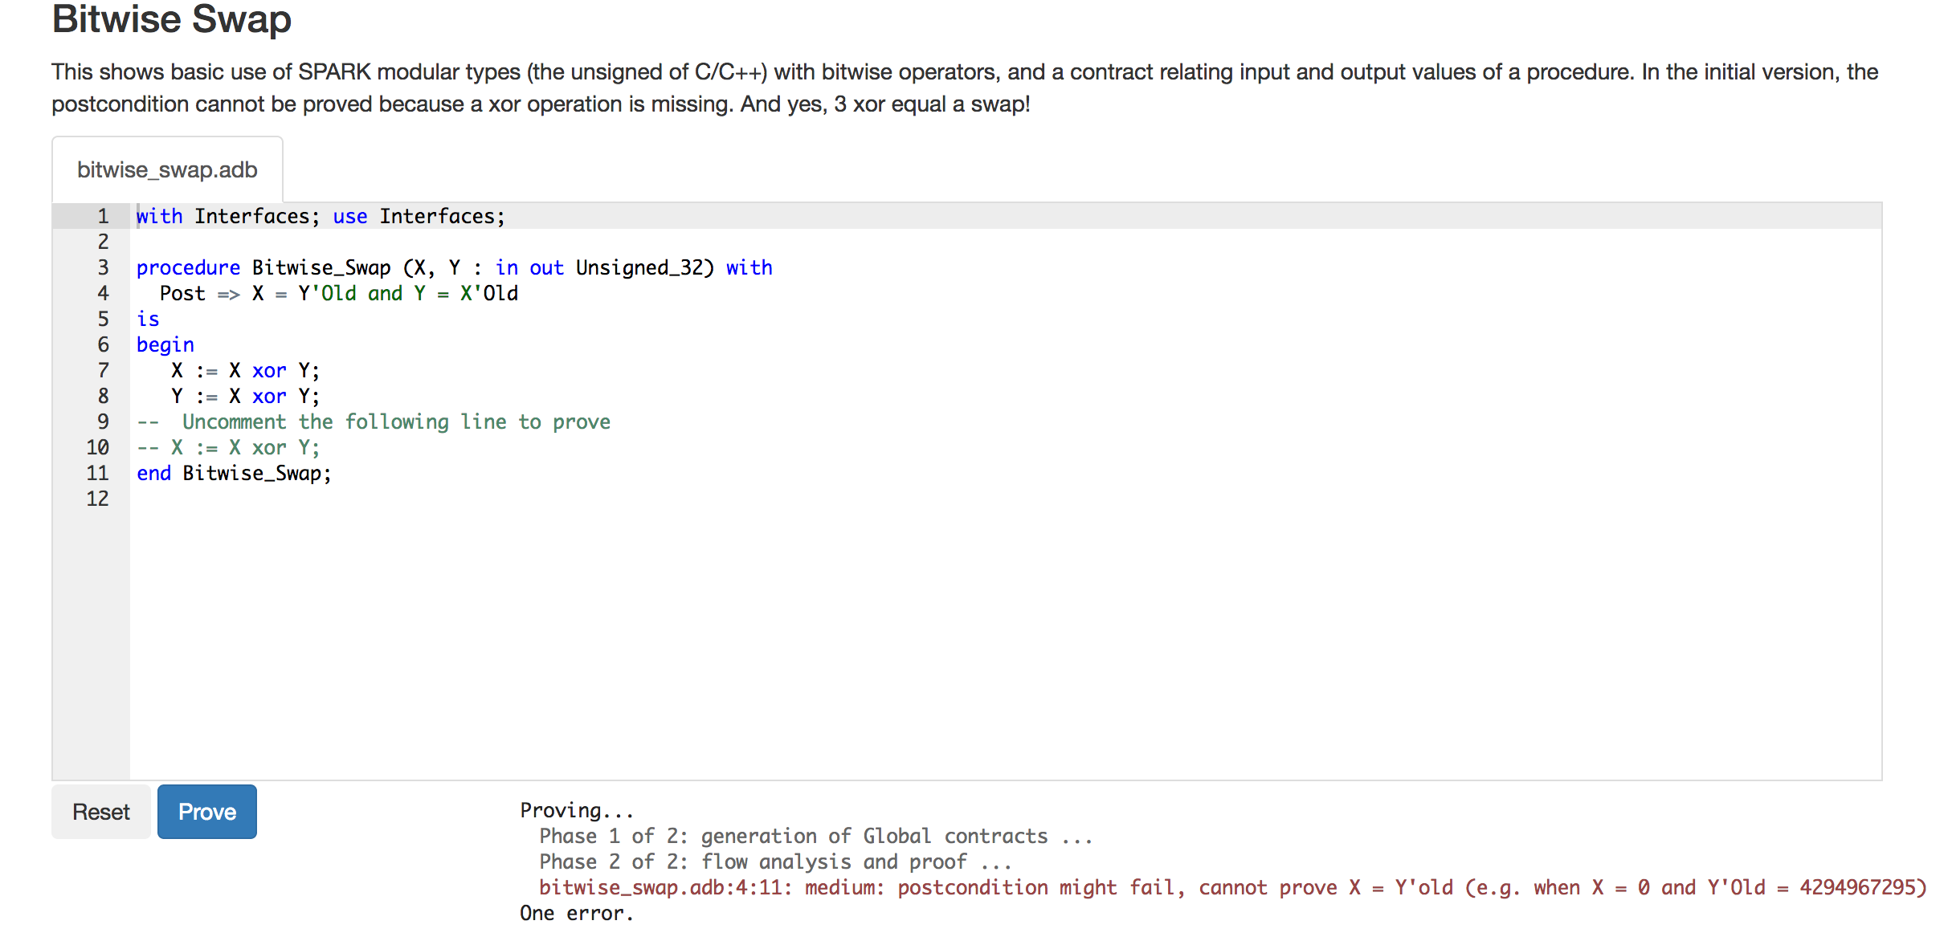
Online proof with SPARK
https://cloudchecker.r53.adacore.com/

Slide 35
What’s your FOSS Project in SPARK?

