Slide 1

Provably Safe Pointers for a Parallel World
High Confidence Software and Systems, May 2018
Annapolis, MD
S. Tucker Taft
Director of Language Research, AdaCore
Lexington, MA

Slide 2
Why Try to Verify Use of Pointers?
Trying to reduce entry barriers to use of formal methods in industry, such as that provided by SPARK 2014
Many complex, dynamic data structures depend on some notion of re-assignable pointers
SPARK forces users to make creative use of arrays instead
Because… unrestricted use of pointers is notoriously hard to formally verify
Separation Logic is one approach, but a challenge for industrial programmers to produce the annotations needed for proof
Some variant of Pointer ownership is a viable alternative

Slide 3
What is the SPARK 2014 Language?
SPARK 2014 is a multiparadigm (OO, FP, RT, MP) programming and specification language designed for formal verification using deductive proof.
SPARK 2014 provides a subset of Ada 2012 run-time semantics, with additional design-time formalisms to support information flow analysis and proof.
SPARK is supported by a set of commercial tools and has been used to formally verify large real-time systems.
Main restrictions relative to Ada 2012:
No exception handling
No re-assignable pointers – topic of this talk

Slide 4
SPARK 2014 – Commercial Tools
SPARK code can be combined with Ada, C, C++ code
SPARK code is marked specially to indicate where extra checking should be performed (at unit/subprogram level)
GNAT compiler
compiles Ada, SPARK, C, and C++ code, including contracts and “ghost” code
checks SPARK legality rules where SPARK mode is specified
GNATprove formal verification tool
checks SPARK verification rules by static analysis and proof
reports useful information on failed proofs (code paths, counterexamples)
IDEs (GPS/GNATbench) integrate all tools

Slide 5
General Goals for Formal Verification
Verify that code implements the specification
Implicit specifications | User defined specifications
No reads of uninitialized data No run-time errors No deadlocks, no data races | Data dependences Functional contracts (pre/post) Integration contracts (pre)

Slide 6
Formal Verification in SPARK
Properties Proved
Correct initialization
Correct data dependencies
Safe concurrent access
Program Dependence Graph (PDG) => Flow Analysis
Properties Proved
Absence of run-time errors
Functional contracts proved
Safety/security properties
∃x. P(x) ⟹
¬∀x. ¬ P(x)
Verification Conditions (VC) => SMT Solvers

Slide 7
SPARK 2014 Methodology
Progressive adoption with incremental benefits relative to effort
SPARK can be used as main programming language (green field) or migrating part of codebase from Ada/C/C++ (brown field)
Useful to think in terms of levels:
Stone level – coding standard checking for language subset
Bronze level – initialization and correct data flow
Silver level – absence of run-time errors
Gold level – proof of key integrity properties
Platinum level – proof of functional correctness

Slide 8
Formal verification levels
circle size = amount of code
Correct
initialization
and data dependencies
Strong coding standard
Absence of run-time errors
Safety and
security
properties
Stone
Bronze
Silver
Functional
Correctness
Gold
Pt

Slide 9
Examples of industrial practice with SPARK
Certification Standard | DO-178, DEFSTAN 00-55 | CAP670 SW01 | Common Criteria GCHQ Standards
Certification level | DO-178 level A, DEFSTAN SIL4 |  | NSA Type 1 Secret
Typical analysis level | Bronze/Silver/Gold | Silver | Silver/Gold
Example projects | Typhoon, SHOLIS, C130J | iFACTS | Turnstile, Muen, MLW
Example customers | Rolls-Royce, Lockheed Martin | NATS | Rockwell Collins, Secunet, MBDA

Slide 10
Goals for Pointer Safety in a Parallel World
No null pointer dereferences: No null pointer is dereferenced
No storage leaks: Every heap object has exactly one “owning” pointer at a time, and when that owner is set to null, the heap object must be reclaimed
No dangling references: This owner may be set to null (and cause reclamation) only when it is the only pointer with access to the heap object
No Hidden Aliasing: So can verify correctness of algorithm
Exclusive write: At most one pointer gives read/write access to any given heap object at a time
When such a pointer exists, no pointers giving read-only access may exist
Concurrent read: One or more pointers may give read-only access to a given heap object at a time
Owning pointer may only give read-only access when such pointers exist
Pointer in read-only heap object may only give read-only access

Slide 11
Pointer Ownership Approach
Alternative to Separation Logic.
Amenable to Deductive Proof.
Full ownership (read/write access) or Partial/Shared ownership (read-only access).
Generalizes the guarantees against aliasing already required by SPARK w.r.t. by-reference parameter passing:
Must not pass a (writable) global as a by-reference parameter
Must not pass same object twice as a by-reference parameter, if either is writable

Slide 12
Aside: “Reference” vs. “Pointer”
Reference
Pointer
Reference acts as an alias for an existing object
Reference refers to same object throughout its life
Assignment with Reference as LHS updates Target Object
Anti-aliasing rules may be necessary for by-reference parameters
Pointer is a separate, assignable object that designates a pre-existing object, or is null
Assignment with Pointer as LHS changes where it points, or sets it to null
“Safe Pointer” rules make restrictions on where pointer may point, number of pointers to same object, etc.

Slide 13
Example – Reverse Last two elements of list -- is this safe?
type List; type List_Ptr is access List with Ownership; type List is record -- Ownership implicitly True Next : List_Ptr; Data : Data_Type; end record; procedure Swap_Last_Two (X : in out List_Ptr) is -- Swap last two elements of list begin if X = null or else X.Next = null then -- < 2 elems return; else if X.Next.Next = null then -- exactly 2 elems declare Second : List_Ptr := X.Next; begin X.Next := null; Second.Next := X; -- swap them X := Second; end; else -- > 2 elems declare Walker : access List := X; begin
while Walker /= null loop declare Next_Ptr : List_Ptr renames Walker.Next; begin if Next_Ptr /= null and then Next_Ptr.Next /= null and then Next_Ptr.Next.Next = null then -- Found second-to-last element declare Last : List_Ptr := Next_Ptr.Next begin -- Swap last two Next_Ptr.Next := null; Last.Next := Next_Ptr; Next_Ptr := Last; return; -- All done end; end if; end;
-- Go to next element Walker := Walker.Next; end loop; end; end if; end Swap_Last_Two;
Storage Leaks?
Dangling Refs?
Null Ptr Derefs?
Circularly Linked?
Correct Result?

Slide 14
Vocabulary for ownership-based pointers
Ownership aspect (Boolean)
Specifiable for named pool-specific access types, anonymous stand-alone access objects, by-ref composite and private types
Owning access type, Owning access object -- provides read/write access
Access-to-variable type with Ownership True
Observing access type, Observing access object -- provides read-only access
Access-to-constant type with Ownership True
Ownership States of object names
Unrestricted -- Default state of static name, unless access-to-constant or subcomponent of a constant
Observed -- Default state for an access-to-constant object or subcomponent of a constant
Also becomes “observed” after being used to initialize an “observing” access object
Borrowed -- After being used to initialize some other owning access object
Dynamic Ownership State – Default state of dynamic name that is not in observed or borrowed state
Managed object
All of the above, plus any part of a dereference of an owning or observing access object

Slide 15
Vocabulary for operations on pointers
Observe a name
Initialize an access-to-constant object (observing access object) from existing access-to-variable reference
Pass a composite object as an in parameter with a subcomponent that is an owning access object
“Observed” state lasts for scope of observer object
Borrow a name
Initialize an access-to-variable object (owning access object) of an anonymous type (including a parameter)
Rename a part of a dereference of an owning object that is in an unrestricted state
Pass a composite object as [in] out with a subcomponent that is an owning access object
“Borrowed” state lasts for scope of borrower object
Move a name
Assign to an access-to-variable object (owning access object) of a named type
RHS and LHS must not be observed nor borrowed; RHS and LHS must be variables
Side-effect of “move” is to null out “moved” (RHS) name and finalize/deallocate former LHS designee (if not “self” move)
Copy a name
Use the ‘Copy attribute, as in: Y := X’Copy;
LHS must be a variable that is neither observed nor borrowed
Notes:
Need rules to make sure same object is not passed as in-out parameter twice.

Slide 16
Vocabulary about names involving pointers
Static name (of an object)
Name that statically denotes an entity
Dereference of static prefix being of an access type with Ownership True
Selected component of static prefix
Name that denotes a renaming where renamed entity denoted by static name
Dynamic name (of an object)
Indexed component
Slice
Dereference of an access type with Ownership False
Name with a dynamic name as prefix
Two names are Statically Overlapping if they are both static and denote the same object, or one is static and matches a prefix of the other
Two dynamic names are Potential Aliases if they are the same ignoring dynamic indexing and slicing, or are aliased and of same type with at least one being a dereference of an access type with Ownership False
Two dynamic names are Potentially Overlapping if they are Potential Aliases, or either is a Potential Alias of a prefix of the other

Slide 17
Example – Reverse Last two elements of list
type List; type List_Ptr is access List with Ownership; type List is record -- Ownership implicitly True Next : List_Ptr; Data : Data_Type; end record; procedure Swap_Last_Two (X : in out List_Ptr) is -- Swap last two elements of list begin if X = null or else X.Next = null then -- < 2 elems return; else if X.Next.Next = null then -- exactly 2 elems declare Second : List_Ptr := X.Next; begin X.Next := null; -- not really necessary Second.Next := X; -- swap them X := Second; end; else -- > 2 elems declare Walker : access List := X; begin
while Walker /= null loop declare Next_Ptr : List_Ptr renames Walker.Next; begin if Next_Ptr /= null and then Next_Ptr.Next /= null and then Next_Ptr.Next.Next = null then -- Found second-to-last element declare Last : List_Ptr := Next_Ptr.Next; begin -- Swap last two Next_Ptr.Next := null; -- not really necessary Last.Next := Next_Ptr; Next_Ptr := Last; return; -- All done end; end if; end;
-- Go to next element Walker := Walker.Next; -- OK to borrow in subtree end loop; end; end if; end Swap_Last_Two;
Key:
Move
Borrow
Borrowed
Storage Leaks?
Dangling Refs?
Null Ptr Derefs?
Circularly Linked?
Correct Result?

Slide 18
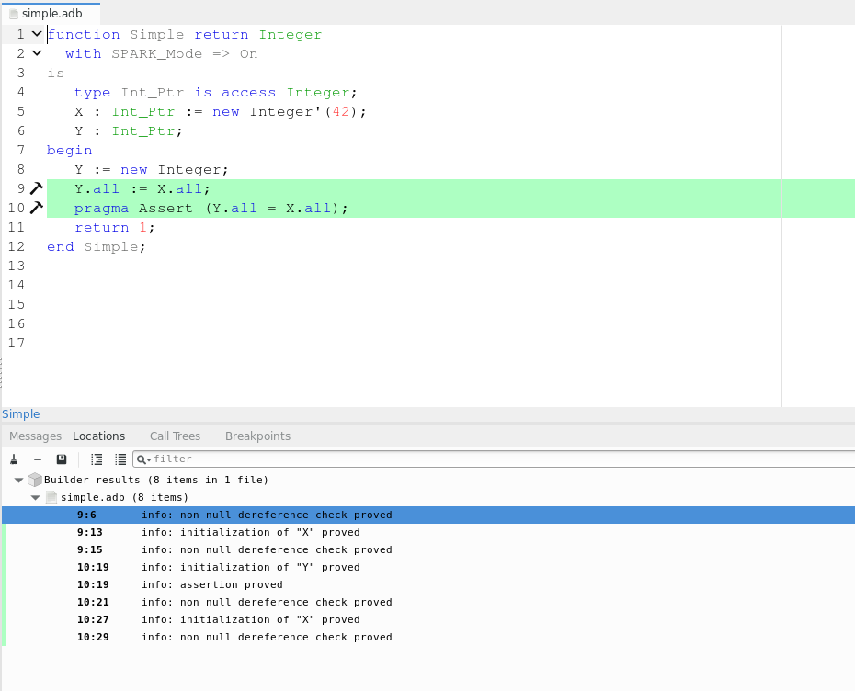
Example of SPARK IDE

Slide 19
Example – Insert into Hashed Set
type Node; type Node_Prtr is access Node with Ownership; type Node is record -- Ownership implicitly True Next : Node_Ptr;
Key : Key_Type; end record;
type Node_Ptr_Array is array (Positive range <>) of Node_Ptr;
type Hashed_Set (Size : Positive) is record
Backbone : Node_Ptr_Array (1 .. Size);
end record;
type Hashed_Set_Ptr is access Hashed_Set;
procedure Include (HS : in out Hashed_Set_Ptr;
Key : Key_Type) is -- insert into Hashed Set if not already there begin if HS = null then
HS := new Hashed_Set (Default_Initial_Size);
end if;
declare
Index : constant Positive :=
Hash (Key) mod HS.Size + 1;
Ptr : access constant Node :=
HS.Backbone (Index);
begin
while Ptr /= null loop
if Equiv (Key, Ptr.Key) then
-- Already in set, just return
return;
end if;
Ptr := Ptr.Next; -- OK to Observe within subtree
-- Ptr := HS.Backbone (J): -- Illegal to observe outside
end loop;
end; -- Ptr ”observing” ends here
-- Not in set, create a new Node and move into
-- front of appropriate bucket
-- This involves two moves with HS.Backbone(I) being
-- null in between the two moves
HS.Backbone (Index) :=
new Node’(Next => HS.Backbone (I),
Key => Key);
end Include;
Key:
Move
Observe
Observed
Storage Leaks?
Dangling Refs?
Null Ptr Derefs?
Circularly Linked?
Correct Result?

Slide 20
Relation to Safe Parallelism
Anti-Aliasing Rules
Pointer Ownership Rules
Data-Race Prevention
Must not pass a (writable) global as a by-reference parameter
Must not pass same object twice as a by-reference parameter, if either provides read/write access
One or more pointers giving read-only access, and no writers
Exactly one pointer giving read-write access, and no readers
One or more threads having read-only access and no writers
Exactly one thread having read-write access, and no readers

Slide 21
Provably Safe Pointers
Pointer Ownership provides sound, understandable, and safe alternative to Separation Logic for verifiable industrial use of pointers
Parallelism safety checks are natural extension of anti-aliasing and ownership checks
Pointer-based structures are more important as critical systems grow in complexity and dynamism

Slide 22


Slide 23
Questions?

