Slide 1

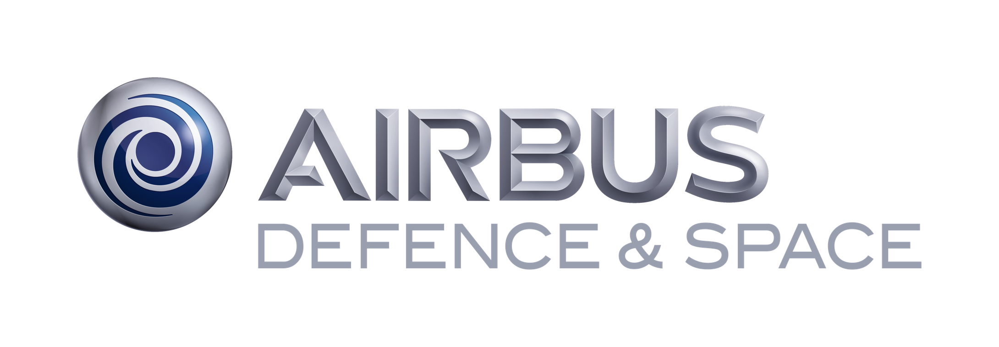

Rail, Space, Security: Three Case Studies for SPARK 2014
Claire Dross, Pavlos Efstathopoulos, David Lesens, David Mentré and Yannick Moy
Embedded Real Time Software and Systems – February 5th, 2014
Notes:
ERTS 2010: introducing project Hi-Lite. case study on analysis of Tokeneer code with multiple approaches
ERTS 2012: show integration of test & proof at the heart of project Hi-Lite, using toy case study
ERTS 2014: report on 3 industrial case studies using the new version of SPARK language and tools, result of project Hi-Lite

Slide 2
SPARK 2014

Slide 3

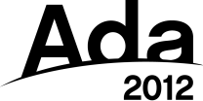


Ada 2012 and SPARK 2014
programming language for long-lived embedded critical software
programming by contract
Ada subset for formal verification
practical formal verification

Slide 4
SPARK 2014 Value Proposition
Functional Requirement
Functional Verification
Software Architecture
Software Architecture Verification
Unit Requirements
Unit Verification
Code
Robustness Verification
Notes:
SPARK 2014 addresses multiple verification objectives on the V cycle:
Robustness verification usually performed with unit testing. Proof guarantees that no run time error can occur.
Unit verificaton, also usually performed with unit testing. Proof guarantees that functional contracts specified on subprograms are fulfilled by the implementation.
Software architecture verification, usually performed with manual reviews. Static analysis guarantees that dependence contracts on subprograms and packages are fulfilled by the implementation.

Slide 5
SPARK 2014 Value Proposition (DO-178C Version)
System Requirements
High Level Requirements
Software Architecture
Low Level Requirements
Software architecture
is consistent
Compliance Robustness
Source Code
Accuracy
Consistency
Property Preservation
Executable Object Code
Notes:
SPARK tools operate at source level, so the Compliance&Robustness activity performed with SPARK must be completed by an activity showing Property Preservation between the Source Code and the Executable Object Code. This activity typically relies on the qualification material developer for the compiler.

Slide 6

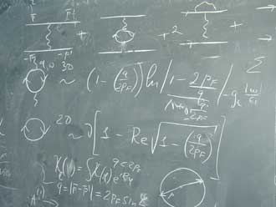
SPARK 2014 Contracts
Program
Contract = agreement between client & supplier
Contract = agreement between client & supplier
caller & callee
Dynamic Verification
Formal Verification
Notes:
SPARK allows fine-grain combination of dynamic verification and formal verification of contracts.

Slide 7
Case Studies
Notes:
3 case studies: different domains, different sizes, different expertise

Slide 8

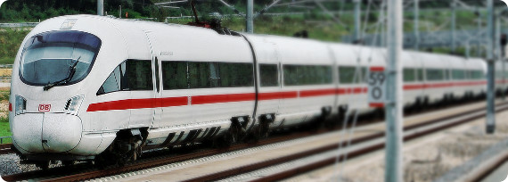
Case study 1: Train Control Systems
David Mentré
Notes:
Small case study, rail domain, user very knowledgable about formal methods (B method, formal verificaiton of C code) but new to Ada/SPARK
Fully available on the Web (both code and report), see URL in paper

Slide 9
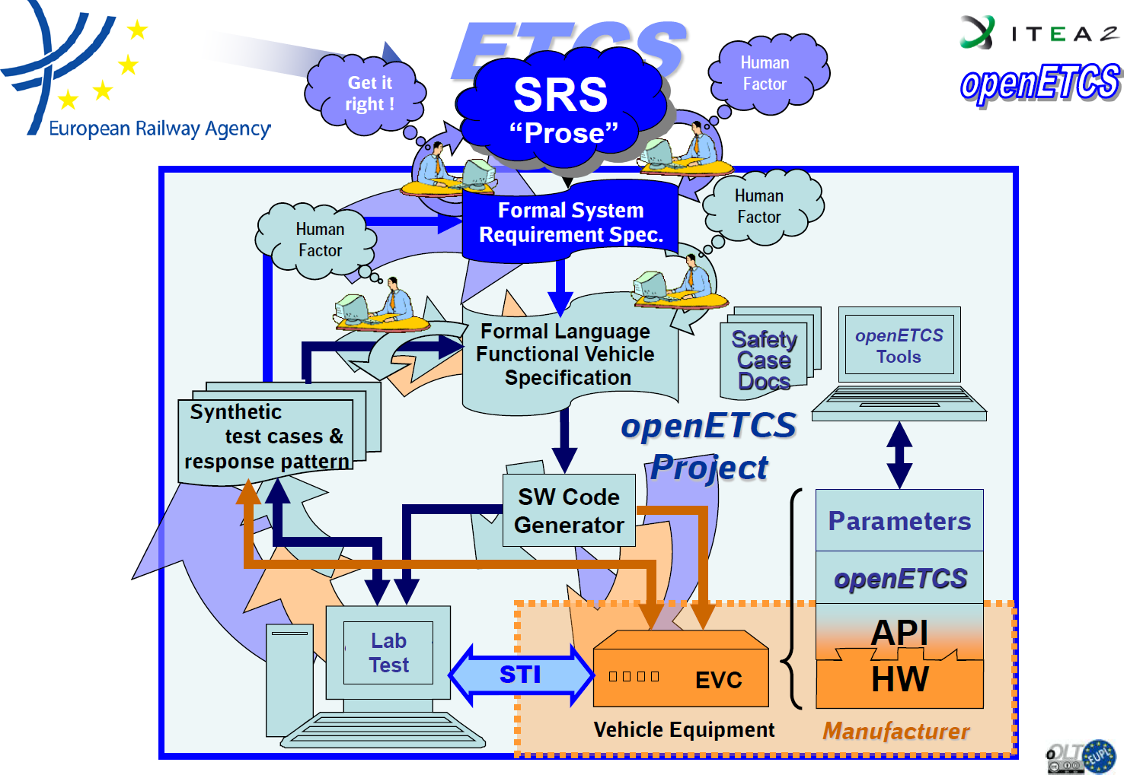
openETCS
Open Source → no vendor lock-in
Model based (SysML)
Formal methods → Strong guaranties of correctness
“Open Proofs” → Everybody can re-check
Notes:
openETCS is a European project aming at developing an integrated toolchain for specification + development + verification of European Train Control System software

Slide 10
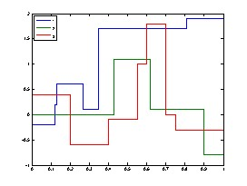
Formalization of the Correctness of Step Functions
Has_Same_Delimiters?
Get_Value?
Minimum_Until_Point?
Restrictive_Merge
Notes:
Formalization of step functions, used to describe maximum speed allowed on rail segments
Various query and build subprograms operate on step functions
Full functional contracts developed for all of these

Slide 11
Results
SPARK 2014 very good for:
Capturing objects in the requirements
Readability of the specifications (= contracts)
Automatic proof of absence of run-time errors
Automatic proof of simple functional contracts
Dynamic verification of contracts and assertions
SPARK 2014 is not good for:
Proving existing code automatically without any modifications
Proving automatically complex functional contracts
Areas requiring improvements:
Possibility to prove some properties interactively (in 2014 roadmap)
Better diagnostic for incomplete loop invariants (in 2014 roadmap)
Training for developers to use proof tools (available in SPARK Pro subscription)
Workflow to make efficient use of developers’ time (in progress)
Notes:
Paper describes one case where it was necessary to rewrite one line of code to allow automatic proof.
Paper describes one case where the most natural contract would not have been provable automatically, and one where proof could not be completely automated.
Better diagnostic will be provided by displaying counter-examples when automatic proof fails.
Existing workflow for previous versions of SPARK being currently updated, as new language and tools are much more powerful.

Slide 12
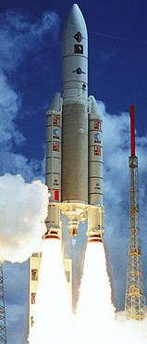

Case study 2: Flight Control and Vehicle Management in Space
David Lesens
Notes:
Large case study over 3 years, space domain, user very knowledgeable about Ada and previous version of SPARK
Detailed report published as paper at DASIA conference in 2013

Slide 13
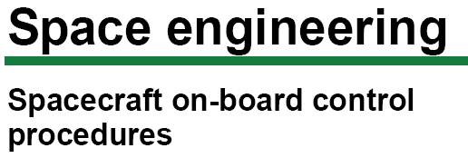


On Board Control Procedure
On-board control procedure
Software program designed to be executed by an OBCP engine, which can easily be loaded, executed, and also replaced, on-board the spacecraft
OBCP code
Complete representation of an OBCP, in a form that can be loaded on-board for subsequent execution
OBCP engine
Application of the on-board software handling the execution of OBCPs
OBCP language
Programming language in which OBCP source code is expressed by human programmers
Notes:
The largest part of the case study targeted the On Board Control Procedure, a standardized means for spacecrafts to receive and execute commands.
Specifically, the OBCP engine was fully developed in SPARK.

Slide 14
Formalization of the Correctness of 1505 Subprograms
Example:
A list of event detection statuses
Request to reset the detection status for Event
procedure Reset_Event_Status (Event : in T_Event) with
Post =>
not Event_Status (Event).Detection and
(for all Other_Event in T_Event =>
(if Other_Event /= Event then
Event_Status (Other_Event) = Event_Status'Old (Other_Event)));
Post-condition
The detection of event is reset
For all other events
The detection status is unchanged
Event1
Event1
Event2
Event2
Event3
Event1
Event3
Event1
Event2
Event2
Event3
Event3
Not detected
Not detected
Detected
Not detected
Detected
Not detected
Detected
Not detected
Not detected
Not detected
Detected
Detected
Notes:
Full functional contracts developed for 1505 subprograms.
The contract for Reset_Event_Status shows how a complex property can be expressed using quantified expressions and conditional expressions.

Slide 15
Automatic Proof Results
Numerical control/command algorithms
Mission and vehicle management
Formal Verification of Aerospace Software, DASIA 2013, http://www.open-do.org/wp-content/uploads/2013/05/DASIA_2013.pdf
Part | # subprograms | # checks | % proved
Math library | 15 | 27 | 92
Numerical algorithms | 30 | 265 | 98
Part | # subprograms | # checks | % proved
Single variable | 85 | 268 | 100
List of variables | 140 | 252 | 100
Events | 24 | 213 | 100
Expressions | 331 | 1670 | 100
Automated proc | 192 | 284 | 74
On board control proc | 547 | 2454 | 95
Notes:
Results for the largest units of the 2 parts of the case study.
Average % of checks automatically proved is 95%, even 98% for functional properties, and 100% for many units.

Slide 16
Results
SPARK 2014 very good for:
Proof of absence of run-time errors
Correct access to all global variables
Absence of out-of-range values
Internal consistency of software unit
Correct numerical protection
Correctness of a generic code in a specific context
SPARK 2014 is good for:
Proof of functional properties
Areas requiring improvements:
Sound treatment of floating-points (done)
Support of object oriented features (in 2014 roadmap)
Helping user with unproved checks (in 2014 roadmap)
Notes:
Helping users by displaying counter-example when automatic proof fails, and guiding the process of writing supporting assertions for proofs (in particular loop invariants).

Slide 17
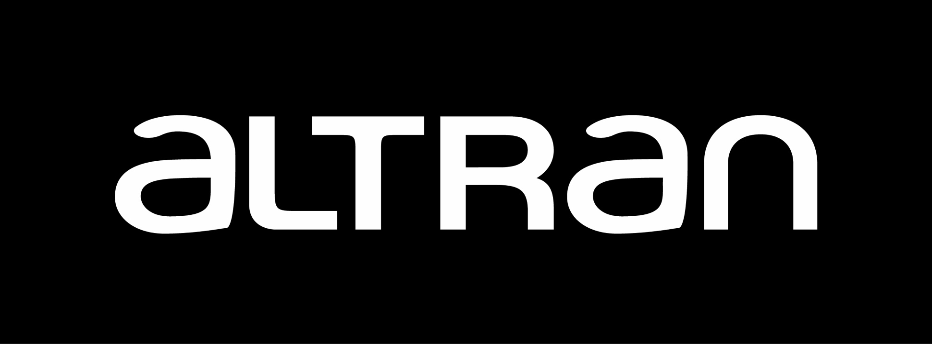


Case study 3: Biometric Access to a Secure Enclave
Pavlos Efstathopoulos
Notes:
Small case study based on a large case study called Tokeneer commissioned by the NSA to assess usability of previous version of SPARK
Security domain, user is a member of SPARK development team, very knowledgeable about SPARK
Original case study fully available on the Web (code, reports, papers)

Slide 18
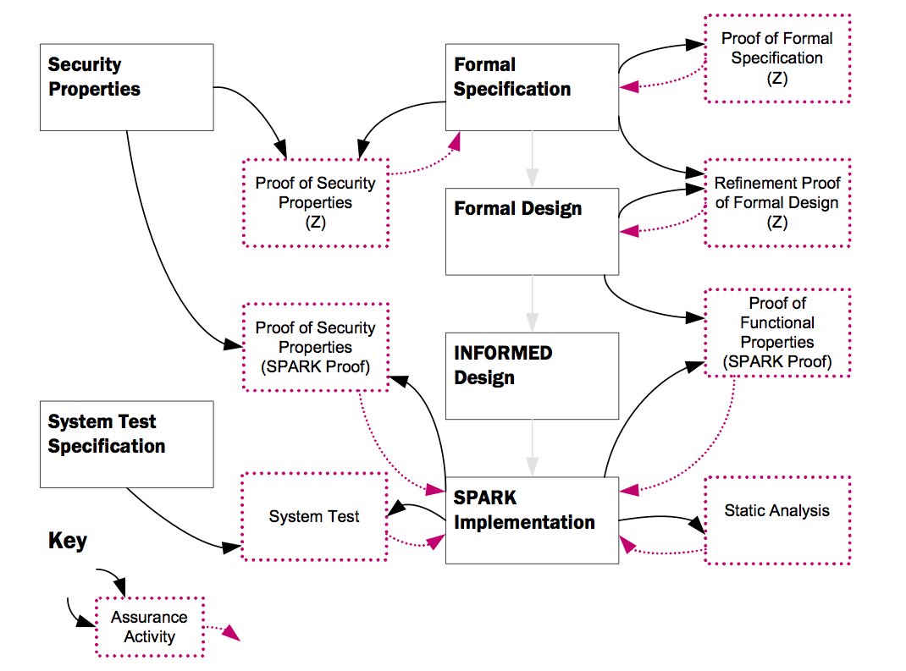
Tokeneer
Notes:
Overall development and verification plan of the original Tokeneer case study
Aim of this case study was to translate existing SPARK 2005 code and contracts to SPARK 2014, and apply new toolset

Slide 19
Formalization of the “Admin” Package
Aspect / Pragma | Num. of occurrences
Global | 197
Refined_Global | 71
Refined_Depends | 40
Depends | 202
Pre | 28
Post | 41
Assume | 3
Loop_Invariant | 10
Dataflow
Refinement
Information flow
Functional contracts
User guidance
Assumptions
Notes:
Full dependency, refinement and functional contracts added to a unit

Slide 20
Results
SPARK 2014 very good for:
Readability of the formal specifications
Expressing specification-only code
SPARK 2014 is better than SPARK 2005 for:
Analysis of code that was not analyzable with SPARK 2005
Automating proofs with less user efforts
Proving complete functional behavior of functions
Uncovering corner cases in specifications related to run-time checks
Areas requiring improvements:
Summary of proof results (done)
Notes:
Translation was a complete success. New toolset largely outperformed previous one.

Slide 21
Lessons Learned
Notes:
From 3 different experiences, similar conclusions drawn

Slide 22

SPARK 2014 Strengths
large, expressive, analyzable language
better
automation
of proofs
executable
contracts
Notes:
3rd place: much better automation of proofs obtained with new toolset, which makes it practical to target proof of functional properties in addition to absence of run-time errors
2nd place: possibility to execute contracts is essential to develop contracts, catch errors early, and in the future combine test & proof
1st place: new version of SPARK is a much larger subset of Ada, which allows using it for many more applications

Slide 23

SPARK 2014 Challenges
code and specifications must be adapted
static debugging
of contracts
need
expert advice
sometimes
Notes:
Common finding: expert advice is needed for more complex automatic proofs
Related issue: need tool support for statically debugging incomplete contracts
Unsurprisingly: although code and specifications can be both tested and proved, automatic proof requires some adaptations

Slide 24
SPARK in 2014

Slide 25
Roadmap
Now available as beta
First release April 2014
See http://www.adacore.com/sparkpro
and http://www.spark-2014.org
New LabCom ProofInUse between AdaCore and INRIA
(hiring 2 R&D software engineer postdocs)

Slide 26
Announcements
Tomorrow Thursday:
8:00 – 8:50 (room Daurat) Information session on the working group on “Theorem Proving in Certification”
10:30 – 12:30 New Trends in Certification I
16:40 – 18:40 New Trends in Certification II

