Slide 1
Formal Program Verification in Avionics Certification
Cyrille Comar – President – AdaCore
Yannick Moy – SPARK Product Manager – AdaCore

Slide 2
A formal model combined with a formal analysis constitutes a formal method. [..] There are many different kinds of formal analysis, but they can typically be classified in three categories: (1) deductive methods, such as theorem proving, (2) model checking, and (3) abstract interpretation.
DO-333 FM.1.6

Slide 3
Formal Methods Landscape
Application domain: system, protocol, software, hardware
Environment assumptions: nominal, faulty, hostile
Models: formal/semi-formal/informal, executable/not, partial/total, abstract/concrete, unique/multiple, deterministic/not
Levels of rigor: conventional/formal design flow, formal/semi-formal/informal specifications, checking tools
Formal Methods for Safe and Secure Computers Systems, Garavel and Graf, BSI, 2013

Slide 4
Formal Methods Landscape
Application domain: system, protocol, software, hardware
Environment assumptions: nominal, faulty, hostile
Models: formal/semi-formal/informal, executable/not, partial/total, abstract/concrete, unique/multiple, deterministic/not
Levels of rigor: conventional/formal design flow, formal/semi-formal/informal specifications, checking tools
Formal Methods for Safe and Secure Computers Systems, Garavel and Graf, BSI, 2013

Slide 5
Formal Methods for Functional Correctness
 | Deductive methods | Model checking | Abstract interpretation
Requirements | PVS, HOL4
Design | AGREE | Kind, MathWorks SDV
Code | Caveat, Frama-C, SPARK | CBMC, SPIN | PolySpace, Astrée
DO-333 Certification Case Studies, Cofer and Miller, Rockwell Collins, 2014

Slide 6
Formal Methods for Functional Correctness
 | Deductive methods | Model checking | Abstract interpretation
Requirements | PVS, HOL4
Design | AGREE | Kind, MathWorks SDV
Code | Caveat, Frama-C, SPARK | CBMC, SPIN | PolySpace, Astrée
DO-333 Certification Case Studies, Cofer and Miller, Rockwell Collins, 2014

Slide 7



Formal Program Verification
C
2002
Airbus
2008
1999
Caveat
2013
1987
SPARK
2014
Ada
1997
C130J
Formal Verification of Avionics Software Products, Souyris et al., Airbus, FM 2009
Are We There Yet? 20 Years of Industrial Theorem Proving with SPARK, Chapman and Schanda, Altran, ITP 2014

Slide 8
Objectives of Formal Program Verification
Verify that code implements the specification
Implicit specifications | User defined specifications
No read of uninitialized data No run-time error No deadlock, no data race | Data dependences Functional contracts (pre/post) Integration contracts (pre)

Slide 9
Executable Formal Specifications
Year | Who? | Contracts =
1969 | Hoare (logic) | logic
1987 | SPARK 83 (PVL) | logic
1988 | Meyer (Eiffel) | code
2005 | JML | either logic or code
2010 | Chalin (JML) | both logic and code
2011 | Frama-C (E-ACSL) | sometimes both
2014 | SPARK 2014 | always both
Engineering a Sound Assertion Semantics for the Verifying Compiler, Chalin, IEEE TSE 2010
Static versus Dynamic Verification in Why3, Frama-C and SPARK 2014, Marché et al., 2016

Slide 10
SPARK 2014 Language
Heir of SPARK language developed at PVL/Praxis/Altran 1987 – 2008
Uses contracts defined in Ada 2012 (new syntax for aspects):
preconditions, postconditions on subprograms
type predicates and type invariants
Defines specific contracts as additional aspects/pragmas:
contract cases to define subprogram contracts by cases
data and flow dependency contracts (not executable)
Uses same semantics for executable and logical views of contracts

Slide 11
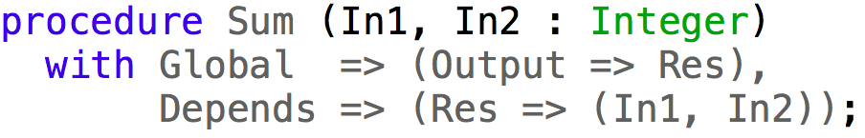
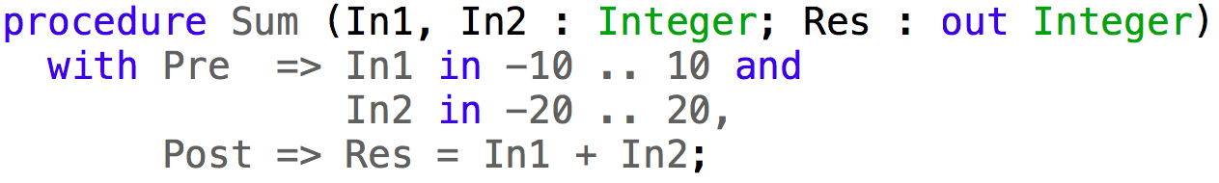
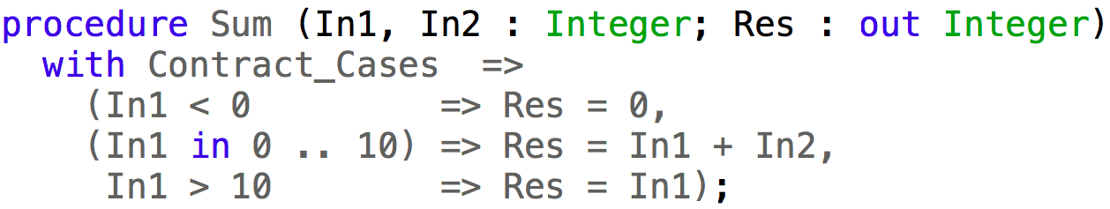
SPARK 2014 Language Examples

Slide 12
SPARK 2014 Tools
SPARK code is marked specially inside Ada code (unit/subprogram)
GNAT compiler
compiles Ada and SPARK code, including contracts and ghost code
checks SPARK legality rules
GNATprove formal verification tool
checks SPARK verification rules by static analysis and proof
reports useful information on failed proofs (code paths, counterexamples)
IDEs (GPS/GNATbench) integrate all tools

Slide 13
SPARK 2014 Methodology
Progressive adoption with incremental benefits wrt. efforts
SPARK can be used as main programming language (green field) or migrating part of codebase from Ada/C (brown field)
Eight usual objectives described in SPARK User’s Guide
Outside of certification, useful to think in term of level:
Stone level – coding standard checking for language subset
Bronze level – initialization and correct data flow
Silver level – absence of run-time errors
Gold level – proof of key integrity properties

Slide 14
When formal analysis is used to meet a verification objective, there is an additional objective to ensure that each formal method used is correctly defined, justified, and appropriate to meet this verification objective.
DO-333 FM.6.2.1

Slide 15
Contracts and Code Are a Formal Model
New activities
All notations used for formal analysis should be verified to have precise, unambiguous, mathematically defined syntax and semantics; that is, they are formal notations. [FM 6.2.1(a)]
Syntax and semantics defined precisely in language Reference Manual
Formal subset defined unambiguously
Mathematical interpretation is possible on formal subset
Notes:
FM.6.2.1 tables FM.A-4(FM 17) FM.A-5(FM 13) FM.A-7(FM 10)

Slide 16
Verification Tool Does a Formal Analysis
New activities
The soundness of each formal analysis method should be justified. A sound method never asserts that a property is true when it may not be true. [FM 6.2.1(b)]
Established scientific foundations for formal program verification
Qualification of tools focused on soundness
Inconsistencies should be prevented or detected (Rushby’s internal consistency)
Formal Methods and the Certification of Critical Systems, Rushby, FAA, 1993
Notes:
FM.6.2.1 tables FM.A-4(FM 17) FM.A-5(FM 13) FM.A-7(FM 10)

Slide 17
All Assumptions Should Be Justified
New activities
All assumptions related to each formal analysis should be described and justified; for example, assumptions associated with the target computer or about the data range limits. [FM 6.2.1(c)]
Method and tool assumptions should be described in User’s Guide
Project assumptions should be described
Assumptions should be reviewed and challenged (Rushby’s external fidelity)
Formal Methods and the Certification of Critical Systems, Rushby, FAA, 1993
Notes:
FM.6.2.1 tables FM.A-4(FM 17) FM.A-5(FM 13) FM.A-7(FM 10)

Slide 18
Formal Analysis Cases/Procedures Are Correct
Replaces existing activities
The objective is to provide evidence that the formal analysis covers the objectives [..]. All assumptions that were included in the formal analysis should be justified. [..] [FM.6.3.6(a)]
The objective is to verify that the formal analysis cases were accurately developed into formal analysis procedures and expected results. [FM.6.3.6(b)]
Review ensures formal analysis is used adequately and all assumptions are justified
Notes:
Replaces Reviews and Analyses of Test Cases, Procedures, and Results 6.4.5(a,b)

Slide 19
Formal Analysis Results Are Correct
Replaces existing activities
The objective is to ensure that the formal analysis results are correct and that discrepancies between actual and expected results are explained. [FM.6.3.6(c)]
No error message should be reported by the analysis tool
Any error message should be reviewed and analyzed
Notes:
Replaces Reviews and Analyses of Test Cases, Procedures, and Results 6.4.5(c)

Slide 20
Formal methods might be used in a very selective manner to partially address a small set of objectives, or might be the primary source of evidence for the satisfaction of many of the objectives concerned with development and verification.
DO-333 FM.1.0

Slide 21
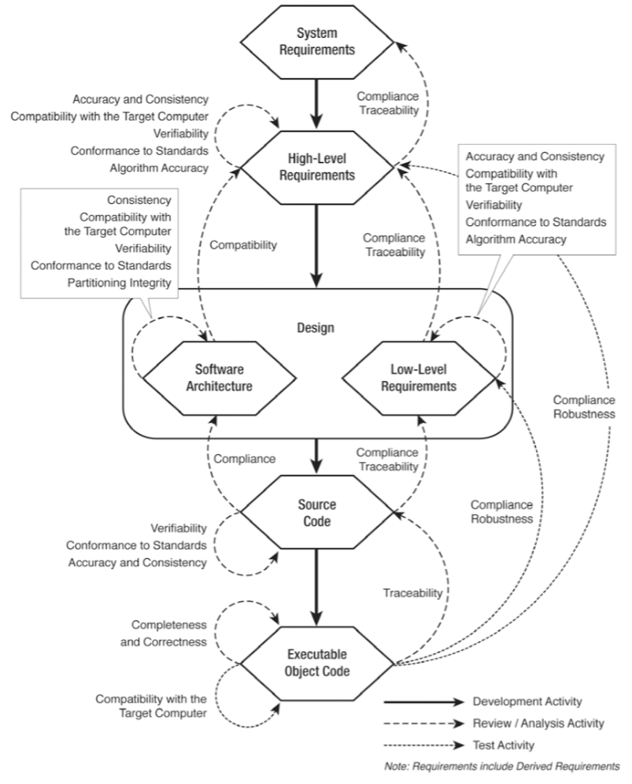
DO-333, Figure FM.6-1 Level A Software Verification Processes

Slide 22
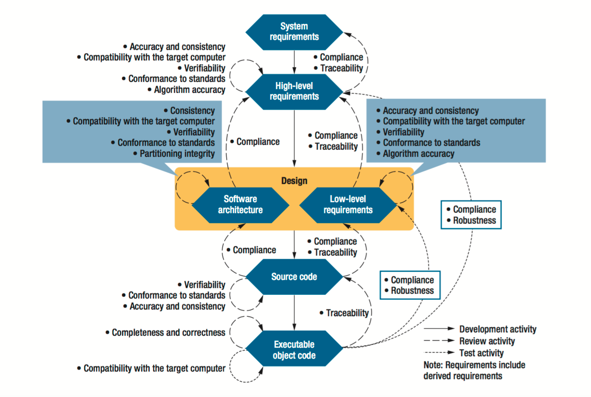
Testing or Formal Verification: DO-178C Alternatives and Industrial, Moy et al., IEEE Software 2013

Slide 24
LLR

Slide 25
For requirements (HLR and LLR), architecture and source code, the use of formal methods is a particular case of analysis. Thus the “only” guidance needed for formal analysis in these cases is the criteria and conditions for the use of formal methods.
LLR
Guidance for Using Formal Methods in a Certification Context, Brown et al., SC-205/WG-71, ERTS 2010

Slide 26
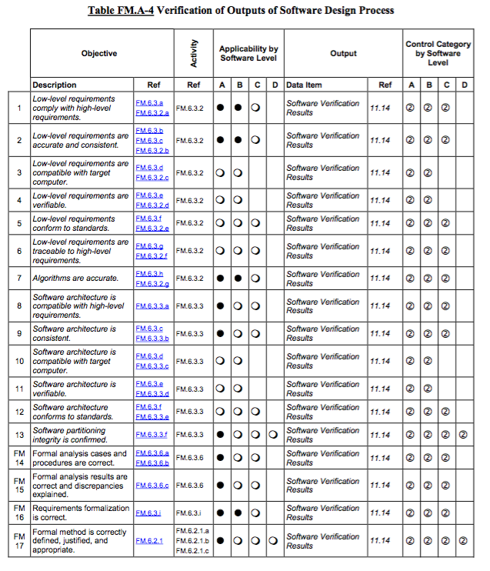
LLR

Slide 27
FM.A-4(2) – LLR are accurate and consistent
LLR
Replaces existing activities
LLR expressed as formal contracts are precise and unambiguous → accuracy is guaranteed
Contrary to axioms, multiple contracts on distinct subprograms cannot conflict → absence of inconsistencies is guaranteed
Consistency of individual contracts can be formally analyzed:
Contract is free from run-time errors
Contract can be expressed by disjoint and complete cases
Guidance for Using Formal Methods in a Certification Context, Brown et al., SC-205/WG-71, ERTS 2010
Notes:
Replaces Reviews and Analyses of Low-Level Requirements 6.3.2(b)

Slide 28
FM.A-4(4) – LLR are verifiable
LLR
Removes existing activities
LLR expressed as formal contracts are verifiable
Guidance for Using Formal Methods in a Certification Context, Brown et al., SC-205/WG-71, ERTS 2010
Notes:
Removes Reviews and Analyses of Low-Level Requirements 6.3.2(d)

Slide 29
FM.A-4(5) – LLR conform to standards
LLR
Replaces existing activities
LLR expressed as formal contracts are checked to be well-defined by formal analysis → conformance to formal language is guaranteed
Restrictions of contracts can be enforced:
Complexity of contract can be bounded (e.g. cyclomatic complexity)
Some notions of completeness of contract can be required (e.g. all inputs and outputs referenced)
Guidance for Using Formal Methods in a Certification Context, Brown et al., SC-205/WG-71, ERTS 2010
Notes:
Replaces Reviews and Analyses of Low-Level Requirements 6.3.2(e)

Slide 30
FM.A-4(16) – LLR formalization is correct
LLR
Replaces and extends existing activities
Review should ensure that informal LLR has been correctly translated into formal contract (when such translation occurred)
Guidance for Using Formal Methods in a Certification Context, Brown et al., SC-205/WG-71, ERTS 2010
Notes:
Replaces and extends Reviews and Analyses of Low-Level Requirements 6.3.2(b)

Slide 31
A.2(3) – Software architecture is developed
Arch
Replaces existing activities
Interfaces between software components, in the form of data flow and control flow, should be defined to be consistent between the components. [5.5.2(d)]
Data dependencies can be specified as formal contracts
Example:
Notes:
Replaces same activity performed by review

Slide 32
SC

Slide 33
For requirements (HLR and LLR), architecture and source code, the use of formal methods is a particular case of analysis. Thus the “only” guidance needed for formal analysis in these cases is the criteria and conditions for the use of formal methods.
SC
Guidance for Using Formal Methods in a Certification Context, Brown et al., SC-205/WG-71, ERTS 2010

Slide 34
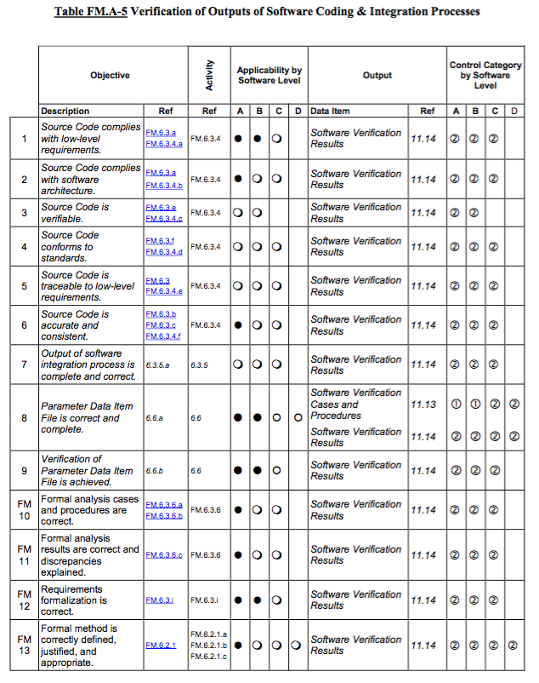
SC

Slide 35
FM.A-5(1) – SC complies with LLR
SC
Automates existing activities
Automatic proof can guarantee that code for subprogram implements its formal contract
Example:
Guidance for Using Formal Methods in a Certification Context, Brown et al., SC-205/WG-71, ERTS 2010
Notes:
Automates Reviews and Analyses of Source Code 6.3.4(a)

Slide 36
FM.A-5(2) – SC complies with software arch.
SC
Automates existing activities
Automatic proof can guarantee that code for subprogram implements specified data dependencies
Example:
Guidance for Using Formal Methods in a Certification Context, Brown et al., SC-205/WG-71, ERTS 2010
Notes:
Automates Reviews and Analyses of Source Code 6.3.4(b)

Slide 37
FM.A-5(3) – SC is verifiable
SC
Removes existing activities
SC formally analyzed is verifiable
Guidance for Using Formal Methods in a Certification Context, Brown et al., SC-205/WG-71, ERTS 2010
Notes:
Removes Reviews and Analyses of Source Code 6.3.4(c)

Slide 38
FM.A-5(4) – SC conforms to standards
SC
Replaces and extends existing activities
SC is checked during formal analysis for conformance to formal subset:
Subset is guaranteed to be free of ambiguities
Compiler-specific or platform-specific features are clearly defined
Unsafe language features are excluded (e.g. side-effects in expressions, interferences through aliasing, pointers)
Other coding standards can be enforced
Guidance for Using Formal Methods in a Certification Context, Brown et al., SC-205/WG-71, ERTS 2010
Notes:
Replaces and extends Reviews and Analyses of Source Code 6.3.4(d)

Slide 39
FM.A-5(5) – SC is traceable to LLR
SC
Automates existing activities
Each subprogram is directly traceable to its formal contract
Automatic proof ensures all formal contracts have been implemented into subprograms
Guidance for Using Formal Methods in a Certification Context, Brown et al., SC-205/WG-71, ERTS 2010
Notes:
Automates Reviews and Analyses of Source Code 6.3.4(e)

Slide 40
FM.A-5(6) – SC is accurate and consistent
SC
Automates existing activities
SC expressed in formal subset is precise and unambiguous → accuracy is guaranteed
Consistency of SC can be formally analyzed:
SC is free from reads of uninitialized data
SC is free from arithmetic overflows
SC is free from run-time errors
SC is free from unused computations (variables, statements, etc.)
Guidance for Using Formal Methods in a Certification Context, Brown et al., SC-205/WG-71, ERTS 2010
Notes:
Automates Reviews and Analyses of Source Code 6.3.4(f)

Slide 41
EOC

Slide 42
For the formal analysis of source code to be used as verification evidence for the target system, verification should be performed to establish property preservation between source and object code.
EOC
Guidance for Using Formal Methods in a Certification Context, Brown et al., SC-205/WG-71, ERTS 2010

Slide 43
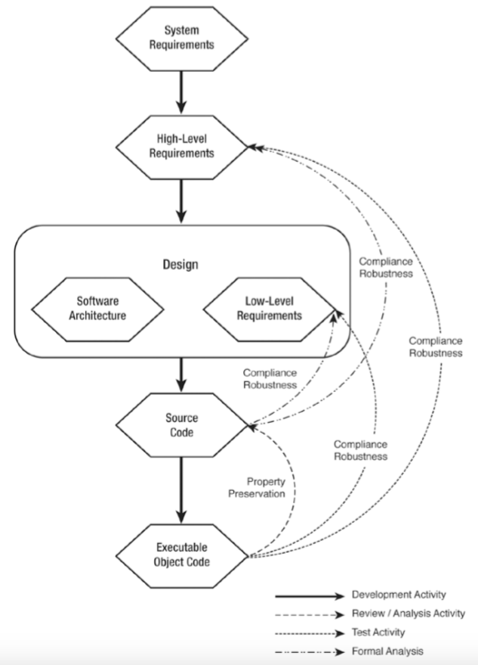
EOC
DO-333, Figure FM.6-2 Possible Verification Paths for Executable
Objects Code with Respect to Source Code and Requirements

Slide 44
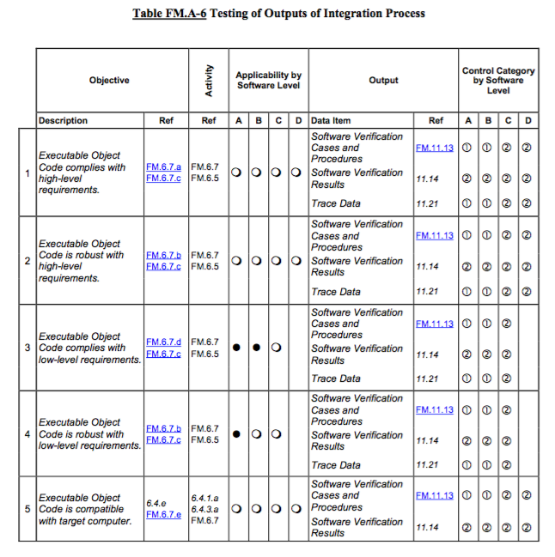
EOC
Notes:
We address here objectives 3 and 4 by relying on the similar activities at SC level, as described in FM.6.7(f(2)) and FM.6.7.1

Slide 45
Property Preservation Between SC and OC
EOC
Replaces existing activities
At Compiler Level | At Project Level
Analysis of OC generated by the compiler ensures property preservation (similar in spirit to source to object traceability study) | Integration tests are performed twice to ensure property preservation: both with and without formal contracts executed
+ only done once + done by compiler vendor - weak confidence | - done for each project once - done by applicant +++ strong confidence
Notes:
Replaces Software Testing 6.4(c,d) by relying on the similar activities at SC level, as described in FM.6.7(f(2)) and FM.6.7.1

Slide 46
FM.6.7.1.1 – Coverage of LLR is achieved
EOC
Replaces existing activities
LLR correctly traced to formal contract
Review ensures compliance of LLR with HLR
Review ensures robustness of LLR
Any deficiencies are addressed
Notes:
Replaces Test Coverage Analysis 6.4.4(b,c)

Slide 47
FM.6.7.1.2 – Complete coverage of each LLR
EOC
Replaces existing activities
Objective: detect missing verification evidence
Formal analysis guarantees complete coverage of formal contract
All assumptions need to be described and justified
Testing or Formal Verification: DO-178C Alternatives and Industrial, Moy et al., IEEE Software 2013
Notes:
Replaces Test Coverage Analysis 6.4.4(b,c)

Slide 48
FM.6.7.1.3 – Completeness of the set of LLR
EOC
Replaces existing activities
Objective: detect missing or incomplete requirements
Need to ensure all requirements have been expressed:
For all input conditions, the required output has been specified
For all outputs, the required input conditions have been specified
For (1) specification by disjoint and complete cases is enough
For (2) analysis can detect missing inputs or outputs in specifications, completed by review
Testing or Formal Verification: DO-178C Alternatives and Industrial, Moy et al., IEEE Software 2013
Notes:
Replaces Test Coverage Analysis 6.4.4(b,c)

Slide 49
FM.6.7.1.4 – Unintended dataflow relations
EOC
Replaces existing activities
Objective: detect unintended dataflows
Demonstrate absence of unintended dependencies between inputs and outputs (whether specified inputs/outputs or not)
Formal contracts can be used in SPARK or Frama-C to specify dataflows
SPARK or Frama-C tools can perform automatic analysis
Testing or Formal Verification: DO-178C Alternatives and Industrial, Moy et al., IEEE Software 2013
Notes:
Replaces Test Coverage Analysis 6.4.4(b,c)

Slide 50
FM.6.7.1.5 – Extraneous code
EOC
Replaces existing activities
Objective: detect code that does not correspond to a requirement
Two kinds of extraneous code:
“dead code” is present by error and unreachable
“unintended functionality” can be executed
Less problems with (1), can be addressed by statement coverage of integration testing + review of uncovered code
For (2) review can complete formal analysis and other objectives to give enough confidence of absence of unintended functionality
Testing or Formal Verification: DO-178C Alternatives and Industrial, Moy et al., IEEE Software 2013
Notes:
Replaces Test Coverage Analysis 6.4.4(b,c)

Slide 51
Formal analysis can be used to satisfy many of the verification objectives, completely in some cases and only partly in others. In this last case, the verification plan should describe how the combination of formal analysis and other methods satisfies the objective completely.
DO-333 FM.6.1

Slide 52
Test vs. Proof
Test | Proof
- only partial verification | + exhaustive verification
- as good as test oracle | - only if requirement (LLR or HLR) can be expressed formally
+ verifies both SC and EOC | - only applicable to SC
+ can be applied on final executable | - relies on assumptions

Slide 53
Unit Test vs. Unit Proof for LLR
Test | Proof
- only partial verification | + exhaustive verification
- as good as test oracle | - only if LLR can be expressed formally (more likely than HLR)
- test harness or stubbing or instrumentation does not allow unit test to apply to final EOC | + only applicable to SC, which is ok in verification of LLR
- cannot be applied on final executable | - relies on mostly local assumptions

Slide 54
Unit Test and Unit Proof for LLR
LLR expressed as executable contracts have a dual interpretation:
Oracles for unit test
Specifications for unit proof
If the same semantics is used in execution and proof, contract can become boundary in combination of test and proof
Tested calls proved → Enable preconditions during tests
Proved calls tested → Enable postconditions during tests
Complete contract goes beyond preconditions and postconditions
Integrating Formal Program Verification with Testing, Comar et al., ERTS 2012

Slide 55
Need for Explicit Assumption Management
Complete requirement on caller:
Precondition satisfied
All inputs initialized
No unintended aliasing causing interferences
…
Complete requirement on callee:
Postcondition satisfied
All outputs initialized
Only specified outputs are modified
Subprogram terminates
…
Explicit Assumptions - A Prenup for Marrying Static and Dynamic Program Verification, Kanig et al., TAP 2014

Slide 56
Any tool that supports the formal analysis should be assessed under the tool qualification guidance required by DO-178 and qualified where necessary.
DO-333 FM.B.1.3.2

Slide 57
Tool Qualification Strategy
Formal analysis tool should be qualified at level TQL-4:
Allows the satisfaction of multiple objectives with one activity
Increases the confidence as expected when adopting new technology
Previous experience in Airbus qualifying Caveat as a verification tool for DO-178B, to achieve unit proof in replacement of unit test [FM.B.1.5.1]
SPARK qualification planned for 2018

Slide 58
Tool Architecture
SPARK 2014 Toolset
Included Automatic Provers
Ada Files
GNAT Frontend
Why3
Alt-Ergo
CVC4
CodePeer Static Analysis
Z3
3rd Party Automatic Provers
3rd Party Manual Provers
Yices
Coq
Gappa
Isabelle/HOL

Slide 59
Bibliography
Are We There Yet? 20 Years of Industrial Theorem Proving with SPARK, Chapman and Schanda, Altran, ITP 2014
DO-333 Certification Case Studies, Cofer and Miller, Rockwell Collins, 2014
Engineering a Sound Assertion Semantics for the Verifying Compiler, Chalin, IEEE TSE 2010
Explicit Assumptions - A Prenup for Marrying Static and Dynamic Program Verification, Kanig et al., TAP 2014
Formal Methods and the Certification of Critical Systems, Rushby, FAA, 1993
Formal Methods for Safe and Secure Computers Systems, Garavel and Graf, BSI, 2013
Formal Verification of Avionics Software Products, Souyris et al., Airbus, FM 2009
Guidance for Using Formal Methods in a Certification Context, Brown et al., SC-205/WG-71, ERTS 2010
Guidelines for the Use of Theorem Proving in the Certification of Critical Systems (draft), workshop on TPC, 2015
Integrating Formal Program Verification with Testing, Comar et al., ERTS 2012
Static versus Dynamic Verification in Why3, Frama-C and SPARK 2014, Marché et al., 2016
Testing or Formal Verification: DO-178C Alternatives and Industrial, Moy et al., IEEE Software 2013

