Slide 1
Abstract Software Specifications
and Automatic Proof of Refinement
Claire Dross and Yannick Moy
RSSRail 2016

Slide 2


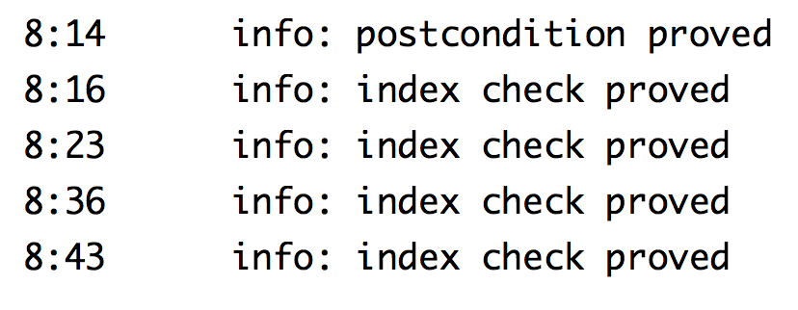
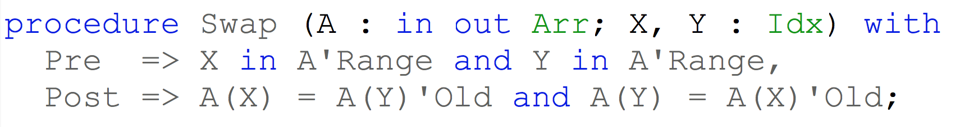

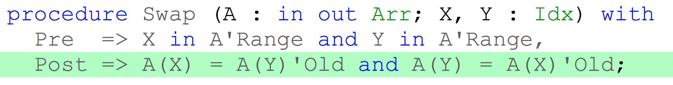
SPARK 2014

Slide 3
Ghost Code in SPARK 2014
^{contracts}
ghost
functions
with assertions
+
^{code}
compile
^{executable}
used in formal + test

Slide 4
Ghost Code in SPARK 2014
^{contracts}
ghost
functions
with assertions
+
ghost
variables,
types,
procedures
^{code}
compile
^{executable}
used in formal + test

Slide 5
Ghost Code in SPARK 2014
^{contracts}
ghost
functions
with assertions
+
ghost
variables,
types,
procedures
^{code}
compile
^{executable}
removed in final build

Slide 6
Container Library in SPARK 2014
Functional Containers
Sequence
Set
Map
Standard Imperative Containers
CONTRACTS
List
Vector
Set
Map
User Code
DATA
STRUCTURES
CONTRACTS

