Slide 1


Mostly harmless – luring programmers into proof with SPARK
Yannick Moy – AdaCore

Slide 2
SPARK – the language
strong typing
low level programming
generics
object orientation
concurrency
Abstract_State
Initializes
Initial_Condition
Contract_Cases
Global
Depends
pointers
exception handlers
controlled types
function with effects
Ada
features outside
the SPARK subset
Core language constructs common to Ada and SPARK
Additional SPARK aspects
Ada
SPARK

Slide 3
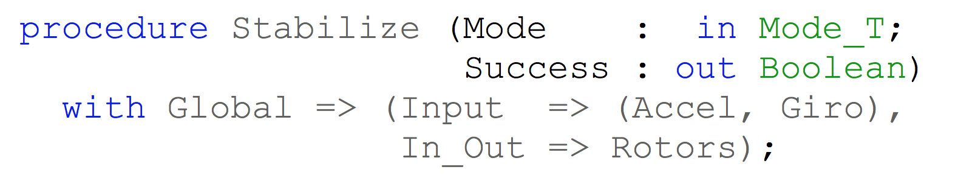
SPARK – flow analysis
Specification of effects
Flow analysis
Program implements specification

Slide 4
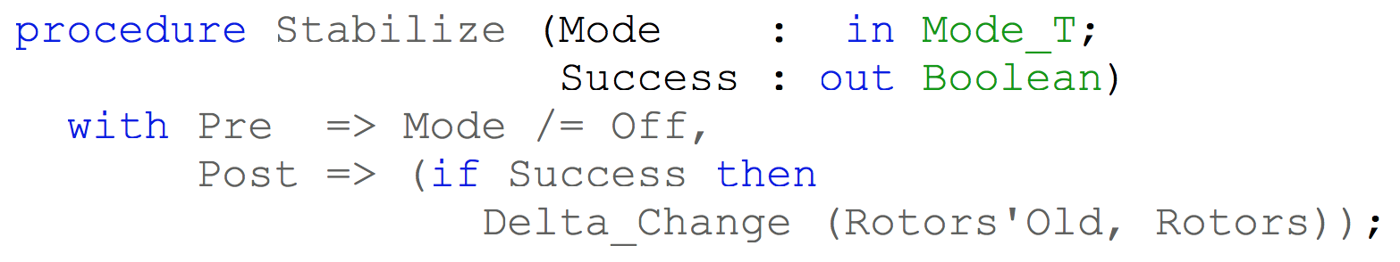
SPARK – proof
Specification of properties
Proof
Program implements specification

Slide 5
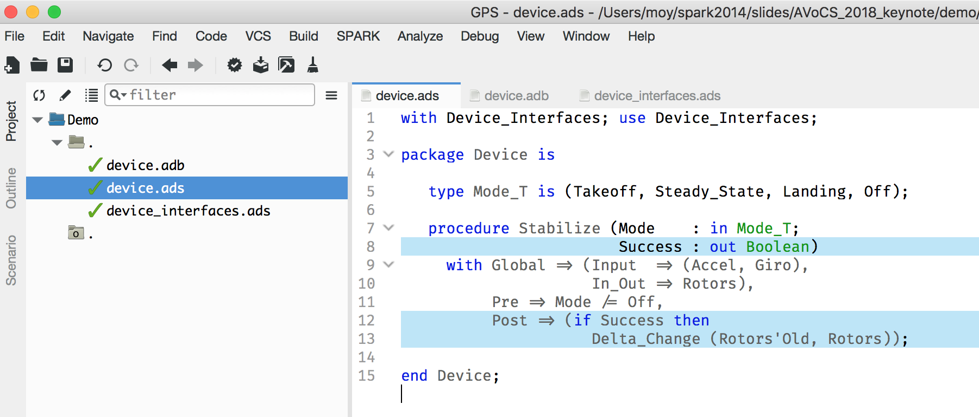
SPARK – demo

Slide 6
How to investigate unproved properties?

Slide 7
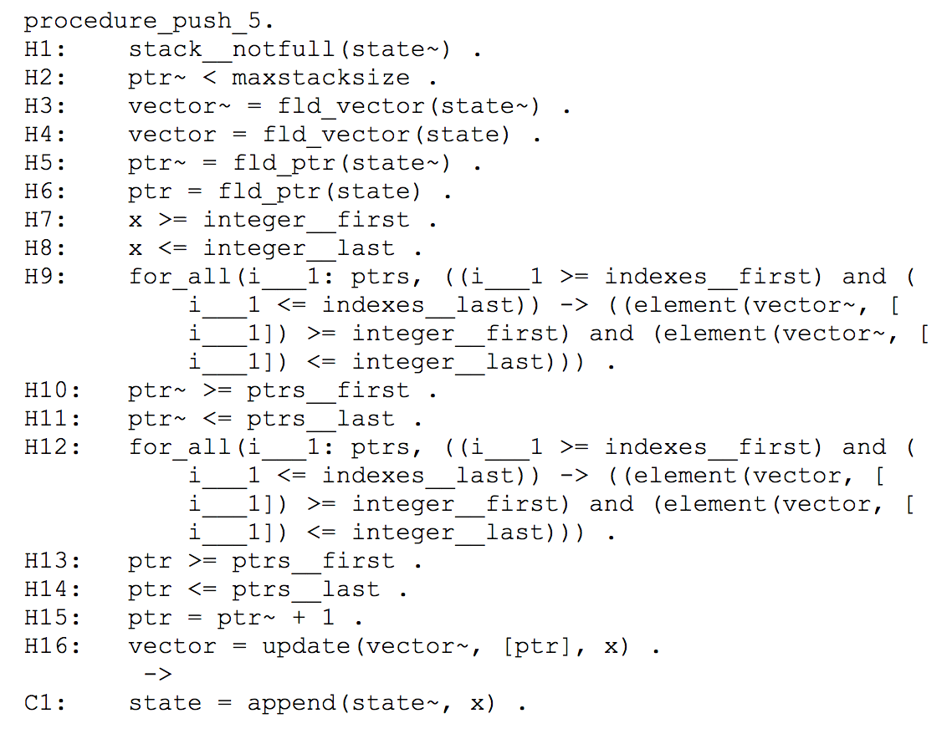

Back to 2008…
This requires Sherlock Homes-like observational skills.
Verification Condition
in SPARK 2005

Slide 8

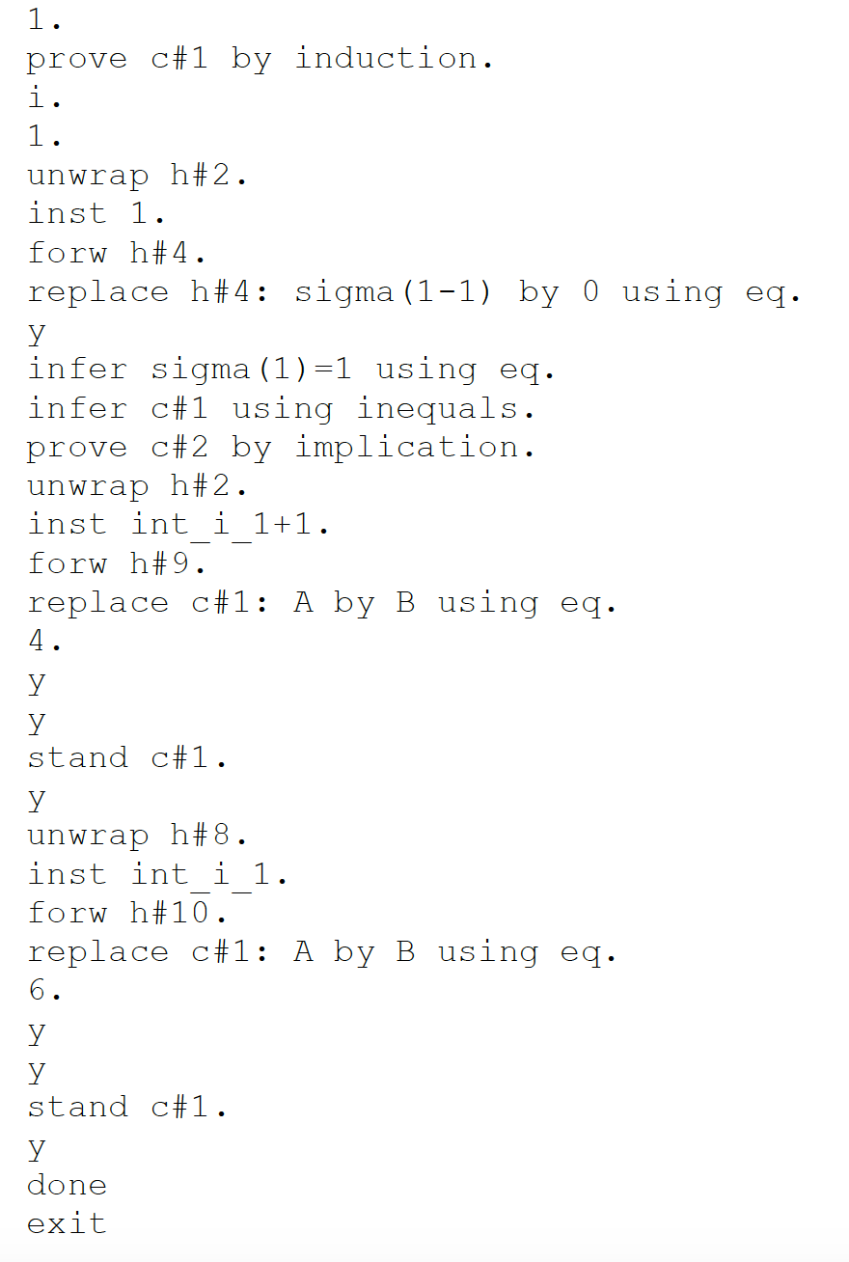
Back to 2008…
This is Vogon poetry to most developers.
Verification Condition
in SPARK 2005
Manual Proof
in SPARK 2005

Slide 9
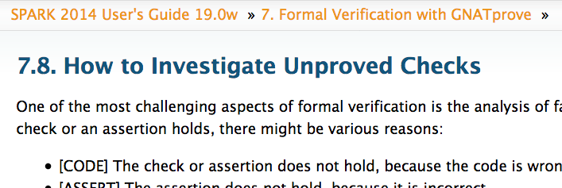
And now 10 years later…
Detailed process for finding root cause of unproved property:
Code is incorrect
Specification is incorrect
Specification is missing/incomplete
Limitation of the program model used in proof
Prover timeouts
Prover is not smart enough

Slide 10
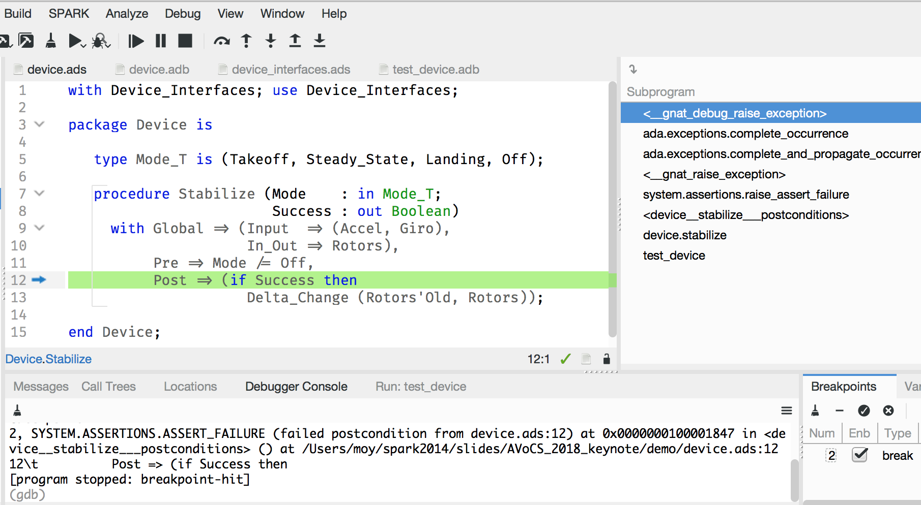
Investigating incorrect code or specification
Code and specification can be executed in tests
Failures can be investigated using debugging tools

Slide 11
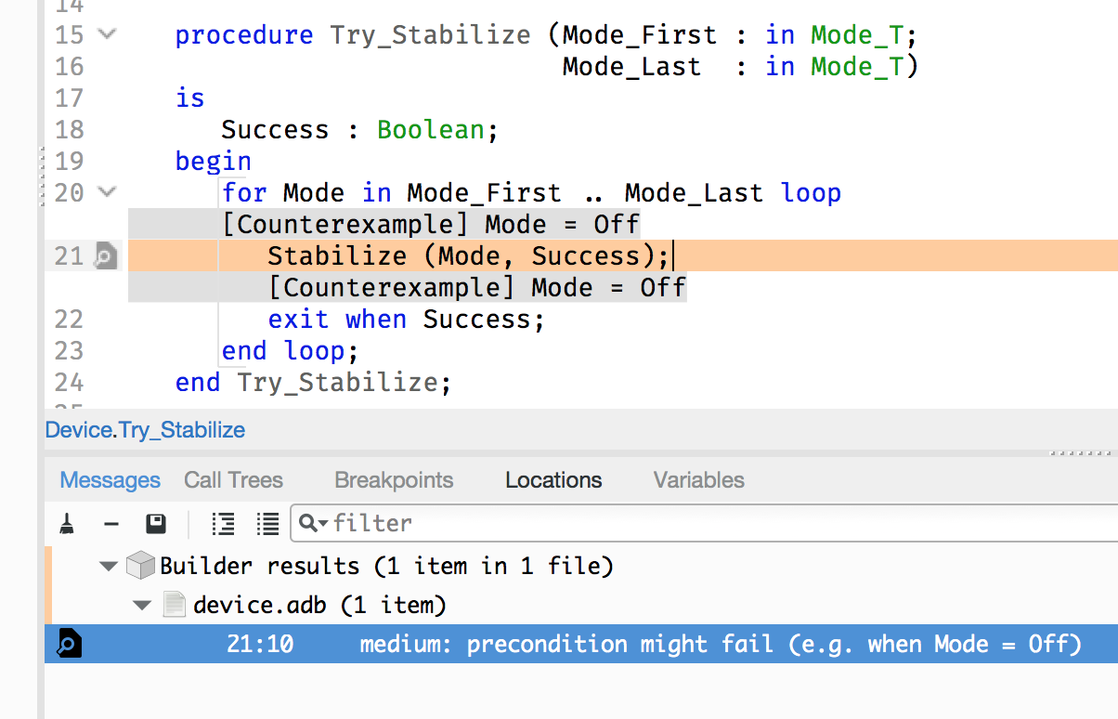
Investigating missing/incomplete specification
Counterexample trace gives values leading to error
Message contains values from the counterexample

Slide 12
Typical missing/incomplete specifications
Proof is modular at subprogram level
precondition of the subprogram is too weak
postcondition of a called subprogram is too weak
Proof is inductive over loops
loop invariant is missing
loop invariant is too weak to prove the property
loop invariant is not inductive

Slide 13
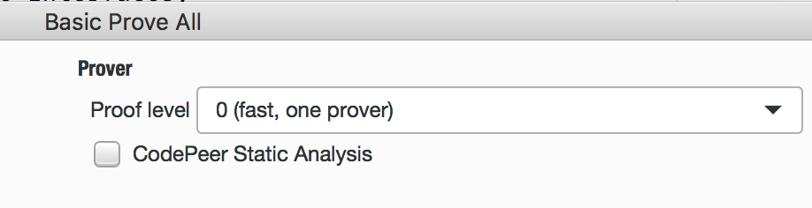
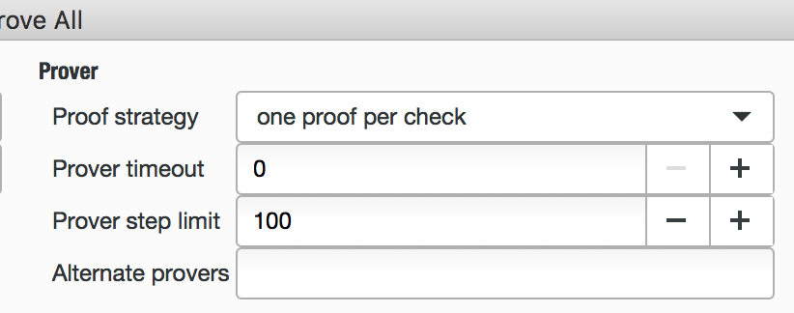
Investigating prover shortcomings
Proof level from 0 to 4 to increase proof effort
Use static analysis for float programs
Lower-level switches to change provers, timeout, step limit, strategy

Slide 14
Typical prover shortcomings
Complex proof context
intermediate assertions repeat the desired property
No one prover can prove the complete property
intermediate assertions decompose the desired property
Non-linear integer/float arithmetic and mixed integer-float arithmetic
static analysis can bound values
intermediate assertions split issues: bitvectors / integers / quantifiers

Slide 15
How to prove properties despite prover shortcomings?

Slide 16


Guide the Proof Tool
Intermediate assertions can help the tool.
pragma Assert (Intermediate_Assertion_1);
pragma Assert (Intermediate_Assertion_2);
pragma Assert (Complex_Assertion);

Slide 17




Ghost Code – General Definition
Ghost code does not affect normal execution of a program.
It is used to monitor execution (can terminate the program).
Example: assertions in code / subprogram contracts
Regular Code
pragma Assert (X /= 0); -- Runtime exception: raised Assert_Failure – failed assertion procedure Increment(X : in out Integer) with Pre => X < Integer’Last, Post => X = X’Old + 1; Increment (X); -- Runtime exception: raised Assert_Failure – failed precondition
Ghost Code
Notes:
Ghost code is a feature available in most languages allowing program proof. It allows to write code which does not affect normal execution of the program. If ghost code is removed by hand, the program will still have the same expected behavior. It is used as instrumentation to monitor the execution, and cause abortion in case of unexpected behavior.

Slide 18
Ghost Code in SPARK
In SPARK, all entities (variables, subprograms, types…) can be ghost.
The compiler detects most incorrect usage.
procedure Do_Something (X : in out T) is X_Init : constant T := X with Ghost; begin Do_Some_Complex_Stuff (X); pragma Assert (Transformation_Is_Correct (X_Init, X)); -- It is OK to use X_Init inside an assertion.
procedure Do_Something (X : in out T) is X_Init : constant T := X with Ghost; begin Do_Some_Complex_Stuff (X); pragma Assert (Transformation_Is_Correct (X_Init, X)); -- It is OK to use X_Init inside an assertion. X := X_Init; -- Compilation error: -- Ghost entity cannot appear in this context.

Slide 19
Ghost Code in SPARK – Execution
Ghost code can be executed like normal code …
… or can be removed at compilation.
Regular Code
Compilation with assertions enabled
Ghost Code
Compilation without assertions

Slide 20


Ghost Code in SPARK – Verification
Static verification applies to regular code + ghost code.
SPARK also verifies that ghost does not affect regular code.
$→$ Regular code is verified.
Regular Code
Regular Code
Ghost Code

Slide 21
Guide the Proof Tool – Provide Witnesses
Proving an existential quantifier is difficult for provers.
A witness can be constructed and provided.
…
0 |  | 0 | 5 |  | 9
function Find_Pos (A : Nat_Array) return Positive with Ghost, Pre => A (A’First) = 0 and then A (A’Last) > 0, Post => Find_Pos’Result in A’First .. A’Last - 1 and then A (Find_Pos’Result) = 0 and then A (Find_Pos’Result + 1) > 0; pragma Assert (A (A’First) = 0 and then A (A’Last) > 0); pragma Assert (Find_Pos (A) in A’Range); pragma Assert (for some I in A’Range => I < A’Last and then A (I) = 0 and then A (I + 1) > 0);
pragma Assert (A (A’First) = 0 and then A (A’Last) > 0); pragma Assert (for some I in A’Range => I < A’Last and then A (I) = 0 and then A (I + 1) > 0);

Slide 22
Guide the Proof Tool – Proof by Induction
>
>
Provers mostly can’t perform induction.
Loop invariants allow to perform induction.
>
>
1 | 3 | 4 | 6 | 9
>
>
>
>
procedure Prove_Sorted (A : Nat_Array) with Ghost is begin for K in 0 .. A’Length loop pragma Loop_Invariant (for all I in A’Range => (for all J in A’Range => (if I > J and then I - J <= K then A (I) > A (J)))); end loop; pragma Assert (for all I in A'Range => (for all J in A'Range => (if I > J then A (I) > A (J)))); end Prove_Sorted;
pragma Assert (for all I in A'Range => (if I > A'First then A (I) > A (I - 1))); pragma Assert (for all I in A'Range => (for all J in A'Range => (if I > J then A (I) > A (J))));

Slide 23
Guide the Proof Tool – Lemmas
Procedures for lemmas have a contract but no effects.
They must be called manually to assume the lemma.
A lemma library is provided with SPARK for classical lemmas.
procedure Prove_Sorted (A : Nat_Array) with Ghost, Pre => (for all I in A’Range => (if I > A’First then A (I) > A (I - 1))), Post => (for all I in A’Range => (for all J in A’Range => (if I > J then A (I) > A (J))));
pragma Assert (for all I in A’Range => (if I > A’First then A (I) > A (I - 1))); Prove_Sorted (A); -- Precondition of Prove_Sorted is proved pragma Assert (for all I in A’Range => (for all J in A’Range => (if I > J then A (I) > A (J))));
procedure Lemma_Div_Is_Monotonic (Val1 : Int; Val2 : Int; Denom : Pos) with Ghost, Pre => Val1 <= Val2, Post => Val1 / Denom <= Val2 / Denom; -- Proven manually using Coq

Slide 24
How to specify properties not visible in the code?

Slide 25
Specification-Only Functions
Ghost functions are used to factor out expressions in contracts.
They can disclose state abstractions for specification purposes.
Inefficient is OK if assertions are disabled in the final executable.
function Sort (A : in out Nat_Array) with Post => Is_Sorted (A) and then Is_Permutation (A, A’Old); function Is_Sorted (A : Nat_Array) return Boolean is (for all I in A’Range => (if I > A’First then A (I) >= A (I – 1))) with Ghost; function Search (A : Nat_Array; E : Natural) return Index with Pre => Is_Sorted (A);
package Private_Counter is function Disclose_Content return Natural with Ghost; function Is_Max return Boolean with Post => Is_Max’Result = (Disclose_Content = Max); procedure Incr with Pre => not Is_Max; Post => Disclose_Content = Disclose_Content’Old + 1; private Counter_Value : Natural := 0; end Private_Counter;
function Occurrences (A : Nat_Array; E : Natural) return Natural; function Is_Permutation (A, B : Nat_Array) return Boolean is (for all E in Natural => Occurrences (A, E) = Occurrences (B, E)) with Ghost;
Notes:
Ghost functions can be used to factor out expression is contracts

Slide 26
Specification-Only Data
Ghost variables can be used to store intermediate values of variables.
Some properties are best expressed by constructing a witness.
Ghost variables can also store interprocedural information.
X_Interm : T with Ghost; procedure Do_Two_Thing (X : in out T) with Post => First_Thing_Done (X’Old, X_Interm) and then Second_Thing_Done (X_Interm, X) is X_Init : constant T := X with Ghost; begin Do_Something (X); pragma Assert (First_Thing_Done (X_Init, X)); X_Interm := X; Do_Something_Else (X); pragma Assert (Second_Thing_Done (X_Interm, X)); end Do_Two_Things;
Perm : Permutation with Ghost; procedure Perm_Sort (A : Nat_Array) with Post => A = Apply_Perm (Perm, A’Old) is begin Perm := Identity_Perm; for Current in A'First .. A'Last - 1 loop Smallest := Index_Of_Minimum (A, Current, A'Last); if Smallest /= Current then Swap (A, Current, Smallest); Permute (Perm, Current, Smallest); end if;
History : Buffer_Of_Bool (1 .. 2) with Ghost; procedure Count_To_Three (Is_Third : out Boolean) with Post => Is_Third = (not Last_Value (History’Old) and then not Before_Last_Value (History’Old)) and then History = Enqueue (History’Old, Is_Third);

Slide 27
Models of Control Flow
Ghost variable can also model interprocedural control flow.
More generally, expected control flow can be expressed as an automaton.
An invariant can link the ghost and regular states.
Last_Accessed_Is_A : Boolean := False with Ghost; procedure Access_A with Post => Last_Accessed_Is_A; procedure Access_B with Pre => Last_Accessed_Is_A, Post => not Last_Accessed_Is_A;
type State_Kind is (S1, S2, S3) with Ghost; State : State_Kind := S1 with Ghost; procedure Access_A with Pre => State in S1 | S3, Contract_Cases => (State = S1 => State = S2, State = S3 => State = S3); procedure Access_B with Pre => State in S2 | S3, Post => State = S3;
A
type Mailbox_Status_Kind is (Empty, Full) with Ghost; Mailbox_Status : Mailbox_Status_Kind := Empty with Ghost; function Invariant return Boolean is (if Mailbox_Status = Full then Valid (Message_Content)) with Ghost; procedure Receive with Pre => Invariant and then Mailbox_Status = Full, Post => Invariant and then Mailbox_Status = Empty;
A
B
S1
S2
S3
B

Slide 28
Models of Data Structures
A model is an alternative view of a data structure.
They are typically simpler and less efficient.
They can be stored in global variables or computed through a function.
A ring buffer
Its model : an array
type Buffer_Type is record …; subtype Model_Type is Nat_Array with Ghost; function Get_Model (B : Buffer_Type) return Model_Type with Ghost; procedure Enqueue (B : Buffer_Type, E : Natural) with Post => Get_Model (B) = E & Get_Model (B)’Old (1 .. Max – 1);
Buffer_Content : Nat_Array; Buffer_Top : Natural; Buffer_Model : Nat_Array with Ghost; procedure Enqueue (E : Natural) with Post => Buffer_Model = E & Buffer_Model’Old (1 .. Max – 1);

Slide 29
How to prove properties that provers can’t prove?

Slide 30
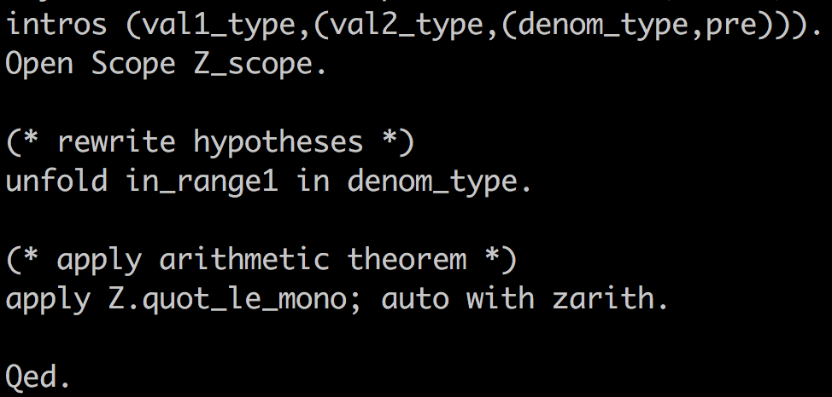
Use Coq or Isabelle
Proof in Coq that operator div over integers is monotonic

Slide 31
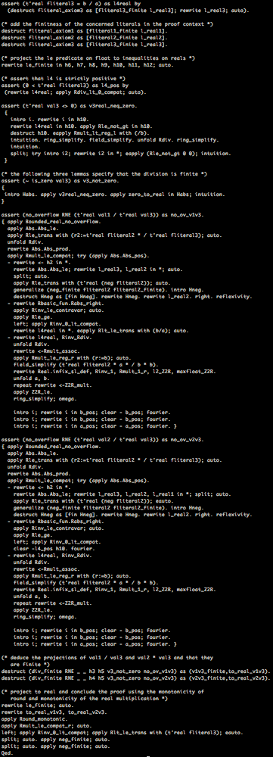
Use Coq or Isabelle
Proof in Coq that operator div over floats is monotonic
More Vogon poetry for developers.

Slide 32
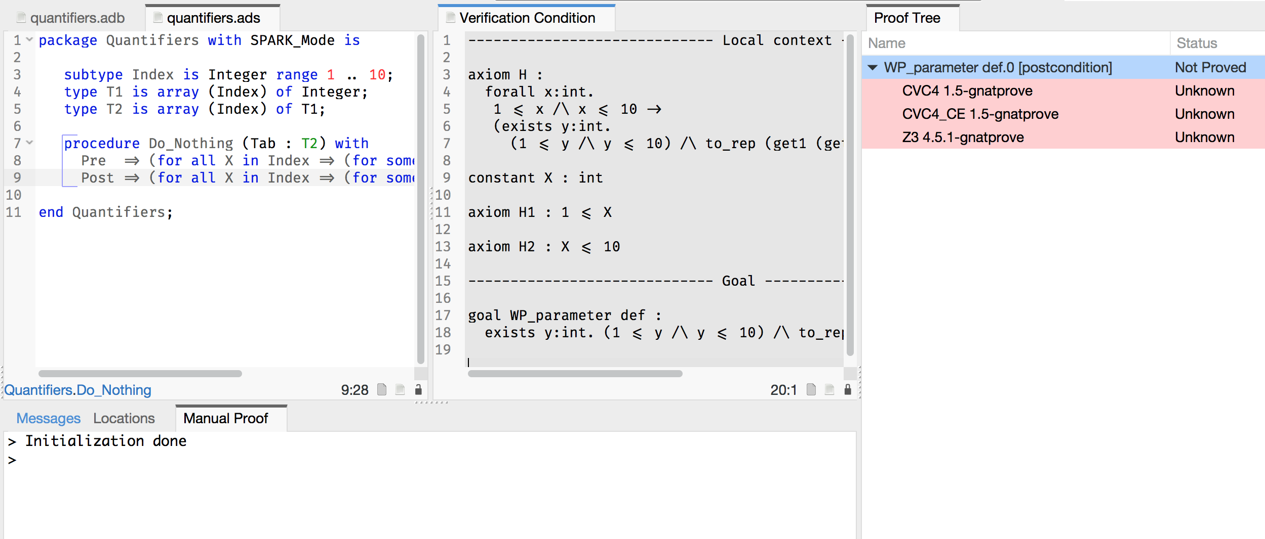
Or use manual proof inside IDE

Slide 33
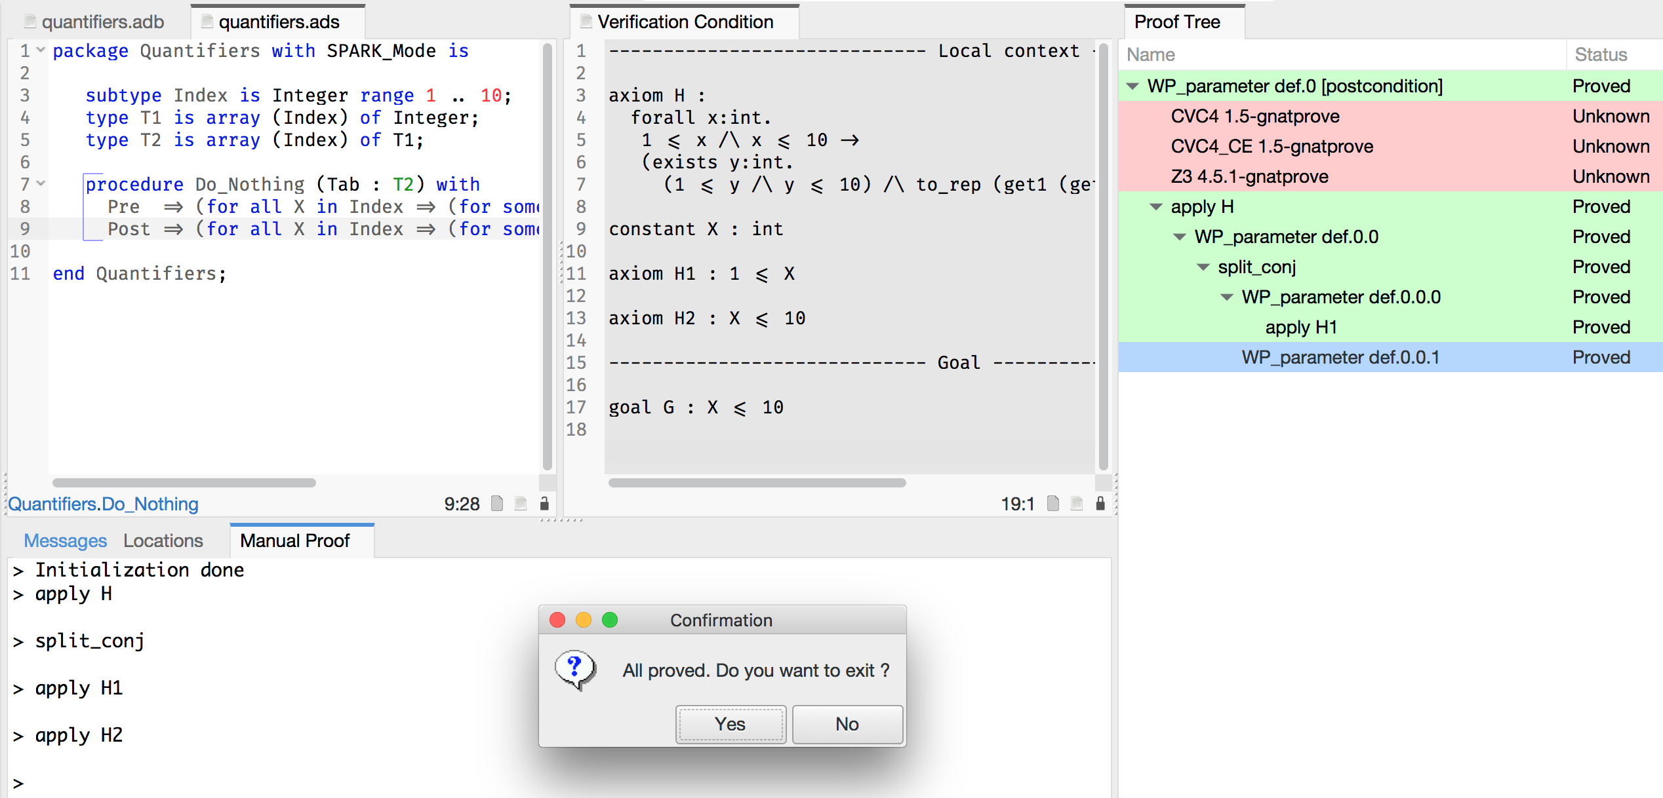
Or use manual proof inside IDE

Slide 34
So if everything does not prove…

Slide 35


Slide 36
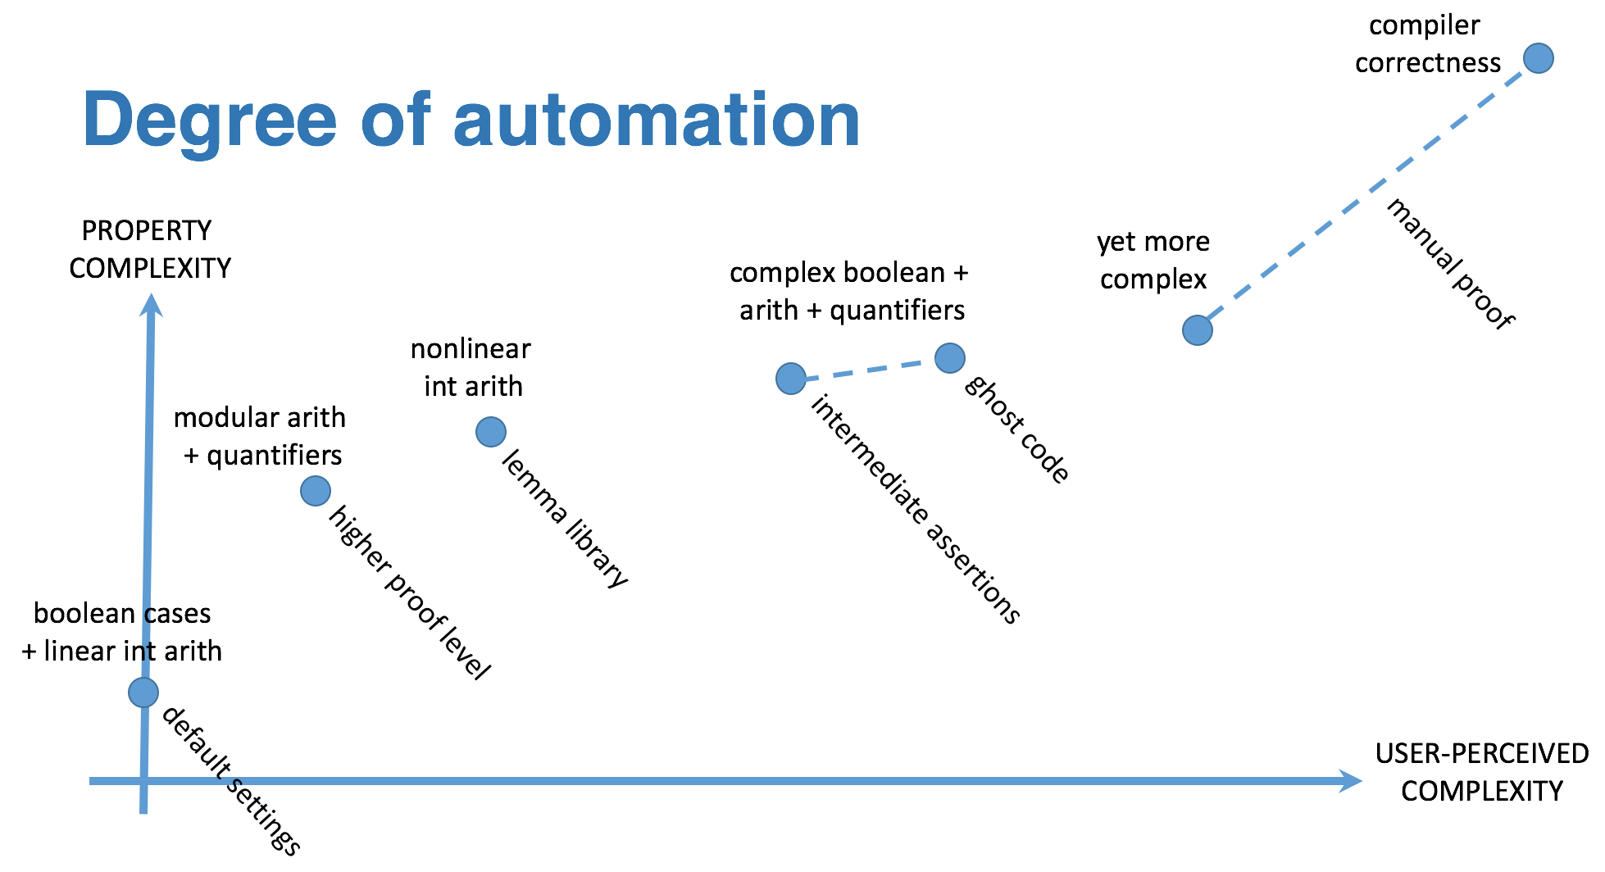

Slide 37
But what if you have a loop?!?

Slide 39
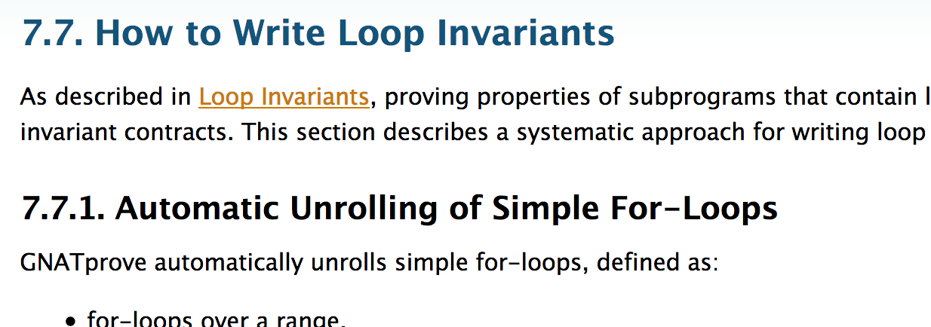
Loops and loop invariants
Path before the loop invariant
Loop rewritten in normal form
Path from/to the loop invariant
Stmt1; loop Stmt2; exit when Cond; Stmt3; end loop; Stmt4;
Smt1
Smt2 + Cond + Smt4
Smt2 + not Cond + Smt3
Path exiting the loop

Slide 40
Loop invariants – fun facts!
Only source of information in the tool about some variables:
Information about modifications of variables by previous iterations of the loop is lost
The tool knows only about values of unmodified variables
And about the loop’s range or condition if any
No information about constants is accumulated

Slide 41
The 4 properties of a good loop invariant
[INIT] | It should be provable in the first iteration of the loop
[INSIDE] | It should allow proving absence of run-time errors and local assertions inside the loop
[AFTER] | It should allow proving absence of run-time errors, local assertions and the subprogram postcondition after the loop
[PRESERVE] | It should be provable after the first iteration of the loop

Slide 42
If you want to know more…

Slide 43
