Slide 1
Challenges of Program Verification with SPARK
Yannick Moy
CP Meets Verification 2016

Slide 2
SPARK 2014

Slide 3
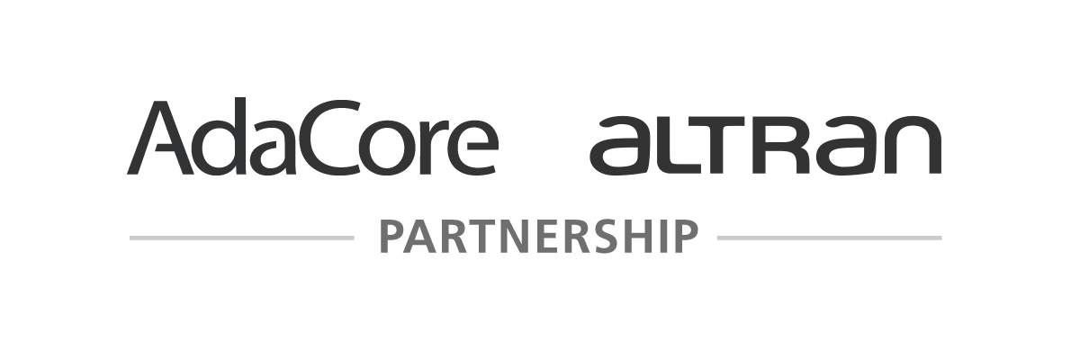
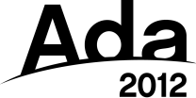
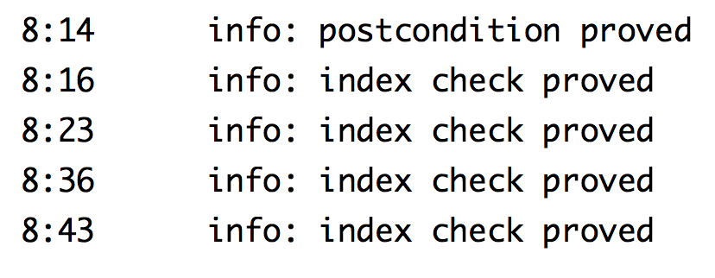
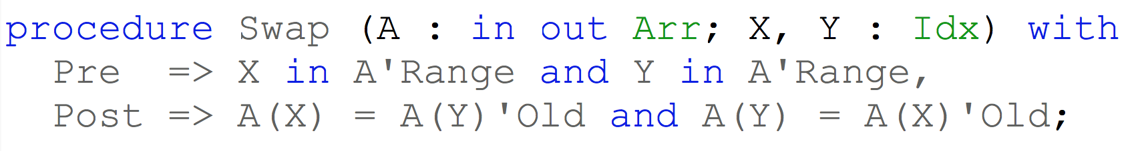
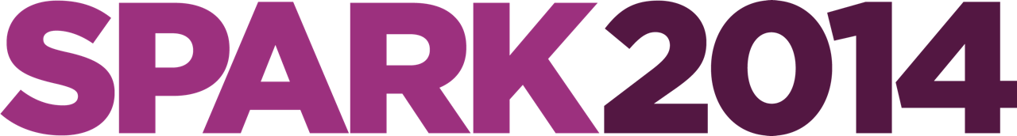
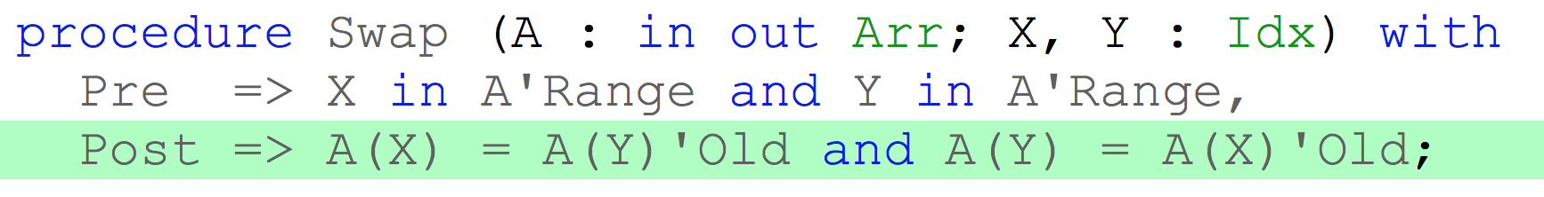
SPARK 2014

Slide 4
Objectives of Using SPARK
Safe coding standard for critical software
Prove absence of run-time errors (AoRTE)
Prove correct integration between components
Prove functional correctness
Ensure correct behavior of parameterized software
Safe optimization of run-time checks
Address data and control coupling
Ensure portability of programs
{
PROOF

Slide 5
Automatic Proof Using SMT Provers
Three provers shipped with SPARK: Alt-Ergo, CVC4, Z3
All three are SMT provers supporting first order logic (axioms).
Many other provers (SMT or not) can be used through Why3 bridge.
Strengths of SMT provers:
Good handling of arithmetic (integers, bitvectors, reals, ≈ floats)
Good handling of axioms
Reasonably fast
Agreed semantics between all provers (SMTLIB)
But some challenges too…

Slide 6
Challenges

Slide 7
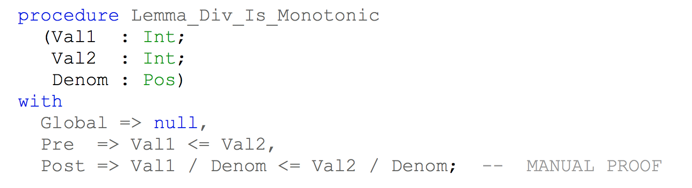
Nonlinear Integer Arithmetic
Many properties combining / * ** mod rem are not proved by SMT provers.
Current solution in SPARK: use a library of predefined lemmas
A lemma is a ghost procedure (= no visible effect, removed by compiler) with a postcondition (the lemma) and possibly a precondition (the conditions for applying the lemma).
Each lemma is generic in the argument/result type.
Each lemma is instantiated for 32 bits and 64 bits integers (either signed or modular).
Each instantiation is proved using SMT provers and Coq.
Users can call lemmas in their code to get properties for free.
For example:

Slide 8
Floating-point Arithmetic
Most properties involving floating-point values are not proved by SMT provers.
Current solution in SPARK: mix abstract interpretation and proof
Types in SPARK provide bounds of variables and record/array components.
Simple interval analysis based on types proves most bounds are preserved.
Abstract interpretation handles more complex cases of relations to prove safe bounds.
Axiomatization is used to encode floats for SMT provers.
Many axioms are needed:
Difference between real value X and rounding of value bounded by ε1 . X + ε2
Every single precision float is a double precision float.
Monotonicity of rounding.
…
Current attempt to use the support for floats → overall less precise
Z3 float support quite precise
But change from (real + rounding) to (float + axioms) loses proofs for Alt-Ergo and CVC4.

Slide 9
Conversions Between Types
Properties involving conversions between types are not proved by SMT provers:
integers ⟷ bitvectors
integers ⟷ reals (with rounding)
integers ⟷ floats
Current solution in SPARK: avoid conversions as much as possible
Float literals are replaced by integral part + fractional part.
Translation of integer literals into integer or bitvector is context sensitive.
This is facilitated by the strong typing in SPARK which requires explicit conversions.
No need to consider reals in SPARK. But useful to consider integers (unbounded version) which can be used in specifications.
Attempt to use only integers → cannot handle bitwise/modulo operations
Attempt to use only bitvectors → less precise on computation of bounds

Slide 10
Handling of Quantifiers
Quantified axioms are essential to:
Encode the semantics of the language types.
Encode user-defined contracts of subprograms.
Encode user-defined properties over collections.
Quantifier instantiation in SMT solvers based on:
Syntax-directed instantiation (triggers)
Value-directed instantiation (models)
Mixing quantifiers and theories (arithmetic in particular) lead sometimes to surprising results…
Current solution in SPARK: use no / simple quantifiers when possible
Use types integer/bitvector whenever possible (instead of axiomatized abstract type)
Split variables to get frame condition for free (instead of using quantification)
Use triggers to force direction of instantiation (for definitions)

Slide 11
Roadmap

Slide 12
Better Automatic Provers
Objective of project SOPRANO (2014 – 2019) between AdaCore, CEA, Inria, OCamlPro, Université Paris-Sud, Université Rennes 1:
Integration of CP and SMT in Popop (developed at CEA).
Support for floats in Alt-Ergo (developed at OCamlPro).
Experiments with use of Gappa (from Inria) and Colibri (CP solver from CEA).
Goals:
Handle well floating-point arithmetic.
Deal with conversions between types.
Handle better nonlinear integer arithmetic.
… while preserving the good quantifier instantiation of SMT provers.
Objective of joint labo ProofInUse (2014 – 2017) between AdaCore and Inria.
Goals:
Use support for bitvectors (done) and floats in SMT provers.
Generate counterexamples from SMT provers when possible (done).

Slide 13
Better Interactive Provers
Objective of joint lab ProofInUse (2014 – 2017) between AdaCore and Inria.
Goals:
Support auto-active proof method (done).
Support manual proof guidance at source code level.

Slide 14
Conclusion

Slide 15
Better Integration of Automatic and Interactive Provers
compiler
correctness
PROPERTY
COMPLEXITY
yet more
complex
complex boolean +
arith + quantifiers
nonlinear
int arith
manual proof
modular arith
+ quantifiers
ghost code
lemma library
intermediate assertions
boolean cases
+ linear int arith
higher proof level
default settings
USER-PERCEIVED
COMPLEXITY

Slide 16
SPARK Resources
SPARK toolset
http://libre.adacore.com/
SPARK source code (GPLv3)
https://forge.open-do.org/anonscm/git/spark2014/spark2014.git/
SPARK blog and resources (Reference Manual and User’s Guide)
http://www.spark-2014.org
SPARK online training
http://u.adacore.com

