Slide 1
Writing reliable applications: formal verification and static analysis assets
Yannick Moy
Senior Software Engineer
GNAT Industrial User Day – September 25th, 2013

Slide 2
1994
T
Why use formal analysis?

Slide 3


High-level goals

Slide 4


Formal analysis tools at AdaCore
“static analysis”
First release in 2009
Based on technology developed since 2002
Applicable on any Ada project
Many use cases:
Find bugs
Impact analysis
Code reviews
Race conditions
Robustness verification evidence
“formal verification”
First release in 2010
Based on technology developed since 1983
Development discipline (Ada subset + abstractions) and tools
Used for the core safety/security part of projects:
Check data flows
Guarantee no run-time errors
Functional verification

Slide 5
1994
T
CodePeer vs. SPARK 2014

Slide 6
Use case: run time errors and initialization
Detects most obvious bugs and problems
Reduce amount of manual analysis
Focus manual analysis on potential problems
Development of code 100% free of run time errors and initialization errors

Slide 7
Use case: functional correctness
Assertions used to help the analyzer
Limited capability to prove complex assertions
Subprogram contracts define a formal specification
Allow 100% automatic proof of functional correctness
Can replace unit testing

Slide 8
Use case: DO-178 certification
Allows to reduce the analysis done for accuracy and consistency, by removing cases of overflow, underflow, uninitialized variables, divisions by zero
Allows to completely cover some aspects of accuracy and consistency
Allows to perform data coupling and (will) allow to do control coupling analysis
Allows to replace unit tests by unit proof in the context of Formal Methods supplement
(will) allow to perform formal substitutability analysis in the context of the OOP supplement

Slide 9
In Summary, formal analysis capabilities
Works on all Ada code
For informal analysis, detects obvious bugs and problems
For formal analysis, reduces the amount of run-time errors locations to manually review
Works on the SPARK Ada subset
Requires additional specification
For formal analysis, allows to completely prove absence of runtime errors
For formal analysis, allows to perform proof of correctness

Slide 10
1994
T
SPARK 2014 update

Slide 11
SPARK 2014 vs. SPARK 2005
SPARK 2014 language subset is most of Ada 2012 (no pointers, no exceptions)
SPARK and full Ada code can be combined easily
No contracts are required
Subprogram contracts use Ada 2012 preconditions and postconditions
Functional annotations can be executed, tested and proved
New aspects, pragmas and attributes supported for formal verification (higher-level abstractions, data and information flows, etc.)
SPARK 2014 allows 100% automatic proof

Slide 12
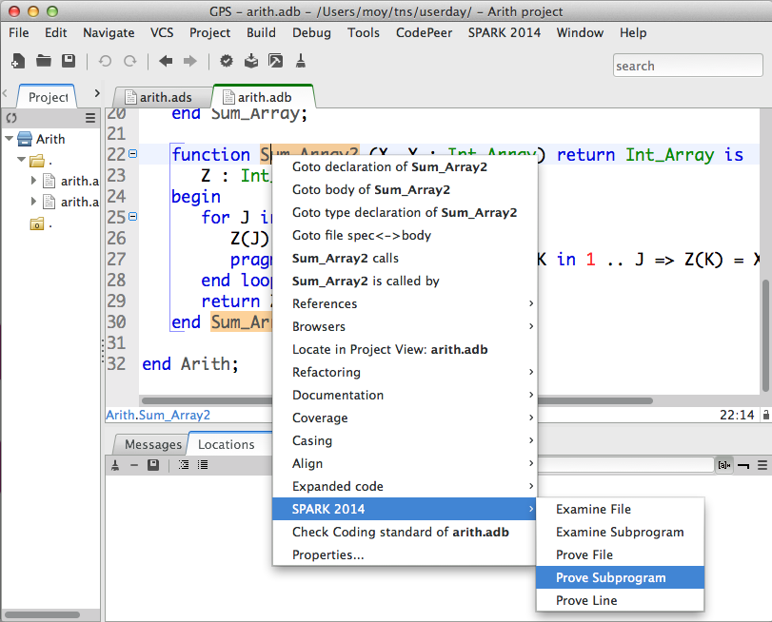
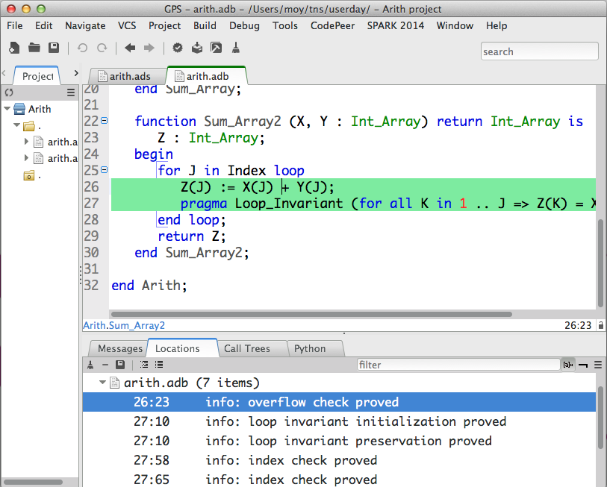
SPARK 2014 integration in GPS and GNATbench
Run on selected piece of code
Results linked to code

Slide 13
Feedback from industrial use
Medium use case from aerospace: 20.000 sloc, 5418 checks
Many Ada features used: generics, discriminant types, floating-points, etc.
Achieves 96% automatic proof (98% for assertions and contracts!)
Astrium assessment: « formal proof techniques did not, up to now, break through in the software industry in general and the space domain in particular […] SPARK 2014 has suppressed these current limitations of formal proof »
Results publicly available:
Project report at
http://www.open-do.org/wp-content/uploads/2013/05/Industrial_Case_Studies_Final_Report.pdf
DASIA conference article at
http://www.open-do.org/wp-content/uploads/2013/05/DASIA_2013.pdf
Article submitted at ERTS conference in Toulouse in February 2014

Slide 14
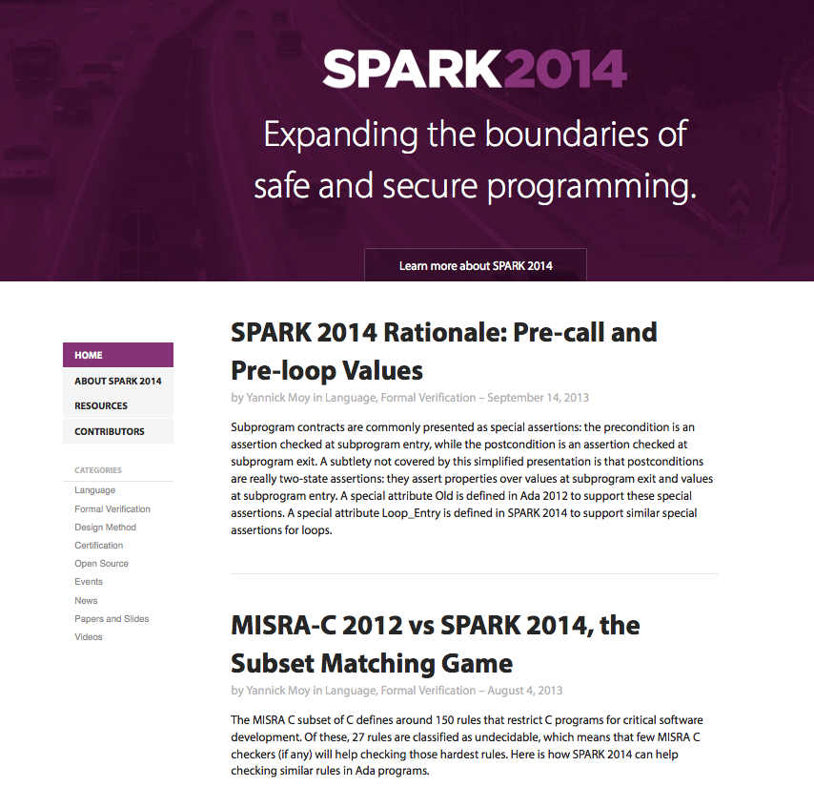
SPARK 2014 roadmap
November 2013: beta release of SPARK Pro 14
November 2013: release of SPARK Pro 11.1 (SPARK 2005 toolset)
April 2014: release of SPARK Pro 14
www.spark-2014.org

