Slide 1
Prove with SPARK: No Math, Just Code
Yannick Moy – SPARK Product Manager – AdaCore

Slide 2







Slide 3

Program Integrity
Functionality
Correct data initialization
No language error or
exception (division by zero,
buffer overflow)
Correct data flow
Complete lines are removed
Falling piece does not overlap
with fallen pieces or board
background

Slide 4

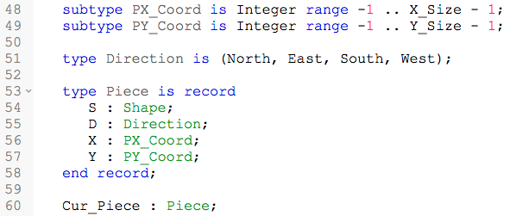
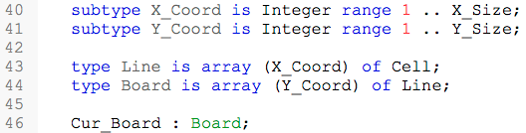
?

Slide 5
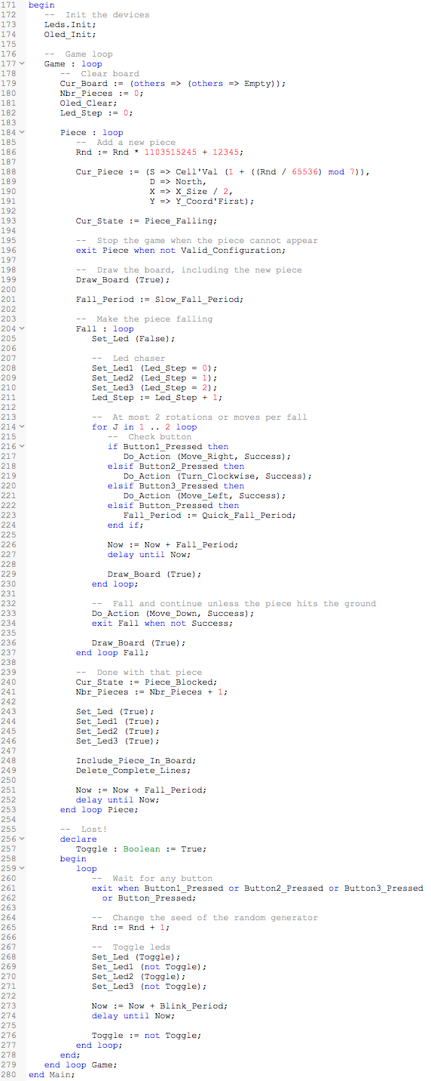
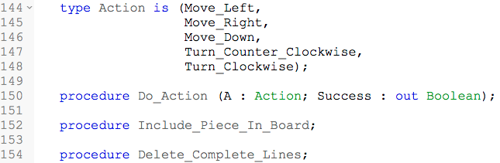

Slide 6
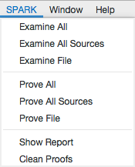
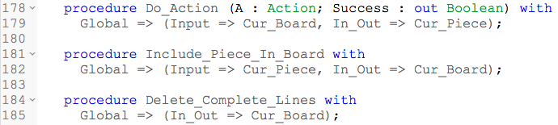
no message?
no reads of uninitialized data
Program Integrity
no message?
previous + correct data dependencies
Functionality

Slide 7
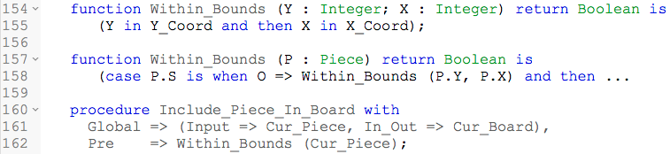
Program Integrity
no message?
previous + no run-time error (division by zero, buffer overflow…)
here: 6 messages on buffer overflows + 4 on scalar ranges
no message!

Slide 8
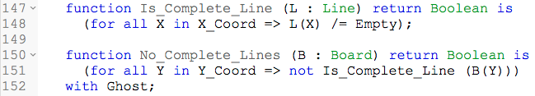
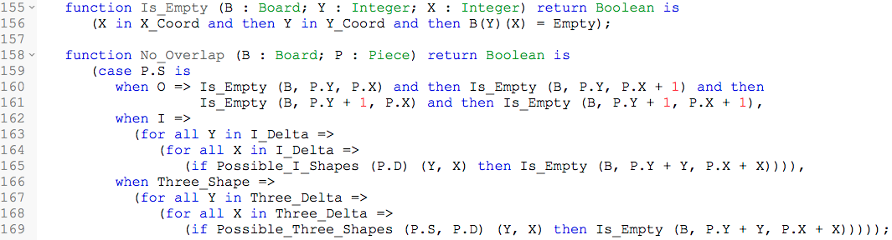
Functionality
NO_COMPLETE_LINES - Complete lines are removed
Functionality
NO_OVERLAP - Falling piece does not overlap with fallen pieces or board background

Slide 9
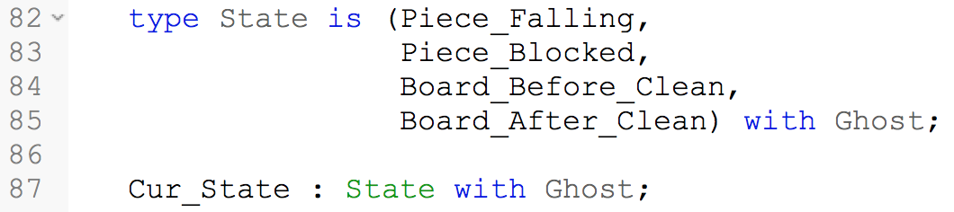

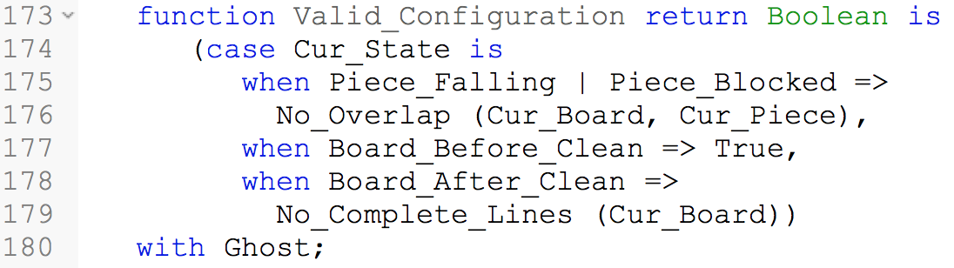
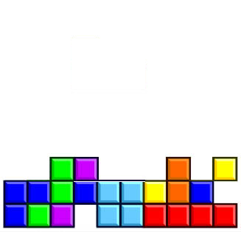
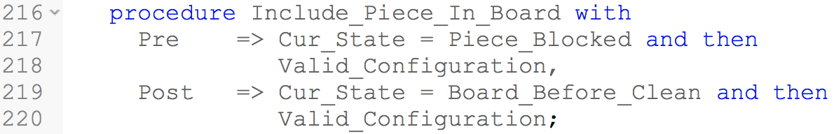
State automaton
Ghost code
piece falling
piece blocked
board before clean
board after clean

Slide 10
no message?
previous + code implements specification
Functionality
How hard is it?
Fully proved at level 0 in 11 seconds
…out of 5 levels!
level 0 =
one prover only
≈ 1 sec timeout
no splitting
…on one core!
4 seconds with
multicore

Slide 11
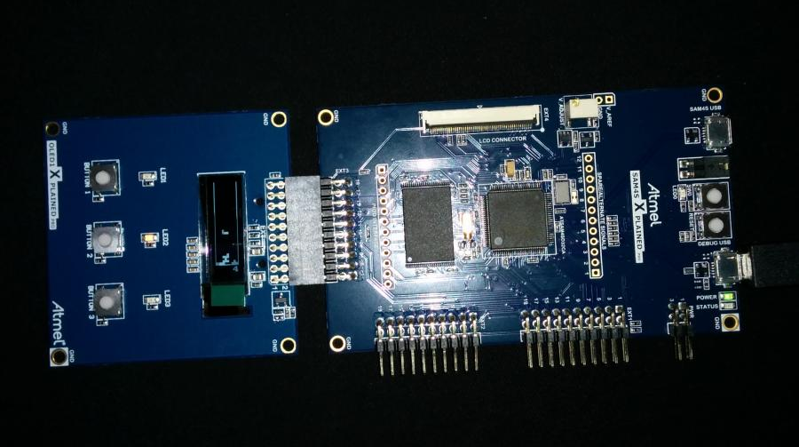

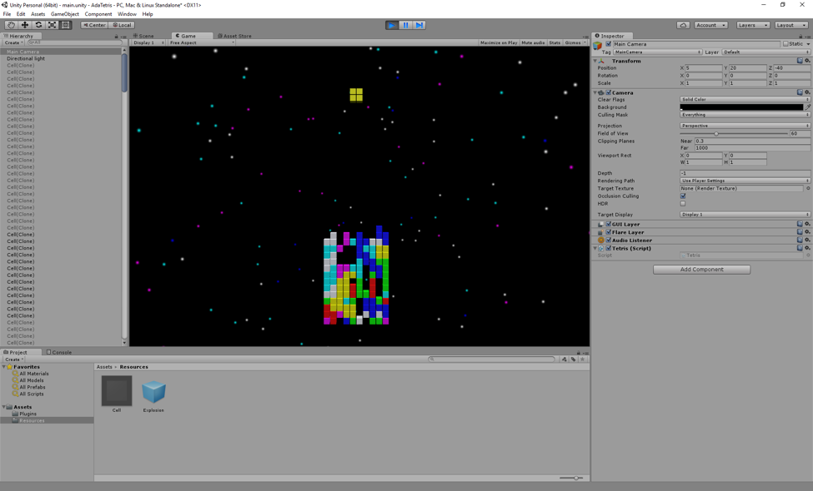
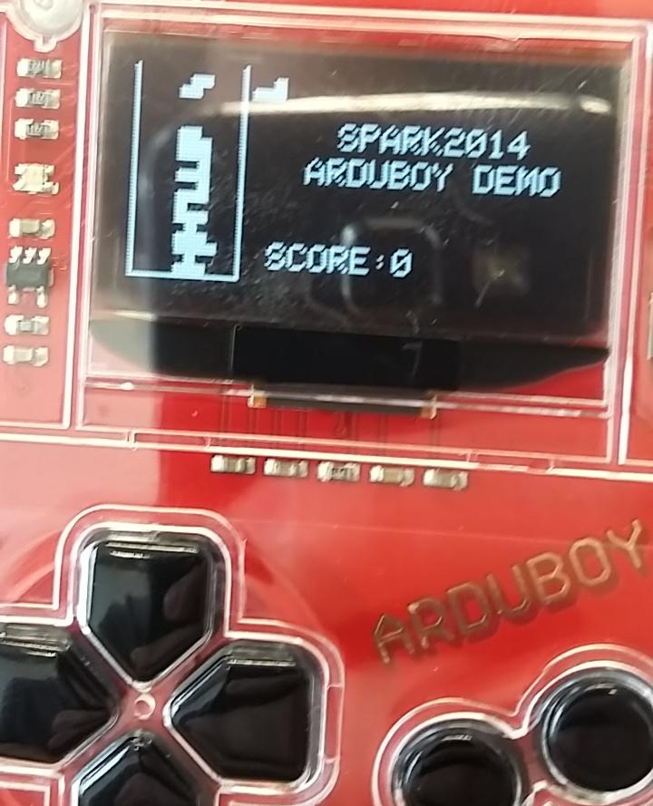
blog.adacore.com
libre.adacore.com

