Slide 1


Slide 2

Objectives

Slide 3
Milestones

Slide 4
Partners

Slide 5






Project Partners

Slide 6
Project Objectives
Facilitate proofs of safety / security
One language of assertions
Test + proofs + static analysis
SPARK profile for Ada
Mixed Ada-C code
Mixed Ada-C code
Mixed Ada-C code

Slide 7
Project Objectives
Facilitate proofs of safety / security
  Bullet 2
  Bullet 2
One language of assertions
Test + proofs + static analysis
SPARK profile for Ada
Mixed Ada-C code

Slide 8
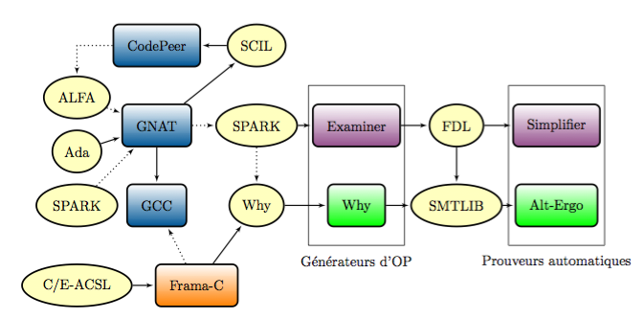
Schematic of proposed interaction

