Slide 1
Hybrid Verification in SPARK 2014:
Combining Formal Methods with Testing
Steve Baird
Senior Software Engineer

Slide 2
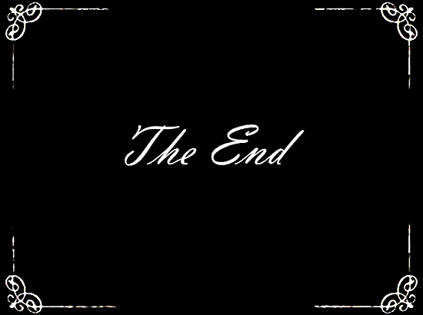
“Ada is not for me!”

Slide 3
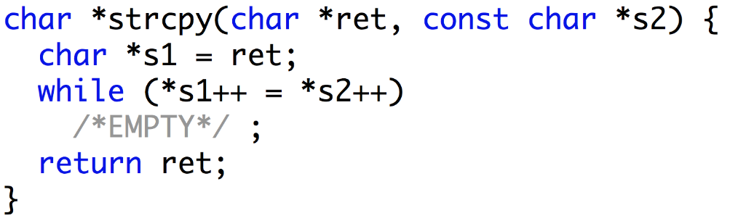
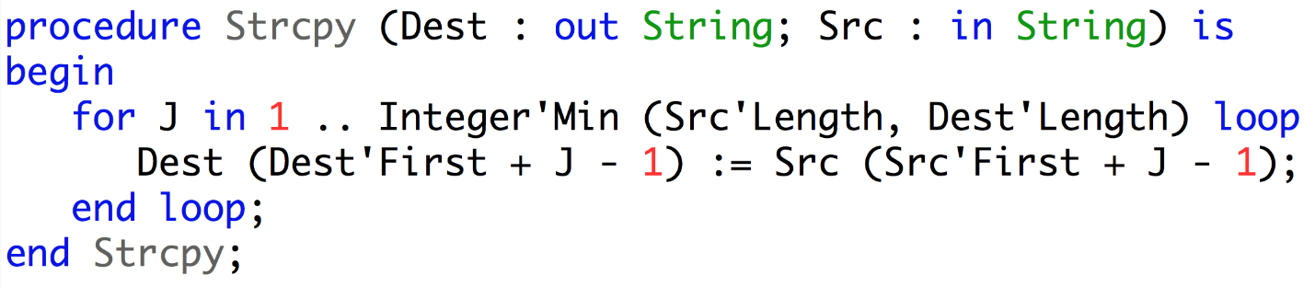
“Ada, why not?”
Ada favors clarity over conciseness, reader over writer
C
116 characters
Ada
208 characters

Slide 4
“Ada, why not?”
Ada favors clarity over conciseness, reader over writer
Means that “ret” is an output
Means that “s2” is an input
C
At the same time an assignment and a test
that the end of the string has been reached
Means that “Dest” is an output
Means that “Src” is an input
Ada
Loop
Assignment

Slide 5
“Ada, why not?”
Ada allows run-time detection of typing and memory errors
C
Possible buffer overflow
Ada
Overflow detected at run-time

Slide 6
“SPARK, why not?”
SPARK allows static detection of typing and memory errors
C
Possible buffer overflow
SPARK
Overflow detected statically

Slide 7
Advantages of Ada and SPARK over C
Buffer overflows in Ada?
Easily avoided by programmers (array types carry their bounds)
Automatically caught at run-time
Integer overflows in Ada?
Easily avoided by programmers (using bounded integer types)
Automatically caught at run-time
Buffer and integer overflows in SPARK?
If present, automatically caught by analysis
If absent, automatic proof that no such error can occur
Buffer overflows and integer overflows are still major sources of pain in C

Slide 8
Languages for Critical Software

Slide 9
Ada 2012 and SPARK 2014
Ada: programming language for long-lived embedded critical software
SPARK: Ada subset for formal verification
Ada version | Main features
Ada 83 | modularity + genericity + type safety + tasking
Ada 95 | + object orientation + protected objects
Ada 2005 | + containers + interfaces
Ada 2012 | + contracts
SPARK version | Main features
SPARK 83/95/2005 | contracts in comments mathematical semantics of contracts many language restrictions
SPARK 2014 | contracts in the language executable semantics of contracts few language restrictions

Slide 10
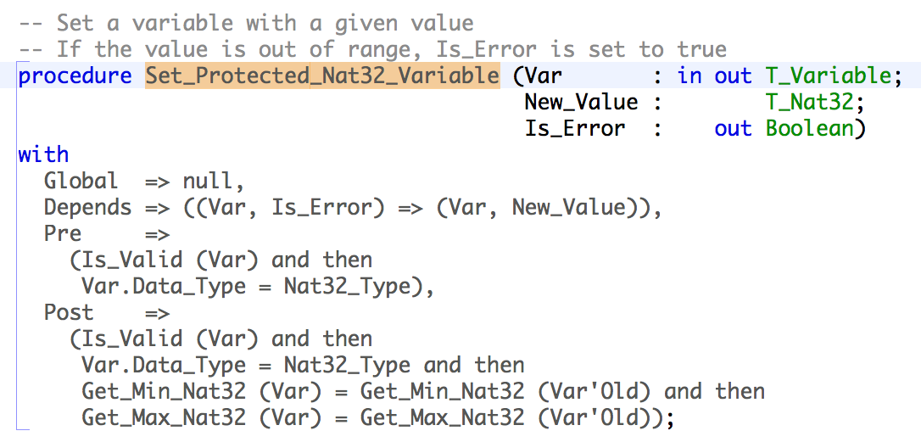
Ada and SPARK Contracts
Contract: agreement between the client and the supplier of a service
Program contract: agreement between the caller and the callee subprograms

Slide 11
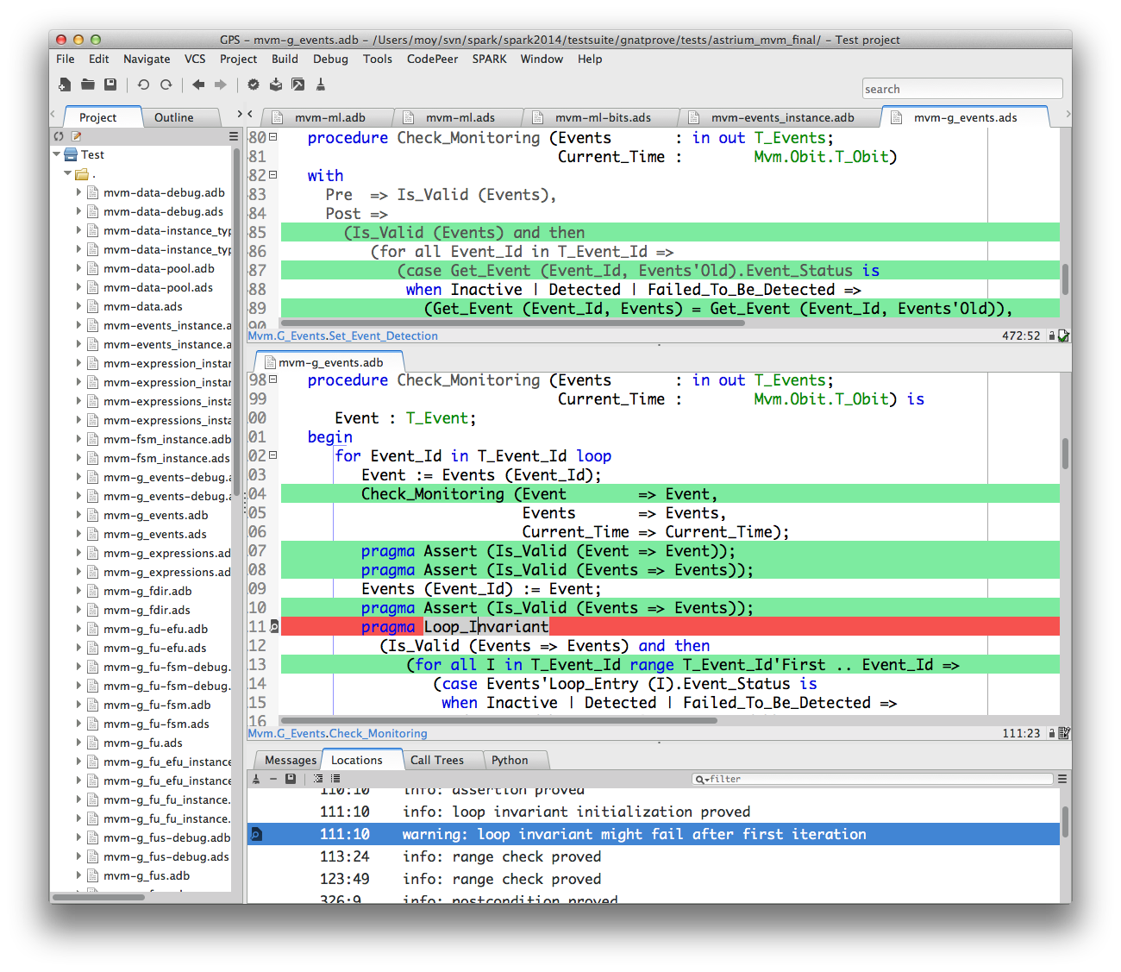
Integration of Static Validation in Developer Workflow

Slide 12
Dynamic Verification

Slide 13
Contracts = Assertions
Precondition: assertion checked at subprogram entry
Replaces defensive coding
Postcondition: assertion checked at subprogram return
Replaces equivalent assertion at all “return” points
Makes it easy to mention pre-call values X’Old
In a function, makes it easy to mention function result F’Result
At run time:
Assertion failure → exception Assertion_Error is raised
X’Old → copy of X made at subprogram entry
Fine-grain control of enabled assertions:
Compiler switch
Pragma Assertion_Policy in code, for each kind of assertion

Slide 14
Use Cases for Checking Contracts at Run Time
During design and specification
  Express dependencies and constraints on unit specs
During development
  More precise documentation of intent than comments
  Provides quick initial feedback
  Assertion failure can be analyzed in debugger
During testing
  Provides oracles for unit testing
  Can be reused for integration testing
  Can sometimes achieve exhaustive verification (using “for all”)
In production code
  Preconditions can replace defensive coding

Slide 15
Formal Verification

Slide 16
Correct Access to Data
Correct access to global variables
Global contract on subprograms specifies modes of global variables accessed
Depends contract on subprograms specifies flow of information
Abstract_State contract on packages specs specifies hidden state
Correct access to initialized data
no reads of uninitialized variables
in parameters and Input globals must be fully initialized on subprogram entry
out parameters and Output globals must be fully initialized on subprogram exit
Fast static analysis (≈ compilation time) checks correct access
Also detects unused parameters, globals, assignments, statements

Slide 17
Proof of Properties
Properties of interest:
Absence of run-time errors
Compliance with Low-Level Requirements formalized as subprogram contracts
(See Airbus use of Unit Proof: http://www.open-do.org/wp-content/uploads/2013/04/IEEE_Software_Formal_Or_Testing.pdf)
Property = mathematical formula
Proof is done subprogram by subprogram
Run-time checks in contracts are also proved

Slide 18
Robustness analysis: Absence of Run-Time Errors
Run-time check = mathematical formula
Ex: absence of division by zero in expression “X / Y” if formula “Y /= 0” holds
Checks in SPARK:
Range check (bounds of scalar types)
Index check (bounds of arrays)
Overflow check (bounds of machine scalar types)
Division by zero check
Length check (array operations)
Discriminant check (access to discriminant record)
Proof is done subprogram by subprogram
Run-time checks in contracts are also proved

Slide 19
Functional analysis: Compliance with Low-Level Requirements
Low-level requirement can be formalized as subprogram contract
(See Airbus use of Unit Proof:
  http://www.open-do.org/wp-content/uploads/2013/04/IEEE_Software_Formal_Or_Testing.pdf)
Assertion = mathematical formula
Proof is done subprogram by subprogram:
Precondition is assumed
Precondition of each call is proved
Postcondition of each call is assumed
Postcondition is proved
Additional assertions may be needed for proof:
Pragma Loop_Invariant for summarizing loop effects
Pragma Loop_Variant to prove loop termination
Pragma Assert to guide automatic prover

Slide 20
Formal Verification and Testing

Slide 21
Mixing Proof and Test
Testing is expensive and inaccurate
Proving is more accurate, but proving 100% is even more expensive…
… especially the last 20%
How about proving what’s easy to prove and test the rest?

Slide 22
Ada 2012 Additions for Contract Specification
Contracts on subprograms
Contracts on types
New expressions such as quantifiers
All of these construction are provided with dynamic semantics by Ada 2012
All of these construction are provided with proof semantics by SPARK 2014
G : Integer; procedure P (X, Y : Integer) with Pre => X + Y > 0, Post => G = G’Old + 1;
type Even is new Integer with Dynamic_Predicate => Even mod 2 = 0;
type Sorted_Array is array (Integer range <>) of Integer with Dynamic_Predicate => Sorted_Array’Size <= 1 or else (for all I in Sorted_Array’First .. Sorted_Array’Last – 1 => Sorted_Array (I) <= Sorted_Array (I + 1));

Slide 23
Proof Instead of Testing
Prove absence of run-time errors (AoRTE)
  In replacement of robustness testing
  Equivalent to exhaustive testing
  Few contracts required
  Typically 95% - 98% of RTE proved
  Proof can be completed by testing
Prove correct integration between components
  In replacement of defensive coding
  Simple contracts are needed
Prove functional correctness (including input partitioning)
  In replacement of unit testing
  More complex contracts are needed

Slide 24
Proof in Combination with Testing
At the level of individual runtime checks
  Possible RTE covered by tests
  Also the approach in VectorCAST with CodePeer
Between proof and integration testing
  Contract used for AoRTE at unit level
  Same contract used for integration testing (no unit tests)
Between proof and unit testing
  Contract as boundary between proof and unit test
  Very relevant in DO-178C context for avionics

Slide 25
Conclusion

Slide 26
Main Strengths
SPARK 2014 provides one of the highest level of safety/security/reliability on the market
  Implementing strategies used by industrials
  Inheriting from 20+ years of industrialization and usage of SPARK
  Fit for safety and security standard
SPARK 2014 allows to progressively introduce higher reliability standards
  Offers a unique formalism for executable and formal notations
  Can be deployed at the subprogram level
SPARK 2014 reduces unit testing costs as well as integration work and deployment hazards
  Unit test are replaced by unit proof verifying 100% of the cases

Slide 27
Conclusion
SPARK 2014 is the only language and toolset providing industrial support for both dynamic and formal contract-based verification of software.
  See http://www.adacore.com/sparkpro and http://www.spark-2014.org

