Slide 1
Abstract Software Specifications
and Automatic Proof of Refinement
Claire Dross and Yannick Moy
RSSRail 2016

Slide 2
SPARK 2014

Slide 3


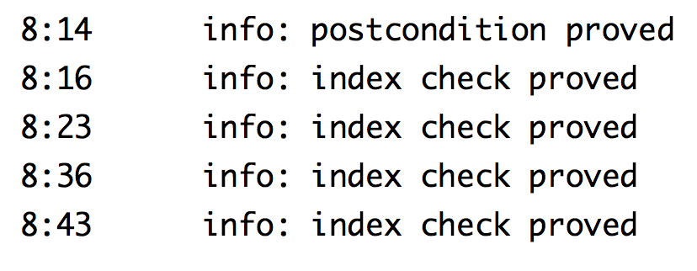
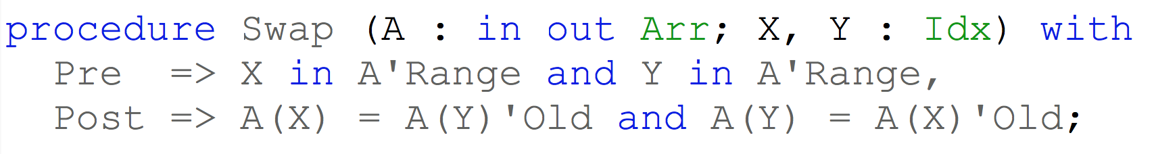

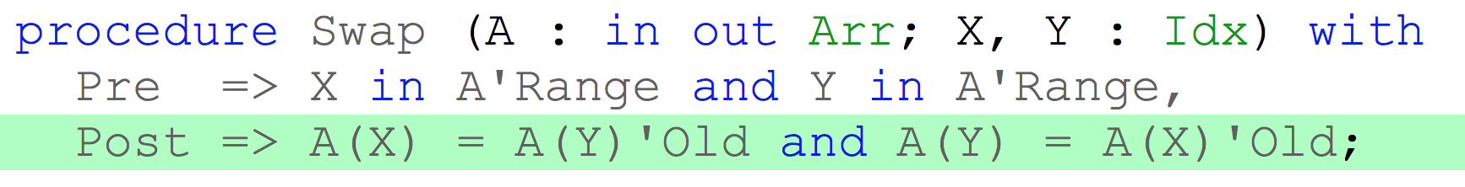
SPARK 2014

Slide 4
Contracts in SPARK 2014
^{contracts}
with assertions
+
^{code}
compile
^{executable}
used in formal + test

Slide 5
Ghost Code in SPARK 2014
^{contracts}
ghost
functions
with assertions
+
^{code}
compile
^{executable}
used in formal + test

Slide 6
Ghost Code in SPARK 2014
^{contracts}
ghost
functions
with assertions
+
ghost
variables,
types,
functions,
procedures,
packages
^{code}
compile
^{executable}
used in formal + test

Slide 7
Ghost Code in SPARK 2014
^{contracts}
ghost
functions
with assertions
+
ghost
variables,
types,
functions,
procedures,
packages
^{code}
compile
^{executable}
removed in final build

Slide 8
Container Library in SPARK 2014
Functional Containers
Sequence
Set
Map
Standard Imperative Containers
CONTRACTS
List
Vector
Set
Map
User Code
DATA
STRUCTURES
CONTRACTS

Slide 9
Abstraction and Proof

Slide 10
Abstract Specification of the Imperative Container Library
Specification / API
Feature 1 Pre
Post
Feature 2 Pre
Post
Functional Containers
{
Sequence
USE
{
Set
Map
IMPLE MENTS
Body / Implementation
Feature 1
in full Ada
Feature 2
abstract specification of imperative containers
implemented using dynamic allocation, arrays, etc.
{

Slide 11
Abstract Specification + Verification of Software Based on Imperative Containers
Specification / API
Feature 1 Pre
Post
Feature 2 Pre
Post
Functional Containers
{
Sequence
USE
{
Set
Map
IMPLE MENTS
Body / Implementation
Feature 1
based on
imperative
Feature 2 containers
abstract specification and verification
of user software implemented using imperative containers
{

Slide 12
Abstract Specification + Verification of Software Based on Arrays
Specification / API
Feature 1 Pre
Post
Feature 2 Pre
Post
Functional Containers
{
Sequence
USE
{
Set
Map
IMPLE MENTS
Body / Implementation
Feature 1
based on
arrays
Feature 2
abstract specification and verification
of user software implemented using arrays
{

Slide 13
Abstract Specification + Verification of Software with B Method
Abstract B Machine
Feature 1 Pre
Subst
Feature 2 Pre
Subst
Set Theory
{
Sequence
USE
{
Set
Map
IMPLE MENTS
Concrete B Machine
Feature 1
based on
arrays
Feature 2
abstract specification and verification
of user software
with B Method
{

Slide 14
Three Examples

Slide 15
Abstract Specification + Verification of Simple Allocator
Simple Allocator Spec
Alloc Pre
Post
Free Pre
Post
Model of Allocator
Available
Resources
Allocated
Resources
{
Set
IS-A
{
Set
IMPLE MENTS
Simple Allocator Body
Alloc
based on
arrays
Free
abstract specification and verification
of simple allocator implemented using arrays
{

Slide 16
Data Refinement of Simple Allocator
Refinement expressed in ghost function Is_Valid
Is_Valid is the Post of function Model
Two loop invariants in Alloc and Model
AoRTE + refinement proved at level 2 (3s)
Available
Allocated
GHOST
FUNCTION
Model
ABSTRACT
CONCRETE

Slide 17
Abstract Specification + Verification of Free List Allocator Based on Arrays
Free List Allocator Spec
Alloc Pre
Post
Free Pre
Post
Model of Allocator
Available
Resources
Allocated
Resources
{
Sequence
IS-A
{
Set
IMPLE MENTS
Free List Allocator Body
Alloc
based on
list over Free arrays
abstract specification and verification
of free list allocator implemented using arrays
{

Slide 18
Data Refinement of Free List Allocator
GHOST
VARIABLE
Model
Refinement expressed in ghost variable Model and ghost function Is_Valid
Is_Valid is in the Pre and Post of Alloc and Free
Two loop invariants in elaboration code
AoRTE + refinement proved at level 4 (30s)
Available
Allocated
GHOST
FUNCTION
Is_Valid
ABSTRACT
CONCRETE

Slide 19
Data Refinement of Free List Allocator (Modified)
Refinement expressed in ghost function Is_Valid based on Model
Is_Valid in Pre/Post
Ghost function Model with Pre/Post
Five loop invariants
AoRTE + refinement proved at level 4 (40s)
Available
Allocated
GHOST
FUNCTION
Model
ABSTRACT
CONCRETE

Slide 20
Conclusion

Slide 21
Comparison of the Three Modeling Approaches
Allocator | Simple | Free List | Free List (Mod)
Model | Ghost function | Ghost variables | Ghost function
Invariant in Pre/Post | no | yes | yes
Loop Invariants | 2 – 6 conditions | 2 – 9 conditions | 5 – 23 conditions
Ghost Functions | 2 | 1 | 4 + 2
Auto-active Verification | no | no | yes
Slocs (code) | 38 | 49 | 49
Slocs (contracts) | 67 | 103 | 138
Slocs (total) | 119 | 167 | 261

Slide 22
SPARK Resources
SPARK toolset
http://libre.adacore.com/
Code source of examples
https://forge.open-do.org/anonscm/git/spark2014/spark2014.git/
SPARK blog and resources (User’s Guide)
http://www.spark-2014.org
SPARK online training
http://u.adacore.com

