Slide 1
SPARK 2014: Hybrid Verification using Proofs and Tests
José F. Ruiz
Senior Software Engineer
FOSDEM 2014 – February 1st, 2014

Slide 2
Outline
Language evolution
From a safety point of view
SPARK 2014
Why and what
Modular verification
Dynamic validation
Formal proofs
Conclusions
Including some results from case studies

Slide 3
Languages for Critical Software

Slide 4
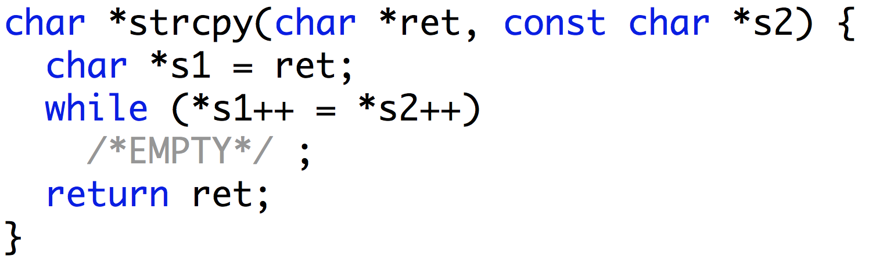
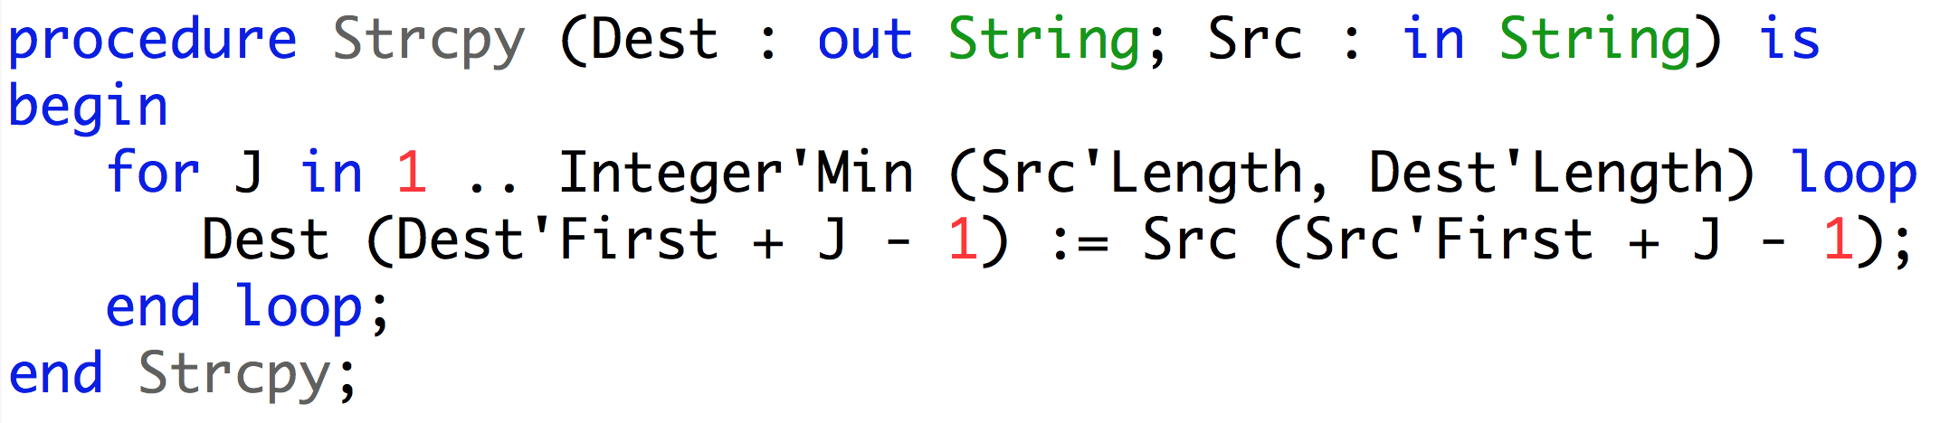
“Ada, why not?”
Ada favors clarity over conciseness, reader over writer
C
116 characters
Ada
208 characters

Slide 5
“Ada, why not?”
Ada favors clarity over conciseness, reader over writer
Means that “ret” is an output
Means that “s2” is an input
C
At the same time an assignment and a test
that the end of the string has been reached
Means that “Dest” is an output
Means that “Src” is an input
Ada
Loop
Assignment

Slide 6
“Ada, why not?”
Ada allows run-time detection of typing and memory errors
C
Possible buffer overflow
Ada
Overflow detected at run-time

Slide 7
“SPARK, why not?”
SPARK allows static detection of typing and memory errors
C
Possible buffer overflow
SPARK
Overflow detected statically

Slide 8
Advantages of Ada and SPARK over C
Buffer overflows in Ada?
Easily avoided by programmers (array types carry their bounds)
Automatically caught at run-time
Integer overflows in Ada?
Easily avoided by programmers (using bounded integer types)
Automatically caught at run-time
Buffer and integer overflows in SPARK?
If present, automatically caught by analysis
If absent, automatic proof that no such error can occur
Buffer overflows and integer overflows are still major sources of pain in C

Slide 9
Ada 2012 and SPARK 2014
Ada: programming language for long-lived embedded critical software
SPARK: Ada subset for formal validation
Ada version | Main features
Ada 83 | modularity + genericity + type safety + tasking
Ada 95 | + object orientation + protected objects
Ada 2005 | + containers + interfaces
Ada 2012 | + contracts
SPARK version | Main features
SPARK 83/95/2005 | contracts in comments mathematical semantics of contracts many language restrictions
SPARK 2014 | contracts in the language executable semantics of contracts few language restrictions

Slide 10
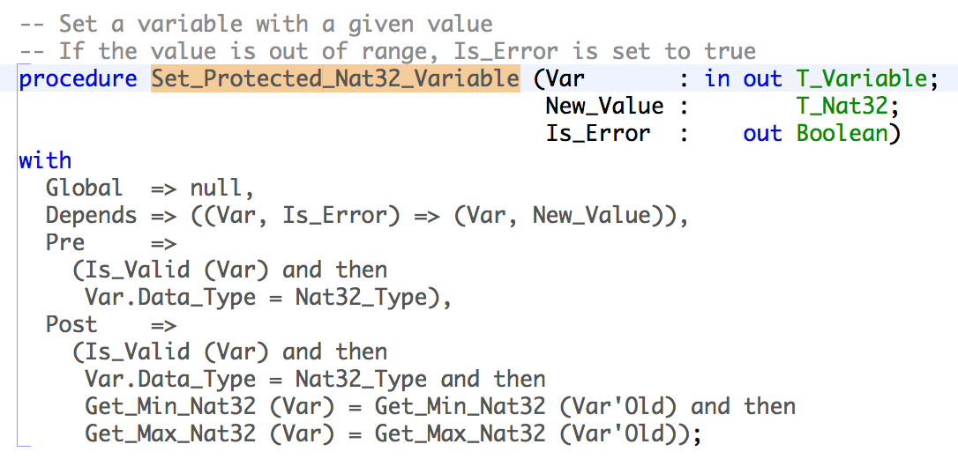
Ada and SPARK Contracts
Contract: agreement between the client and the supplier of a service
Program contract: agreement between the caller and the callee subprograms

Slide 11
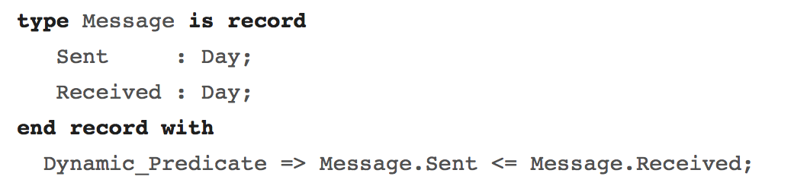
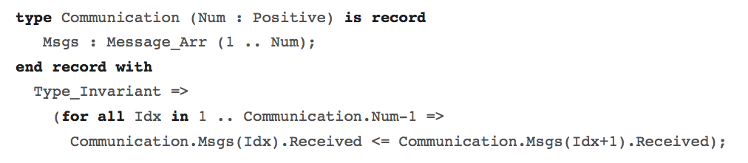
Ada Type Invariants and Predicates
Type predicate: permanent property of objects
Type invariant: property of objects at public boundary

Slide 12
SPARK 2014

Slide 13
What is SPARK 2014?
SPARK (Vintage) is a Ada-based language and toolset allowing to perform formal analysis
Absence of run-time errors
Data Flow and Information Flow analysis
Correctness with regards to contracts
SPARK (Vintage) is based on a provable Ada 2005 subset and additional annotations
The Ada 2012 language extends the Ada 95 / 2005 definition, including requirements from SPARK language
SPARK 2014 is a new language and toolset based on Ada 2012 including
A much wider support for the Ada constructions
A format for contract associated with formal and executable semantics
An environment ready for local type substitutability proof
An environment ready for low-level requirement compliance and robustness verification
An integration environment between unit testing and unit proof

Slide 14
Why SPARK 2014: … the usual story of finding problems earlier …
SPARK will help finding more problems here

Slide 15

Why SPARK 2014: … but we can do better …
Unit Proof
Unit Testing
Unit Verification (Modular Verification)

Slide 16

Why SPARK 2014: Value Proposition
Functional Requirement
Functional Verification
Software Architecture
Software Architecture Verification
Unit Requirements
Unit Verification
Code
Robustness Verification
Notes:
SPARK 2014 addresses multiple verification objectives on the V cycle:
Robustness verification usually performed with unit testing. Proof guarantees that no run time error can occur.
Unit verificaton, also usually performed with unit testing. Proof guarantees that functional contracts specified on subprograms are fulfilled by the implementation.
Software architecture verification, usually performed with manual reviews. Static analysis guarantees that dependence contracts on subprograms and packages are fulfilled by the implementation.

Slide 17
Mixing Proof and Test
Testing is expensive and inaccurate
Proving is more accurate, but proving 100% is even more expensive…
… especially the last 20%
How about proving what’s easy to prove and test the rest?

Slide 18
Ada 2012 Additions for Contract Specification
Contracts on subprograms
Contracts on types
New expressions such as quantifiers
All of these construction are provided with dynamic semantics by Ada 2012
All of these construction are provided with proof semantics by SPARK 2014
G : Integer; procedure P (X, Y : Integer) with Pre => X + Y > 0, Post => G = G’Old + 1;
type Even is new Integer with Dynamic_Predicate => Even mod 2 = 0;
type Sorted_Array is array (Integer range <>) of Integer with Dynamic_Predicate => Sorted_Array’Size <= 1 or else (for all I in Sorted_Array’First .. Sorted_Array’Last – 1 => Sorted_Array (I) <= Sorted_Array (I + 1));

Slide 19
Extensions to Architecture Definition
Clarify access to global variables
Aspects for subprograms
with Global => null; -- Not reference to global items with Global => V; -- V is an input of the subprogram with Global => (X, Y, Z); -- X, Y and Z are inputs of the subprogram with Global => (Input => V); -- V is an input of the subprogram. with Global => (Input => (X, Y, Z)); -- X, Y and Z are inputs of the subprogram with Global => (Output => (A, B, C)); -- A, B and C are outputs of the subprogram with Global => (In_Out => (D, E, F)); -- D, E and F are both inputs and outputs of -- the subprogram with Global => (Proof_In => (G, H)); -- G and H are only used in assertion -- expressions within the subprogram with Global => (Input => (X, Y, Z), Output => (A, B, C), In_Out => (P, Q, R), Proof_In => (T, U)); -- A global aspect with all types of global specification

Slide 20
Extensions to Architecture Definition (II)
Clarify information flow
Aspects for subprograms
procedure P (X, Y, Z : in Integer; A, B, C : in out Integer; D, E out Integer) with Depends => ((A, B) =>+ (A, X, Y), C =>+ null, D => Z, E => null); -- The "+" sign attached to the arrow indicates self-dependency -- The exit value of A depends on the entry value of A as well as the entry -- values of X and Y. -- Similarly, the exit value of B depends on the entry value of B as well as -- the entry values of A, X and Y. -- The exit value of C depends only on the entry value of C. -- The exit value of D depends on the entry value of Z. -- The exit value of E does not depend on any input value.
G is a global variable written
No other global variable is accessed or modified
G : Integer; procedure P (X, Y : Integer) with Global => (Out => G), Depends => ((G) => (X, Y));
The value of G is computed from the value of X and Y

Slide 21
Extensions to Language Definition
Excluded features not amenable to sound static verification
Access types
Function side effects
Aliasing
Renaming is allowed
goto statements
Tagged types not yet supported
Exception handlers
Limited raise statements are allowed
Tasking not yet supported
Additions with respect to previous versions of SPARK
Generic subprograms and packages
Discriminated types
Types with dynamic bounds
Array slicing
Array concatenation
Recursion
Early exit and return statements
Computed constants
A limited form of raise statements

Slide 22
Extensions to Language Definition (II)
Formal Container Library
SPARK 2014 excludes data structures based on pointers
Vectors, Lists, Maps, Sets are being defined
Specifically designed to facilitate the proof of client units

Slide 23
Extensions to Contract Definition
Contract cases
Enhance clarity and readability
Structured way of defining a subprogram contract using mutually exclusive subcontract cases
function Compute_Action (S : State) return Action with Post => (if S = Off then Compute_Action’Result = Activate) and then (if S = Normal then Compute_Action’Result = Nothing) and then (if S = Alarm then Compute_Action’Result = Evacuate);
Better this way
function Compute_Action (S : State) return Action with Contract_Cases => (S = Off => Compute_Action’Result = Activate, S = Normal => Compute_Action’Result = Nothing, S = Alarm => Compute_Action’Result = Evacuate);

Slide 24
Extensions to Behavior Definition
Non-varying properties
procedure Loop_Var_Loop_Invar is type Total is range 1 .. 100; subtype T is Total range 1 .. 10; I : T := 1; R : Total := 100; begin while I < 10 loop pragma Loop_Invariant (R >= 100 - 10 * I); pragma Loop_Variant (Increases => I, Decreases => R); R := R - I; I := I + 1; end loop; end Loop_Var_Loop_Invar;
Used to demonstrate that a loop will terminate by specifying expressions that will increase or decrease as the loop is executed

Slide 25
DO-178C Verification Activities
System Requirements
High Level Requirements
Software Architecture
Low Level Requirements
Source Code
Executable Object Code

Slide 26
What we want to address
System Requirements
High Level Requirements
Software Architecture
Low Level Requirements
Software architecture is
consistent.
by Review
Source Code
Accuracy and Consistency
Compliance Robustness
by Review & Static Analysis
by Testing
Executable Object Code

Slide 27
How we want to do it
System Requirements
High Level Requirements
Software Architecture
Low Level Requirements
Software architecture is
consistent.
by Formal Proof
Compliance Robustness
Source Code
by Formal Proof
Accuracy and Consistency
by Formal Proof
Executable Object Code
Property Preservation

Slide 28
SPARK 2014 Value Proposition (DO-178C Version)
System Requirements
High Level Requirements
Software Architecture
Low Level Requirements
Software architecture
is consistent
Compliance Robustness
Source Code
Accuracy
Consistency
Property Preservation
Executable Object Code
Notes:
SPARK tools operate at source level, so the Compliance&Robustness activity performed with SPARK must be completed by an activity showing Property Preservation between the Source Code and the Executable Object Code. This activity typically relies on the qualification material developer for the compiler.

Slide 29


SPARK 2014 Contracts
Program
Contract = agreement between client & supplier
Contract = agreement between client & supplier
caller & callee
Dynamic Verification
Formal Verification
Notes:
SPARK allows fine-grain combination of dynamic verification and formal verification of contracts.

Slide 30
Dynamic Validation

Slide 31
Contracts = Assertions
Precondition: assertion checked at subprogram entry
Replaces defensive coding
Postcondition: assertion checked at subprogram return
Replaces equivalent assertion at all “return” points
Makes it easy to mention pre-call values X’Old
In a function, makes it easy to mention function result F’Result
At run time:
Assertion failure → exception Assertion_Error is raised
X’Old → copy of X made at subprogram entry
Fine-grain control of enabled assertions:
Compiler switch
Pragma Assertion_Policy in code, for each kind of assertion

Slide 32
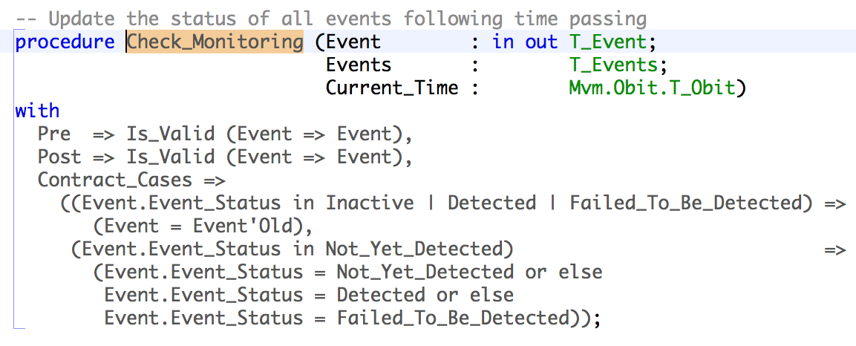
Contracts by Cases
Many subprograms are more easily specified by cases that are:
Disjoint: two different cases should not be enabled at the same time
Complete: cases should cover all possibilities
→ Additional properties also checked at run time

Slide 33
Use Cases for Checking Contracts at Run Time
During design and specification
Express dependencies and constraints on unit specs
During development
More precise documentation of intent than comments
Provides quick initial feedback
Assertion failure can be analyzed in debugger
During testing
Provides oracles for unit testing
Can be reused for integration testing
Can sometimes achieve exhaustive verification (using “for all”)
In production code
Preconditions can replace defensive coding

Slide 34
Formal Validation

Slide 35
What can you verify formally?
Data-flow analysis
Initialization of variables
Data dependencies of subprograms
Parameters and variables read or written
Information-flow analysis
Coupling between the inputs and outputs of a subprogram
Which input values of parameters and variables influence which output values
Robustness analysis
Predefined checks will never fail at run time
Functional analysis
Contracts expressed as preconditions, postconditions, type invariants, …

Slide 36
Flow analysis: Correct Access to Data
Correct access to global variables
Abstract_State contract on packages specs specifies hidden state
Global contract on subprograms specifies modes of global variables accessed
Depends contract on subprograms specifies flow of information
Correct access to initialized data
no reads of uninitialized data
in parameters and Input globals must be fully initialized on subprogram entry
out parameters and Output globals must be fully initialized on subprogram exit
Fast static analysis (≈ compilation time) checks correct access
Also detects unused parameters, globals, assignments, statements

Slide 37
Flow analysis: Correct Access to Global Variables
Global state of a program is made up of:
Visible global variables
Hidden global variables (in private parts and bodies)
Abstract_State contract on packages specs specifies hidden state
Global contract on subprograms specifies modes of global variables accessed
Depends contract on subprograms specifies flow of information
Fast static analysis (≈ compilation time) checks correct access
Typical errors / warnings:
file.adb:20:09: "G" must be a global output of ”T" [illegal_update]
f.adb:18:3: warning: missing dependency "Y => Pa" [depends_missing]

Slide 38
Flow analysis: Correct Access to Initialized Data
Modes of parameters and globals have a strong semantics in SPARK:
in parameters and Input globals must be fully initialized on subprogram entry
out parameters and Output globals must be fully initialized on subprogram exit
Packages declare initialized state in Initializes contract
Fast static analysis (≈ compilation time) checks correct initialization
Typical errors / warnings:
file.adb:103:13: ”Rec.Arr" is not initialized [uninitialized]
file.adb:8:4: warning: "X" might not be initialized [uninitialized]
Also detects unused parameters, globals, assignments, statements

Slide 39
Proof of Properties
Properties of interest:
Absence of run-time errors
Compliance with Low-Level Requirements formalized as subprogram contracts
(See Airbus use of Unit Proof: http://www.open-do.org/wp-content/uploads/2013/04/IEEE_Software_Formal_Or_Testing.pdf)
Property = mathematical formula
Proof is done subprogram by subprogram
Run-time checks in contracts are also proved

Slide 40
Robustness analysis: Absence of Run-Time Errors
Run-time check = mathematical formula
Ex: absence of division by zero in expression “X / Y” if formula “Y /= 0” holds
Checks in SPARK:
Range check (bounds of scalar types)
Index check (bounds of arrays)
Overflow check (bounds of machine scalar types)
Division by zero check
Length check (array operations)
Discriminant check (access to discriminant record)
Proof is done subprogram by subprogram
Run-time checks in contracts are also proved

Slide 41
Functional analysis: Compliance with Low-Level Requirements
Low-level requirement can be formalized as subprogram contract
(See Airbus use of Unit Proof:
http://www.open-do.org/wp-content/uploads/2013/04/IEEE_Software_Formal_Or_Testing.pdf)
Assertion = mathematical formula
Proof is done subprogram by subprogram:
Precondition is assumed
Precondition of each call is proved
Postcondition of each call is assumed
Postcondition is proved
Additional assertions may be needed for proof:
Pragma Loop_Invariant for summarizing loop effects
Pragma Loop_Variant to prove loop termination
Pragma Assert to guide automatic prover

Slide 42
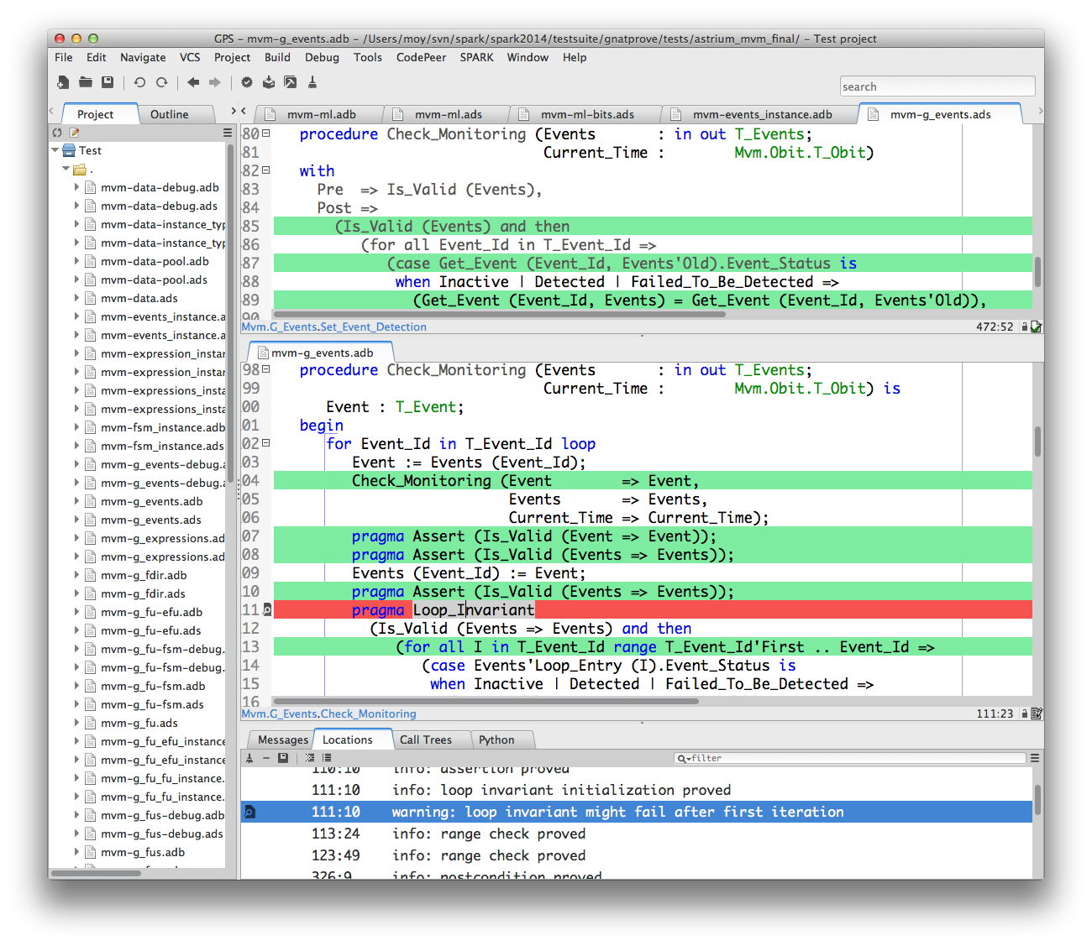
Integration of Static Validation in Developer Workflow

Slide 43
Space Case Study

Slide 44
Case Study by Astrium Space Transportation (David Lesens)
Numerical control/command algorithms
Mission and vehicle management
Formal Verification of Aerospace Software, DASIA 2013, http://www.open-do.org/wp-content/uploads/2013/05/DASIA_2013.pdf
Part | # subprograms | # checks | % proved
Math library | 15 | 27 | 92
Numerical algorithms | 30 | 265 | 98
Part | # subprograms | # checks | % proved
Single variable | 85 | 268 | 100
List of variables | 140 | 252 | 100
Events | 24 | 213 | 100
Expressions | 331 | 1670 | 100
Automated proc | 192 | 284 | 74
On board control proc | 547 | 2454 | 95

Slide 45
Conclusions

Slide 46
Main Strengths
SPARK 2014 provides one of the highest level of safety/security/reliability on the market
Implementing strategies used by industrials
Inheriting from 20+ years of industrialization and usage of SPARK
Fit for safety and security standard
SPARK 2014 allows to progressively introduce higher reliability standards
Offers a unique formalism for executable and formal notations
Can be deployed at the subprogram level
SPARK 2014 reduces unit testing costs as well as integration work and deployment hazards
Unit test are replaced by unit proof verifying 100% of the cases

Slide 47
Case Study Conclusions
SPARK 2014 very good for:
Proof of absence of run-time errors
Correct access to all global variables
Absence of out-of-range values
Internal consistency of software unit
Correct numerical protection
Correctness of a generic code in a specific context
SPARK 2014 is good for:
Proof of functional properties
Areas requiring improvements:
Sound treatment of floating-points (done)
Support of tagged types (in the development roadmap for 2014)
Helping user with unproved checks (for example counter-examples, in roadmap)

Slide 48
SPARK 2014
SPARK 2014 is the only language and toolset providing industrial support for both dynamic and formal contract-based validation of software.
Now available as beta
First release April 2014
See http://www.adacore.com/sparkpro and http://www.spark-2014.org

