Slide 1



Rail, Space, Security: Three Case Studies for SPARK 2014
Claire Dross, Pavlos Efstathopoulos, David Lesens, David Mentré and Yannick Moy
Embedded Real Time Software and Systems – February 5th, 2013

Slide 2
SPARK 2014

Slide 3




Ada 2012 and SPARK 2014
programming language for long-lived embedded critical software
programming by contract
Ada subset for formal verification
practical formal verification

Slide 4
SPARK 2014 Value Proposition
Functional Requirement
Functional Verification
Software Architecture
Software Architecture Verification
Unit Requirements
Unit Verification
Code
Robustness Verification

Slide 5
SPARK 2014 Value Proposition (DO-178C Version)
System Requirements
High Level Requirements
Software Architecture
Low Level Requirements
Software architecture
is consistent
Compliance Robustness
Source Code
Accuracy
Consistency
Property Preservation
Executable Object Code

Slide 6


SPARK 2014 Contracts
Program
Contract = agreement between client & supplier
Contract = agreement between client & supplier
caller & callee
Dynamic Verification
Formal Verification

Slide 7
Case Studies

Slide 8

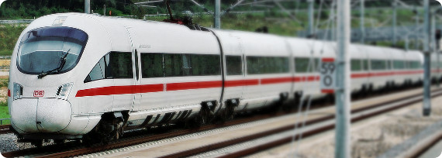
Case study 1: Train Control Systems
David Mentré

Slide 9
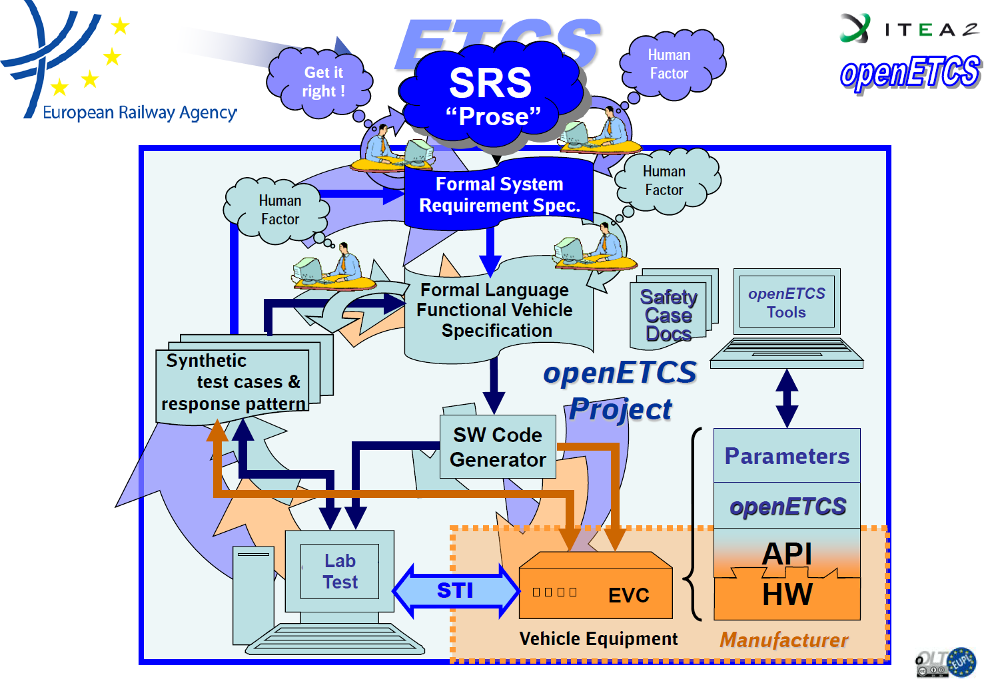
openETCS
Open Source → no vendor lock-in
Model based (SysML)
Formal methods → Strong guaranties of correctness
“Open Proofs” → Everybody can re-check

Slide 10
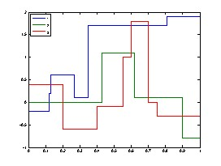
Formalization of the Correctness of Step Functions
Has_Same_Delimiters?
Get_Value?
Minimum_Until_Point?
Restrictive_Merge?

Slide 11
Results
SPARK 2014 very good for:
Capturing objects in the requirements
Readability of the specifications (= contracts)
Automatic proof of absence of run-time errors
Automatic proof of simple functional contracts
Dynamic verification of contracts and assertions
SPARK 2014 is not good for:
Proving existing code without any modifications
Proving automatically complex functional contracts
Areas requiring improvements:
Possibility to prove some properties interactively (in 2014 roadmap)
Better diagnostic for incomplete loop invariants (in 2014 roadmap)
Training for developers to use proof tools (available in SPARK Pro subscription)
Workflow to make efficient use of developers’ time (in progress)

Slide 12
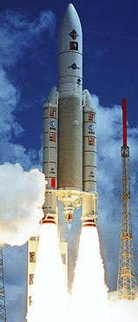

Case study 2: Flight Control and Vehicle Management in Space
David Lesens

Slide 13



On Board Control Procedure
On-board control procedure
Software program designed to be executed by an OBCP engine, which can easily be loaded, executed, and also replaced, on-board the spacecraft
OBCP code
Complete representation of an OBCP, in a form that can be loaded on-board for subsequent execution
OBCP engine
Application of the on-board software handling the execution of OBCPs
OBCP language
Programming language in which OBCP source code is expressed by human programmers

Slide 14
Formalization of the Correctness of 1505 Functions
Example:
A list of event detection statuses
Request to reset the detection status for Event
procedure Reset_Event_Status (Event : in T_Event) with
Post =>
not Event_Status (Event).Detection and
(for all Other_Event in T_Event =>
(if Other_Event /= Event then
Event_Status (Other_Event) = Event_Status'Old (Other_Event)));
Post-condition
The detection of event is reset
For all other events
The detection status is unchanged
Event1
Event1
Event2
Event2
Event3
Event1
Event3
Event1
Event2
Event2
Event3
Event3
Not detected
Not detected
Detected
Not detected
Detected
Not detected
Detected
Not detected
Not detected
Not detected
Detected
Detected

Slide 15
Automatic Proof Results
Numerical control/command algorithms
Mission and vehicle management
Formal Verification of Aerospace Software, DASIA 2013, http://www.open-do.org/wp-content/uploads/2013/05/DASIA_2013.pdf
Part | # subprograms | # checks | % proved
Math library | 15 | 27 | 92
Numerical algorithms | 30 | 265 | 98
Part | # subprograms | # checks | % proved
Single variable | 85 | 268 | 100
List of variables | 140 | 252 | 100
Events | 24 | 213 | 100
Expressions | 331 | 1670 | 100
Automated proc | 192 | 284 | 74
On board control proc | 547 | 2454 | 95

Slide 16
Results
SPARK 2014 very good for:
Proof of absence of run-time errors
Correct access to all global variables
Absence of out-of-range values
Internal consistency of software unit
Correct numerical protection
Correctness of a generic code in a specific context
SPARK 2014 is good for:
Proof of functional properties
Areas requiring improvements:
Sound treatment of floating-points (done)
Support of tagged types (in 2014 roadmap)
Helping user with unproved checks (in 2014 roadmap)

Slide 17



Case study 3: Biometric Access to a Secure Enclave
Pavlos Efstathopoulos

Slide 18
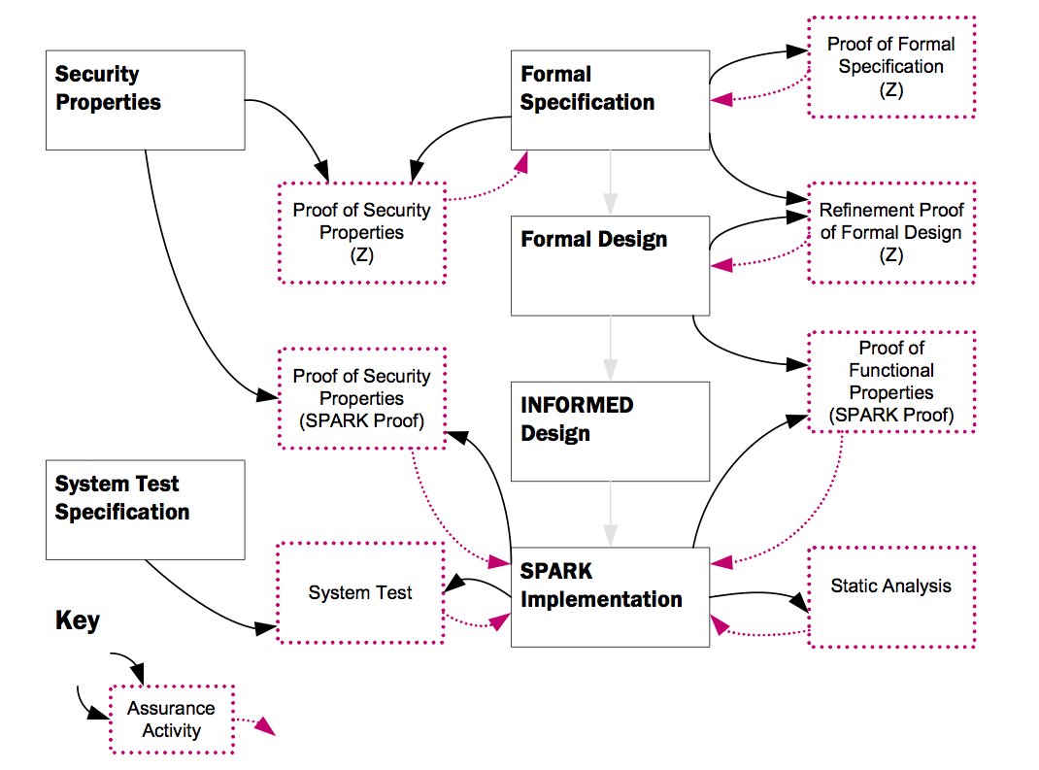
Tokeneer

Slide 19
Formalization of the “Admin” Package
Aspect / Pragma | Num. of occurrences
Global | 197
Refined_Global | 71
Refined_Depends | 40
Depends | 202
Pre | 28
Post | 41
Assume | 3
Loop_Invariant | 10
Dataflow
Refinement
Information flow
Functional contracts
User guidance
Assumptions

Slide 20
Results
SPARK 2014 very good for:
Expressing specification-only code
Analysis of code that was not analyzable with SPARK 2005
Automating proofs with less user efforts
Expressing complete functional behavior of functions
Readability of the formal specifications
Uncovering corner cases related to run-time checks
Areas requiring improvements:
Summary of proof results (done)

Slide 21
Lessons Learned

Slide 22

SPARK 2014 Strengths
expressive
specification
language
better
automation
of proofs
executable
contracts

Slide 23

SPARK 2014 Challenges
code and specifications must be adapted
static debugging
of contracts
need
expert advice
sometimes

Slide 24
SPARK in 2014

Slide 25
Roadmap
Now available as beta
First release April 2014
See http://www.adacore.com/sparkpro
and http://www.spark-2014.org

