Slide 1
Writing reliable applications: formal verification and static analysis assets
Yannick Moy
Senior Software Engineer
GNAT Pro User Day – September 25th, 2013

Slide 2
1994
T
Why use formal analysis?

Slide 3


High-level goals

Slide 4
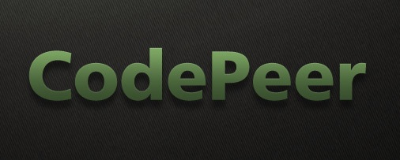
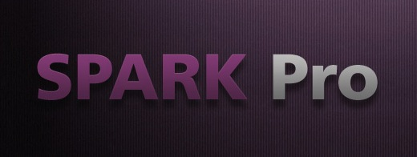
Formal analysis tools at AdaCore
“static analysis”
First release in 2009
Based on technology developed since 2002
Applicable on any Ada project
Many use cases:
Find bugs
Impact analysis
Code reviews
Race conditions
Robustness verification evidence
10% of our customers
“formal verification”
First release in 2010
Based on technology developed since 1983
Development discipline (Ada subset) and tools
Used for the most critical safety/security projects:
Check data flows
Guarantee no run-time errors
Functional verification
2% of our customers

Slide 5
1994
T
CodePeer vs. SPARK 2014

Slide 6
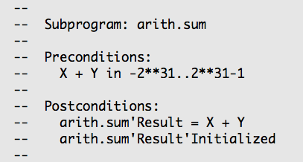

Simple Sum function without contract

Slide 7
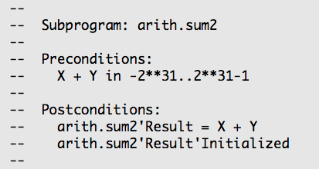
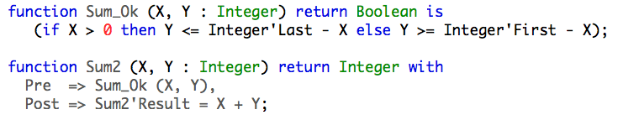
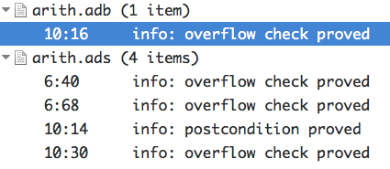
Simple Sum function with contract

Slide 8
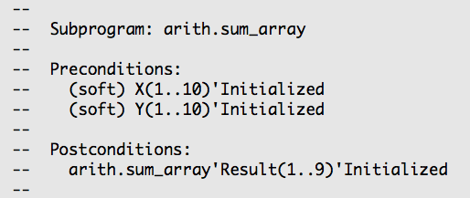

Sum function over arrays without contract

Slide 9
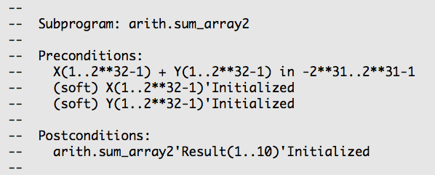

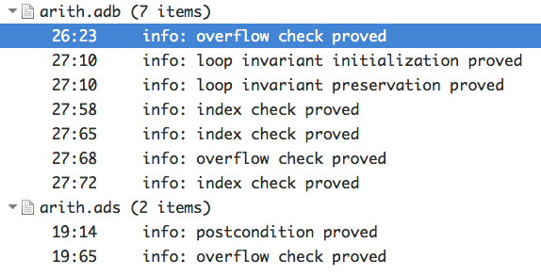
Sum function over arrays with contract

Slide 10
Summary of the comparison
Complex function without contract
Complex function with contract
Simple function with contract
Simple function without contract

Slide 11
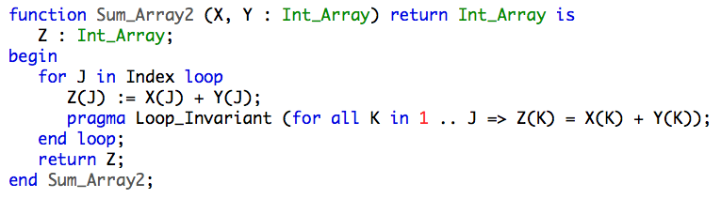
Contracts and loop invariants for
Contracts on all subprograms:
Loop invariants on all loops:

Slide 12
1994
T
SPARK 2014 update

Slide 13
SPARK 2014 vs. SPARK 2005
SPARK 2014 language subset is most of Ada 2012
SPARK and full Ada code can be combined easily
No contracts are required
Subprogram contracts use Ada 2012 preconditions and postconditions
Functional annotations can be executed, tested and proved
New aspects, pragmas and attributes supported for formal verification
SPARK 2014 aims at 100% automatic proof

Slide 14
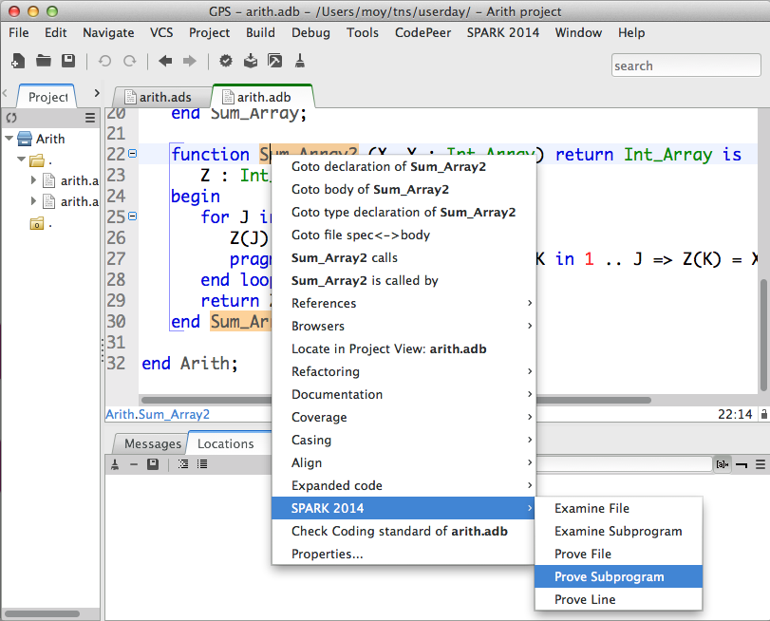
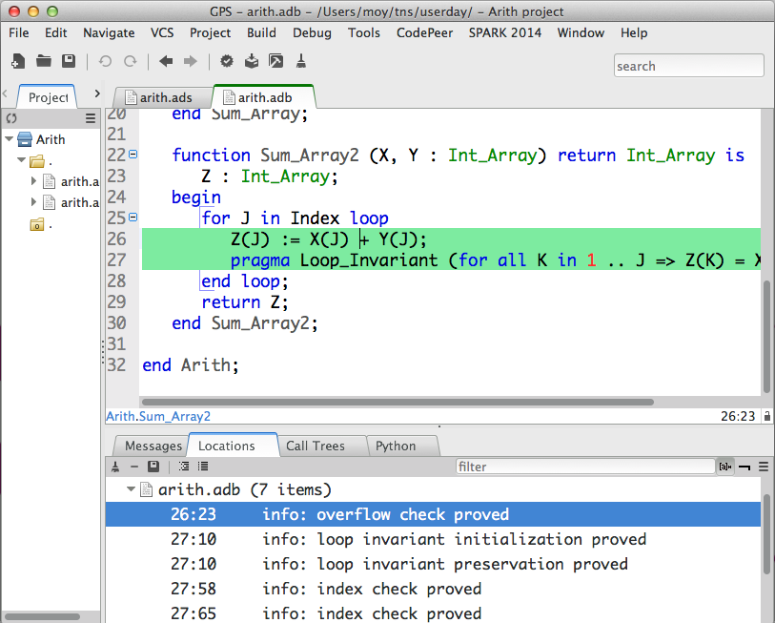
SPARK 2014 integration in GPS and GNATbench
Run on selected piece of code
Results linked to code

Slide 15
Feedback from industrial use
Medium use case from aerospace: 20.000 sloc, 5418 checks
Many Ada features used: generics, discriminant types, floating-points, etc.
Achieves 96% automatic proof (98% for assertions and contracts!)
Astrium assessment: « formal proof techniques did not, up to now, break through in the software industry in general and the space domain in particular […] SPARK 2014 has suppressed these current limitations of formal proof »
Results publicly available:
Project report at
http://www.open-do.org/wp-content/uploads/2013/05/Industrial_Case_Studies_Final_Report.pdf
DASIA conference article at
http://www.open-do.org/wp-content/uploads/2013/05/DASIA_2013.pdf
Article submitted at ERTS conference in Toulouse in February 2014

Slide 16
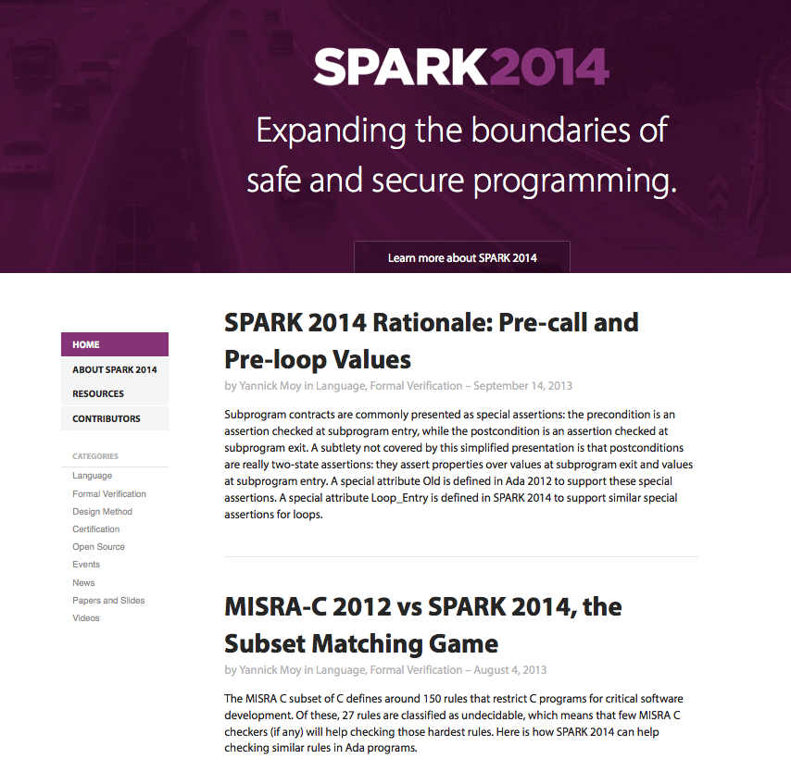
SPARK 2014 roadmap
November 2013: BETA release of SPARK Pro 14
April 2014: release of SPARK Pro 14
www.spark-2014.org

