Slide 1

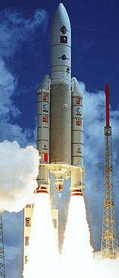
Formal Validation of Aerospace Software
DASIA 2013

Slide 2

Software crisis in space
Software was of low quality
Software often did not meet requirements
Projects were unmanageable and code difficult to maintain
…
15/05/2013
p<number>

Slide 3

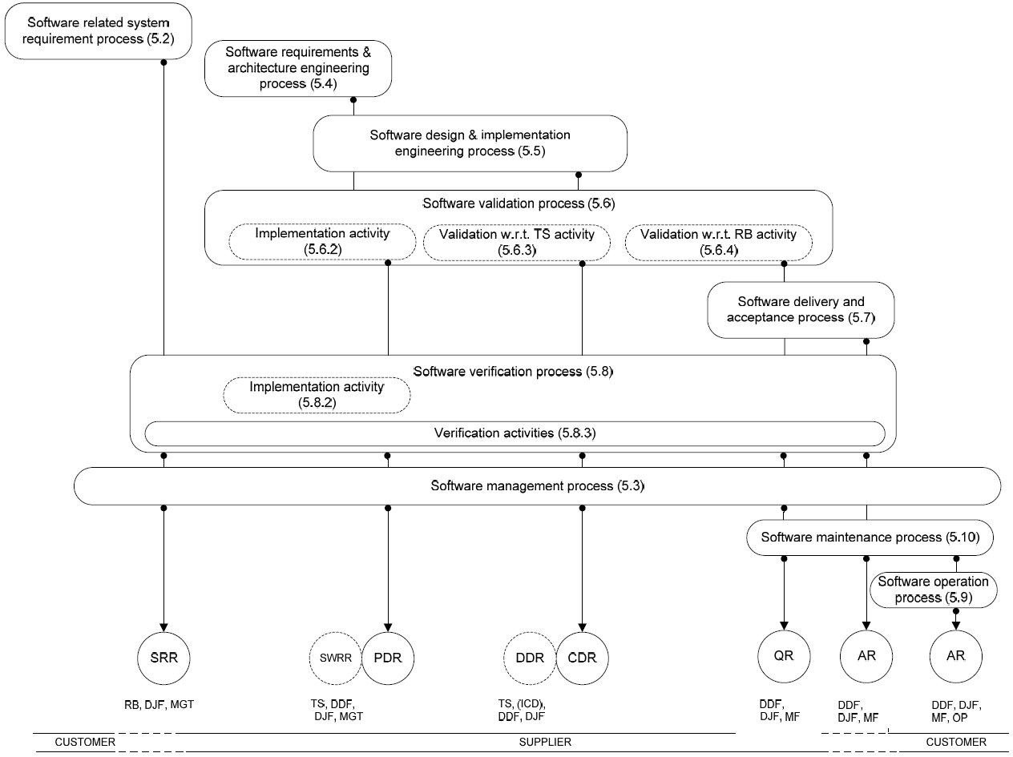

Where is the
software crisis?
15/05/2013
p<number>

Slide 4
The software crisis
is everywhere
Topics of this
presentation
15/05/2013
p<number>

Slide 5

Agenda
Implementation in C or in Ada? 
Ada 2012 and SPARK 2014 
Application – On Board Control Procedure 
Conclusion 
15/05/2013
p<number>

Slide 6
How to chose a programming language?
Availability of a compiler for the target
Quality of the compiler
Training of the development teams
What about the intrinsic qualities of the language?
Ada is known to be safer than C
15/05/2013
p<number>

Slide 7
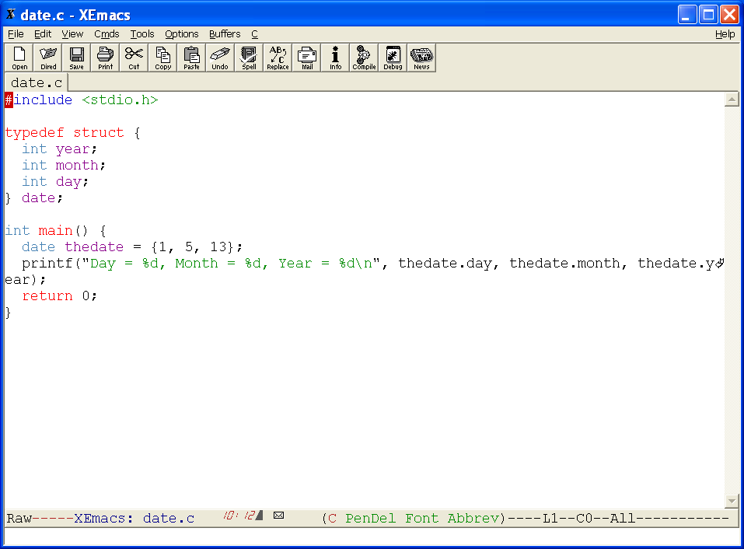
C syntax is
not always
perfectly clear
ISO format
French format
15/05/2013
p<number>

Slide 8
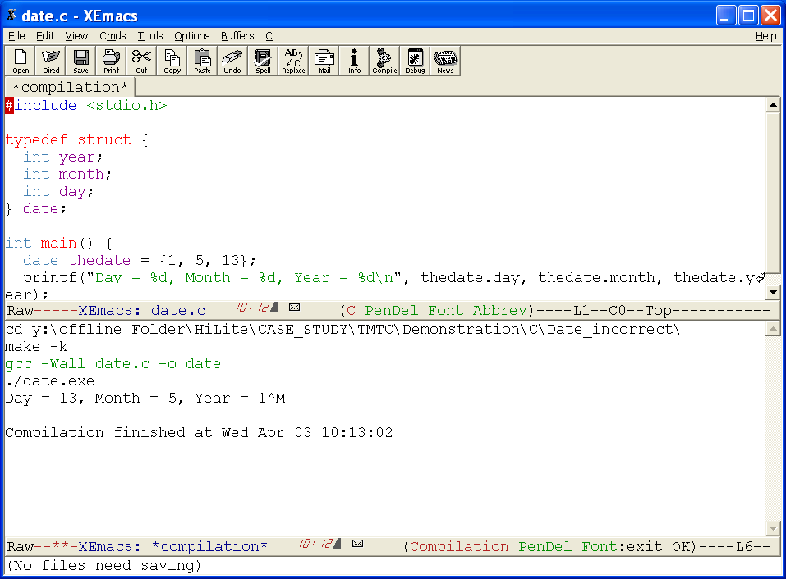
C syntax is
not always
perfectly clear
15/05/2013
p<number>

Slide 9
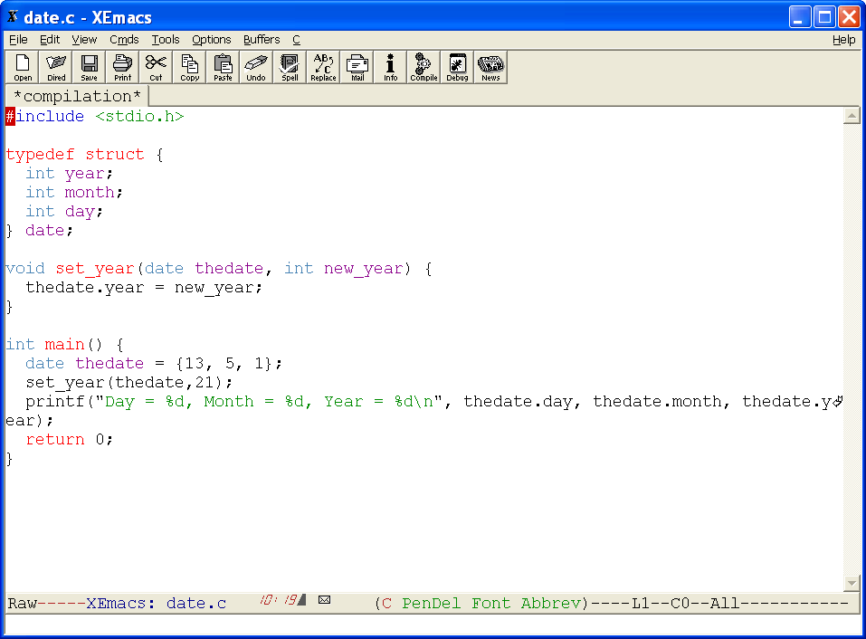
C syntax is
sometimes
not understandable
by a non expert
15/05/2013
p<number>

Slide 10
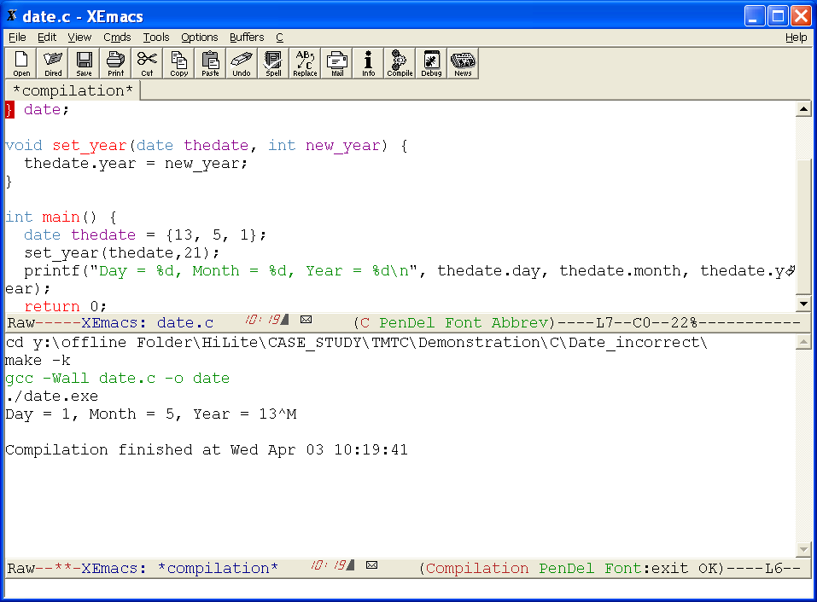
C syntax is
sometimes
not understandable
by a non expert
15/05/2013
p<number>

Slide 11
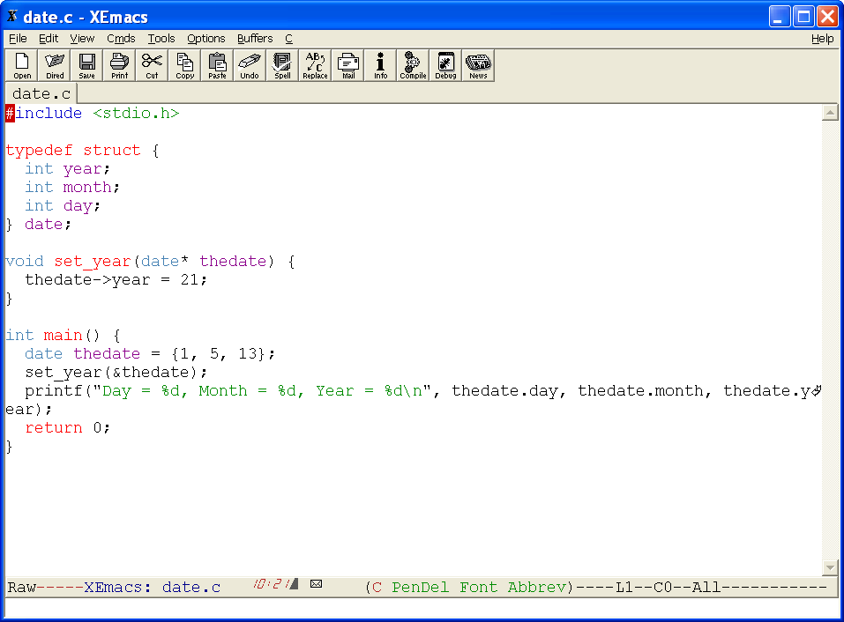
C syntax is
sometimes
not understandable
by a non expert
Can this code be reviewed by a non software engineer?
15/05/2013
p<number>

Slide 12
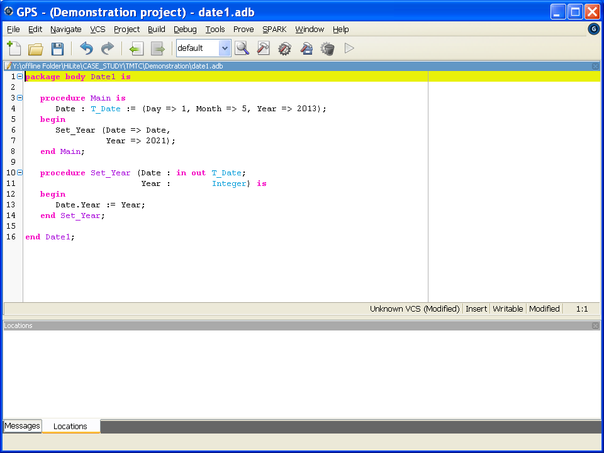
Ada has a less
ambiguous syntax
15/05/2013
p<number>

Slide 13
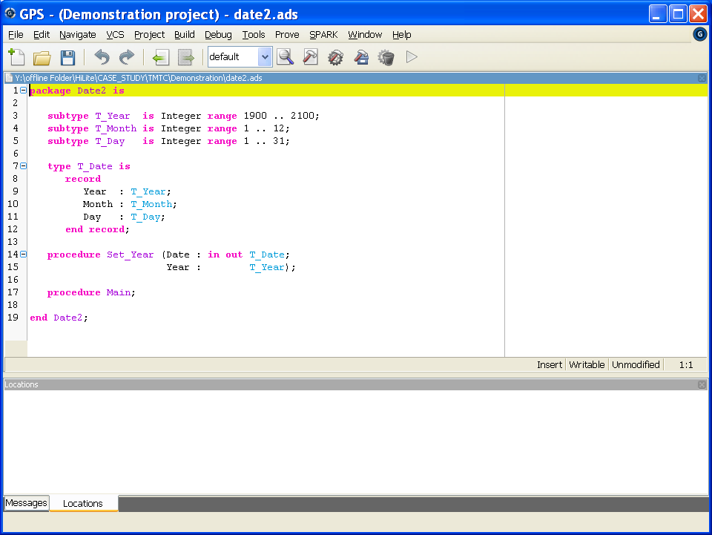
Ada has a less
ambiguous syntax
and a stronger
semantics
Does it really matter?
15/05/2013
p<number>

Slide 14
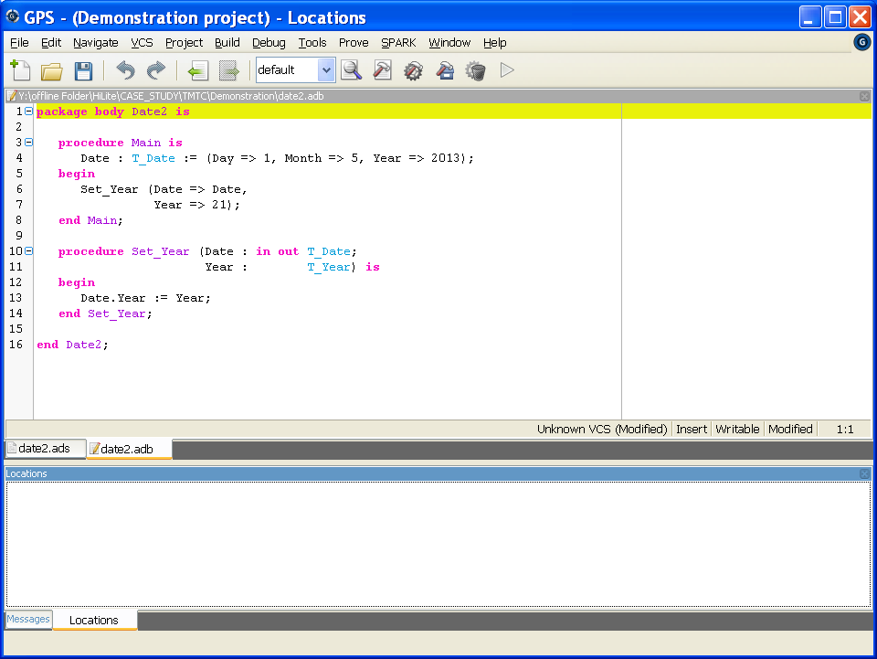
Does it really matter?
15/05/2013
p<number>

Slide 15
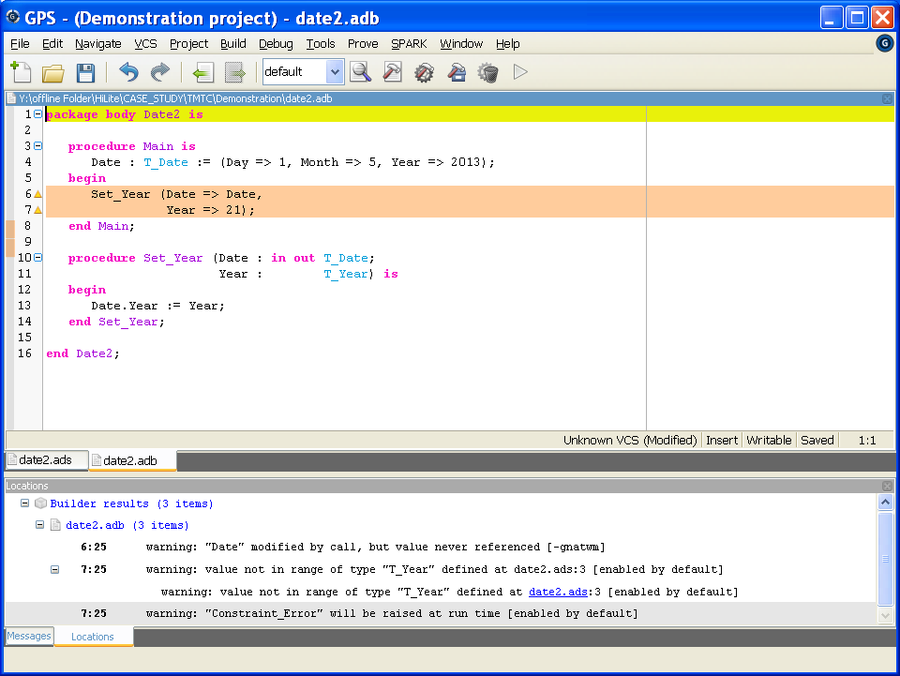
An Ada compiler
may detect bugs…
…even before testing
15/05/2013
p<number>

Slide 16
Is Ada the perfect programming language?
Unfortunately no!
15/05/2013
p<number>

Slide 17
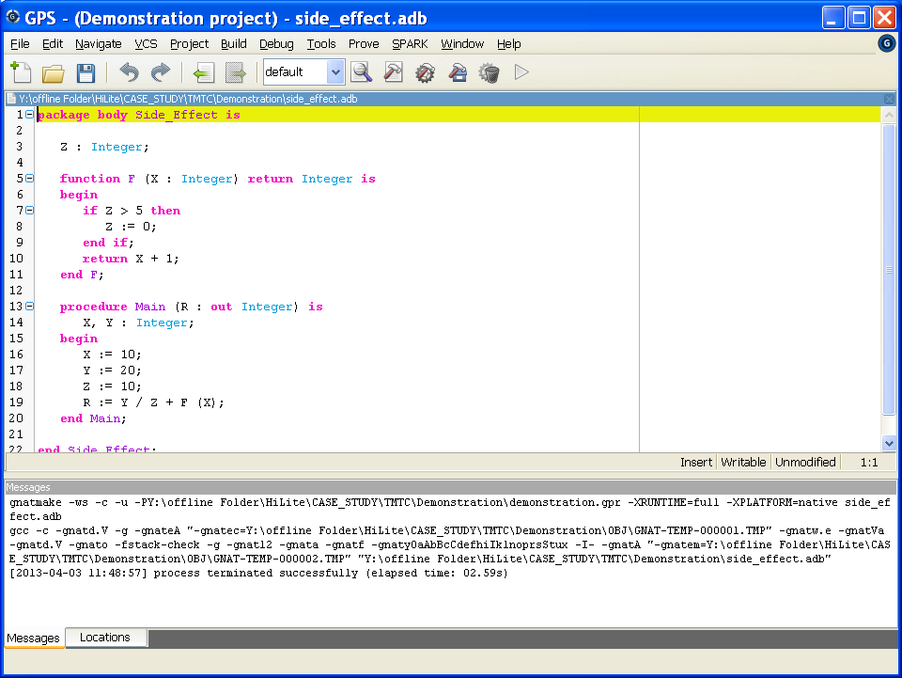
Correct if Y / Z is evaluated first
Run time error if
F(X) is evaluated first !
15/05/2013
p<number>

Slide 18








Objectives:
Improve the quality thanks to formal proof
Prepare SPARK 2014
15/05/2013
p<number>

Slide 19
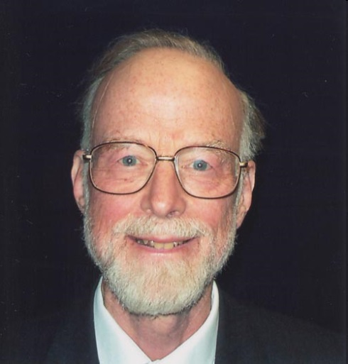
Our approach
There are two ways of constructing a
software design. One way is to make it so
simple that there are obviously no
deficiencies. And the other way is to make
it so complicated that there are no
obvious deficiencies.
Professor C. A. R. Hoare
The 1980 Turing award lecture
Applicable to
Requirements Baseline
Technical Specification
Design
Coding
Validation & Verification
Applicable to
Requirements Baseline
Technical Specification
Design
Coding
Validation & Verification
15/05/2013
p<number>

Slide 20
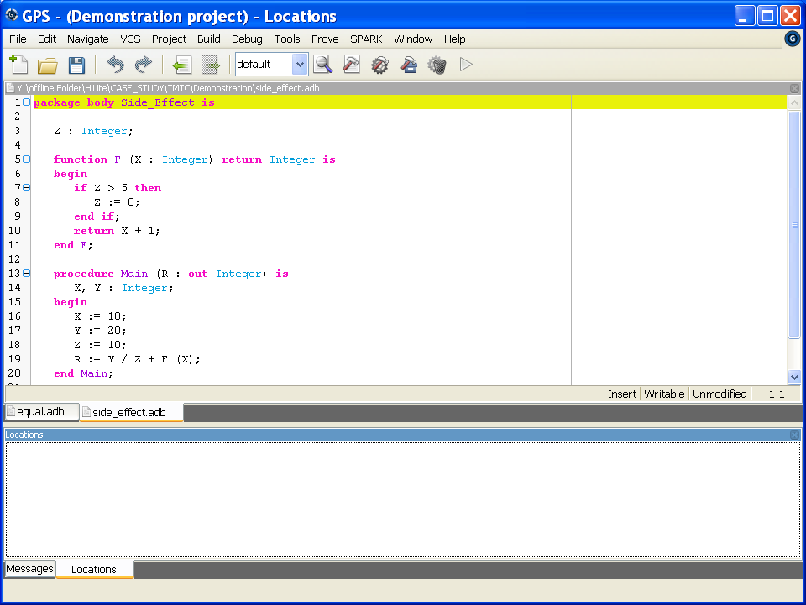
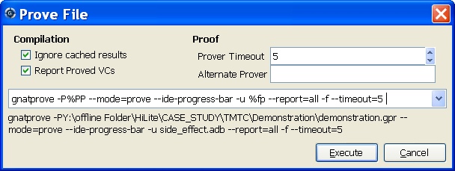
SPARK is
a restriction of Ada
15/05/2013
p<number>

Slide 21
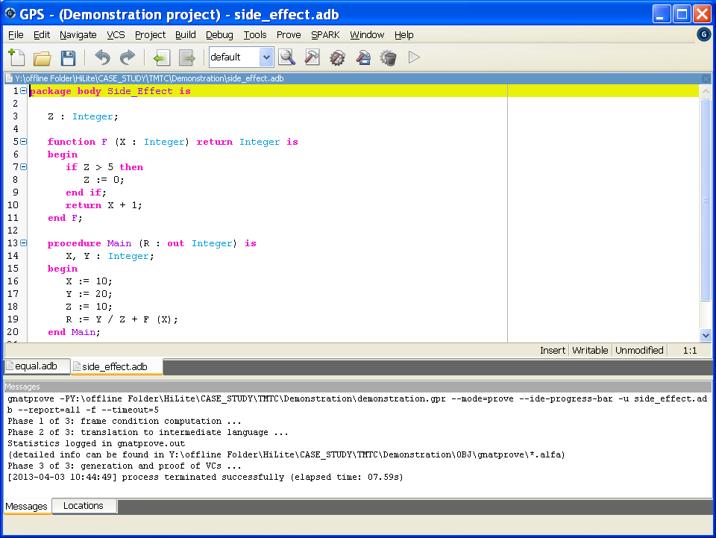
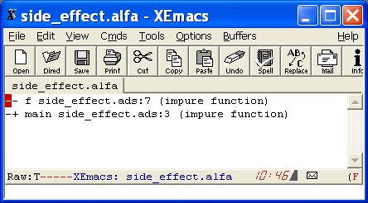
SPARK is
a restriction of Ada
Function with side effects
are potentially dangerous
and thus not in SPARK
15/05/2013
p<number>

Slide 22
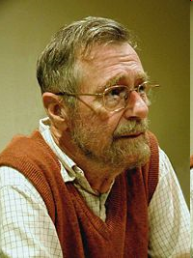
Limitations of testing
Testing shows the presence, not the absence of bugs
Edsger Wybe Dijkstra
15/05/2013
p<number>

Slide 23
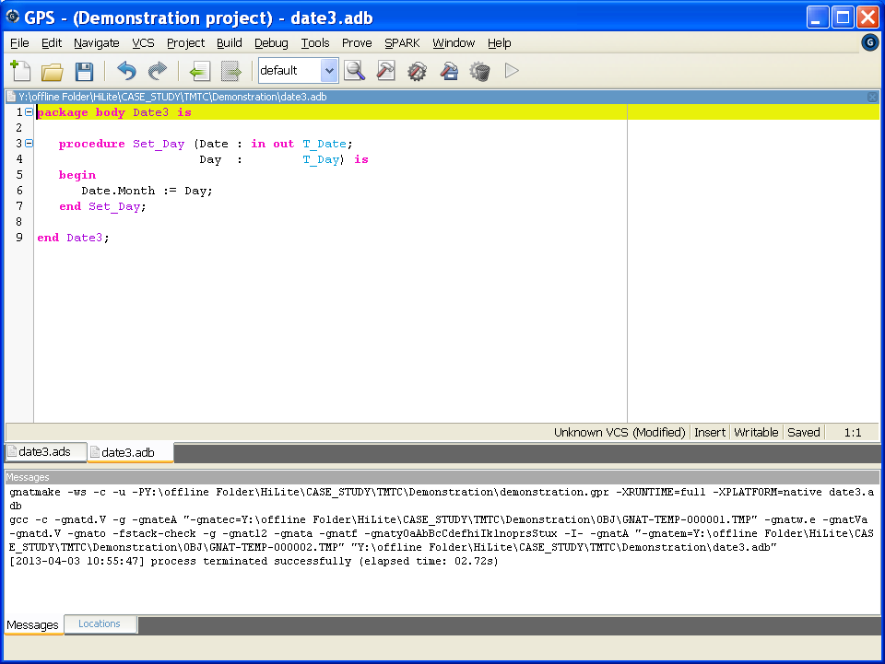
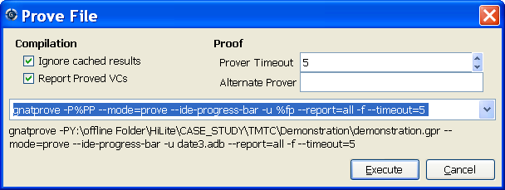
SPARK allows
formal proof
15/05/2013
p<number>

Slide 24
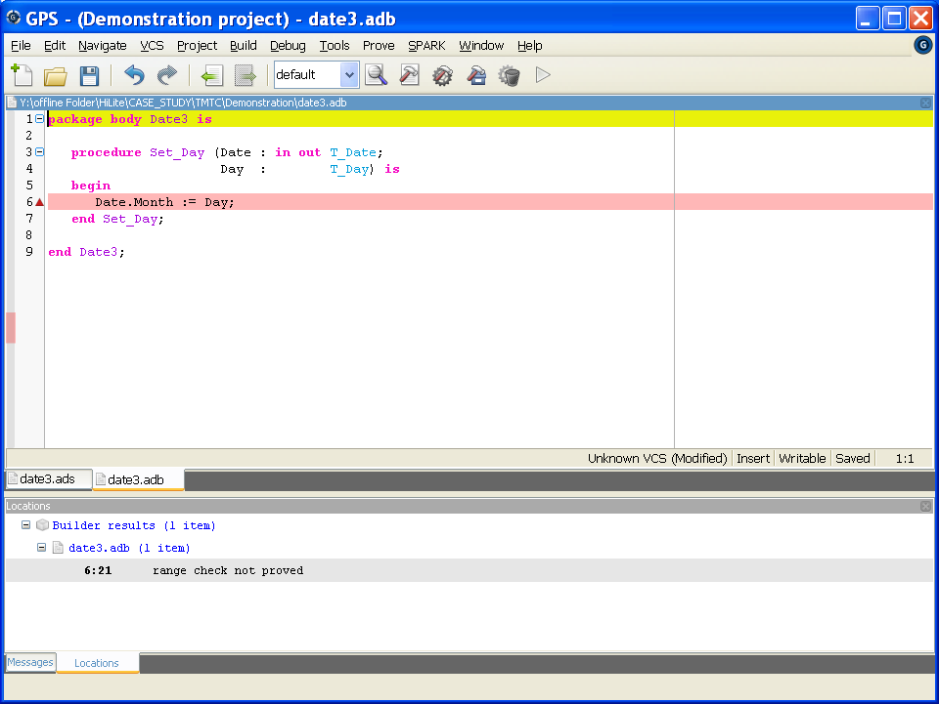
SPARK allows
formal proof
That is still SPARK 2005!
Why SPARK 2014?
15/05/2013
p<number>

Slide 25
Agenda
Implementation in C or in Ada? 
Ada 2012 and SPARK 2014 
Application – On Board Control Procedure 
Conclusion 
15/05/2013
p<number>

Slide 26
Ada 2012 and SPARK 2014
SPARK has been based on the notion of contract
  Pre- and Postcondition as logical formulas for formal proof
Ada 2012, inspired by SPARK, introduces executable contracts
  Pre- and Postconditions as Boolean expressions for dynamic verification
SPARK 2014 introduces formal proof for Ada 2012
  Ease of use (e.g. Boolean expressions instead of logical formulas)
  Support for dynamic verification (executable contracts)
  Automation of proof
  Mixing of dynamic and static verification
15/05/2013
p<number>

Slide 27
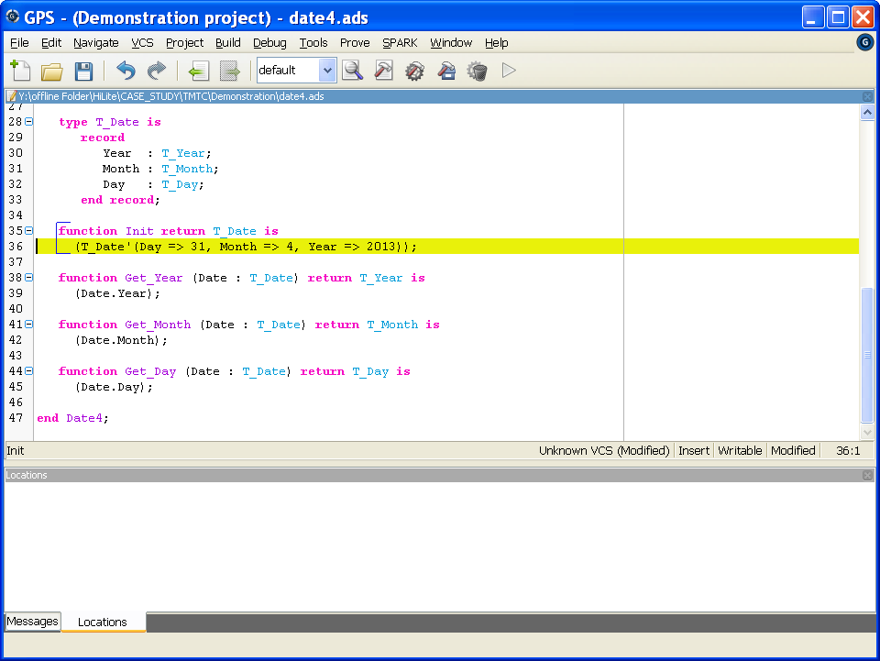
How can we avoid
such incorrect
setting?
15/05/2013
p<number>

Slide 28
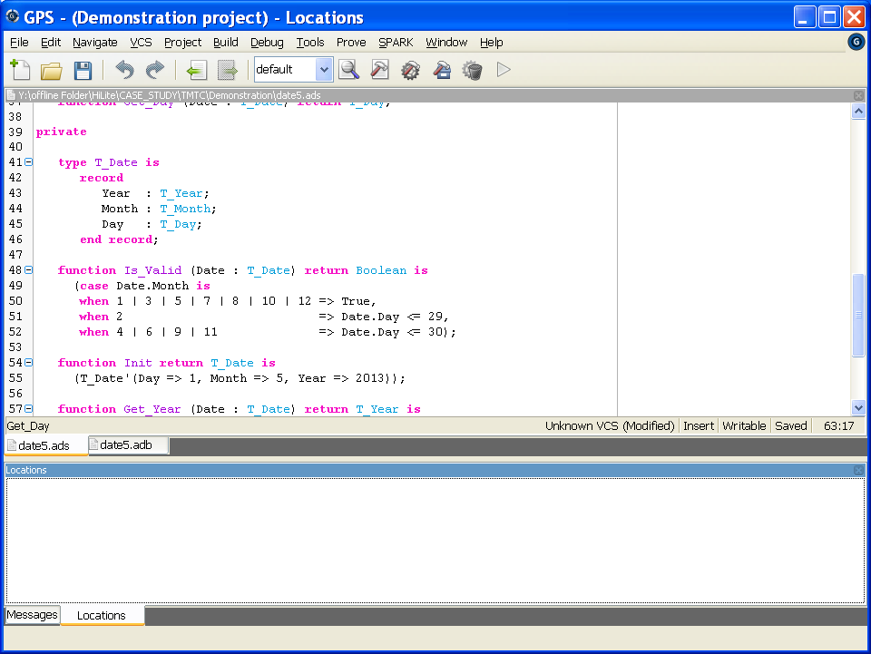

We can define
a validity function
New in
(expression function,
case expression)
15/05/2013
p<number>

Slide 29
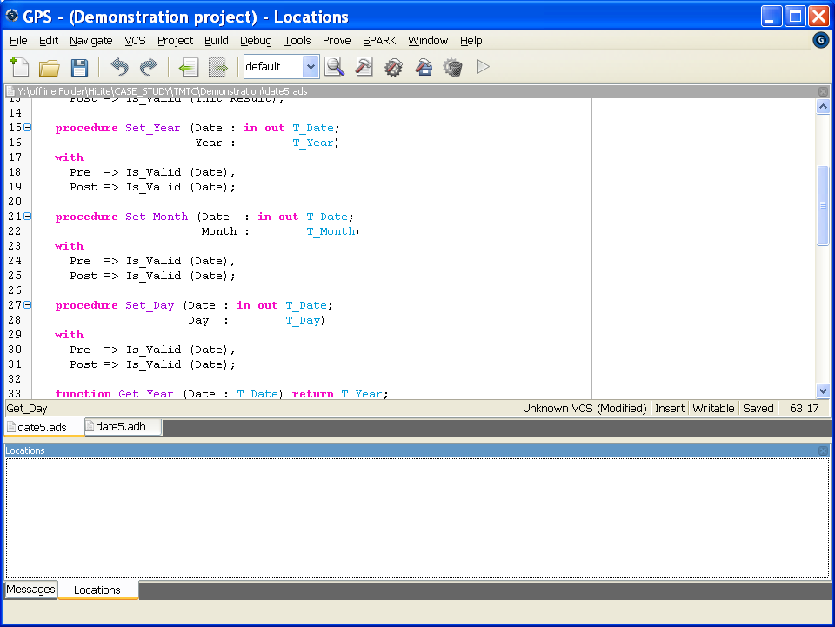
…and use it in
a contract
New in
(contract)
“Set_Year” can be called
only if its Precondition is true
Then, it ensures that
its Postcondition will be true
15/05/2013
p<number>

Slide 30
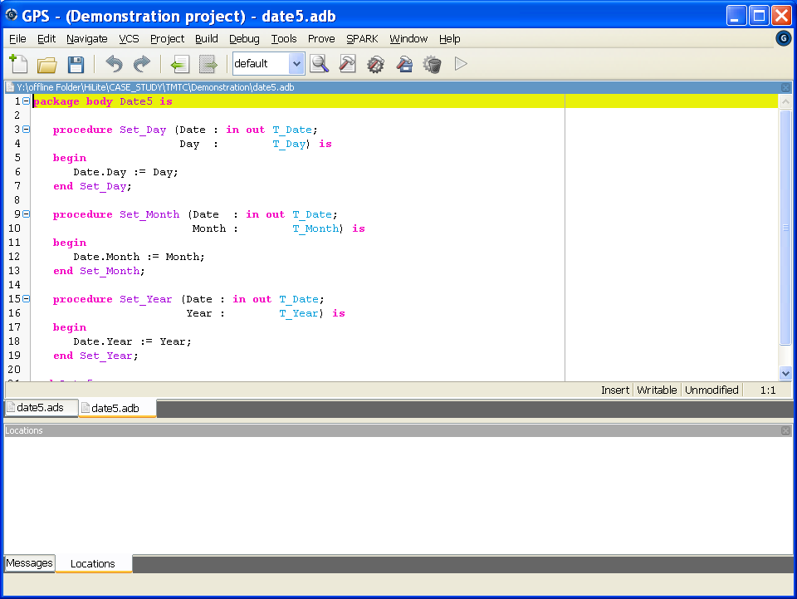

The correctness of
contracts can then
be formally proved
15/05/2013
p<number>

Slide 31
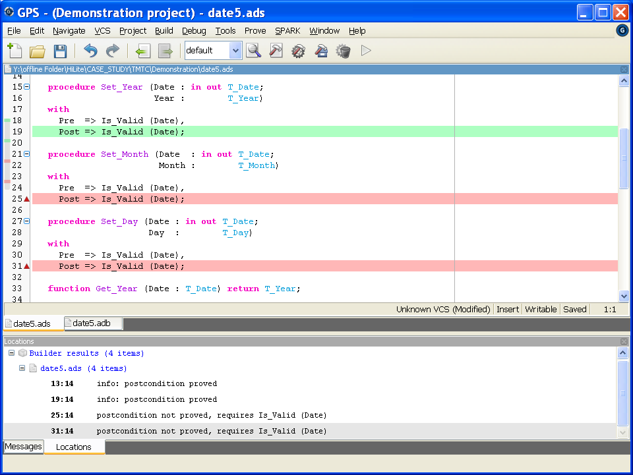
Proved!
Not proved!
Not proved!
15/05/2013
p<number>

Slide 32
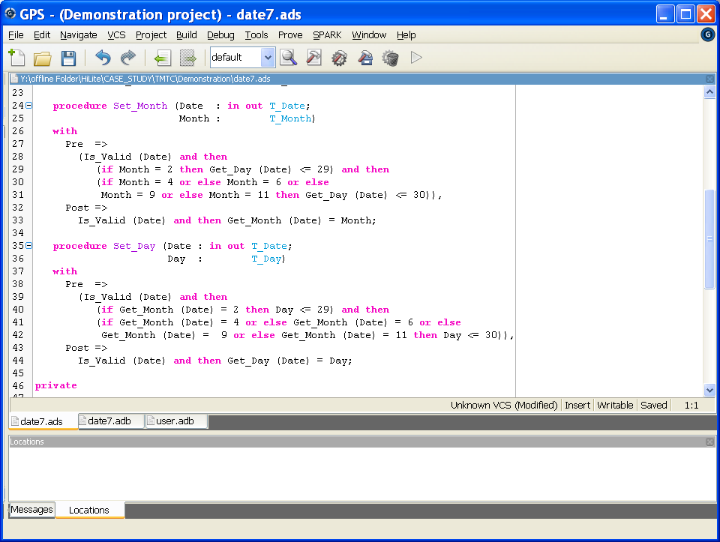
The contract
shall be
complete
15/05/2013
p<number>

Slide 33
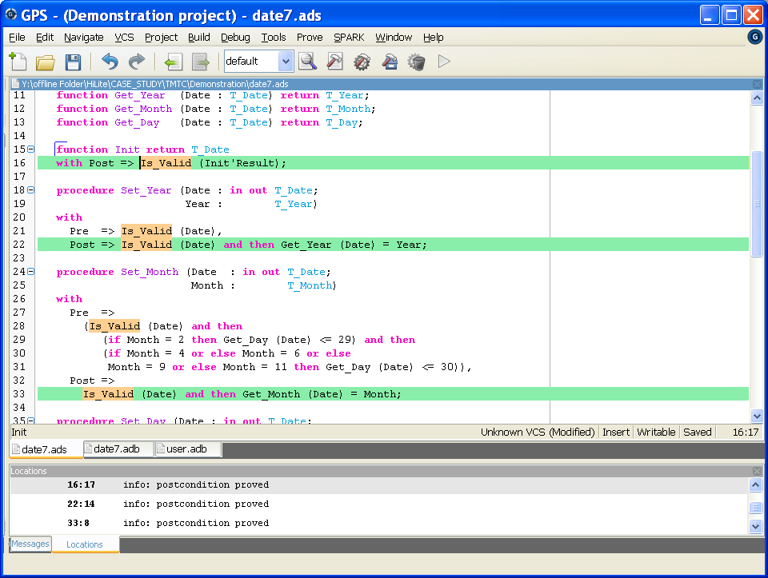
The code is now correct
Proved!
Proved!
Proved!
15/05/2013
p<number>

Slide 34
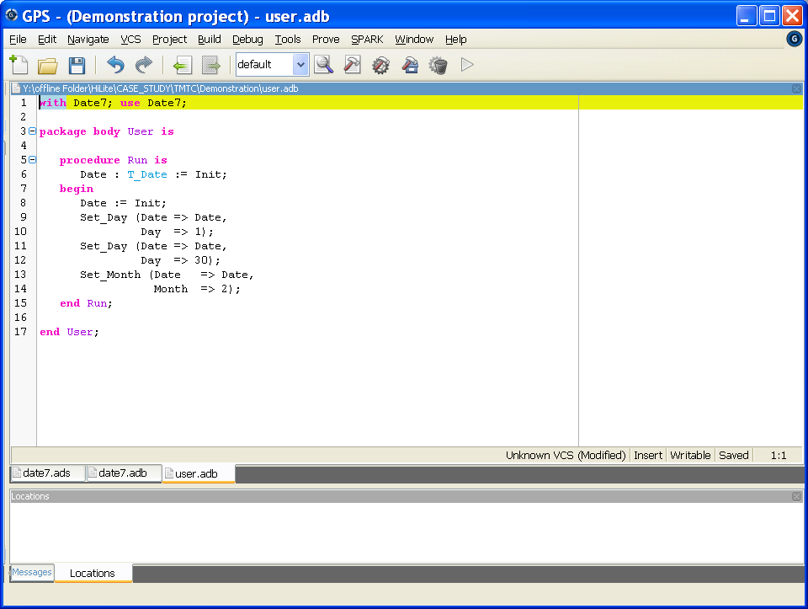
The proof tool
checks that the user
respects the contract
15/05/2013
p<number>

Slide 35
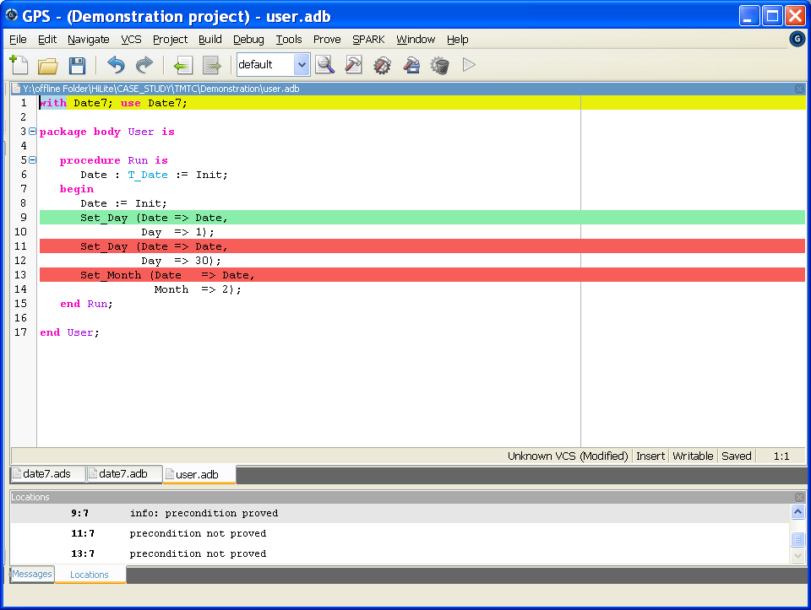
Proved!
Not proved!
Not proved!
The proof tool
checks that the user
respects the contract
15/05/2013
p<number>

Slide 36
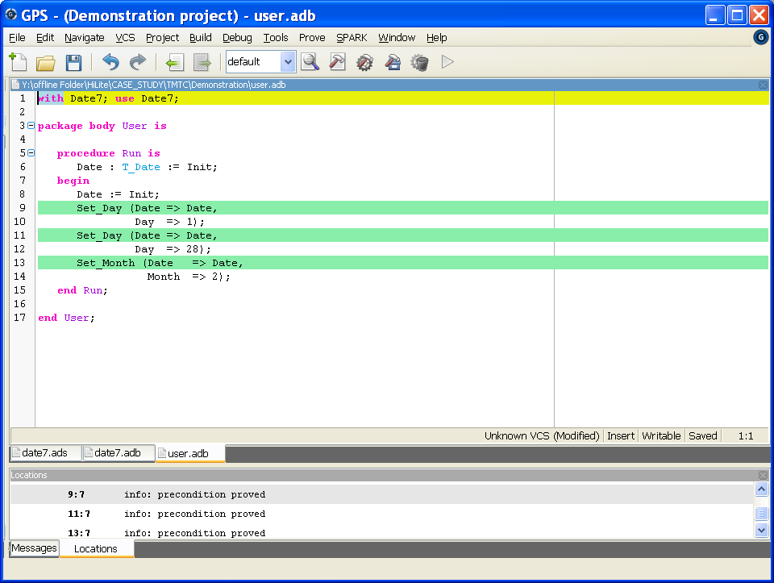
Proved!
Proved!
Proved!
The proof tool
checks that the user
respects the contract
15/05/2013
p<number>

Slide 37
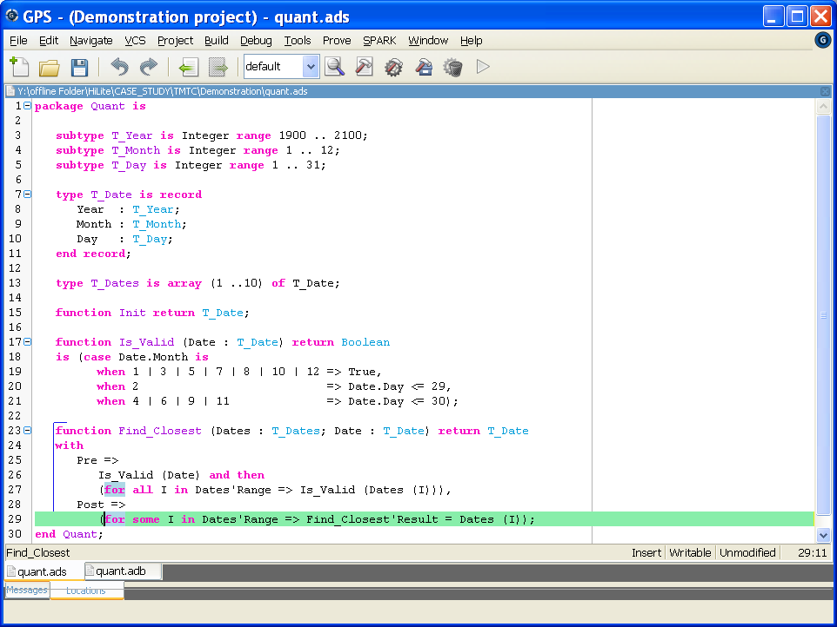
New in
(quantified expressions)
Express properties of arrays
15/05/2013
p<number>

Slide 38
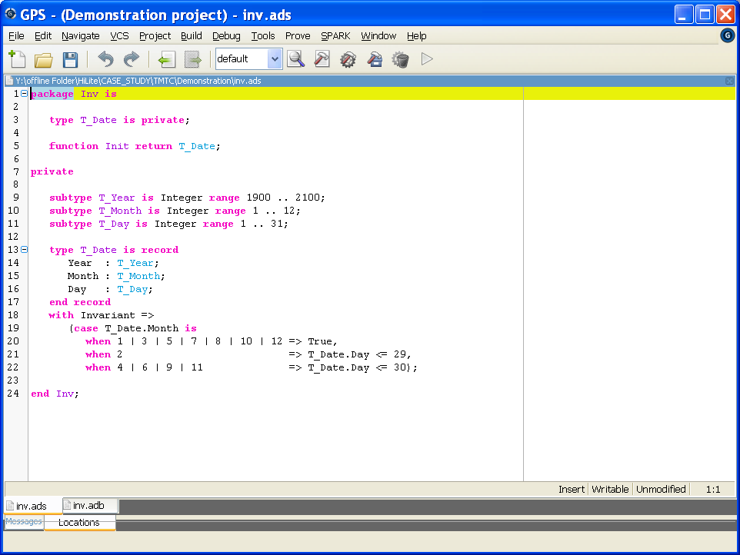
New in
(type invariants)
Avoid to write Is_Valid all the time
Not supported
by current version of proof tool
15/05/2013
p<number>

Slide 39
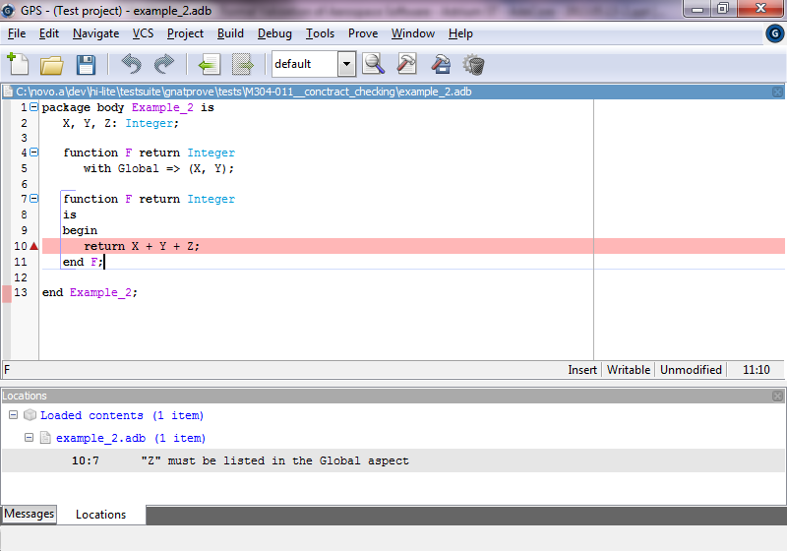
Keep track of global variables
Z is also read
New in SPARK 2014
(globals annotations)
15/05/2013
p<number>

Slide 40
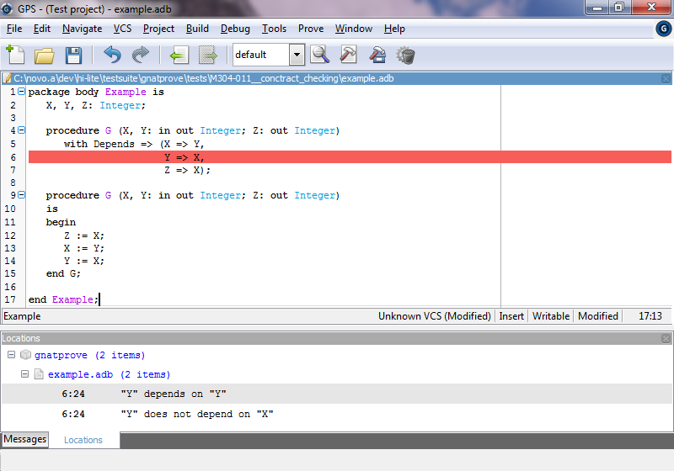
Incorrect flow
Keep track of information flow
New in SPARK 2014
(information flow)
15/05/2013
p<number>

Slide 41
SPARK 2014 – The tools
Automatic proof
Execution of annotations possible
  Allows dynamic verification of properties
Integration with tool chain:
  Compiler
  GUI
  Target configuration
15/05/2013
p<number>

Slide 42
SPARK 2014 Restrictions
Forbidden features:
  Access types (pointers)
  Exceptions
  Aliasing between variables
  Concurrency features of Ada (Tasking)
  Side effects in expressions and functions
But free mixing of SPARK and non-SPARK code possible
Combination of verification results possible
15/05/2013
p<number>

Slide 43
SPARK 2014 - Methodology
Proof as a means to increase confidence and cut cost
  Use proof when it is really required or cheaper than test
Unit Test as a fallback method
  Use test when full proof of some code is too complex or not applicable
Mixing of test and proof is supported
  Assumptions of proof can be verified by testing
  Avoid cost explosion of formal methods (All or nothing)
15/05/2013
p<number>

Slide 44
Agenda
Implementation in C or in Ada? 
Ada 2012 and SPARK 2014 
Application – On Board Control Procedure 
Conclusion 
15/05/2013
p<number>

Slide 45
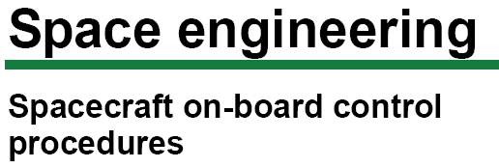


On-board control procedure
  Software program designed to be executed by an OBCP engine, which can easily be loaded, executed, and also replaced, on-board the spacecraft
OBCP code
  Complete representation of an OBCP, in a form that can be loaded on-board for subsequent execution
OBCP engine
  Application of the on-board software handling the execution of OBCPs
OBCP language
  Programming language in which OBCP source code is expressed by human programmers
15/05/2013
p<number>

Slide 46

OBCP architecture
Functional
Unit 2
Functional
Unit 1
Init
S1
S2
OBCP
engine
Init
S1
S2
Functional
Unit n
Functional
Unit 3
Init
S1
S2
Init
S1
S2
15/05/2013
p<number>

Slide 47
Example of contract
Example:
A list of event detection statuses
Request to reset the detection status for Event
procedure Reset_Event_Status (Event : in T_Event) with
Post =>
not Event_Status (Event).Detection and
(for all Other_Event in T_Event =>
(if Other_Event /= Event then
Event_Status (Other_Event) = Event_Status'Old (Other_Event)));
Post-condition
The detection of event is reset
For all other events
The detection status is unchanged
Event1
Event1
Event1
Event1
Event2
Event2
Event2
Event2
Event3
Event3
Event3
Event3
Not detected
Not detected
Not detected
Not detected
Detected
Not detected
Not detected
Not detected
Detected
Detected
Detected
Detected
15/05/2013
p<number>

Slide 48
Example of results
Features | Total cheks | Number proved | Percent proved
assertion | 385 | 385 | 100
discriminant_check | 767 | 767 | 100
loop_invariant_initialization | 2 | 2 | 100
loop_invariant_preservation | 2 | 2 | 100
overflow_check | 2 | 2 | 100
postcondition | 97 | 97 | 100
precondition | 413 | 413 | 100
range_check | 2 | 2 | 100
Total | 1670 | 1670 | 100
15/05/2013
p<number>

Slide 49
Some limitations of the proof tool
subtype R is Integer range 1 .. 100;
type T_Array is array (R range <>) of Boolean;
type T_Record (L : R) is
record
A : T_Array (1 .. L);
end record;
function G (X : T_Record) return Boolean is
(for all I in X.A'Range => X.A (I));
The size of an array
depends on a
discriminant
Not proved with
the current tool version
pragma Assert(X >= 0.0 and then x <= 180.0);
pragma Assert(Y >= -180.0 and then Y <= 0.0);
pragma Assert(Z >= 0.0 and then Z <= 1.0);
pragma Assert(X + Y >= 0.0);
Result := X + Y * Z;
pragma Assert (Result >= 0.0 and then Result <= 360.0);
Non linear
expression
15/05/2013
p<number>

Slide 50
Agenda
Implementation in C or in Ada? 
Ada 2012 and SPARK 2014 
Application – On Board Control Procedure 
Conclusion 
15/05/2013
p<number>

Slide 51
Formal Validation of Aerospace Software: Conclusion
A programming language with a formal semantics
  Increases the quality of the software
  Decreases the development costs
Formal proof can be used
  For complex software
  As an efficient complement of tests
SPARK 2014 is foreseen in … 2014
  Some developments are still in progress
15/05/2013
p<number>

Slide 52


Thank you for your attention
Any question ?
david.lesens@astrium.eads.net
kanig@adacore.com
15/05/2013
p<number>

