Slide 1


Slide 2

Objectives

Slide 3
Milestones

Slide 4
Partners

Slide 5






Project Partners

Slide 6
The Goals and Objectives for Project Hi-Lite
Bullet number one
  Sub bullet number two
  Sub bullet number three
Bullet number two
Bullet number three

Slide 7
Project Objectives
Facilitate proofs of safety / security
One language of assertions
Test + proofs + static analysis
SPARK profile for Ada
Mixed Ada-C code

Slide 8
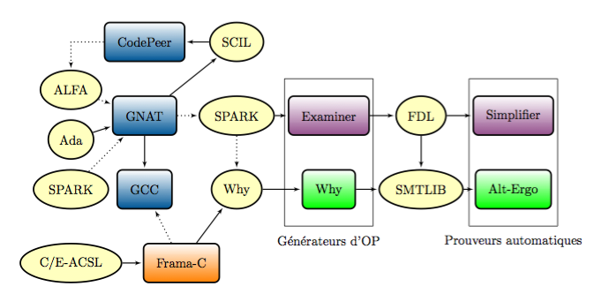
Schematic of proposed interaction

