Slide 1
Overview

Slide 2
A Little History

Slide 3
The Name
  First called DoD-1
  Renamed Ada after the "first programmer"
    Augusta Ada Byron, Countess of Lovelace
      Lord Byron's daughter
    Drafted a plan of how Charles Babbage's Analytical Engine might calculate Bernoulli numbers, now considered the first computer program
  Writing Ada is like writing C++
    The cognoscenti will know...
  An International Standards Organization standard
    A new version formally adopted about every 10 years

Slide 4
Ada Evolution Highlights
  Ada 83
    Abstract Data Types
    Modules
    Concurrency
    Generics
    Exceptions
    etc.
  Ada 95
    OOP
    Efficient synchronization
    Better Access Types
    Child Packages
    Annexes
  Ada 2005
    Multiple Inheritance
    Containers
    Better Limited Types
    More Real-Time
    Ravenscar
  Ada 2012
    Contracts
    Iterators
    Flexible Expressions
    More containers
    Multi-processor Support
    More Real-Time

Slide 5
Big Picture

Slide 6
Language Structure (Ada95 and Onward)
  "Core" is required of all implementations
    Reference Manual (RM) sections 1 through 13
    Predefined Language Environment (Annex A)
    Foreign Language Interfaces (Annex B)
  "Specialized Needs Annexes" are optional
    Provide more functionality but not additional syntax
    Systems Programming (C)
    Real-Time Systems (D)
    Distributed Systems (E)
    Information Systems (F)
    Numerics (G)
    High-Integrity Systems (H)

Slide 7
"Core" Language Content
  Several language-defined types, including string
  Extensive support for user-defined types
  Overloading procedures and functions
  Modules for compile-time visibility control
  Abstract Data Types
  Exceptions
  Generic Units
  High-level dynamic memory management
  Low-level Programming
  Object-Oriented Programming
  Concurrent Programming
  Contract-Based Programming

Slide 8
Ada Type Model
  Statically Typed
    Each object is permanently declared to be of one type
    Still have run-time polymorphism for OOP...
  Strongly Typed
    Compiler enforces appropriate manipulation and values
    Objects of "closely-related" types may be explicitly converted
    Conversions between unrelated types are explicitly unchecked
  Many types are predefined
  Users extend the language by defining additional application-specific types
    Optional!

Slide 9
Weakly-Typed Languages
typedef enum { north, south, east, west } directions;
typedef enum { mon, tue, wed, thur, fri, sat, sun } days;
directions heading;
days day;
day = wed;
day = north;
heading = east;
heading = south + north;
heading = tue + 3 * south/sun;

Slide 10
Strongly-Typed Languages
type Directions is ( North, South, East, West );
type Days is ( Mon, Tue, Wed, Thu, Fri, Sat, Sun );
Heading : Directions;
Day : Days;
...
Day := Mon;
Day := North; -- Compile Error
Heading := South;
Heading := Wed; -- Compile Error
Heading := Tue + 3 * South/Sun; -- Compile Error

Slide 11
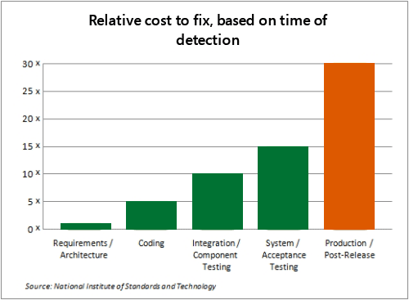
Type Model Benefit: Saves Money!
  Shifts costs from later, expensive phases to earlier, cheaper phase
image

Slide 12
Type Model Run-Time Costs
  Proper values verified during execution if necessary
  But performance of semantically identical programs will be the same
    Includes requirements for value checking
    If checking is not required turn it off!
  C
  int X;
  int Y; // range 1 .. 10
  ...
  if (X > 0 && X < 11)
  Y = X;
  else
  // signal a failure
  Ada
  X : Integer;
  Y, Z : Integer range 1 .. 10;
  ...
  Y := X;
  Z := Y; -- no range check required

Slide 13
Subprograms
  Can be either a function or a procedure
    Functions represent values
    Procedures represent actions
  Are syntactically distinguished
  function Is_Leaf (T : Tree) return Boolean
  procedure Split (T : in out Tree;
  Left : out Tree;
  Right : out Tree)
  Provide direct syntactic support for separation of specification from implementation
  function Is_Leaf (T : Tree) return Boolean;
  function Is_Leaf (T : Tree) return Boolean is
  begin
  ...
  end Is_Leaf;

Slide 14
Dynamic Memory Management
  Pointers are known to be error-prone
    Easy to misuse
  Ada defines more abstract facility
    Called "access types" instead of "pointers"
  Can designate "declared" or "allocated" objects
  Can designate subprograms
  Values always meaningful unless unchecked programming used
  Users can define their own storage managers

Slide 15
Packages
  Modules that group related entities together
  Support abstraction
    Separate specification from implementation
  Support information hiding
    Compiler enforces visibility for references by clients
  Isolate implementation decisions
    Defined in one place, used everywhere by clients

Slide 16
Package Structure
  Visible part
    Compiler allows client references
  package Name is
  -- exported declarations of
  -- types, variables, subprograms ...
  end Name;
  Implementation part
    Compiler prevents client references
  package body Name is
  -- hidden declarations of
  -- types, variables, subprograms ...
  -- implementations of exported subprograms etc.
  end Name;

Slide 17
Abstract Data Types (ADT)
  State is encapsulated within variables of the type
  Classic definition
    Set of applicable values
    Set of applicable operations on objects of the type
    Compile-time hidden representation
  The compiler enforces your application model
    Allowed values
    Allowed operations
  Makes the computer work for you
    Bookkeeping is what it does best!
    Allows us to focus on "the hard stuff"

Slide 18
Package Optional Private Part
package Name is
-- exported declarations of
-- types, variables, subprograms ...
private
-- hidden declarations of
-- types, variables, subprograms ...
end Name;
package body Name is
-- hidden declarations of
-- types, variables, subprograms ...
-- implementations of exported subprograms etc.
end Name;

Slide 19
Private Types
  Directly support Abstract Data Types
  package Bounded_Stacks is
  type Stack is private;
  procedure Push (This : in out Stack;
  Item : in Integer);
  procedure Pop (This : in out Stack;
  Item : out Integer);
  ...
  Max : constant := 100;
  private
  type Contents is array (1 .. Max) of Integer;
  type Stack is record
  Values : Contents;
  Top : Integer range 0 .. Max := 0;
  end record;
  end Bounded_Stacks;

Slide 20
Corresponding Expression In C++
#ifndef BOUNDED_STACKS_
#define BOUNDED_STACKS_
namespace Bounded_Stacks {
enum {Max=100};
class Stack {
public:
Stack();
void Push (int X);
void Pop (int& X);
private:
int Values[Max];
int Top;
}; // Stack
} // Bounded_Stacks
#endif

Slide 21
Exceptions
  Facilities for dealing with errors or other unexpected situations during execution
  Common in modern languages
    Represent errors and are raised when necessary
    Can be handled to express recovery
  Have different syntax from class-based languages
    Exceptions are not classes in Ada
  Allow flexible manipulation (within limits)
    Re-raising outside original scope, etc.
    Attaching messages to occurrences

Slide 22
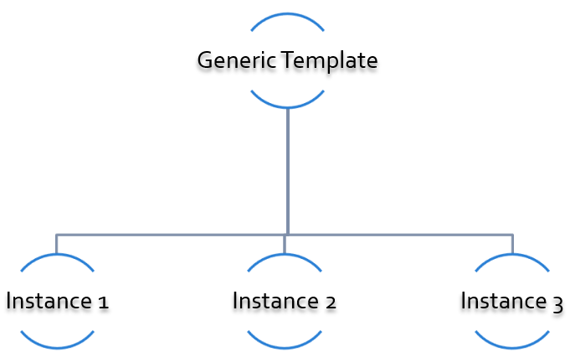
Generic Units
  Are templates for program units
    Subprograms
    Packages
  Allow parameterization of program units
    Tailorable components within a strongly typed environment
image

Slide 23
Generic Version of Stack ADT
generic
type Content is ... -- type is factored out
package Bounded_Stacks is
type Stack is private;
procedure Push (This : in out Stack;
Item : in Content);
procedure Pop (This : in out Stack;
Item : out Content);
...
Max : constant := 100;
private
type Contents is array (1 .. Max) of Content;
type Stack is
record
Values : Contents;
Top : Integer range 0 .. Max := 0;
end record;
end Bounded_Stacks;

Slide 24
Object-Oriented Programming
  Next step after "ADT Programming"
    Abstract Data Types
    Builds upon ADT concepts and practices
  OOP = ADT Programming plus run-time flexibility
  Directly supported
    Inheritance
    Run-time polymorphism
    Dynamic dispatching
    Abstract types and subprograms
    Interface types for multiple inheritance
      Thread-safe too

Slide 25
Contract-Based Programming
  Pre- and postconditions specify subprogram obligations for caller and implementer
  procedure P (This : in out Integer) with
  Pre => This < Integer'Last, -- Requirement
  Post => This = This'Old + 1; -- Guarantee
  Type Invariants ensure general properties of objects
  type Table is private with Invariant => Sorted (Table);

Slide 26
Pre- and Postconditions Example
package Bounded_Stacks is
type Stack is private;
function Empty (This : Stack) return Boolean;
function Full (This : Stack) return Boolean;
procedure Push (This : in out Stack; Value : Content)
with Pre => not Full (This),
Post => not Empty (This) and Top (This) = Value;
procedure Pop (This : in out Stack; Value : out Content)
with Pre => not Empty (This),
Post => not Full (This);
function Top (This : Stack) return Content
with Pre => not Empty (This);
private
...
end Bounded_Stacks;

Slide 27
Language-Based Concurrency Approach
  Compile-time checking
    Interactions
    Parameter types and modes
    Interface consistency
  Closer mapping of problem space
  Specific constructs for interactions
  Explicit interactions within source code
  Enhanced portability
    Source code
    People
    Much less dependent upon OS and vendor

Slide 28
Ada Concurrency Mechanisms
  Task objects
    Provide active threads of control
  Protected objects
    Passive
    Essentially "monitors" plua high-level condition synchronization
    Synchronize access to values without thread overhead
  Integrated with OOP
    Synchronized interfaces
    Dynamic dispatching to entries and protected subprograms
    Et cetera

Slide 29
Low Level Programming
  Facilities designed for embedded systems
    Direct manipulation of hardware
    Direct interaction with assembly language
  As effective as any high order language
    Expressive
    Well-specified
    Efficient
  Reasonably portable
    Not all software can or should be absolutely portable!
  Abstraction largely preserved

Slide 30
Low Level Programming Support
  Extensive representation queries
  Explicit representation specifications
    Flexible bit-specific type layouts with guaranteed semantics
    Size (in bits) for objects
    Storage requirements for tasks
    Dynamic storage collection ("heap") sizes for access types
    Memory locations for individual objects
    Others...
  Interfacing with other languages
    FORTRAN, C, Assembly, etc.
  Inline assembly language code insertions

Slide 31
Predefined Language Environment
  Standard types and operations for them
    Integer, floating- and fixed-point, unsigned
    Boolean
    Characters and Strings of different sizes
    etc.
  Character handling and string handling routines
  Elementary numeric functions (sine, cosine, etc.)
  Pseudo-random number generators
  I/O for text, direct/sequential binary, streams
  Exception information manipulation
  Command-line argument access
  Environment variables access and manipulation
  Standard "containers" data structures library
  And more...

Slide 32
Language Examination Summary
  A uniquely powerful combination of capabilities
  Designed with three overriding concerns
    Program reliability and maintenance
    Programming as a human activity
    Efficiency
  An easy-to-use language
    Once you know it!
    Very few pitfalls

Slide 33
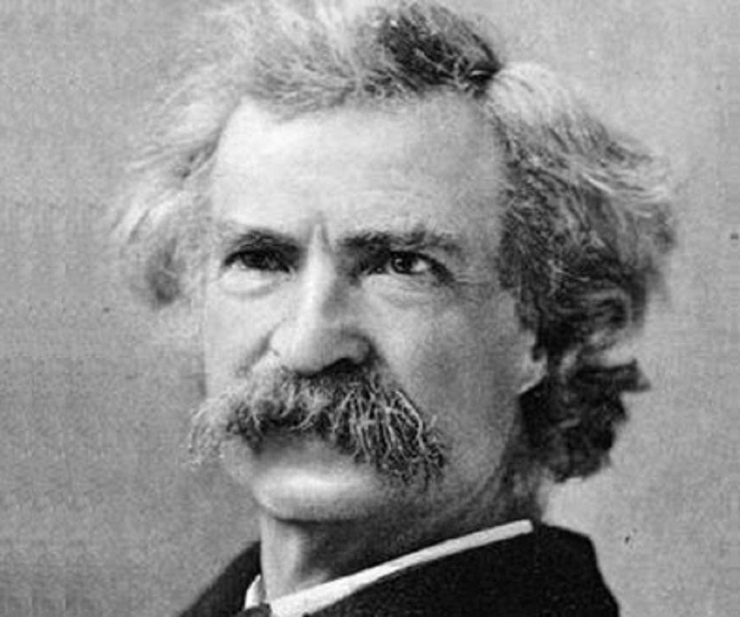
So Why Isn't Ada Used Everywhere?
  "... in all matters of opinion our adversaries are insane"
    Mark Twain
image

Slide 34
Setup

Slide 35
Canonical First Program
1 with Ada.Text_IO;
2 -- Everyone's first program
3 procedure Say_Hello is
4 Ada.Text_IO.Put_Line ("Hello, World!");
5 end Say_Hello;
  Line 1 - with - Notification of dependence on a module
  Line 2 - -- - Comment
  Line 3 - Say_Hello - Subprogram name
  Line 4 - Ada.Text_IO.Put_Line - Subprogram call
  Line 4 - "Hello, World!" - String literal (type-checked)

Slide 36
"Hello World" Lab
  Use an editor to enter the program shown on the previous slide
    Use your favorite editor or just gedit/notepad/etc.
  Save and name the file say_hello.adb exactly
    In a command prompt shell, go to where the new file is located and issue the following command:
      gnatmake say_hello
  In the same shell, invoke the resulting executable:
    say_hello (Windows)
    ./say_hello (Linux/Unix)

Slide 37
Declarations

Slide 38
Introduction

Slide 39
Some New or Possibly Different Symbols

Slide 40
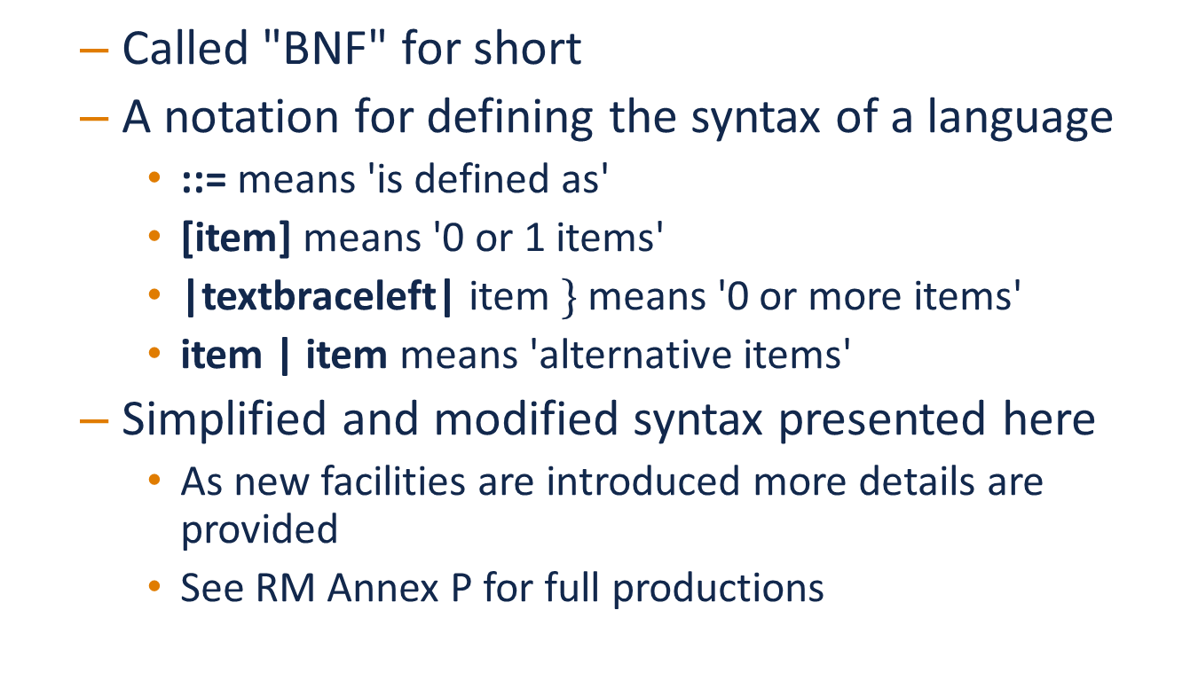
Backus-Naur Form
  Called "BNF" for short
  A notation for defining the syntax of a language
    ::= means 'is defined as'
    [item] means '0 or 1 items'
    |textbraceleft| item $\}$ means '0 or more items'
    item | item means 'alternative items'
  Simplified and modified syntax presented here
    As new facilities are introduced more details are provided
    See RM Annex P for full productions

Slide 41
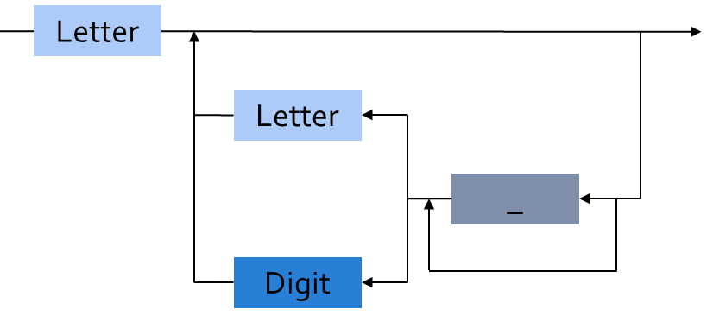
BNF for Identifiers
  identifier ::= letter {[underline] letter_or_digit}
  Legal identifiers
  Phase2
  A
  Space_Person
  Not legal identifiers
  Phase2__1
  A_
  _space_person
image

Slide 42
BNF for String Literals
string_literal ::= "{string_element}"
string_element ::=
"" | non_quotation_mark_graphic_character
graphic_character ::= identifier_letter |
digit |
special_character |
space_character
A_Null_String : constant string := "";
-- two double quotes with nothing inside*
String_Of_Length_One : constant string := "A";
Embedded_Single_Quotes : constant string :=
"Embedded 'single' quotes";
Embedded_Double_Quotes : constant string :=
"Embedded ""double"" quotes";
Note that the last example literal (that has embedded double quotes) is not an example of concatenation!

Slide 43
BNF Shows Only Syntax
  Not all details and no semantics
case_statement ::= case expression is
case_statement_alternative
{ case_statement_alternative }
end case;
case_statement_alternative ::=
when choice { | choice } =>

Slide 44
Identifiers, Comments, and Pragmas

Slide 45
Identifiers
  Syntax
  identifier ::= letter {[underline] letter_or_digit}
  Character set essentially Unicode 4.0
    Has 8-, 16-, and 32-bit characters and strings
  Rules
    Case is not significant
      SpacePerson is the same as SPACEPERSON
    Underline is significant
      But not the same as Space_Person
    May not be one of the reserved words (see RM 2.9)

Slide 46
Reserved Words
abort do not reverse
abs else null select
abstract (95) elsif of separate
accept end or some (2012)
access entry others subtype
aliased (95) exception out synchronized (2005)
all for overriding (2005) tagged (95)
and function package task
array generic pragma terminate
at goto private then
begin if procedure type
body in protected (95) until (95)
case interface (2005) range use
constant is record when
declare limited rem while
delay loop renames with
delta mod requeue (95) xor
digits new return

Slide 47
Comments
  Syntax
  comment ::= --{non_end_of_line_character}
  Terminate at end of line (i.e., no comment terminator sequence)
  -- This is a multi-
  -- line comment
  A : B; -- this is an end-of-line comment

Slide 48
Pragmas
  Compiler directives (pragma is "action" in Greek)
    Tell compiler to do something special
    Suggestions only, since compiler may not be able to comply
  Some are predefined
  Some are implementation-defined
    But portability becomes an issue
    But if that is what it takes...
  Unrecognized pragmas have no effect on semantics
    Must cause a warning (in standard mode)
    Malformed pragmas are illegal (predefined or not)

Slide 49
Numeric Literals

Slide 50
Decimal Numeric Literals
  Syntax
  decimal_literal ::= numeral [.numeral] [exponent]
  numeral ::= digit {[underline] digit}
  exponent ::= E [+] numeral | E - numeral
  Examples
  12 0 1E6 123_456
  12.0 0.0 0.456 3.14159_26
  Underscore is not significant

Slide 51
Based Numeric Literals
  Syntax
  based_literal ::= base # based_numeral [.based_numeral] # [exponent]
  base ::= numeral
  based_numeral ::= extended_digit {[underline] extended_digit}
  extended_digit ::= digit | A | B | C | D | E | F
  Base can be 2 .. 16
  Exponent is always a decimal number
  16#FFF# => 4095
  2#1111_1111_1111# => 4095
  16#F.FF#E+2 => 4095.0
  8#10#E+3 => 4096 (8 * 8**3)

Slide 52
Designed In Reaction To C's Based Literals
  C didn't support all the typical bases
    Only bases 8, 10, 16
    Why not base 2?! (It does now)
  C's octal literals started with zero
    Not human friendly $→$ unproductive
    Easy to misinterpret
    Easy to change without realizing

Slide 53
Object Declarations

Slide 54
Declarations
  Most declarations associate a name with an entity
    Objects
    Types
    Subprograms
    et cetera
  All names must be declared before used
    Most names must be explicitly declared
      User-defined objects!
    Some names are implicitly declared for you
      Types and operations
  Predefined items are of course already declared

Slide 55
Object Declarations
  Variables and constants
  Basic Syntax
  object_declaration ::= defining_identifier_list :
  [constant] subtype_indication [:= expression];
  defining_identifier_list ::= defining_identifier
  {, defining_identifier}
  subtype_indication ::= name [constraint]
  Examples
  Z, Phase : Analog;
  Max : constant Integer := 200;
  -- variable with a constraint
  Count : Integer range 0 .. Max := 0;
  -- dynamic initial value via function call
  Root : Tree := F(X);

Slide 56
Multiple Object Declarations
  Allowed for convenience
  A, B : Integer := F(X);
  Semantically same as series of single declarations
  A : Integer := F(X);
  B : Integer := F(X);
  Thus they could receive different values!
  T1, T2 : Time := Clock;

Slide 57
Predefined Declarations
  Many items are already declared for users
    Defined by language standard
    Defined by the implementation
  See Annex A for details of predefined declarations
    Package named Standard
    Numeric types and operators
    Character types and string types
    Input/Output facilities
    String handling facilities
    Access to command line arguments
    Many, many others
  Half the RM describes the Standard Libraries
    Some in the optional Specialized Needs Annexes too

Slide 58
Implicit vs. Explicit Declarations
  Explicit declarations actually appear in the source
  type Counter is range 0 .. 1000;
  Implicit declarations are declared automatically by the compiler
  function "+" ( Left, Right : Counter ) return Counter;
  function "-" ( Left, Right : Counter ) return Counter;
  function "*" ( Left, Right : Counter ) return Counter;
  function "/" ( Left, Right : Counter ) return Counter;
  ...

Slide 59
Elaboration
  Means by which declarations achieve their effects
  Essentially the execution of the declaration
    Happens at run-time, if at all
  Objects
    Memory logically allocated
    Initial values assigned
  Elaboration is linear, based on the program text
  declare
  First_One : Integer := 10;
  Next_One : Integer := First_One;
  Another_One : Integer := Next_One;
  begin
  ...

Slide 60
Universal Types

Slide 61
Universal Types
  Implicitly defined
  Represent entire classes of numeric types
    universal_integer
    universal_real
    universal_fixed
  Values match any integer or real type, respectively
    Values are implicitly converted to required type
    X : Integer64 := 2;
    Y : Integer8 := 2;

Slide 62
Numeric Literals Are Universally Typed
  No need to specify the "size" or "class"
    No need for suffixes indicating unsigned, long, etc
    e.g 0UL in C
  Compiler keeps everything straight
    No bugs due to loading insufficient number of bytes
    X : Unsigned_Long := 0;
    Y : Unsigned_Short := 0;

Slide 63
Literals Must Match "Class" of Context
  universal_integer literals match the integer types
  universal_real literals match the fixed and floating point types
  Legal
  X : Integer := 2;
  Y : Float := 2.0;
  Not legal
  X : Integer := 2.0;
  Y : Float := 2;

Slide 64
Named Numbers

Slide 65
Named Numbers
  Associate a name with a literal expression
    Presumably to be used in place of the expression
  Syntax
  number_declaration ::=
  defining_identifier_list : constant
  := static_expression;
  Expression must be static
  Are of universal types
    universal_integer and universal_real
    Thus compatible with any integer or real type, respectively
  Pi : constant := 3.141592654;
  One_Third : constant := 1.0 / 3.0;

Slide 66
A Sample Collection of Named Numbers
package Physical_Constants is
Polar_Radius : constant := 20_856_010.51;
Equatorial_Radius : constant := 20_926_469.20;
Earth_Diameter : constant :=
2.0 * ((Polar_Radius + Equatorial_Radius)/2.0);
Gravity : constant := 32.1740_4855_6430_4;
Sea_Level_Air_Density : constant :=
0.002378;
Altitude_Of_Tropopause : constant := 36089.0;
Tropopause_Temperature : constant := -56.5;
end Physical_Constants;

Slide 67
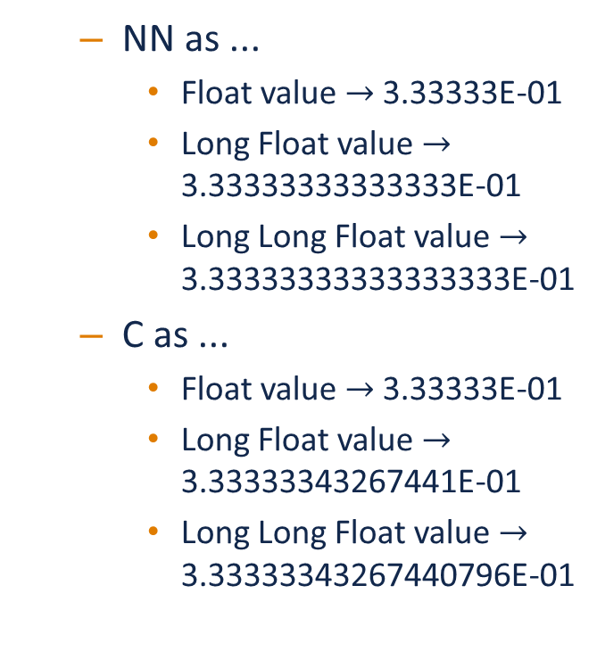
Named Number Benefit
  Evaluated exactly at compile time
    Just as if expression was used directly in the code
  Thus no loss of accuracy in different type contexts
NN : constant := 1.0 / 3.0;
C : constant float :=
1.0 / 3.0;
  NN as ...
    Float value $→$ 3.33333E-01
    Long Float value $→$ 3.33333333333333E-01
    Long Long Float value $→$ 3.33333333333333333E-01
  C as ...
    Float value $→$ 3.33333E-01
    Long Float value $→$ 3.33333343267441E-01
    Long Long Float value $→$ 3.33333343267440796E-01

Slide 68
Scope and Visibility

Slide 69
Scope and Visibility
  Determine those places in which a given name can be used to reference a given entity
  Scope of a name
    Region of text where potentially available for reference
    No longer exists when no longer "in scope"
    Scopes can be nested
  Visibility of a name
    Region of text where actually available for reference
    Visibility rules determine which names are visible
    When hidden, a name is "in scope" but not visible

Slide 70
Introducing Block Statements
  Statements with an optional declarative part
    Must occur within sequence of statements (between begin-end reserved word pairs)
    Can be nested since they are themselves statements
  Form a semi-complete context for visibility examples
  Syntax
  [block-name :] declare
  {declarative part}
  begin
  statement-sequence
  end [block-name];
  Example
  Swap: declare
  Temp : Integer;
  begin
  Temp := U;
  U := V;
  V := Temp;
  end Swap;

Slide 71
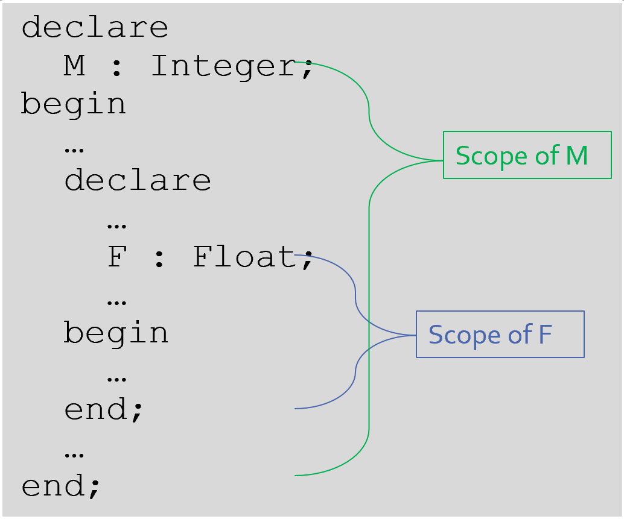
Scope and "Lifetime"
  Declared objects exist as long as they are in scope
  Not controlled by keywords such as static etc.
image

Slide 72
Name Hiding
  Results from "homographs"
    Homographs are indistinguishable names
  declare
  M : Integer;
  begin
  ... -- M here is an INTEGER
  declare
  M : Float;
  begin
  ... -- M here is a FLOAT
  end;
  ... -- M here is an INTEGER
  end;

Slide 73
Overcoming Hiding
  Based on providing additional name qualifiers
    Works for any named scope
  But should question use of object homographs
    These are just example names - not necessarily good ones!
Outer : declare
M : Integer;
begin
...
declare
M : Float;
begin
Outer.M := Integer(M);
end;
...
end Outer;

Slide 74
Aspect Clauses

Slide 75
Aspect Clauses
Language Variant
Ada 2012
  Define characteristics of a declared entity
  Applicable to objects, types, program units, etc.
  Syntax
  aspect_specification ::= with aspect_mark [ => expression]
  {, aspect_mark [ => expression] }
    Note this is always part of a larger construct, i.e., never stand-alone
  Many `aspect_mark`s defined by the language
  Vendors can define `aspect_mark`s too

Slide 76
Aspect Clause Example: Objects
Language Variant
Ada 2012
  Updated object syntax
  object_declaration ::= defining_identifier_list :
  [constant] subtype_indication
  [:= expression]
  with aspect_mark [ => expression]
  {, aspect_mark [ => expression] };
  Usage
  CR : Control_Register
  with Size => 8,
  Address => To_Address (16#DEAD_BEEF#);

Slide 77
Boolean Aspect Clauses
Language Variant
Ada 2012
  Support shorthand when "True" is the value to be specified
    Longhand
    procedure Foo with inline => true;
    Shorthand
    procedure Foo with inline;
  If aspect is omitted entirely, the value is "False"
    Longhand
    procedure Foo with inline => false;
    Shorthand
    procedure Foo;
      Original form!

Slide 78
Summary

Slide 79
Summary
  BNF provides a detailed syntax definition
    See Annex P, including index at end
  All declarations are permanently of a single type
    But recall flexibility of OOP from Overview
  Elaboration concept is not really new
    Applies to other entities as well as objects
  Scope and visibility rules are fairly traditional
    New language constructs deal with problems
  More detail will be introduced as need arises
    How and when scopes come into existence
    Additional declarations
    Aspect clauses for other entities

Slide 80
Basic Types

Slide 81
Introduction

Slide 82
Ada Type Model
  Statically Typed
    Each object is permanently declared to be of one type
  Strongly Typed
    Based on types' names
    Compiler enforces appropriate manipulation and values
    Objects of "closely-related" types may be converted
    Conversions between unrelated types are not checked
  Many types are language-defined
  Users extend the language by defining new types
    Optional, could make everything a single (numeric) type if you wish...

Slide 83
Strong Typing
  Definition of type
    Set of applicable values
    Set of applicable operations on objects of the type
  The compiler enforces your application model
    Allowed values
    Allowed operations
  Making the computer work for you
    Bookkeeping is what it does best!
    Allows us to focus on "the hard stuff"

Slide 84
A Little Terminology
  Type names are introduced by declarations
  type name is type-definition;
  A type-definition defines the type's structure
    Characteristics and operations
    The "kind" of the type itself
    type typemark is digits 12; -- floating point
    type typemark is range -200 .. 200; -- signed integer
    type typemark is mod 256; -- unsigned integer

Slide 85
Ada Uses "Named Typing"
  Types are differentiated by name, not structure
  Hence identical structures do not convey interoperability
  type Yen is range 0 .. 100_000_000;
  type Ruble is range 0 .. 100_000_000;
  Mine : Yen;
  Yours : Ruble;
  ...
  Mine := Yours; -- not legal

Slide 86
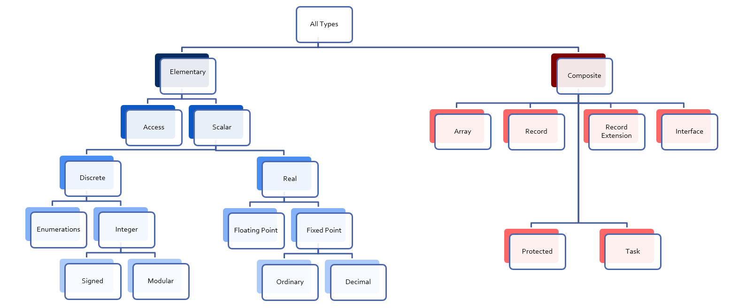
Categories of Types
image

Slide 87
Scalar Types
  Logically indivisible
    Have no components
  Ordered
    Relational operators <, >, =, /=, and so on are defined
  Support common "attributes" (language-defined functions applied to types)
  Flavors
    Discrete Types
    Real Types

Slide 88
Discrete Types

Slide 89
Discrete Types
  Define individual ("discrete") values
    1,2,3,4 ...
    Red, Yellow, Green
  Signed integer types
  Modular integer types
    Unsigned values with wrap-around semantics
  Enumeration types
    An enumerated list of values

Slide 90
Signed Integer Types
  Define a range of signed whole numbers
    Symmetric around zero
  Syntax
  type <identifier> is range <lower> .. <upper>;
  Numeric operators are automatically defined
  -- 12-bit device
  type Analog_Conversions is range 0 .. 4095;
  Count : Analog_Conversions;
  ...
  begin
  ...
  Count := Count + 1;
  ...
  end;

Slide 91
Specifying Integer Type Bounds
  Must be static
    Compiler assigns a hardware-supported integer type
  Insupportable ranges are rejected at compile-time

Slide 92
Predefined Integer Types
  A predefined signed integer type exists
    Name (confusingly) is integer
    Range is implementation-defined but at least 16 bits wide
  Other predefined integer types are also likely
    Long_Integer, Short_Integer, etc.
    Relationship of sizes to Integer's size is guaranteed
      Size of Short_Integer <= Size of Integer <= Size of Long_Integer
  Best to avoid predefined types
    Portability may suffer
    Sometimes difficult to avoid

Slide 93
Operators for Any Integer Type
  Ordered by increasing precedence
  relational operator
  = | /= | < | <= | > | >=
  binary adding operator
  + | -
  unary adding operator
  + | -
  multiplying operator
  * | / | mod | rem
  highest precedence operator
  ** | abs
  Note on exponentiation
    Requested power must be a non-negative Integer value, otherwise you're asking for a floating point (real) result
  Division by zero raises Constraint_Error

Slide 94
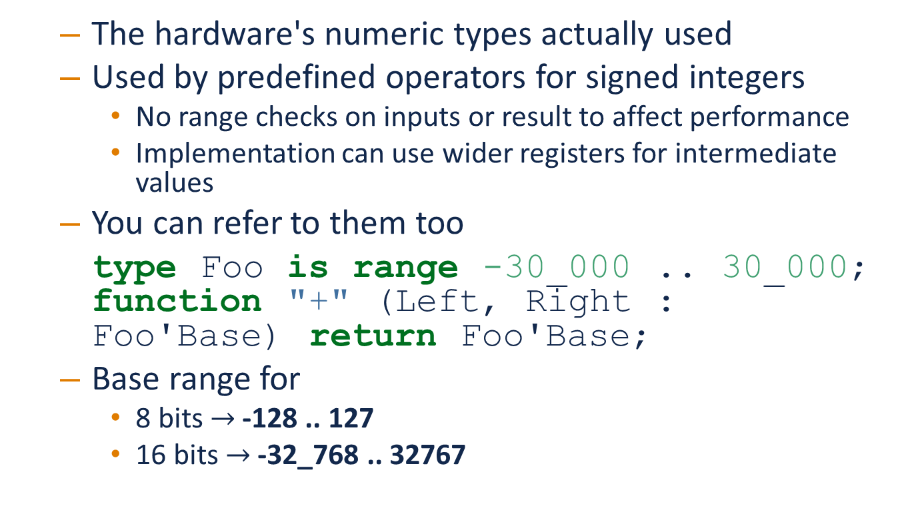
Base Ranges
  The hardware's numeric types actually used
  Used by predefined operators for signed integers
    No range checks on inputs or result to affect performance
    Implementation can use wider registers for intermediate values
  You can refer to them too
  type Foo is range -30_000 .. 30_000;
  function "+" (Left, Right : Foo'Base) return Foo'Base;
  Base range for
    8 bits $→$ -128 .. 127
    16 bits $→$ -32_768 .. 32767

Slide 95
Compile-Time Constraint Violation Detection
  May generate warnings and produce executable
  Allowed to be treated as errors
    Hence program may be rejected at compile-time
  Requirements for rejection
    Value is static
    Value exceeds base range of corresponding type
procedure Test is
type Some_Integer is range -200 .. 200;
Object : Some_Integer;
begin
Object := 50_000; -- probably rejected by compiler
end;

Slide 96
Either Way You Find Out
  Compile-time rejection depends on base range
    Selected by the compiler
    Depends on underlying hardware
  Run-time exception otherwise
  So assume an exception will be the result and be happy when the compiler catches them beforehand

Slide 97
Values of Integer Types Can Overflow
  A result of finite binary representation
K : Integer := Integer'Last;
...
K := K + 1;
2#01111111111111111111111111111111# - (2**32)-1
+ 1
===================================
2#100000000000000000000000000000000#
( = -2,147,483,64810 )

Slide 98
What Happens On Integer Overflow?
  Ada
    Language-defined exception Constraint_Error
    Exception means numerical analysis was incorrect
  Java
    Silently wraps around (that's what the hardware does)
  C/C++
    Undefined behavior (but silent wrap-around is typical)

Slide 99
Overflow Detection At Compile Time
  Allowed by Ada
  Code to raise Constraint_Error replaces code that causes Constraint_Error
    Only for language-defined operations since no side-effects
  procedure Compute is
  K : Integer := Integer'Last;
  begin
  K := K + 1; -- generated code raises Constraint_Error
  ...
  end Compute;

Slide 100
Modular Types
  Another form of integer type
  Support unsigned values and additional operations
  Syntax
  type <identifier> is mod <modulus>;
  Modulus must be static
  Resulting range is 0 .. modulus-1
  type Unsigned_Word is mod 2**16; -- 16 bits, 0 .. 65_535
  type Byte is mod 256; -- 8 bits, 0 .. 255

Slide 101
Modular Type Semantics
  Predefined operators as for any integer type
    Addition, subtraction, et cetera
  But values "wrap-around" from 0 to modulus-1
    Like other languages' unsigned types
    Mathematical operators
    Attributes 'Pred and 'Succ
  Additional bit-oriented operations are defined
    and, or, xor, not
    Treat values as bit-sequences

Slide 102
Bit Pattern Values and Range Constraints
  Bit pattern assignments will not violate constraints if they represent values in the range, even if they represent negative numbers in a signed integer type
procedure Demo is
type Byte is mod 256; -- 0 .. 255
B : Byte;
begin
B := 2#1000_0000#; -- not a negative value
end Demo;

Slide 103
Modular Range Must Be Respected
procedure Unsigned is
type Byte is mod 2**8; -- 0 .. 255
B : Byte;
type Signed_Byte is range -128 .. 127;
SB : Signed_Byte;
begin
...
B := -256; -- compile error
SB := -1;
B := Byte (SB); -- runtime error
...
end Unsigned;

Slide 104
Safely Converting Signed To Unsigned
  Since conversion may raise Constraint_Error
  Attribute T'Mod returns argument mod T'Modulus
    Argument is a Universal_Integer so allows any integer type
  procedure Test is
  type Byte is mod 2**8; -- 0 .. 255
  B : Byte;
  type Signed_Byte is range -128 .. 127;
  SB : Signed_Byte;
  begin
  SB := -1;
  B := Byte'Mod (SB); -- OK (255)

Slide 105
Predefined Modular Types
  Declared in package Interfaces
    Not automatically available like the language-defined types
  Represent machine numeric types
  Types' characteristics vary with hardware but have common name format
    Unsigned_n
    Integer_n
type Integer_8 is range -2 ** 7 .. 2 ** 7 - 1;
type Integer_16 is range -2 ** 15 .. 2 ** 15 - 1;
...
type Unsigned_8 is mod 2 ** 8;
type Unsigned_16 is mod 2 ** 16;

Slide 106
Shift/Rotate Functions
  Defined just for the modular types in Interfaces
    Shift_Left
    Shift_Right
    Shift_Right_Arithmetic
    Rotate_Left
    Rotate_Right
    others...

Slide 107
Bit-Oriented Operations Example
  Assume an unsigned 16-bit type is provided
with Interfaces;
use Interfaces;
...
procedure Swap( X : in out Unsigned_16 ) is
begin
X := ( Shift_Left(X,8) and 16#FF00# ) or
( Shift_Right(X,8) and 16#00FF# );
end Swap;

Slide 108
Why Not Shift and Rotate For All Modulars?
  Designers considered making them available
    Like arithmetic and logical operators
  Limitation to types in Interfaces is for good reason
    Non-overloadable user-defined declarations (e.g. variables) with the same identifiers would be hidden
    If Shift and Rotate were made into operators, hiding would not be a problem but then new operators would have had to be defined by the language (a potentially big deal)
    Shift and Rotate could have been made into reserved words but that would introduce an upward incompatibility

Slide 109
Shift/Rotate for User-Defined Types
  Modular types, of course
  Approach 1: use types in Interfaces directly
  with Interfaces; use Interfaces;
  with Ada.Text_IO;
  with ...
  Approach 2: derive types from those in Interfaces
    All primitive operations are inherited
  type Byte is new Interfaces.Unsigned_8;
  type Half_Word is new Interfaces.Unsigned_16;
  type Word is new Interfaces.Unsigned_32;

Slide 110
Integer Type (Signed and Modular) Literals
  Must not contain a fractional part
  No silent promotion/demotion done by compiler
type Event_Counter is range 0 .. 40_000; -- integer type
OK : Event_Counter := 0; -- legal
Bad : Event_Counter := 0.0 ; -- compile error

Slide 111
Enumeration Types
  Represent an enumeration of logical values
  Syntax
  type <identifier> is ( <identifier-list> ) ;
  Literals
    Distinct, ordered
    Can be overloaded between types
  type Colors is (Red, Orange, Yellow, Green, Blue, Violet);
  type Stop_Light is (Red, Yellow, Green);
  ...
  Shade : Colors := Red;
  Light : Stop_Light := Red;

Slide 112
Enumeration Type Operations
  Assignment, relationals
  Cannot be treated as numeric quantities
    Can achieve the effect via attributes
type Directions is ( North, South, East, West );
type Days is ( Mon, Tue, Wed, Thu, Fri, Sat, Sun );
Heading : Directions;
Today, Tomorrow : Days;
...
Today := Mon;
Today := North; -- compile error
Heading := South;
Heading := East + 1; -- compile error
if Today < Tomorrow then ...

Slide 113
Character Types
  Literals
    Enclosed in single quotes
    Case-sensitive
  Declared as enumeration types
    An enumeration type with at least one character enumeral
  Language defines various character types
  Users can define their own character types
  type EBCDIC is ( nul, ..., 'a' , ..., 'A', ..., del );
  Control : EBCDIC := 'A';
  Nullo : EBCDIC := nul;

Slide 114
Language-Defined Character Types
  Character
    8-bit (Latin-1) character set
    Used in language-defined type String
  Wide_Character
    16-bit Unicode
    Used in language-defined type Wide_String
  Wide_Wide_Character
    32-bit Unicode
    Used in language-defined type Wide_Wide_String

Slide 115
Character Oriented Packages
  Language-defined
  Ada.Characters.Handling
    Classification and conversion functions for Character data
  Ada.Characters.Latin_1
    Declares a set of constants
  See Annex A for details

Slide 116
Ada.Characters.Latin_1 Sample Content
package Ada.Characters.Latin_1 is
NUL : constant Character := Character'Val (0);
...
LF : constant Character := Character'Val (10);
VT : constant Character := Character'Val (11);
FF : constant Character := Character'Val (12);
CR : constant Character := Character'Val (13);
...
Commercial_At : constant Character := '@'; -- Character'Val(64)
...
LC_A : constant Character := 'a'; -- Character'Val (97)
LC_B : constant Character := 'b'; -- Character'Val (98)
...
Inverted_Exclamation : constant Character := Character'Val (161);
Cent_Sign : constant Character := Character'Val (162);
...
LC_Y_Diaeresis : constant Character := Character'Val (255);
end Ada.Characters.Latin_1;

Slide 117
Ada.Characters.Handling Sample Content
package Ada.Characters.Handling is
function Is_Control (Item : Character) return Boolean;
function Is_Graphic (Item : Character) return Boolean;
function Is_Letter (Item : Character) return Boolean;
function Is_Lower (Item : Character) return Boolean;
function Is_Upper (Item : Character) return Boolean;
function Is_Basic (Item : Character) return Boolean;
function Is_Digit (Item : Character) return Boolean;
function Is_Decimal_Digit (Item : Character) return Boolean renames Is_Digit;
function Is_Hexadecimal_Digit (Item : Character) return Boolean;
function Is_Alphanumeric (Item : Character) return Boolean;
function Is_Special (Item : Character) return Boolean;
function To_Lower (Item : Character) return Character;
function To_Upper (Item : Character) return Character;
function To_Basic (Item : Character) return Character;
function To_Lower (Item : String) return String;
function To_Upper (Item : String) return String;
function To_Basic (Item : String) return String;
...
end Ada.Characters.Handling;

Slide 118
Language-Defined Type Boolean
  An enumeration type
  type Boolean is ( False, True );
  Supports assignment, relationals, attributes
  A : Boolean;
  Counter : Integer;
  ...
  A := Counter = 22; -- is Counter 22?
  Includes logical operators: and, or, xor, not
  A := B or ( not C ); -- assuming A, B, C boolean

Slide 119
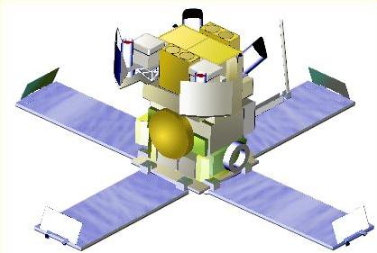
Why Boolean Isn't Just An Integer?
  Consider a real-life example of an error
    The HETE-2 satellite attitude control system software (ACS)
    Written in C
  ACS includes control of four "solar paddles" deployed after launch
image

Slide 120
Why Boolean Isn't Just An Integer!
  HETE-2 ACS Solar Paddle State allowed callers to test whether all paddles were or were not deployed
  Initial approach was a boolean variable
  if (rom->paddles_deployed == 1)
  use_deployed_inertia_matrix();
  else
  use_stowed_inertia_matrix();
  Later, each paddle became monitored individually, so paddles_deployed became a 4-bit value (0 : all stowed, 0xF : all deployed)
  But not all client code (above) was changed!
    Now use_deployed_inertia_matrix is called only when 1 specific paddle is deployed!
Of course, it should have been a boolean function anyway, so that the change to four-bits would only matter in that one place (where the function is implemented).

Slide 121
Boolean Operators' Operand Evaluation
  Order not specified by the language
    Unlike, for example, C which is always left before right
  Usually does not matter
    Sometimes critical to avoid errors!
      Dividing by zero
      Dereferencing null pointers
      Using some inappropriate value in a user-defined operation
    if Divisor /= 0 and K / Divisor = Max then ... -- Problem!

Slide 122
Short-Circuit Control Forms
  Boolean operators with fixed evaluation order
  Left operand is always evaluated first
  Right operand only evaluated if necessary
    Two forms
    and then if left operand is False, doesn't evaluate right
    if Divisor /= 0 and then K / Divisor = Max then ...
    or else if left operand is True, doesn't evaluate right
    if Divisor = 0 or else K / Divisor = Max then ...

Slide 123
Attributes
  Built-in functions associated with types
    Supply a value
    Some take input parameters
  Some are language-defined
    Summarized in RM K.2 "Language-Defined Attributes"
  May be implementation-defined
  Syntax for calls
    Type-Name ' Attribute-Name
    I := Integer'Last;
    Type-Name ' Attribute-Name ( input-value )
    E1 := Some_Type'Succ ( E2 );

Slide 124
String Attributes For All Scalars
  T'Image( input )
    Converts given internal value to a String value
    Input value must be of type T
  T'Value( input )
    Converts given String value to an internal value of type T
    Input must be of type String
type Days is ( Sun, Mon, Tue, Wed, Thu, Fri, Sat );
Today : Days := Some_Value;
Input : String( 1 .. N );
...
Put_Line( Days'Image(Today) );
...
Get( Input );
Today := Days'Value( Input );

Slide 125
Neighbor Attributes For All Scalars
  T'Pred( input )
    Yields the predecessor of specified value
    Input must be of type T
  T'Succ ( input )
    Yields the successor of specified value
    Input must be of type T
type Days is ( Sun, Mon, Tue, Wed, Thu, Fri, Sat );
Today : Days := Some_Value;
Tomorrow : Days;
Yesterday : Days;
...
Tomorrow := Days'Succ( Today );
...
Yesterday := Days'Pred( Today );

Slide 126
Range Attributes For All Scalars
  T'First
    Yields the first (least) value of type T
  T'Last
    Yields the last (greatest) value of type T
  T'Range
    Is a shorthand for T'First .. T'Last
type Days is ( Sun, Mon, Tue, Wed, Thu, Fri, Sat );
Today : Days := Days'First; -- Sun
...
Tomorrow : Days := Days'Last; -- Sat

Slide 127
Min/Max Attributes For All Scalars
  T'Min
    Yields the lesser of two values of type T`
  T'Max
    Yields the greater of two values of type T`
Safe_Lower : constant := 10;
Safe_Upper : constant := 30;
C : Integer := 15;
...
C := Integer'Max (Safe_Lower, C - 1);
...
C := Integer'Min (Safe_Upper, C + 1);
First one says we can't decrement below 10 Second one says we can't increment above 30

Slide 128
Order Attributes For All Discrete Types
  T'Pos ( input )
    Yields the "logical position number" of specified value
    Input must be a value of type T
  T'Val ( input )
    Converts specified position number to a value of type T
type Days is ( Sun, Mon, Tue, Wed, Thu, Fri, Sat ); -- 0 .. 6
Today : Days := Some_Value;
Position : Integer;
...
Position := Days'Pos( Today );
...
Get( Position );
Today := Days'Val( Position );
Val/pos compared to value/image - same number of characters

Slide 129
Enumeration Representation Values
type Enum_T is (Able, Baker, Charlie, Dog, Easy, Fox);
for Enum_T use (1, 2, 4, 8, Easy => 16, Fox => 32);
  Not provided by 'Pos and 'Val
    They work in terms of logical ordering
    Regardless of the actual value used to represent enumerals
  Are accessible, but not by built-in function
    Unchecked conversion
    Implementation-defined facility
    -- GNAT-specific function
    function T'Enum_Rep (Arg : T'Base)
    return Universal_Integer;
    Are same as position numbers unless overridden
    Thus users can rely on consistency when necessary

Slide 130
Real Types

Slide 131
Real Types
  Define approximations to continuous values
    1.0, 1.1, 1.11, 1.111 ... 2.0, ...
    Values are approximations since digital hardware is finite
  Come in two flavors
    Floating-point types
      Radix-point position depends upon value's magnitude
    Fixed-point types
      Radix-point position is not dependent upon the magnitude
  Fixed-point types come in two flavors as well
    Ordinary fixed-point types
    Decimal fixed-point types
  Focus on floating point types here

Slide 132
Real Type (Floating and Fixed) Literals
  Must contain a fractional part
  No silent promotion/demotion done by compiler
type Phase is digits 8; -- floating point
OK : Phase := 0.0;
Bad : Phase := 0 ; -- compile error

Slide 133
Declaring Floating Point Types
  Syntax
  type <identifier> is
  digits <expression> [range constraint];
    Decimal digits of precision
  Automatic representation choice
    Compiler chooses closest implementation available
    May be more accurate, but not less
    If not available, declaration is rejected

Slide 134
Predefined Floating Point Types
  Type Float
    Number of digits is implementation-defined
    At least 6 digits if the hardware can support 6 or more
  Additional implementation-defined types may exist
    Long_Float, if present, will support at least 11 digits (if...)
  Use when you don't care what you get
    Or when 6/11/etc. digits will always be enough
  Best to avoid predefined types
    Portability may suffer
    Easier to avoid than Integer
    Assume type Real is user-defined in class examples

Slide 135
Base Decimal Precision
  That which is actually provided
    Based on type declaration
    Perhaps beyond requested number of digits
  Referenced via attribute 'Base
    Example: Compiler supports 6, 12, or 24 digits of precision
    User requests 8 bits of precision
  type my_type is digits 8;
    Compiler can create objects using 12 or 24 digits of precision

Slide 136
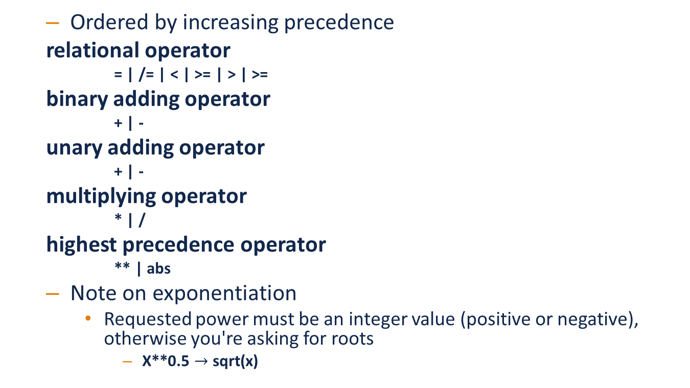
Floating Point Type Operators
  Ordered by increasing precedence
  relational operator
  = | /= | < | >= | > | >=
  binary adding operator
  + | -
  unary adding operator
  + | -
  multiplying operator
  * | /
  highest precedence operator
  ** | abs
  Note on exponentiation
    Requested power must be an integer value (positive or negative), otherwise you're asking for roots
      X**0.5 $→$ sqrt(x)

Slide 137
Floating Point Division By Zero
  Language-defined types do what the machine does
    Raises exception if attribute T'Machine_Overflows is True
      For some type T, e.g., Float
      Constraint_Error
    Generates infinities otherwise
    Best performance
  If that's not what you want, define a constrained range:
  subtype MyFloat is Float range Float'First .. Float'Last;
  type MyFloat is new Float range Float'First .. Float'Last;

Slide 138
Using Equality for Floating Point Types
  Questionable due to representation issue
    As for any programming language
    Watch out for holes around zero, etc.
  To return True, bits must be exactly the same
  But digital computers approximate real numbers
  Perhaps define your own function
    Using attributes to determine if values are "close enough"
Foo : constant Boolean := ( X = 0.01 );

Slide 139
Floating Point Type Attributes
  Core attributes (for some type named Real)
  type Real is digits N; -- for some static value N
    Real'Digits
      Yields the number of digits requested (N)
    Real'Base'Digits
      Yields the number of digits actually provided
    Real'Pred and Real'Succ
      Provide the previous/next implemented number
    Real'Rounding( X : Real )
      Yields integral value nearest to X, rounding away from zero if X lies exactly halfway between two integers
    Several others
      See Reference Manual
  Additional model-oriented attributes also exist
    Provide detailed, more powerful behavior and functionality

Slide 140
Miscellaneous

Slide 141
"Checked" Type Conversions
  Allowed only between "closely related" types
    Numeric types
    Types related by inheritance
    Array types
  Compiler rejects illegal conversions
  Uses explicit functional syntax
    As if the target type is the name of a function
Source_Value : Integer;
Target_Value : Float;
...
Target_Value := Float (Source_Value);

Slide 142
"Unchecked" Type Conversions
  Allowed between any types
  Some practical restrictions may be applied
function As_Byte is new
Ada.Unchecked_Conversion (
Source => Byte_Mask,
Target => Byte);
Sizes should be the same, but not a requirement

Slide 143
Default Initialization, by Type
Language Variant
Ada 2012
  Not defined by language
    Access values ("pointers") are the exception
  Not as essential as in some languages
    Record types can have component default values
    Since most private types are records, this is often sufficient
  Can be defined for user-defined types
  Applicable for only some kinds of types
    Scalar types
    Array types with scalar component types
    All others are either already covered or not meaningful
      What would a default task value mean?

Slide 144
Default Initialization Syntax
Language Variant
Ada 2012
  Uses aspect clauses on type declarations
  full_type_declaration ::= type defining_identifier is
  type_definition [aspect_specification];
  Only on type declarations, so only on user-defined
  Uses aspect Default_Value for scalar types
    Specified value must be static
  type Tertiary_Switch is (Off, On, Neither)
  with Default_Value => Neither;
  Implicit : Tertiary_Switch;
  Explicit : Tertiary_Switch := Neither;

Slide 145
Simple Static Type Derivation
  A way to create a new type from an existing type
    A limited form of inheritance: not full OOP!
  Syntax specifies new type and existing type names
    Remember Ada uses named typing
  derived type ::= type identifier is new subtype_indication;
  subtype_indication ::= type-or-subtype-name [constraint]
  We use it for convenience occasionally

Slide 146
Summary

Slide 147
Benefits of Strongly Typed Numerics
  Designed to prevent subtle bugs
  Cannot accidentally delete a fractional part
  Cannot mix apples and oranges
  type Yen is range 0 .. 1_000_000;
  type Ruble is range 0 .. 1_000_000;
  Mine : Yen := 1;
  Yours : Ruble := 1;
  Mine := Yours; -- illegal

Slide 148
User-Defined Numeric Type Benefits
  Reflect application requirements
    Source code explicitly indicates algorithm requirements (e.g., range or precision)
  Compiler either implements or rejects declaration
    No surprises or debugging at run-time
  Portability enhanced
    Since hardware dependencies reduced

Slide 149
Summary
  User-defined types and strong typing make sense
    Programs can be written in application's terms
    Book-keeping can be left to the computer
  No free lunch
    Security, reliability requirements impose a price
    Performance roughly the same, given same requirements
  Several classes of type are available for user definitions
  Don't make distinct numeric types for everything
    Miles, minutes, altitude, velocity, etc...
  Default initialization is possible but use sparingly

