Slide 1
Subprogram Contracts
University.adacore.com

Slide 2
Subprogram Contracts in Ada 2012 and SPARK 2014
Originate in Floyd-Hoare logic (1967-1969)
a Hoarse triple {P}C{Q}
P is the precondition before executing command C
Q is the postcondition after executing command C
Executable version by Meyer in Eiffel (1988)
Called Design by Contract ™
Precondition is checked dynamically before a routine starts
Postcondition is checked dynamically when a routine returns
SPARK 2014 combines both views
SPARK 2005 version was only logic, Ada version is only executable

Slide 3
Dynamic Execution of Subprogram Contracts
Contract on subprogram declaration
Different from subprogram body in general (but not always)
Ada Reference Manual allows implementations choice
Contract can be checked in the caller or in the callee
GNAT’s choice is to execute in the callee
GNAT introduces wrappers in some cases for contracts
For an imported subprogram (e.g. from C) with a contract
For cases where contracts on static call/dispatching are different
Contracts are not enabled by default
Switch -gnata enables dynamic checking of contracts in GNAT

Slide 4
Dynamic Behavior when Subprogram Contracts Fail
Violation of contract raises an exception
Standard exception Assertion_Error is raised (same as for pragma Assert and all other assertions)
Exception cannot be caught by subprogram’s own exception handler → implementation choice caller/callee has no effect
Idiom allows to select another exception
Control over sequencing of checks
Typical pre/post is a conjunction of Boolean conditions
Use and when no possible RTE, and then otherwise (recommended for SPARK)
function Sqrt (X : Float) return Float with Pre => X >= 0.0 or else raise Argument_Error;

Slide 5
Precondition
Better alternative to defensive programming, compare
and
Preconditions can be activated alone
function Sqrt (X : Float) return Float with Pre => X >= 0.0 or else raise Argument_Error;
-- X should be non-negative or Argument_Error is raised function Sqrt (X : Float) return Float; function Sqrt (X : Float) return Float is begin if X >= 0.0 then raise Argument_Error; end if;
pragma Assertion_Policy (Pre => Check);

Slide 6
Postcondition
Single place to check all return paths from the subprogram
Avoids duplication of checks before each return statement
Much more robust during maintenance
Only applies to normal returns (not in exception, not on abort)
Can relate input and output values
Special attribute X‘Old for referring to input value of variable X
Special attribute Func‘Result for referring to result of function Func
Special attribute Rec’Update or Arr’Update for referring to modified value of record Rec or array Arr → replaced by delta aggregate syntax in Ada 202X: (Rec with delta Comp => Value)

Slide 7
Contract Cases
Convenient syntax to express a contract by cases
Cases must be disjoint and complete (forming a partition)
Introduced in SPARK, planned for inclusion in Ada 202X
Case is (guard => consequence) with ‘Old/’Result in consequence
Can be used in combination with precondition/postcondition
Both a precondition and a postcondition
On subprogram entry, exactly one guard must hold
On subprogram exit, the corresponding consequence must hold
function Sqrt (X : Float) return Float with Contract_Cases => (X > 1.0 => Sqrt’Result <= X, X = 1.0 => Sqrt’Result = 1.0, X < 1.0 and X > 0.0 => Sqrt’Result >= X, X = 0.0 => Sqrt’Result = 0.0);

Slide 8
Attribute ‘Old
X’Old expresses the input value of X in postconditions
Same as X when variable not modified in the subprogram
Compiler inserts a copy of X on subprogram entry → if X is large, copy can be expensive in memory footprint!
X can be a variable, a function call, a qualification (but not limited!)
Expr’Old is rejected in potentially unevaluated context
Pragma Unevaluated_Use_Of_Old(Allow) allows it
In Ada, user is responsible – in SPARK, user can rely on proof
procedure Extract (A : in out My_Array; J : in Integer; V : out Value) with Post => (if J in A'Range then V = A(J)'Old and A(J) = 0);

Slide 9
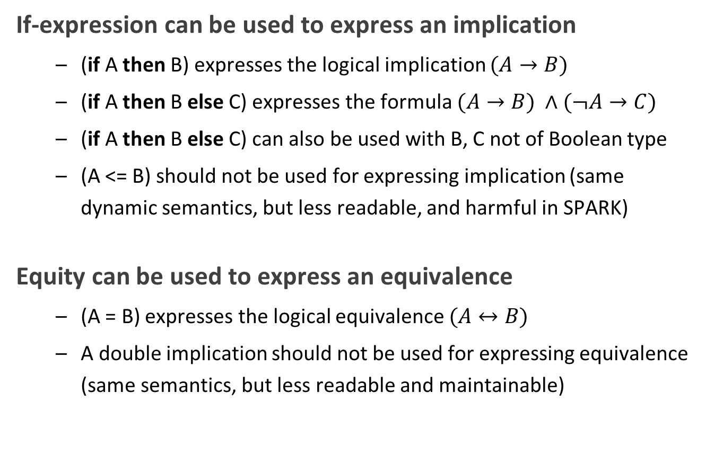
Implication and Equivalence
If-expression can be used to express an implication
(if A then B) expresses the logical implication $(A→B)$
(if A then B else C) expresses the formula $(A→B) ∧(¬A→C)$
(if A then B else C) can also be used with B, C not of Boolean type
(A <= B) should not be used for expressing implication (same dynamic semantics, but less readable, and harmful in SPARK)
Equity can be used to express an equivalence
(A = B) expresses the logical equivalence $(A↔B)$
A double implication should not be used for expressing equivalence (same semantics, but less readable and maintainable)

Slide 10
Reasoning by Cases
Case-expression can be used to reason by cases
Case only on values of expressions of discrete type
Can sometimes be an alternative to contract cases
Can sometimes be used at different levels in the expression
procedure Open (F : File; Success : out Boolean) with Post => (case F.Mode’Old is when Open => Success, when Active => not Success, when Closed => Success = (F.Mode = Open));
procedure Open (F : File; Success : out Boolean) with Post => Success = (case F.Mode’Old is when Open => True, when Active => False, when Closed => F.Mode = Open);

Slide 11
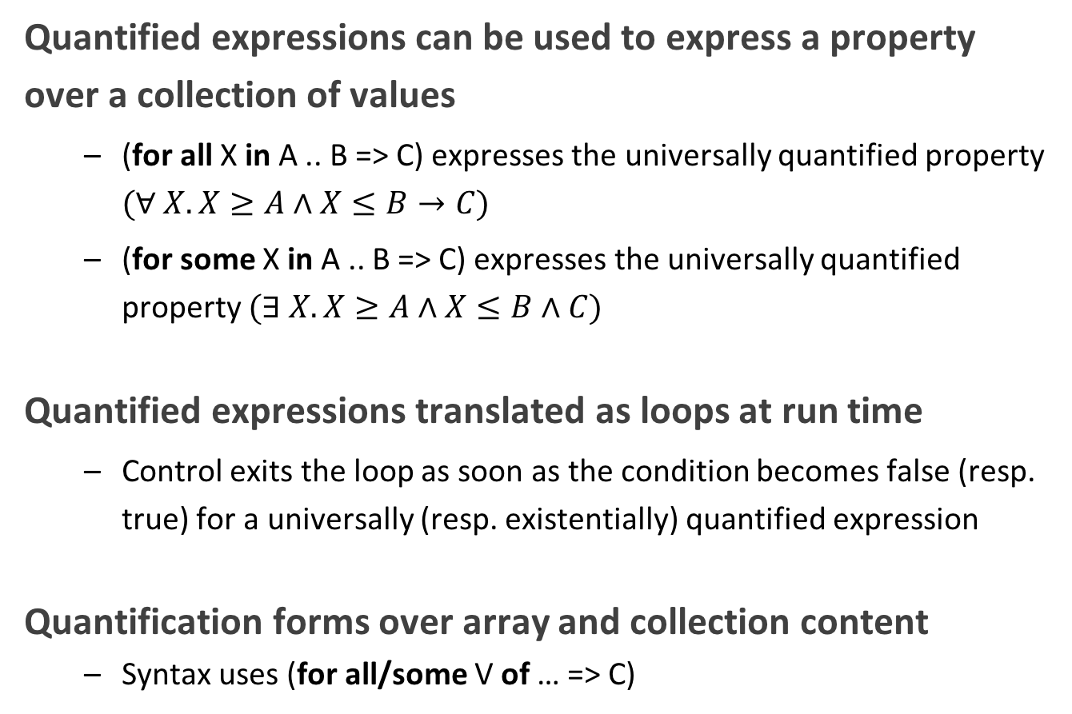
Universal and Existential Quantification
Quantified expressions can be used to express a property over a collection of values
(for all X in A .. B => C) expresses the universally quantified property $(∀ X. X≥A∧X≤B→C)$
(for some X in A .. B => C) expresses the universally quantified property $(∃ X. X≥A∧X≤B∧C)$
Quantified expressions translated as loops at run time
Control exits the loop as soon as the condition becomes false (resp. true) for a universally (resp. existentially) quantified expression
Quantification forms over array and collection content
Syntax uses (for all/some V of … => C)

Slide 12
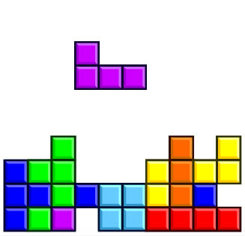
Expression Functions
Without abstraction, contracts can become unreadable
Also, use of quantifications can make them unprovable
Expression functions provide the means to abstract contracts
Expression function is a function consisting in an expression
Definition can complete a previous declaration
Definition is allowed in a package spec! (crucial for proof with SPARK)
function Valid_Configuration return Boolean is (case Cur_State is when Piece_Falling | Piece_Blocked => No_Overlap (Cur_Board, Cur_Piece), when Board_Before_Clean => True, when Board_After_Clean => No_Complete_Lines (Cur_Board));

Slide 14
1/10
-- Fail systematically fails a precondition and catches the -- resulting exception. procedure Fail (Condition : Boolean) with Pre => Condition is Bad_Condition : Boolean := False; begin Fail (Bad_Condition); exception when Assertion_Error => return; end Fail;

Slide 15


1/10
-- Fail systematically fails a precondition and catches the -- resulting exception. procedure Fail (Condition : Boolean) with Pre => Condition is Bad_Condition : Boolean := False; begin Fail (Bad_Condition); exception when Assertion_Error => return; end Fail;
The exception from the recursive call is always caught in the handler, but not the exception raised if caller of Fail passes False as value for Condition.

Slide 16
2/10
with Interfaces.C; use Interfaces.C; procedure Memset (B : in out char_array; Ch : in int; N : in size_t) with Import, Pre => N <= B'Length, Post => (for all Idx in B'Range => (if Idx < B'First + N then B (Idx) = Ch else B (Idx) = B'Old (Idx)));

Slide 17
2/10
with Interfaces.C; use Interfaces.C; procedure Memset (B : in out char_array; Ch : in int; N : in size_t) with Import, Pre => N <= B'Length, Post => (for all Idx in B'Range => (if Idx < B'First + N then B (Idx) = Ch else B (Idx) = B'Old (Idx)));
GNAT will create a wrapper for checking the precondition and postcondition of Memset, calling the imported memset from libc.

Slide 18
3/10
pragma Assertion_Policy (Pre => Ignore); function Sqrt (X : Float) return Float with Pre => X >= 0.0; pragma Assertion_Policy (Pre => Check); function Sqrt (X : Float) return Float is begin … end Sqrt;

Slide 19
3/10
pragma Assertion_Policy (Pre => Ignore); function Sqrt (X : Float) return Float with Pre => X >= 0.0; pragma Assertion_Policy (Pre => Check); function Sqrt (X : Float) return Float is begin … end Sqrt;
Although GNAT inserts precondition checks in the subprogram body instead of its caller, it is the value of Pre assertion policy at the declaration of the subprogram that decides if preconditions are activated.

Slide 20
4/10
function Sqrt (X : Float) return Float with Pre => X >= 0.0; function Sqrt (X : Float) return Float with Pre => X >= 0.0 is begin … end Sqrt;

Slide 21
4/10
function Sqrt (X : Float) return Float with Pre => X >= 0.0; function Sqrt (X : Float) return Float with Pre => X >= 0.0 is begin … end Sqrt;
Contract is allowed only on the spec of a subprogram. Hence it is not allowed on the body when a separate spec is available.

Slide 22
5/10
procedure Add (X, Y : Natural; Z : out Integer) with Contract_Cases => (X <= Integer’Last – Y => Z = X + Y, others => Z = 0) is begin Z := 0; Z := X + Y; end Add;

Slide 23
5/10
procedure Add (X, Y : Natural; Z : out Integer) with Contract_Cases => (X <= Integer’Last – Y => Z = X + Y, others => Z = 0) is begin Z := 0; Z := X + Y; end Add;
Postcondition is only relevant for normal returns.

Slide 24
6/10
procedure Add (X, Y : Natural; Z : out Integer) with Post => Z = X + Y is begin Z := 0; Z := X + Y; end Add;

Slide 25
6/10
procedure Add (X, Y : Natural; Z : out Integer) with Post => Z = X + Y is begin Z := 0; Z := X + Y; end Add;
Procedure may raise an exception, but postcondition correctly describes normal returns.

Slide 26
7/10
procedure Add (X, Y : Natural; Z : out Integer) with Pre => X <= Integer’Last – Y, Post => Z = X + Y is begin Z := X + Y; end Add;

Slide 27
7/10
procedure Add (X, Y : Natural; Z : out Integer) with Pre => X <= Integer’Last – Y, Post => Z = X + Y is begin Z := X + Y; end Add;
Precondition prevents exception inside Add.
Postcondition is always satisfied.

Slide 28
8/10
procedure Memset (B : in out String; Ch : in Character; N : in Natural) with Pre => N <= B'Length, Post => (for all Idx in B'Range => (if Idx < B'First + N then B (Idx) = Ch else B (Idx) = B (Idx)’Old));

Slide 29
8/10
procedure Memset (B : in out String; Ch : in Character; N : in Natural) with Pre => N <= B'Length, Post => (for all Idx in B'Range => (if Idx < B'First + N then B (Idx) = Ch else B (Idx) = B (Idx)’Old));
‘Old on expression including a quantified variable is not allowed.

Slide 30
9/10
procedure Memset (B : in out String; Ch : in Character; N : in Natural) with Pre => N <= B'Length, Post => (for all Idx in 1 .. N => B (B’First + Idx - 1) = Ch) and then B (B’First - 1) = B (B’First - 1)’Old and then B (B’First + N) = B (B’First + N)’Old;

Slide 31
9/10
procedure Memset (B : in out String; Ch : in Character; N : in Natural) with Pre => N <= B'Length, Post => (for all Idx in 1 .. N => B (B’First + Idx - 1) = Ch) and then B (B’First - 1) = B (B’First - 1)’Old and then B (B’First + N) = B (B’First + N)’Old;
Expr’Old on potentially unevaluated expression is allowed only when Expr is a variable.

Slide 32
10/10
procedure Memset (B : in out String; Ch : in Character; N : in Natural) with Pre => N <= B'Length, Post => (for all Idx in 1 .. N => B (B’First + Idx - 1) = Ch) and B (B’First - 1) = B (B’First - 1)’Old and B (B’First + N) = B (B’First + N)’Old;

Slide 33
10/10
procedure Memset (B : in out String; Ch : in Character; N : in Natural) with Pre => N <= B'Length, Post => (for all Idx in 1 .. N => B (B’First + Idx - 1) = Ch) and B (B’First - 1) = B (B’First - 1)’Old and B (B’First + N) = B (B’First + N)’Old;
Expr’Old does not appear anymore in a potentially unevaluated expression.
Another solution would have been to use
pragma Unevaluated_Use_Of_Old(Allow);

