Slide 1
Basic Types
Presented by Quentin Ochem
university.adacore.com

Slide 2
A Few Syntactical Notes

Slide 3

Identifiers
Ada identifiers are case insensitive
  HELLO = hello = HellO
Start with a letter
Ends with a letter or a number
May contain non-consecutive underscores
Which of the following are legal?
  Something
  My__Id
  _Hello
  A_67_9
  _CONSTANT
  09_A_2
  YOP_

Slide 4

Identifiers
Ada identifiers are case insensitive
  HELLO = hello = HellO
Start with a letter
Ends with a letter or a number
May contain non-consecutive underscores
Which of the following are legal?
  Something
  My__Id
  _Hello
  A_67_9
  _CONSTANT
  09_A_2
  YOP_

Slide 5
Comments
Ada provides end of line comments with --
There is no block comment (/* */)
-- This is an Ada comment | // This is a C++ comment

Slide 6
Numbers
The underscore is allowed for numbers
  1_000_000 = 1000000
Numbers can be expressed with a base (from 2 to 16)
  10#255# = 2#1111_1111# = 8#377# = 16#FF#
Float literals must have a dot
  With a digit before and after the dot.
  1.0 /= 1

Slide 7

Variable Declaration
Defined by one (or several) names, followed by :, followed by type reference and possibly an initial value
Elaboration is done sequentially
Initialization is called for each variable individually
“:=“ on a declaration is an initialization, not an assignment (special properties, mentioned later)
A : Integer; B : Integer := 5; C : constant Integer := 78; D, E : Integer := F (5); | int A; int B = 5; const int C = 78; int d = F (5), e = F(5);
A : Integer := 5; B : Integer := A; C : Integer := D; -- COMPILATION ERROR D : Integer := 0;
A, B : Float := Compute_New_Random; -- This is equivalent to: A : Float := Compute_New_Random; B : Float := Compute_New_Random;

Slide 8
Simple Scalar Types

Slide 9
Ada Strong Typing
Types are at the base of the Ada model
Semantic ≠ Representation
Ada types are named
Associated with properties (ranges, attributes…) and operators
The compiler will warn in case of inconsistencies
A : Integer := 10 * Integer (0.9); A : Integer := Integer (Float (10) * 0.9); | int A = 10 * 0.9

Slide 10
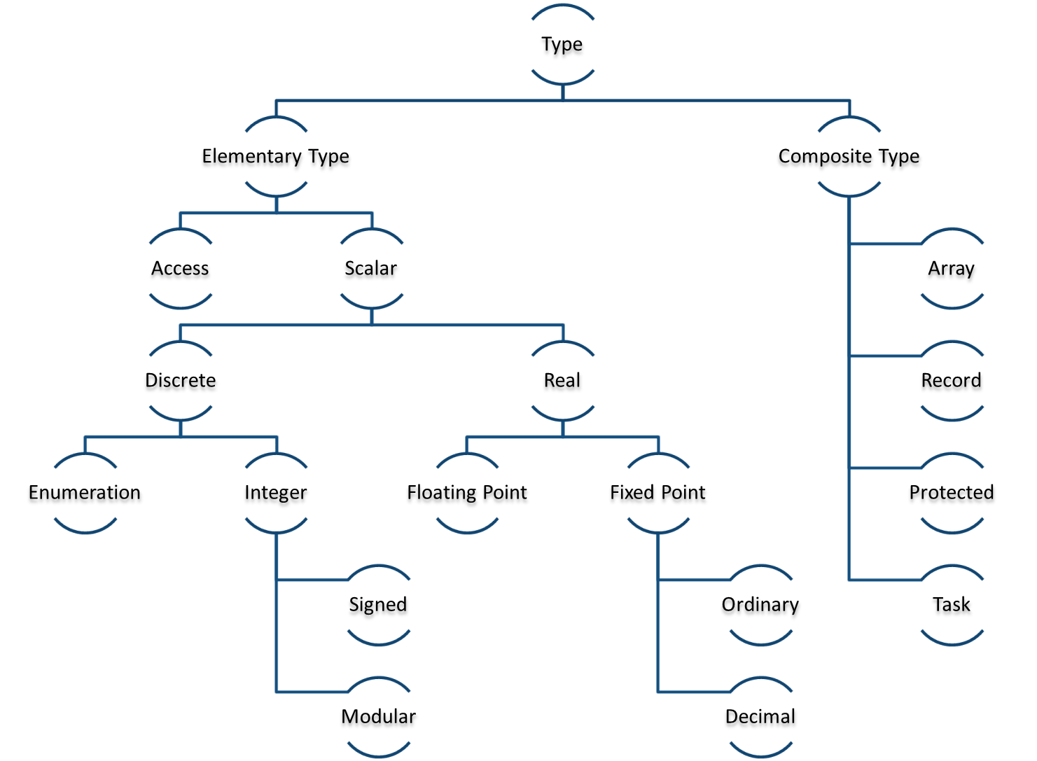
Ada Type Model

Slide 11
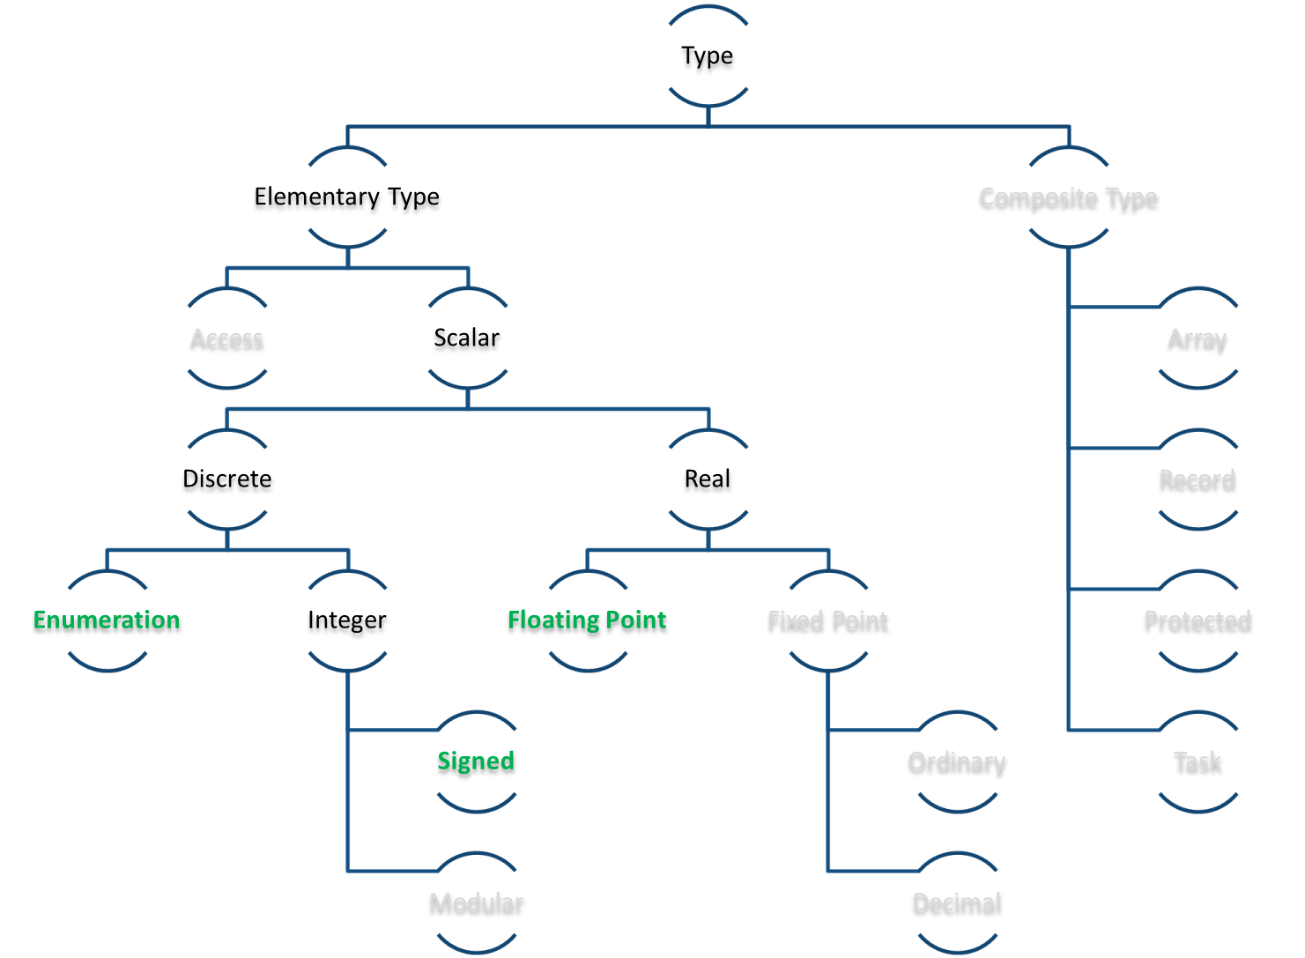
Ada Type Model

Slide 12
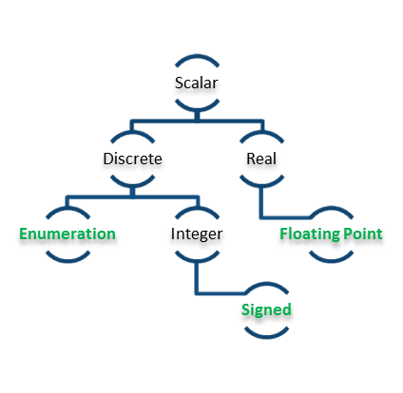
Scalar, Discrete and Real Types
A scalar type is a “single” value
  Integer, floating point, enumerations are all
  scalars
Scalar types are divided between “discrete” types (that have a finite number of values) and “continuous” types
Some scalar types are associated with numerical operations

Slide 13
Standard Types
Signed Integers
  Short_Integer, Integer, Long_Integer, Long_Long_Integer
Enumerations
  Character, Boolean
Floating Points
  Short_Float, Float, Long_Float, Long_Long_Float

Slide 14

Custom Types Declaration
Integer types are defined by a range of values
Enumeration types are defined by a list of values
Float types are defined by a minimal number of significant (decimal) digits
A range will decrease performances of floating point types
type Score is range 0 .. 20; type Percentage is range -100 .. 100;
type Color is (Red, Green, Blue, Yellow, Black); type Ternary is (True, False, Unknown);
type Distance is digits 10; type Temperature is digits 5 range -273.15 .. 1_000_000.0;

Slide 15
Creating a Type from an Existing Type
It is possible to create a new type based on an existing type
The new type can restrict the range of values
type Math_Score is new Score;
type Math_Score is new Score range 0 .. 10; type Primary_Color is new Color range Red .. Blue;

Slide 16
Type Conversion
In certain cases, types can be converted from one to the other
  They’re of the same structure
  One is the derivation of the other
Conversion needs to be explicit
Conversion may introduce a verification
V1 : Float := 0.0; V2 : Integer := Integer (V1);
type T1 is range 0 .. 10; type T2 is range 1 .. 10; V1 : T1 := 0; V2 : T2 := T2 (V1); -- Run-time error!

Slide 17
Ada Operators
Common to Signed and Floating Point Types
Specific to Signed Types
= | /= | < | <= | > | >= | + | - | * | / | abs | **
mod | rem
-11 mod 5 => 4
-11 rem 5 => -1

Slide 18
Attributes
An attribute is a standard property of an Ada entity
Accessed through '
Different set of attributes are available depending of the category of the type
Example
S : String := Integer'Image (42);

Slide 19
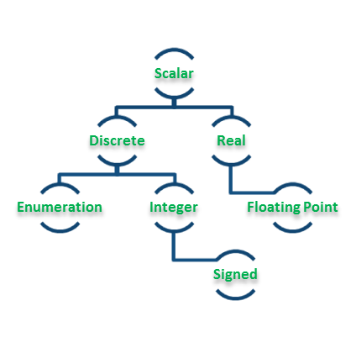
Sample of Attributes Specific to all Scalar
Attribute Name | Documentation
First | Returns the first value of the type
Last | Returns the last value of the type
Image (X) | Converts a value to its corresponding String
Value (X) | Converts a String to its corresponding value
Min (X, Y) | Returns the maximum of two values
Max (X, Y) | Returns the minimum of two values
Pred (X) | Returns the previous value
Succ (X) | Returns the next value
Range | Equivalent of T’First ..T’Last

Slide 20
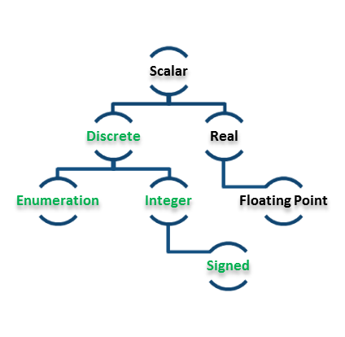
Sample of Attributes Specific to Discrete Types
Attribute Name | Documentation
Pos (X) | Returns the position of the value in the type
Val (X) | Returns a value according to its position
V : Character := Character’Val (0); W : Next_Character := Character’Val (Character’Pos (V) + 1);

Slide 21
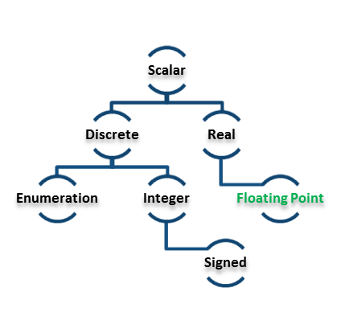
Sample of Attributes Specific to Floating Point
Conversion Float to Integer is using Rounding, not Truncation!
Attribute Name | Documentation
Ceiling (X) | Returns the smallest integral value after X
Floor (X) | Returns the largest integral value before X
Truncation (X) | Truncates towards 0
Rounding (X) | Rounds to the closest integer
Remainder (X, Y) | Returns the remainder of the Euclidian division

Slide 23
(1/10)
V : Integer := 7; V : Integer := V + 5;

Slide 24
(1/10)
V : Integer := 7; V : Integer := V + 5;
Compilation error, V is already declared

Slide 25
(2/10)
type N is range -2 ** 256 .. 2 ** 256;

Slide 26
(2/10)
type N is range -2 ** 256 .. 2 ** 256;
This is likely to be to big on most systems today,
so the compiler won’t be able to represent this and
will issue an error.

Slide 27
(3/10)
V : Float := 5.0;

Slide 28
(3/10)
V : Float := 5.0;
No Error

Slide 29
(4/10)
ClassRoom : constant Natural := 5; Next_ClassRoom : Natural := classroom + 1;

Slide 30
(4/10)
ClassRoom : constant Natural := 5; Next_ClassRoom : Natural := classroom + 1;
No Error, Ada is case insensitive

Slide 31
(5/10)
type T1 is new Integer range -10 .. 10; type T2 is new T1 range -100 .. 100;

Slide 32
(5/10)
type T1 is new Integer range -10 .. 10; type T2 is new T1 range -100 .. 100;
A range cannot be extended, only reduced

Slide 33
(6/10)
X : Float := Float'Succ (0.9);

Slide 34
(6/10)
X : Float := Float'Succ (0.9);
Correct. Succ is available for floating point number,
and will provide the closest floating point value above
the representation of 0.9.

Slide 35
What’s the output of this code? (7/10)
F : Float := 7.6; Div : Integer := 10; begin F := Float (Integer (F) / Div); Put_Line (Float’Image (F));

Slide 36
What’s the output of this code? (7/10)
F : Float := 7.6; Div : Integer := 10; begin F := Float (Integer (F) / Div); Put_Line (Float’Image (F));
0.0

Slide 37
(8/10)
type T is (A, B, C); V1 : T := T'Val ("A"); V2 : T := T'Value (2);

Slide 38
(8/10)
type T is (A, B, C); V1 : T := T'Val ("A"); V2 : T := T'Value (2);
Compilation errors.
T’Val returns a value from a position
T’Value returns a value from a String

Slide 39
(9/10)
type T is (A, B, C); V1 : T := T'Value ("A"); V2 : T := T'Value ("a"); V3 : T := T'Value (" a ");

Slide 40
(9/10)
type T is (A, B, C); V1 : T := T'Value ("A"); V2 : T := T'Value ("a"); V3 : T := T'Value (" a ");
No Error.
Conversions are case-insentitive,
automatically trimmed.

Slide 41
(10/10)
type T is range 1 .. 0; V : T;

Slide 42
(10/10)
type T is range 1 .. 0; V : T;
No Error.
T has an empty range, useful in some
circumstances.

