Slide 1
SPARK 2014: Ghost Code
University.adacore.com

Slide 2
What is ghost code?
ghost code is part of the program that
is added for the purpose of specification
Why3 team, “The Spirit of Ghost Code”
… or verification
addition by SPARK team
Examples of ghost code:
  contracts (Pre, Post, Contract_Cases, etc.)
  assertions (pragma Assert, loop (in)variants, etc.)
  special values Func’Result, Var’Old, Var’Loop_Entry
Is it enough?

Slide 3

Ghost code – A trivial example
Data : Data_Array; Free : Natural; procedure Alloc is begin -- some computations here assert that Free “increases” end Alloc;
how to express it?

Slide 4
Ghost variables – aka auxiliary variables
Variables declared with aspect Ghost
  declaration is discarded by compiler when ghost code ignored
Ghost assignments to ghost variables
  assignment is discarded by compiler when ghost code ignored
Data : Data_Array; Free : Natural; procedure Alloc is Free_Init : Natural with Ghost; begin Free_Init := Free; -- some computations here pragma Assert (Free > Free_Init); end Alloc;

Slide 5
Ghost variables – non-interference rules
Ghost variable cannot be assigned to non-ghost one
Ghost variable cannot indirectly influence assignment to non-ghost one
Free := Free_Init;
if Free_Init < Max then Free := Free + 1; end if;
procedure Assign (From : Natural; To : out Natural) is begin To := From; end Assign; Assign (From => Free_Init, To => Free);

Slide 6

Ghost statements
Ghost variables can only appear in ghost statements
  assignments to ghost variables
  assertions and contracts
  calls to ghost procedures
procedure Assign (From : Natural; To : out Natural) with Ghost is begin To := From; end Assign; Assign (From => Free, To => Free_Init); Assign (From => Free_Init, To => Free);

Slide 7
Ghost procedures
Ghost procedures cannot write into non-ghost variables
Used to group statements on ghost variables
  in particular statements not allowed in non-ghost procedures
Can have Global (including Proof_In) & Depends contracts
procedure Assign (Value : Natural) with Ghost is begin Free := Value; end Assign;
procedure Assign_Cond (Value : Natural) with Ghost is begin if Condition then Free_Init := Value; end if; end Assign_Cond;

Slide 8
Ghost functions
Functions for queries used only in contracts
Typically implemented as expression functions
  in private part – proof of client code can use expression
  or in body – only proof of unit can use expression
procedure Alloc with Pre => Free_Memory > 0, Post => Free_Memory < Free_Memory'Old; function Free_Memory return Natural with Ghost;
function Free_Memory return Natural is (…); -- if completion of ghost function declaration function Free_Memory return Natural is (…) with Ghost; -- if function body as declaration

Slide 9
Imported ghost functions
Ghost functions without a body
  cannot be executed
Typically used with abstract ghost private types
  definition in SPARK_Mode(Off) → type is abstract for GNATprove
Definition of ghost types/functions given in proof
  either in Why3 using External_Axiomatization
  or in an interactive prover (Coq, Isabelle, etc.)
function Free_Memory return Natural with Ghost, Import;
type Memory_Chunks is private; function Free_Memory return Memory_Chunks with Ghost, Import; private pragma SPARK_Mode (Off); type Memory_Chunks is null record;

Slide 10
Ghost packages and ghost abstract state
Every entity in a ghost package is ghost
  local ghost package can group all ghost entities
  library-level ghost package can be withed/used in regular units
Ghost abstract state can only represent ghost variables
Non-ghost abstract state can contain both ghost and non-ghost variables
package Mem with Abstract_State => (State with Ghost) is
package body Mem with Refined_State => (State => (Data, Free, Free_Init)) is

Slide 11
Executing ghost code
Ghost code can be enabled globally
  using compilation switch -gnata (for all assertions)
Ghost code can be enabled selectively
  using pragma Assertion_Policy (Ghost => Check)
  SPARK rules enforce consistency – in particular no write disabled
GNATprove analyzes all ghost code and assertions
pragma Assertion_Policy (Ghost => Ignore, Pre => Check); procedure Alloc with Pre => Free_Memory > 0; function Free_Memory return Natural with Ghost;

Slide 12
Example of use – encoding a state automaton
Tetris in SPARK
  at http://blog.adacore.com/tetris-in-spark-on-arm-cortex-m4
Global state encoded in global ghost variable
  updated at the end of procedures of the API
Properties encoded in ghost functions
type State is (Piece_Falling, …) with Ghost; Cur_State : State with Ghost;
function Valid_Configuration return Boolean is (case Cur_State is when Piece_Falling => …, when …) with Ghost;

Slide 13
Example of use – expressing useful lemmas
GCD in SPARK
  at http://www.spark-2014.org/entries/detail/gnatprove-tips-and-tricks-proving-the-ghost-common-denominator-gcd
Lemmas expressed as ghost procedures
Most complex lemmas further refined into other lemmas
  code in procedure body used to guide proof (e.g. for induction)
procedure Lemma_Not_Divisor (Arg1, Arg2 : Positive) with Ghost, Global => null, Pre => Arg1 in Arg2 / 2 + 1 .. Arg2 - 1, Post => not Divides (Arg1, Arg2);

Slide 14
Example of use – specifying an API through a model
Red black trees in SPARK
  at http://www.spark-2014.org/entries/detail/research-corner-auto-active-verification-in-spark
Invariants of data structures expressed as ghost functions
  using Type_Invariant on private types
Model of data structures expressed as ghost functions
  called from Pre/Post of subprograms from the API
Lemmas expressed as ghost procedures
  sometimes without contracts to benefit from inlining in proof

Slide 15
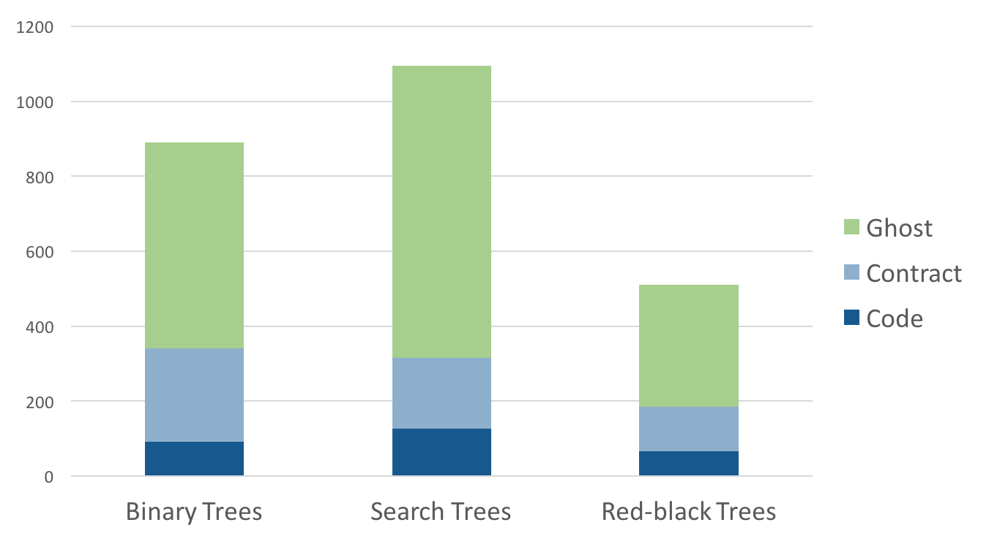
Extreme proving with ghost code – red black trees in SPARK

Slide 16
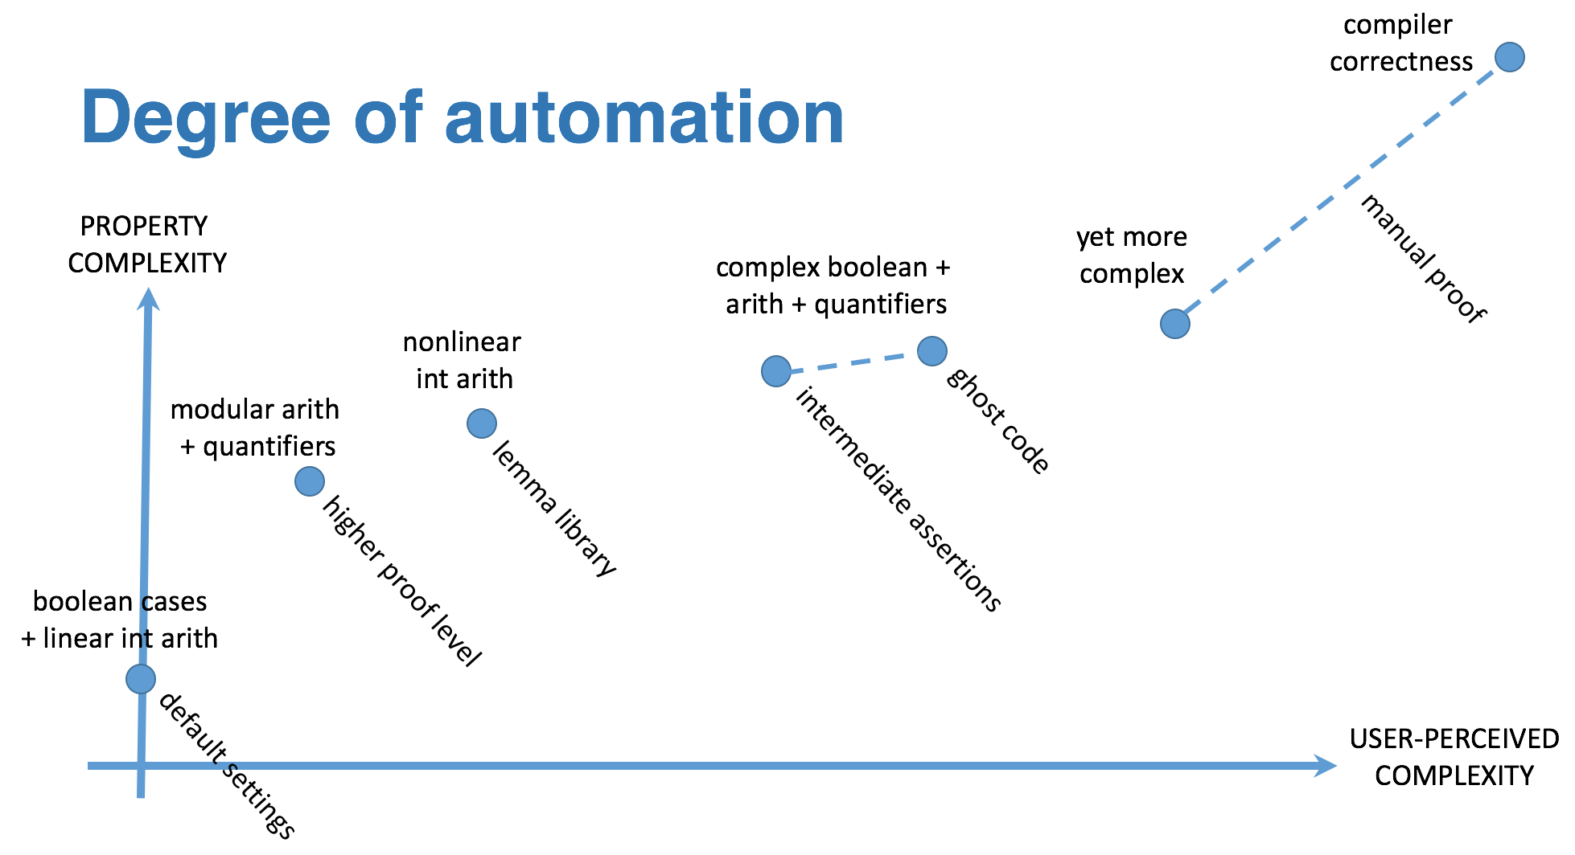
Positioning ghost code in proof techniques

Slide 18
1/10
Data : Data_Array; Free : Natural; procedure Alloc is Free_Init : Natural with Ghost; begin Free_Init := Free; -- some computations here if Free <= Free_Init then raise Program_Error; end if; end Alloc;

Slide 19
1/10
Data : Data_Array; Free : Natural; procedure Alloc is Free_Init : Natural with Ghost; begin Free_Init := Free; -- some computations here if Free <= Free_Init then raise Program_Error; end if; end Alloc;
ghost entity cannot appear in this context

Slide 20
2/10
Data : Data_Array; Free : Natural; procedure Alloc is Free_Init : Natural with Ghost; procedure Check with Ghost is begin if Free <= Free_Init then raise Program_Error; end if; end Check; begin Free_Init := Free; -- some computations here Check; end Alloc;

Slide 21
2/10
Data : Data_Array; Free : Natural; procedure Alloc is Free_Init : Natural with Ghost; procedure Check with Ghost is begin if Free <= Free_Init then raise Program_Error; end if; end Check; begin Free_Init := Free; -- some computations here Check; end Alloc;
Note that procedure Check is inlined for proof (no contract).

Slide 22
3/10
pragma Assertion_Policy (Pre => Check); procedure Alloc with Pre => Free_Memory > 0; function Free_Memory return Natural with Ghost;

Slide 23
3/10
pragma Assertion_Policy (Pre => Check); procedure Alloc with Pre => Free_Memory > 0; function Free_Memory return Natural with Ghost;
Incompatible ghost policies in effect during compilation, as ghost code is ignored by default.
Note that GNATprove accepts this code as it enables all ghost code and assertions.

Slide 24
4/10
procedure Alloc with Post => Free_Memory < Free_Memory’Old; function Free_Memory return Natural with Ghost;
Max : constant := 1000; function Free_Memory return Natural is begin return Max - Free + 1; end Free_Memory; procedure Alloc is begin Free := Free + 10; end Alloc;

Slide 25
4/10
procedure Alloc with Post => Free_Memory < Free_Memory’Old; function Free_Memory return Natural with Ghost;
Max : constant := 1000; function Free_Memory return Natural is begin return Max - Free + 1; end Free_Memory; procedure Alloc is begin Free := Free + 10; end Alloc;
No postcondition on Free_Memory that would allow proving the postcondition on Alloc.

Slide 26
5/10
procedure Alloc with Post => Free_Memory < Free_Memory’Old; function Free_Memory return Natural with Ghost;
Max : constant := 1000; function Free_Memory return Natural is (Max - Free + 1); procedure Alloc is begin Free := Free + 10; end Alloc;

Slide 27
5/10
procedure Alloc with Post => Free_Memory < Free_Memory’Old; function Free_Memory return Natural with Ghost;
Max : constant := 1000; function Free_Memory return Natural is (Max - Free + 1); procedure Alloc is begin Free := Free + 10; end Alloc;
Free_Memory has an implicit postcondition as an expression function.

Slide 28
6/10
subtype Resource is Natural range 0 .. 1000; subtype Num is Natural range 0 .. 6; subtype Index is Num range 1 .. 6; type Data is array (Index) of Resource; function Sum (D : Data; To : Num) return Natural is (if To = 0 then 0 else D(To) + Sum(D,To-1)) with Ghost; procedure Create (D : out Data) with Post => Sum (D, D'Last) < 42 is begin for J in D'Range loop D(J) := J; pragma Loop_Invariant (2 * Sum(D,J) <= J * (J+1)); end loop; end Create;

Slide 29
6/10
subtype Resource is Natural range 0 .. 1000; subtype Num is Natural range 0 .. 6; subtype Index is Num range 1 .. 6; type Data is array (Index) of Resource; function Sum (D : Data; To : Num) return Natural is (if To = 0 then 0 else D(To) + Sum(D,To-1)) with Ghost; procedure Create (D : out Data) with Post => Sum (D, D'Last) < 42 is begin for J in D'Range loop D(J) := J; pragma Loop_Invariant (2 * Sum(D,J) <= J * (J+1)); end loop; end Create;
info: expression function body not available for proof
("Sum" may not return)

Slide 30
7/10
subtype Resource is Natural range 0 .. 1000; subtype Num is Natural range 0 .. 6; subtype Index is Num range 1 .. 6; type Data is array (Index) of Resource; function Sum (D : Data; To : Num) return Natural is (if To = 0 then 0 else D(To) + Sum(D,To-1)) with Ghost, Annotate => (GNATprove, Terminating); procedure Create (D : out Data) with Post => Sum (D, D'Last) < 42 is begin for J in D'Range loop D(J) := J; pragma Loop_Invariant (2 * Sum(D,J) <= J * (J+1)); end loop; end Create;

Slide 31
7/10
subtype Resource is Natural range 0 .. 1000; subtype Num is Natural range 0 .. 6; subtype Index is Num range 1 .. 6; type Data is array (Index) of Resource; function Sum (D : Data; To : Num) return Natural is (if To = 0 then 0 else D(To) + Sum(D,To-1)) with Ghost, Annotate => (GNATprove, Terminating); procedure Create (D : out Data) with Post => Sum (D, D'Last) < 42 is begin for J in D'Range loop D(J) := J; pragma Loop_Invariant (2 * Sum(D,J) <= J * (J+1)); end loop; end Create;
Note that GNATprove does not prove the termination of Sum here.

Slide 32
8/10
subtype Resource is Natural range 0 .. 1000; subtype Num is Natural range 0 .. 6; subtype Index is Num range 1 .. 6; type Data is array (Index) of Resource; function Sum (D : Data; To : Num) return Natural is (if To = 0 then 0 else D(To) + Sum(D,To-1)) with Ghost, Annotate => (GNATprove, Terminating); procedure Create (D : out Data) with Post => Sum (D, D'Last) < 42 is begin for J in D'Range loop D(J) := J; end loop; end Create;

Slide 33
8/10
subtype Resource is Natural range 0 .. 1000; subtype Num is Natural range 0 .. 6; subtype Index is Num range 1 .. 6; type Data is array (Index) of Resource; function Sum (D : Data; To : Num) return Natural is (if To = 0 then 0 else D(To) + Sum(D,To-1)) with Ghost, Annotate => (GNATprove, Terminating); procedure Create (D : out Data) with Post => Sum (D, D'Last) < 42 is begin for J in D'Range loop D(J) := J; end loop; end Create;
The loop is unrolled by GNATprove here, as D’Range is 0..6.
The automatic prover unrolls the recursive definition of Sum.

Slide 34
9/10
subtype Resource is Natural range 0 .. 1000; subtype Index is Natural range 1 .. 42; package Seqs is new Ada.Containers.Functional_Vectors (Index, Resource); use Seqs; function Create return Sequence with Post => (for all K in 1 .. Last (Create'Result) => Get (Create'Result, K) = K) is S : Sequence; begin for K in 1 .. 42 loop S := Add (S, K); end loop; return S; end Create;

Slide 35
9/10
subtype Resource is Natural range 0 .. 1000; subtype Index is Natural range 1 .. 42; package Seqs is new Ada.Containers.Functional_Vectors (Index, Resource); use Seqs; function Create return Sequence with Post => (for all K in 1 .. Last (Create'Result) => Get (Create'Result, K) = K) is S : Sequence; begin for K in 1 .. 42 loop S := Add (S, K); end loop; return S; end Create;
Loop requires a loop invariant to prove the postcondition.

Slide 36
10/10
subtype Resource is Natural range 0 .. 1000; subtype Index is Natural range 1 .. 42; package Seqs is new Ada.Containers.Functional_Vectors (Index, Resource); use Seqs; function Create return Sequence with Post => (for all K in 1 .. Last (Create'Result) => Get (Create'Result, K) = K) is S : Sequence; begin for K in 1 .. 42 loop S := Add (S, K); pragma Loop_Invariant (Integer (Length (S)) = K); pragma Loop_Invariant (for all J in 1 .. K => Get (S, J) = J); end loop; return S; end Create;

Slide 37
10/10
subtype Resource is Natural range 0 .. 1000; subtype Index is Natural range 1 .. 42; package Seqs is new Ada.Containers.Functional_Vectors (Index, Resource); use Seqs; function Create return Sequence with Post => (for all K in 1 .. Last (Create'Result) => Get (Create'Result, K) = K) is S : Sequence; begin for K in 1 .. 42 loop S := Add (S, K); pragma Loop_Invariant (Integer (Length (S)) = K); pragma Loop_Invariant (for all J in 1 .. K => Get (S, J) = J); end loop; return S; end Create;

