Slide 1
Mixed Language Programming in Ada
Martyn Pike
university.adacore.com
Notes:
Hello my name is Martyn Pike and welcome to this lecture from the Ada University course on Mixed Language Programming with Ada.
The subject of this lecture is an Introduction to the features of the Ada Programming Language that provide support for mixed language programming.
Together we shall complete a series of slides and then you will be assessed on your learning using some quiz questions.

Slide 2
What is Mixed Language Programming ?
Large systems are rarely written in a single language
Need for reuse of low-level routines in C or assembly
GUI Toolkits might be written in C++ or Java
Numeric Libraries may be written in FORTRAN
Legacy libraries may be written in COBOL
Newer code may be written in Python
Code from different languages is foreign to each other
Careful consideration when combining foreign modules
Notes:
It is rare, especially in large systems, for the software to be developed solely in one programming language.
Often there is a need for low-level routines written in C or assembly language, GUI components that might be written in C++ or Java, or numeric libraries that might be written in Fortran.
Mixed Language Programming involves giving careful consideration when combining modules written in multiple languages, or when calling operating system or library APIs from a language other than the one in which they are written; in these cases, special care must be taken to coordinate the calling conventions used by caller and callee.
Lack of coordination in these matters will result in invalid programs and Ada provides some unique features for limiting the chance of errors in mixed language programming.

Slide 3
Importing C Subprograms
with Interfaces.C; with Ada.Text_IO; procedure Main is function Get_Length return Interfaces.C.size_t with Convention => C, Import => True, External_Name => "getLength"; begin Ada.Text_IO.Put_Line(Get_Length’Img); end Main;
#include <stdlib.h> extern size_t getLength(void) { return (size_t)10; }
Notes:
Here is a concrete example of how a subprogram implemented in C can be imported into an Ada main program and executed.
The example code below shows an Ada main program declaring a nested subprogram that is an imported function using the C calling convention.
The External_Name aspect has been used to identify the name of the subprogram in the C source code.
The subsequent fragment of C code shows the subprogram implementation that returns the numeric value 10.
The body code of the Ada main program calls the imported C function using the Ada entity identifier which causes the value 10 to be output.

Slide 4
Details of Mixed Language Programming
Compilers output Object Code.
Compiler can use its own policies to do this.
An example policy is subprogram Calling Convention.
Another is object memory layout.
Calling convention can be language or compiler specific.
Linkers aren’t interested in the calling convention used in object code.
Programmer is left to correctly reference symbols
Ada has features to ease mixed language programming
Notes:
Let’s start with a review of basic compilation tools including a compiler and linker and why mixed language programming is needed.
A compiler takes source code and produces object code and is free to use whatever symbol names it likes and indeed it can impose a particular object memory layout or subroutine calling convention.
A linker is normally used to combine these object files in a modular fashion into either libraries or executables and the linker uses symbol names to do this.
The calling convention and object memory layout is not something the linker is concerned with.
In languages other than Ada it is up to the programmer to make sure they have used the correct calling convention and symbol names for foreign subroutines or memory objects.
Ada allows the programmer to specify a subprogram in Ada, but utilize an algorithm developed in another language, as the body of the routine.

Slide 5
Features of Ada for Mixed Language Programming
Interfacing to foreign languages is part of the Ada Language Standard
Ada 83, Ada95 and Ada 2005 uses pragmas
Ada 2012 can also use aspects
with Interfaces; package Test is procedure Proc1(In_Param : in Interfaces.Unsigned_8); pragma Import(C, Proc1); end Test;
with Interfaces; package Test is procedure Proc2(In_Param : in Interfaces.Unsigned_8); pragma Import(C, Proc2); procedure Proc1(In_Param : in Interfaces.Unsigned_8) with Import => True, Convention => C; end Test;
Notes:
Ada is one of the few languages where interfacing to foreign programming languages is part of its own language standard.
Ada 83, 95 and 2005 used pragmas to identify the calling convention for a subprogram declaration. The first code snippet is an example of this.
The second code snippet shows that Ada 2012 has adopted Aspects for interfacing to foreign languages and the associated pragmas are now deprecated.
We shall adopt the Ada 2012 aspect notation for the remainder of the lecture.

Slide 6
Aspects - Import
Applicable to subprograms and entities
An Ada program is not responsible for elaboration of Imported entities. Explicit initialisation is illegal.
with Interfaces; package Test is procedure Proc1(In_Param : in Interfaces.Unsigned_8) with Import => True, Convention => C; A_Byte : Interfaces.Unsigned_8 with Import => True, Convention => C; function Func1 return Interfaces.Unsigned_8 with Import => True, Convention => C; end Test;
A_Byte : Interfaces.Unsigned_8 := 0 with Import => True, Convention => C;
Notes:
Let’s continue by looking specifically at how Ada can use entities from foreign languages starting with Importing.
Specifying the Import aspect to have the value True is used to import an entity defined in a foreign language into an Ada program, thus allowing a foreign-language subprogram to be called from Ada, or a foreign-language variable to be accessed from Ada.
The Import aspect is of type Boolean and the entity is thereafter said to be imported.
The code snippet shows two imported foreign-language subprograms and a single imported foreign-language variable.
The last code snippet shows an attempt to initialise an imported entity which is illegal given the rule that Ada is not responsible for the elaboration of any Imported entities.

Slide 7
Aspects - Export
Similar rules to the Import aspect
Bodies must be provided for exported subprograms
Explicit initialisation of exported variables is legal
with Interfaces; use Interfaces; package Test is procedure Proc1(In_Param : in Unsigned_8) with Export => True, Convention => C; A_Byte : Unsigned_8 := 0 with Export => True, Convention => C; function Func1 return Unsigned_8 with Export => True, Convention => C; end Test;
package body Test is procedure Proc1(In_Param : in Unsigned_8) is begin null; end Proc1; function Func1 return Unsigned_8 is begin return Unsigned_8'First; end Func1; end Test;
Notes:
Specifying the Export aspect to have the value True is used to export an Ada entity to a foreign language, thus allowing an Ada subprogram to be called from a foreign language, or an Ada object to be accessed from a foreign language.
In a similar way to the Import aspect the Export aspect is of type Boolean and the entity is thereafter said to be exported.
Of course bodies must be provided for exported subprograms and explicit initialisation of variables is legal.
In this code we show a procedure and function exported along with an Unsigned_8 variable that has been explicitly initialised and exported.

Slide 8
Packages - Interfaces
Size constrained types
Integer_8, Integer_16, Integer_32 and Integer_64
Unsigned_8, Unsigned_16, Unsigned_32 and Unsigned_64
IEEE_Float_32, IEEE_Float_64 and IEEE_Extended_Float
Bit Wise Operations as Subprograms
Shift_Left, Shift_Right, Shift_Right_Arithmetic
Rotate_Left, Rotate_Right
Defined for all Unsigned_xx types
Essential for interfacing to external hardware
Child packages of Interface are available for C, C++, Fortran and COBOL
Notes:
Before we move onto the other aspects it is useful to take a look at the Ada packages that support mixed language programming.
We have already come across one in the previous slides called Interfaces that provides some useful size constrained types along with numerous bit wise operator helper subprograms.
This package is particularly useful when dealing with external interfaces such as serial ports or TCP/IP sockets and forms the basis of a package hierarchy that is key to mixed language programming in Ada.
There is a child package of Interfaces for each value of the Convention aspect permitting; the programmer to use types that have been defined in a way that are guaranteed to match the convention of the foreign language.
These packages include Interfaces.C, Interfaces.CPP, Interfaces.Fortran and Interfaces.Cobol.
These packages will be covered in detail by futures lectures that deal with interfacing to each specific language.

Slide 9
Aspects - Convention
Fortran
COBOL
with Interfaces.Fortran; use Interfaces.Fortran; package Test is type Fortran_Matrix is array (Integer range <>, Integer range <>) of Double_Precision with Convention => Fortran; -- stored in Fortran's -- column-major order end Test;
with Interfaces.COBOL; use Interfaces.COBOL; package Test is type COBOL_Record is record Name : Numeric(1..20); SSN : Numeric(1..9); Salary : Binary; -- Assume Binary = 32 bits end record with Convention => COBOL; procedure Prog(Item : in out COBOL_Record) with Import => True, Convention => COBOL; end Test;
Notes:
The Convention aspect is used to indicate that an Ada entity should use the conventions of another language.
If no convention is specified as an aspect of an entity then the default Ada convention is used.
Ada supports C, C++, Fortran and Cobol convention identifiers.
The first code snippet shows how the use of the Fortran convention will alter how columns and rows are used in multidimensional arrays by Ada programs.
The second snippet shows a record being declared with the Convention aspect value of Cobol and it then being used to type a parameter being passed to a procedure imported using the Cobol calling convention.
Both of the code snippets show the use of child package of Interfaces for Fortran and COBOL.
I would like to take this opportunity to encourage that you seek out these package specifications in the Ada Language Reference Manual for further reading.

Slide 10
Aspects - External_Name
Aspect value is of string type
Name of the entity as seen by the foreign language
Can be applied to Imported and Exported entities
Useful for renaming entities
Workaround for different casing conventions
Provides a thin veneer if required
with Interfaces; package Test is A_Byte : Interfaces.Unsigned_8 with Convention => C, Import => True, External_Name => "byte_for_ada"; end Test;
Notes:
An external name aspect is a string value for the name used by a foreign language program either for an entity that an Ada program imports, or for referring to an entity that an Ada program exports
This allows foreign languages to use different identifiers for entities exported to or imported from Ada programs.
It offers the programmer a workaround for different naming or casing conventions used by foreign languages. It is not uncommon for languages to have a trending naming convention of all upper or camel case with and without underscore delimiters.
In the small code snippet we see an imported byte using the C naming convention for which the External_Name aspect has been specified.
The external name has been specified as “byte_for_ada” allowing the foreign language naming and casing conventions to be used even though the Ada program will refer to this entity using A_Byte.

Slide 11
Aspects - Link_Name
Aspect value is of string type
Symbol Name of the entity as it appears in the foreign languages object code symbol table
Introduces a compiler specific identifier
Incorrect link name may not show as an error until link time
with Interfaces; package Test is A_Byte : Interfaces.Unsigned_8 with Convention => C, Import => True, Link_Name => "__byte_for_ada"; end Test;
Notes:
A link name aspect is a string value for the name of an exported or imported entity, based on the conventions of the foreign language's compiler in interfacing with the system's linker tool.
This feature allows the programmer to explicitly state the symbol name of the foreign language entity as it appears in an externally compiled object file.
If the link name aspect is not used then the convention and the external name will be used to build a suitable symbol name.
The link name aspect is an advanced feature and unless absolutely necessary it is best to avoid using it and to let the compiler synthesise the symbol name for you. This is to avoid making the source code compiler specific, however there may be times where using the actual symbol name is unavoidable.
On a final cautionary note, the Ada language reference manual states if both External_Name and Link_Name are specified for a given entity, then the External_Name is ignored.

Slide 12
Notes:
We’ve now reached the end of the slide section of this lecture.
You should now have enough basic knowledge of Mixed Language Programming with Ada to complete a small quiz with questions designed to test your understanding.
Each question is marked and you will have a chance to review your score at the end of the lecture.
Good luck !

Slide 13
(1/10)
pragma Ada_05; with Interfaces; package Test is A_Byte : Interfaces.Unsigned_8 with Convention => C, Import => True, External_Name => "byte_for_ada"; end Test;
Notes:
Our first question starts off with an attempt to simply import an 8-bit value using the C convention whose name is “byte_for_ada” in the foreign language.
If you think this code is correct then please click the tick icon, otherwise click the line of code that is incorrect.

Slide 14

(1/10)
Ada 2005 does not support Aspect notation
pragma Ada_05; with Interfaces; package Test is A_Byte : Interfaces.Unsigned_8 with Convention => C, Import => True, External_Name => "byte_for_ada"; end Test;
Correct Ada 2005 code
pragma Ada_05; with Interfaces; package Test is A_Byte : Interfaces.Unsigned_8; pragma Import( Convention => C, Entity => A_Byte, External_Name => "byte_for_ada“ ); end Test;
Notes:
The answer is NO – the code is incorrect.
The language version set by the pragma Ada_05 fixes the language to Ada 2005 which did not include Aspects but instead used pragmas for mixed language programming.
The correct Ada 2005 code is shown in the second snippet.

Slide 15
(2/10)
package Test is procedure Proc1 with Export => True, Convention => C; procedure Proc2 with Import => True, Convention => C; end Test;
package body Test is procedure Proc1 is begin null; end Proc1; end Test;
Notes:
Question 2 presents a package with an imported procedure and an exported procedure.
If you think this code is correct then please click the tick icon, otherwise click the line of code that is incorrect.

Slide 16
(2/10)
package Test is procedure Proc1 with Export => True, Convention => C; procedure Proc2 with Import => True, Convention => C; end Test;
package body Test is procedure Proc1 is begin null; end Proc1; end Test;
Notes:
The answer is YES – the code is correct.
It is perfectly fine to mix imported and exported subprograms within packages but as you can see there must be a body for any subprogram exported from Ada to a foreign language.

Slide 17
(3/10)
with Interfaces; procedure Main is A_Byte : Interfaces.Unsigned_8 with Convention => C, Import => True, External_Name => "byte_for_ada"; begin byte_for_ada := Interfaces.Unsigned_8'Last; end Main;
Notes:
Question 3 imports an 8 bit value using the C calling convention and recognises that the entity is called “byte_for_ada” in the foreign language.
The body code goes onto initialise this imported entity.
If you think this code is correct then please click the tick icon, otherwise click the line of code that is incorrect.

Slide 18
(3/10)
with Interfaces; procedure Main is A_Byte : Interfaces.Unsigned_8 with Convention => C, Import => True, External_Name => "byte_for_ada"; begin byte_for_ada := Interfaces.Unsigned_8'Last; end Main;
Incorrect use of foreign language entity name and not the Ada entity name
Notes:
The answer is NO – the code is incorrect.
The foreign language entity name “byte_for_ada” has been used to reference the Ada entity. This is wrong and the Ada entity name A_Byte should have been used instead.

Slide 19
(4/10)
with Interfaces; use Interfaces; procedure Main is A_Byte : constant Unsigned_8 := 0 with Convention => C, Import => True; B_Byte : Unsigned_8; begin B_Byte := A_Byte; end Main;
Notes:
The next question in the quiz imports a 8-bit constant value using the C convention and then assigns the constant value to an Ada entity.
If you think this code is correct then please click the tick icon, otherwise click the line of code that is incorrect.

Slide 20
(4/10)
Imported entities cannot be initialised
with Interfaces; use Interfaces; procedure Main is A_Byte : constant Unsigned_8 := 0 with Convention => C, Import => True; B_Byte : Unsigned_8; begin B_Byte := A_Byte; end Main;
Notes:
The answer is NO – the code is incorrect.
An imported entity cannot be explicitly initialised.

Slide 21
(5/10)
with Interfaces; use Interfaces; procedure Main is A_Byte : Unsigned_8 with Convention => C, Import => True, Link_Name => a_byte_for_ada; begin null; end Main;
Notes:
Question 5 imports an 8-bit value using the C convention and it’s name in the object code is a_byte_for_ada.
If you think this code is correct then please click the tick icon, otherwise click the line of code that is incorrect.

Slide 22
(5/10)
Link_Name aspect is of string type
with Interfaces; use Interfaces; procedure Main is A_Byte : Unsigned_8 with Convention => C, Import => True, Link_Name => a_byte_for_ada; begin null; end Main;
Notes:
The answer is NO – the code is incorrect.
The Link_Name aspect must be of string type – the code has used an identifier rather than a string.

Slide 23
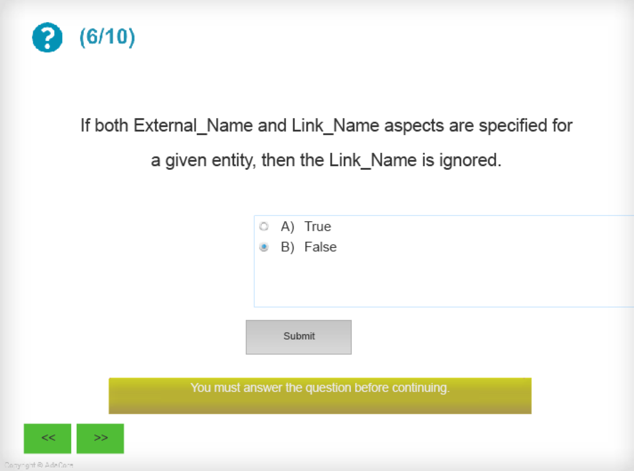
(6/10)
Notes:
Question 6 presents the statement - If both External_Name and Link_Name aspects are specified for a given entity, then the Link_Name is ignored.
Please select if you believe the statement is TRUE or FALSE and click Submit.

Slide 24
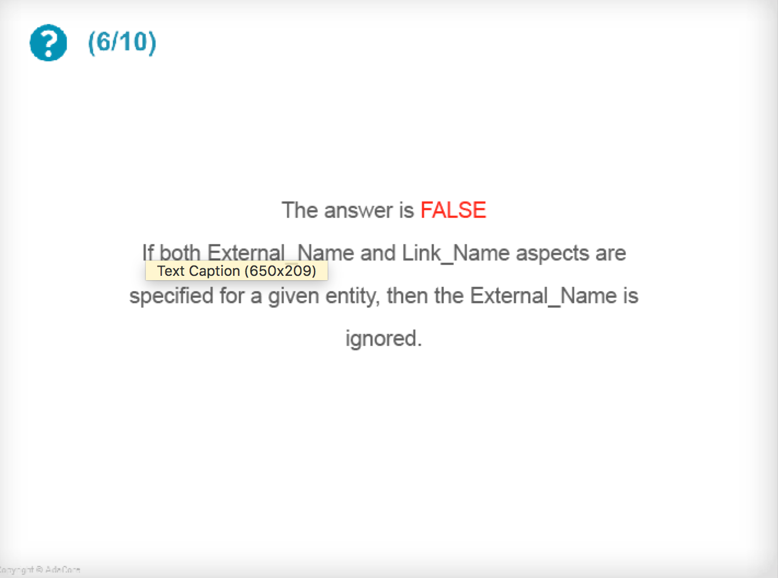
(6/10)
Notes:
The answer was FALSE - if both External_Name and Link_Name aspects are specified for a given entity, then the External_Name is ignored.

Slide 25
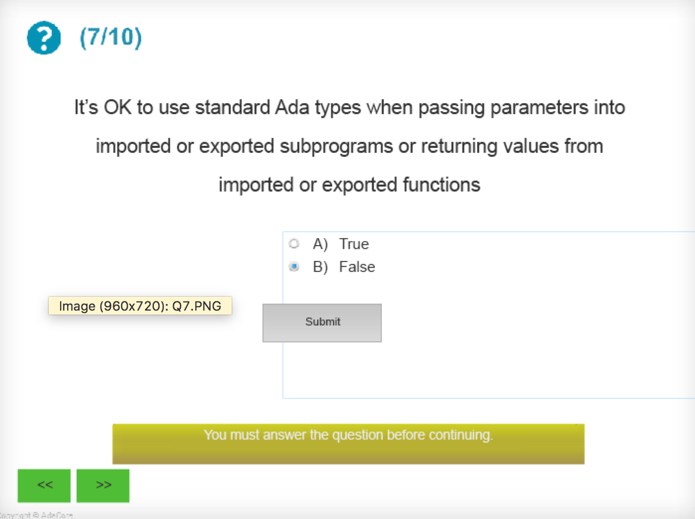
(7/10)
Notes:
Question 7 presents the statement - It’s OK to use standard Ada types when passing parameters into imported or exported subprograms or returning values from imported or exported functions.
Please select if you believe the statement is TRUE or FALSE and click Submit.

Slide 26
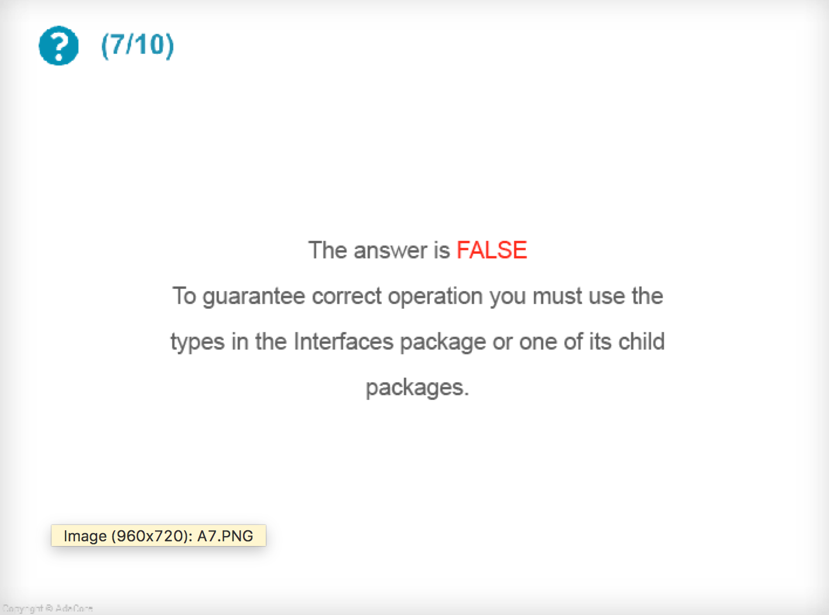
(7/10)
Notes:
The answer was FALSE – to guarantee correct operation it is best to use the types in the Interfaces package or one of its child packages.

Slide 27
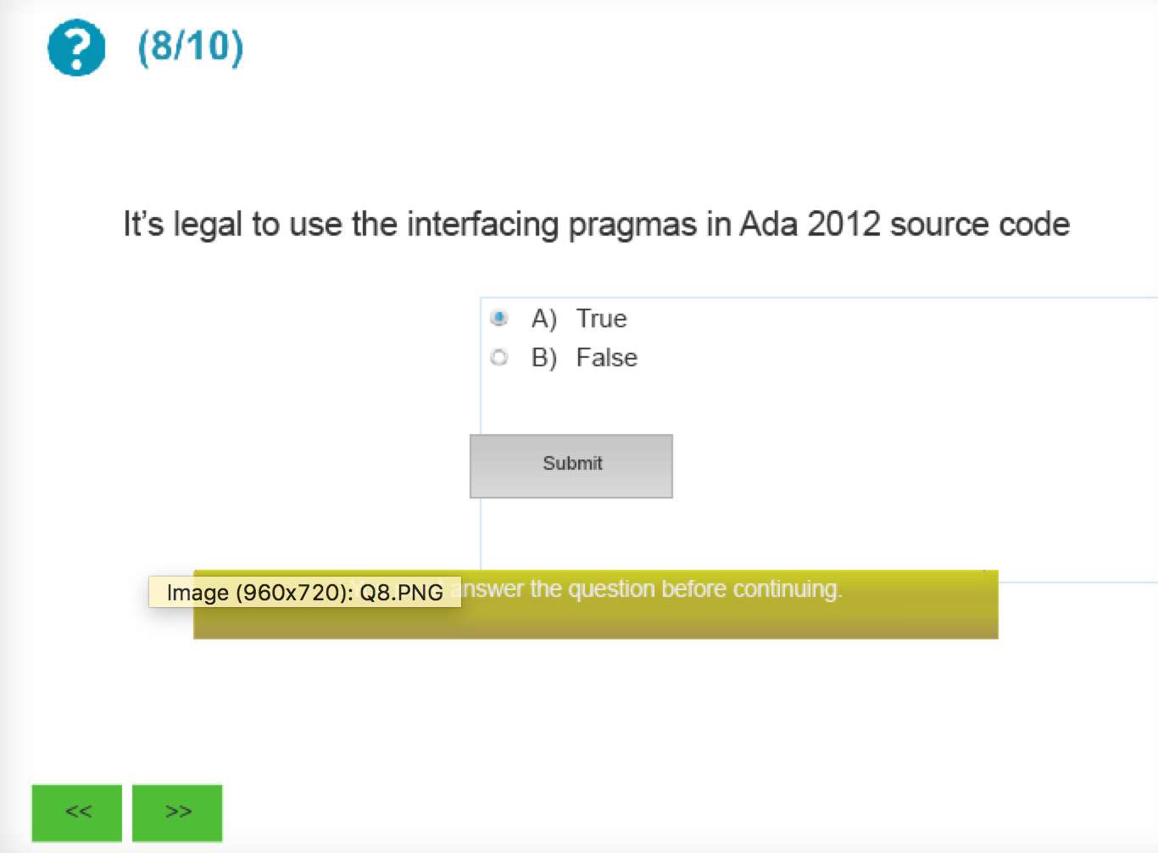
(8/10)
Notes:
Question 8 presents the statement - It’s not possible to use the interfacing pragmas in Ada 2012 source code ?
Please select if you believe the statement is TRUE or FALSE and click Submit.

Slide 28
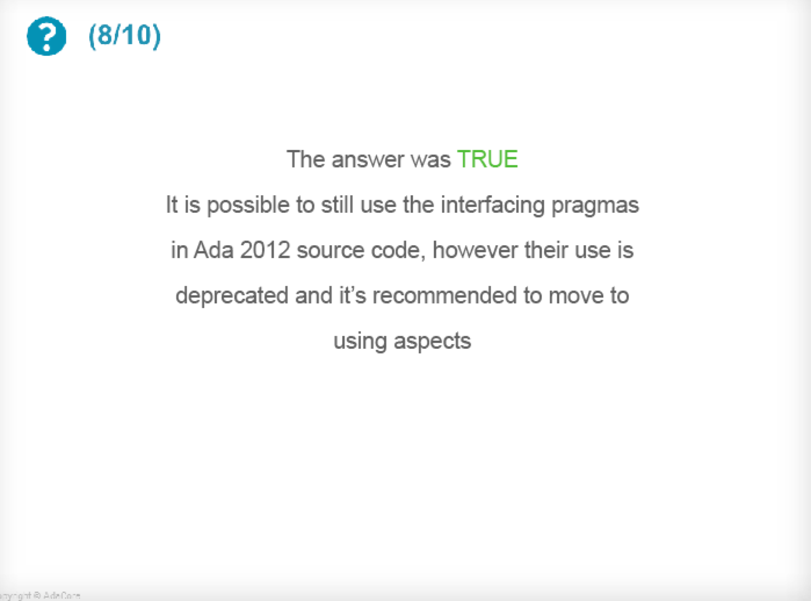
(8/10)
Notes:
The answer was TRUE – it is possible to still use the interfacing pragmas in Ada 2012 source code, however their use is deprecated and it’s recommended to move to using aspects.

Slide 29
(9/10)
with Interfaces; use Interfaces; procedure Main is A_Byte : constant Unsigned_8 := 0 with Convention => C, Export => True; begin null; end Main;
Notes:
Question 9 shows a 8 bit constant entity being exported in the C calling convention.
If you think this code is correct then please click the tick icon, otherwise click the line of code that is incorrect.

Slide 30
(9/10)
with Interfaces; use Interfaces; procedure Main is A_Byte : constant Unsigned_8 := 0 with Convention => C, Export => True; begin null; end Main;
Notes:
The answer is YES – the code is correct.
It is perfectly legal for Ada programs to export constants to foreign languages.

Slide 31
(10/10)
with Interfaces.C; with Ada.Text_IO; procedure Main is function Get_Length return Interfaces.C.size_t with Convention => C, Import => True, External_Name => "getLength"; begin Ada.Text_IO.Put_Line(Get_Length’Img); end Main;
#include <stdlib.h> extern size_t getLength(void) { return (size_t)10; }
Notes:
Question 10 presents a specific example of interfacing Ada to C.
The Ada main program has imported a C subprogram as a function entity that returns a numeric value 10.
The call to the imported function is made and it’s return value is passed to the Put_Line subprogram from Ada.Text_IO

Slide 32
(10/10)
with Interfaces.C; with Ada.Text_IO; procedure Main is function Get_Length return Interfaces.C.size_t with Convention => C, Import => True, External_Name => "getLength"; begin Ada.Text_IO.Put_Line(Get_Length’Img); end Main;
#include <stdlib.h> extern size_t getLength(void) { return (size_t)10; }
Notes:
The Ada main program will output the value 10 on the console.
Please click the continue to button to review your quiz score.

Slide 33
Notes:
Thank you for attending this introductory lecture as part of the course on Mixed Language Programming with Ada.
The aim of this lecture has been to lay the foundation for future learning about interfacing to specific foreign languages and to show how Ada can be used effectively in diverse large scale software systems.
I hope you have found it a valuable step in learning the Ada Programming Language and that you continue onto the other lectures in the course from the Ada University.
Thank you.

