Slide 1
Stars – Statements
Presented by Quentin Ochem
university.adacore.com

Slide 2
Question 1

Slide 3
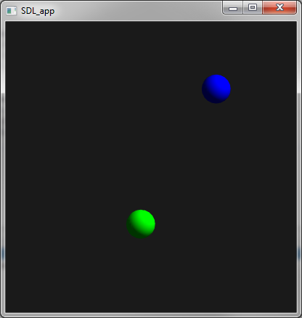
{X = cos (a) * d,
Y = sin (a) * d}
d
a

Slide 4
Question 2

