Slide 1
Record Types
Presented by Quentin Ochem
university.adacore.com

Slide 2
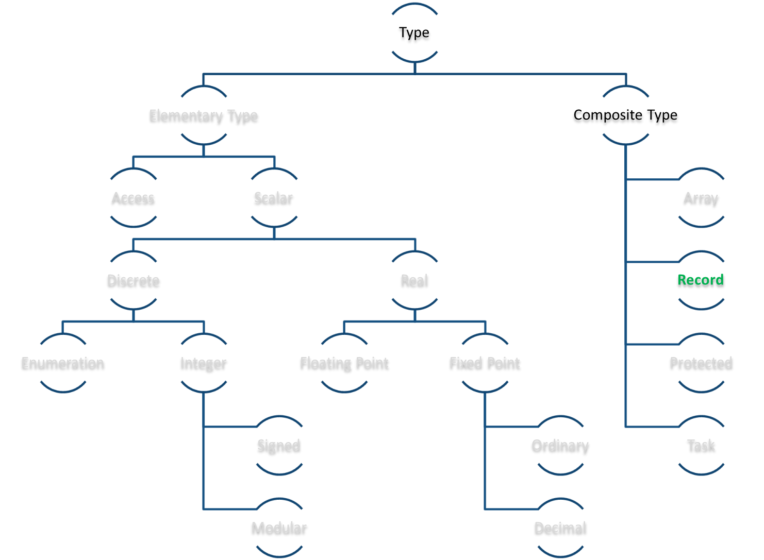
Ada Type Model

Slide 3
Record Types
Allow to store named heterogeneous data in a type
Fields are accessed through dot notation
type Shape is record Id : Integer; X, Y : Float; end record;
S : Shape; begin S.X := 0.0; S.Id := 1;

Slide 4
Nested Record Types
Any kind of definite type can be used as component types
Size may only be known at elaboration time
  Has impact on code generated
type Position is record X, Y : Integer; end record; type Shape is record Name : String (1 .. 10); P : Position; end record;
Len : Natural := Compute_Len; type Name_Type is new String (1 .. Len); type Shape is record Name : Name_Type; P : Position; end record;

Slide 5
Default Values
Default Values can be provided to record components:
Default values are dynamic expressions evaluated at object elaboration
type Position is record X : Integer := 0; Y : Integer := 0; end record;
Cx, Cy : Integer := 0; type Position is record X : Integer := Cx; Y : Integer := Cy; end record; P1 : Position; -- = (0, 0); begin Cx := 1; Cy := 1; declare P2 : Position; -- = (1, 1);

Slide 6

Aggregates (1/2)
Like arrays, record values can be given through aggregates
Named aggregates are possible (but cannot switch back to positional)
type Position is record X, Y : Integer; end record; type Shape is record Name : String (1 .. 10); P : Position; end record; Center : Position := (0, 0); Circle : Shape := ((others => ' '), Center);
P1 : Position := (0, Y => 0); -- OK P2 : Position := (X => 0, Y => 0); -- OK P3 : Position := (Y => 0, X => 0); -- OK P4 : Position := (X => 0, 0); -- NOK

Slide 7
Aggregates (2/2)
Named aggregate is required for one-elements records
Default values can be referred as <> after a name or others
If all remaining types are the same, others can use an expression
type Singleton is record V : Integer; end record; V1 : Singleton := (V => 0); -- OK V2 : Singleton := (0); -- NOK
type Rec is record A, B, C, D : Integer; end record; V1 : Rec := (others => <>); V2 : Rec := (A => 0, B => <>, others => <>);
type Rec is record A, B : Integer; C, D : Float; end record; V1 : Rec := (0, 0, others => 0.0);

Slide 8
Discriminant Rationale
Only a subset of the components are needed to use this type, depending on the context
Why do we need to use the memory for Radius if the shape is a line?
type Shape is record X, Y : Float; X2, Y2 : Float; Radius : Float; Outer_Radius : Float; end record;

Slide 9
Use of a Discriminant
Types can be parameterized after a discrete type
This type is indefinite, need to be constrained at object declaration
type Shape_Kind is (Circle, Line, Torus); type Shape (Kind : Shape_Kind) is record X, Y : Float; case Kind is when Line => X2, Y2 : Float; when Torus => Outer_Radius, Inner_Radius : Float; when Circle => Radius : Float; end case; end record;
V : Shape (Circle);

Slide 10
Usage of a Record with Discriminant
As for arrays – the unconstrained part has to be specified
Accessing to a component not accessible for a given constraint will raise Constraint_Error
Note: A discriminant is constant, set at object declaration
V1 : Shape (Circle) := …; V2 : Shape := V1; -- OK, constrained by initialization begin V1.Radius := 0.0; -- OK, radius is in the Circle case V2.X2 := 0.0; -- Raises constraint error

Slide 11
Aggregates with Discriminants
Same as record aggregates – but have to give a value to the discriminant
Only the values related to the constraint are supplied
V1 : Shape := (Kind => Line, X => 0.0, Y => 0.0, X2 => 10.0, Y2 => 10.0); V2 : Shape := (Circle, 0.0, 0.0, 5.0);

Slide 13
(1/10)
type R is record A, B, C : Integer := 0; end record; V : R := (A => 1);

Slide 14
(1/10)
type R is record A, B, C : Integer := 0; end record; V : R := (A => 1);
Compilation error, the aggregate should give a default value for other fields,
for example (A => 1, others => <>)

Slide 15
(2/10)
type My_Integer is new Integer; type R is record A, B, C : Integer := 0; D : My_Integer := 0; end record; V : R := (others => 1);

Slide 16
(2/10)
type My_Integer is new Integer; type R is record A, B, C : Integer := 0; D : My_Integer := 0; end record; V : R := (others => 1);
Compilation error, all components are not of the same type,
they can't be given a common value through others

Slide 17
(3/10)
type Cell is record Val : Integer; Next : Cell; end record;

Slide 18
(3/10)
type Cell is record Val : Integer; Next : Cell; end record;
Compilation error, this type definition is recursive

Slide 19
(4/10)
type My_Integer is new Integer; type R is record A, B, C : Integer; D : My_Integer; end record; V : R := (others => <>);

Slide 20
(4/10)
type My_Integer is new Integer; type R is record A, B, C : Integer; D : My_Integer; end record; V : R := (others => <>);
This is correct. In the absence of explicit values given in the record definition,
A, B, C and D will be of whatever value is in the memory at this time

Slide 21
(5/10)
type R is record A : Integer := 0; end record; V : R := (0);

Slide 22
(5/10)
type R is record A : Integer := 0; end record; V : R := (0);
Compilation error, only the named notation is allowed
in singleton values, e.g. (A => 0)

Slide 23
(6/10)
type R is record V : String; end record; V : R := (V => "Hello");

Slide 24
(6/10)
type R is record V : String; end record; V : R := (V => "Hello");
Compilation error, a record can't have an unconstrained component

Slide 25
(7/10)
type R is record S : String (1 .. 10); end record; V : R := (S => "Hello");

Slide 26
(7/10)
type R is record S : String (1 .. 10); end record; V : R := (S => "Hello");
Run-time error (and possible a compile-time warning).
The size of the string given here is 5, while we expect a string of 10 elements

Slide 27
(8/10)
type R (D : Integer) is record null; end record; V1 : R := (D => 5); V2 : R := (D => 6); begin V1 := V2;

Slide 28
(8/10)
type R (D : Integer) is record null; end record; V1 : R := (D => 5); V2 : R := (D => 6); begin V1 := V2;
V1 and V2 have different discriminant values,
they're considered structurally different

Slide 29
(9/10)
type Shape_Kind is (Circle, Line); type Shape (Kind : Shape_Kind) is record case Kind is when Line => X, Y : Float; X2, Y2 : Float; when Circle => X, Y : Float; Radius : Float; end case; end record;

Slide 30
(9/10)
type Shape_Kind is (Circle, Line); type Shape (Kind : Shape_Kind) is record case Kind is when Line => X, Y : Float; X2, Y2 : Float; when Circle => X, Y : Float; Radius : Float; end case; end record;
X and Y components are duplicated

Slide 31
(10/10)
type Shape_Kind is (Circle, Line); type Shape (Kind : Shape_Kind) is record X, Y : Float; case Kind is when Line => X2, Y2 : Float; when Circle => Radius : Float; end case; end record; V : Shape := (Circle, others => <>); begin V.Kind := Line; V.X2 := 0.0; V.Y2 := 0.0;

Slide 32
(10/10)
type Shape_Kind is (Circle, Line); type Shape (Kind : Shape_Kind) is record X, Y : Float; case Kind is when Line => X2, Y2 : Float; when Circle => Radius : Float; end case; end record; V : Shape := (Circle, others => <>); begin V.Kind := Line; V.X2 := 0.0; V.Y2 := 0.0;
The discriminant of an object is constant

