Slide 1

Lecture 3.2
Ranging and tracking using sound
(Part 2)
CMSC 818W : Spring 2019
Tu-Th 2:00-3:15pm
CSI 2118
Nirupam Roy
Feb. 21st 2019

Slide 2
1. Distance from the speed information
a. Techniques
b. Signal detection
2. Distance from the amplitude information
a. Absorption
b. Propagation loss
3. Distance from the frequency information
a. Doppler effect
b. A case study (Doppler + Triangulation)
4. Distance from the phase information
a. Overview
b. Impulse function, Impulse response, Convolution
c. A case study

Slide 3
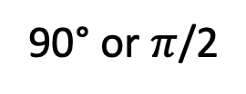

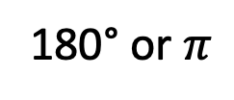

Phase
90° or $π$/2
135°or $3π$/4
180° or $π$
Amplitude
Distance or Time
$$A . sin⁡(Θ)$$

Slide 4
Distance from the phase information
Signal source
+ observer
Reflector

Slide 5


Distance from the phase information
Amplitude
Time (sec)
Amplitude
$$A . sin⁡(2πft)$$
$$A . sin⁡(2πft+Θ)$$

Slide 6

Distance from the phase information
Amplitude
Time (sec)
Amplitude
$$A . sin⁡(2πft)$$
$$A . sin⁡(2πft+Θ)$$
Phase difference, $Θ$

Slide 7



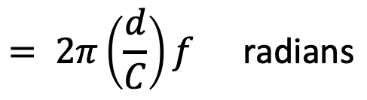

Distance from the phase information
$$A . sin⁡(2πft+Θ)$$
$$A . sin⁡(2πft)$$
Signal source
+ observer
Reflector
Phase difference, $Θ$
$$= 2π\left(\frac{d}{C}\right)f \text{radians}$$
$$= 2πd/\text{λ} \text{radians}$$

Slide 8


Distance from the phase information
Phase wrap
Phase difference, $Θ$
0 ≤ $phase \text{≤} 2Π$

Slide 9
Distance from the phase information
Phase wrap
Phase difference, $Θ$
0 ≤ $phase \text{≤} 2Π$
2Π
Phase(radian)
0
Time
Solution: Phase unwrapping

Slide 10
Convolution and Impulse response

Slide 11
Impulse response
Impulse
Room’s acoustic environment (reflections, absorption etc.)
Amplitude
Time (sec)
0.00
0.25
0.50
Impulse Response

Slide 12
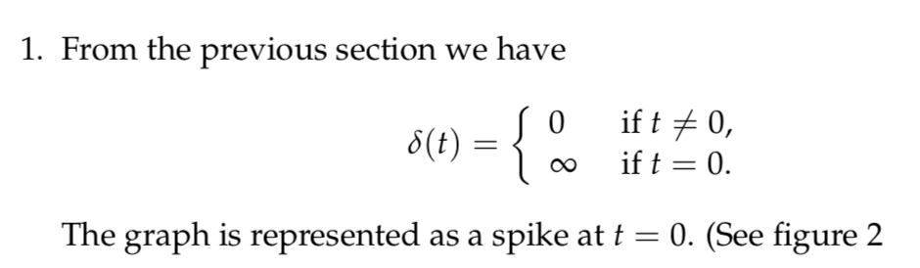
Impulse response: Theory
Unit Impulse
Amplitude
Time (sec)
0.00
0.25
0.50

Slide 13
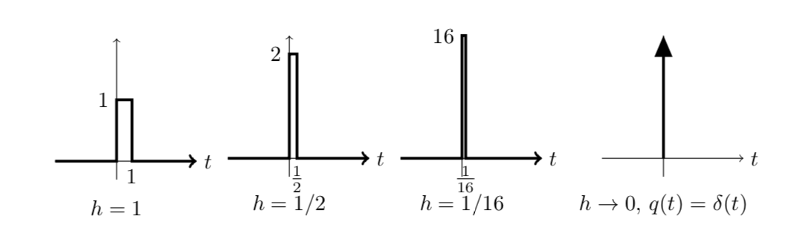
Impulse response: Theory
Unit Impulse

Slide 14
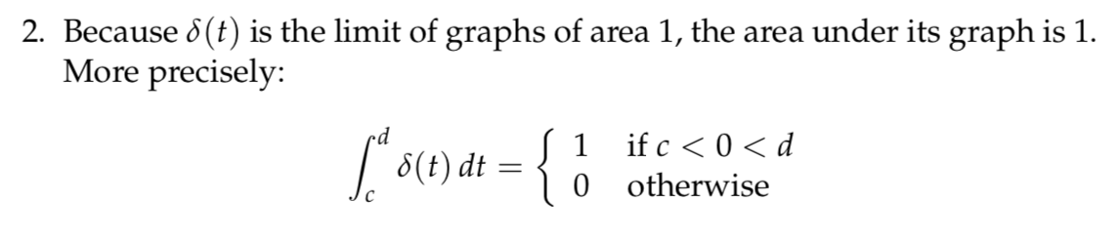
Impulse response: Theory

Slide 15
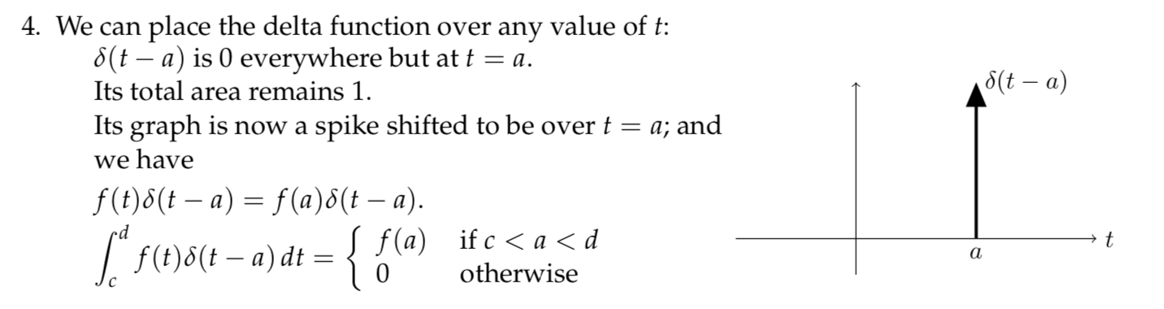
Impulse response: Theory
3.

Slide 16
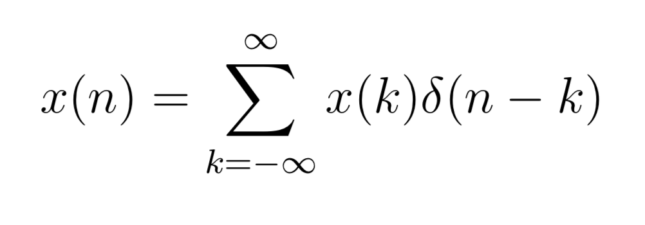
Impulse response: Theory
Amplitude
Time/Sample

Slide 17
Impulse response: Theory
Amplitude
Amplitude
Time/Sample
Time/Sample

Slide 18
Impulse response: Theory
Amplitude
Amplitude
Time/Sample
Time/Sample

Slide 19
Impulse response
Impulse
SYSTEM
Impulse Response

Slide 20
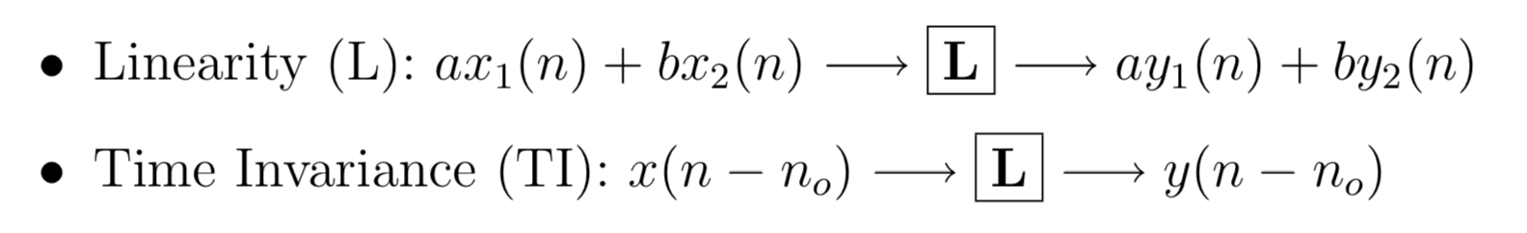
Impulse response
Linear and Time-invariant (LTI) System
Input
Output
x(n)
y(n)

Slide 21
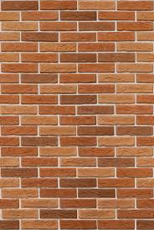
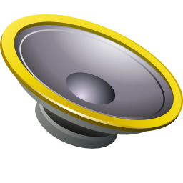

Multipath

Slide 22
Multipath: Convolution
Amplitude
Time (sec)
0.00
0.25
0.50
0.75
1.00
1.25

Slide 23
Multipath: Convolution
Amplitude
Time (sec)
0.00
0.25
0.50
0.75
1.00
1.25
Direct path
Amplitude
Time (sec)
0.00
0.25
0.50
0.75
1.00
1.25

Slide 24
Multipath: Convolution
Amplitude
Time (sec)
0.00
0.25
0.50
0.75
1.00
1.25
Direct path
Echo
Amplitude
Time (sec)
0.00
0.25
0.50
0.75
1.00
1.25

Slide 25
Impulse response: Theory
Impulse
0
Time/Sample

Slide 26
Impulse response: Theory
Impulse
0
Time/Sample
LTI System
Impulse response
0
Time/Sample

Slide 27
Impulse response: Theory
0
Time/Sample
LTI System

Slide 28
Impulse response: Theory
0
Time/Sample
LTI System

Slide 29
Impulse response: Theory
0
Time/Sample
0
Time/Sample

Slide 30
Impulse response: Theory
0
Time/Sample
0
Time/Sample

Slide 31
Impulse response: Theory
0
Time/Sample
0
Time/Sample

Slide 32
Impulse response: Theory
0
Time/Sample
0
Time/Sample

Slide 33
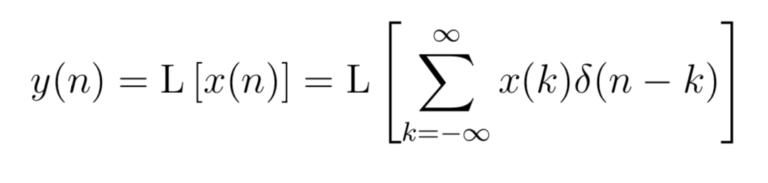
Impulse response: Theory

Slide 34
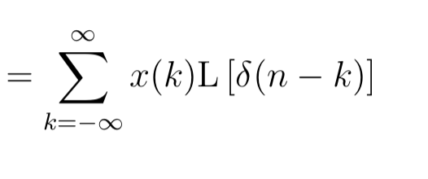
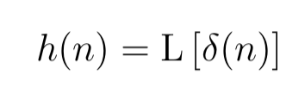
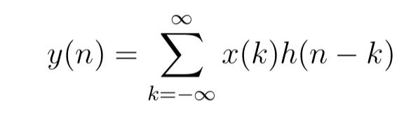
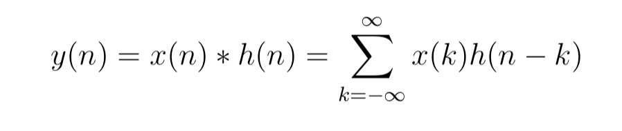
Impulse response: Theory
Impulse response,
Convolution

Slide 35
Impulse response
Impulse
LTI System
Impulse Response
Input
Input
LTI System
*
Impulse Response
Convolution
Output = conv (input, impulse response)

Slide 36
Impulse response
Impulse
LTI System
Impulse Response
Input
Input
LTI System
*
Impulse Response
Convolution
Output = conv (input, impulse response)
Impulse response = deconv (output, input)

Slide 37
Impulse response: Theory
Time domain
Frequency domain
Convolution
Multiplication
Deconvolution
Division
x[n]
X[f]
y = conv(x,h)
Y = X . H
h = deconv(y,x)
H = Y / X

Slide 38
Impulse response: Theory
Time domain
Frequency domain
Convolution
Multiplication
Deconvolution
Division
x[n]
X[f]
y = conv(x,h)
Y = X . H
h = deconv(y,x)
H = Y / X

Slide 39


Strata: Fine-Grained Acoustic-based Device-Free Tracking
Case study
Sangki Yun, Yi-Chao Chen, Huihuang Zheng, Lili Qiu, and Wenguang Mao
The University of Texas at Austin
Notes:
In this talk, I will introduce acoustic signal based device-free object tracking mechanism, which is very useful to design user interface for smart watch and VR devices.

Slide 40
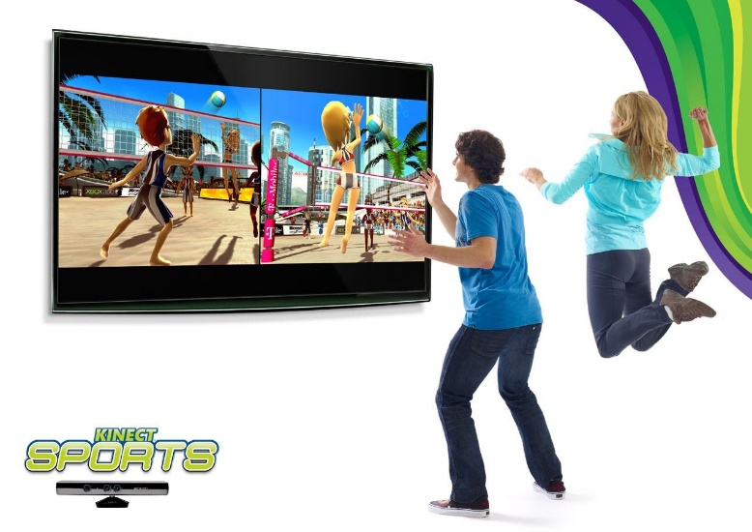
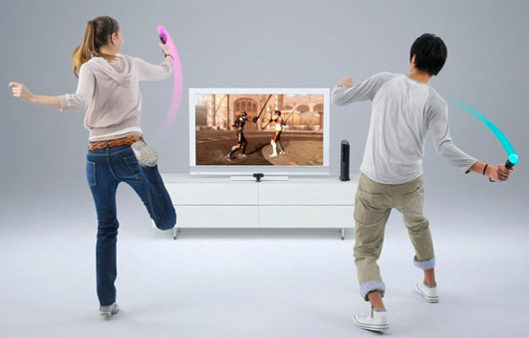


Applications of Object tracking
Motion-based Gaming
Gesture-based Remote Controller
Notes:
These days, object tracking has huge amount of applications. It can introduce gesture based interactive game, and can intuitively control the smart appliances and VR headset.

Slide 41
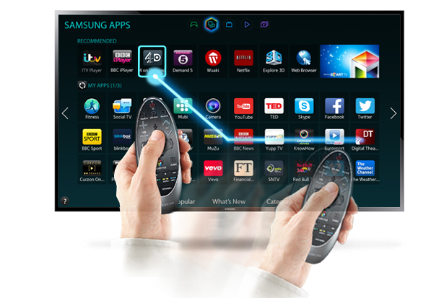
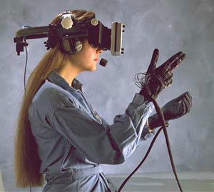
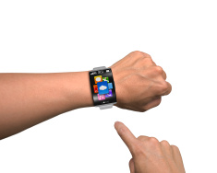
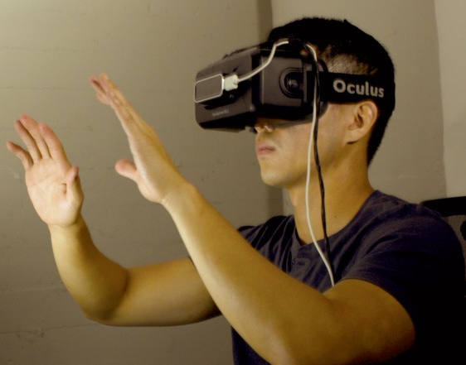
Device-Free tracking
With Device
Device-Free
Notes:
For emerging techniques such as smart watch and VR device, device free object tracking is particularly useful. For example, AR and VR users wears the headset, so tracking controller position and controlling the device based on it can uncomfortable to user, because it is difficult to grab the device. In such environment, it is more desirable if we can find the finger or hand location, and track the device based on it.

Slide 42


Device-Free tracking: challenge
Both transmitter and receiver are static
Should rely on the reflected signal
Notes:
Unfortunately, enabling device free tracking is very challenging. For the device tracking, we mostly rely on the directly received wireless signal. But in case of device-free tracking, we should use the signal reflected from the target object, which is weak, and overlapped with many other reflections.

Slide 43
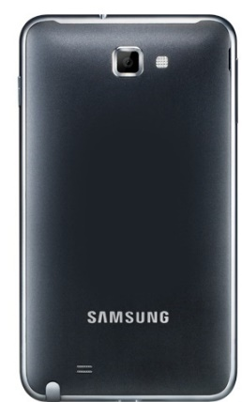


Strata: Acoustic based Fined grained tracking
Device-free passive tracking only relying on mobile device
Track the small object such as finger
All implemented in software
Notes:
In this talk, we introduce strata that enables device-free finger tracking only using the commercial smartphone. Using the speaker and microphones of the smartphone, we send and receive audio signal in inaudible frequency band, and track the movement of small object such as finger. The tracking algorithm is all implemented in software.

Slide 44
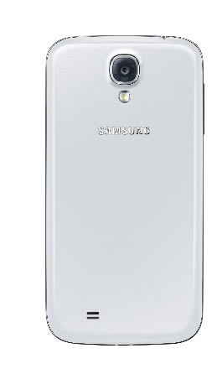
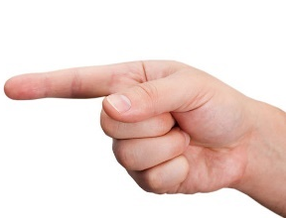

Acoustic based object tracking
Phase change proportional to the
(distance change$/$wavelength) (1.7 cm in 20 kHz)
Tracking phase enables very fine-grained positioning
Finger movement of 1mm changes the phase 0.2$π$!
Notes:
Basically, tracking object with acoustic signal have several advantages. One of the important advantages is that it have small wavelength, so small travel distance change causes significant phase change. For example, when we use 20 KHz band, the wavelength is 1.7 cm, so changing the distance of the object only by 1 mm causes the phase change of 0.2pi, which is large enough to detect and monitor. By observing the phase change, we can track the movement of the target in fine resolution.

Slide 45
Impulse response: Theory
Impulse
0
Time/Sample
Phase changes for one of the reflections
Linear System
Impulse response
0
Time/Sample

Slide 46
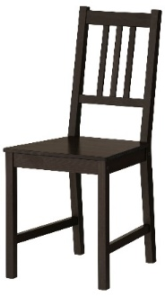
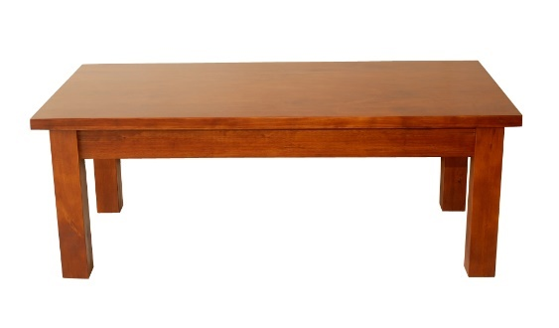
Challenges
Reflections from multiple objects
Notes:
But in practice, there are several challenges in acoustic passive tracking. First of all, the received signals from the microphone is the combination of all of the reflected signal including the signal reflected by the finger. Therefore, even if the finger movement causes the phase change, it is difficult to observe it because of the other reflections

Slide 47

Challenges
Reflections from multiple dynamic objects
Notes:
Moreover, what makes it more difficult is when there are multiple moving objects. If multiple objects cause different phase change, it becomes really challenging to separately observe them. Considering that this tracking technique will be used for smart watch and VR devices that are exposed to the movement of the surrounding objects, this is very serious problem that we have to address in practice.

Slide 48

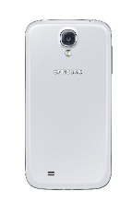






Our solution
Tracking from the channel impulse response (CIR)
Can distinguish multiple reflections in different ranges
Represented as a vector $H=\left\{h\left[0\right], h\left[1\right], …,h\left[n\right]\right\}$
Each $h[k]$ captures reflections with different delay
0.6 ms
Amplitude
0.3 ms
0.3 ms
0.8 ms
0.6 ms
Time
0.8 ms
$$h[0]$$
$$h[1]$$
$$h[2]$$
$$h[3]$$
Notes:
In Strata, we address these challenges by tracking the object using the channel impulse response. CIR is characterization of all of the reflected paths between transmitter and the receiver. It is represented as the complex vector h[n], where each element includes the signal path information in different delays. Let’s say there are three different reflecting objects in the channel. Depending on the delay of them, they are represented in different elements in the channel impulse response vector. This is a general mathematical representation of the channel. It is represented as a complex number where the magnitude is determined by the strength of the reflected signal, and the phase is determined by the delay. Here I presented only 3 reflector, but in practice, there are much more reflectors, and the profile of the multiple reflectors in a single element are linearly added.
In the remainder the talk, I will explain how to get the CIR from the acoustic channel, and how to track the finger movement using it.

Slide 49
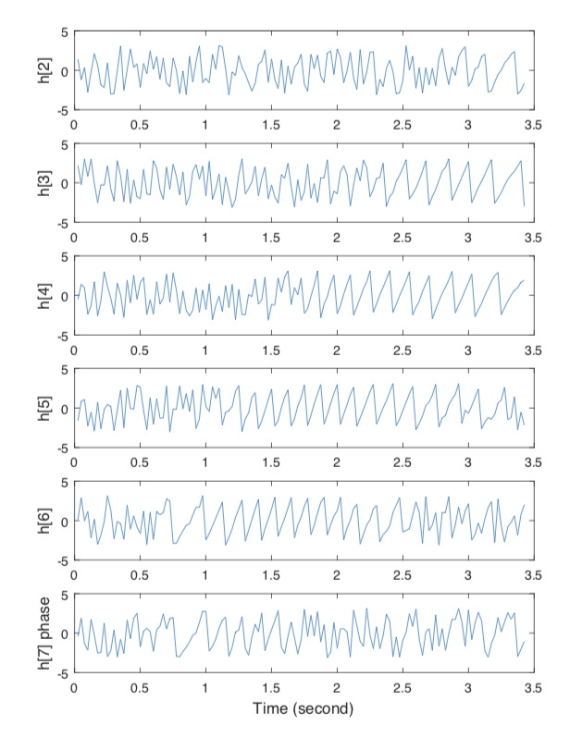
Impulse response
0
Time/Sample

