Slide 1
Smartphone Sensors and Android Overview
CS/ECE 498
Ashutosh Dhekne
(borrowed from Nirupam Roy)

Slide 2
Roadmap
An overview of smartphone sensors and possible applications
Overview of Android architecture

Slide 3
Smartphone Sensors
Accelerometer
Gyroscope
Magnetometer
Light sensor
Humidity sensor
Touch screen
Barometer
Microphone and Camera …

Slide 4

Smartphone Sensors: Accelerometer

Slide 5

Smartphone Sensors: Accelerometer

Slide 6
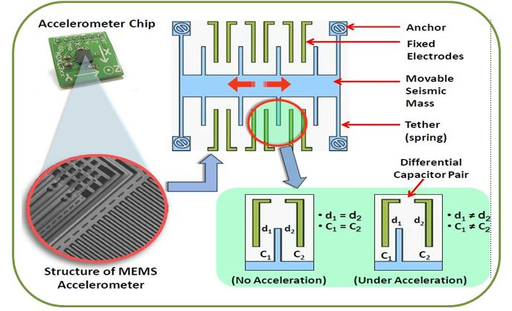
Smartphone Sensors: Accelerometer

Slide 7
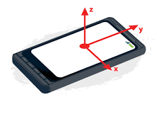
Smartphone Sensors: Accelerometer

Slide 8
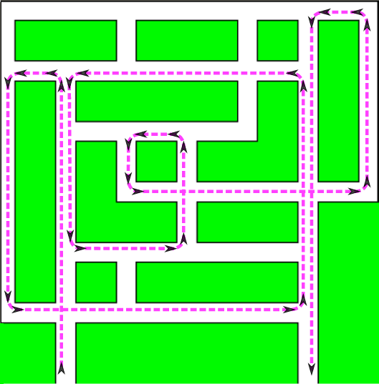
Smartphone Sensors: Gyroscope

Slide 9
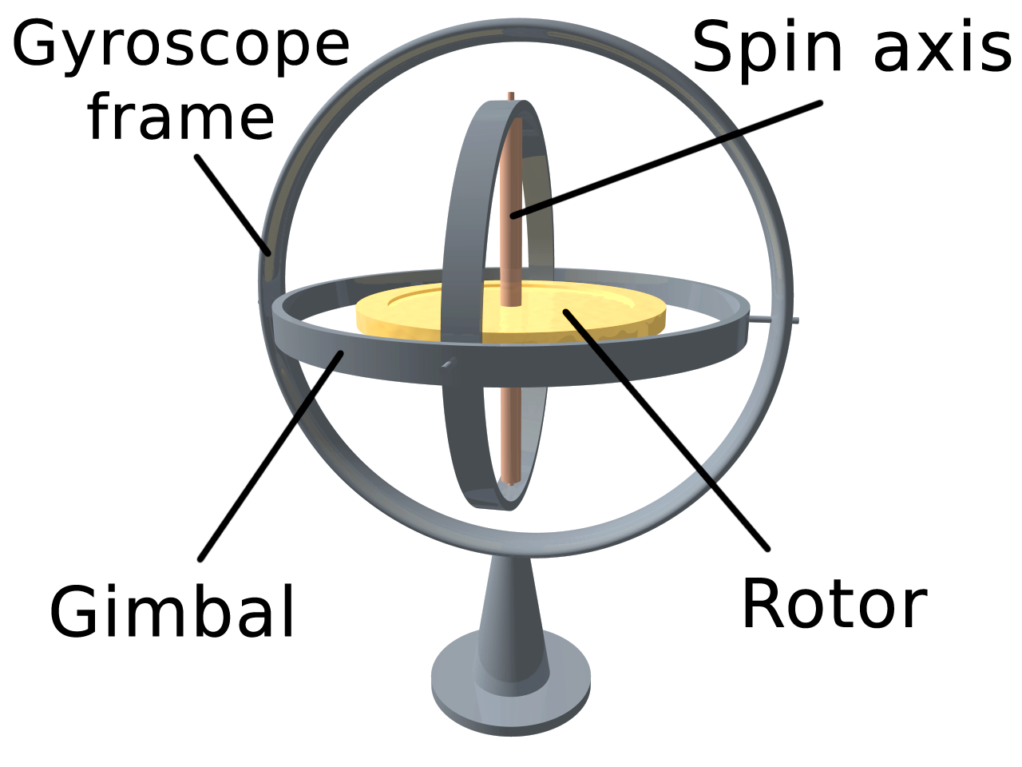

Smartphone Sensors: Gyroscope

Slide 10
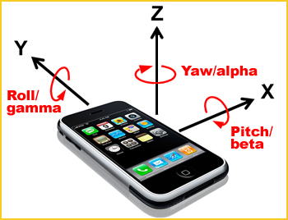
Smartphone Sensors: Gyroscope

Slide 11
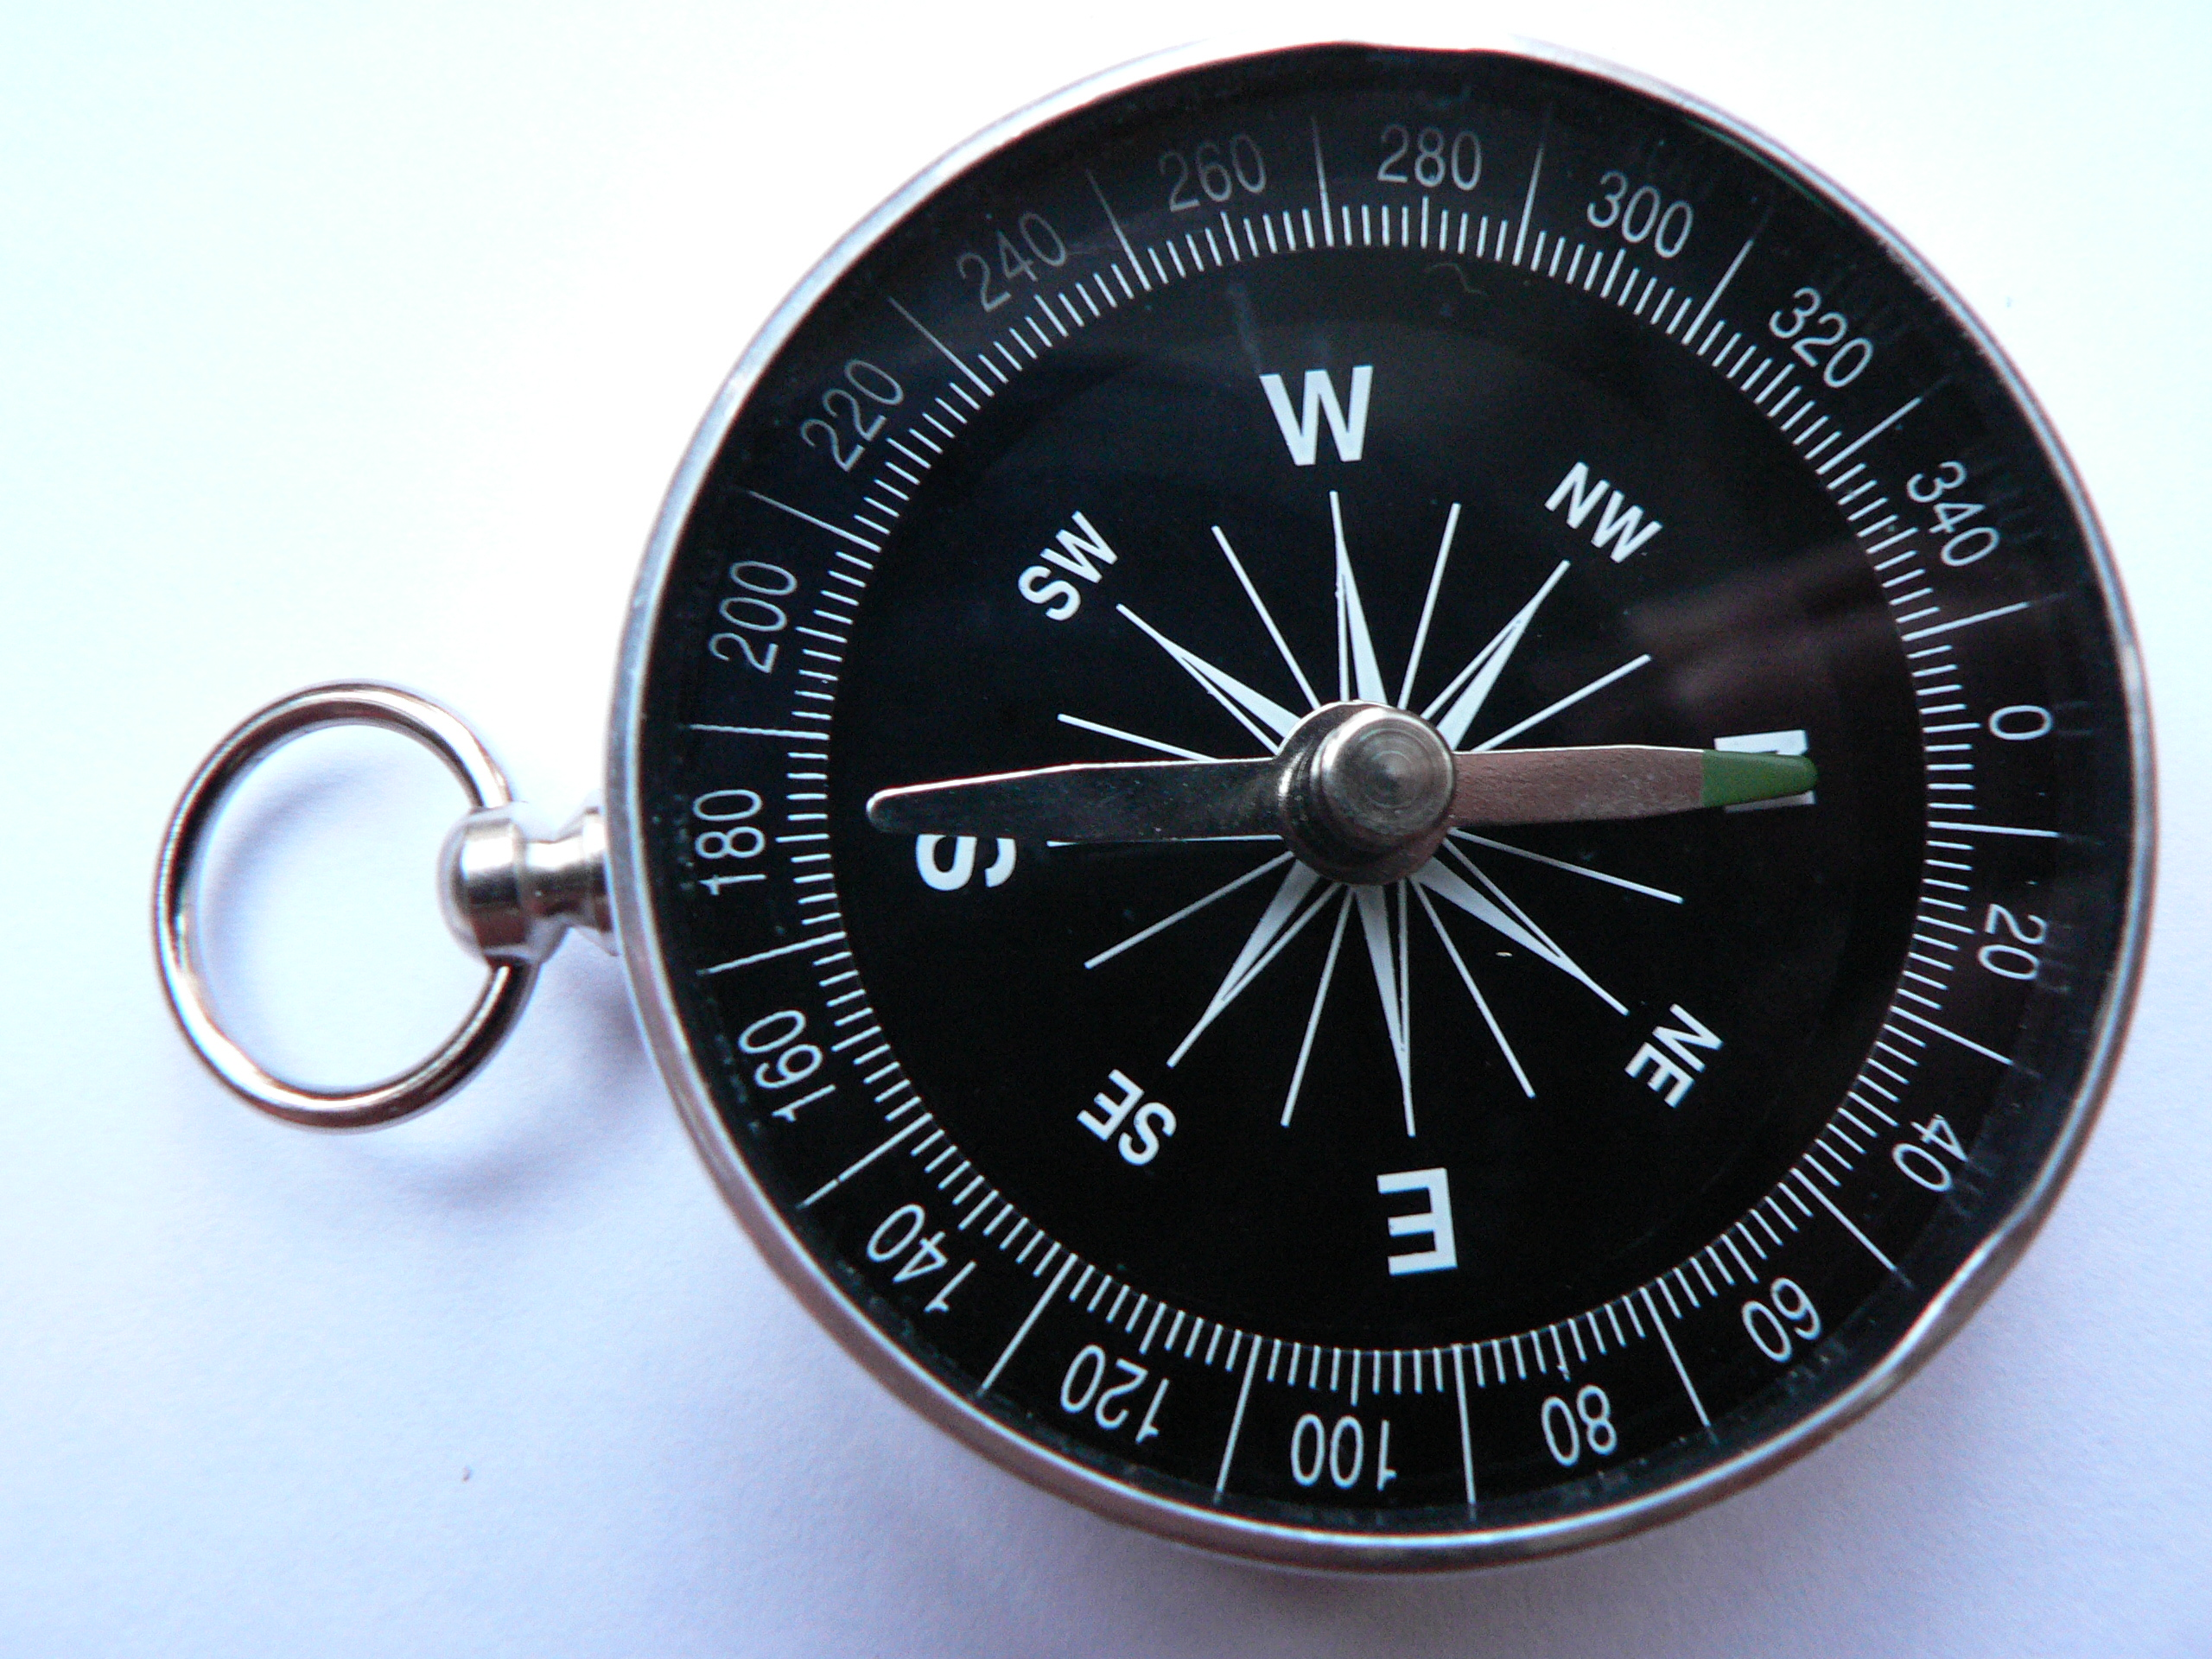

Smartphone Sensors: Magnetometer

Slide 12

Smartphone Sensors: Magnetometer

Slide 13

Smartphone Sensors: Magnetometer

Slide 14
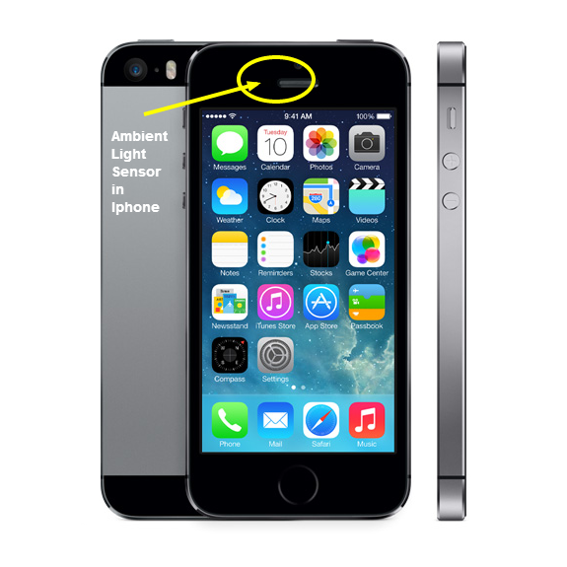
Smartphone Sensors: Light Sensor

Slide 15
Smartphone Sensors
Accelerometer
Gyroscope
Magnetometer
Light sensor
Humidity sensor
Touch screen
Barometer
Microphone and Camera …

Slide 16
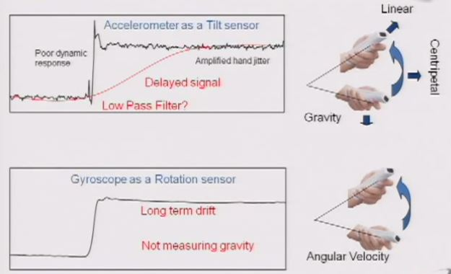
Smartphone Sensors: Fusion Sensor

Slide 17
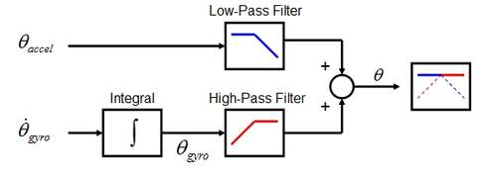
Smartphone Sensors: Fusion Sensor

Slide 18
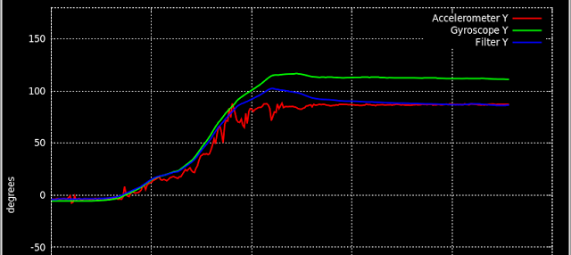
Smartphone Sensors: Fusion Sensor

Slide 19
Any question on sensors?

Slide 20
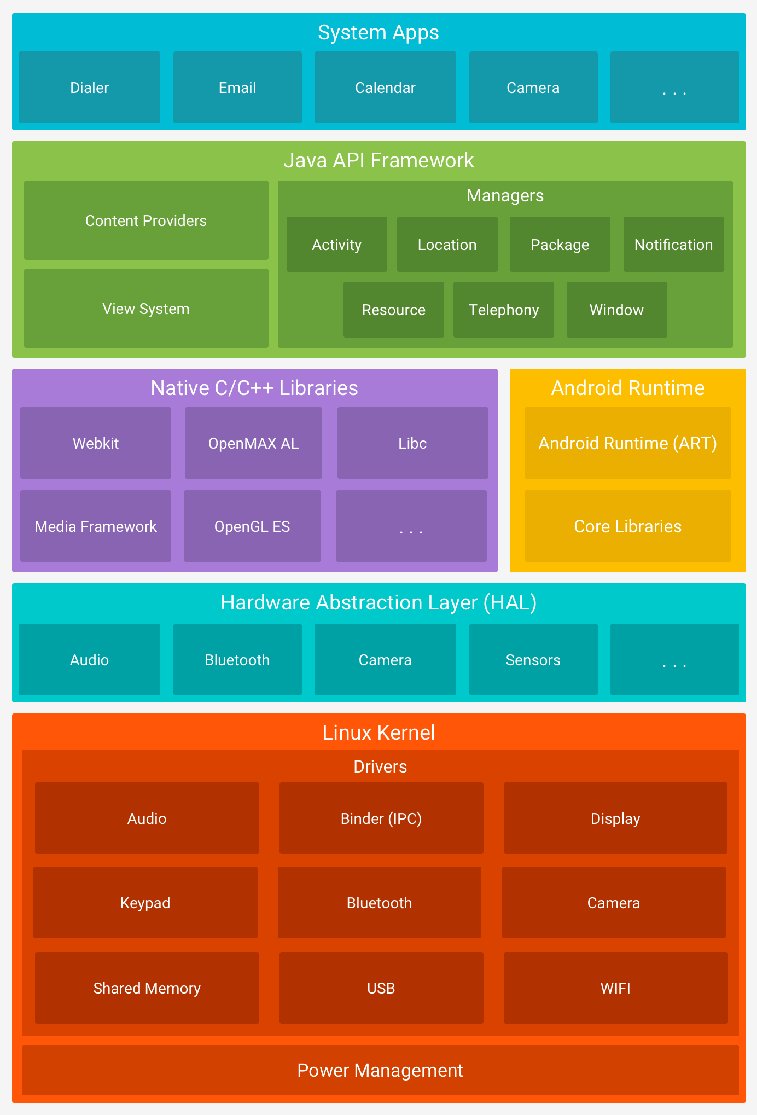
Android Architecture
Your Mobile App

Slide 21
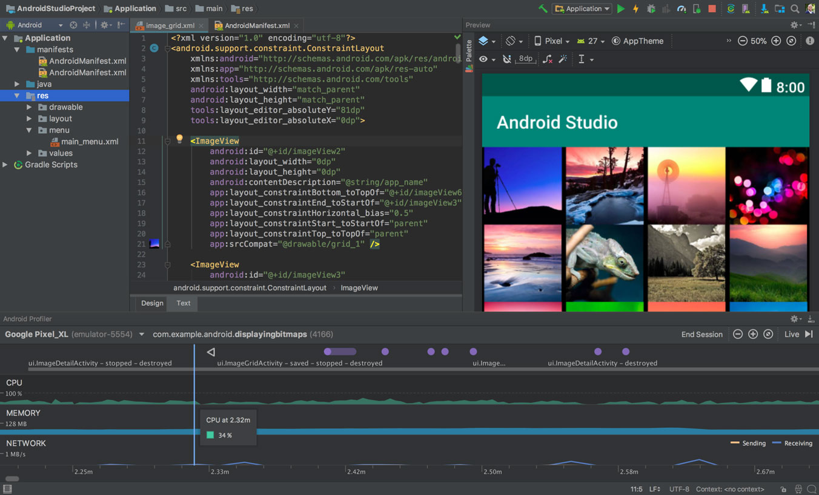
Programming for Android

Slide 22
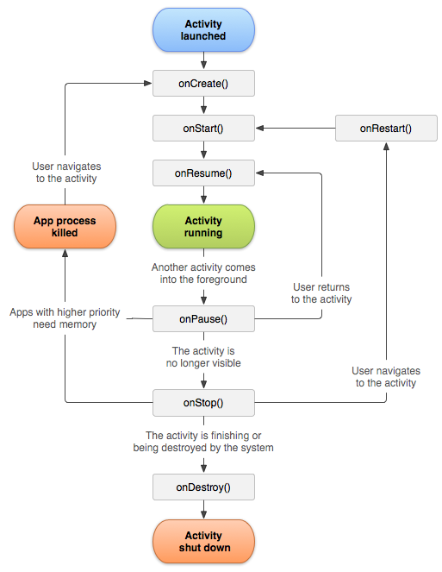
Android Application Life-cycle

Slide 23
Android Code to Access Sensor Data
http://developer.android.com/guide/topics/sensors/sensors_overview.html
private SensorManager sensorManager; ... sensorManager = (SensorManager) getSystemService(Context.SENSOR_SERVICE); if (sensorManager.getDefaultSensor(Sensor.TYPE_MAGNETIC_FIELD) != null){ // Success! There's a magnetometer. } else { // Failure! No magnetometer. }

Slide 24
Android Code to Access Sensor Data
public class SensorActivity extends Activity implements SensorEventListener { private SensorManager sensorManager; private Sensor mLight; @Override public final void onCreate(Bundle savedInstanceState) { super.onCreate(savedInstanceState); setContentView(R.layout.main); sensorManager = (SensorManager) getSystemService(Context.SENSOR_SERVICE); mLight = sensorManager.getDefaultSensor(Sensor.TYPE_LIGHT); } @Override public final void onAccuracyChanged(Sensor sensor, int accuracy) { // Do something here if sensor accuracy changes. } @Override public final void onSensorChanged(SensorEvent event) { // The light sensor returns a single value. // Many sensors return 3 values, one for each axis. float lux = event.values[0]; // Do something with this sensor value. } @Override protected void onResume() { super.onResume(); sensorManager.registerListener(this, mLight, SensorManager.SENSOR_DELAY_NORMAL); } @Override protected void onPause() { super.onPause(); sensorManager.unregisterListener(this); } }
Reading Values
How often do you want updates?

Slide 25
Android Code to Access Sensor Data
Main Activity
XML file
Android Manifest file
The main computing codes
Code for organizing the UI
The application meta-data
Most of your code will be here
Get all needed permissions

Slide 26
Asking for Permissions
Reading or writing might need permissions from the user.
<manifest ...> <uses-permission android:name="android.permission.WRITE_EXTERNAL_STORAGE" /> ... </manifest>
https://developer.android.com/training/data-storage/files#ExternalStoragePermissions

Slide 27
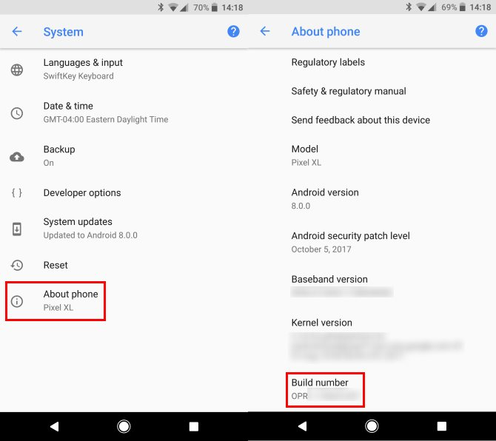
Become a Developer
http://www.imagezap.org/how-to-enable-developer-mode-on-android/

Slide 28
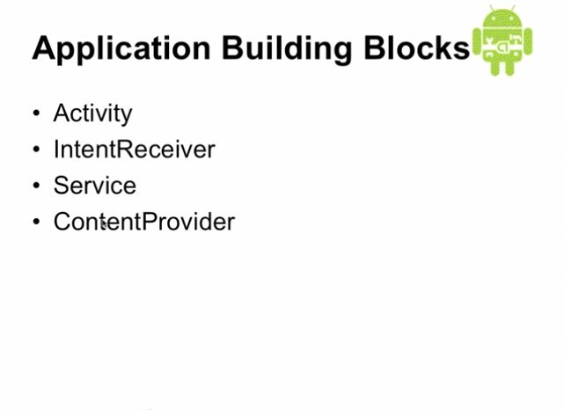

Slide 29
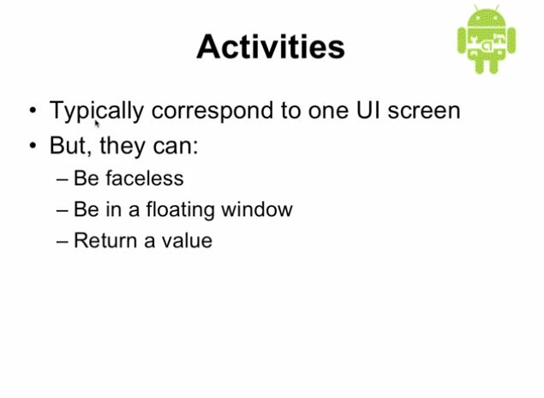

Slide 30
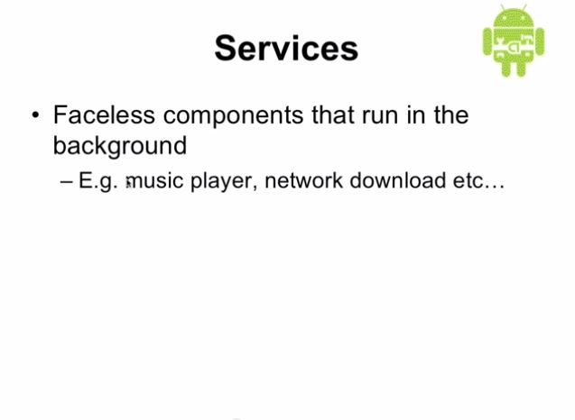
Keep collecting data when not on your activity

