Slide 1



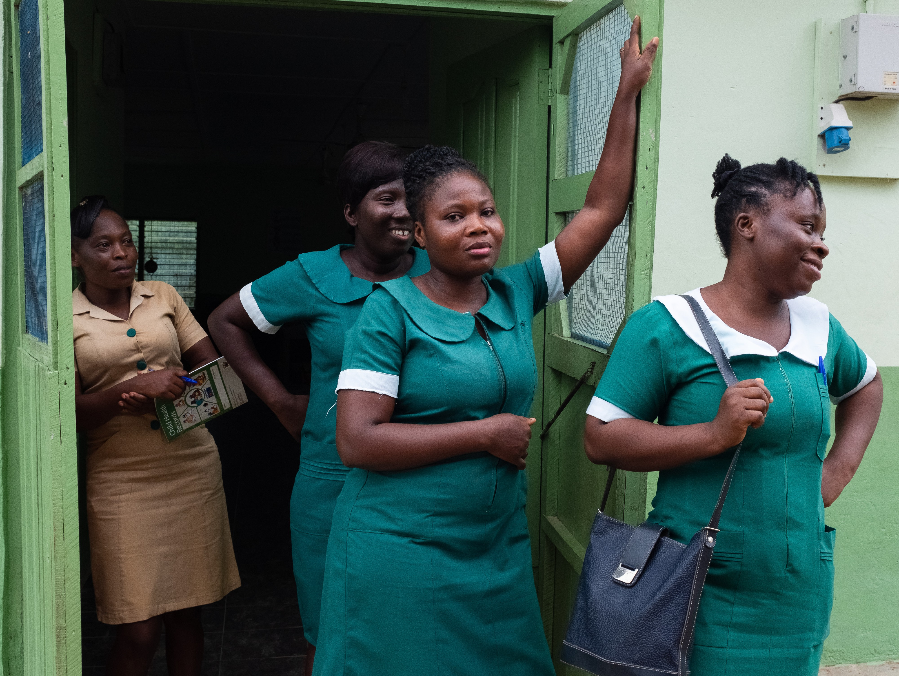

Pollution-free environments for healthy generations WHO information slides for the health sector
What every community health worker needs to know about children’s environmental health
© World Health Organization/Francis Kokoroko
www.who.int/ceh
1
Notes:
This PowerPoint slides were created on the basis of the information sheet on children’s environmental health entitled, “what every community-health worker needs to know about children’s environmental health”. Please refer to this information sheet for further details (WHO/HEP/ECH/CHE/22.03). Contents in the slides can be revised adapting to the specific needs of countries and professional groups.

Slide 2


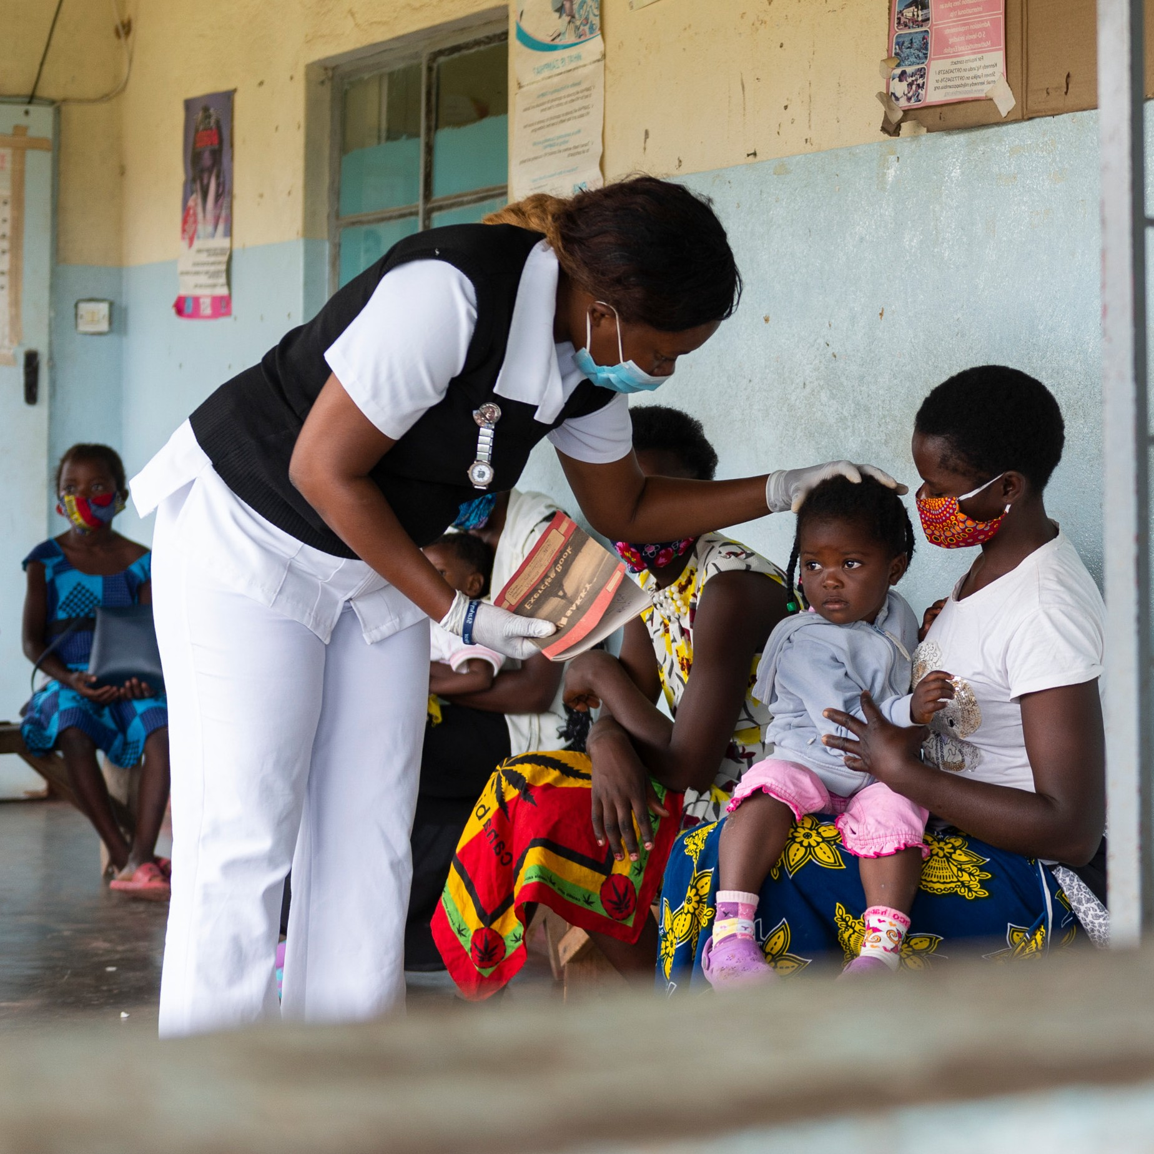
Key Facts
Early-life environment affects lifelong health and risk for disease
Unhealthy environment causes death
Prevention works
Action to reduce early exposure can protect health
Environmental threats during preconception, prenatal life and early childhood can have immediate and future health consequences.
In 2016, the environment was responsible for an estimated
13.7 million deaths globally
Decreasing exposure to pollutants reduces disease
2
© World Health Organization/Blink Media - Gareth Bentley
Notes:
Early-life environment affects lifelong health and risk for disease
Environmental threats during preconception, prenatal life and early childhood can have immediate and future health consequences.
Unhealthy environment causes death
In 2016, the environment was responsible for an estimated 13.7 million deaths globally, including 1 in 4 deaths of children under 5 years of age and 23% of all disease burden.
Prevention works
Decreasing exposure to air pollution and hazardous chemicals and waste, while securing access to safe water and adequate hygiene and sanitation, reduces disease.
Action to reduce early exposure can protect health
Reducing and potentially eliminating the exposure of children to environmental threats in the early years of their lives, and even before conception, can protect their health and that of future generations.

Slide 3





What can community health workers do?
Identify links between health outcomes and sources of environmental and occupational exposure in children
Disseminate knowledge about the most common environmental risks and measures to prevent them
Identify and report to the local authorities the potential sources of environmental exposure
Be on the alert for cases of disease linked to environmental exposure
Advocate, raise health concerns, influence decision- makers in implementing action to protect communities from exposure to environmental pollution
3
Notes:
In their everyday work, community health workers can take the following specific actions to protect children’s health:
identify and recognize the links between health outcomes and environmental and occupational sources of exposure in children. This could be done through questionnaires in local clinics, or by asking questions during home visits (for example, postnatal visits);
disseminate knowledge and educate families and communities about the most common environmental risks and measures to prevent them;
identify and report to the local authorities the potential point sources of environmental exposure in communities;
be on the alert for cases of disease linked to potential environmental exposure in communities;
advocate, raise health concerns about, and influence decision-makers in implementing action to protect communities from exposure to environmental pollution, including hazardous chemicals and waste.

Slide 4


Air pollution
Environmental issues affecting children’s health
Health effects
Air pollution can result in:
reduced lung function and rate of lung growth, respiratory infections (for example, pneumonia), and exacerbation or aggravation of asthma;
pre-term birth, low birth weight, still birth and small for gestational age;
impairment of children’s cognitive and neurological development;
increased risk and incidence of otitis media;
development of some childhood cancers, including leukaemia;
4
Notes:
Air pollution can result in:
reduced lung function and rate of lung growth, respiratory infections (for example, pneumonia), and exacerbation or aggravation of asthma;
some adverse outcomes, including pre-term birth, low birth weight, still birth and small for gestational age;
impairment of children’s cognitive and neurological development.
increased risk and incidence of otitis media;
development of some childhood cancers, including leukaemia;
some chronic health conditions later in life, for example lung disease.

Slide 5
Air pollution
Environmental issues affecting children’s health
Recommended actions
Be informed about the health effects of exposure to air pollution, especially on children
Advise families on ways of promoting sustainable lifestyles
Engage with other sectors and advocate adoption of air pollution policies at local and national levels
Recognize and assess exposure risks in pregnant women and/or child patients
Advise families on switching to clean household fuels, increasing indoor ventilation, and keeping indoor environments dry
Be aware of local, national and international medical and health-related societies active in the field of air pollution
5
Notes:
Be informed about existing and emerging evidence on the health effects of exposure to air pollution, paying particular attention to susceptible and vulnerable population groups, such as children, with the aim of educating patients, as well as colleagues and peers in community centres.
Recognize and assess exposure risks in pregnant women and/or child patients via their medical histories and by talking to them.
Advise families about behaviours that promote sustainable lifestyles with a positive impact on people’s health and mitigate air pollution and greenhouse-gas emissions. These include walking, cycling, using public transport, limiting meat consumption, and – where possible – buying locally produced food.
Advise families on the importance of switching to clean household fuels and fuel devices, increasing indoor ventilation, and keeping indoor environments dry and free of mould.
Engage with other sectors on the adoption of air-pollution policies in line with the WHO Air Quality Guidelines and provide leadership in health matters, advocating this goal at the local and national levels.
Be aware of local, national and international medical and health-related societies that are active in the field of air pollution and health with the aim of staying informed about and supporting or engaging in their activities.

Slide 6
Chemicals: heavy metals, persistent
Environmental issues affecting children’s health
organic pollutants (POPs), pesticides and endocrine disrupting chemicals (EDCs)
Health effects
Exposure to lead in utero can cause reduced IQ, increased antisocial behaviour and reduced educational attainment
Exposure to mercury in utero can cause neurological and behavioural disorders
Acute pesticide poisoning is also a serious public health problem and children are particularly vulnerable to its effects
Many POPs and EDCs may impact the immune, reproductive and neurodevelopmental systems
6
Notes:
Exposure to:
lead in utero and during childhood can cause reduced intelligence quotient (IQ), behavioural changes, such as reduced attention span and increased antisocial behaviour, and reduced educational attainment;
mercury and methylmercury in utero and during early life can cause neurological and behavioural disorders.
Acute pesticide poisoning is also a serious public health problem in many parts of the world, its health effects depending on the type and quantity of pesticide involved, duration and timing of exposure. Children are particularly vulnerable to chemicals as their unique exposure pathways and developmental physiology increase their risk of exposure and effects on their development and health.
Many persistent organic pollutants (POPs) are also endocrine disrupting chemicals (EDCs) and may impact the immune, reproductive and neurodevelopmental systems.

Slide 7
Chemicals: heavy metals, persistent
Environmental issues affecting children’s health
organic pollutants (POPs), pesticides and endocrine disrupting chemicals (EDCs)
Recommended actions
Advise people to limit their intake of POPs and mercury from food by following the advice of the local food-safety authorities
Advise people against keeping toxic chemicals in the home. Promote the safe packaging and clear labelling of toxic substances, as well as their storage out of the reach of children to prevent poisoning
Identify and report to the local authorities the potential sources of environmental exposure, such as hazardous waste sites and electronic waste- recycling activities.
Advise parents and caretakers to prevent children from accessing waste sites
7
Notes:
Remind people that some fish and seafood can be contaminated with mercury and raise awareness of the essential need for uncontaminated local sources.
Advise people to limit their intake of POPs from food by following the advice of the local food-safety authorities.
Identify traditional practices and folk medicines as sources of mercury and spread awareness of the potential harm from their use. Work with individuals and communities to identify substitute practices.
Advise people about the dangers of informal recycling of lead-containing products in and around the home backyard and community areas.
Advise people against keeping toxic chemicals in the home. Promote the safe packaging and clear labelling of toxic substances, as well as their storage out of the reach of children to prevent poisoning.
Identify and report to the local authorities the potential point sources of environmental exposure in communities, such as hazardous waste sites, artisanal and small-scale gold mining (ASGM), or electronic waste-recycling activities.
Advise parents and caretakers about the importance of preventing children from accessing waste sites, especially hazardous waste sites.

Slide 8





Water, sanitation and hygiene (WASH)
Environmental issues affecting children’s health
Health effects
Lack of WASH is a major risk factor for diarrhoea, parasitic infections and malnutrition in children. Diarrhoea is the fourth leading cause of death among children under 5 years
Infections associated with unclean births account for 26% of neonatal deaths
Inadequate WASH in health-care facilities and the unsafe disposal of wastewater from health centres can contribute to the spread of antimicrobial resistance among patients and communities
The unsafe management of health-care waste exposes health-care workers, waste handlers, patients and their families, and the community to
preventable infections and the effects of toxic substances, including injuries
8
Notes:
Lack of safe water, sanitation and hygiene (WASH) is a major risk factor for diarrhoea, parasitic infections and malnutrition in children, as well as school absenteeism.
Diarrhoea is the fourth leading cause of death among children under 5 years, while 24% of the world’s population are infected with soil-transmitted helminths, causing impaired growth and physical development in children.
Infections associated with unclean births account for 26% of neonatal deaths and 11% of maternal mortality, totalling more than 1 million deaths each year.
Inadequate WASH in health-care facilities and the unsafe disposal of wastewater from health centres can contribute to the spread of antimicrobial resistance among patients and communities.
Inadequate WASH has a negative impact on social and economic well-being and, in health facilities, affects patient health-care-seeking behaviour and staff morale.
The unsafe management of health-care waste exposes health-care workers, waste handlers, patients and their families, and the community to preventable infections and the effects of toxic substances, including injuries.

Slide 9
Water, sanitation and hygiene (WASH)
Environmental issues affecting children’s health
Recommended actions
Promote breastfeeding
Raise awareness about WASH-related practices
Contribute to health surveillance on WASH-related diseases with the aim of informing appropriate WASH-related actions
Advocate essential actions to ensure access to WASH in homes, schools and health facilities
9
Notes:
Promote breastfeeding, and exclusive breastfeeding for the first 6 months of life.
Practise safe WASH, including frequent and effective handwashing with soap, safe treatment and storage of drinking water and safe disposal of children’s excreta, and promote these practices among staff in health facilities.
Raise awareness among patients and the wider community of the health risks linked to poor WASH-related practices.
Contribute to health surveillance on WASH-related diseases with the aim of informing appropriate WASH-related actions.
Advocate essential action to be taken by authorities at the community and local levels to ensure access to safe drinking-water and adequate sanitation and hygiene in homes, schools and health facilities.

Slide 10
Disclaimer
Acknowledgements
WHO is grateful to the Center for Preventive Medical Sciences, Chiba University, Japan, for providing the technical and financial support that made this project possible.
WHO/HEP/ECH/CHE/slides/22.03
© World Health Organization 2022
Some rights reserved. This work is available under the Creative Commons Attribution-NonCommercial-ShareAlike 3.0 IGO licence (CC BY-NC-SA 3.0 IGO; https://creativecommons.org/licenses/by-nc-sa/3.0/igo).
Under the terms of this licence, you may copy, redistribute and adapt the work for non-commercial purposes, provided the work is appropriately cited, as indicated below. In any use of this work, there should be no suggestion that WHO endorses any specific organization, products or services. The use of the WHO logo is not permitted. If you adapt the work, then you must license your work under the same or equivalent Creative Commons licence. If you create a translation of this work, you should add the following disclaimer along with the suggested citation: “This translation was not created by the World Health Organization (WHO). WHO is not responsible for the content or accuracy of this translation. The original English edition shall be the binding and authentic edition”. Any mediation relating to disputes arising under the licence shall be conducted in accordance with the mediation rules of the World Intellectual Property Organization (http://www.wipo.int/amc/en/mediation/rules/).
•
•
The opinions and conclusions expressed do not necessarily represent the official position of the World Health Organization.
•
This publication is being distributed without warranty of any kind, either express or implied. In no event shall the World Health Organization be liable for damages, including any general, special, incidental, or consequential damages, arising out of the use of this publication
•
The contents of this PowerPoint slides are based upon references available in the published literature as of its last update. Users are encouraged to search standard medical databases for updates in the science for issues of particular interest or sensitivity in their regions and areas of specific concern.
10

