Slide 1

High Throughput Log Analytics
MonitoringEngine
Python | Dask | Streamlit | Plotly
Presented by: Ada Poojitha

Slide 2

Problem Statement
Modern distributed systems and applications generate massive volumes of log data across servers, services, and applications.
Analyzing these logs manually or using basic tools becomes inefficient as data grows, making it difficult to detect errors, performance bottlenecks, and security anomalies in real time.
The lack of scalable, automated log analysis leads to delayed incident response, system downtime, and reduced operational reliability.

Slide 3





Project Overview
Real-time log monitoring system
Handles high-volume log data efficiently
Detects abnormal patterns using statistical methods
Uses parallel processing for faster performance
Provides interactive dashboard for visualization

Slide 4





Tech Stack
Python
Dask
Z-Score
Core programming language
Parallel processing for large data
Statistical anomaly detection
Streamlit
Plotly
Interactive dashboard
Data visualization

Slide 5




System Architecture
1
2
3
4
▶
▶
▶
Log Generator
Processing Pipeline
Anomaly Detection
Dashboard

Slide 6
Dask vs Pandas
🐼 Pandas
⚡ Dask
Works on a single machine
Slower for large datasets
Simpler API, great for small data
Sequential processing only
Supports parallel processing
Handles large-scale data efficiently
Multiple workers improve performance
Scales beyond single machine
VS

Slide 7
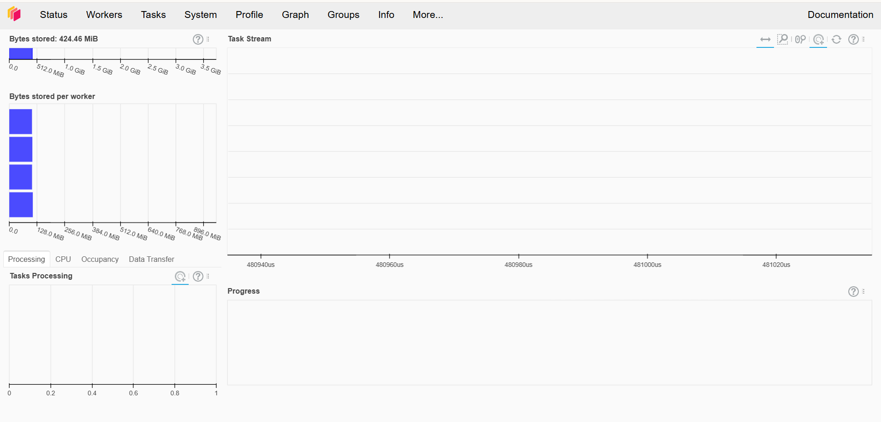




Dask Cluster Setup & Execution
Dask cluster is used for parallel processing
Distributes log data across multiple workers
Speeds up processing of large-scale logs
Provides real-time execution monitoring
Run with: dask.distributed.Client() — spawns local cluster with parallel workers

Slide 8
Log Processing Pipeline
01
02
03
04
05
Read Logs
Parse
Clean
Transform
Analyze
Read logs from file or source
▼
Parse raw logs into structured format
▼
Clean and filter invalid entries
▼
Convert data into DataFrame
▼
Prepare data for analysis

Slide 9
Anomaly Detection
Groups logs based on time (per minute)
Counts number of ERROR logs
Calculates normal behavior (mean & standard deviation)
Uses Z-Score to detect abnormal spikes
Flags unusual patterns as anomalies
🚨 Anomaly Detected in System Logs
Timestamp: 2026-03-18 17:06:00 Error Count: 4 Z-Score: 0 Please investigate immediately. Regards,
Log Monitoring System

Slide 10




Dashboard Features
Graphical Display
Log Type Views
Real-time Viz
Anomaly Alerts
Tabular View
Displays logs in graphical format for easy analysis
Separate views for ERROR, INFO, and WARN logs
Real-time visualization of live log data streams
Shows anomaly alerts and current system status
Provides tabular view of most recent log entries

Slide 11
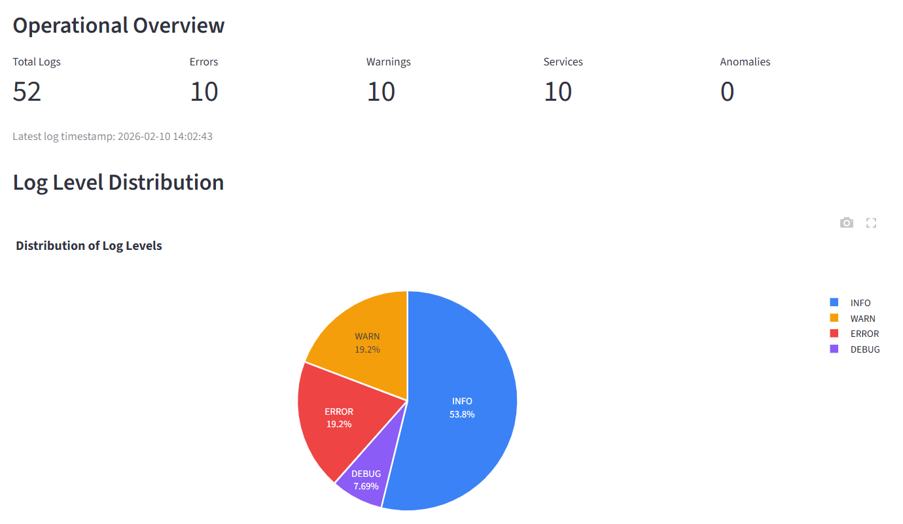
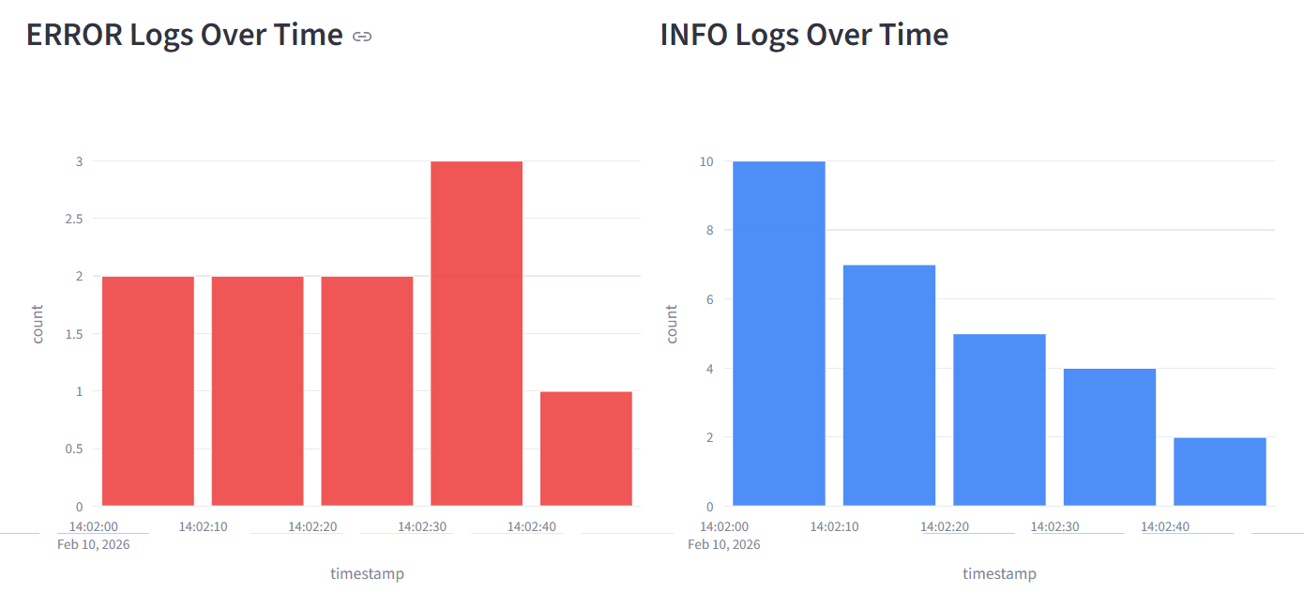
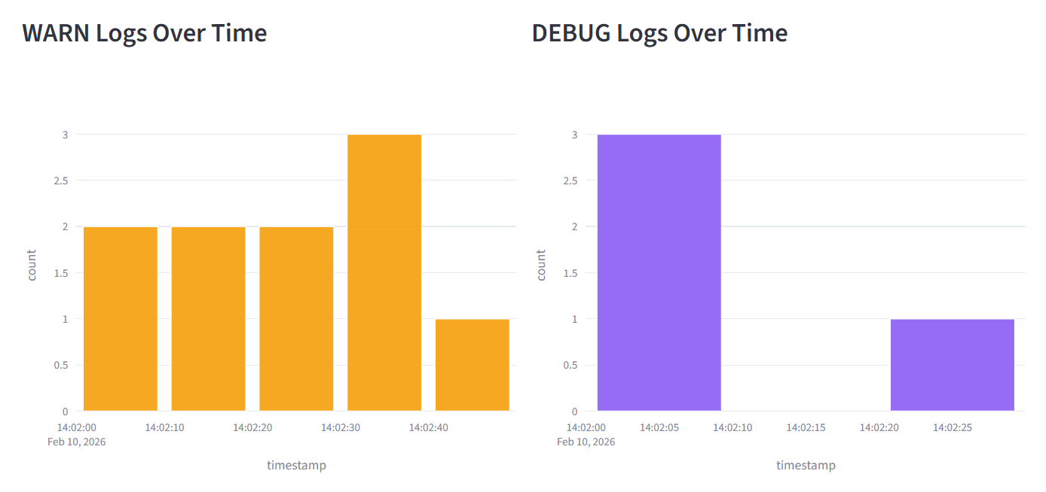
Streamlit
Open-source Python framework to build interactive web apps
No frontend required (no HTML/CSS/JS)
Used for ML apps, dashboards, and prototypes
Runs with simple scripts (streamlit run app.py)
Fast to develop but limited customization

Slide 12
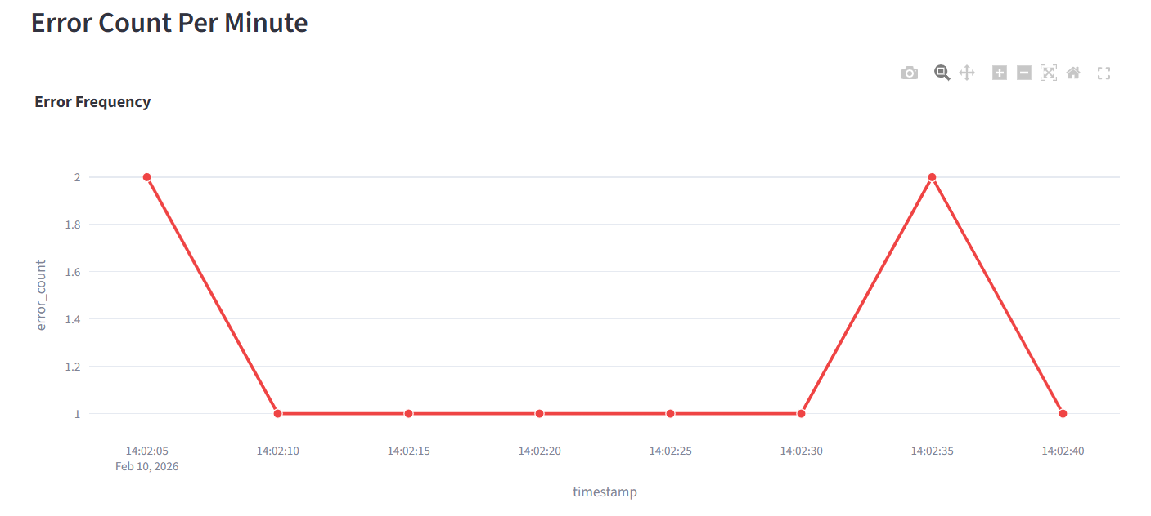
Plotly
Python library for interactive data visualization
Creates graphs like charts, maps, and 3D plots
Works inside Streamlit, Jupyter, and Dash
Highly customizable and visually appealing

Slide 13
Conclusion
The system automates monitoring of large-scale log data and reduces manual effort. It detects anomalies quickly using statistical methods, enabling faster issue identification. Overall, it improves system performance, reliability, and real-time decision making.
Automated
Scalable
Real-time
High Throughput Log Analytics Monitoring Engine

