Slide 1
PyBradford
Python + Machine learning for beginners
Amr Abdullatif
(Lecturer in Computer Science)
14 November 2019
Python + Machine Learning for beginners

Slide 2
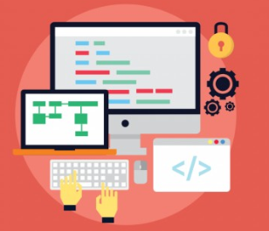
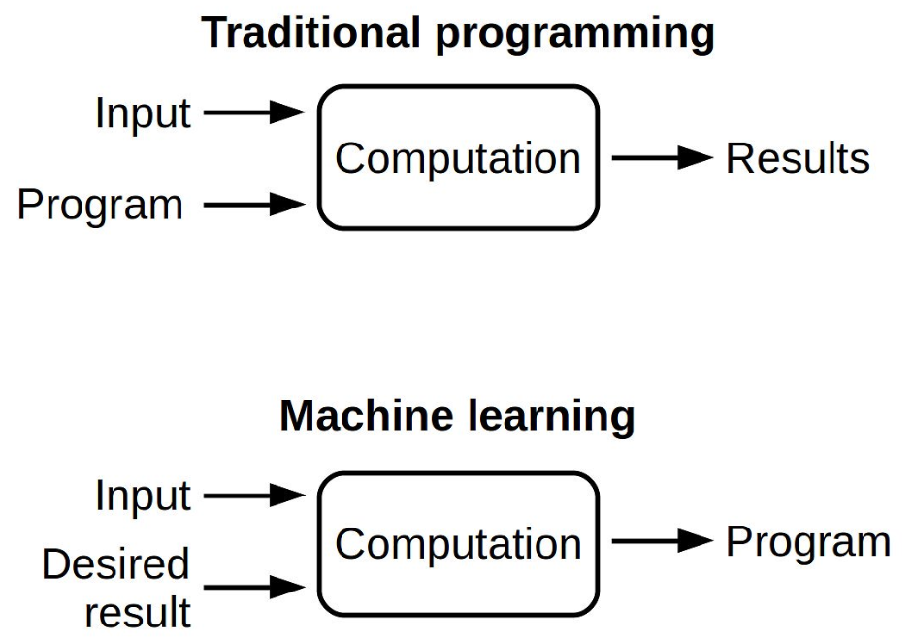
What is programming?
A program is a detailed set of instructions telling the computer exactly what to do or what to learn.
14 November 2019
Python + Machine Learning for beginners

Slide 3
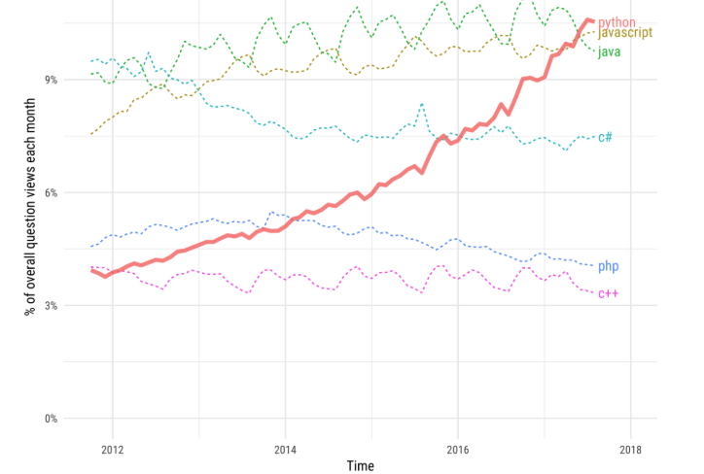
Programming languages
There are many different programming language.
Popular programing languages:
  Java
  C++, C, C#
  Python
  Javascript
14 November 2019
Python + Machine Learning for beginners

Slide 4
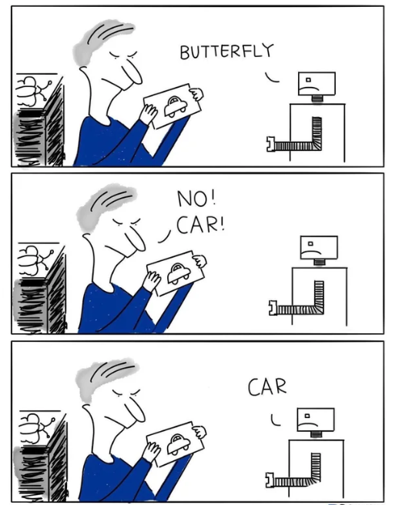
Python
Python can be used for Building:
  Machine learning apps.
  Webapps.
  Games.
  Scientific computing.
14 November 2019
Python + Machine Learning for beginners

Slide 5
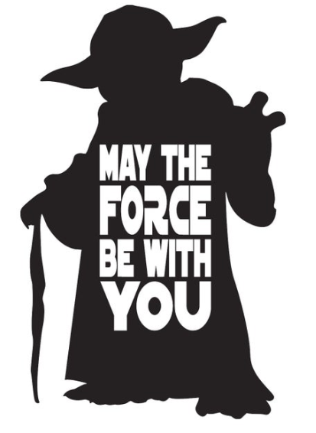
Coding
14 November 2019
Python + Machine Learning for beginners

Slide 6
https://github.com/AdaScience/PyBradford
14 November 2019
Python + Machine Learning for beginners

Slide 7
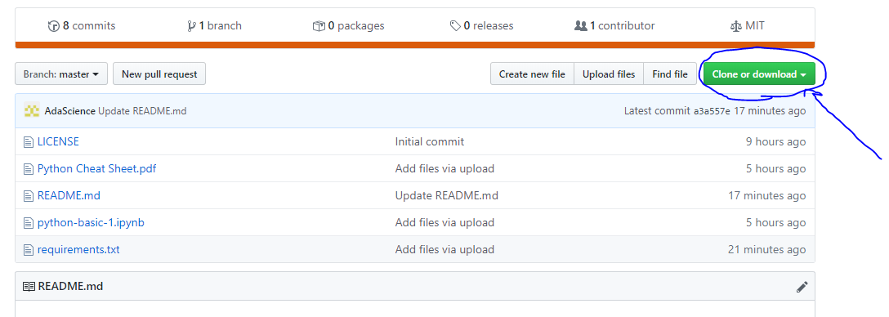
14 November 2019
Python + Machine Learning for beginners

Slide 8
Unzip and follow the GitHub instructions
Install python
Python coding
Watermelon machine learning
Lets draw with machine learning
Machine learning demo code
14 November 2019
Python + Machine Learning for beginners

Slide 9
Thank you
14 November 2019
Python + Machine Learning for beginners

