Slide 1
PyBradford
Python + Machine learning for beginners

Slide 2
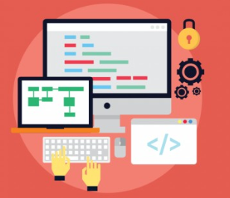
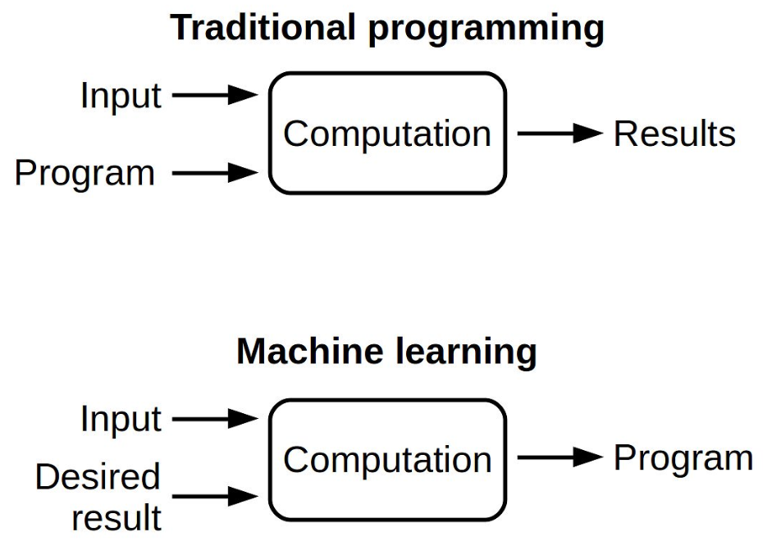
What is programming?
A program is a detailed set of instructions telling the computer exactly what to do or what to learn.

Slide 3
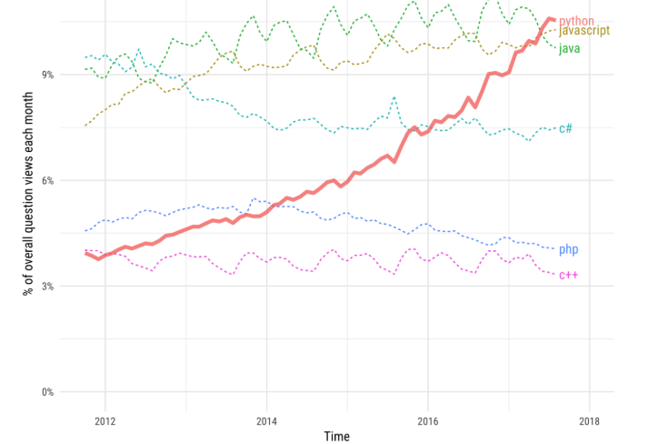
Programming languages
There are many different programming language.
Popular programing languages:
Java
C++, C, C#
Python
Javascript
From stackoverflow

Slide 4
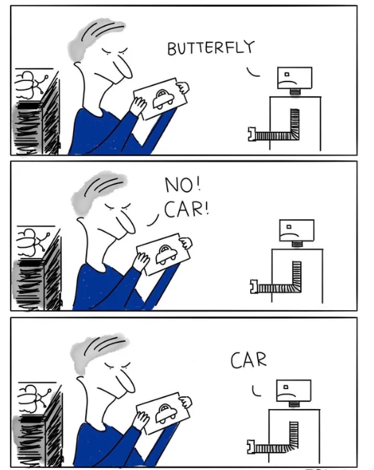
Python
Python can be used for Building:
Machine learning apps.
Webapps.
Games.
Scientific computing.

Slide 5
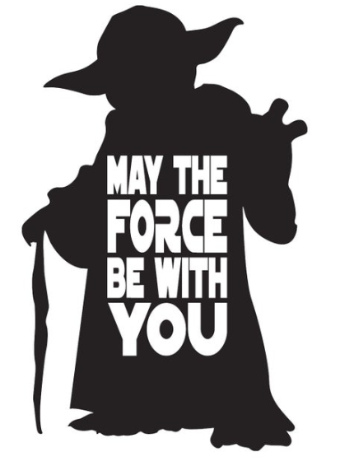
Coding

Slide 6
https://github.com/AdaScience/PyBradford

Slide 7
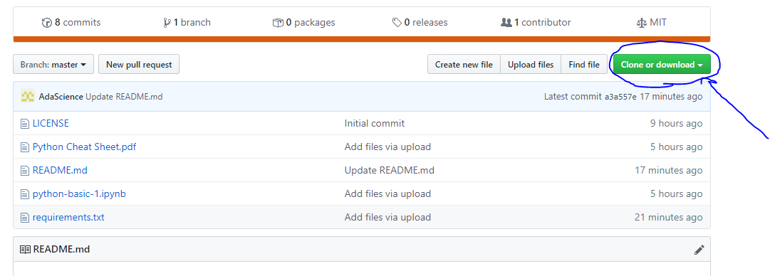

Slide 8
Unzip and follow the GitHub instructions
Install python
Python coding
Watermelon machine learning
Lets draw with machine learning
Machine learning demo code

