Slide 1
peakMax bits wide
Np bits wide
Address 0(b’000)
Bin 0
TH-
Address 1(b’001)
Bin 1
TH+
Pixel 1
Address 2(b’010)
Bin 2
Pixel 1
CH
Address …
Bin …
TH-
Pixel 2
Address BIN_NUM_PER_HIS - 1
Bin BIN_NUM_PER_HIS - 1
Filter parameter
part
TH+
Address 2*(BIN_NUM_PER_HIS - 1)
Bin 0
CH
Bin 1
Pixel 2
…
…
Bin 2
TH-
Histogram part
Address …
Bin …
TH+
Pixel PIXEL_NUM_PER_RAM
Bin BIN_NUM_PER_HIS - 1
CH
…
…
addrSaver
Pixel 1
Address (PIXEL_NUM_PER_RAM) *(BIN_NUM_PER_HIS - 1)
Bin 0
peakResult
addrSaver
Pixel 2
Bin 1
Pixel PIXEL_NUM_PER_RAM
Result saving part
peakResult
Bin 2
…
…
Bin …
addrSaver
Pixel PIXEL_NUM_PER_RAM
Bin BIN_NUM_PER_HIS - 1
peakResult
State saving part
BIN_NUM_PER_RAM * BIN_NUM_PER_HIS bits in total
stateRAM
SRAM1
SRAM2

Slide 2
peakMax bits wide
Np bits wide
peakMax bits wide
Np bits wide
TH-
TH-
Bin 0
TH+
Pixel 1
Bin 0
TH+
Pixel 4
Bin 1
Pixel 1
Filter parameter
part
CH
…
Bin 1
Filter parameter
part
CH
…
Bin 2
…
Bin 2
Pixel 4
…
Bin …
TH-
Bin …
TH-
Bin BIN_NUM_PER_HIS - 1
TH+
Pixel 3
Bin BIN_NUM_PER_HIS - 1
TH+
Pixel 6
Histogram part
…
…
CH
Histogram part
…
…
CH
Bin 0
addrSaver
Pixel 1
Bin 0
addrSaver
Pixel 4
Bin 1
Result saving part
peakResult
…
Bin 1
peakResult
Bin 2
Pixel 3
…
Bin 2
Pixel 6
Result saving part
…
…
Bin …
addrSaver
Pixel 3
Bin …
addrSaver
Pixel 6
Bin BIN_NUM_PER_HIS - 1
peakResult
Bin BIN_NUM_PER_HIS - 1
peakResult
SRAM1_1
State saving part
BIN_NUM_PER_RAM * PIXEL_NUM_PER_RAM bits in total
stateRAM
SRAM1_2
State saving part
BIN_NUM_PER_RAM * PIXEL_NUM_PER_RAM bits in total
stateRAM
SRAM2_1
SRAM2_1

Slide 3
peakMax bits wide
Np bits wide
peakMax bits wide
Np bits wide
TH-
TH-
Bin 0
TH+
Pixel 1
Bin 0
TH+
Pixel 4
Bin 1
Pixel 1
Filter parameter
part
CH
…
Bin 1
Pixel 4
Filter parameter
part
CH
…
Bin 2
…
Bin 2
…
Bin …
TH-
Bin …
TH-
Bin BIN_NUM_PER_HIS - 1
TH+
Pixel 3
Bin BIN_NUM_PER_HIS - 1
TH+
Pixel 6
Histogram part
…
…
CH
Histogram part
…
…
CH
Bin 0
addrSaver
Pixel 1
Bin 0
addrSaver
Pixel 6
Bin 1
Result saving part
peakResult
…
Bin 1
peakResult
Bin 2
Pixel 3
…
Bin 2
Pixel 6
Result saving part
…
…
Bin …
addrSaver
Pixel 3
Bin …
addrSaver
Pixel 6
Bin BIN_NUM_PER_HIS - 1
peakResult
Bin BIN_NUM_PER_HIS - 1
peakResult
SRAM1_1
SRAM2_1
SRAM1_2
SRAM2_2

Slide 4
1 bit
peakMax bits wide
Np bits wide
Bin 0
TH-
x
TH+
Pixel 1
x
Bin 1
Pixel 1
CH
x
Bin 2
TH-
x
Bin …
Filter parameter
part
TH+
Pixel 2
x
Bin BIN_NUM_PER_HIS - 1
CH
x
Bin 0
…
…
x
Bin 1
Pixel 2
TH-
Bin 2
x
Bin …
Histogram part
x
TH+
Pixel PIXEL_NUM_PER_RAM
x
Bin BIN_NUM_PER_HIS - 1
CH
x
…
…
addrSaver
Pixel 1
peakResult
Bin 0
addrSaver
x
Result saving part
peakResult
Pixel 2
Bin 1
x
…
…
Bin 2
x
Pixel PIXEL_NUM_PER_RAM
Bin …
x
addrSaver
Pixel PIXEL_NUM_PER_RAM
x
Bin BIN_NUM_PER_HIS - 1
peakResult
state
peakMax bits wide
SRAM2
SRAM1

Slide 5
peakMax bits wide
Bin 0
Bin 1
Pixel 1
Bin 2
Bin …
Bin BIN_NUM_PER_HIS - 1
Bin 0
Bin 1
Pixel 2
Bin 2
Histogram part
Bin …
Bin BIN_NUM_PER_HIS - 1
…
…
Np bits wide
Bin 0
Bin 1
Pixel PIXEL_NUM_PER_RAM
TH-
Bin 2
TH+
Pixel 1
Bin …
CH
Bin BIN_NUM_PER_HIS - 1
TH-
State saving part
BIN_NUM_PER_RAM * PIXEL_NUM_PER_RAM bits in total
Filter data
saving part
TH+
Pixel 2
stateRAM
CH
…
…
addrSaver, Nb bits in total
TH-
Pixel PIXEL_NUM_PER_RAM
Pixel 1
TH+
peakResult, Np bits in total
CH
SRAM2
addrSaver, Nb bits in total
Pixel 2
Result saving part
peakResult, Np bits in total
…
…
addrSaver, Nb bits in total
Pixel PIXEL_NUM_PER_RAM
peakResult, Np bits in total
SRAM1

Slide 6
peakMax bits wide
peakMax bits wide
Bin 0
Bin 0
Bin 1
Pixel 1
Bin 1
Pixel 1
Bin 2
Bin 2
Bin …
Bin …
Bin BIN_NUM_PER_HIS - 1
Bin BIN_NUM_PER_HIS - 1
Bin 0
Bin 0
Bin 1
Pixel 2
Bin 1
Pixel 2
Bin 2
Bin 2
Histogram part
Bin …
Histogram part
Bin …
Bin BIN_NUM_PER_HIS - 1
Bin BIN_NUM_PER_HIS - 1
…
…
Np bits wide
…
…
Np bits wide
Bin 0
TH-
Bin 0
TH-
Bin 1
Pixel PIXEL_NUM_PER_RAM
TH+
Pixel 1
Bin 1
Pixel PIXEL_NUM_PER_RAM
TH+
Pixel 1
Bin 2
CH
Bin 2
CH
Bin …
TH-
Bin …
TH-
Bin BIN_NUM_PER_HIS - 1
Filter data
saving part
TH+
Pixel 2
Bin BIN_NUM_PER_HIS - 1
Filter data
saving part
TH+
Pixel 2
State saving part
BIN_NUM_PER_RAM * PIXEL_NUM_PER_RAM bits in total
CH
State saving part
BIN_NUM_PER_RAM * PIXEL_NUM_PER_RAM bits in total
CH
stateRAM
…
…
stateRAM
…
…
TH-
Pixel PIXEL_NUM_PER_RAM
TH-
Pixel PIXEL_NUM_PER_RAM
addrSaver, Nb bits in total
TH+
addrSaver, Nb bits in total
TH+
Pixel 1
CH
Pixel 1
CH
peakResult, Np bits in total
SRAM2
peakResult, Np bits in total
SRAM4
addrSaver, Nb bits in total
Pixel 2
addrSaver, Nb bits in total
Pixel 2
Result saving part
peakResult, Np bits in total
Result saving part
peakResult, Np bits in total
…
…
…
…
addrSaver, Nb bits in total
Pixel PIXEL_NUM_PER_RAM
addrSaver, Nb bits in total
Pixel PIXEL_NUM_PER_RAM
peakResult, Np bits in total
peakResult, Np bits in total
SRAM1
SRAM3

Slide 7
Address 0
peakMax bits wide
peakMax bits wide
Address 0
0
Bin 0 (TH-)
Address 1
0
Bin 1
Pixel 1
Address 2
0
Bin 2
Address 3
0
Bin …
Address 4
0
Pixel 1
Bin BIN_NUM_PER_HIS – 2
Address 5
0
Bin BIN_NUM_PER_HIS – 1 (TH+ -1)
Address 6
0
Histogram 2
Address 7
0
Histogram 1

Slide 8
Np = 4, Nb = 3,
peakMax=5
Address 0(b’000)
3 bits wide
4 bits wide
Address 1(b’001)
0 (b’000)
Filter parameter
part
TH- -> x
0 (b’000)
TH+ -> x
Pixel 1
Address 2(b’010)
0 (b’000)
CH -> x
Address 3(b’011)
0 (b’000)
Pixel 1
Result saving part
addrSaver -> 5(b’101)
Pixel 1
Address 4(b’100)
0 (b’000)
peakResult ->
Address 5(b’101)
0 (b’000)
Address 6(b’110)
0 (b’000)
The initial value in SRAM2
x means high impedance, no data is saved
Address 7(b’111)
0 (b’000)
peakMax bits wide
The initial value in SRAM1
Bin 0 (TH-)
Bin 1
Pixel 1
Bin 2
3 bits wide
3 bits wide
Bin …
Address 0(b’000)
4 bits wide
Bin BIN_NUM_PER_HIS – 2
Address 1(b’001)
0 (b’000)
Address 0(b’000)
0 (b’000)
Bin BIN_NUM_PER_HIS – 1 (TH+ -1)
0 (b’000)
After counting all the inputs into the SRAM
Address 1(b’001)
0 (b’000)
Peak value of first histogram (5(b’101))
Filter parameter
part
TH- -> x
Histogram 2
9(b’1011) 11(b’1011)
Address 2(b’010)
0 (b’000)
Address 2(b’010)
0 (b’000)
TH+ -> x
Pixel 1
Acquisition1 in serial
Address 3(b’011)
0 (b’000)
Pixel 1
Address 3(b’011)
0 (b’000)
Pixel 1
CH -> x
Address 4(b’100)
0 (b’000)
Address 4(b’100)
1 (b’001)
Result saving part
addrSaver -> 5(b’101)
Pixel 1
4 bits wide
Address 5(b’101)
0 (b’000)
Address 5(b’101)
2 (b’010)
peakResult ->
Address 6(b’110)
0 (b’000)
Address 6(b’110)
0 (b’000)
The initial value in SRAM2
Filter parameter
part
TH- -> x
Address 7(b’111)
0 (b’000)
Address 7(b’111)
0 (b’000)
TH+ -> x
Pixel 1
The initial value in SRAM1
Histogram 1 in SRAM
CH -> x
3 bits wide
Result saving part
addrSaver -> x
Pixel 1
3 bits wide
peakResult -> 2 (b’010)
Address 0(b’000)
0 (b’000)
Address 0(b’000)
0 (b’000)
The initial value in SRAM2
Address 1(b’001)
0 (b’000)
After counting all the inputs into the SRAM
Address 1(b’001)
0 (b’000)
Peak value of first histogram (5(b’101))
115(b’1111) 11(b’1011)
Address 2(b’010)
0 (b’000)
Address 2(b’010)
0 (b’000)
Address 3(b’011)
0 (b’000)
Pixel 1
Address 3(b’011)
0 (b’000)
Pixel 1
Acquisition1 in serial
Address 4(b’100)
1 (b’001)
Address 4(b’100)
1 (b’001)
3 bits wide
Address 5(b’101)
2 (b’010)
Address 5(b’101)
2 (b’010)
Address 6(b’110)
0 (b’000)
Address 6(b’110)
0 (b’000)
Address 0(b’000)
0
Address 7(b’111)
0 (b’000)
Address 7(b’111)
0 (b’000)
Address 1(b’001)
0
Histogram 1 in SRAM
Histogram 1 in SRAM
Address 2(b’010)
0
Address 3(b’011)
0
Pixel 1
4 bits wide
Address 4(b’100)
0
Filter parameter
part
TH- -> x
After counting all the inputs into the SRAM
Address 5(b’101)
0
Peak value of first histogram (5(b’101))
TH+ -> x
Pixel 1
Address 6(b’110)
0
CH -> x
Address 7(b’111)
0
Result saving part
addrSaver -> x
Pixel 1
Histogram 2
peakResult -> 2 (b’010)
The initial value in SRAM2
SRAM2_1
State saving part
BIN_NUM_PER_RAM * PIXEL_NUM_PER_RAM bits in total
stateRAM

Slide 9
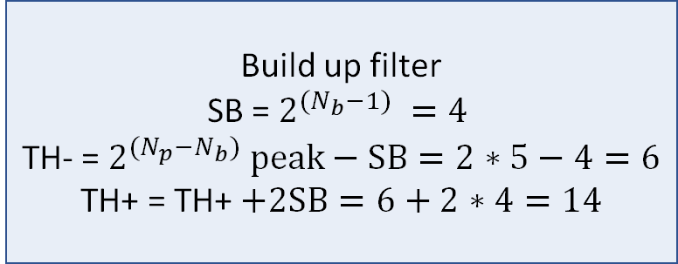
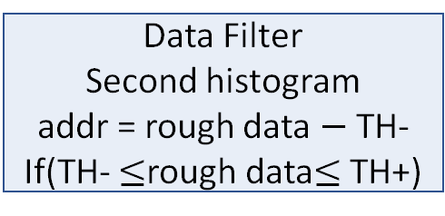
Address 0(b’000)
3 bits wide
4 bits wide
Data Filter
Second histogram
addr = rough data $−$ TH-
If(TH- $≤$rough data$≤$ TH+)
Address 1(b’001)
0 (b’000)
Filter parameter
part
TH- -> x
0 (b’000)
TH+ -> x
Pixel 1
Address 2(b’010)
0 (b’000)
CH -> x
Np = 4, Nb = 3,
peakMax=5
Address 3(b’011)
0 (b’000)
Pixel 1
Result saving part
addrSaver -> x
Pixel 1
Address 4(b’100)
0 (b’000)
peakResult -> x
Data Filter
First histogram
Address 5(b’101)
0 (b’000)
Address 6(b’110)
0 (b’000)
The initial value in SRAM2
x means high impedance, no data is saved
Address 7(b’111)
0 (b’000)
After counting all the inputs into the SRAM
The initial value in SRAM1
Timeline
Timeline
3 bits wide
Start building histogram1
Acquisition1
Address 0(b’000)
0 (b’000)
Filter parameter
part
4 bits wide
Address 1(b’001)
0 (b’000)
TH- -> x
Data Filter
First histogram
addr = rough data[3:1]
Address 2(b’010)
0 (b’000)
Current addr (5(b’101))
TH+ -> x
Pixel 1
9(b’1001) 11(b’1011)
5(b’101)
Address 3(b’011)
0 (b’000)
Pixel 1
CH -> x
Acquisition1 in serial
addr
Address 4(b’100)
0 (b’000)
Counts in current addr (1)
Result saving part
addrSaver -> 5(b’101)
Pixel 1
Address 5(b’101)
1 (b’001)
peakResult -> 1
Address 6(b’110)
0 (b’000)
State saving part
0
0
0
0
stateRAM
Address 7(b’111)
0 (b’000)
0
1
0
0
Histogram 1 in SRAM1
Current value in SRAM2
Address 0(b’000)
3 bits wide
4 bits wide
peakMax bits wide
Address 1(b’001)
0 (b’000)
Filter parameter
part
TH- -> x
Bin 0 (TH-)
Data Filter
First histogram
addr = rough data[3:1]
0 (b’000)
TH+ -> x
Pixel 1
Bin 1
Pixel 1
9(b’1001)
4(b’100)
Address 2(b’010)
0 (b’000)
Current addr (4(b’100))
CH -> x
Bin 2
Acquisition1 in serial
addr
Address 3(b’011)
0 (b’000)
Pixel 1
Counts in current addr (1)
Result saving part
addrSaver -> 5(b’101)
Pixel 1
Bin …
Address 4(b’100)
1 (b’001)
peakResult -> 1
Bin BIN_NUM_PER_HIS – 2
Address 5(b’101)
1 (b’001)
State saving part
0
0
0
0
stateRAM
Bin BIN_NUM_PER_HIS – 1 (TH+ -1)
Address 6(b’110)
0 (b’000)
1
1
0
0
Histogram 2
Address 7(b’111)
0 (b’000)
Current value in SRAM2
Histogram 1 in SRAM1
4 bits wide
Filter parameter
part
TH- -> x
TH+ -> x
Pixel 1
CH -> x
Result saving part
addrSaver -> x
Pixel 1
peakResult -> 2 (b’010)
The initial value in SRAM2
Timeline
Acquisition2
3 bits wide
4 bits wide
TH = - 6(b’0110)
TH+ 14(b’1110)
3 bits wide
Address 0(b’000)
0 (b’000)
Filter parameter
part
TH- -> x
Address 0(b’000)
0
15(b’1111) 11(b’1011)
Data Filter
First histogram
addr = rough data[3:1]
Address 1(b’001)
0 (b’000)
Current addr (5(b’101))
TH+ -> x
Pixel 1
Address 1(b’001)
0
5(b’101)
Address 2(b’010)
0 (b’000)
CH -> x
Address 2(b’010)
0
Acquisition2 in serial
addr
Address 3(b’011)
0 (b’000)
Pixel 1
Counts in current addr (2)
Result saving part
addrSaver -> 5(b’101)
Pixel 1
Address 3(b’011)
0
Pixel 1
Address 4(b’100)
1 (b’001)
peakResult -> 1
Address 4(b’100)
0
Address 5(b’101)
2 (b’010)
State saving part
0
0
0
0
stateRAM
Address 5(b’101)
0
Address 6(b’110)
0 (b’000)
1
1
0
0
Address 6(b’110)
0
Address 7(b’111)
0 (b’000)
Current value in SRAM2
Address 7(b’111)
0
Histogram 1 in SRAM1
Histogram 2
15(b’1111)
Data Filter
First histogram
addr = rough data[3:1]
Both SRAM1 and SRAM2 do not change, since b’1111 indicates an invalid input data
SRAM2_1
Timeline
Acquisition2 in serial
BIN_NUM_PER_RAM * PIXEL_NUM_PER_RAM bits in total
Finish building histogram1
4 bits wide
4 bits wide
State saving part
stateRAM
Filter parameter
part
TH- -> x
Build up filter
SB = $2^{(N_{b}−1) }=4$
TH- = $2^{(N_{p}−N_{b}) }peak−SB=2∗5−4=6$
TH+ = TH+ $+2SB=6+2∗4=14$
Filter parameter
part
TH- -> 6
TH+ -> x
Pixel 1
Peak value of first histogram (5(b’101))
TH- TH+ and CH
TH+ -> 14
Pixel 1
CH -> x
CH -> 5(b’101)
Result saving part
addrSaver -> 5(b’101)
Pixel 1
Build up filter
All the other parameters will be reset
Result saving part
addrSaver -> 5(b’101)
Pixel 1
peakResult -> 1
peakResult -> 1
State saving part
0
0
0
0
stateRAM
State saving part
0
0
0
0
stateRAM
1
1
0
0
0
0
0
0
Current value in SRAM2
Current value in SRAM2
Timeline
3 bits wide
4 bits wide
Start building histogram2
Acquisition1
Address 0(b’000)
0 (b’000)
Filter parameter
part
TH- -> x
Data Filter
First histogram
addr = rough data[3:1]
Address 1(b’001)
0 (b’000)
TH+ -> x
Pixel 1
15(b’1111) 11(b’1011)
5(b’101)
Address 2(b’010)
0 (b’000)
Current addr (5(b’101))
CH -> x
addr
Address 3(b’011)
0 (b’000)
Pixel 1
Counts in current addr (2)
Result saving part
addrSaver -> 5(b’101)
Pixel 1
Acquisition1&2 in serial
Address 4(b’100)
1 (b’001)
peakResult -> 1
Address 5(b’101)
2 (b’010)
State saving part
0
0
0
0
stateRAM
Address 6(b’110)
0 (b’000)
1
1
0
0
Address 7(b’111)
0 (b’000)
Current value in SRAM2
Histogram 1 in SRAM
Filter parameter
part
4 bits wide
Peak value of first histogram (5(b’101))
TH- -> x
After counting all the inputs into the SRAM
TH+ -> x
Pixel 1
CH -> x
Result saving part
addrSaver -> x
Pixel 1
peakResult -> 2 (b’010)
The initial value in SRAM2

Slide 10
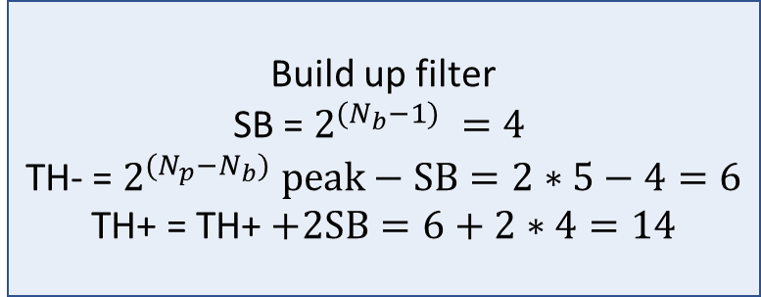
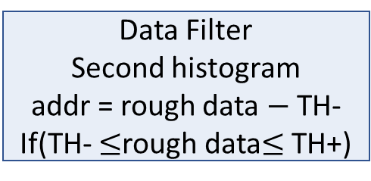
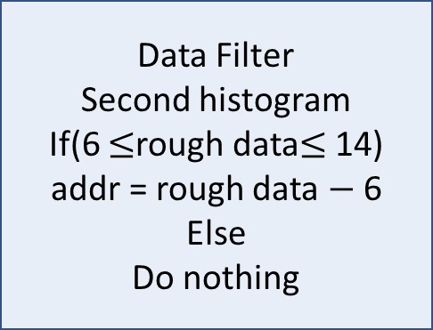
Address 0(b’000)
3 bits wide
4 bits wide
Address 1(b’001)
0 (b’000)
Filter parameter
part
TH- -> x
0 (b’000)
TH+ -> x
Pixel 1
Address 2(b’010)
0 (b’000)
CH -> x
Np = 4, Nb = 3,
peakMax=5
Address 3(b’011)
0 (b’000)
Pixel 1
Result saving part
addrSaver -> x
Pixel 1
Address 4(b’100)
0 (b’000)
peakResult -> x
Data Filter
First histogram
Address 5(b’101)
0 (b’000)
Address 6(b’110)
0 (b’000)
The initial value in SRAM2
x means high impedance, no data is saved
Address 7(b’111)
0 (b’000)
After counting all the inputs into the SRAM
The initial value in SRAM1
Timeline
rough data
(input from the
second measurement)
Timeline
3 bits wide
Start building histogram2
Acquisition1
Data Filter
Second histogram
If(6 $≤$rough data$≤$ 14)
addr = rough data $−$ 6
Else
Do nothing
Address 0(b’000)
0 (b’000)
4 bits wide
Address 1(b’001)
0 (b’000)
Filter parameter
part
TH- -> x
10(b’1010) 10(b’1010)
4(b’100)
Address 2(b’010)
0 (b’000)
Current addr (4(b’100))
TH+ -> x
Pixel 1
Acquisition1 in serial
addr
Address 3(b’011)
0 (b’000)
Pixel 1
CH -> x
Address 4(b’100)
1 (b’001)
Counts in current addr (1)
Result saving part
addrSaver -> 4(b’100)
Pixel 1
Address 5(b’101)
0 (b’001)
peakResult -> 1
Address 6(b’110)
0 (b’000)
Current value in SRAM2
Address 7(b’111)
0 (b’000)
Histogram 1 in SRAM1
peakMax bits wide
3 bits wide
Bin 0 (TH-)
Address 0(b’000)
0 (b’000)
4 bits wide
Bin 1
Pixel 1
Address 1(b’001)
0 (b’000)
Filter parameter
part
TH- -> x
Bin 2
Data Filter
Second histogram
Address 2(b’010)
0 (b’000)
Current addr (4(b’100))
TH+ -> x
Pixel 1
Bin …
10(b’1010)
4(b’100)
Address 3(b’011)
0 (b’000)
Pixel 1
CH -> x
Bin BIN_NUM_PER_HIS – 2
Acquisition1 in serial
addr
Address 4(b’100)
2 (b’001)
Counts in current addr (2)
Result saving part
addrSaver -> 4(b’100)
Pixel 1
Bin BIN_NUM_PER_HIS – 1 (TH+ -1)
Address 5(b’101)
0 (b’001)
peakResult -> 2
Histogram 2
Address 6(b’110)
0 (b’000)
Current value in SRAM2
Address 7(b’111)
0 (b’000)
4 bits wide
Histogram 1 in SRAM1
Filter parameter
part
TH- -> x
TH+ -> x
Pixel 1
Timeline
CH -> x
rough data
(input from the
second measurement)
Result saving part
addrSaver -> x
Pixel 1
Finish building histogram1
peakResult -> 2 (b’010)
The initial value in SRAM2
11(b’1011) 15(b’1111)
Data Filter
Second histogram
since b’1111 indicates an invalid input data, both SRAM1 and SRAM2 do not change,
3 bits wide
Acquisition2 in serial
Address 0(b’000)
0
3 bits wide
Address 1(b’001)
0
TH = - 6(b’0110)
TH+ 14(b’1110)
Address 2(b’010)
0
Address 0(b’000)
0 (b’000)
4 bits wide
Address 3(b’011)
0
Pixel 1
Address 1(b’001)
0 (b’000)
Filter parameter
part
TH- -> x
Address 4(b’100)
0
Address 2(b’010)
0 (b’000)
Current addr (5(b’101))
TH+ -> x
Pixel 1
Address 5(b’101)
0
11(b’1011)
Data Filter
Second histogram
Address 3(b’011)
0 (b’000)
CH -> x
Address 6(b’110)
0
Address 4(b’100)
2 (b’010)
Pixel 1
Counts in current addr (1)
Result saving part
addrSaver -> 4(b’100)
Address 7(b’111)
0
Acquisition2 in serial
Address 5(b’101)
1 (b’001)
peakResult -> 2
Pixel 1
Histogram 2
Address 6(b’110)
0 (b’000)
Current value in SRAM2
Address 7(b’111)
0 (b’000)
SRAM2_1
Histogram 1 in SRAM1
Timeline
State saving part
BIN_NUM_PER_RAM * PIXEL_NUM_PER_RAM bits in total
stateRAM
Finish building histogram1
Acquisition2
4 bits wide
Filter parameter
part
4 bits wide
Filter parameter
part
TH- -> x
Peak value of first histogram 4(b’100)
Build up filter
SB = $2^{(N_{b}−1) }=4$
TH- = $2^{(N_{p}−N_{b}) }peak−SB=2∗5−4=6$
TH+ = TH+ $+2SB=6+2∗4=14$
TH- -> x
TH+ -> x
Pixel 1
TH+ -> x
Pixel 1
CH -> 4(b’100)
CH -> x
Result saving part
addrSaver -> 4(b’100)
Build up filter
Result saving part
addrSaver -> 4(b’100)
Pixel 1
peakResult -> 2
Pixel 1
peakResult -> 2
Current value in SRAM2
Current value in SRAM2
Data Filter
Second histogram
addr = rough data $−$ TH-
If(TH- $≤$rough data$≤$ TH+)
Filter parameter
part
4 bits wide
Peak value of first histogram (5(b’101))
TH- -> x
After counting all the inputs into the SRAM
TH+ -> x
Pixel 1
CH -> x
Result saving part
addrSaver -> x
Pixel 1
peakResult -> 2 (b’010)
The initial value in SRAM2

Slide 11
Timeline
Timeline
Input (Rough Data)
Input (Rough Data)
Rough data
Data Filter
First histogram
addr
Process
Get the first histogram
Rough data
Data Filter
First histogram
addr
Process
on the first histogram in address addr
PeakHis1
(The peak value of first histogram)
Current bin counts
Build up filter
addr
Peak counter
TH-
TH+
PeakHis1
(The peak value of first histogram)
Rough data
Data Filter
Second histogram
Build up filter
addr
TH-
TH+
Process
Get the second histogram
Rough data
Data Filter
Second histogram
Result
(The peak value of second histogram)
addr
Process
Get the second histogram
addr
Peak counter
Current bin counts
Result
(The peak value of second histogram)

Slide 12
Input (Rough Data)
Data Filter
Input (Rough Data)
Data Filter
Input (Rough Data)
Data Filter
addr
addr
+1 / Reset
binCounts
addr
His Builder
His Builder
binCounts (new)
binCounts
(new)
His Builder
The count result of each bin
Filter parameters
TH- and TH+
The count result of each bin
Filter parameters
TH- and TH+
Peak Detector
Peak Detector
Peak Detector
addrSaver
Algebraic
recentMax
Peak Result
Peak Result
THmin
Algebraic
Algebraic
THmax

Slide 13
peakMax bits wide
peakMax bits wide
Bin 0
Bin 0
Bin 1
Pixel 1
Bin 1
Pixel 4
Np bits wide
Bin 2
Np bits wide
Bin 2
Bin …
Bin …
TH-
Bin BIN_NUM_PER_HIS - 1
TH-
Bin BIN_NUM_PER_HIS - 1
TH+
Pixel 4
Bin 0
TH+
Pixel 1
Bin 0
CH
Bin 1
Pixel 2
CH
Bin 1
Pixel 5
TH-
Bin 2
TH-
Bin 2
TH+
Pixel 5
Bin …
TH+
Pixel 2
Bin …
CH
Bin BIN_NUM_PER_HIS - 1
CH
Bin BIN_NUM_PER_HIS - 1
TH-
Bin 0
TH-
Pixel 3
Bin 0
TH+
Pixel 6
Bin 1
TH+
Bin 1
CH
Bin 2
Pixel 3
CH
Bin 2
Pixel 6
Bin …
SRAM2
Bin …
SRAM4
Bin BIN_NUM_PER_HIS - 1
Bin BIN_NUM_PER_HIS - 1
BIN_NUM_PER_RAM bits in total
stateRAM
BIN_NUM_PER_RAM bits in total
SRAM1
SRAM3
stateRAM

Slide 14



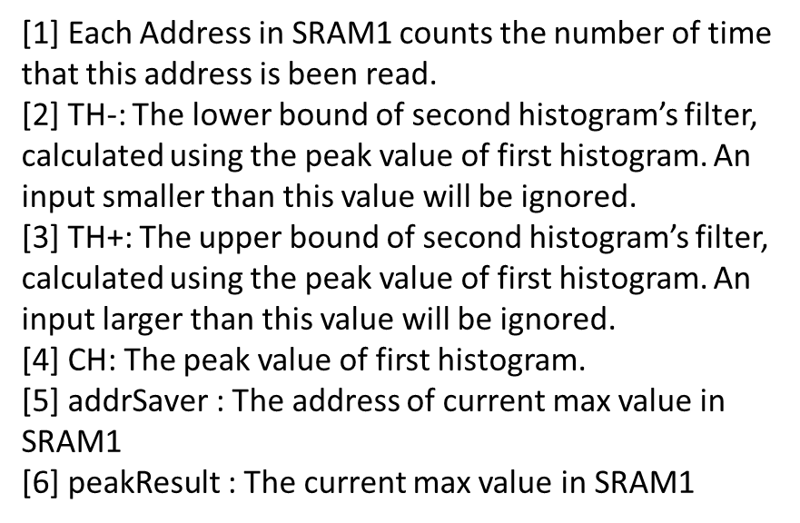


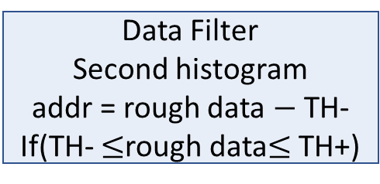

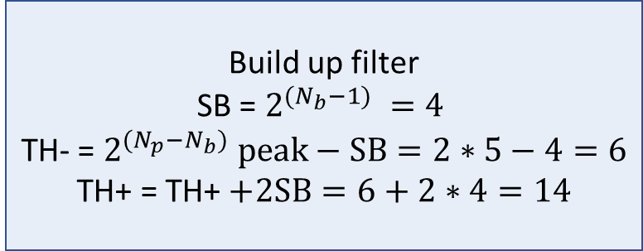

State of Address 1 in SRAM1
State of Address 0 in SRAM1
State saving part
0
0
0
$$0^{[1]}$$
stateRAM
0
0
0
0
State of Address 7 in SRAM1
State of Address 4 in SRAM1
Np = 4, Nb = 3,
peakMax=5
3 bits wide
4 bits wide
[1] Each Address in SRAM1 counts the number of time that this address is been read.
[2] TH-: The lower bound of second histogram’s filter, calculated using the peak value of first histogram. An input smaller than this value will be ignored.
[3] TH+: The upper bound of second histogram’s filter, calculated using the peak value of first histogram. An input larger than this value will be ignored.
[4] CH: The peak value of first histogram.
[5] $\text{addrSaver}$: The address of current max value in SRAM1
[6] $\text{peakResult}$: The current max value in SRAM1
TH = - 6(b’0110)
TH+ 14(b’1110)
Address 0(b’000)
$$\text{0 (}\text{b}\text{’000)}$$
Filter parameter
part
$\text{TH}\text{−}$-> x
Address 1(b’001)
0 (b’000)
$\text{TH}\text{+}$-> x
Pixel 1
Data Filter
Second histogram
addr = rough data $−$ TH-
If(TH- $≤$rough data$≤$ TH+)
Address 2(b’010)
0 (b’000)
$\text{CH}$-> x
Address 3(b’011)
0 (b’000)
Pixel 1
Result saving part
$\text{addrSaver}$-> 0(b’000)
Pixel 1
Address 4(b’100)
0 (b’000)
$\text{peakResult}$-> 0
Address 5(b’101)
0 (b’000)
State saving part
0
0
0
0
stateRAM
Address 6(b’110)
0 (b’000)
0
0
0
0
Address 7(b’111)
0 (b’000)
The initial value in SRAM2
x means high impedance, no data is saved
The initial value in SRAM1
Timeline
Timeline
rough data
(input from the
first measurement)
3 bits wide
Start building histogram1
Acquisition1
Address 0(b’000)
0 (b’000)
Filter parameter
part
4 bits wide
Address 1(b’001)
0 (b’000)
TH- -> x
9(b’1001) 11(b’1011)
Data Filter
First histogram
addr = rough data[3:1]
Address 2(b’010)
0 (b’000)
Current addr (5(b’101))
TH+ -> x
Pixel 1
5(b’101)
Address 3(b’011)
0 (b’000)
Pixel 1
CH -> x
Acquisition1 in serial
addr
Address 4(b’100)
0 (b’000)
Counts in current addr (1)
Result saving part
addrSaver -> 5(b’101)
Pixel 1
Address 5(b’101)
1 (b’001)
peakResult -> 1
Address 6(b’110)
0 (b’000)
State saving part
0
0
0
0
stateRAM
Address 7(b’111)
0 (b’000)
0
1
0
0
Histogram 1 in SRAM1
Current value in SRAM2
Address 0(b’000)
3 bits wide
4 bits wide
Address 1(b’001)
0 (b’000)
Filter parameter
part
TH- -> x
Data Filter
First histogram
addr = rough data[3:1]
0 (b’000)
TH+ -> x
Pixel 1
9(b’1001)
4(b’100)
Address 2(b’010)
0 (b’000)
Current addr (4(b’100))
CH -> x
Acquisition1 in serial
addr
Address 3(b’011)
0 (b’000)
Pixel 1
Counts in current addr (1)
Result saving part
addrSaver -> 5(b’101)
Pixel 1
Address 4(b’100)
1 (b’001)
peakResult -> 1
Address 5(b’101)
1 (b’001)
State saving part
0
0
0
0
stateRAM
Address 6(b’110)
0 (b’000)
1
1
0
0
Address 7(b’111)
0 (b’000)
Current value in SRAM2
rough data
(input from the
first measurement)
Histogram 1 in SRAM1
Timeline
Acquisition2
3 bits wide
4 bits wide
Address 0(b’000)
0 (b’000)
Filter parameter
part
TH- -> x
15(b’1111) 11(b’1011)
Data Filter
First histogram
addr = rough data[3:1]
Address 1(b’001)
0 (b’000)
Current addr (5(b’101))
TH+ -> x
Pixel 1
5(b’101)
Address 2(b’010)
0 (b’000)
CH -> x
Acquisition2 in serial
addr
Address 3(b’011)
0 (b’000)
Pixel 1
Counts in current addr (2)
Result saving part
addrSaver -> 5(b’101)
Pixel 1
Address 4(b’100)
1 (b’001)
peakResult -> 2
Address 5(b’101)
2 (b’010)
State saving part
0
0
0
0
stateRAM
Address 6(b’110)
0 (b’000)
1
1
0
0
Address 7(b’111)
0 (b’000)
Current value in SRAM2
Histogram 1 in SRAM1
15(b’1111)
Data Filter
First histogram
addr = rough data[3:1]
Both SRAM1 and SRAM2 do not change, since b’1111 indicates an invalid input data
Acquisition2 in serial
Timeline
4 bits wide
4 bits wide
Finish building histogram1
Filter parameter
part
TH- -> x
Build up filter
SB = $2^{(N_{b}−1) }=4$
TH- = $2^{(N_{p}−N_{b}) }peak−SB=2∗5−4=6$
TH+ = TH+ $+2SB=6+2∗4=14$
Filter parameter
part
TH- -> 6
TH+ -> x
Pixel 1
Peak value of first histogram (5(b’101))
TH- TH+ and CH
TH+ -> 14
Pixel 1
CH -> 5(b’101)
CH -> 5(b’101)
Result saving part
addrSaver -> 5(b’101)
Pixel 1
Build up filter
All the other parameters will be reset
Result saving part
addrSaver -> 0(b’000)
Pixel 1
peakResult -> 2
peakResult -> 0
State saving part
0
0
0
0
stateRAM
State saving part
0
0
0
0
stateRAM
1
1
0
0
0
0
0
0
Current value in SRAM2
Current value in SRAM2

Slide 15
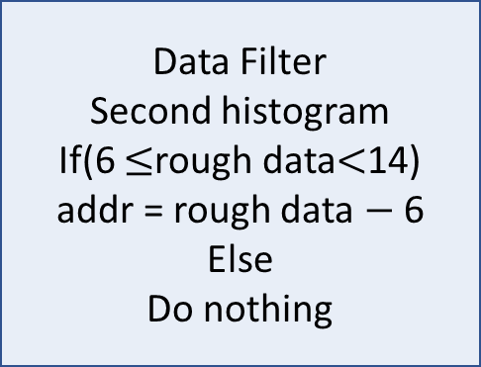
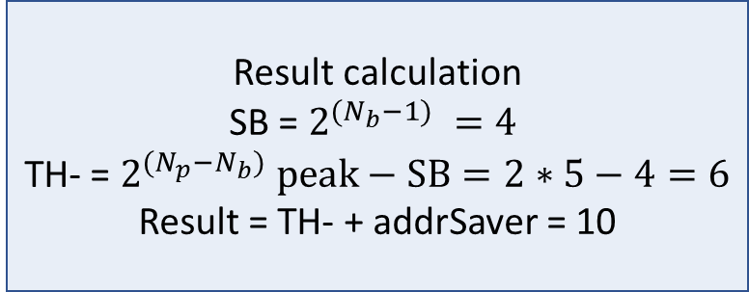
Address 0(b’000)
3 bits wide
4 bits wide
Address 1(b’001)
0 (b’000)
Filter parameter
part
TH- -> x
0 (b’000)
TH+ -> x
Pixel 1
Address 2(b’010)
0 (b’000)
CH -> x
Np = 4, Nb = 3,
peakMax=5
Address 3(b’011)
0 (b’000)
Pixel 1
Result saving part
addrSaver -> x
Pixel 1
Address 4(b’100)
0 (b’000)
peakResult -> x
Data Filter
First histogram
Address 5(b’101)
0 (b’000)
Address 6(b’110)
0 (b’000)
The initial value in SRAM2
x means high impedance, no data is saved
Address 7(b’111)
0 (b’000)
After counting all the inputs into the SRAM
The initial value in SRAM1
Timeline
rough data
(input from the
second measurement)
Timeline
3 bits wide
4 bits wide
Start building histogram2
Acquisition1
Data Filter
Second histogram
If(6 $≤$rough data$<$14)
addr = rough data $−$ 6
Else
Do nothing
Address 0(b’000)
0 (b’000)
Filter parameter
part
TH- -> 6
Address 1(b’001)
0 (b’000)
TH+ -> 14
Pixel 1
10(b’1010) 10(b’1010)
4(b’100)
Address 2(b’010)
0 (b’000)
Current addr (4(b’100))
CH -> 5(b’101)
Acquisition1 in serial
addr
Address 3(b’011)
0 (b’000)
Pixel 1
Result saving part
addrSaver -> 4(b’100)
Pixel 1
Address 4(b’100)
1 (b’001)
Counts in current addr (1)
peakResult -> 1
Address 5(b’101)
0 (b’001)
State saving part
0
0
0
0
stateRAM
Address 6(b’110)
0 (b’000)
0
0
0
1
Address 7(b’111)
0 (b’000)
Current value in SRAM2
Histogram 1 in SRAM1
peakMax bits wide
3 bits wide
4 bits wide
Bin 0 (TH-)
Address 0(b’000)
0 (b’000)
Filter parameter
part
TH- -> 6
Bin 1
Pixel 1
Address 1(b’001)
0 (b’000)
TH+ -> 14
Pixel 1
Bin 2
Data Filter
Second histogram
Address 2(b’010)
0 (b’000)
Current addr (4(b’100))
CH -> 5(b’101)
Bin …
10(b’1010)
4(b’100)
Address 3(b’011)
0 (b’000)
Pixel 1
Result saving part
addrSaver -> 4(b’100)
Bin BIN_NUM_PER_HIS – 2
Acquisition1 in serial
addr
Address 4(b’100)
2 (b’001)
Counts in current addr (2)
peakResult -> 2
Pixel 1
Bin BIN_NUM_PER_HIS – 1 (TH+ -1)
Address 5(b’101)
0 (b’001)
State saving part
0
0
0
0
stateRAM
Histogram 2
Address 6(b’110)
0 (b’000)
0
0
0
1
Address 7(b’111)
0 (b’000)
Current value in SRAM2
4 bits wide
Histogram 1 in SRAM1
Filter parameter
part
TH- -> x
TH+ -> x
Pixel 1
Timeline
CH -> x
rough data
(input from the
second measurement)
Result saving part
addrSaver -> x
Pixel 1
Finish building histogram2
Acquisition2
peakResult -> 2 (b’010)
The initial value in SRAM2
11(b’1011) 15(b’1111)
Data Filter
Second histogram
since b’1111 indicates an invalid input data, both SRAM1 and SRAM2 do not change,
3 bits wide
Acquisition2 in serial
Address 0(b’000)
0
3 bits wide
Address 1(b’001)
0
4 bits wide
TH = - 6(b’0110)
TH+ 14(b’1110)
Address 2(b’010)
0
Address 0(b’000)
0 (b’000)
Filter parameter
part
TH- -> 6
Address 3(b’011)
0
Pixel 1
Address 1(b’001)
0 (b’000)
TH+ -> 14
Pixel 1
Address 4(b’100)
0
Address 2(b’010)
0 (b’000)
Current addr (5(b’101))
CH -> 5(b’101)
Address 5(b’101)
0
11(b’1011)
Data Filter
Second histogram
5b’101)
Address 3(b’011)
0 (b’000)
Address 6(b’110)
0
Address 4(b’100)
2 (b’010)
Pixel 1
Counts in current addr (1)
Result saving part
addrSaver -> 4(b’100)
Pixel 1
Address 7(b’111)
0
Acquisition2 in serial
addr
Address 5(b’101)
1 (b’001)
peakResult -> 2
Histogram 2
Address 6(b’110)
0 (b’000)
State saving part
0
0
0
0
stateRAM
Address 7(b’111)
0 (b’000)
0
0
1
1
SRAM2_1
Histogram 1 in SRAM1
Current value in SRAM2
Timeline
Filter parameter
part
4 bits wide
State saving part
BIN_NUM_PER_RAM * PIXEL_NUM_PER_RAM bits in total
stateRAM
Finish building histogram2
Final result calculation
TH- -> 6
TH+ -> 14
Pixel 1
Peak value of second histogram (4(b’100))
Result calculation
SB = $2^{(N_{b}−1) }=4$
TH- = $2^{(N_{p}−N_{b}) }peak−SB=2∗5−4=6$
Result = TH- + addrSaver = 10
CH -> 5(b’101)
Result saving part
addrSaver -> 4(b’100)
Pixel 1
Result = 10(b’1010)
peakResult -> 2
Calculate the exact result
State saving part
0
0
0
0
stateRAM
0
0
1
1
Current value in SRAM2
Data Filter
Second histogram
addr = rough data $−$ TH-
If(TH- $≤$rough data$≤$ TH+)
Filter parameter
part
4 bits wide
Peak value of first histogram (5(b’101))
TH- -> x
After counting all the inputs into the SRAM
TH+ -> x
Pixel 1
CH -> x
Result saving part
addrSaver -> x
Pixel 1
peakResult -> 2 (b’010)
The initial value in SRAM2

Slide 16



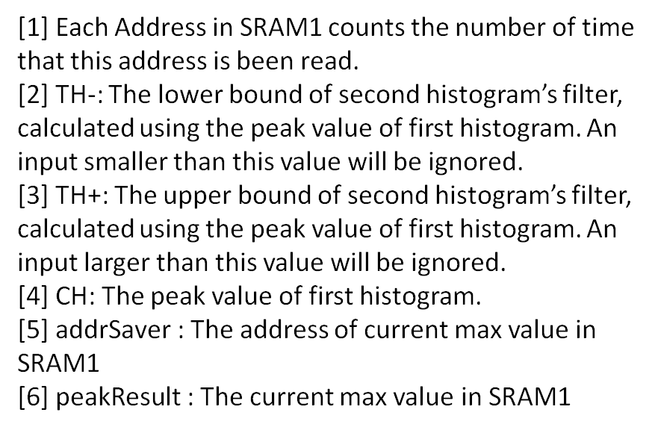





State of Address 1 in SRAM1
State of Address 0 in SRAM1
State saving part
0
0
0
$$0^{[1]}$$
stateRAM
0
0
0
0
State of Address 7 in SRAM1
State of Address 4 in SRAM1
Np = 4, Nb = 3,
peakMax=5
3 bits wide
Filter parameter
part
4 bits wide
[1] Each Address in SRAM1 counts the number of time that this address is been read.
[2] TH-: The lower bound of second histogram’s filter, calculated using the peak value of first histogram. An input smaller than this value will be ignored.
[3] TH+: The upper bound of second histogram’s filter, calculated using the peak value of first histogram. An input larger than this value will be ignored.
[4] CH: The peak value of first histogram.
[5] $\text{addrSaver}$: The address of current max value in SRAM1
[6] $\text{peakResult}$: The current max value in SRAM1
Address 0(b’000)
$$\text{0 (}\text{b}\text{’000)}$$
$\text{TH}\text{−}$-> x
Address 1(b’001)
0 (b’000)
$\text{TH}\text{+}$-> x
Pixel 1
Data Filter
Second histogram
addr = rough data $−$ TH-
If(TH- $≤$rough data$≤$ TH+)
Address 2(b’010)
0 (b’000)
$\text{CH}$-> x
Address 3(b’011)
0 (b’000)
Pixel 1
Result saving part
$\text{addrSaver}$-> 0(b’000)
Pixel 1
Address 4(b’100)
0 (b’000)
$\text{peakResult}$-> 0
Address 5(b’101)
0 (b’000)
State saving part
0
0
0
0
stateRAM
Address 6(b’110)
0 (b’000)
0
0
0
0
Address 7(b’111)
0 (b’000)
The initial value in SRAM2
x means high impedance, no data is saved
The initial value in SRAM1
Timeline
Timeline
rough data
(input from the
first measurement)
3 bits wide
Start building histogram1
Acquisition1
Address 0(b’000)
0 (b’000)
Filter parameter
part
4 bits wide
Address 1(b’001)
0 (b’000)
TH- -> x
9(b’1001) 11(b’1011)
Data Filter
First histogram
addr = rough data[3:1]
Address 2(b’010)
0 (b’000)
Current addr (5(b’101))
TH+ -> x
Pixel 1
5(b’101)
Address 3(b’011)
0 (b’000)
Pixel 1
CH -> x
Acquisition1 in serial
addr
Address 4(b’100)
0 (b’000)
Counts in current addr (1)
Result saving part
addrSaver -> 5(b’101)
Pixel 1
Address 5(b’101)
1 (b’001)
peakResult -> 1
Address 6(b’110)
0 (b’000)
State saving part
0
0
0
0
stateRAM
Address 7(b’111)
0 (b’000)
0
1
0
0
Histogram 1 in SRAM1
Current value in SRAM2
Address 0(b’000)
3 bits wide
4 bits wide
Address 1(b’001)
0 (b’000)
Filter parameter
part
TH- -> x
Data Filter
First histogram
addr = rough data[3:1]
0 (b’000)
TH+ -> x
Pixel 1
9(b’1001)
4(b’100)
Address 2(b’010)
0 (b’000)
Current addr (4(b’100))
CH -> x
Acquisition1 in serial
addr
Address 3(b’011)
0 (b’000)
Pixel 1
Counts in current addr (1)
Result saving part
addrSaver -> 5(b’101)
Pixel 1
Address 4(b’100)
1 (b’001)
peakResult -> 1
Address 5(b’101)
1 (b’001)
State saving part
0
0
0
0
stateRAM
Address 6(b’110)
0 (b’000)
1
1
0
0
Address 7(b’111)
0 (b’000)
Current value in SRAM2
Histogram 1 in SRAM1
Timeline
rough data
(input from the
first measurement)
3 bits wide
4 bits wide
TH = - 6(b’0110)
TH+ 14(b’1110)
Acquisition2
Address 0(b’000)
0 (b’000)
Filter parameter
part
TH- -> x
15(b’1111) 11(b’1011)
Data Filter
First histogram
addr = rough data[3:1]
Address 1(b’001)
0 (b’000)
Current addr (5(b’101))
TH+ -> x
Pixel 1
5(b’101)
Address 2(b’010)
0 (b’000)
CH -> x
Acquisition2 in serial
addr
Address 3(b’011)
0 (b’000)
Pixel 1
Counts in current addr (2)
Result saving part
addrSaver -> 5(b’101)
Pixel 1
Address 4(b’100)
1 (b’001)
peakResult -> 1
Address 5(b’101)
2 (b’010)
State saving part
0
0
0
0
stateRAM
Address 6(b’110)
0 (b’000)
1
1
0
0
Address 7(b’111)
0 (b’000)
Current value in SRAM2
Histogram 1 in SRAM1
15(b’1111)
Data Filter
First histogram
addr = rough data[3:1]
Both SRAM1 and SRAM2 do not change, since b’1111 indicates an invalid input data
Timeline
Acquisition2 in serial
Finish building histogram1
4 bits wide
Filter parameter
part
4 bits wide
Filter parameter
part
TH- -> x
Build up filter
SB = $2^{(N_{b}−1) }=4$
TH- = $2^{(N_{p}−N_{b}) }peak−SB=2∗5−4=6$
TH+ = TH+ $+2SB=6+2∗4=14$
TH- -> 6
TH+ -> x
Pixel 1
Peak value of first histogram (5(b’101))
TH- TH+ and CH
TH+ -> 14
Pixel 1
CH -> x
CH -> 5(b’101)
Result saving part
addrSaver -> 5(b’101)
Pixel 1
Build up filter
All the other parameters will be reset
Result saving part
addrSaver -> 0(b’000)
Pixel 1
peakResult -> 1
peakResult -> 0
State saving part
0
0
0
0
stateRAM
State saving part
0
0
0
0
stateRAM
1
1
0
0
0
0
0
0
Current value in SRAM2
Current value in SRAM2

Slide 17

State of Address 1 in SRAM1
State of Address 0 in SRAM1
State saving part
0
0
0
$$0^{[1]}$$
stateRAM
0
0
0
0
State of Address 7 in SRAM1
State of Address 4 in SRAM1
Np = 4, Nb = 3,
peakMax=5
3 bits wide
4 bits wide
[1] Each Address in SRAM1 counts the number of time that this address is been read.
[2] TH-: The lower bound of second histogram’s filter, calculated using the peak value of first histogram. An input smaller than this value will be ignored.
[3] TH+: The upper bound of second histogram’s filter, calculated using the peak value of first histogram. An input larger than this value will be ignored.
[4] CH: The peak value of first histogram.
[5] $\text{addrSaver}$: The address of current max value in SRAM1
[6] $\text{peakResult}$: The current max value in SRAM1
TH = - 6(b’0110)
TH+ 14(b’1110)
Address 0(b’000)
$$\text{0 (}\text{b}\text{’000)}$$
Filter parameter
part
$\text{TH}\text{−}$-> x
Address 1(b’001)
0 (b’000)
$\text{TH}\text{+}$-> x
Pixel 1
Data Filter
Second histogram
addr = rough data $−$ TH-
If(TH- $≤$rough data$≤$ TH+)
Address 2(b’010)
0 (b’000)
$\text{CH}$-> x
Address 3(b’011)
0 (b’000)
Pixel 1
Result saving part
$\text{addrSaver}$-> 0(b’000)
Pixel 1
Address 4(b’100)
0 (b’000)
$\text{peakResult}$-> 0
Address 5(b’101)
0 (b’000)
State saving part
0
0
0
0
stateRAM
Address 6(b’110)
0 (b’000)
0
0
0
0
Address 7(b’111)
0 (b’000)
The initial value in SRAM2
x means high impedance, no data is saved
The initial value in SRAM1
Timeline
rough data
(input from the
first measurement)
Start building histogram1
Acquisition1
Address 0(b’000)
3 bits wide
Acquisition2
Address 1(b’001)
0 (b’000)
Data Filter
First histogram
addr = rough data[3:1]
0 (b’000)
15(b’1111) 11(b’1011)
9(b’1001) 11(b’1011)
… 5(b’101)
Address 2(b’010)
0 (b’000)
addr
Address 3(b’011)
0 (b’000)
Pixel 1
Acquisition2 in serial
Acquisition1 in serial
Address 4(b’100)
1 (b’001)
Address 5(b’101)
2 (b’010)
Address 6(b’110)
0 (b’000)
Address 7(b’111)
0 (b’000)
Histogram 1 in SRAM1
Timeline
3 bits wide
3 bits wide
Finish building histogram1
Address 0(b’000)
0 (b’000)
Address 0(b’000)
5(b’101)
Address 1(b’001)
0 (b’000)
Peak value of first histogram (5(b’101))
Address 1(b’001)
0 (b’000)
Address 2(b’010)
0 (b’000)
Address 2(b’010)
0 (b’000)
Address 3(b’011)
0 (b’000)
Pixel 1
Address 3(b’011)
0 (b’000)
Pixel 1
Address 4(b’100)
1 (b’001)
Save the peak value of first histogram in first Address
Address 4(b’100)
1 (b’001)
Address 5(b’101)
2 (b’010)
Address 5(b’101)
2 (b’010)
Address 6(b’110)
0 (b’000)
Address 6(b’110)
0 (b’000)
Address 7(b’111)
0 (b’000)
Address 7(b’111)
0 (b’000)
Histogram 1 in SRAM1
Histogram 1 in SRAM1
Timeline
Finish building histogram1
Address 0(b’000)
3 bits wide
Address 1(b’001)
5(b’101)
Peak value of first histogram (5(b’101))
Build up filter
SB = $2^{(N_{b}−1) }=4$
TH- = $2^{(N_{p}−N_{b}) }peak−SB=2∗5−4=6$
TH+ = TH+ $+2SB=6+2∗4=14$
4 bits wide
0 (b’000)
TH- TH+ and CH
Filter parameter
part
TH- -> 6
Address 2(b’010)
0 (b’000)
TH+ -> 14
Pixel 1
Address 3(b’011)
0 (b’000)
Pixel 1
Save the peak value of first histogram in first Address
All the other parameters will be reset
CH -> 5(b’101)
Address 4(b’100)
1 (b’001)
Address 5(b’101)
2 (b’010)
Current value in SRAM2
Address 6(b’110)
0 (b’000)
Address 7(b’111)
0 (b’000)
Histogram 1 in SRAM1

Slide 18
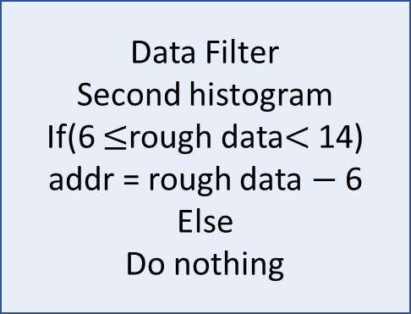
Address 0(b’000)
3 bits wide
4 bits wide
Address 1(b’001)
0 (b’000)
Filter parameter
part
TH- -> x
0 (b’000)
TH+ -> x
Pixel 1
Address 2(b’010)
0 (b’000)
CH -> x
Np = 4, Nb = 3,
peakMax=5
Address 3(b’011)
0 (b’000)
Pixel 1
Result saving part
addrSaver -> x
Pixel 1
Address 4(b’100)
0 (b’000)
peakResult -> x
Address 5(b’101)
0 (b’000)
Address 6(b’110)
0 (b’000)
The initial value in SRAM2
x means high impedance, no data is saved
Address 7(b’111)
0 (b’000)
The initial value in SRAM1
Timeline
Timeline
3 bits wide
Start building histogram2
Acquisition1
Data Filter
Second histogram
If(6 $≤$rough data$<$ 14)
addr = rough data $−$ 6
Else
Do nothing
Address 0(b’000)
0 (b’000)
Address 1(b’001)
0 (b’000)
11(b’1011) 15(b’1111)
10(b’1010) 10(b’1010)
….5b’101)
Address 2(b’010)
0 (b’000)
Acquisition2 in serial
Acquisition1 in serial
addr
Address 3(b’011)
0 (b’000)
Pixel 1
Address 4(b’100)
2 (b’010)
Address 5(b’101)
1 (b’001)
Address 6(b’110)
0 (b’000)
Address 7(b’111)
0 (b’000)
Histogram 1 in SRAM1
Finish building histogram2
Find out the peak value
Timeline
3 bits wide
3 bits wide
Address 0(b’000)
0 (b’000)
Address 0(b’000)
4(b’100)
Address 1(b’001)
0 (b’000)
Peak value of first histogram (4(b’100))
Address 1(b’001)
0 (b’000)
Address 2(b’010)
0 (b’000)
Address 2(b’010)
0 (b’000)
Address 3(b’011)
0 (b’000)
Pixel 1
Save the peak value of first histogram in first Address
Address 3(b’011)
0 (b’000)
Pixel 1
Address 4(b’100)
2 (b’010)
Address 4(b’100)
2 (b’010)
Address 5(b’101)
1 (b’001)
Address 5(b’101)
1 (b’001)
Address 6(b’110)
0 (b’000)
Address 6(b’110)
0 (b’000)
Address 7(b’111)
0 (b’000)
Address 7(b’111)
0 (b’000)
Histogram 1 in SRAM1
Histogram 1 in SRAM1
Timeline
Address 0(b’000)
3 bits wide
Finish building histogram2
Final result calculation
Address 1(b’001)
4(b’100)
4 bits wide
0 (b’000)
Result calculation
Address 2(b’010)
0 (b’000)
Filter parameter
part
TH- -> 6
Address 3(b’011)
0 (b’000)
Pixel 1
TH+ -> 14
Pixel 1
Result = 10(b’1010)
Address 4(b’100)
2 (b’010)
CH -> 5(b’101)
Address 5(b’101)
1 (b’001)
Address 6(b’110)
0 (b’000)
Current value in SRAM2
Address 7(b’111)
0 (b’000)
Histogram 1 in SRAM1

Slide 19














3 bits wide
$$\text{0 (}\text{b}\text{’000)}$$
Input = 0
$$\text{0 (}\text{b}\text{’000)}$$
Input = 1
0 (b’000)
Input = 2
0 (b’000)
Input = 3
3 bits wide
0 (b’000)
Input = 4
Address 0(b’000)
0 $≤$ Input $<$ 2
0 (b’000)
Input = 5
Address 1(b’001)
$$\text{0 (}\text{b}\text{’000)}$$
2 $≤$ Input $<$ 4
Address 0(b’000)
$$\text{0 (}\text{b}\text{’000)}$$
Input = 6
0 (b’000)
4 $≤$ Input $<$ 6
Address 1(b’001)
0 (b’000)
Input = 7
Address 2(b’010)
0 (b’000)
6 $≤$ Input $<$ 8
Address 2(b’010)
0 (b’000)
Input = 8
Address 3(b’011)
0 (b’000)
8 $≤$ Input $<$ 10
Address 3(b’011)
0 (b’000)
Input = 9
Address 4(b’100)
1 (b’010)
10 $≤$ Input $<$ 12
Address 4(b’100)
2 (b’010)
Input = 10
Address 5(b’101)
2 (b’010)
12 $≤$ Input $<$ 14
Address 5(b’101)
1 (b’001)
Input = 11
Address 6(b’110)
0 (b’000)
14 $≤$ Input $<$ 16
Address 6(b’110)
0 (b’000)
Input = 12
Address 7(b’111)
0 (b’000)
Address 7(b’111)
0 (b’000)
Input = 13
The initial value in SRAM1
$$\text{0 (}\text{b}\text{’000)}$$
Input = 14
$$\text{0 (}\text{b}\text{’000)}$$
Input = 15
The initial value in SRAM1

