Slide 1
Introduction to the PhysIO Toolbox
Lars Kasper
Translational Neuromodeling Unit & MR-Technology Group
Institute for Biomedical Engineering, ETH & University of Zurich
Notes:
My Research Projects
Dedicated to improving BOLD sensitivity: increasing signal to noise ratio (SNR) for fMRI by designing of high SNR measurement protocols (matched filter fMRI)

Slide 2
Intro: fMRI
Functional Magnetic Resonance Imaging (fMRI)
Acquire Movies (multiple images) of the behaving brain
Look at Correlations in Time Series Fluctuations
BUT: Much more Fluctuations than Brain Activation

Slide 3
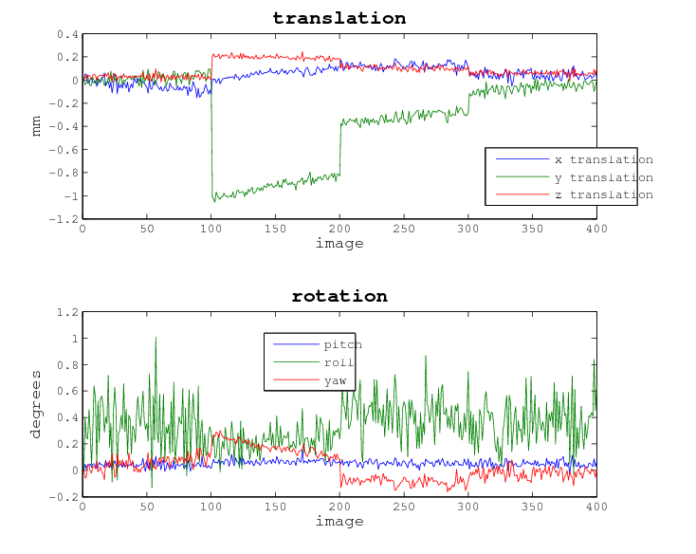
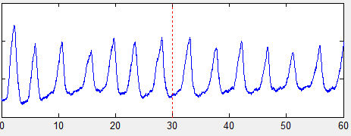
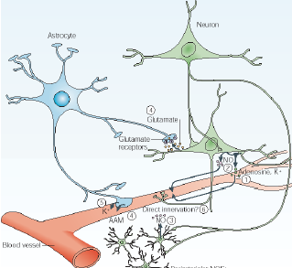
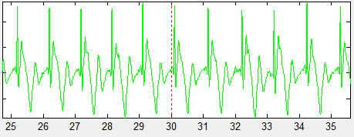
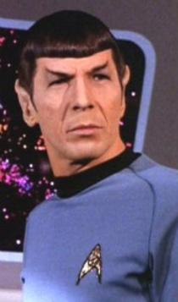
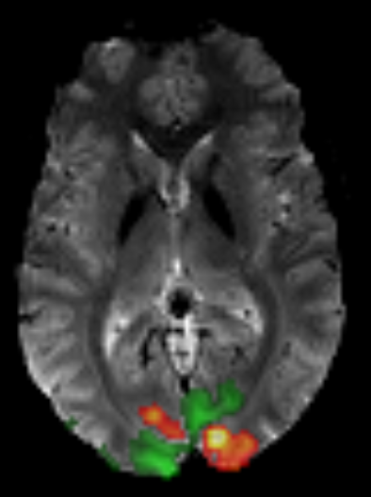
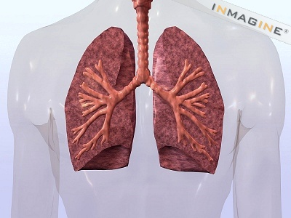
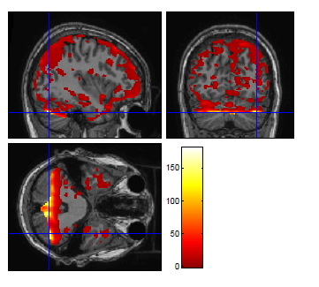
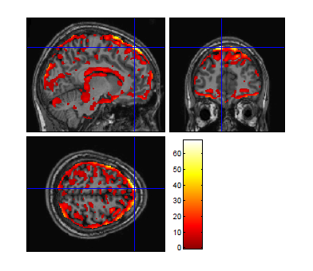
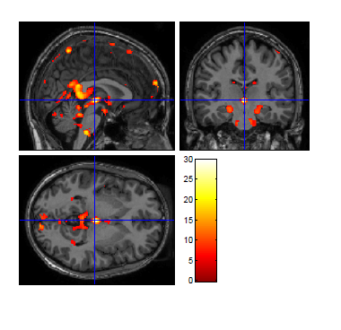
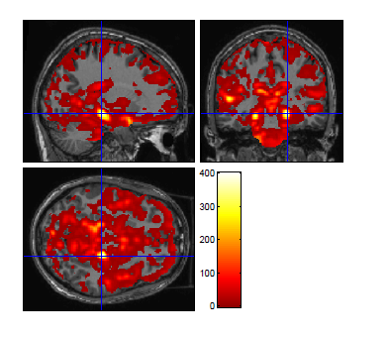
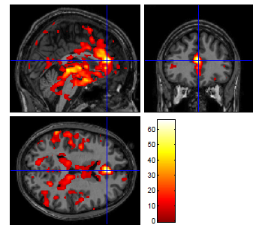
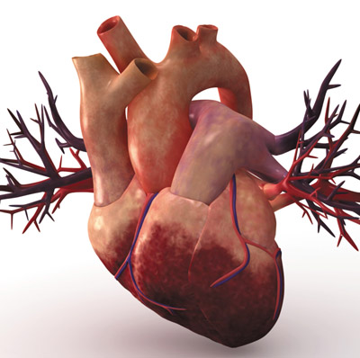
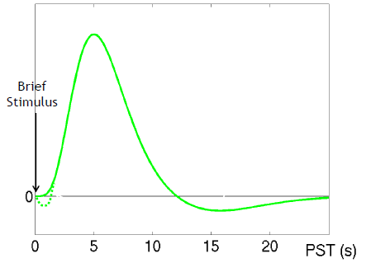
To BOLDly go where no MAN* has gone before

BOLD: Blood Oxygen Level Dependent Contrast
A neuronal activity leads to
Increase in Blood Flow
Increase in Blood Volume
Increase in oxygenation level (via overcompensating consumption)
Finally: Increased T2* and Pixel intensity

*MR-tech Afffliated Nerd

Slide 4
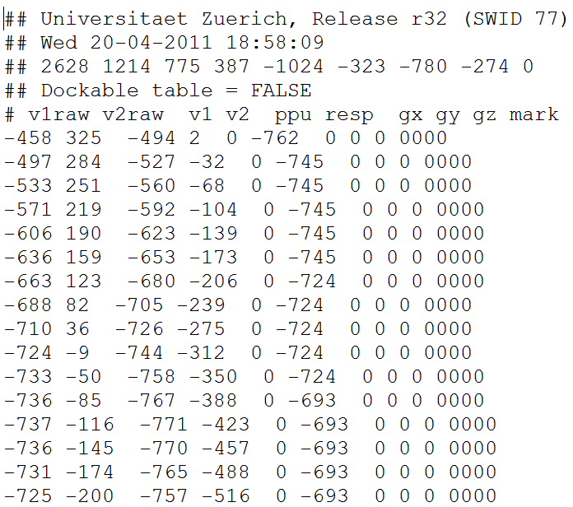
PhysIO Toolbox
Demo…
SCANPHYSLOG.log
…
One line every 2 ms

Slide 5
PhysIO Toolbox

Slide 6
Details….

Slide 7
PhysIO Toolbox

Slide 8
Heartbeat Phase Estimation
Heartbeat Phases

Slide 9
Respiratory Phase Estimation
Respiratory Ballistic Histogram

Slide 10

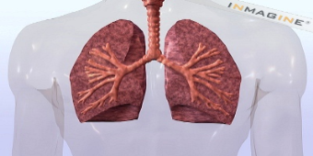
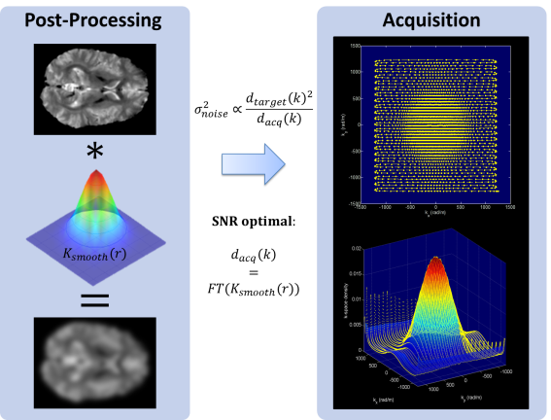
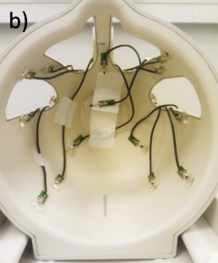
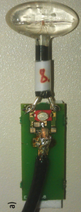
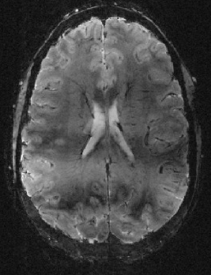
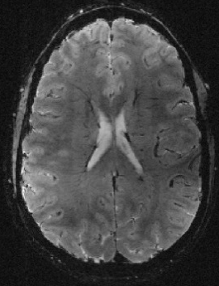
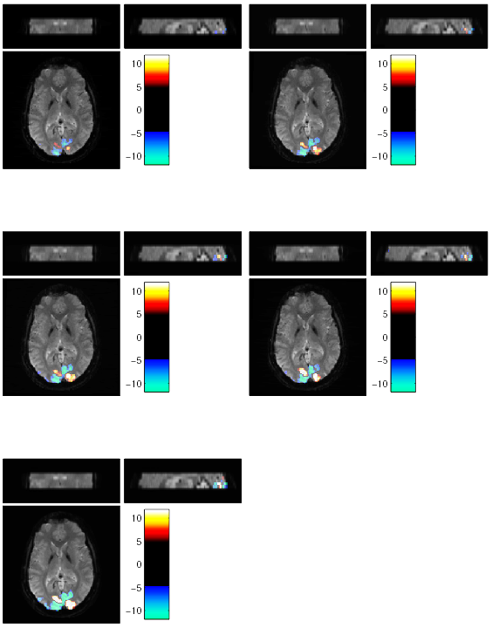
What else?
RETROICOR
Matched Filter fMRI
Field Monitoring fMRI @ 7 Tesla
noise: – 20 %
SNR: + 30 %
Courtesy J. Vannesjö
Contact: Lars Kasper, kasper@biomed.ee.ethz.ch

