Slide 1
Manual.pptx
Note: This file contains the figures presented in the docx file of the same name

Slide 2
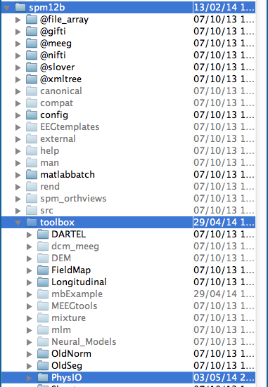
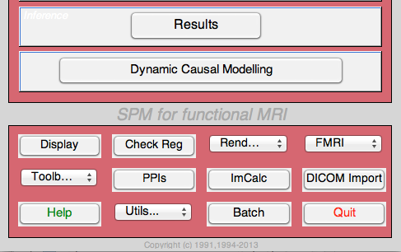
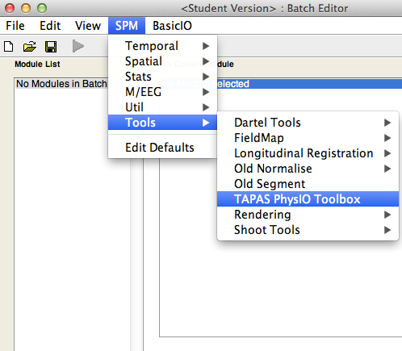
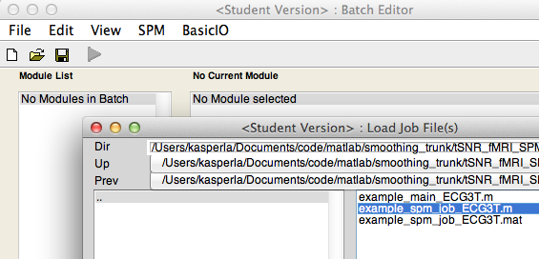
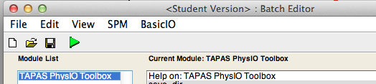
1.
2.
3.
4.
5.

Slide 4
Count scan events from beginning (Nprep is set)
Count Scan Events from end of logfile

Slide 5
Influence of sqpar.Nprep
Count scan events from beginning (Nprep is set)
Count Scan Events from end of logfile

Slide 6
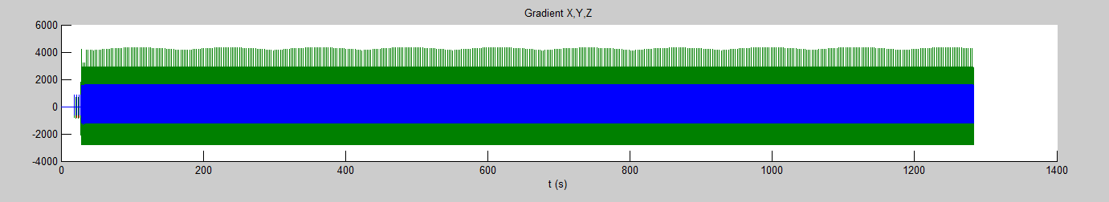
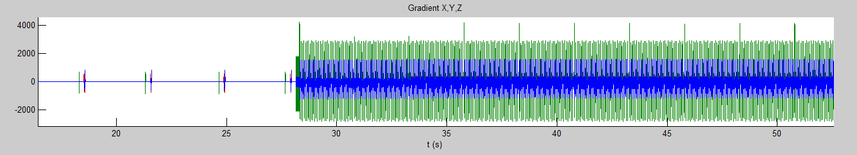
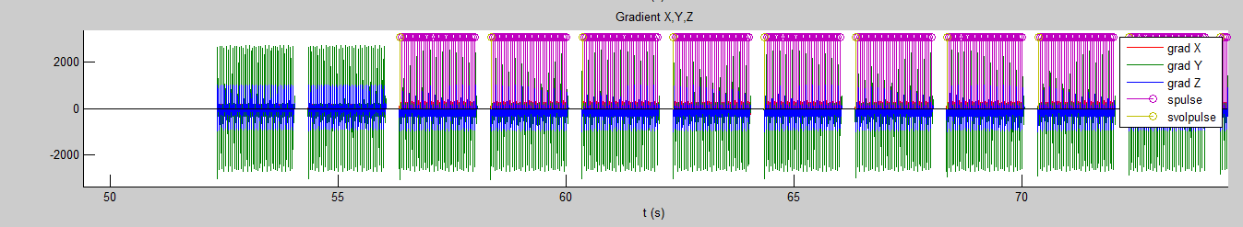
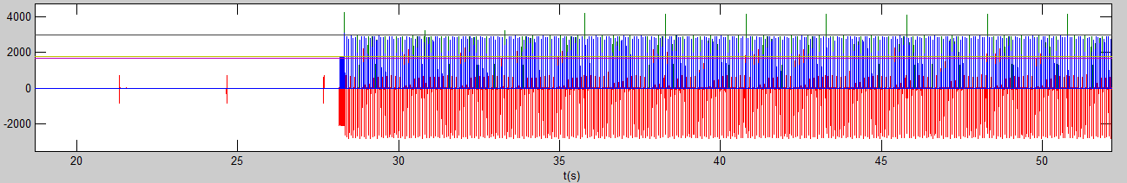
Influence of thresh for slice and volume scan event determination
Figure 2: Raw Timecourses of Physiological Logfile
Volume onsets show
higher gradient amplitude:
use thresh.vol
Volume onsets show larger temporal gap to last slice:
Use thresh.vol_spacing (in samples = 2 ms)
Figure 3: Thresholding Gradient for slice acq start detection
Volume threshold
Slice threshold

