Slide 1
Facial Makeup Recognition Using Machine Learning Techniques
Mengshu Sun, Mo Han, Yaofei Wang, Zhilan Li
EECE 5644 – Machine Learning And Pattern Recognition
Dr. Deniz Ergodmus and Dr. Jennifer Dy
December 07, 2017

Slide 2
Overview
Task distribution
Introduction
Input Output Data
Neural Network Models
CNN
VGG 16
Conclusion
Results
Learning Outcomes

Slide 3
Task Distribution
Mengshu Sun - customize and train the VGG-16 model; improve the model and do data augmentation to improve the performance
Mo Han - build the parser to load image into the CNN, and preprocess the data into the form can be trained; write prediction code to evaluate the model output
Yaofei Wang - build CNN model; tune hyperparameters of each layer
Zhilan Li - extract input data and makeup images; Setup and write the research paper; reviewed and edited paper and presentation

Slide 4
Introduction
Motivation:
Have a deeper understanding on how neural networks work
Current focus on this topic by research and industry
Interesting project
Abstract:
Our goal is to determine the presence or absence of makeup in facial images by image recognition techniques.
we solve it first utilising CNN built by ourselves, and then using VGG 16 which has better results
Notes:
We define our project as a classification problem. For our project we implement 2 methods and compare the performance. One of our methods we use is Keras model. Another is CNN

Slide 5
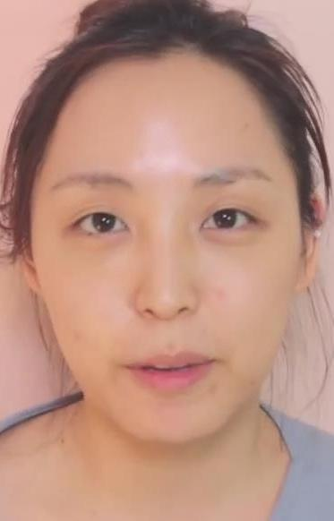
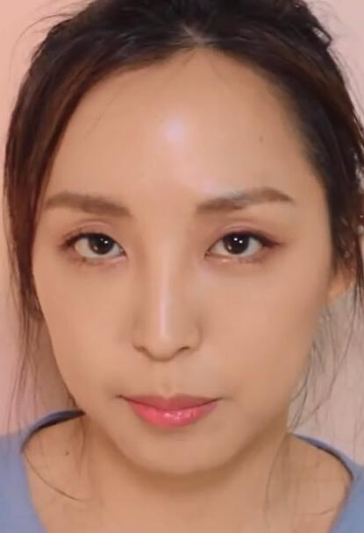
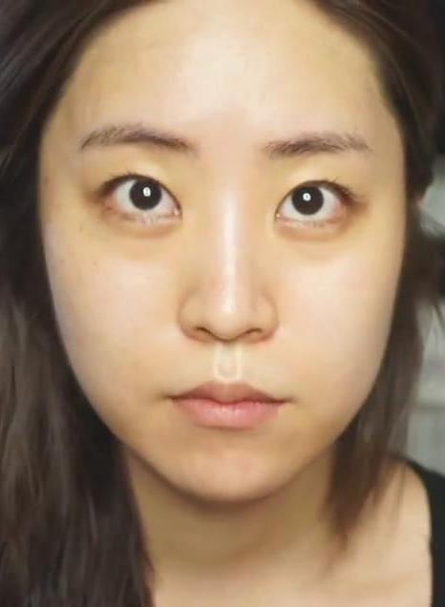
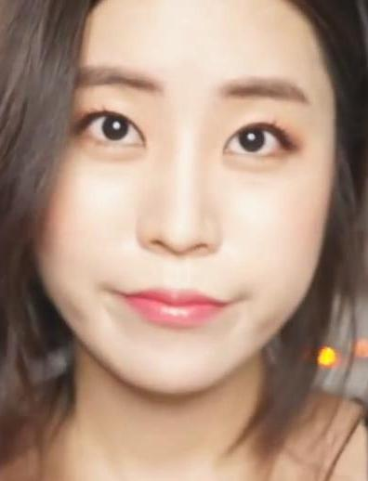
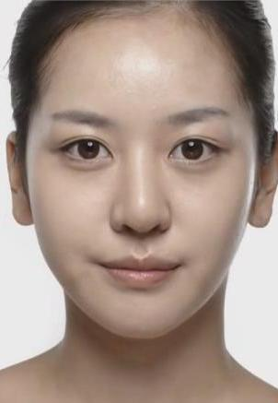
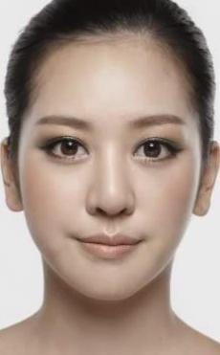
Input Data and Output Data
Makeup images are loaded and divided into train dataset (80%) and test dataset (20%).
Input data is RGB images, which are labeled with ‘makeup’ and ‘no makeup’
First load image, transform different size of images into a uniform size, and then parse them into the network

Slide 6
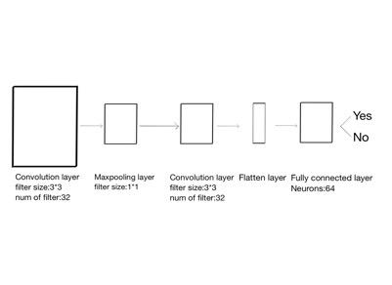
CNN- Convolutional Neural Network
Convolutional Layer
Pooling Layer
Normalization Layer
Fully-connected Layer

Slide 7
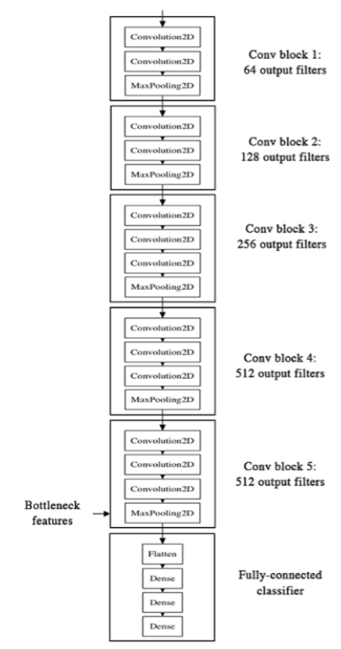
VGG16 Architecture
We refer to the VGG16 architecture
better accuracy compared to the CNN we built
5 convolutional blocks and 1 fully-connected block
zero padding, batch normalization
dropout, regularization
The input and output shapes are specified
two classes
e.g., block 1
Conv
Conv
MaxPooling
To improve the performance
ZeroPadding
Conv
BatchNormalization
ZeroPadding
Conv
BatchNormalization
MaxPoolling

Slide 8
Keras Model
Create model
Compile
choose ‘Adam’ as the optimizer, set the learning rate to 0.0001
the loss function is ‘categorical_crossentropy’
Train
fit: use the original training dataset, 30 epochs
fit_generator: do data augmentation on the training set, including rotation, width/height shift, shearing angle, zooming, etc., 10 epochs
Test
evaluate the accuracy of using fit and fit_generator
Save model

Slide 9
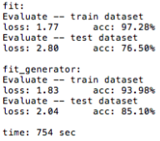
Results
CNN acc: 46%
VGG16 acc:

Slide 10
Conclusion
Comparison with VGG16 and CNN …
Trained CNN did not provide satisfactory results
Compare both model, we prefer to use VGG16 model instead of CNN due to high performance and low error rate.
Allows for easy and fast prototyping
developed with a focus on enabling fast experimentation
Supports both convolutional networks and recurrent networks

Slide 11
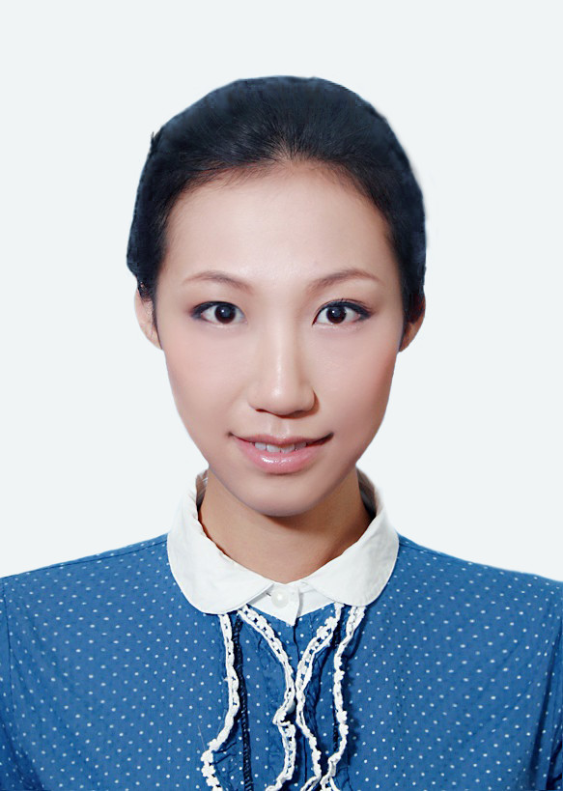
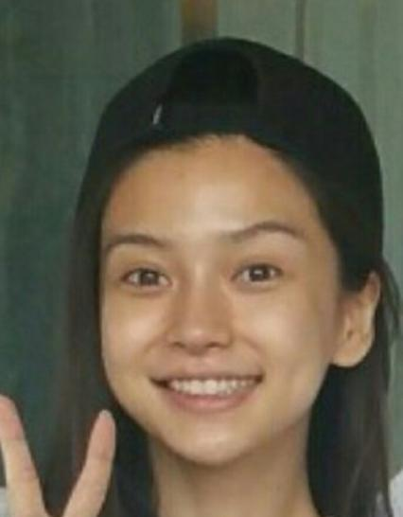
See results
1.jpg
with makeup
2.jpg
without makeup

Slide 12
Learning Outcomes
Things we got from working on this project
How to abstract a practical problem into a machine learning problem
Data gathering and preprocessing
How to build a complete neural network using Keras
How to adjust CNN parameters to get higher accuracy
How to save and load trained model to predict new input
Trained model can be applied in makeup suggestion or recognition
All code available in Google Drive:
https://drive.google.com/drive/u/0/folders/0ByI3HUPpfaaQZXNNdVBJcGZvUFU

