Slide 1
Tree Traversals

Slide 2
Tree Traversal
Tree Traversal
Preorder
Inorder
Postorder

Slide 3
Tree Traversal
There are three commonly used patterns to visit all the nodes in a tree.
The difference between these patterns is the order in which each node is visited (a “traversal”)
The three traversals we will look at are called preorder, inorder, and postorder.

Slide 4
Preorder
In a preorder traversal, we visit the root node first, then recursively do a preorder traversal of the left subtree, followed by a recursive preorder traversal of the right subtree.

Slide 5
Inorder
In an inorder traversal, we recursively do an inorder traversal on the left subtree, visit the root node, and finally do a recursive inorder traversal of the right subtree.

Slide 6
Postorder
In a postorder traversal, we recursively do a postorder traversal of the left subtree and the right subtree followed by a visit to the root node.

Slide 7
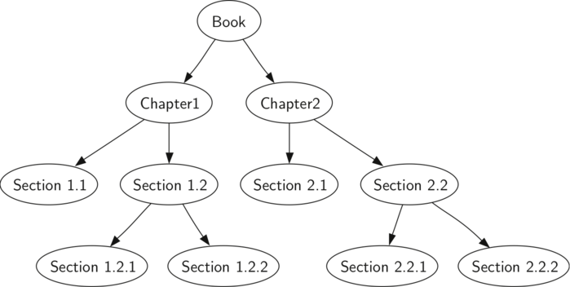
Learning through Example
As an example of a tree to traverse, we will represent this book as a tree. The book is the root of the tree, and each chapter is a child of the root.

Slide 8
Learning through Example

Slide 9
Learning through Example
Suppose that you wanted to read this book from front to back.
The preorder traversal gives you exactly that ordering.

Slide 10
Learning through Example
Starting at the root of the tree (the Book node) we will follow the preorder traversal instructions.
We recursively call preorder on the left child, in this case Chapter1.
We again recursively call preorder on the left child to get to Section 1.1.
Since Section 1.1 has no children, we do not make any additional recursive calls.

Slide 11
Learning through Example
When we are finished with Section 1.1, we move up the tree to Chapter 1.
At this point we still need to visit the right subtree of Chapter 1, which is Section 1.2.
As before we visit the left subtree, which brings us to Section 1.2.1, then we visit the node for Section 1.2.2.
With Section 1.2 finished, we return to Chapter 1.
Then we return to the Book node and follow the same procedure for Chapter 2.

Slide 12
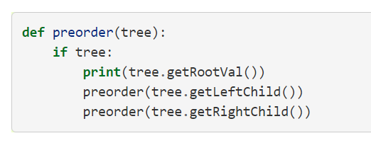
Preorder – Recursive Implementation
Base case is simply to check if the tree exists.
If the tree parameter is None, then the function returns without taking any action.

Slide 13
Preorder – Method Implementation
We can also implement preorder as a method of the BinaryTree class.
The internal method must check for the existence of the left and the right children before making the recursive call to preorder.

Slide 14
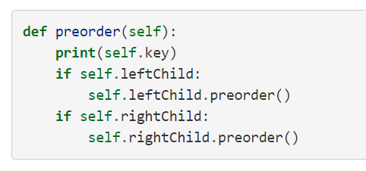
Preorder – Method Implementation

Slide 15
Preorder – Best Implementation
Implementing preorder as an external function is probably better in this case.
The reason is that you very rarely want to just traverse the tree.
In most cases you are going to want to accomplish something else while using one of the basic traversal patterns.
We will write the rest of the traversals as external functions.

Slide 16
Postorder
The algorithm for the postorder traversal is nearly identical to preorder except that we move the call to print to the end of the function.

Slide 17
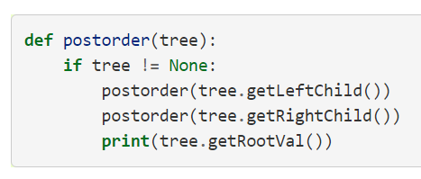
Postorder

Slide 18
Inorder
In the inorder traversal we visit the left subtree, followed by the root, and finally the right subtree.
Notice that in all three of the traversal functions we are simply changing the position of the print statement with respect to the two recursive function calls.

Slide 19
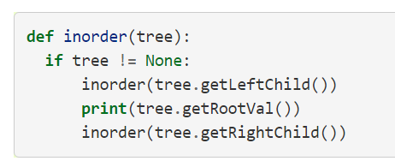
Inorder

Slide 20
Implementation
Your homework assignment is to implement each of these traversals as a function (not method)
Use the BinaryTree() class we made in the last lecture.
The code is in these slides for reference!

