Slide 1
Claude Code
Advanced Training
Commands • Workflows • Superpowers • AI Developer Workflows

Slide 2
Agenda
10:00 - 10:30 Organization & Orientation
10:30 - 12:00 Claude Code Advanced Features
12:00 - 13:00 Lunch
13:00 - 14:00 CLI Tools vs MCP Servers & Superpowers
14:00 - 15:30 AI Developer Workflow
15:30 - 16:00 Conclusion

Slide 3
Where Are You With Claude Code?
➜ How long have you been using Claude Code?
➜ What do you use it for daily?
➜ Have you customized commands, hooks, or settings?
➜ Have you used MCP servers with Claude Code?

Slide 4
What We'll Build Today
Tic-Tac-Toe — built two different ways:
1. Single HTML page with plan mode & spec-interview
2. Superpowers workflow (brainstorm → plan → execute → review)
Then I show you how the Full ADW automation pipeline works
Same app, increasing automation → from manual to zero-touch

Slide 5
Prerequisites
✓ Claude Code CLI installed and authenticated
✓ Node.js, Rust toolchain, uv (Python)
✓ Familiarity with terminal and git basics
✓ A code editor (VS Code / Cursor / terminal)
✓ Running /install command in CC checks and installs required tools

Slide 6
Claude Code Advanced Features
Commands • Plan Mode • Skills • Hooks

Slide 7
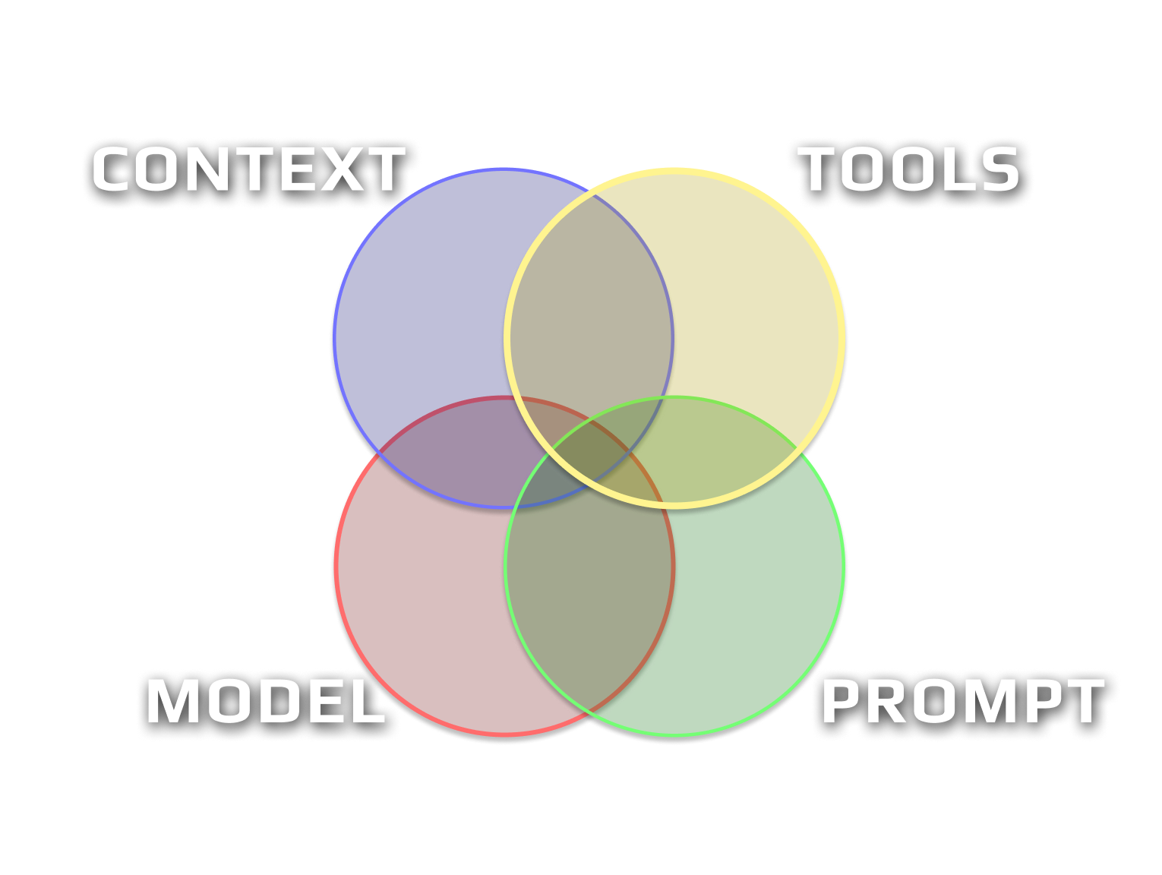

Slide 8
Custom Slash Commands
Reusable prompt templates stored in .claude/commands/
• Markdown files with variable injection ($ARGUMENTS)
• Invoke with /command-name from Claude Code
• Project-local or user-global (~/.claude/commands/)
• Can reference other files with @file syntax
.claude/commands/
├── feature.md # /feature - plan a feature
├── implement.md # /implement - build from plan
├── test.md # /test - run validation suite
├── review.md # /review - review against spec
└── document.md # /document - generate docs

Slide 9
Anatomy of a Slash Command
# Patch Plan
## Variables
adw_id: $1
...
## Instructions
- IMPORTANT: You're creating
a patch plan to fix a
specific review issue.
Keep changes small,
focused, and targeted
...
## Relevant Files
...
## Plan Format
...
## Report
...

Slide 10
Training Repo: Commands & Skills
Commands
Skills
/prime Read codebase structure and summarize understanding
/spec-interview In-depth interview to refine a spec
/feature Plan a new feature with structured spec format
/review Review work against spec, capture screenshots
/install Auto-detect OS, install Node.js, Rust, uv, Git
Install Claude Code plugins (superpowers, skill-creator)
Show manual steps for anything that failed
Stored in .claude/commands/ and .claude/skills/ — shipped with the training repo

Slide 11
Plan Mode
• Dedicated mode for thinking before doing
• Claude explores, analyzes, and writes plans — no code changes
• Toggle with /plan or Shift+Tab
• Output: structured plan files in markdown
> /plan Create a simple tic-tac-toe game. Create only a single html page named tic-tac-toe.html. Write the plan to tic-tac-toe-plan.md

Slide 12
Action Pack 1: Planning
LIVE DEMO
Step 1 Plan tic-tac-toe in plan mode
Step 2 Refine with /spec-interview
Step 3 Implement the improved spec
/spec-interview current plan. ask only three questions
# After answering questions:
Implement the new spec and create tic-tac-toe-improved.html

Slide 13
Skills — Extending Claude's Capabilities
• Reusable instructions that Claude can invoke
• Stored in .claude/skills/ with a SKILL.md file
• Can be auto-loaded or manually triggered
• Great for enforcing patterns, validation rules, coding standards
# .claude/skills/html-validator/SKILL.md
---
disable-model-invocation: true
---
Analyze HTML code for:
- Document structure (DOCTYPE, meta tags)
- Accessibility (alt text, ARIA, landmarks)
- Semantic HTML and heading hierarchy
Output: JSON with issues list and severity

Slide 14
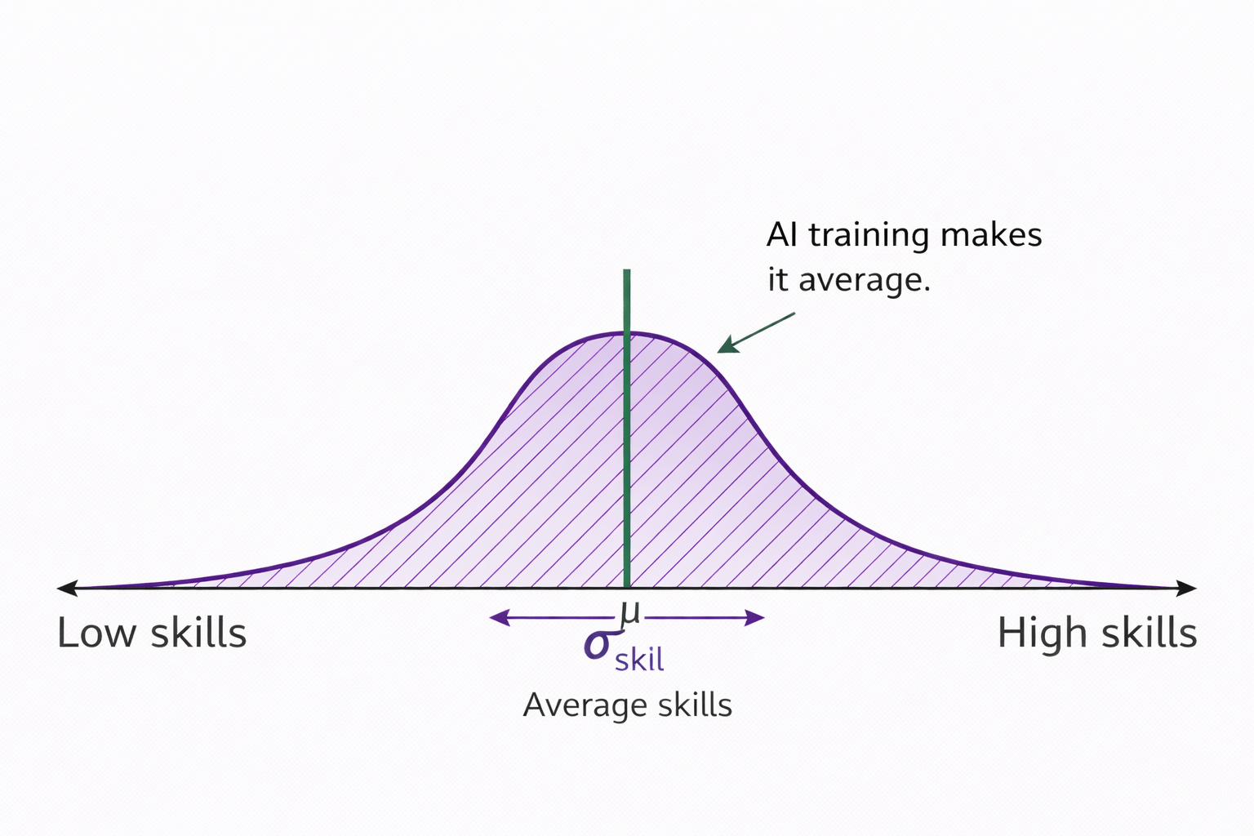
The Problem With AI-Generated Code

Slide 15
Creating a Skill
LIVE DEMO
Using /skill-creator to build an HTML validation skill
/skill-creator Create local skill that can validate any html based code. It should do code analysis only. Output should be json document which contains list of issues found, nothing else. Set up eval test cases to verify the skill works well. Add `disable-model-invocation: true` frontmatter to prevent this skill to autoload.

Slide 16
Practice: Action Pack 1
Try it yourself!
1. Enter plan mode and plan a tic-tac-toe game
2. Use /spec-interview to refine the spec
3. Implement the improved version
4. Create an HTML validation skill with /skill-creator

Slide 17
Superpowers
Pre-built skills for professional workflows

Slide 18
What Are Superpowers?
• Curated skill packs that enhance Claude Code's behavior
• Enforce disciplined workflows (TDD, debugging, planning)
• Auto-trigger based on what you're doing
• Installed via Claude Code /plugin command

Slide 19
Key Superpowers
brainstorming Collaborative design before coding
writing-plans Structured implementation plans
executing-plans Plan execution with review checkpoints
test-driven-dev TDD workflow enforcement
systematic-debugging Root cause analysis before fixes
code-review Requesting and receiving reviews
parallel-agents Dispatch independent work concurrently

Slide 20
Installing Superpowers
LIVE DEMO
Easy to add to any project:
# Install from Claude Code marketplace
/plugin install superpowers@claude-plugins-official
/plugin install skill-creator@claude-plugins-official
# Reload to activate
/reload-plugins
# Or browse interactively: /plugin -> Discover tab
• Plugins stored in .claude/plugins/
• Skills auto-trigger based on what you're doing
• skill-creator plugin also available for building custom skills

Slide 21
Action Pack 2: Superpowers Workflow
LIVE DEMO
Tic-tac-toe using the full superpowers development cycle:
Step 1 /brainstorming — Collaborative design, ask questions, explore approaches
Step 2 /writing-plans — Create structured implementation plan from spec
Step 3 /executing-plans — Execute plan step by step with checkpoints
Step 4 /code-review — Review implementation against the design
Each skill enforces discipline — no skipping steps

Slide 22
/brainstorming
LIVE DEMO
/brainstorming Create a tic-tac-toe game with a Rustweb server backend and TypeScript frontend UI
• Explores project context before asking questions
• Asks clarifying questions one at a time
• Proposes 2-3 approaches with trade-offs
• Presents design section by section for approval
• Writes design spec to docs/ and commits it

Slide 23
/writing-plans → /executing-plans
LIVE DEMO
/writing-plans
/executing-plans
• Reads the approved design spec
• Breaks work into ordered tasks
• Identifies dependencies
• Saves plan as markdown
• Follows plan step by step
• Review checkpoints between steps
• Runs tests after each phase
• Commits working increments

Slide 24
/code-review
LIVE DEMO
• Reviews implementation against the original design spec
• Checks for missed requirements and edge cases
• Verifies tests cover the spec's success criteria
• Provides actionable feedback, not rubber-stamp approval
The full cycle: brainstorm → spec → plan → execute → review Each step builds on the previous, creating an audit trail.

Slide 25
Practice: Action Pack 2
Try the superpowers workflow yourself!
1. Run /brainstorming and answer the design questions
2. Approve the design, then run /writing-plans
3. Execute with /executing-plans
4. Review with /code-review

Slide 26
CLI Tools vs MCP Servers
Always prefer CLI tools — use MCP only as last resort

Slide 27
The Problem with MCP Servers
• MCP tools consume significantly more tokens than CLI
• MCP servers wrap tools behind JSON-RPC abstraction
• Extra process to configure, start, and keep alive
• Adds failure points: server crashes, version mismatches
• Harder to debug — errors are wrapped and opaque
• Most tools already have excellent CLI interfaces
If a tool has a CLI, Claude can already use it via Bash. An MCP wrapper adds complexity with no added capability.

Slide 28
Example: Playwright CLI vs MCP Server
MCP Server (avoid)
CLI (prefer)
# Requires .mcp.json config,
# server process running,
# JSON-RPC communication
mcp__playwright__browser_navigate
mcp__playwright__browser_screenshot
mcp__playwright__browser_click
# Just works via Bash tool
npx playwright screenshot \
--full-page url output.png
npx playwright test
npx playwright test --headed
npx playwright codegen url
Playwright CLI: screenshots, test execution, code generation, device emulation, PDF export — all without an MCP server.

Slide 29
Why CLI Always Wins
No config No .mcp.json, no server setup, no version pinning
No process No background server to start, monitor, or restart
Transparent You see the exact command that runs in Bash
Debuggable Run the same command yourself to reproduce issues
Portable Works on any machine where the tool is installed
Composable Pipe output, chain commands, use shell features

Slide 30
The Rule
If a tool has a CLI, use the CLI via Bash.
Only reach for an MCP server when there is
no CLI alternative at all.
• Playwright has a CLI → use npx playwright, not the MCP server
• Repomix has a CLI → use npx repomix, not the MCP server
• git, npm, cargo, uv → already CLI tools, never need MCP

Slide 31
AI Developer Workflow
Plan → Build → Test → Review → Document

Slide 32
Running Claude Code Programmatically
The Agent SDK enables automated workflows like ADW:
• claude -p runs Claude Code non-interactively from scripts
• Same tools, agent loop, and context as interactive mode
• Available as CLI, Python SDK, and TypeScript SDK
• This is the foundation that makes ADW possible
# Run Claude Code from a script
claude -p "Find and fix the bug in auth.py" \
--allowedTools "Read,Edit,Bash"
# ADW scripts use this under the hood:
claude -p "$prompt" --allowedTools "..." --output-format json

Slide 33
Agent SDK: Key Capabilities
CLI (claude -p)
Python / TypeScript SDK
• --allowedTools to auto-approve tools
• --output-format json for structured output
• --bare for fast, reproducible runs
• --continue / --resume for multi-turn
• --append-system-prompt for custom instructions
• Full programmatic control
• Structured outputs with JSON schema
• Tool approval callbacks
• Streaming with real-time events
• CI/CD integration (GitHub Actions, GitLab)

Slide 34
Why This Enables ADW
# Each ADW phase is a programmatic Claude Code call
result = subprocess.run([
"claude", "-p", plan_prompt,
"--allowedTools", "Read,Edit,Bash,Write,Glob,Grep",
"--output-format", "json",
"--append-system-prompt", system_context
])
• Each SDLC phase runs as an isolated claude -p call
• Structured JSON output lets scripts parse results
• Tool approval flags enable unattended execution
• Worktrees provide filesystem isolation between phases
• Scripts orchestrate the sequence: plan → build → test → review

Slide 35
The SDLC Pipeline
Five phases, each with its own agent and toolset:
Plan
Analyze requirements
Write implementation plan
Build
Execute plan
Write code
Test
Unit + E2E tests
Linting & type checks
Review
Validate against spec
Capture screenshots
Document
Generate markdown
Include screenshots
→
→
→
→

Slide 36
Isolated Execution with Git Worktrees
• Each ADW runs in its own git worktree (trees/<adw_id>/)
• Complete filesystem isolation — no conflicts
• Deterministic port allocation (backend: 9100-9114, frontend: 9200-9214)
• Persistent state tracking in agents/<adw_id>/adw_state.json
• Supports up to 15 concurrent ADW instances

Slide 37
Action Pack 3: Slash Command Pipeline
LIVE DEMO
Tic-tac-toe with Rust backend + TypeScript frontend
Step 1 /feature — Plan with structured spec
Step 2 /implement <plan-file> — Build from plan
Step 3 /test — Run validation suite
Step 4 /review local <plan-file> — Review against spec
Step 5 /document local <plan-file> — Generate docs

Slide 38
The /feature Command
LIVE DEMO
/feature 0 local '{"title":"Tic-Tac-Toe Game",
"body":"Create a tic-tac-toe game with a Rust
web server backend and TypeScript frontend UI.
The Rust server should serve static HTML/JS/CSS
files and expose a REST API for game logic
(new game, make move, get game state).
The TypeScript frontend should render a 3x3 grid,
handle player clicks, display whose turn it is,
detect win/draw conditions, and allow restarting
the game."}'

Slide 39
Action Pack 4: ADW Automation
LIVE DEMO
Same tic-tac-toe, fully automated pipeline:
Step 1 uv run adw_plan_iso.py → get <adw-id>
Step 2 uv run adw_build_iso.py <adw-id>
Step 3 uv run adw_test_iso.py <adw-id>
Step 4 uv run adw_review_iso.py <adw-id>
Step 5 uv run adw_document_iso.py <adw-id>
Each step runs Claude Code as a subprocess in an isolated worktree

Slide 40
ADW System Architecture
adw_modules/agent.py Claude Code CLI integration
adw_modules/workflow_ops.py Core workflow operations
adw_modules/state.py State persistence (JSON)
adw_modules/git_ops.py Git operations + worktrees
adw_modules/github.py GitHub API (issues, PRs)
adw_modules/worktree_ops.py Worktree + port management

Slide 41
Orchestration Patterns
Single Phase adw_plan_iso.py — one step at a time
Multi Phase adw_plan_build_iso.py — combine phases
Full SDLC adw_sdlc_iso.py — all five phases
Zero Touch adw_sdlc_zte_iso.py — auto-merge to main
Progressive automation: start manual, add automation as confidence grows. ZTE = full pipeline with automatic PR approval and merge.

Slide 42
GitHub Integration
• Issue classification → automatic workflow selection
• Branch creation with semantic naming
• PR generation with descriptions and screenshots
• Webhook triggers for real-time processing
• Cron-based polling (20-second intervals)

Slide 43
Wrapping Up

Slide 44
Key Takeaways
1. Slash commands make workflows repeatable and shareable
2. Plan mode + spec-interview = better requirements upfront
3. Skills and hooks extend Claude Code to your project's needs
4. Prefer CLI tools over MCP servers when possible
5. Superpowers enforce disciplined development practices
6. ADW automates the full SDLC with isolated execution

Slide 45
The Automation Ladder
Level 1 Manual prompting — chat with Claude Code
Level 2 Slash commands — repeatable workflows
Level 3 Superpowers — enforced best practices
Level 4 ADW scripts — automated multi-phase pipelines
Level 5 Zero Touch — issue → merged PR, fully automated

Slide 46
Resources & Next Steps
• Training repo: explore .claude/commands/ and .claude/skills/
• Claude Code docs: docs.anthropic.com
• Tactical Agentic Coding: https://agenticengineer.com/tactical-agentic-coding
Practical patterns for working effectively with AI coding agents

Slide 47
Recommended Tools & Plugins
CC Status Line
• Shows model, context %, session cost, clock, git branch
• Context % is critical — past ~50% Claude starts forgetting
npx ccstatusline@latest
Superpowers (Plugin)
• Orchestration layer dispatching sub-agents in their own context
• Prevents context poisoning in your main session
• Core: /brainstorming → /writing-plans → /executing-plans
/plugin install superpowers@claude-plugins-official

Slide 48
Recommended Tools & Plugins (cont.)
Code Simplifier (Plugin)
• Reviews changed code for reuse, quality, and efficiency, then fixes issues
/plugin → search 'code simplifier' → install
Sequential Thinking (MCP Server)
• Chain-of-thought reasoning for deeper analysis during brainstorming and planning
Tell Claude: 'please install sequential thinking MCP server'
Context7 (Plugin)
• Up-to-date API/library docs — fixes hallucinated outdated APIs
/plugin → search 'context7' → install

Slide 49
Thank You!
Questions?

