Slide 1


Team Details
  Team name: Adagard
  Team leader name: Nivakaran Shanmugabavan
  Problem Statement: Challenge 1 (BFSI) · Stopping the payment a scam victim approves (APP fraud)
Notes:
FirstStep: an AI copilot for first-time investors in Sri Lanka, built on Gemini and Google Cloud.

Slide 2
Brief about the idea
FirstStep is the last checkpoint before the money leaves. It catches the scam at the moment of payment, explains it to the customer in Sinhala, Tamil or English, and gives the bank and regulator a record that can't be quietly changed.
In an authorised push payment scam the customer passes every check herself: right login, right OTP, her own decision to pay. Regulators are moving that loss onto banks.
Oct 2024
Dec 2024
Jun 2026
UK: mandatory reimbursement of APP scam losses, up to GBP 85,000 per claim
Singapore: Shared Responsibility Framework puts duties on banks and telcos
Sri Lanka: CBSL makes “Be Scam Proof” its consumer-protection theme
1
Pay a new payee
2
Check the offer
3
Explained
4
Sealed record
Kamala starts a Rs 30,000 transfer; the gateway asks for fresh proof
The WhatsApp message gets a STOP verdict, and why
In Sinhala, with every figure checked against the tools
Evidence for disputes, reimbursement and the regulator
Also: USD 88–114 bn lost to online scams across Asia-Pacific in 2025 (UNODC); only 22% of victims recover anything (GASA).
Notes:
Sources: UK PSR APP reimbursement (7 Oct 2024); Singapore MAS/IMDA Shared Responsibility Framework (16 Dec 2024); Newsfirst 2 Jun 2026 (CBSL 'Be Scam Proof'); UNODC 2025; GASA 2025.

Slide 3
Opportunities
Why not existing apps?
How it solves the problem
USP
• Google Messages and ScamShield protect the phone and need the victim to doubt the offer; many victims never check
• FirstStep protects the payment: it acts at the transfer, on any phone, whatever the channel (WhatsApp, calls)
• A bank-side control, so it fits Singapore's and the UK's duties on banks
• Step-up on a new payee, the moment regulators single out as high risk
• Plain-language reasons in the customer's language, where generic English warnings fail
• Policy decides, Gemini reads: the bank can tell a regulator exactly why a payment was stopped
• A sealed, verifiable record for disputes and reimbursement claims
• Protects the payment, not just the phone
• Live and tested on Cloud Run, not a slide: 11/11 end-to-end checks
• Built for Sri Lanka: Sinhala, Tamil, LKR, CSE

Slide 4
List of features offered by the solution
1
Payment checkpoint
2
Scam Shield
3
Explained in her language
Every transfer is scored by the gateway; a new payee or unusual behaviour triggers a one-time-code step-up before money leaves.
Paste a WhatsApp, SMS or email offer. Gemini reads the red flags, policy SHIELD-P001 decides: a STOP / CHECK / CLEAR stamp with what to do next.
Ask why, by text or voice, in Sinhala, Tamil or English. Gemini answers from the platform's tools; any unchecked figure is withheld.
4
Sealed evidence
5
Scam knowledge, open
6
Slowing down is cheap
Each decision is hashed with its model and policy and anchored in a contract; change one field and verification fails. Readable over OData.
Scam patterns in Google's Open Knowledge Format, with sources and trust tiers, cited in every verdict.
Scammers sell urgency. The cash planner shows what rushing a sale costs, and the cheapest way to raise money calmly.

Slide 5
Process flow diagram
Transfer
Gateway
STEP‑UP
Check the offer
STOP
Kamala pays Rs 30,000 to a new payee
Behavioural and network risk score
Fresh one-time-code proof before money moves
Gemini reads the WhatsApp message's red flags
SHIELD-P001 verdict, what to do, why, scam patterns
Then the customer's question and the bank's record
Ask why
Decide
Sealed
Verify
Report
Assistant answers in Sinhala; invented figures are withheld
She cancels, or proves it is really her
Verdict and transfer decision hashed with model and policy
Any change later fails against the contract
Bank and regulator read every decision over OData
Today the transfer check and the message check run side by side; feeding the message verdict into the transfer decision is next.

Slide 6
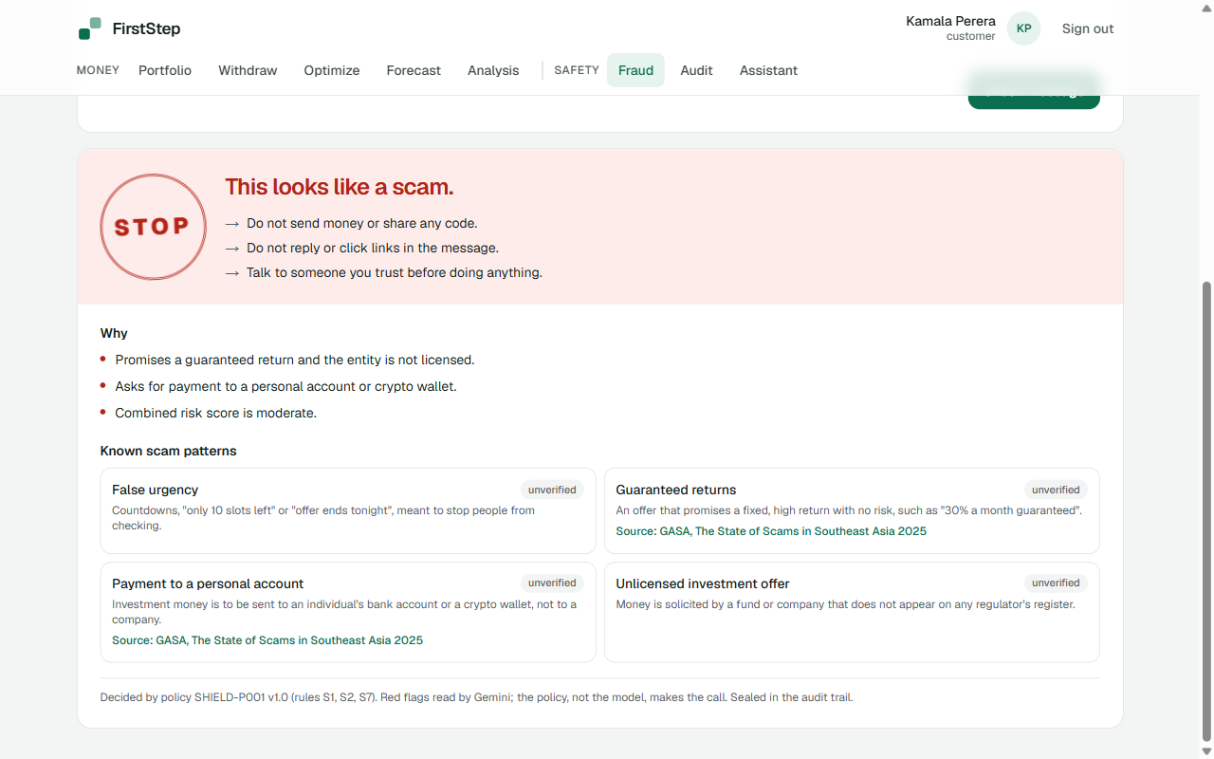
Design: the verdict is the product
One decision, one stamp.
The visual world is a bank passbook: paper, ink, savings-book green for safe, stamp red for stop. The verdict is a stamp with a word and a shape, never colour alone, then what to do, then why.
STOP
This looks like a scam
CHECK
Some warning signs
CLEAR
No warning signs found
UNSURE
Too little to call it safe
Live screen. Every text colour clears 4.5:1 contrast in light and dark; layouts are checked at phone width (390 px).

Slide 7
Architecture diagram of the proposed solution
Customers
Web app and mobile app
Google Cloud Run · each service verifies every request itself
Gemini
Red flags, agent reasoning, Sinhala and Tamil answers
Web (Next.js)
Platform
Scam Shield, planner, audit, assistant UI
Accounts, roles, portfolios, token signing
Banks, regulators
OData v4 clients (Excel, BI)
Secret Manager
Signing key, service-client secrets
C2 Fraud & Scam
C1 Portfolio
Gemini red flags, SHIELD-P001, gateway G1-G7, step-up, OKF bundle
Fuzzy GA cash planner, MOEA/D, forecast bands, statement import
Cloud Build
Images per service, kept in Artifact Registry
C4 Assistant
C3 Audit
LangGraph agent on Gemini, grounding check, Trust Panel
Hash-committed decision log; AuditRegistry.sol on the audit service chain
GitHub Actions + WIF
Keyless deploy on every push

Slide 8
Technologies used in the solution
Gemini (red flags, agent, Sinhala/Tamil) · Cloud Run (6 services) · Cloud Build · Artifact Registry · Secret Manager · Workload Identity Federation · Open Knowledge Format (OKF) · Cloud Logging
Live
Next.js 16 + React 19 · FastAPI · Express · LangGraph · Expo (React Native) · Hardhat EVM + Solidity · OData v4 · RS256 / JWKS
Live
TimesFM fine-tuned with LoRA on a Colab T4 + LSTM residual head; walk-forward evaluation
Offline
Vertex AI, ADK + Agent Engine, BigQuery ML AI.FORECAST, Document AI, Vertex AI Search, Pub/Sub, Firestore, Firebase Auth, Cloud Armor, VPC-SC, Blockchain Node Engine
Planned
Status as deployed on 18 Oct 2026. The README's technology map lists the same split.

Slide 9
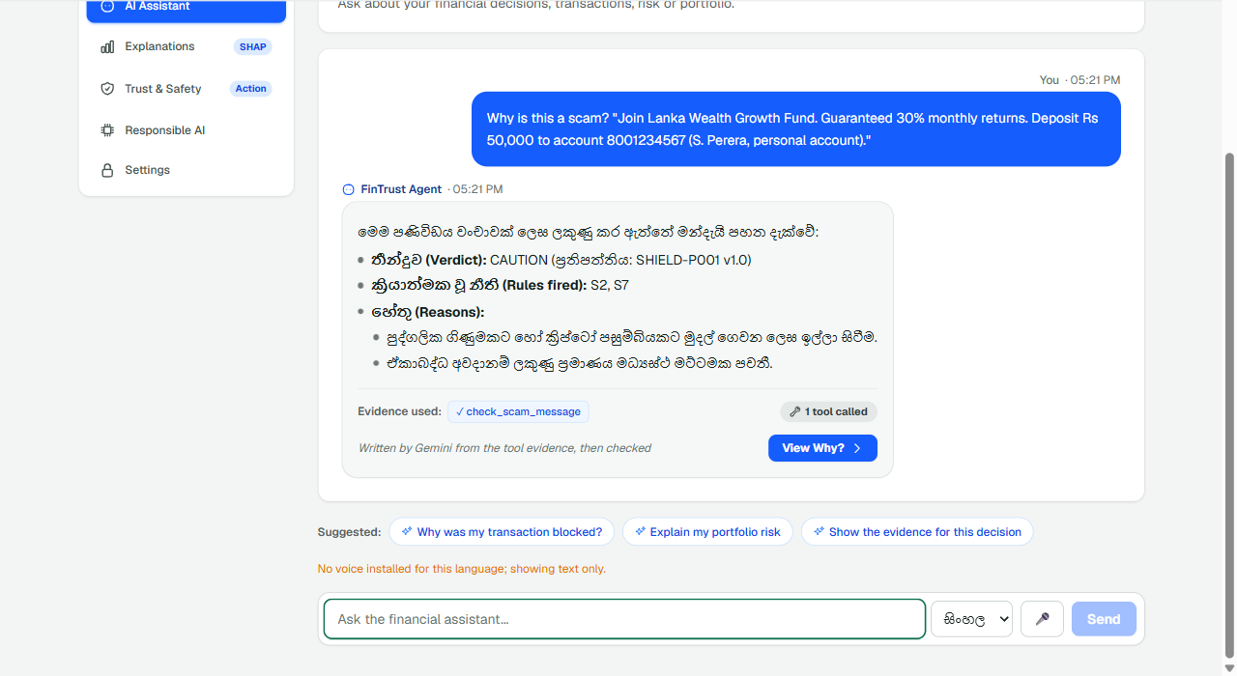
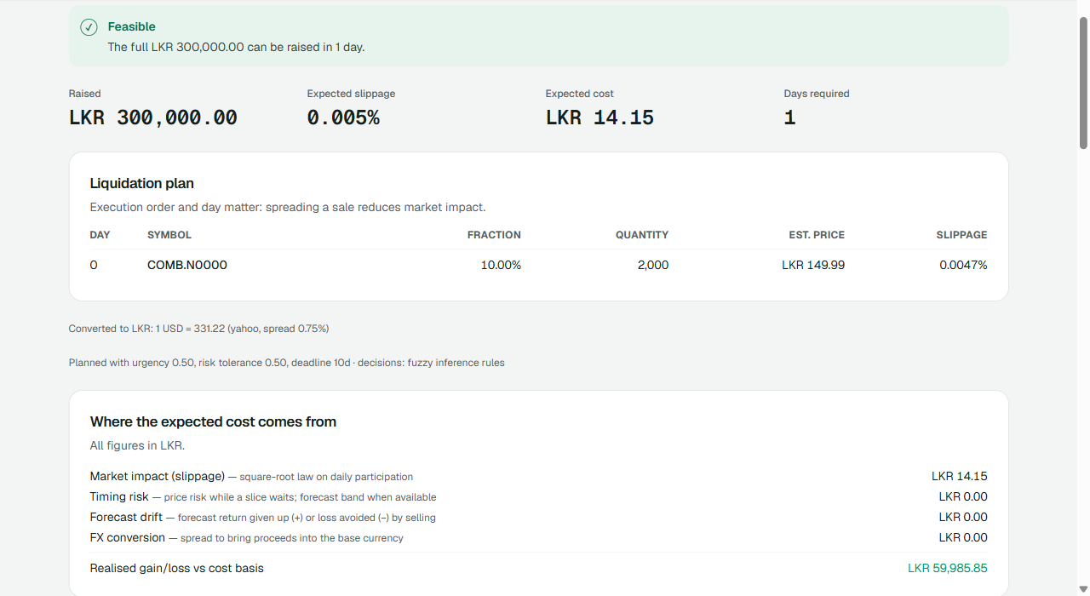
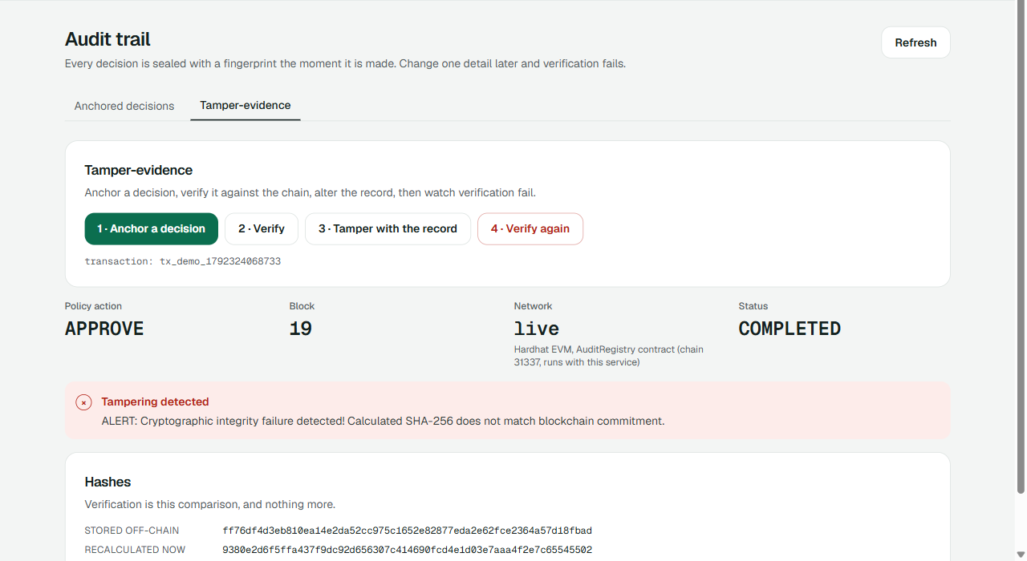
Snapshots of the prototype
Scam Shield: STOP stamp, reasons, cited OKF scam patterns; red flags read by Gemini
Assistant answering in Sinhala, from the scam-check tool
Cash planner: feasible plan and its cost against three baselines
Audit: record altered, verification fails against the contract

Slide 10
Prototype performance report / benchmarking
11 / 11
live end-to-end checks pass on Cloud Run
176 +
automated tests passing: platform 63, fraud 46, assistant 22, web 38, mobile 7, plus the audit suite
20 / 20 scams flagged, 0 false alarms
Gemini reading red flags lifts recall from 45% to 100% at the same zero false-positive rate (precision 1.00). Honest limits: 40 synthetic English messages written by the team (eval/scam_synthetic_v1.jsonl); Sinhala and Tamil not yet measured; a real labelled Sri Lankan set is next.
Forecasting (offline): fine-tuned TimesFM hybrid, −6.8% pinball loss vs LSTM.
401 / 403
no token or wrong role is refused, by every service
6 / 6
services live on Cloud Run, redeployed by CI on every push

Slide 11
Additional details / future development
Already in place
Next
Honest by design
Link the checks
Feed the message verdict into the transfer decision.
The README separates what is live, offline and planned; negative results are reported.
Real-world eval
Labelled Sri Lankan messages, Sinhala and Tamil, with partner banks.
Gemini on Vertex AI + ADK
Move the agent to Agent Engine; Document AI for statements.
Responsible AI
Policies decide, figures are grounded, privacy and advice checks run on every answer; family guardian alerts wait for the user's consent.
Public anchoring
Anchor the log on a public testnet via Blockchain Node Engine.
WhatsApp bot
Forward a message, get the verdict back in the same chat.

Slide 12
Provide links to your:
GitHub Public Repository: https://github.com/Adagard-Trios/AI-Buildathon-2026
Demo Video Link (3 Minutes): ADD THE VIDEO LINK
Final Product Link: https://firststep-web-214625202650.us-central1.run.app
Try it
Register any email: every account starts with a demo portfolio of CSE, US and crypto holdings.
Fraud → Scam Shield: paste an investment offer and see the verdict, reasons and scam patterns.
Fraud → Check a transfer: tick New beneficiary, amount 30,000 → STEP-UP → enter the code.
Audit → Tamper-evidence: anchor, verify, tamper, verify again.
Services scale to zero to keep cost near nothing: the first click on a quiet service takes ~15 s.

Slide 13
Built to be trusted
1
Verify every request
2
Least privilege
3
Your data only
Each service checks RS256 tokens against the platform's JWKS; no token means 401, wrong audience or role 403.
Roles come from deployment config only; staff addresses cannot be self-registered.
Row-level reads: customers see only their own records; auditors read all, alter nothing.
4
Fresh proof for risk
5
Fail closed
6
No invented numbers
STEP-UP one-time codes on risky transfers, even inside a valid session.
Misconfiguration refuses instead of allowing; denials are sealed in the audit trail.
An answer with a figure no tool produced is withheld.

Slide 14


