Slide 1

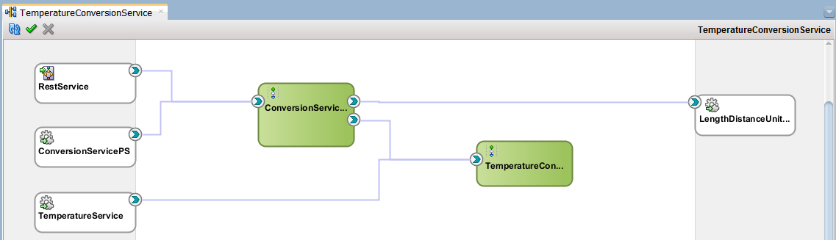
Chapter 3
JAX-WS
www.webservicex.net
/LengthDistanceUnitConvertorService

Slide 2

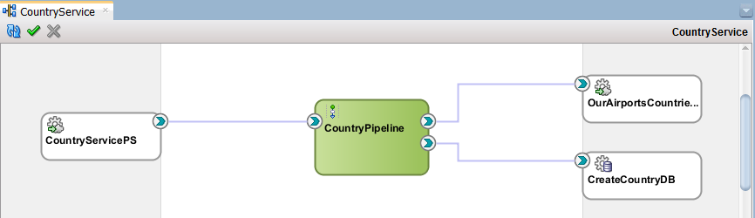
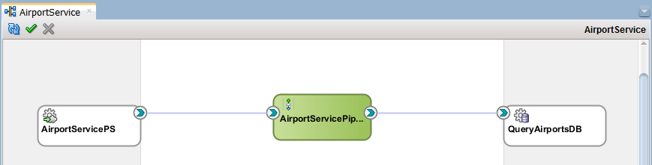

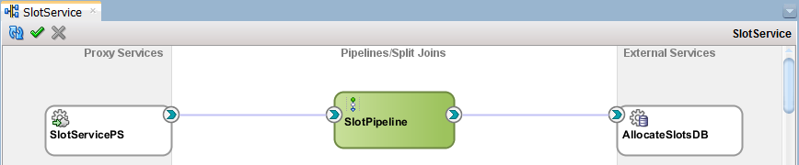

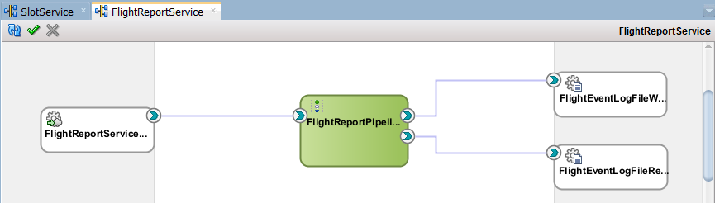
Chapter 4
www.ourairports.org
countries.csv
countries
airports
fut_allocate_slots
slots
/{FLIGHT_EVENTLOG_DIRECTORY}
/1-31/KL607FlightEventLog.txt
/MH89FlightEventLog.txt
/5-8/AM3FlightEventLog.txt
/LH9FlightEventLog.txt

Slide 3



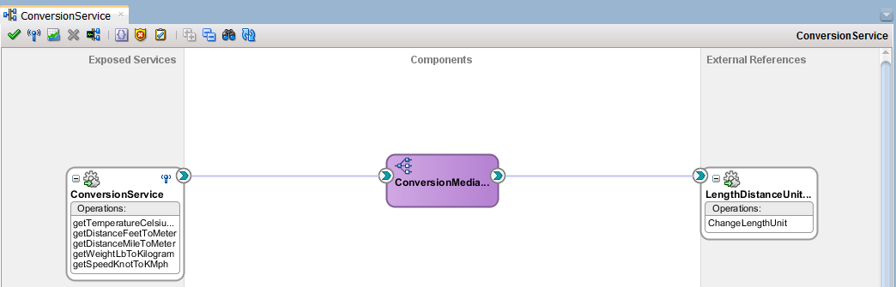

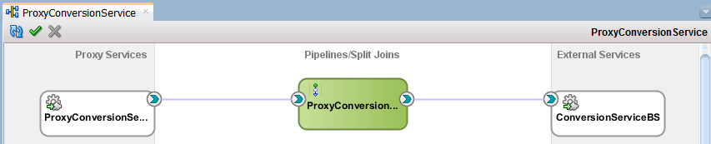
Chapter 5
www.webservicex.net
/LengthDistanceUnitConvertorService

Slide 4

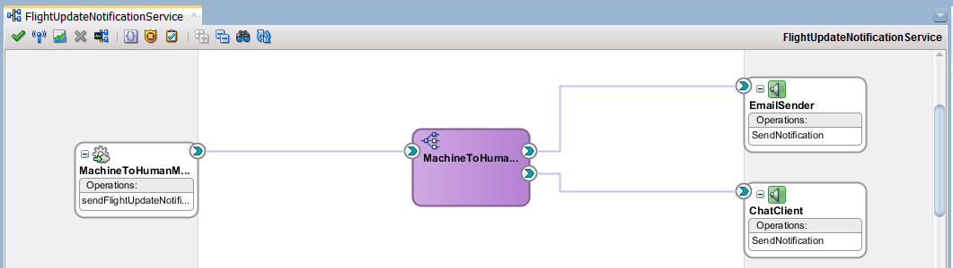

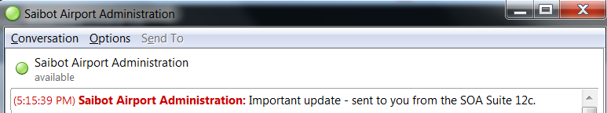
Chapter 6
Any mail
Gmail
XMPP Server
Chat Contacts on same or other XMPP Server

Slide 5
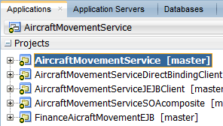
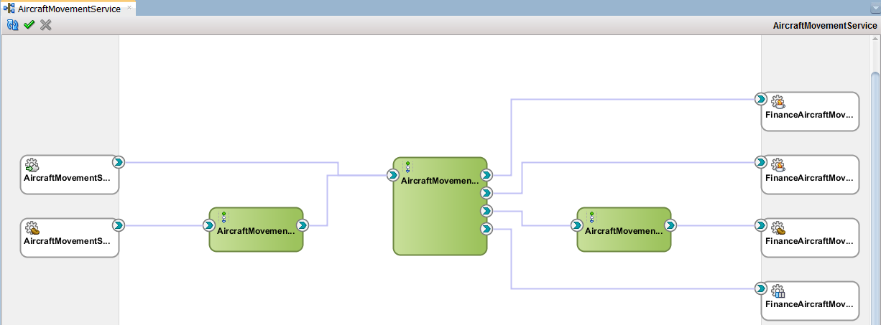
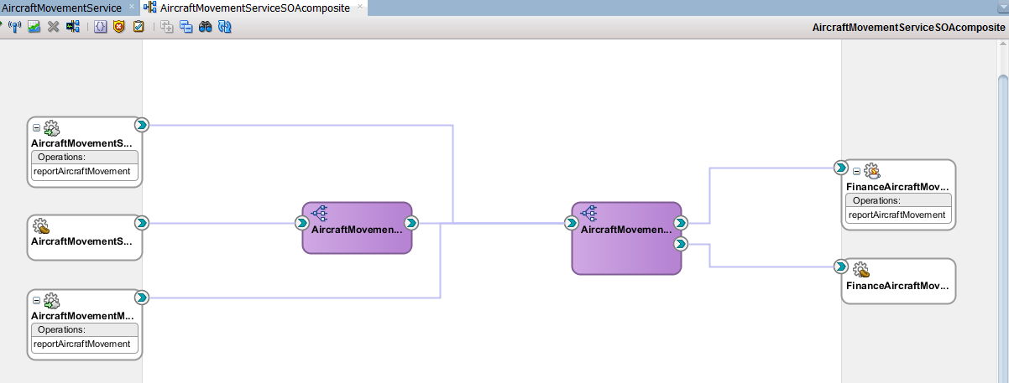
Chapter 6
SAIBOT_FINANCE
AQ
aircraft_movements_queue
JEJB
AircraftMovementServiceJEJBClient
JMS Queue
jms/finance/AircraftMovementsQueue
EJB
EJB
FinanceAircraft MovementReporter
Direct
Binding
AircraftMovement ServiceDirectBindingClient

Slide 6

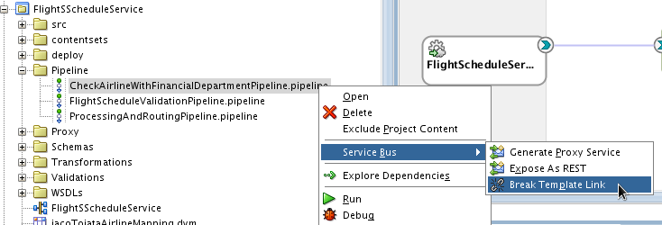
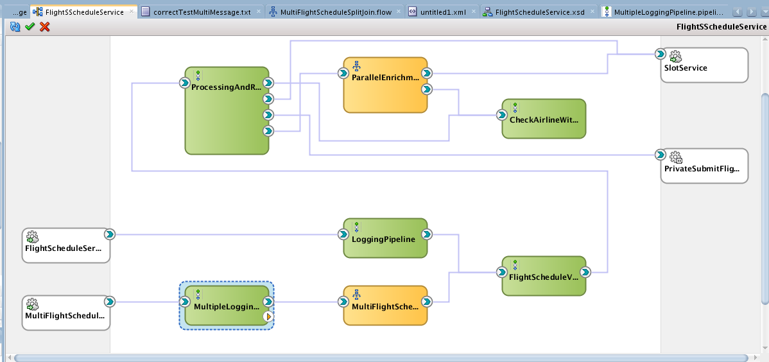
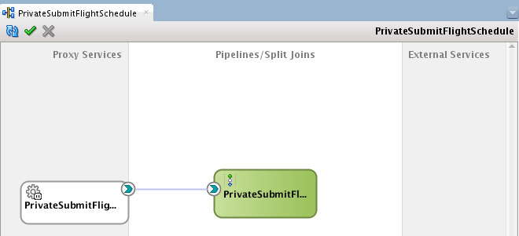
Chapter 7
SlotService (Ch4)
Java Class
ScheduledFlight Processor
Pipeline Template FinancialDepartment AirlineCheckPipeline
XQuery Library TimePlanningUnit Validations
Domain Value Map
icaoToiataAirline Mapping.dvm

Slide 7
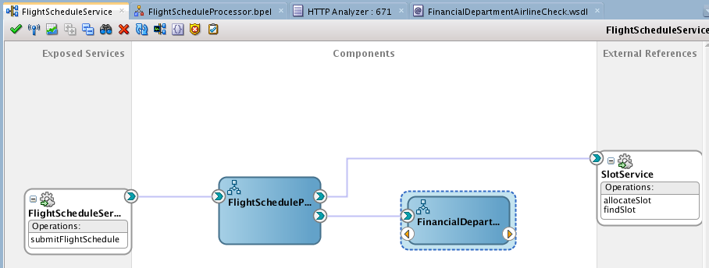
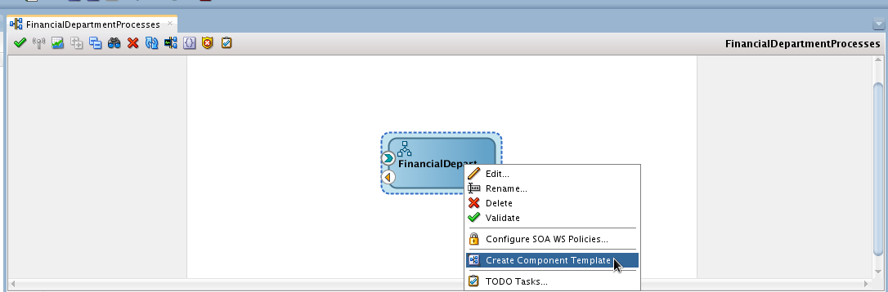
Chapter 8
SlotService (Ch4)
Java Class
FlightSchedule Processor
XQuery Library TimePlanningUnit Validations
Domain Value Map
icaoToiataAirline Mapping.dvm

Slide 8
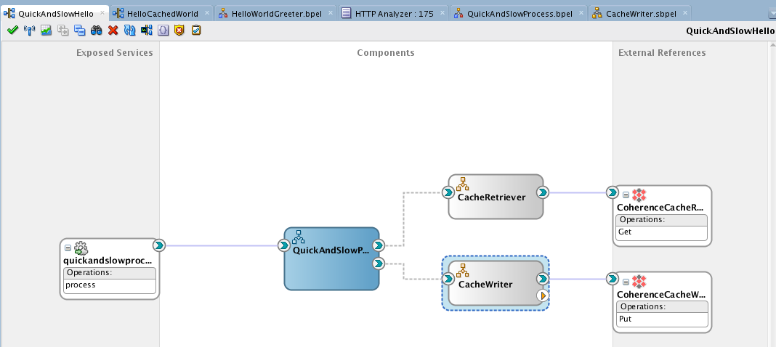
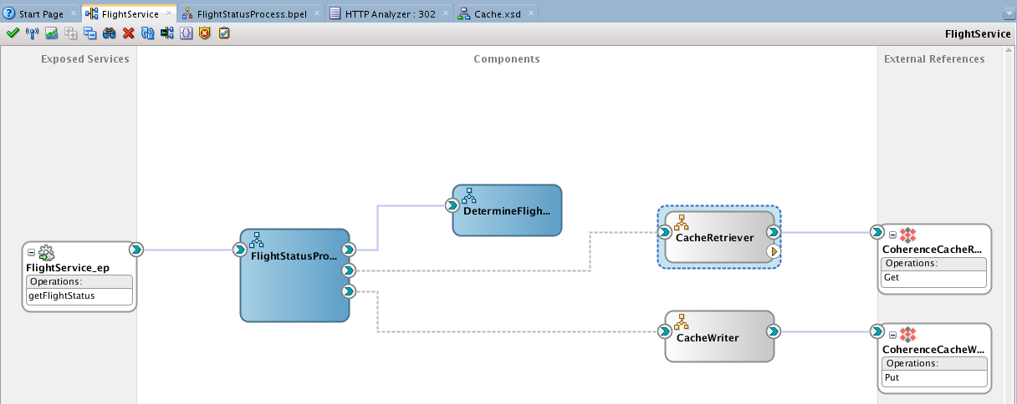

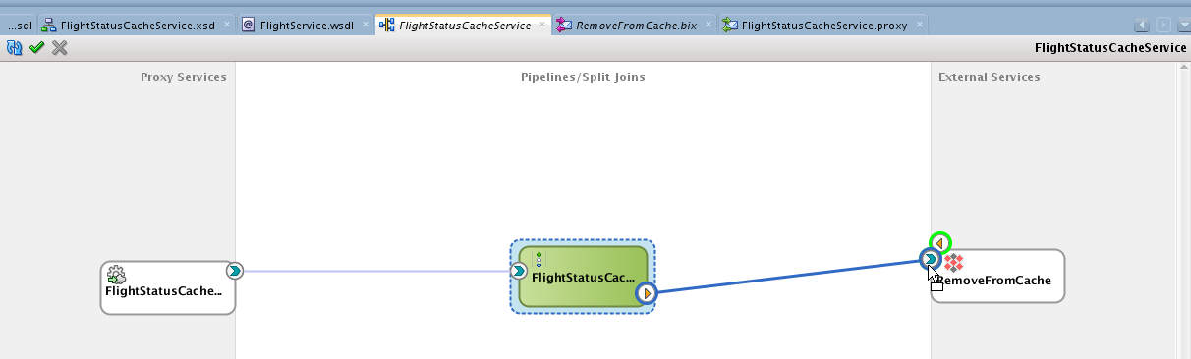
Chapter 9
SOA Component Templates
Coherence Cache

Slide 9
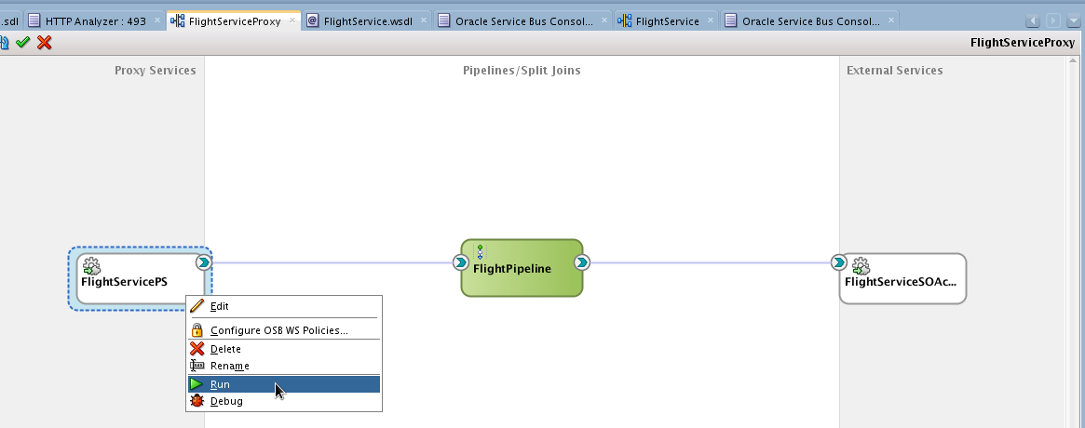
Chapter 9
Coherence Cache
Service Result Cache

Slide 10
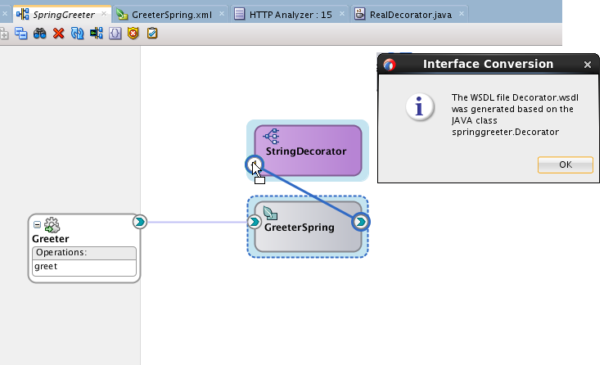
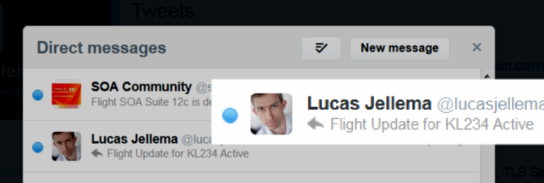
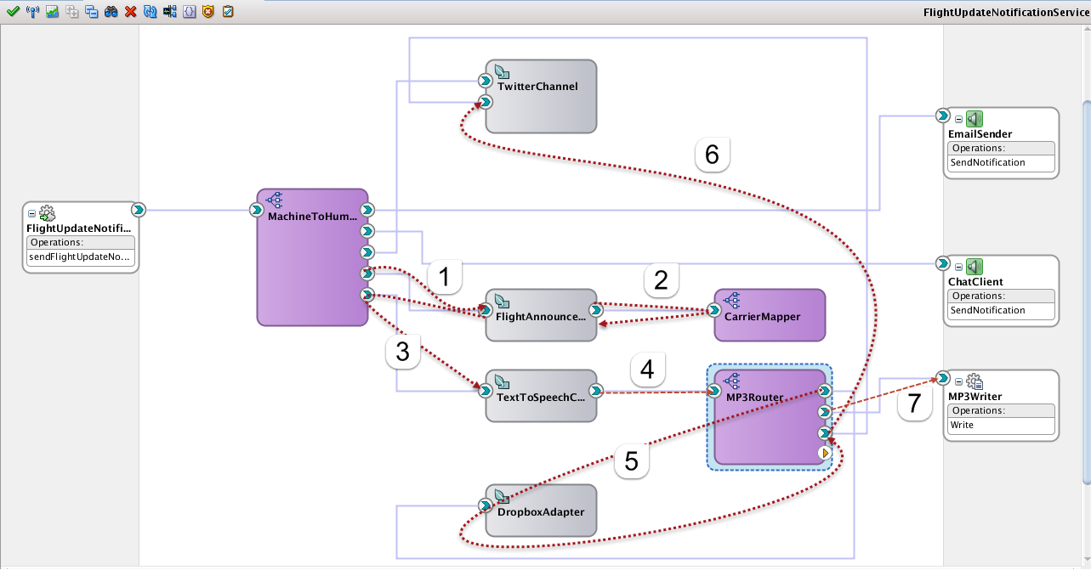
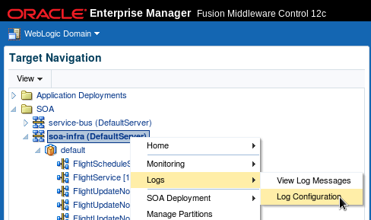

Chapter 10
Domain Value Map Airlines.dvm

Slide 11
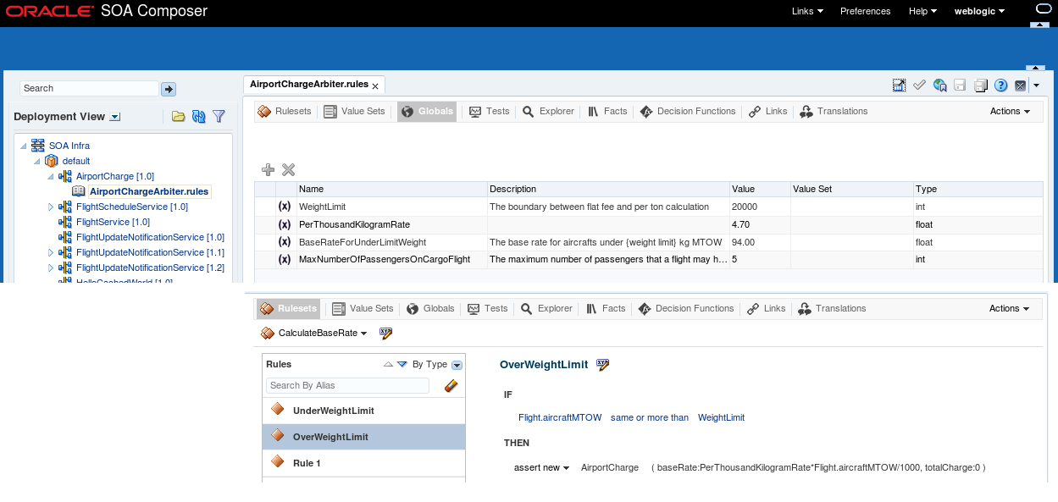
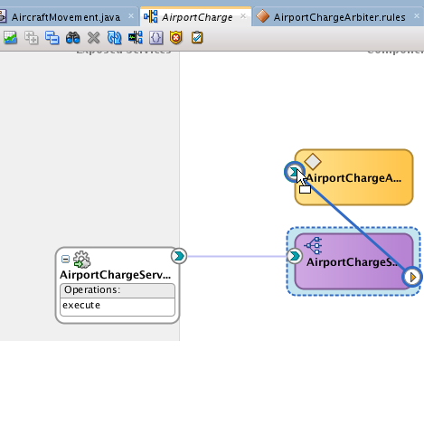
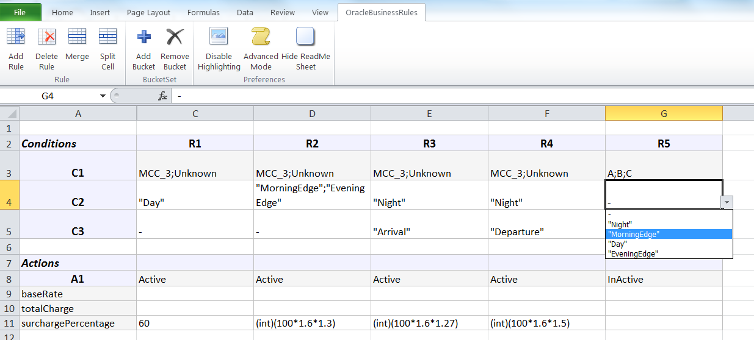
Chapter 11

Slide 12
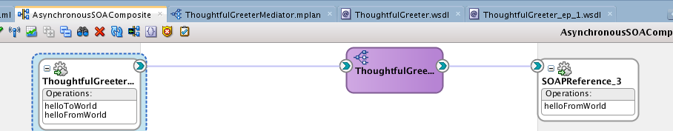
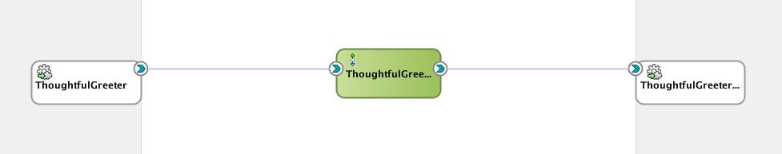
Chapter 12
Asynchronous Response/ Callback
Asynchronous Response/ Callback

Slide 13
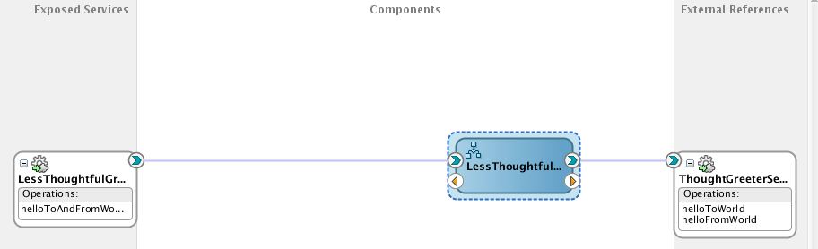
Chapter 12
Asynchronous Response/ Callback

Slide 14
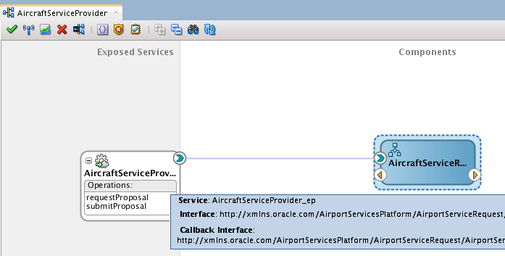
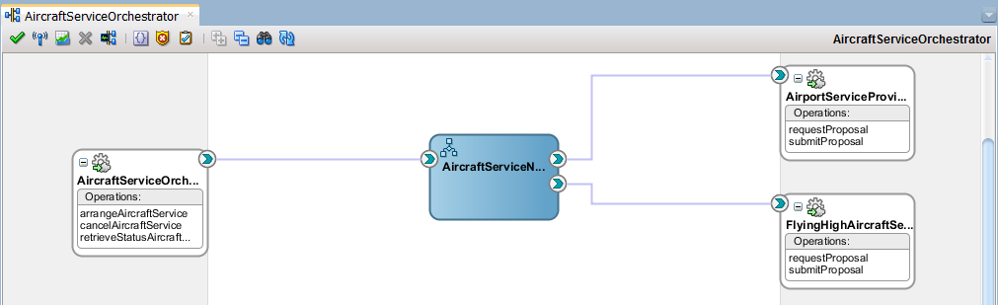
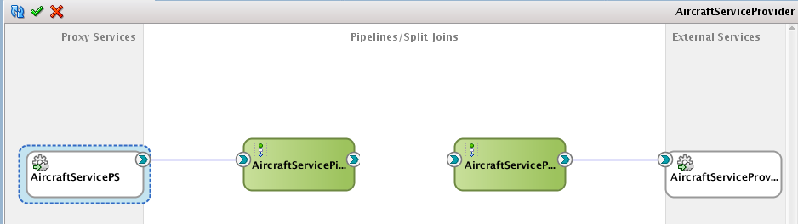
Chapter 12
Air Carrier
Cancel RFP
Initiate RFP
Get status
Asynchronous Response/ Callback

Slide 15

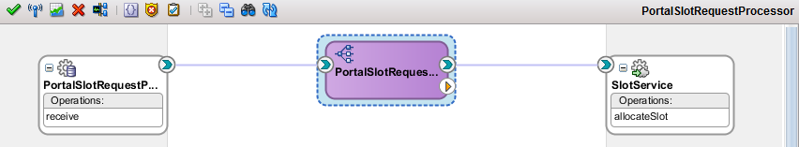
Chapter 13
PORTAL_SLOT_ALLOCATIONS
SlotService (Ch4)
fut_allocate_slots

Slide 16
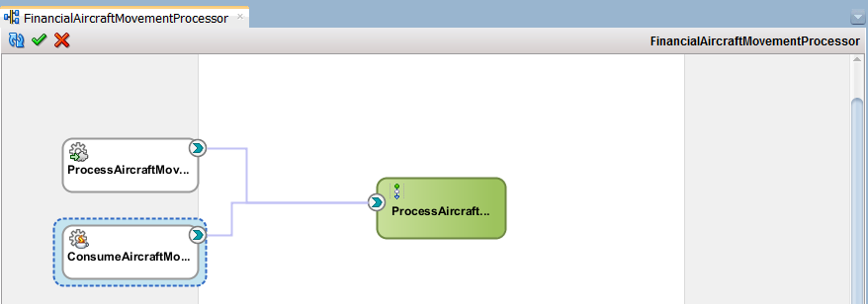
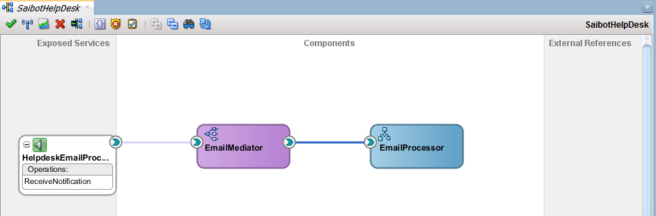
Chapter 13
Chapter 6
JMS Queue
jms/finance/AircraftMovementsQueue

Slide 17

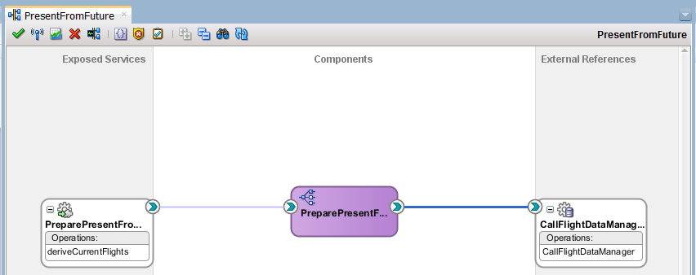

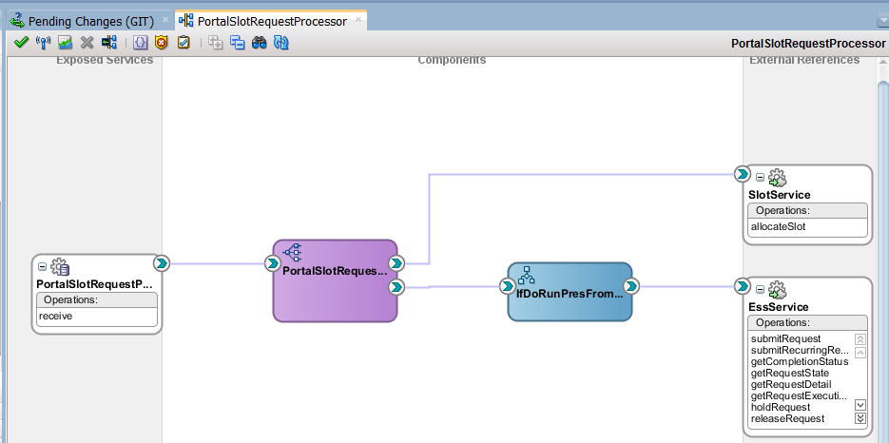
Chapter 14
CURRENT_ <FLIGHT-DATA>
Job Create CurrentFlightData
flight_data_manager
Enterprise Scheduling Service
Job CreateCurrent FlightDataPLSQL
FUTURE_ <SLOT-DATA>
Activate/ deactivate
SlotService (Ch4)
PORTAL_SLOT_ALLOCATIONS
Request for Job Create CurrentFlightDataPLSQL

Slide 18
Chapter 15
Publish from:
Mediator, BPEL
Java Client, ESS, DB?
FlightStatus Update event
SB:
read from JMS
Use intermediary SOA composite

Slide 19
Chapter 15
Air Carrier Suspended event
FlightCanceller
FlightStatus Update event

